Slide 1
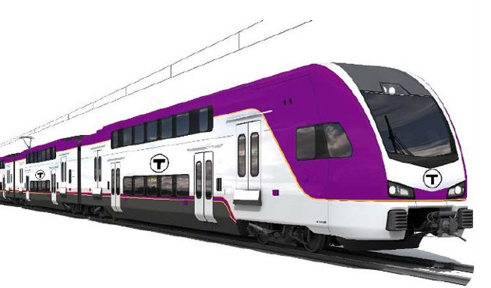
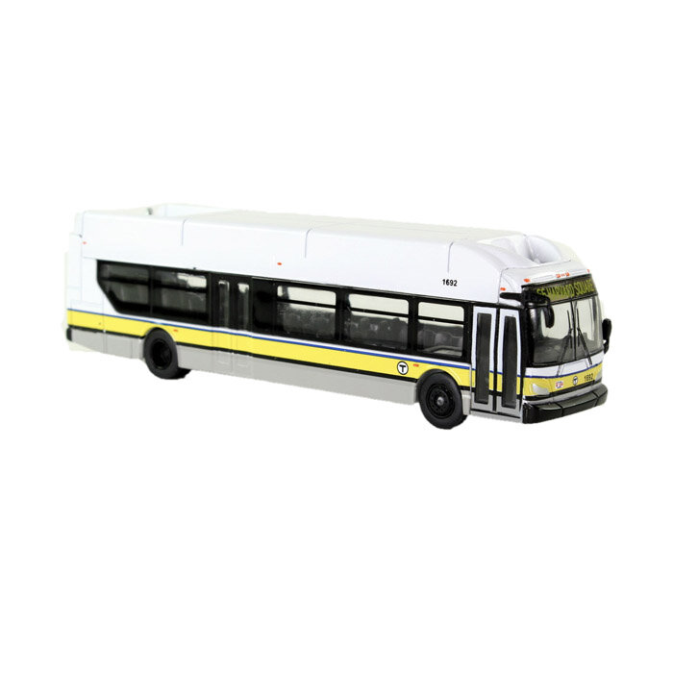
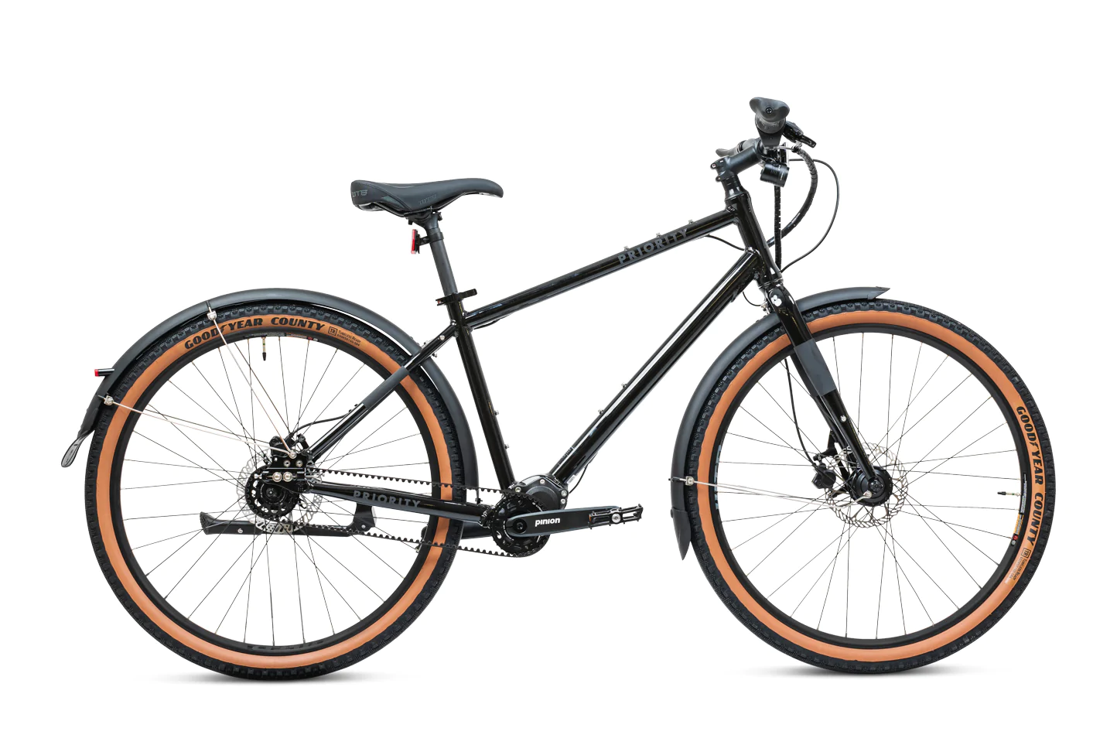
3 ways to get around the city!
How can we compare them?
K.MD.A2
Notes:
Week of April 28, 2025

Slide 2
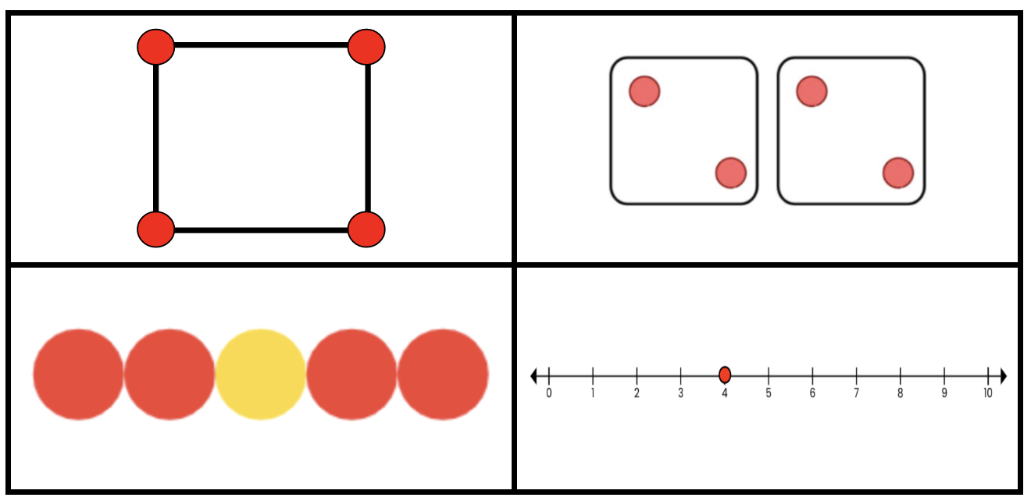
Which one does not belong?
K.CC.C6

Slide 3
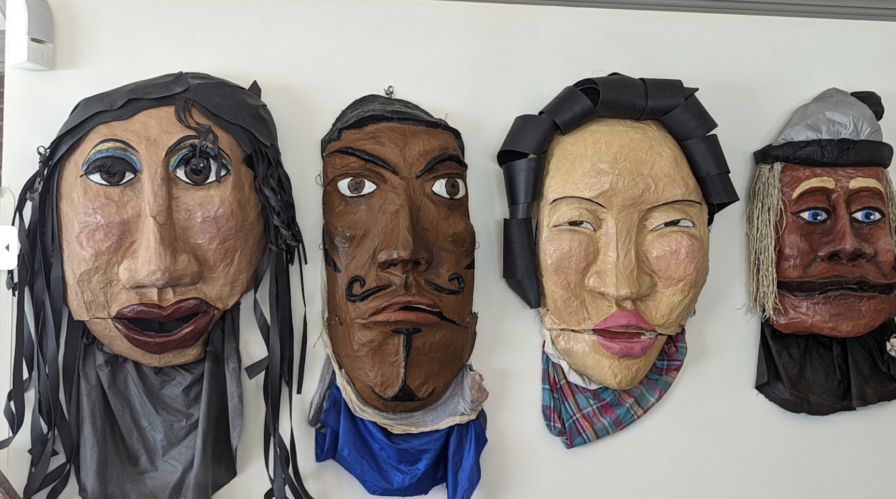
How many masks are in the Homestead Bakery?
How many different ways can we make 4?
K.OA.A3

Slide 4
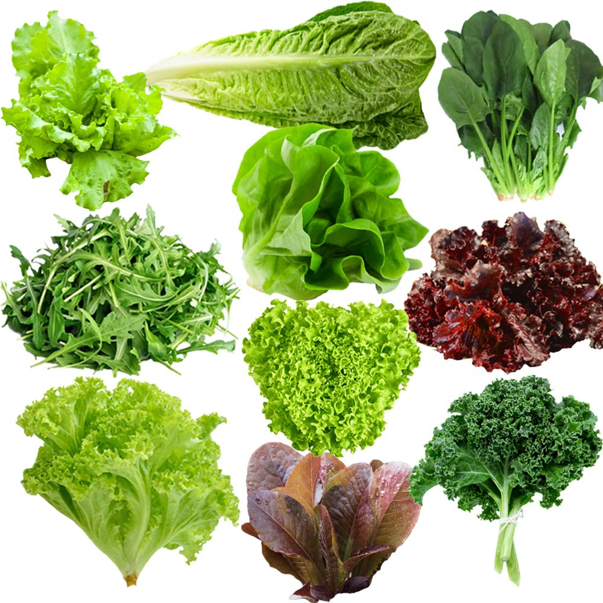
May is National Salad Month!
Here are 10 different kinds of lettuce.
How many ways can we make 10?
K.OA.A2

Slide 5
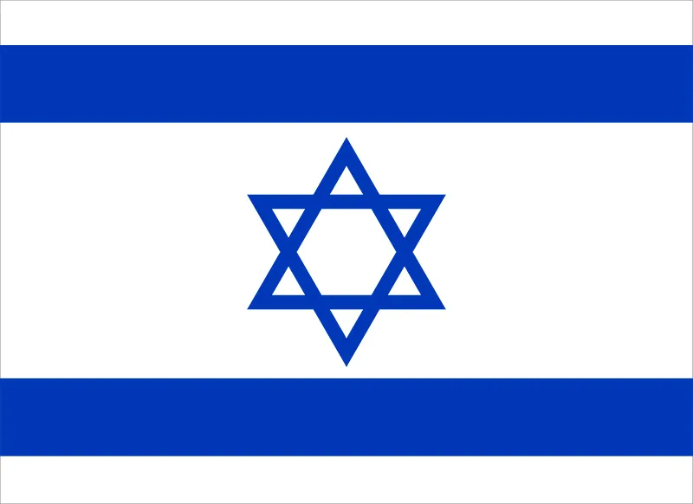
Today is Independence Day in Israel!
What interesting shapes are hiding in the flag of Israel?
K.G.A2

Slide 6
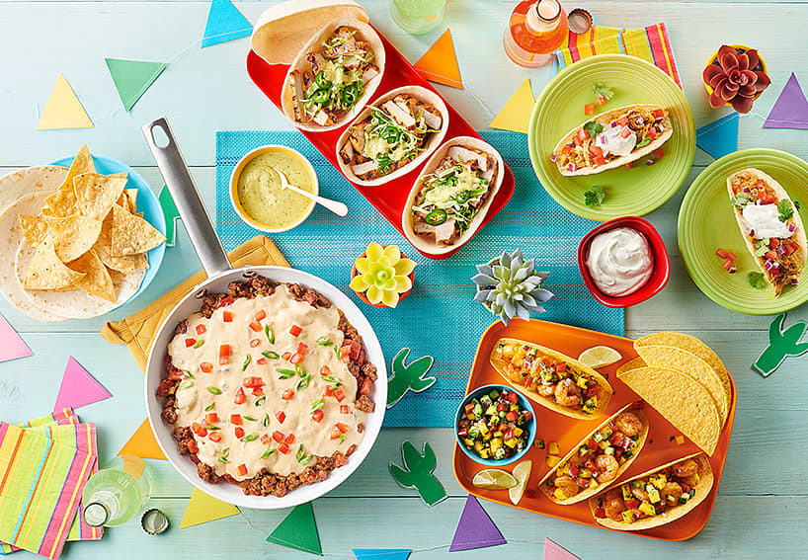
Happy Cinco de Mayo!
Where do we see triangles in this picture?
What other fun shapes do we see?
K.G.B4
Notes:
Week of May 5, 2025

Slide 7
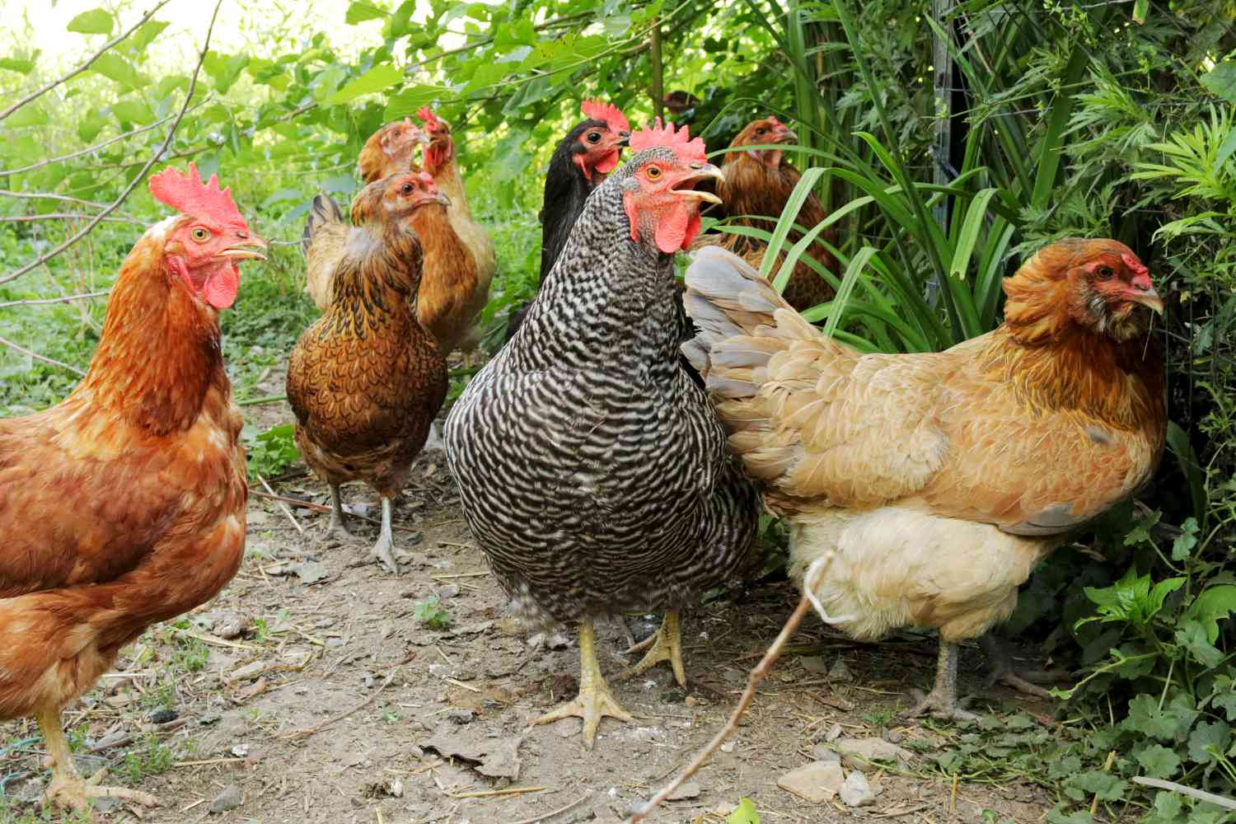
Happy International Respect for Chicken Day!
How many chickens are here?
How many chicken legs?
How many chicken eyes?
K.OA.A1

Slide 8
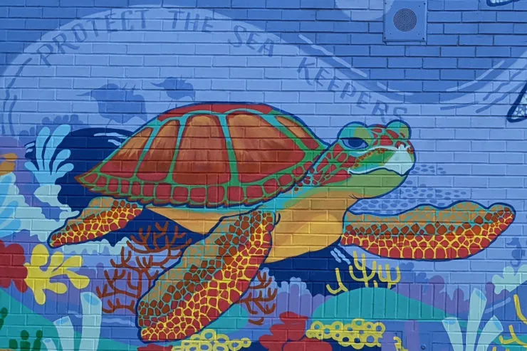
How can we count the bricks in this mural at the Donald McKay School in Boston?
Can we count by 2s?
5s?
10s?
What would be more fun?
“Sea Keepers” by Sabrina Dorsainvil
K.CC.A1

Slide 9
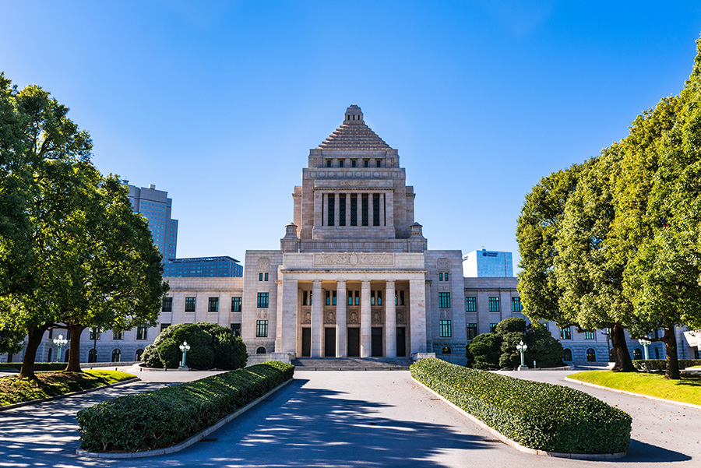
Today is Constitution Memorial Day in Japan!
Be a shape detective!
What shapes are hidden in this photo?
K.G.A2

Slide 10
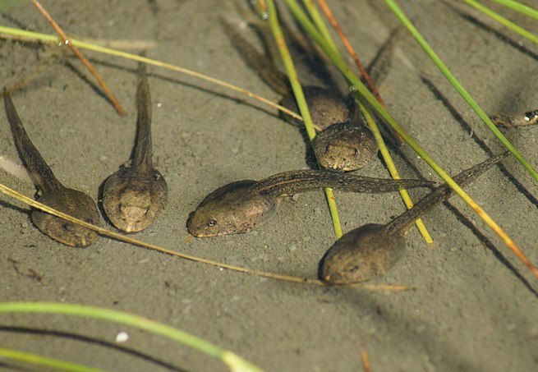
Tadpoles!
How many tadpoles are here?
If they each weigh 2 grams, how much do they weigh altogether?
K.OA.A2

Slide 11
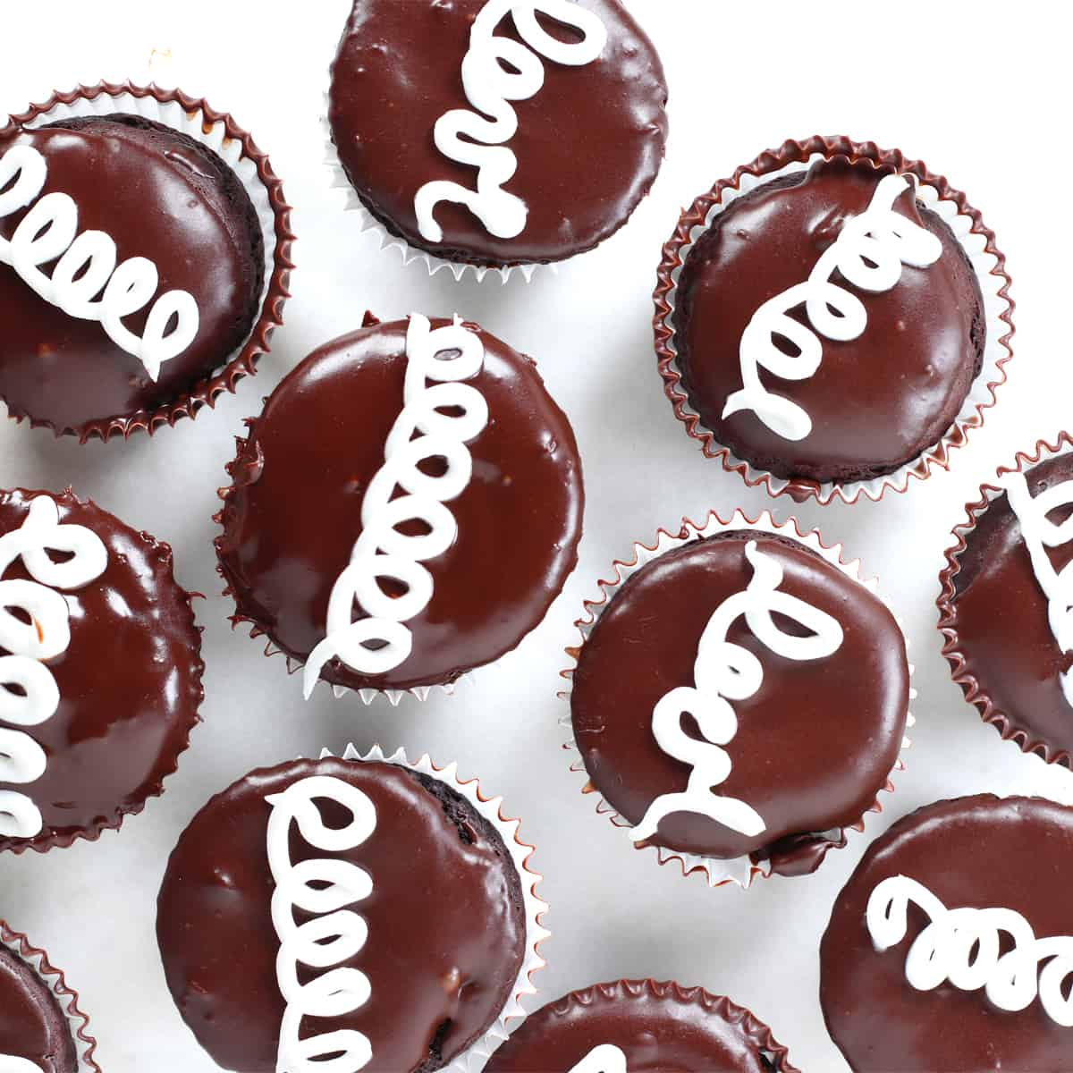
Happy Hostess Cupcake Day!
How many do we see?
How many don’t we see?
How many altogether?
Can we create a number sentence to match our thinking?
K.CC.B5
Notes:
Week of May 12, 2025

Slide 12
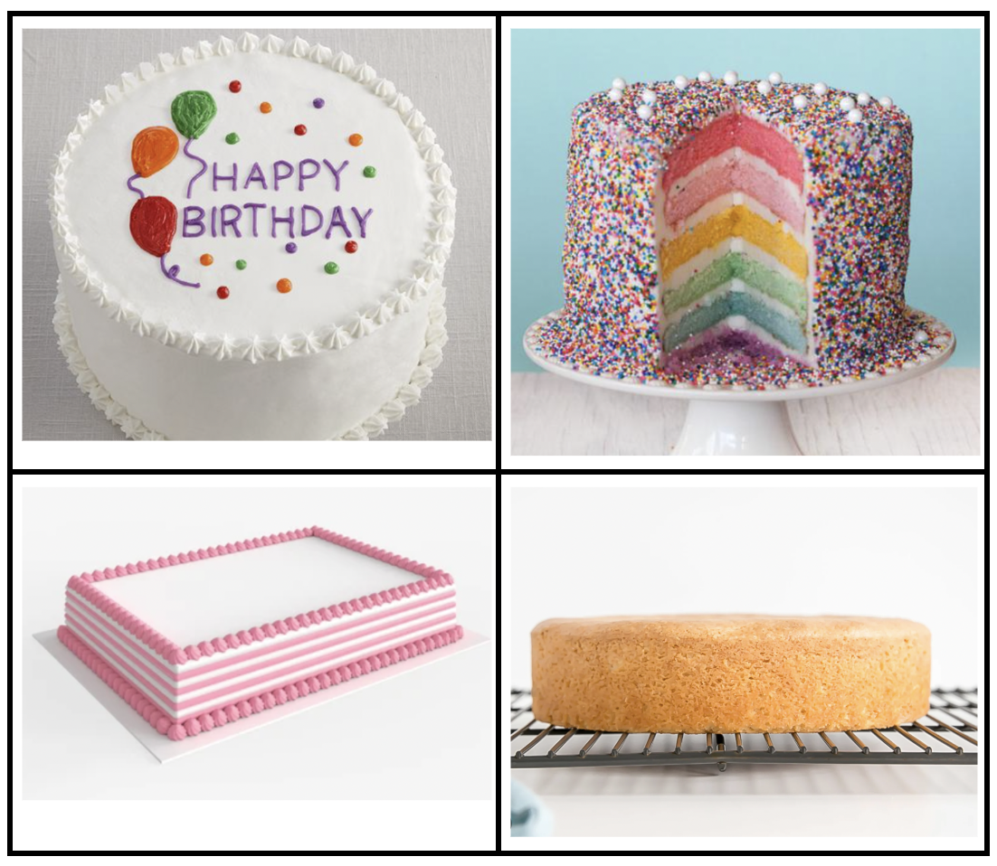
Which one doesn’t belong?
What do they all have in common?
K.SMP.3

Slide 13
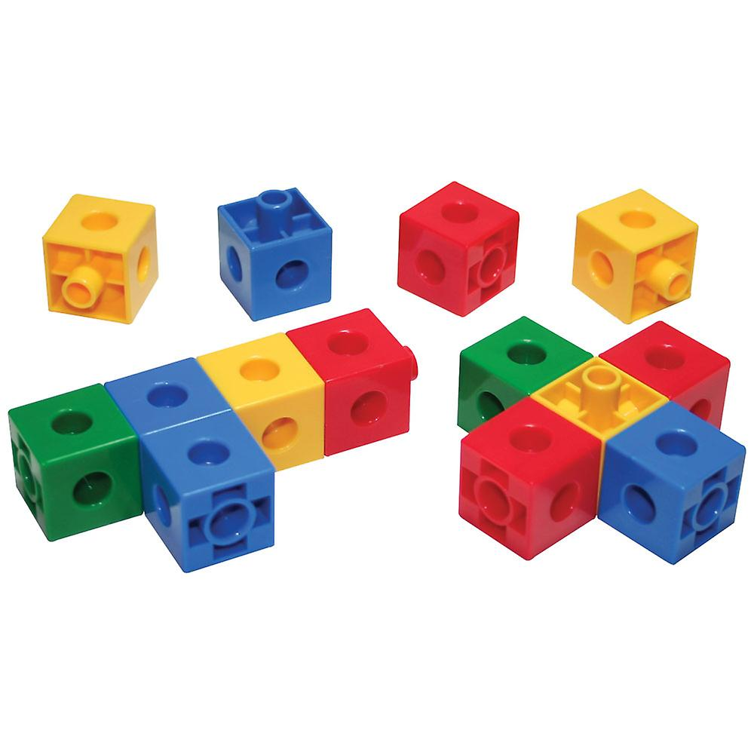
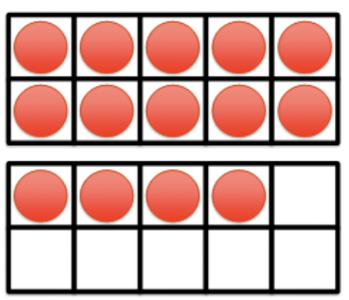
What is the same? What is different?
K.CC.C6

Slide 14
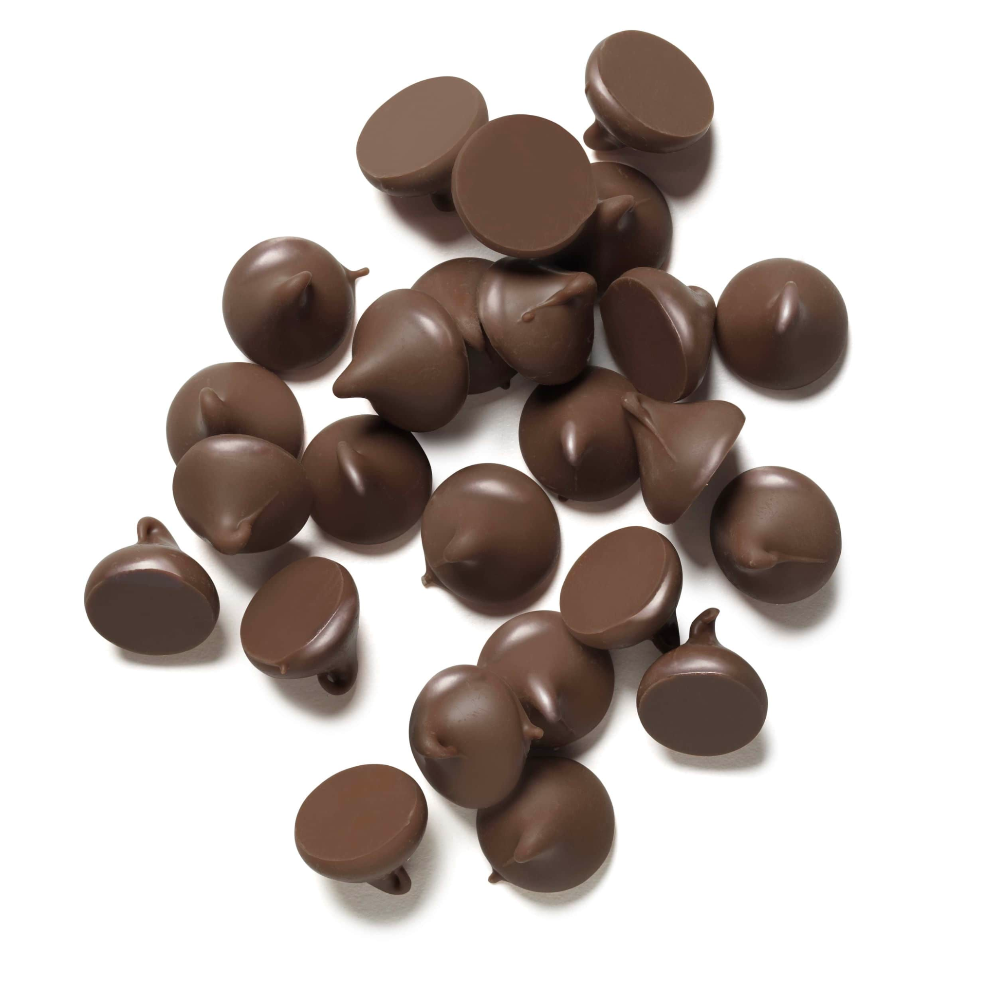
Today is National Chocolate Chip Day!
Do we think there are more than 20 chips here, or less?
How do we know?
How many different ways can we count them?
K.CC.A1

Slide 15
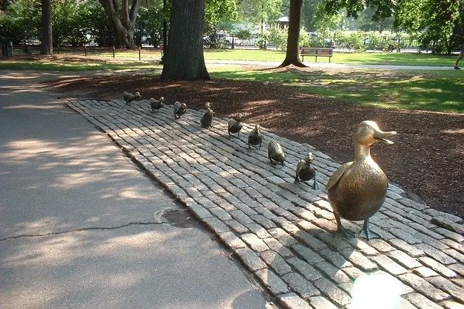
Today is National Public Garden Day!
Let’s create equations to match this photo of “Make Way For Ducklings” at the Boston Public Garden.
K.OA.A2

Slide 16
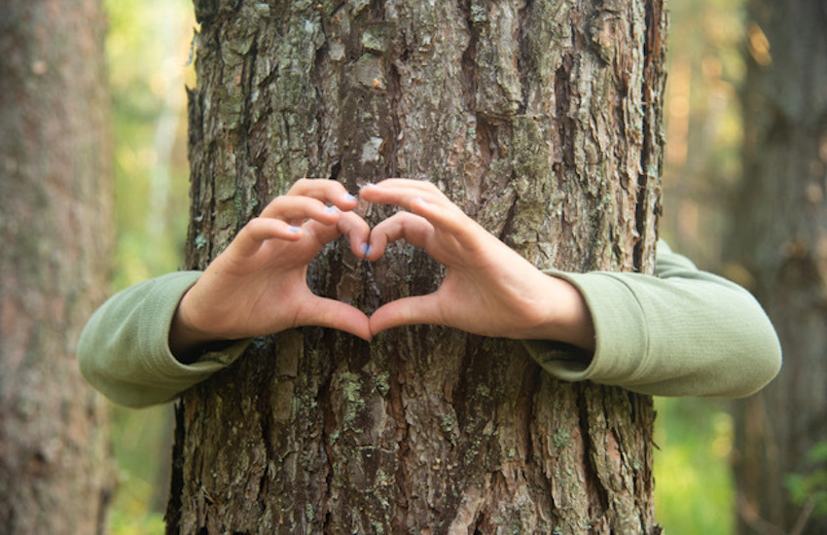
Today is LOVE a Tree Day!
How high do we think a tree is?
What if we measured the height of a tree in children!
Estimate how many kindergarten students high a tree on our playground is!
K.MD.A1
Notes:
Week of May 19, 2025

Slide 17
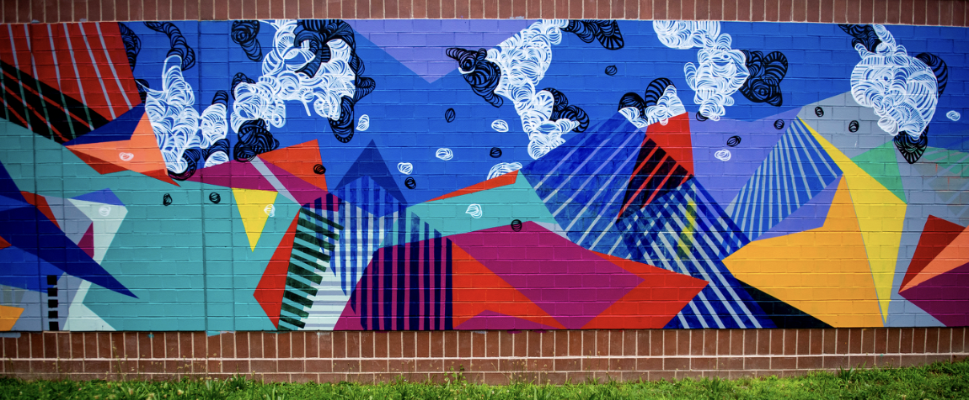
Let’s find hidden shapes in this Boston mural, “Dreaming isn’t so concrete” by Destiny Palmer.
K.G.A2

Slide 18
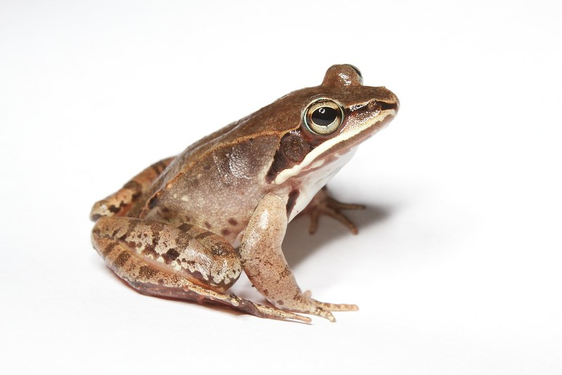
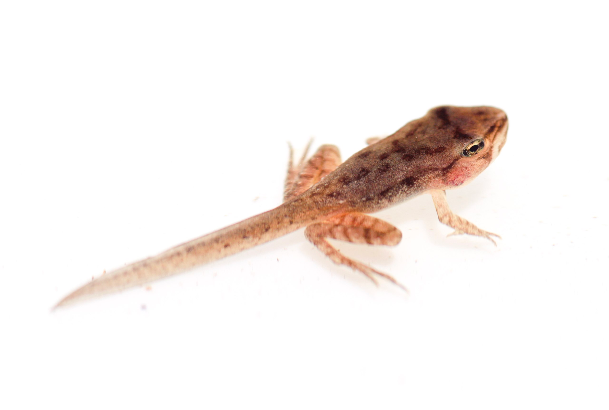
How can we compare these two amphibians?
K.MD.A2

Slide 19
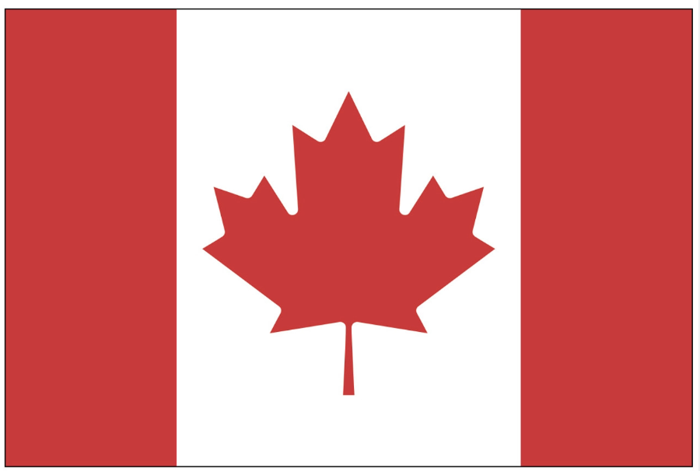
Today is Victoria Day in Canada!
What interesting shapes can we make with the Maple Leaf in the Canadian Flag?
K.G.A2

Slide 20
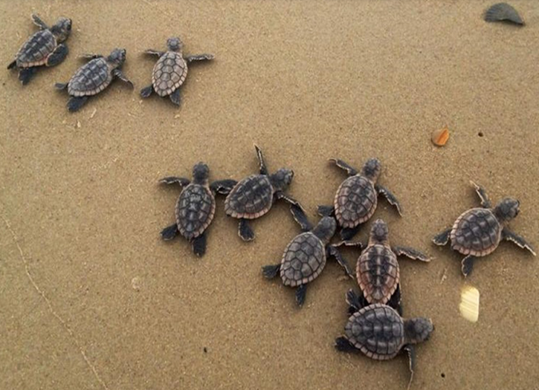
It is World Turtle Day!
How many hatchlings are on the beach?
How can we count them?
Can we create an equation to match this photo?
K.OA.A1

Slide 21
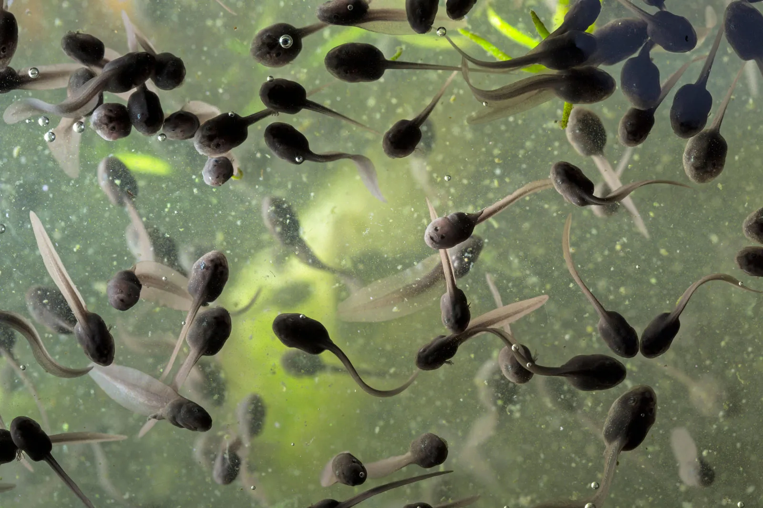
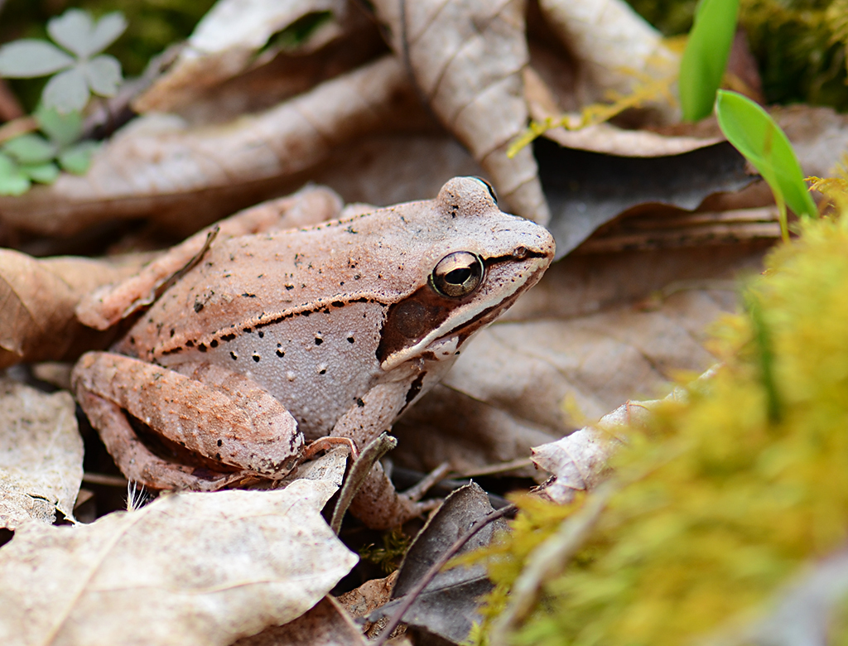
What is the same? What is different?
K.SMP.3
Notes:
Week of May 27, 2025

Slide 22

Today is Independence Day in Jordan!
What do we notice about the flag of Jordan?
What fun shapes can we create from the shapes that are in the flag?
K.G.A2

Slide 23
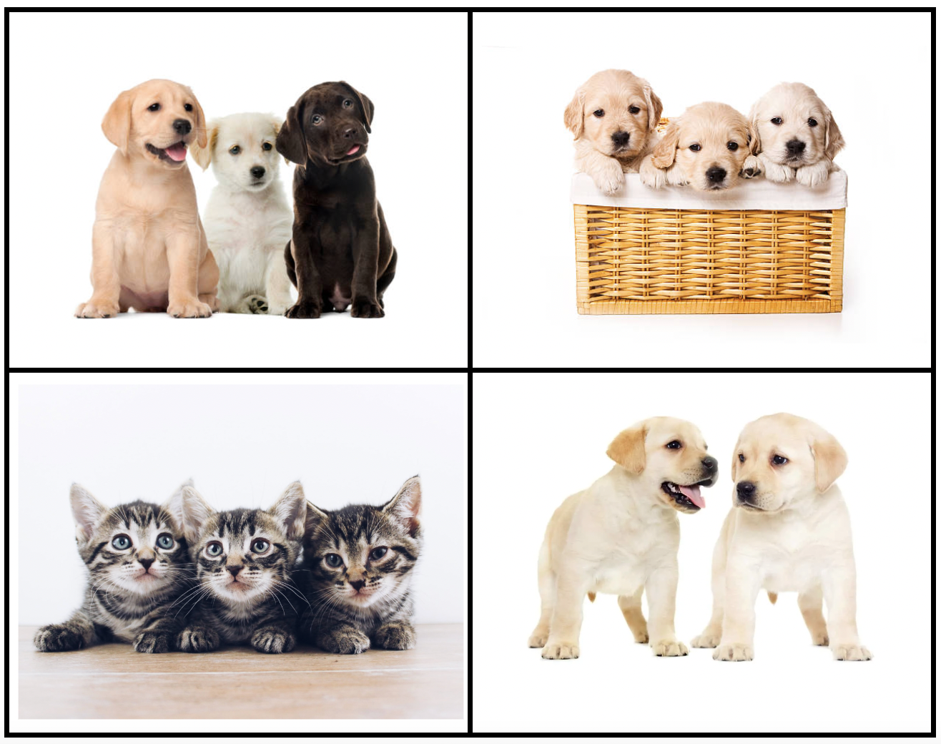
Which one doesn’t belong?
What do they all have in common?
K.SMP.3

Slide 24
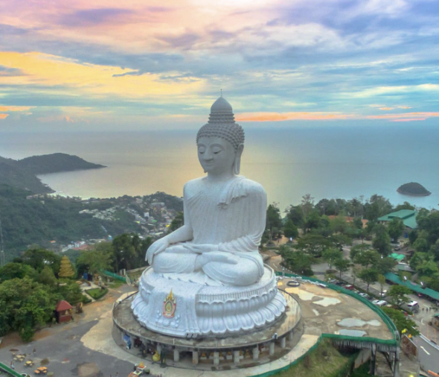
Happy Buddha Day!
The Great Buddha of Phuket is one of Thailand’s biggest statues!
How does it compare to how tall you are?
K.MD.A1

