Slide 1
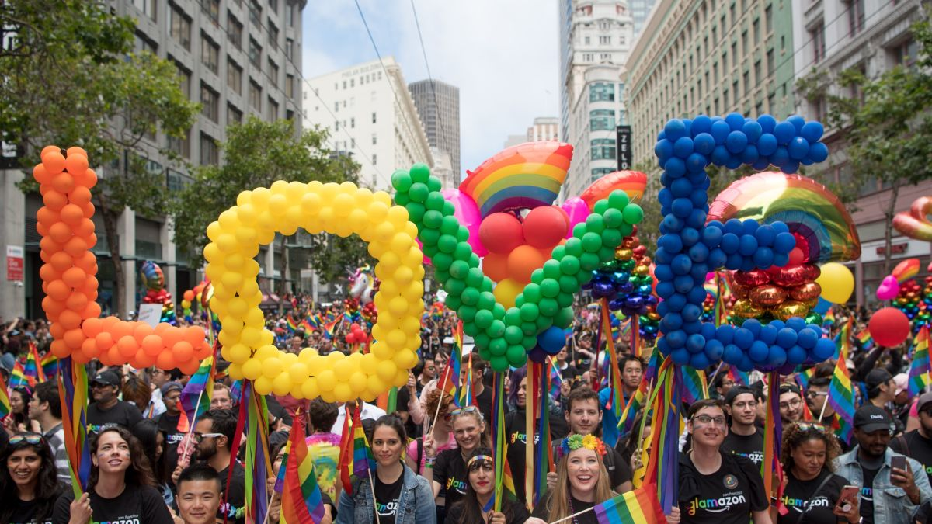
There are more than 100 balloons in each letter of LOVE!
How many ways can we count to 100?
What is the fastest way?
What is the slowest way?
K.CC.A1
Notes:
June is Pride Month!
Week of June 2, 2025

Slide 2
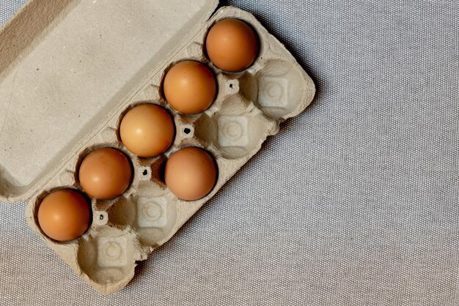
Happy National Egg Week
What can we say about these eggs?
Create an equation to represent your thinking.
K.OA.A1

Slide 3
Which one doesn’t belong?
K.G.A2,3

Slide 4
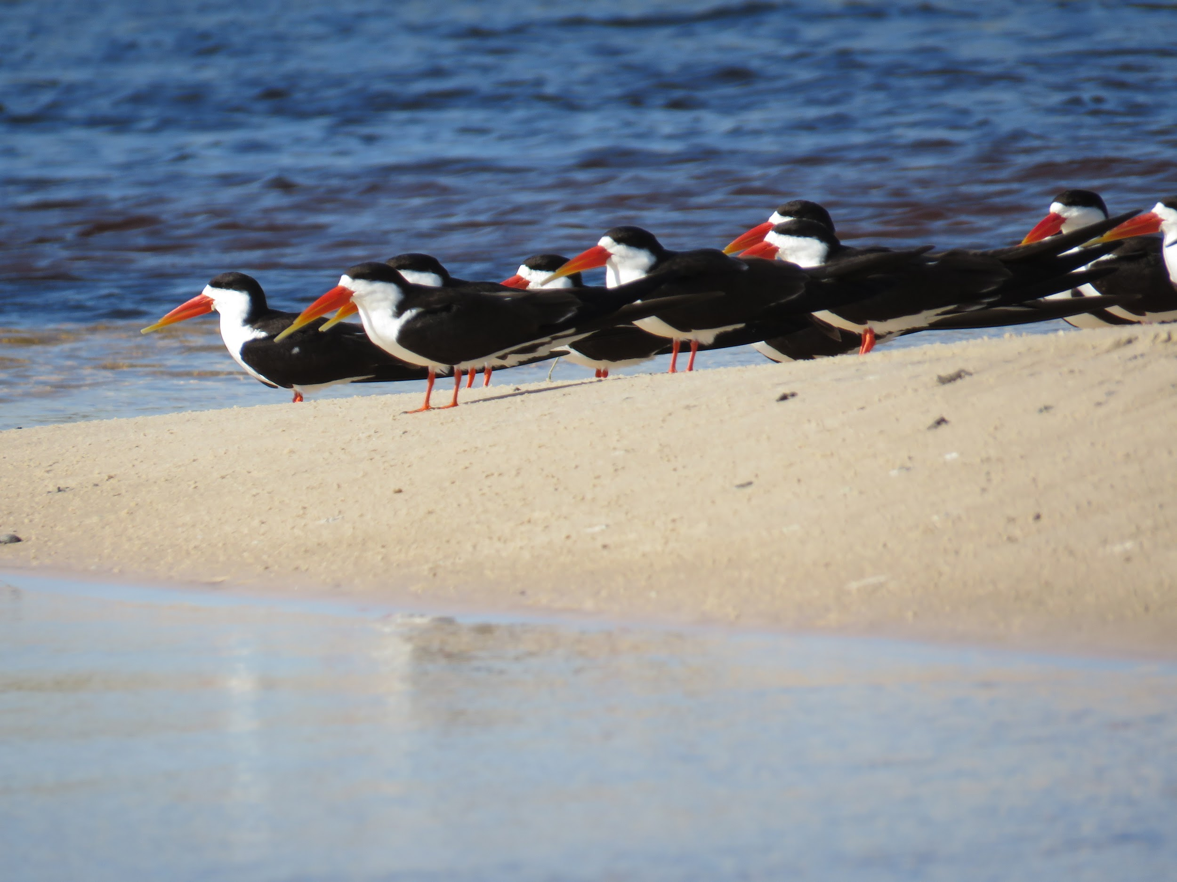
These are African Skimmers.
There are 9 you can see.
There are 20 altogether.
How many are missing from the picture?
Okavango Delta, Botswana (C.Manousaridis)
K.OA.A2

Slide 5

Today is Linggo Ng Kalayaan, Independence Day, in the Philippines.
What can we say about the flag of the Philippines?
K.G.A2

Slide 6
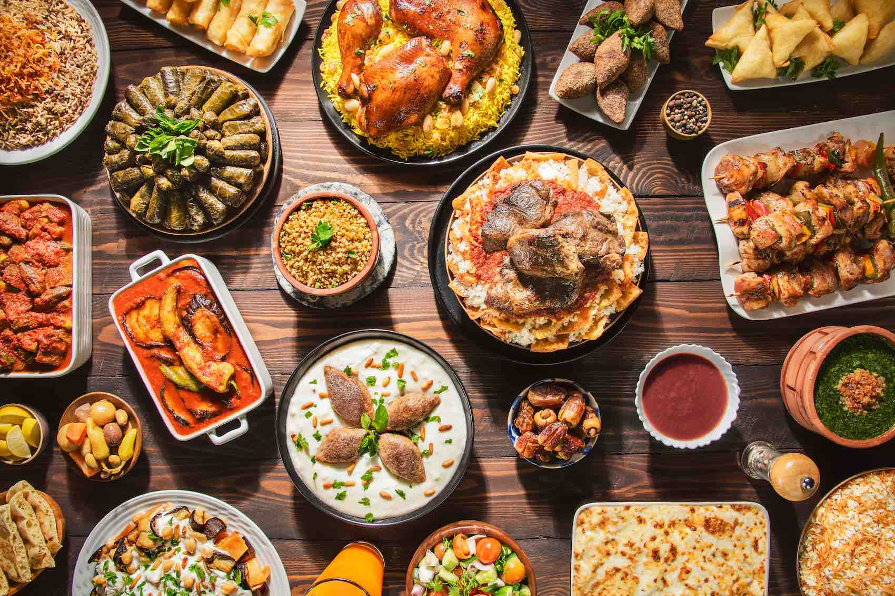
Happy Eid al-Adha!
Shape Detectives!
What are some of the interesting shapes we see?
K.G.A2
Notes:
Week of June 9, 2025

Slide 7
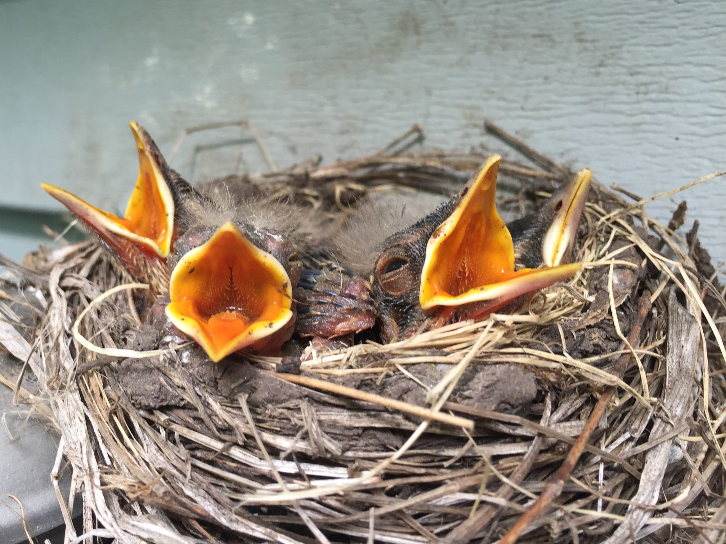
4 Baby Robins are in the nest!
If they each eat 2 worms every day, how many worms does Mama Robin need to get?
K.OA.A2

Slide 8
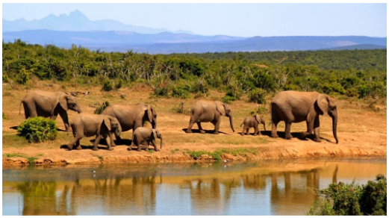
How many elephants are in the picture? How many more would make 10?
Can you write a number sentence to show that?
K.OA.A4

Slide 9
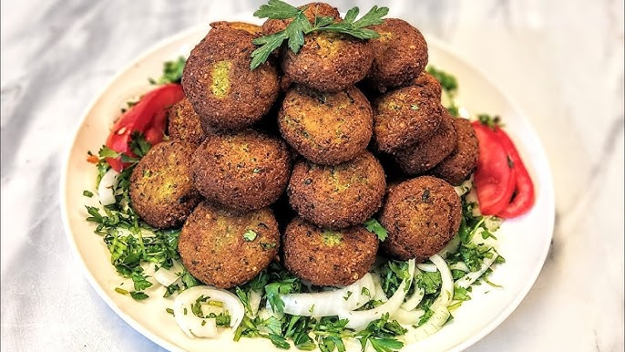
Happy International Falafel Day!
How many delicious falafel do we see?
How many don’t we see?
Estimate how many falafel are on the plate!
K.CC.B5

Slide 10
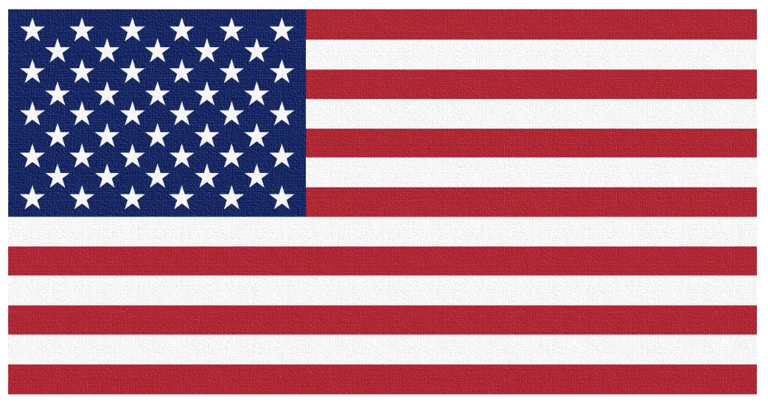
Tomorrow is Flag Day!
What can we count?
How many red stripes? How many white ones?
How many stars?
How can we count them?
K.CC.B4

Slide 11
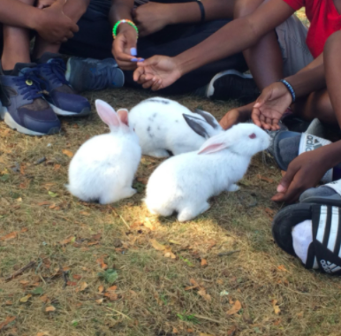
Bunnies at Land’s Sake Farm!
If there are 3 bunnies, how many legs do they have altogether?
What if 2 more bunnies hopped in?
What if there were 10 bunnies?
K.OA.A1
Notes:
Week of June 16, 2025

Slide 12


What is the same? What is different?
+ 5
K.NBT.A1

Slide 13
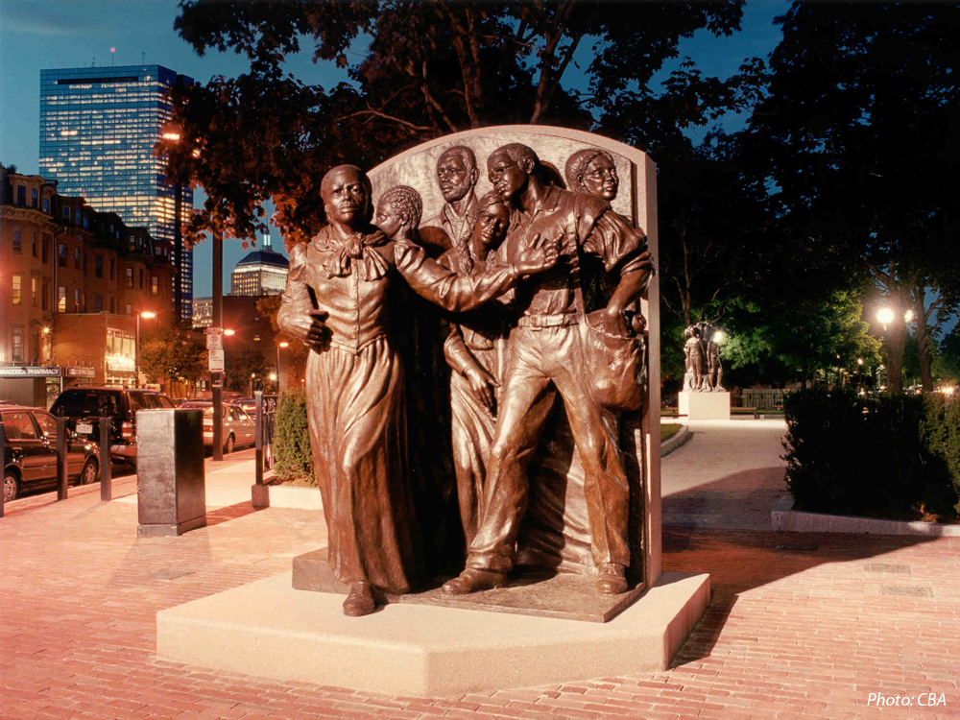
Harriet Tubman is leading 5 people North to freedom in this monument.
How many different ways can we make 6?
How many different number sentences can we create to show what we know?
Harriet Tubman Park, South Boston
K.OA.A3
Notes:
Juneteenth (tomorrow)

Slide 14
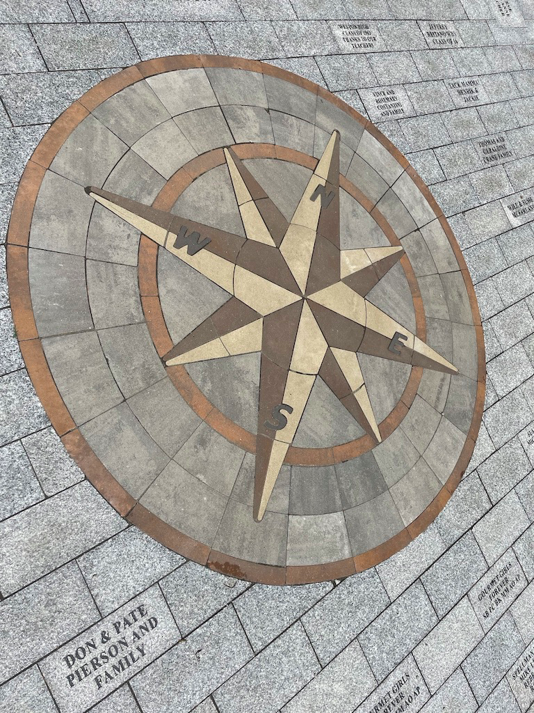
What fun shapes do you see in this compass rose along the Legacy Trail?
Can you sketch them?
K.G.A2

Slide 15
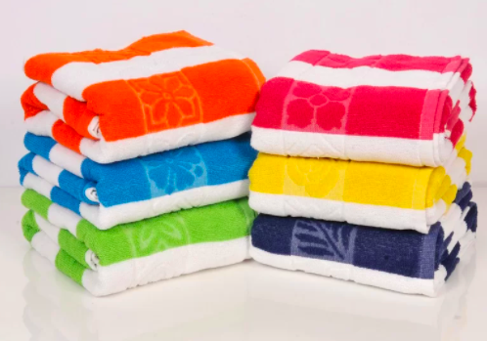
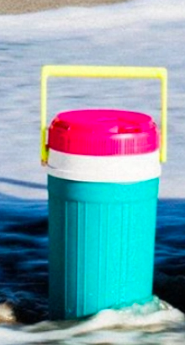
Would you rather….
Carry the giant beach towels or the jug of lemonade?
K.SMP.3
Notes:
June 23, 2025
Happy Last Day of School!

