Slide 1
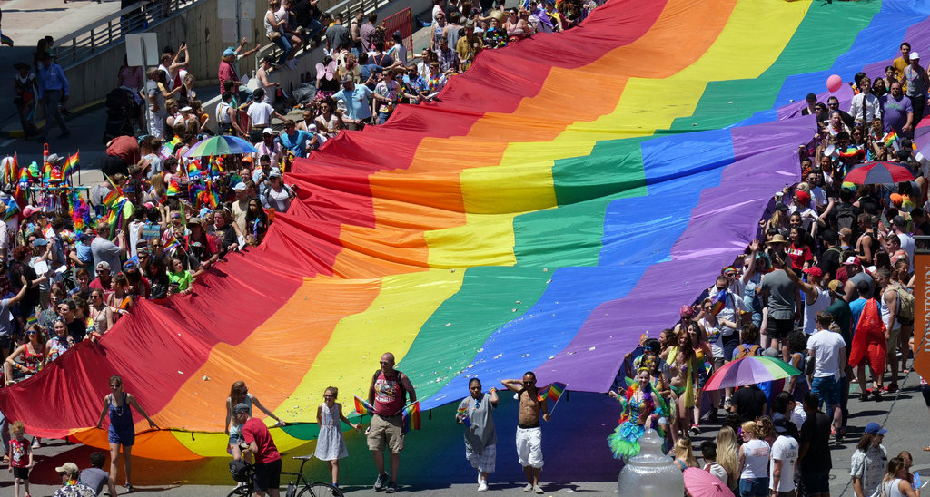
Wowza! Look at that Pride Flag in the
Salt Lake City Pride Parade!
Estimate the length and width of the Pride Flag.
What’s the area? What’s the perimeter?
This flag is actually 15 meters by 50 meters
4.MD.A3
Notes:
Week of June 2, 2025
June is Pride Month!

Slide 2
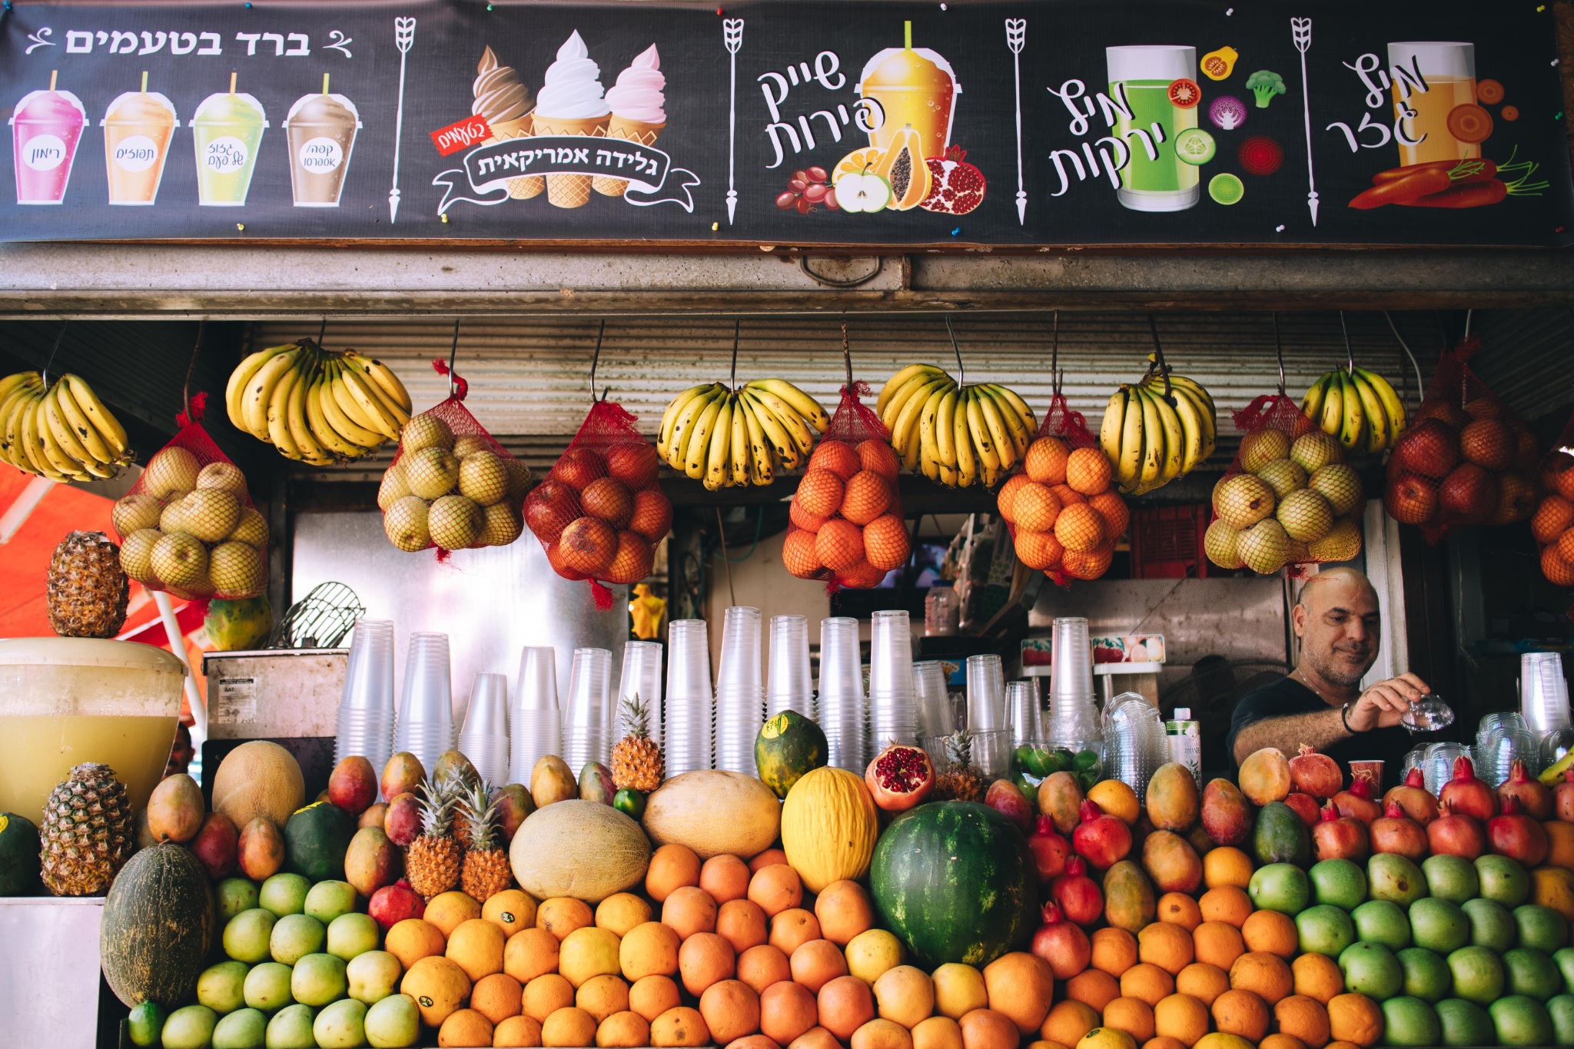
This is Tel Aviv’s famous Shuk HaCarmel or Carmel Market.
Where’s the Math?
Create a fun MATH EXPRESSION that matches this photo.
Solve it!
Create another one!
4.OA.A3

Slide 3

What do you notice?
What do you wonder?
What is going on in this data visualization?
4.MD.SMP3

Slide 4
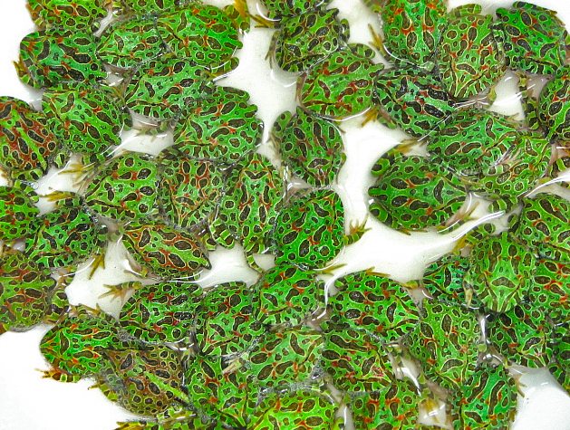
These Pacman frogs weigh about
8 ounces each.
How many are here?
How much do they weigh altogether?
How many pounds is that?
There are
16 ounces in 1 pound.
4.MD.A1

Slide 5
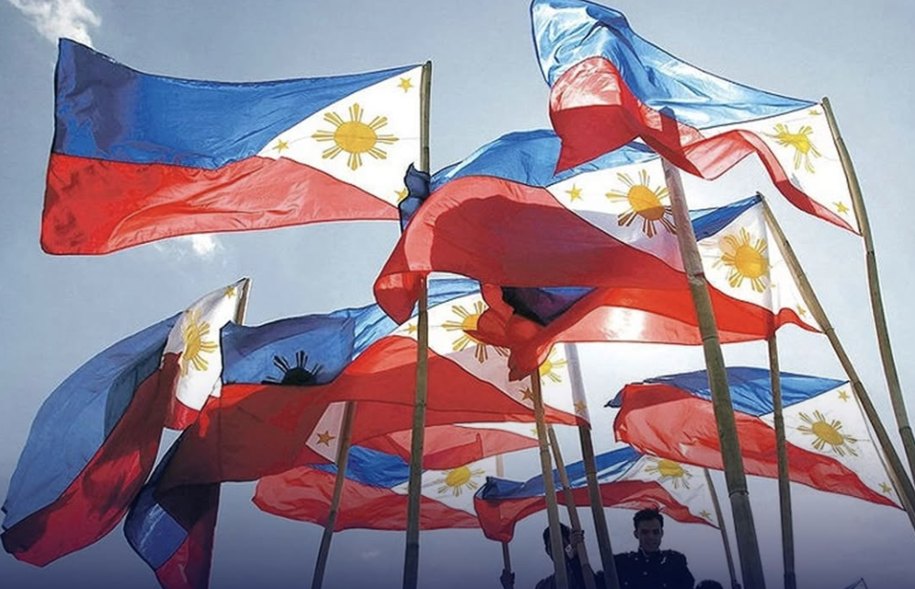
Today is Linggo Ng Kalayaan, Independence Day, in the Philippines
The Republic of the Philippines declared independence from Spain in 1898.
How long ago was 1898?
How many years?
How many months?
Let’s share our strategies!
4.NBT.B4

Slide 6
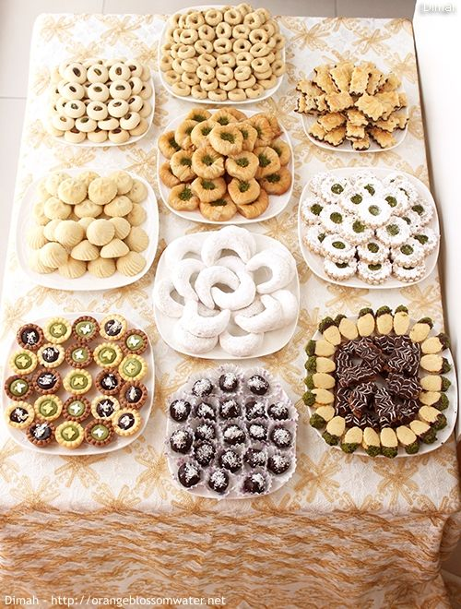
Happy Eid al-Adha!
Look at all of these yummy Eid sweets!
How can we use our math skills to determine how many sweets are here?
How many on each plate?
How many altogether?
Create an equation to match your thinking!
4.OA.A3
Notes:
Week of June 9, 2025

Slide 7
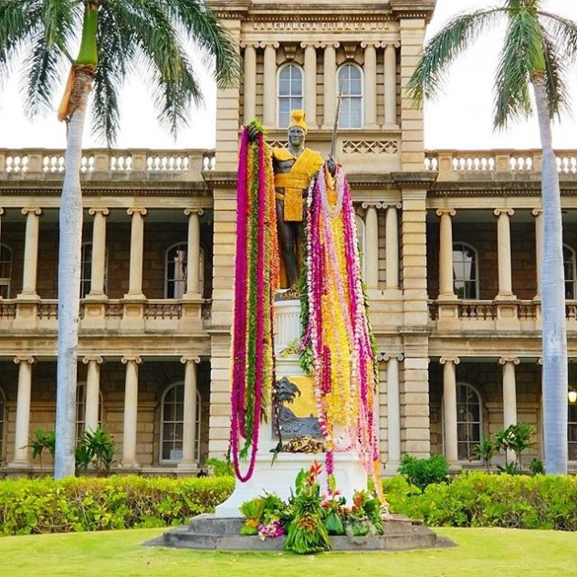
It’s King Kamehameha Day
In Hawaii!
This statue honoring the great King Kamehameha, a warrior, leader, and diplomat is in Oahu and stands over 18 feet tall.
How many inches is that?
How many times (think fractions) taller is it than YOU?
4.NF.B3
Notes:
June 10, 2022
King Kamehameha Day in Hawaii

Slide 8
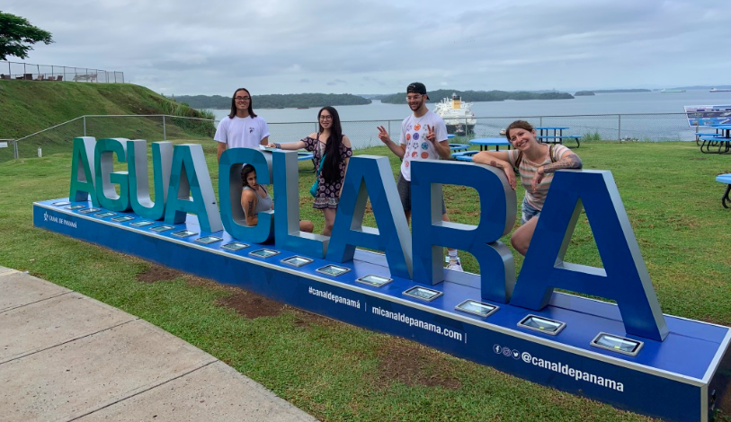
How many line segments are needed to make the letter A? How about the L?
How many angles are there? Are they acute, obtuse, or right angles?
ESTIMATE the sizes of the angles.
Are any of the line segments perpendicular? Are any of the line segments parallel?
4.MD.C5

Slide 9
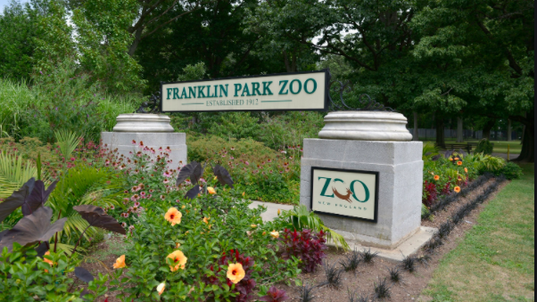
The Franklin Park Zoo is part of Franklin Park, the largest open space in Boston! The zoo officially opened in October, 1912.
How many years has it been open? How did you figure it out?
4.NBT.B4

Slide 10
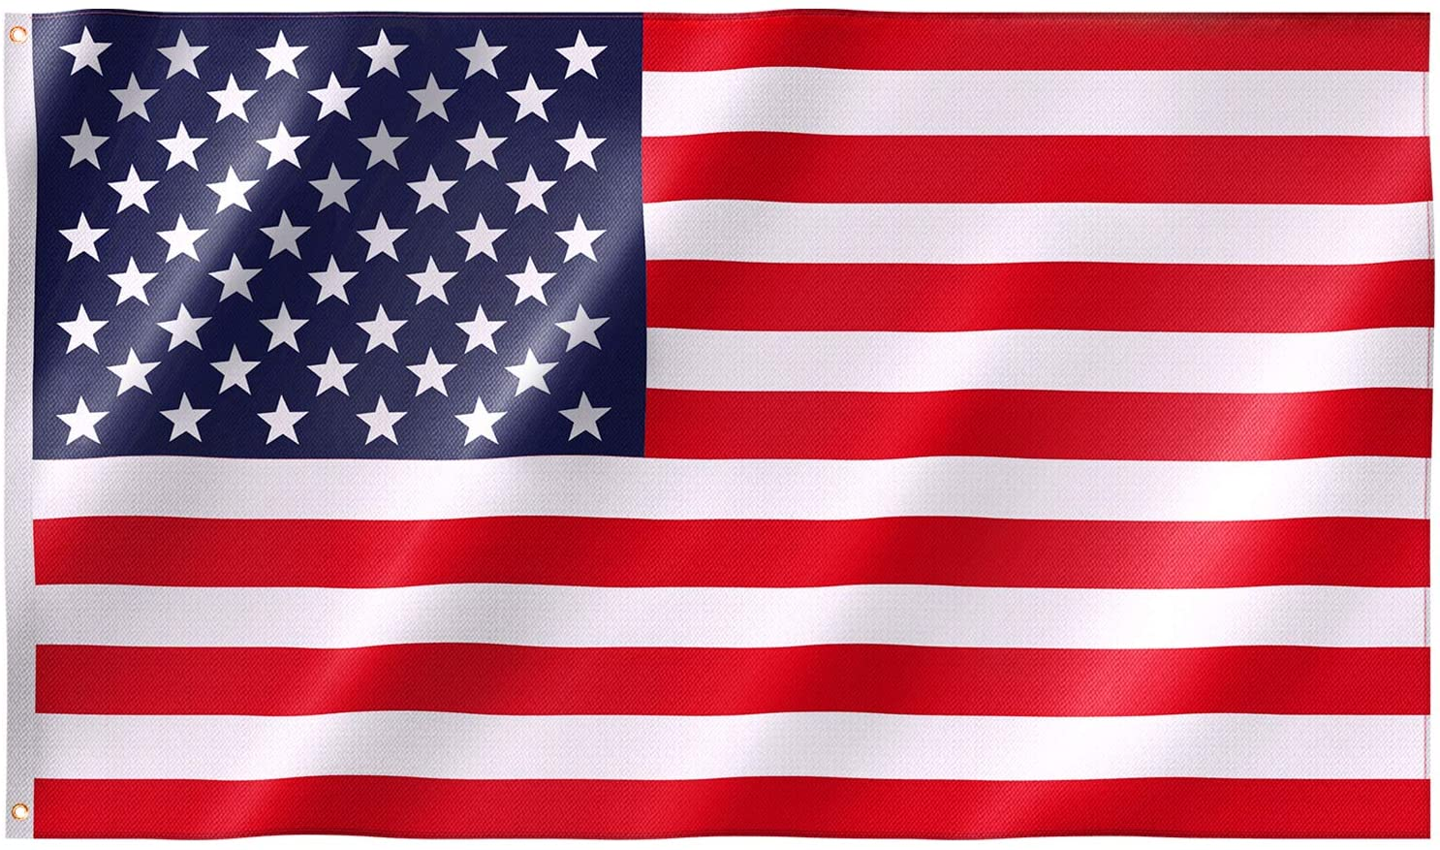
Happy Flag Day!
What GEOMETRY do you see in our flag?
Estimate the size of the INTERIOR angles in the stars?
4.MD.C5

Slide 11
Which ones go together?
0.49 | 0.51
0.46 | 4.09
A
B
C
D
4.NF.C6
Notes:
Week of June 16, 2025

Slide 12
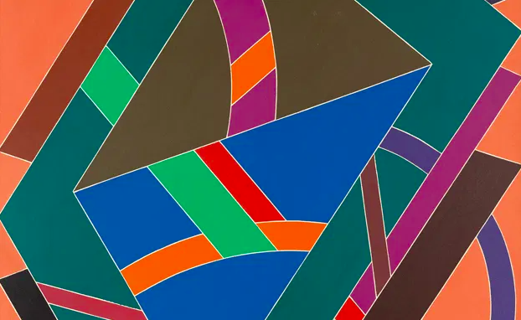
What interesting shapes do you see here?
Estimate the angle measurements
Justify your reasoning.
“Truckin” by William T. Williams (1969)
4.G.A2

Slide 13
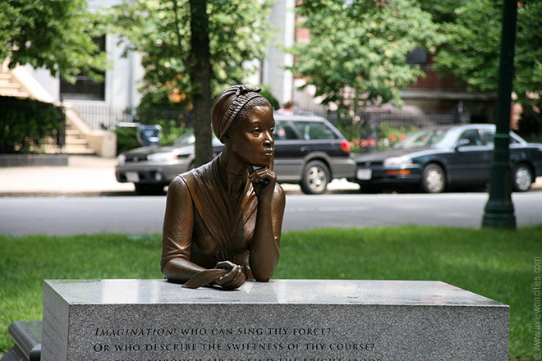
Phillis Wheatley (1753-1784) was a famous poet from Boston. She was also a slave in a wealthy home in Boston.
Her first book was published (by someone else) in 1834.
How old would she have been in 1834?
How long after her death was her poetry published?
Phillis Wheatley Statue on Commonwealth Avenue, Boston by Meredith Gang Bergmann
4.NBT.A1
Notes:
Juneteenth

Slide 14
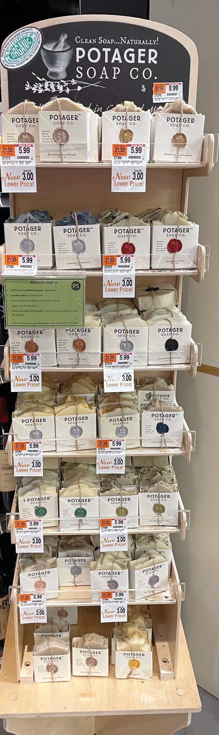
Where’s the Math?
How many bars of soap are in this display at Brother’s Market?
How can we use our estimation skills to get really close?
If we want to buy all of them at $2.99 each, how much money do we need?
4.OA.A3

Slide 15
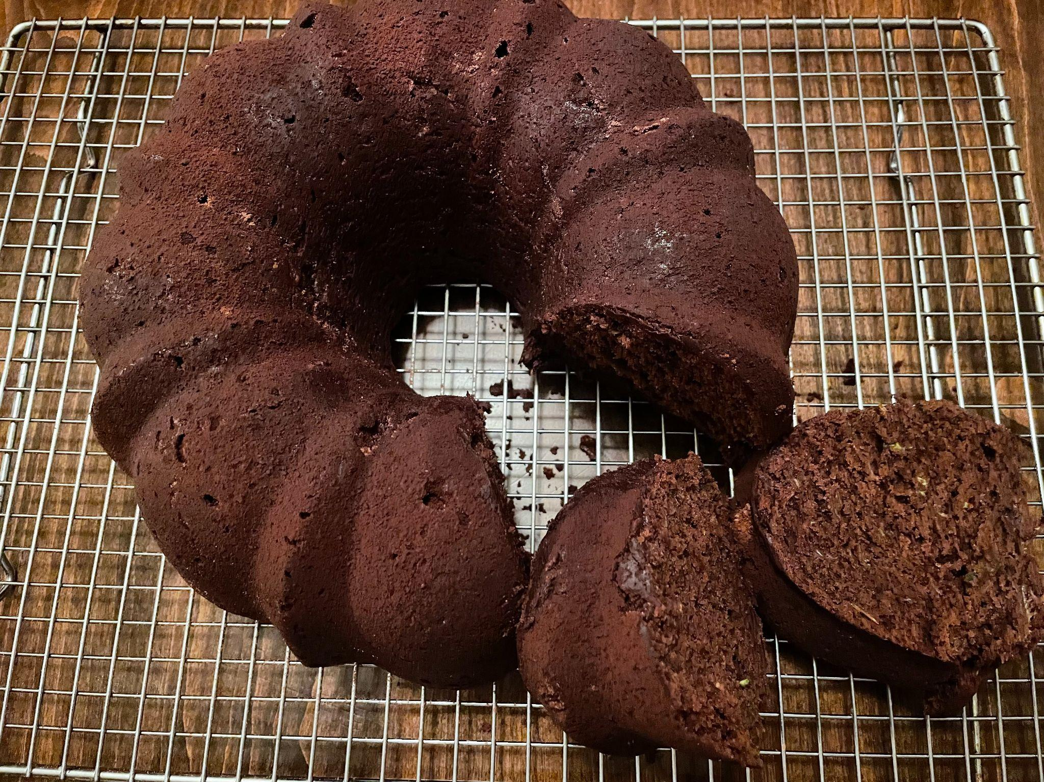
About what fraction of the cake is not cut into slices?
4.NF.A2
Notes:
June 23, 2025
Last Day of School

