Slide 1
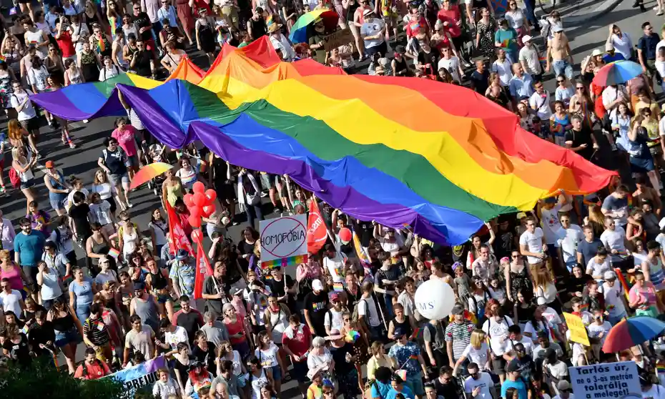
Wow! Look at that Pride Flag in Budapest!
The dimensions of this flag are 12 meters by 35 meters.
What is the perimeter?
What is the area?
3.MD.D8
Notes:
Week of June 2, 2025
June is Pride Month

Slide 2
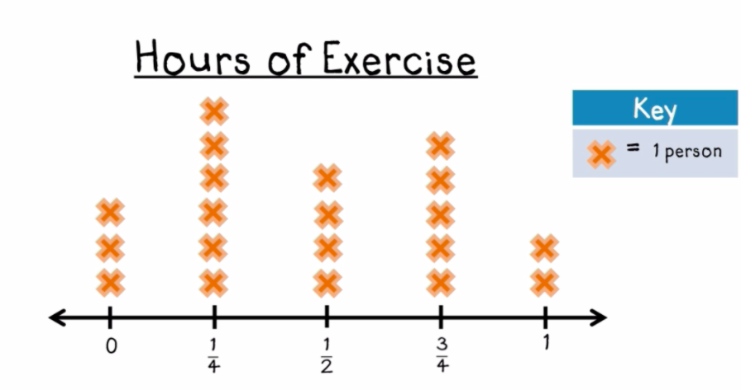
If this graph could talk,
what would it say?
What do you notice? What do you wonder?
What is a good name for this line plot?
3.MD.B4

Slide 3
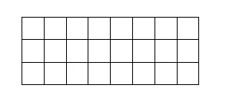

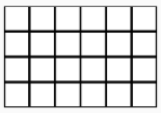
Which ones go together?
A | B
C | D
3.G.A2

Slide 4
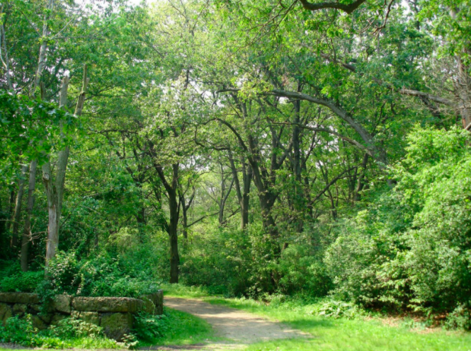
Franklin Park in Boston is beautiful!
It was established in 1890. How old is the park?
How did you solve it?
3.NBT.A2

Slide 5
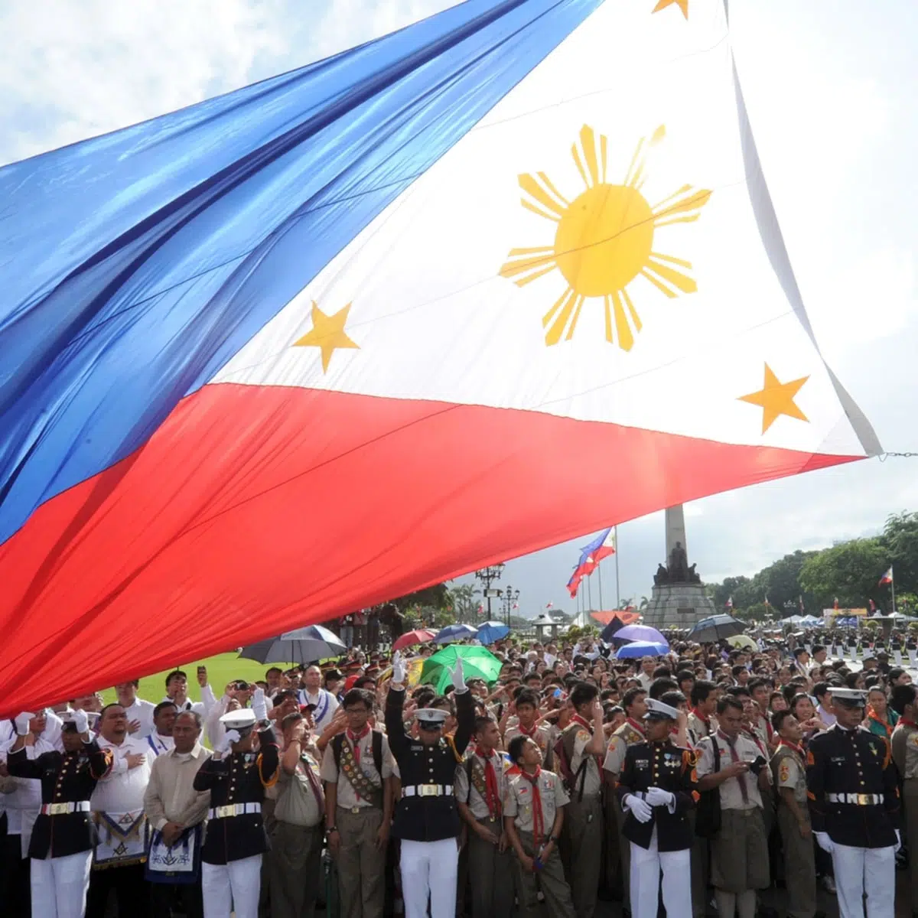
Today is Linggo Ng Kalayaan, Independence Day, in the Philippines.
The Republic of the Philippines declared independence from Spain in 1898.
How long ago was 1898?
Let’s share our strategies!
3.NBT.A2

Slide 6
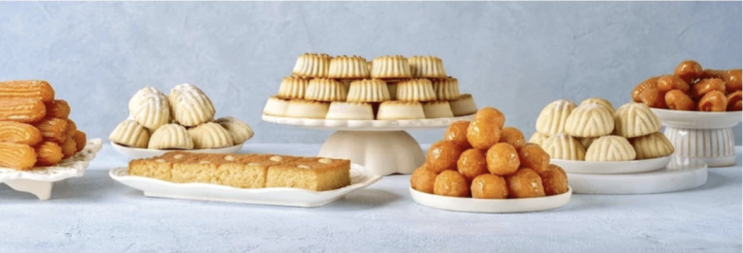
Happy Eid al-Adha!
Estimate how many sweets are on each tray? How many altogether?
How can we use our math knowledge to come close?
Create an equation to match your mathematical thinking.
3.OA.D8
Notes:
Week of June 9, 2025

Slide 7
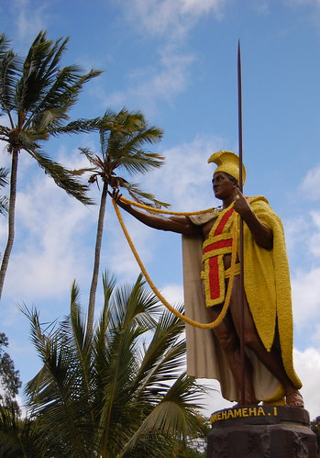
It’s King Kamehameha Day
In Hawaii!
This statue in Kapaau honors Hawaii’s grandest king. A great warrior, diplomat, and leader King Kamehameha united the Hawaiian Islands into one royal kingdom.
Historians believe King Kamehameha was born in 1758.
How long ago was that?
Write an equation to match your thinking, and solve it!
3.NBT.A2
Notes:
June 10, 2025
King Kamehameha Day in Hawaii

Slide 8
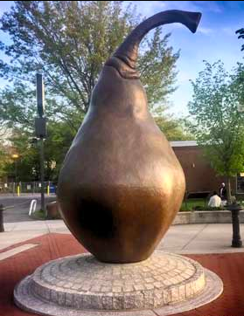
This 12 foot tall pear sits in the middle of Everett Square in Dorchester.
How many times taller is the pear than you?
3.OA.B6

Slide 9

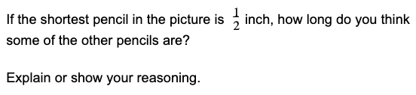
3.NF.A3

Slide 10

Happy Flag Day!
Where do you see an array here?
Can you write a number sentence using addition AND multiplication to match your thinking?
3.OA.A3
Notes:
Flag Day

Slide 11
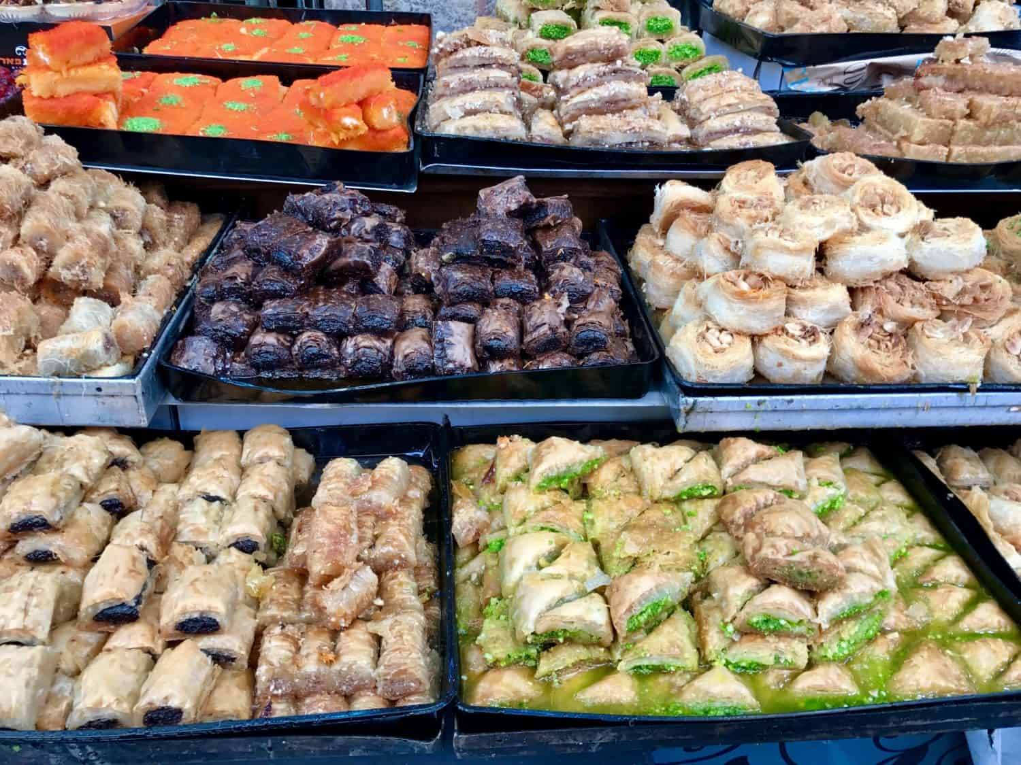
Wow... and Yum!
What interesting shapes do we see in this photo from the Shuk in Jerusalem?
Can we ESTIMATE how many of each sweet we see here?
How can we use MATH to help get really close?
3.NBT.A1
Notes:
Week of June 16, 2025

Slide 12
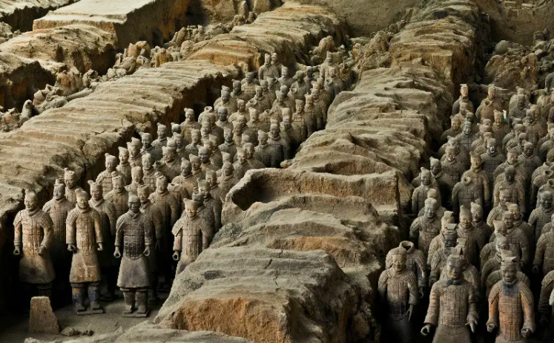
The Terracotta Army, Xi'an 秦陵兵马俑
The Qin Tomb Terracotta Warriors and Horses in Xian China features a whole army of about 8,000 life sized figures.
What MIGHT the actual number be?
3.NBT.A1

Slide 13
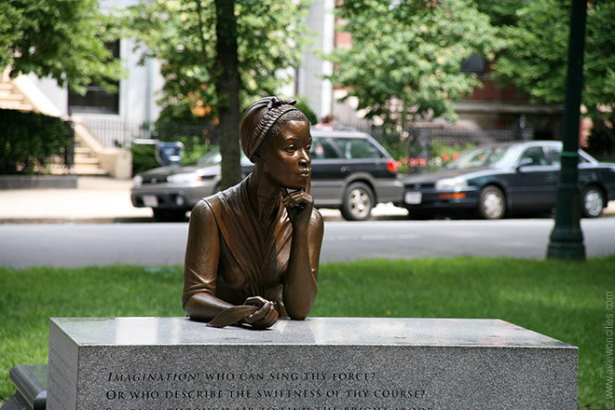
Phillis Wheatley (1753-1784) was a famous poet from Boston. She was also a slave in a wealthy home in Boston.
Her first book was published (by someone else) in 1834.
How old would she have been in 1834?
How long after her death was her poetry published?
Phillis Wheatley Statue on Commonwealth Avenue, Boston by Meredith Gang Bergmann
3.NBT.A2
Notes:
Juneteenth

Slide 14
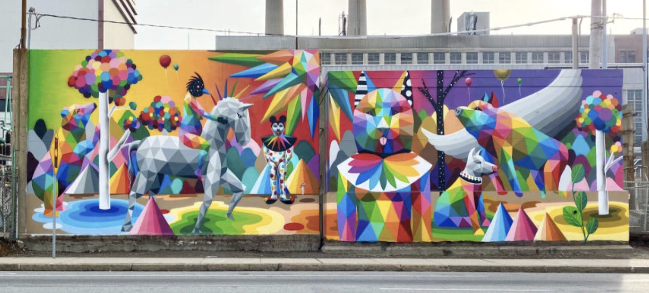
What interesting shapes can we find in this Boston mural by Okuda San Miguel? Sketch one of the shapes.
Now sketch a shape that is the SAME in one way and DIFFERENT in another way.
3.G.A1

Slide 15
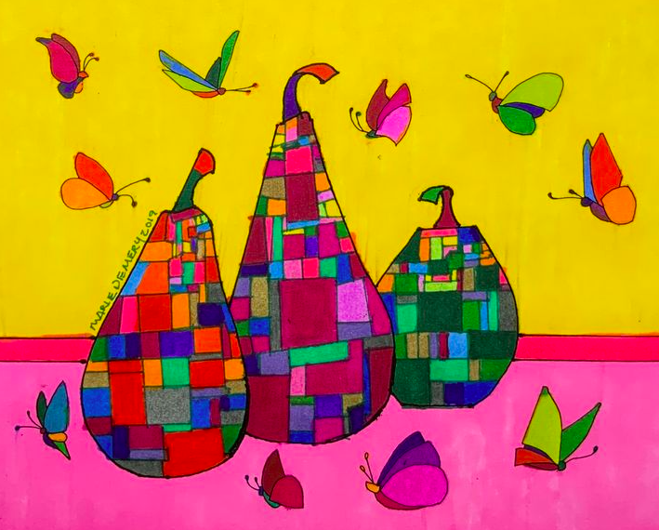
This abstract painting by Marie Demery has a lot of interesting shapes hidden inside.
Describe some of the shapes using their attributes.
How would you classify them?
3.G.A1
Notes:
June 23, 2025
Last Day of School!

