Slide 1
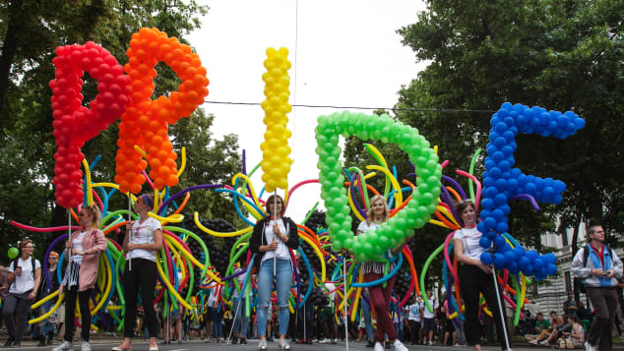
Wow! Look at all of the balloons at this
Pride Parade in Vienna, Austria!
There are over 100 balloons in the “I” letter in PRIDE!
So what is possible?
How many might there be altogether?
Create some fun equations to show your mathematical thinking!
2.NBT.B7
Notes:
Week of June 2, 2025
June is Pride Month!

Slide 2
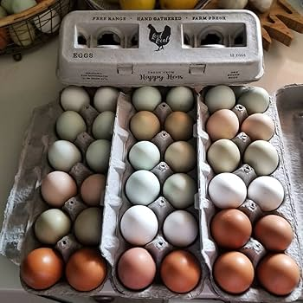
Happy National
Egg Day!
How many eggs in these cartons?
Let’s create some fun equations to match our math thinking!
2.OA.A1

Slide 3

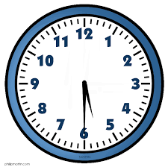
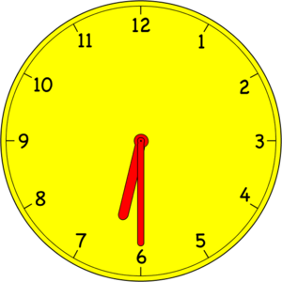
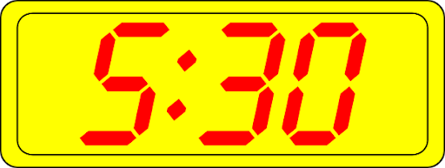
Which ones go together?
A | B
C | D
2.MD.C7

Slide 4
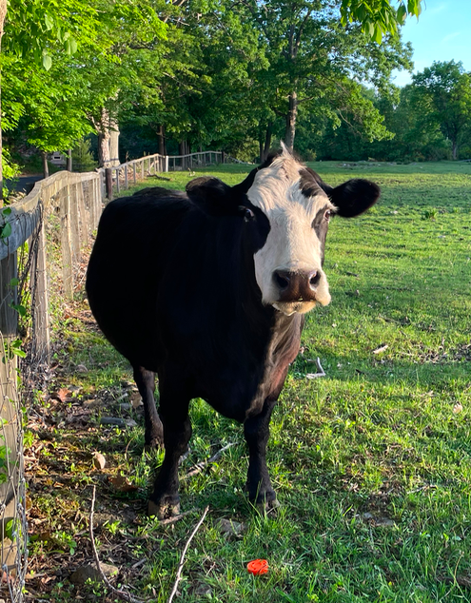
An average cow weighs about 1,200 pounds. That’s big number!
Can you write a number sentence that equals 1,200?
2.OA.A1

Slide 5
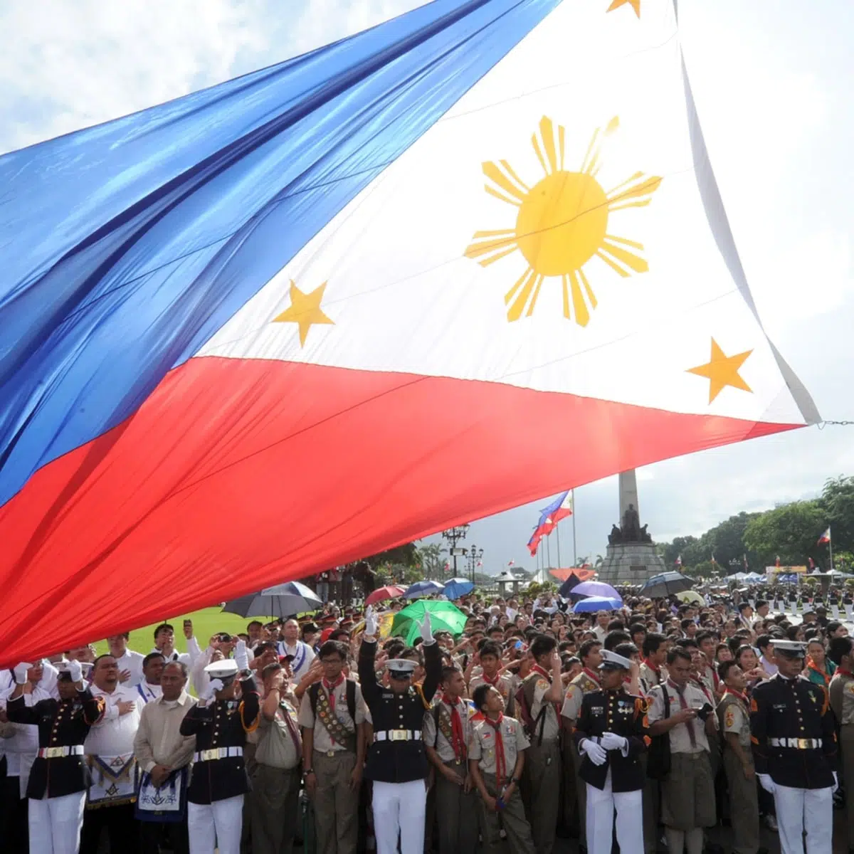
Today is Linggo Ng Kalayaan, Independence Day, in the Philippines.
The Republic of the Philippines declared independence from Spain in 1898.
How long ago was 1898?
Let’s share our strategies!
2.NBT.B5

Slide 6
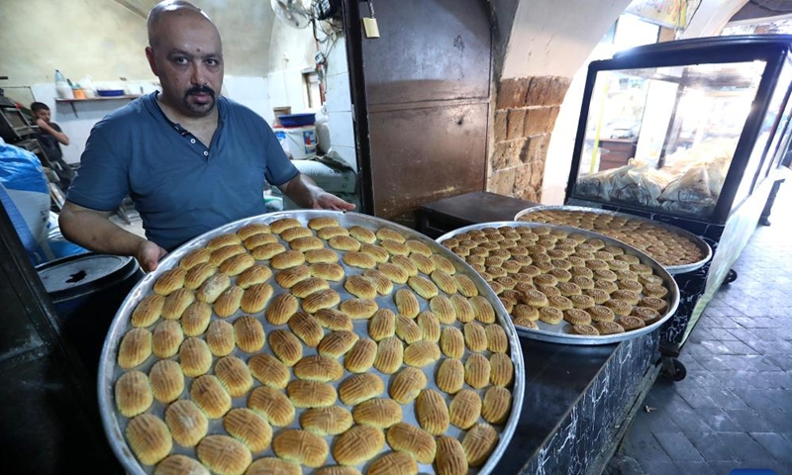
Happy Eid al-Adha!
This baker in Lebanon is preparing sweets for the holiday.
Estimate how many maamoul cookies are on each tray?
How can we use our math knowledge to come close?
2.NBT.B7
Notes:
Week of June 9, 2025

Slide 7
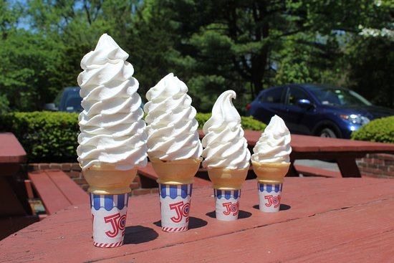
Ice cream at Dairy Joy!
The smallest cone is $2.50 and the largest one is TWICE as much.
What might the middle two sizes cost?
2.MD.C8

Slide 8

9 dimes and 11 pennies > 1 dollar
10 dollars and 7 quarters = 12 dollars
1 dollar + 23 dimes + 13 pennies < 3 dollars
2.MD.C8

Slide 9
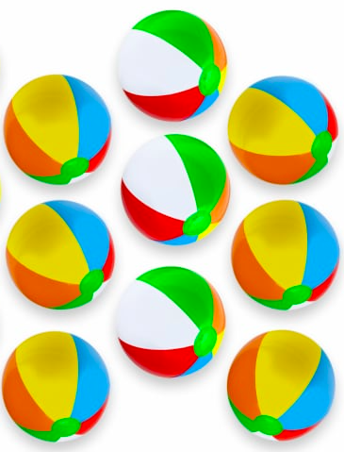
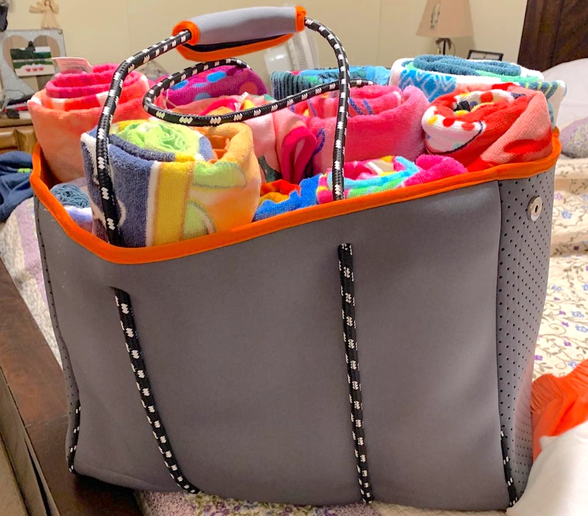
Would you rather . . .
Carry 9 beach towels or 9 beach balls?
2.SMP.3

Slide 10
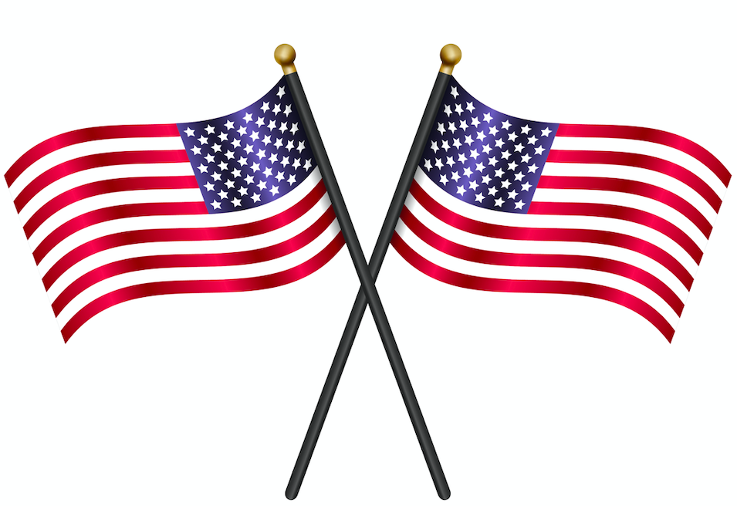
Happy Flag Day!
How many stars?
How many stripes?
How many on two flags? Three flags? Four?
Create an equation to match your thinking!
2.OA.C3

Slide 11
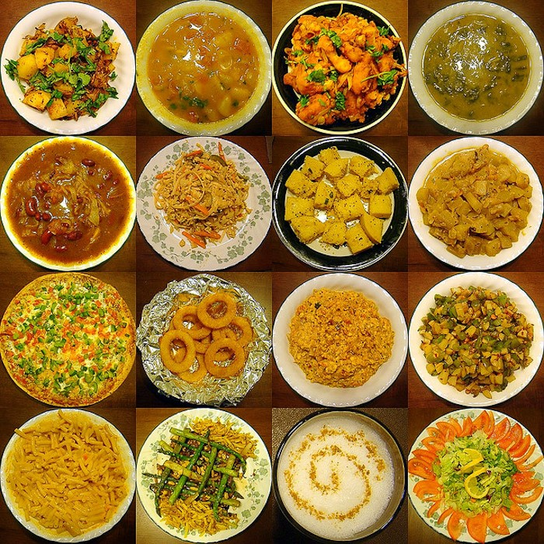
What can we say about this display of Indian Foods?
Where’s the math?
How many different number sentences can we create to match this photo?
2.OA.B2
Notes:
Week of June 16, 2025

Slide 12
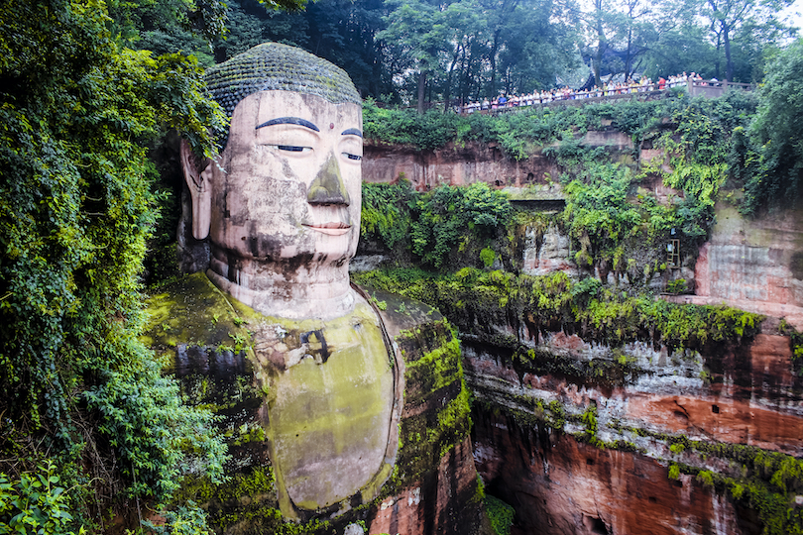
The Leshan Giant Buddha was built during the Tang Dynasty, some time between 690 and 705.
How old is this Giant Buddha?
How do you know?
Do you wonder how big it is? (Look at the people on the observation deck!)
2.NBT.B9
Leshan, China, Baoyan Zeng

Slide 13
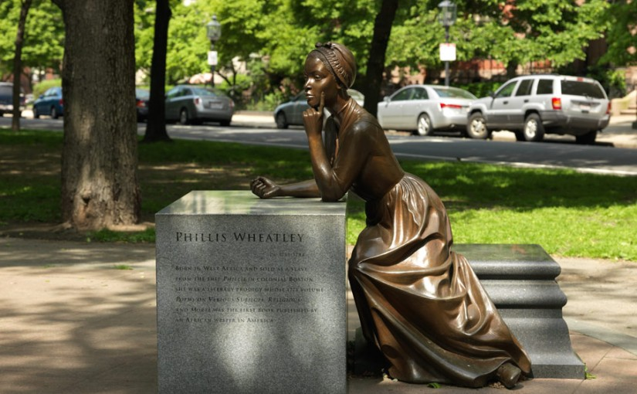
Phillis Wheatley was a very famous poet, she was also a slave in a wealthy home in Boston in the 1700s.
This statue of Phillis Wheatley by Meredith Gang Bergmann was created in 2003.
How long ago was that?
How can you use mental math to figure it out?
Phillis Wheatley Statue on Commonwealth Avenue, Boston
2.NBT.B7
Notes:
Juneteenth 2025

Slide 14
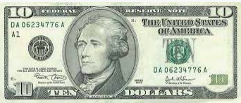
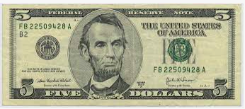
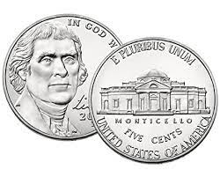

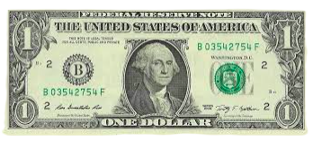
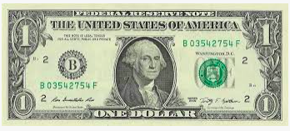
Which ones go together?
A | B
C | D
2.MD.C8

Slide 15
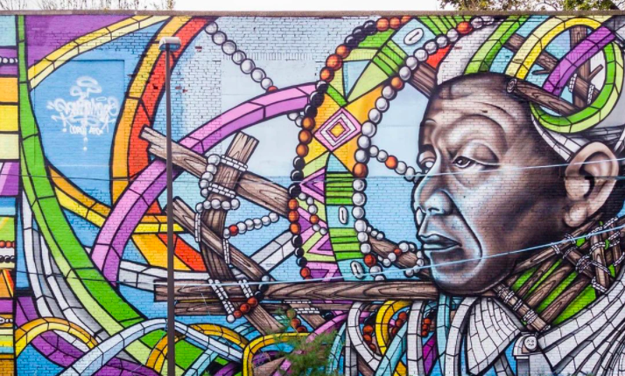
There are some very interesting shapes in this downtown Boston mural!
Pick two and find ONE way they are the same, and ONE way they are different.
2.G.A1
Notes:
June 23, 2025
Last Day of School!

