Slide 1

Happy Pride Month!
What fun shapes do we see in the Pride Flag?
1.G.A1
Notes:
Week of June 2, 2025

Slide 2
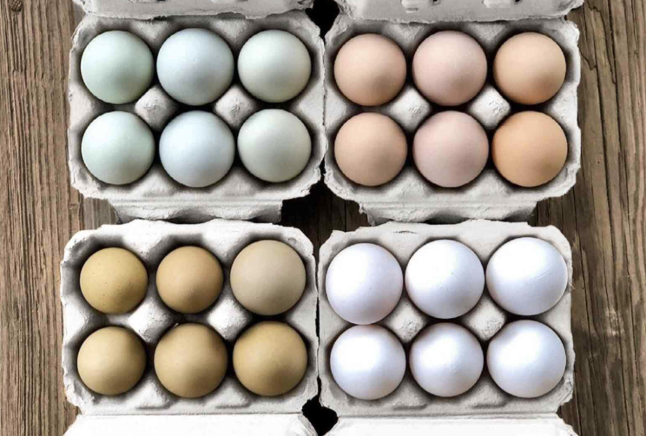
Happy National Egg Day!
How many eggs do we see?
Let’s create equations to match this photo!
1.NBT.C4

Slide 3
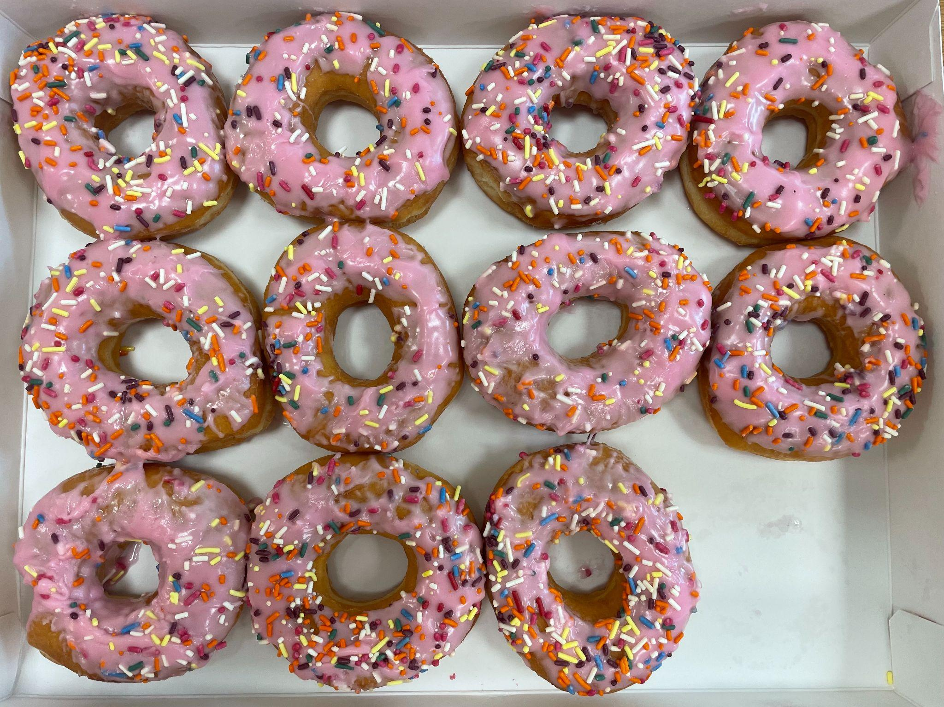
Happy National Donut Day!
What equation matches this photo?
Can we think of another one?
1.OA.C6

Slide 4
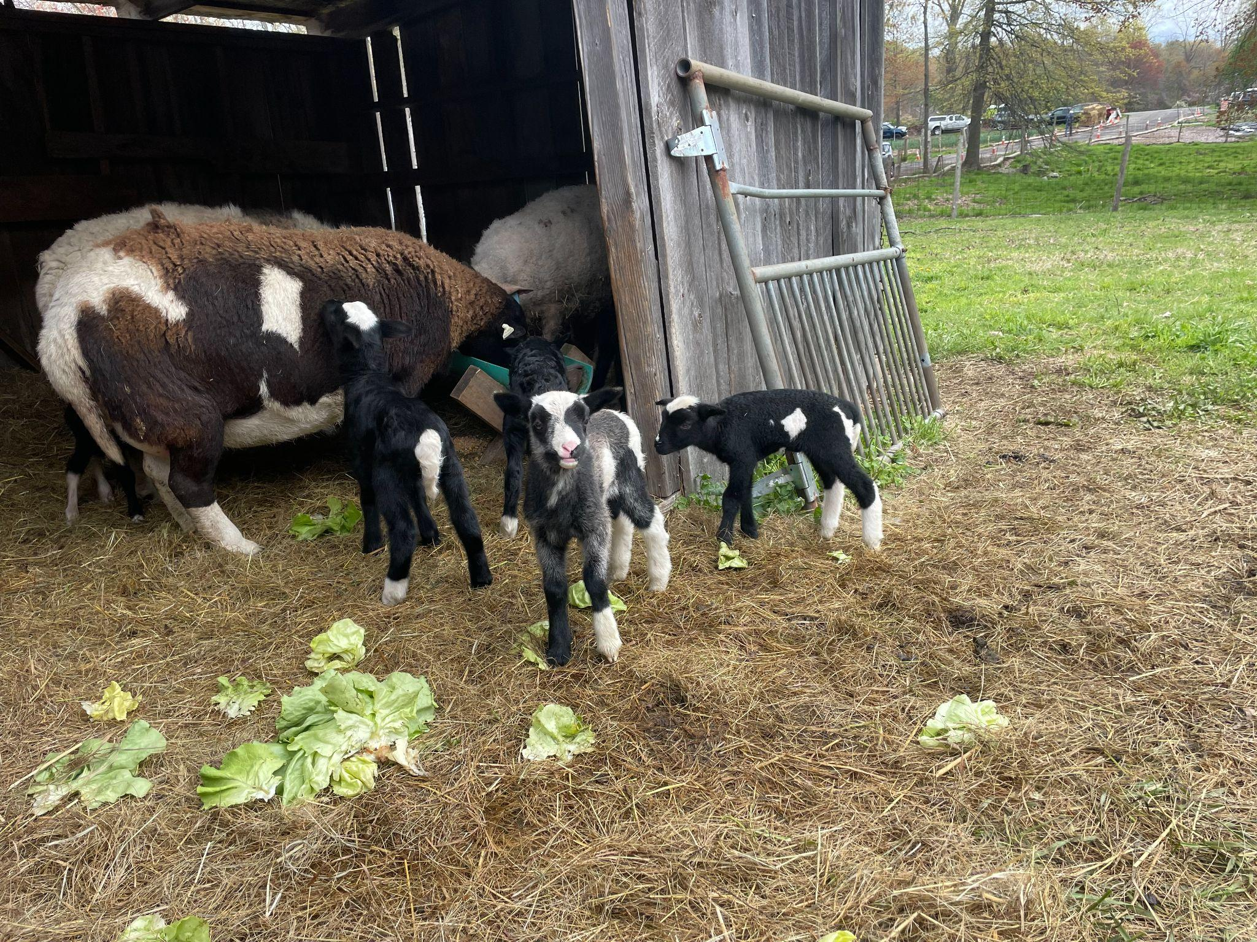
4 baby goats were born this morning at the Community Farm in Natick.
Together, the 4 goats weigh 25 pounds.
What is possible?
1.NBT.C4

Slide 5

Today is Linggo Ng Kalayaan, Independence Day, in the Philippines.
What can we say about the flag of the Philippines?
1.G.A1

Slide 6
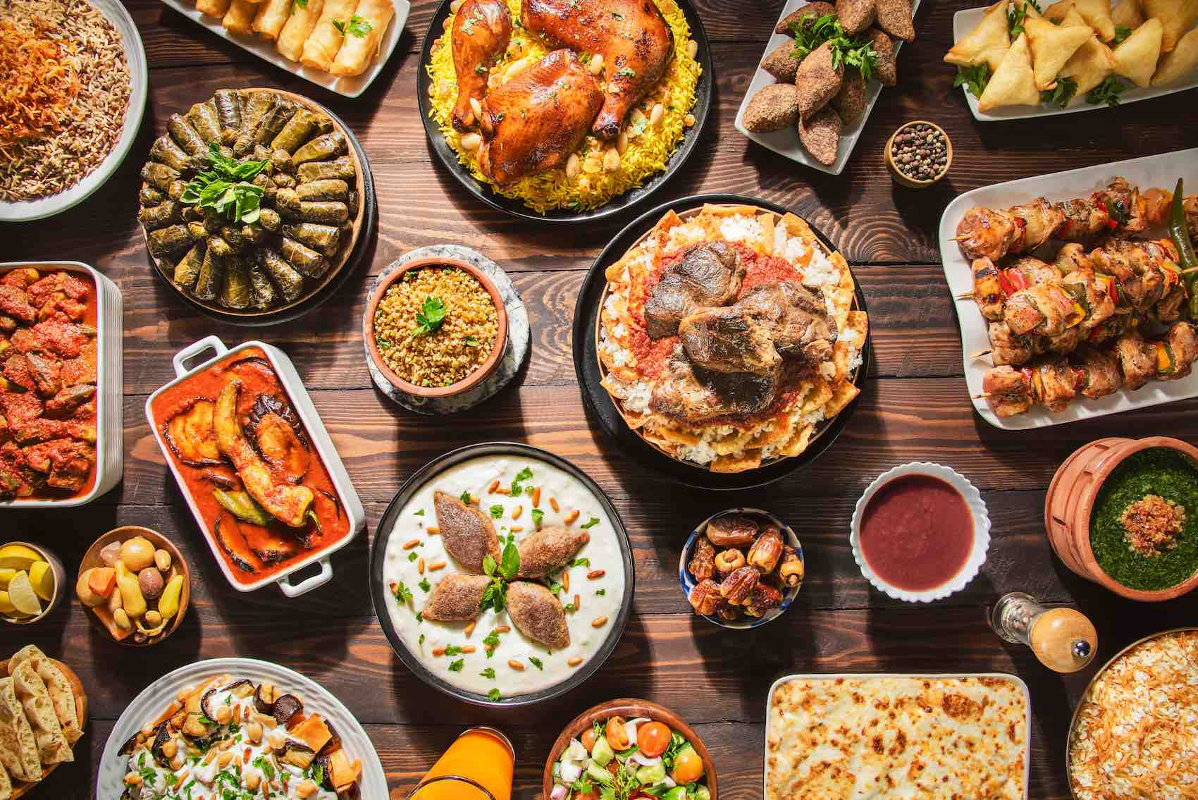
Happy Eid al-Adha!
Shape Detectives!
What are some of the interesting shapes we see?
1.G.A1
Notes:
Week of June 9, 2025

Slide 7
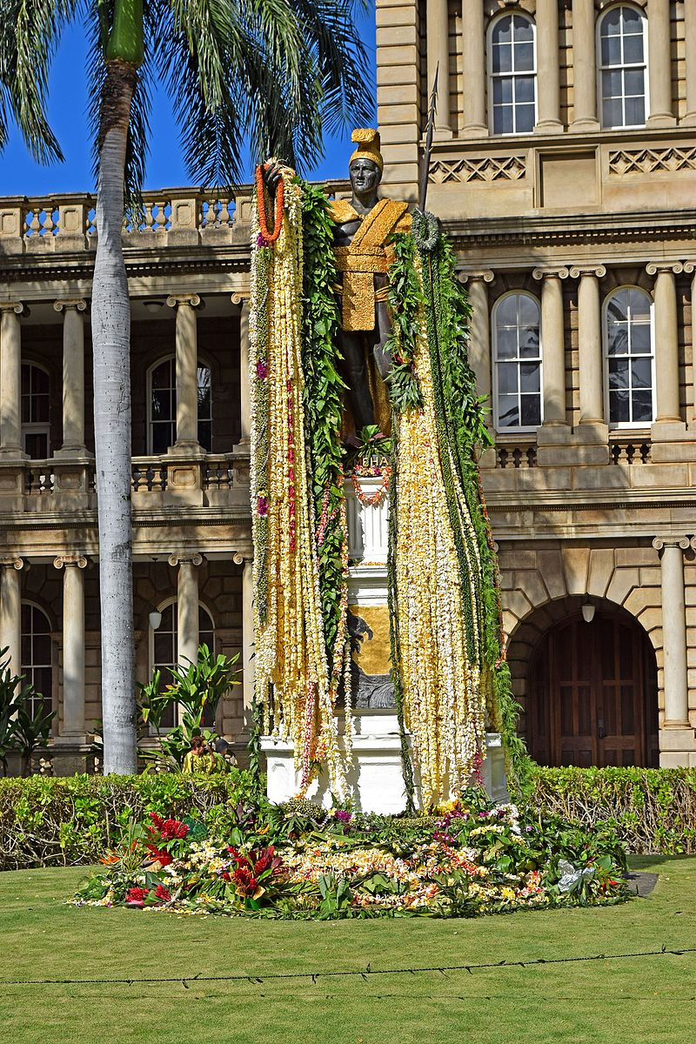
It’s King Kamehameha Day
In Hawaii!
This statue in Oahu stands 18 feet tall.
How much taller is it than you?
How can you figure it out?
1.OA.C5

Slide 8
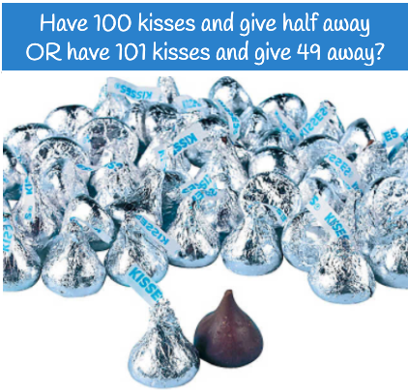
Would you rather . . .
1.NBT.C4

Slide 9
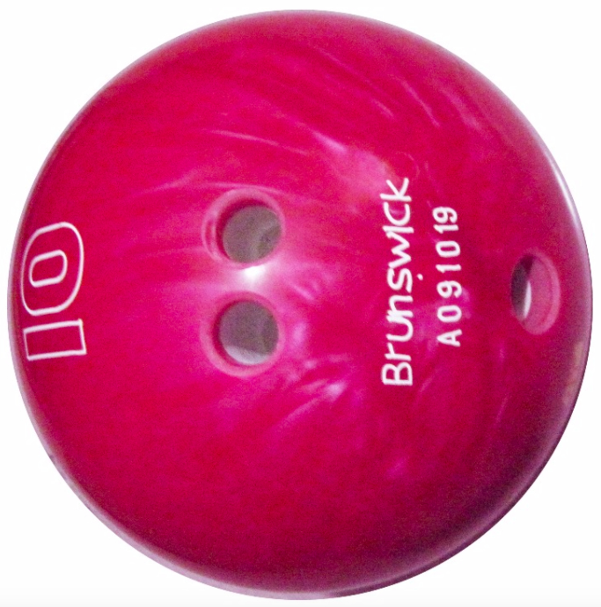
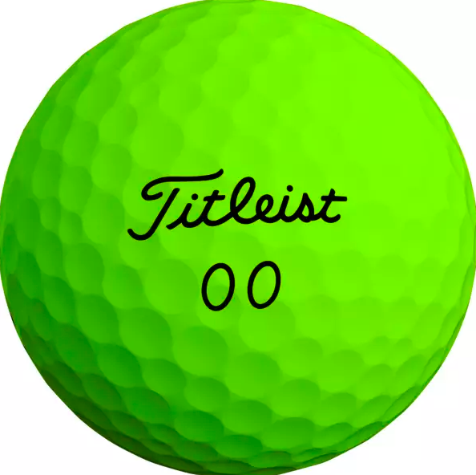
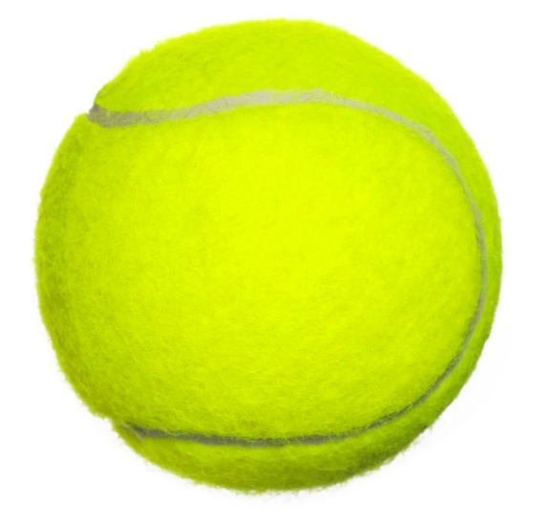
How can we compare
the balls?
1.MD.A1

Slide 10
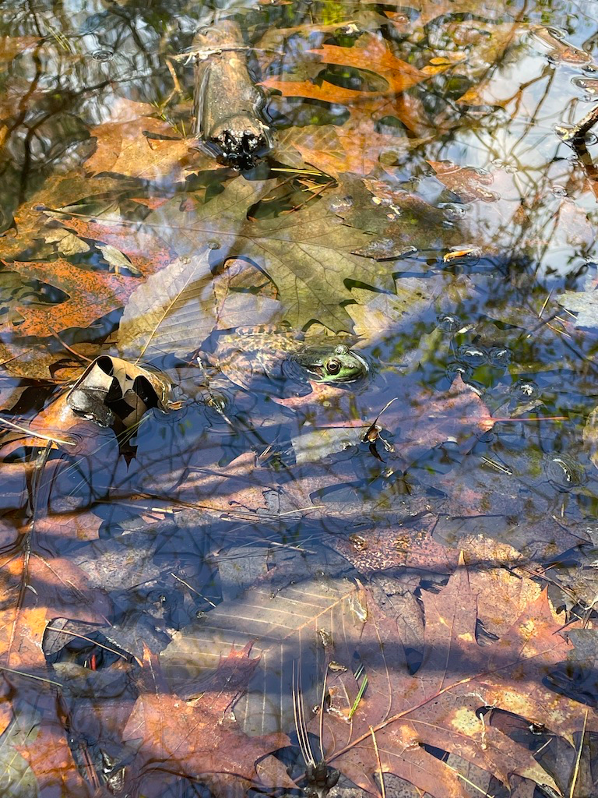
Happy Froggy Friday!
This GREEN FROG lives in our vernal pool!
He makes a really cool banjo sound!
He will be between 5 and 10 centimeters long.
How many connecting cubes do you think that is?
1.MD.A2

Slide 11
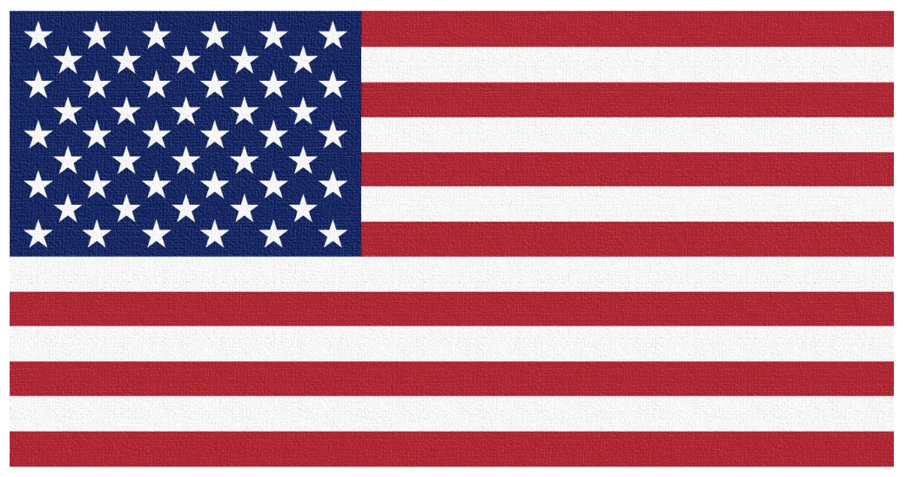
Flag Day was this past Saturday!
What can we count?
How many red stripes? How many white ones?
How many stars?
Let’s write an equation to represent the stars and stripes in the American Flag!
1.NBT.A1
Notes:
Week of June 16, 2025

Slide 12
What is the same? What is different?
1.G.A1

Slide 13
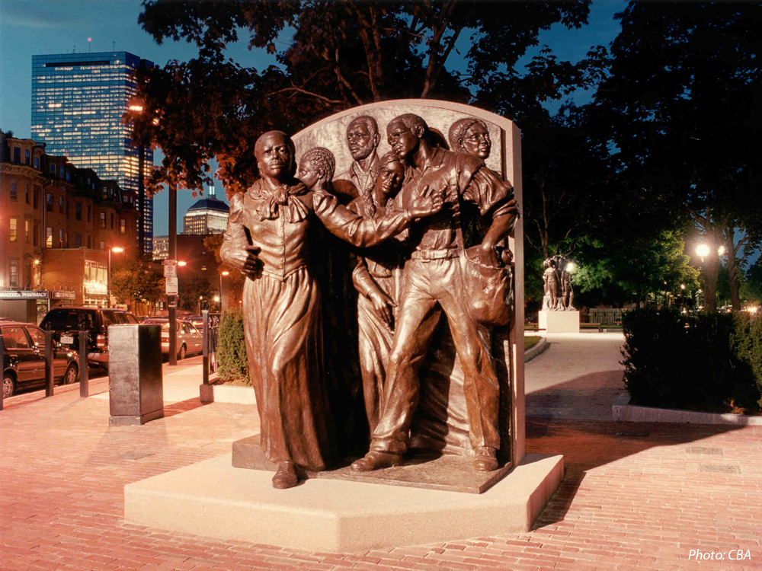
Harriet Tubman is leading 5 people North to freedom in this monument.
How many different ways can we make 6?
How many different number sentences can we create to show what we know?
Harriet Tubman Park, South Boston
1.OA.C6
Notes:
Juneteenth 2025

Slide 14
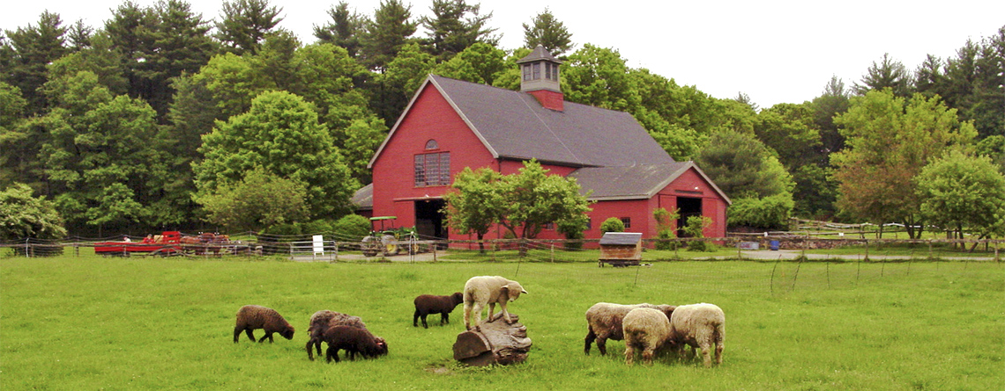
Look at all the sheep at Drumlin Farm?
How many legs are here? How do you know?
1.OA.B3

Slide 15
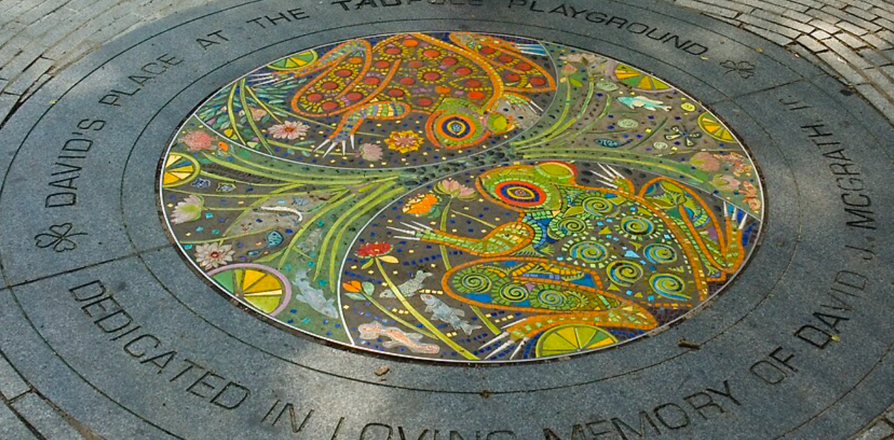
What interesting shapes do we see hidden in the Tadpole Playground Mosaic
in the Boston Common?
1.G.A1
Notes:
June 23, 2025
Last Day of School!

