Slide 1
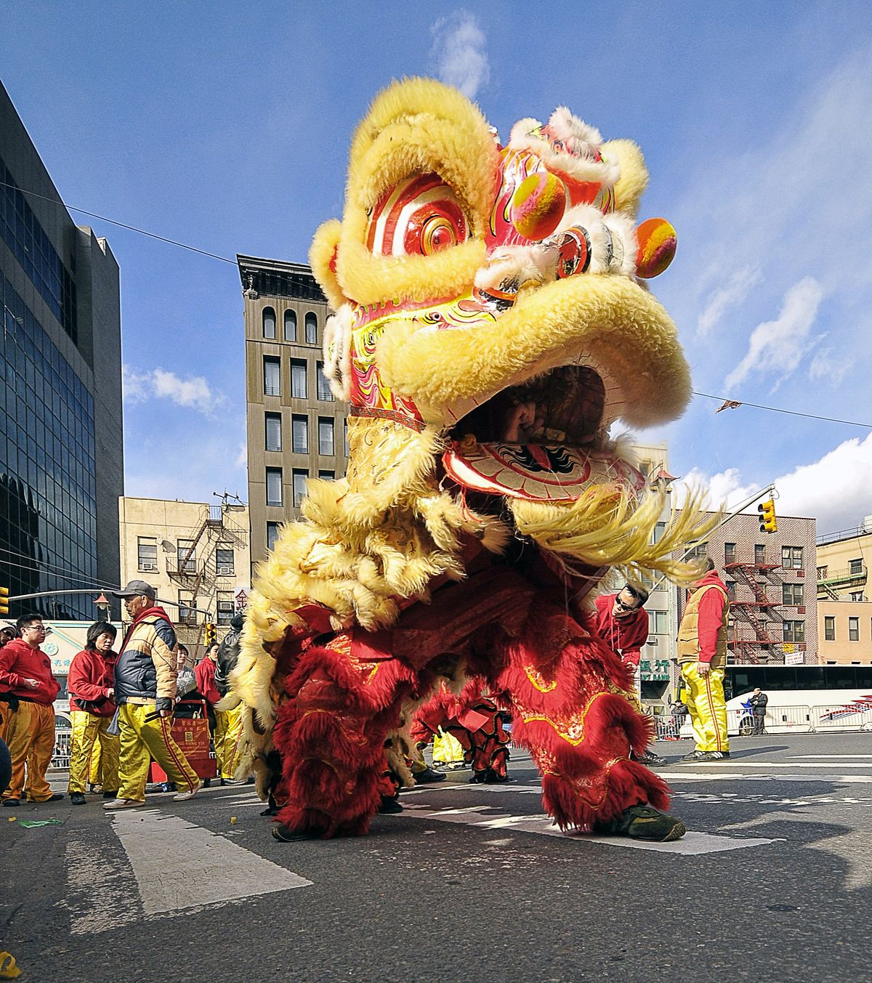
Today is the Hung King Festival in Vietnam!
What would you use to measure the HEIGHT of this lion?
Estimate the height in meters.
Estimate the height in feet.
2.MD.A3
Notes:
Week of April 28, 2025

Slide 2
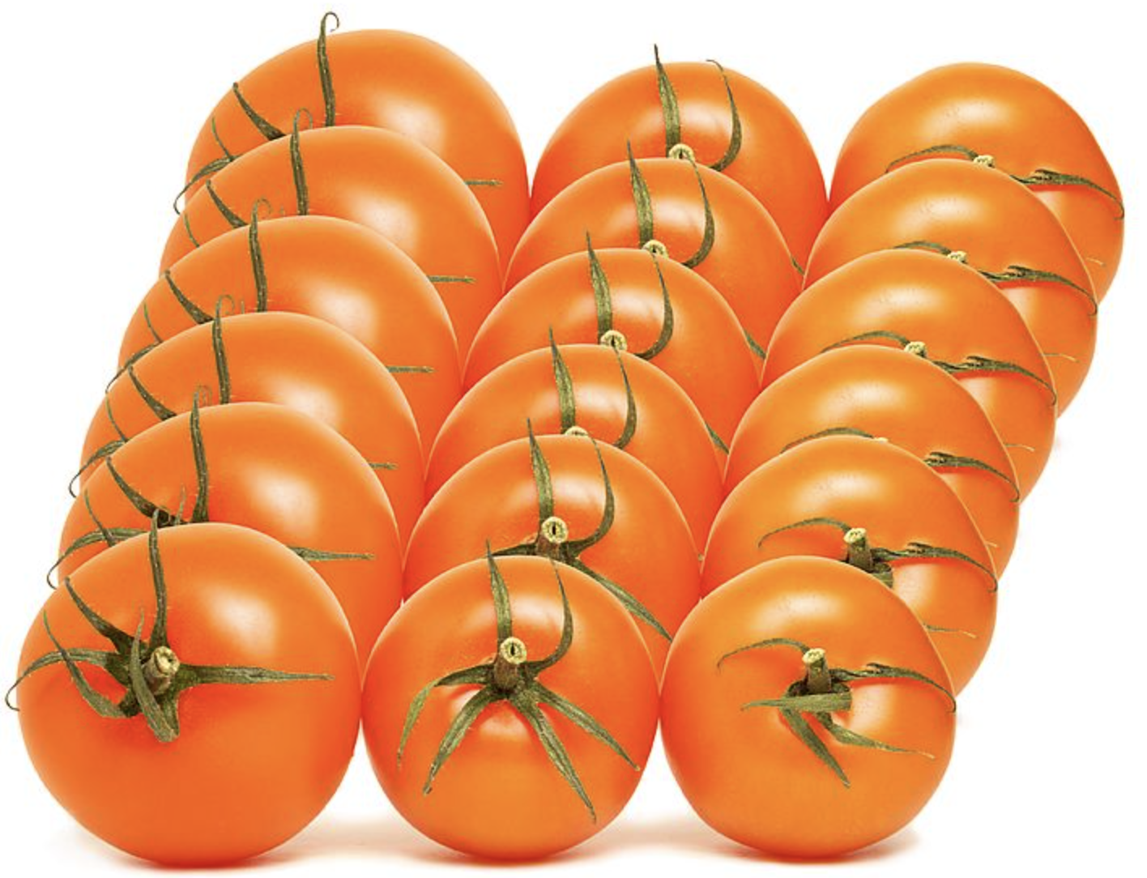
Fresh tomatoes!
How can we use
“groups of”
to determine how many are here?
2.OA.C4

Slide 3
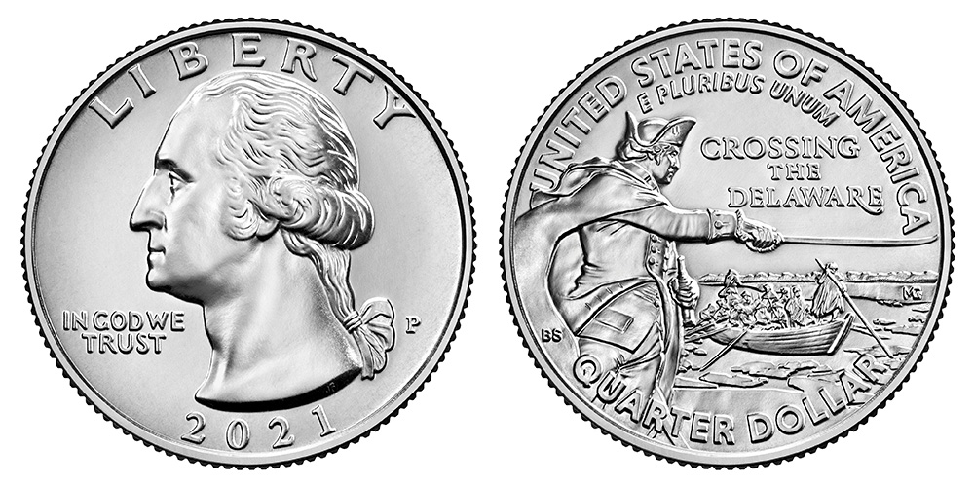
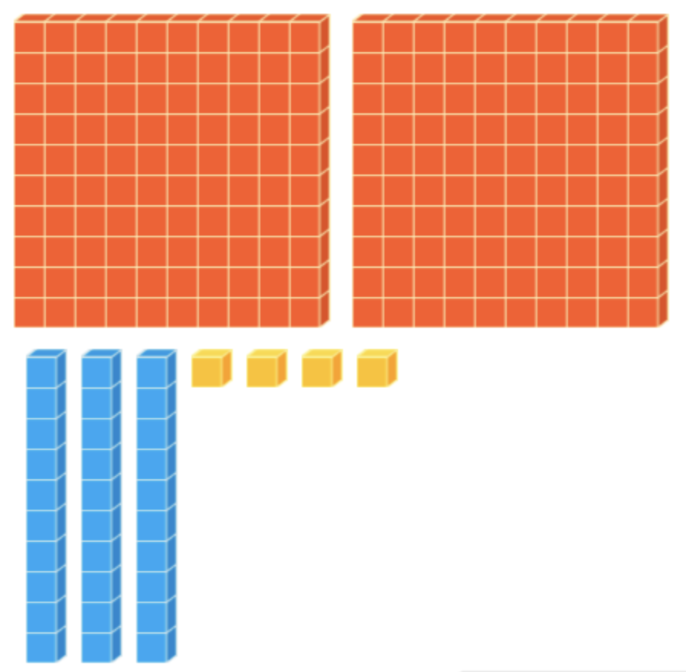
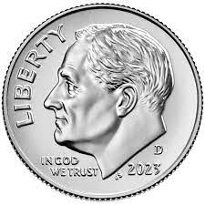
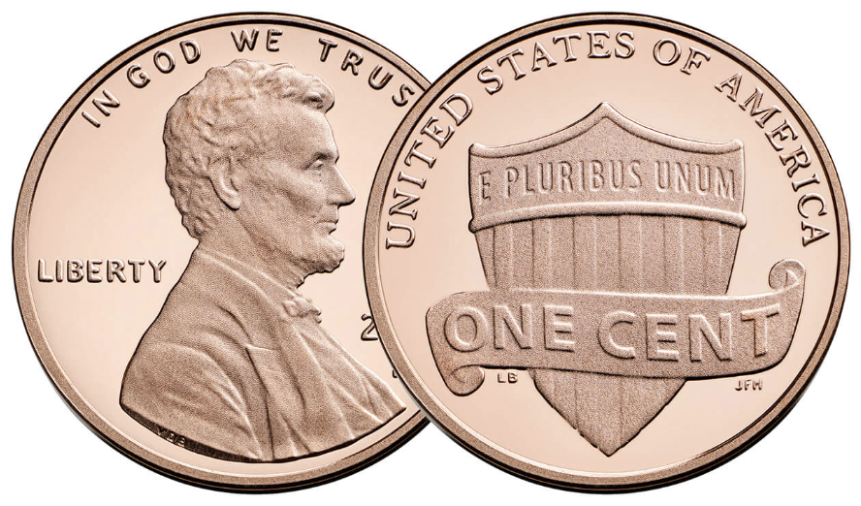
What is the same?
What is different?
2.NBT.A1

Slide 4
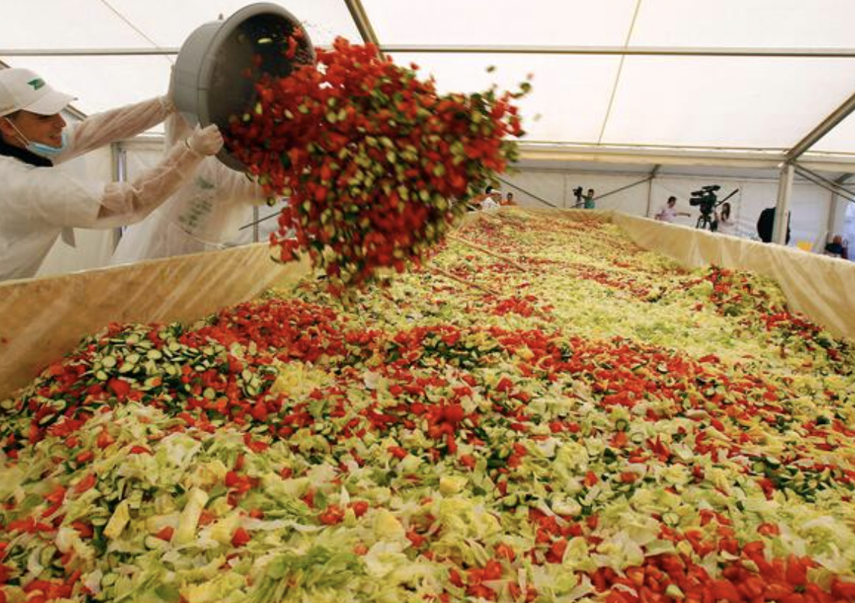
May is National Salad Month!
The world’s largest salad was made in Romania in 2012!
The salad had 975 pounds of cucumbers and 898 pound of tomatoes.
How many MORE pounds of cucumbers were in the salad.
What strategy can we use to solve this?
2.NBT.B7

Slide 5
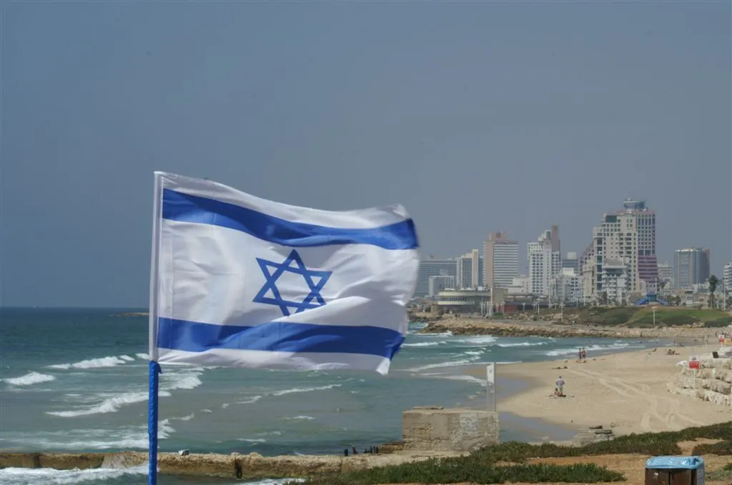
Today is Independence Day in Israel
Israel became an independent state in 1948.
How long ago was that?
How do you know?
2.NBT.B7

Slide 6
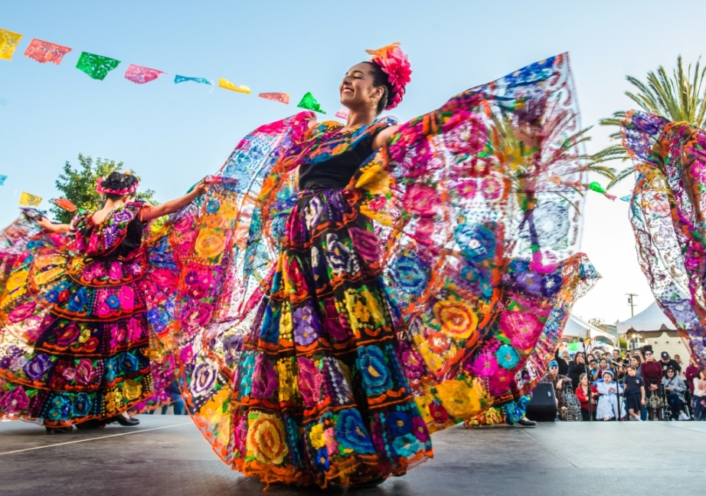
Celebrate Cinco de Mayo!
Cinco de Mayo, or the fifth of May, is a holiday that celebrates the date of the Mexican army’s May 5, 1862 victory over France at the Battle of Puebla during the Franco-Mexican War.
How long ago was that?
How do we know?
2.NBT.B7
Notes:
Week of May 5, 2025

Slide 7
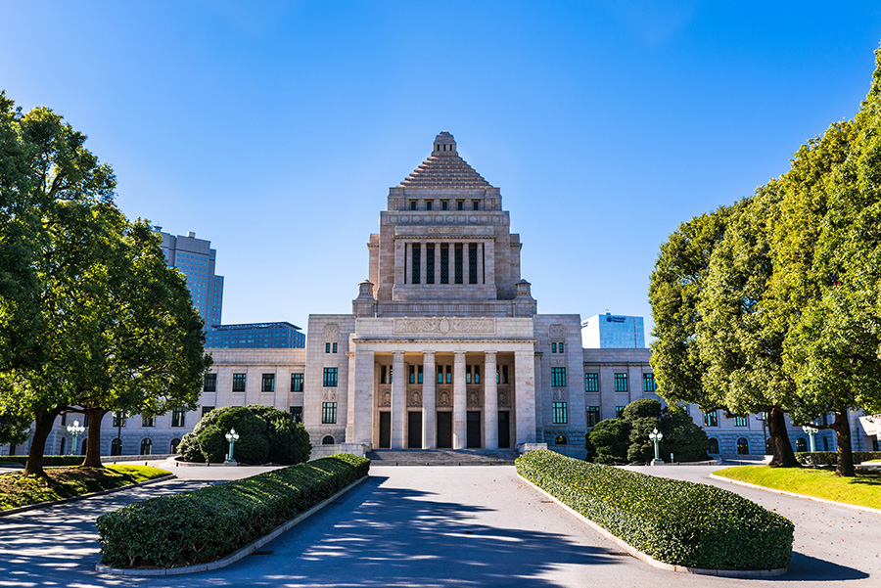
Today is Constitution Memorial Day in Japan!
The current Constitution of Japan came into force on
May 3, 1947.
How long ago was that?
2.NBT.B7

Slide 8
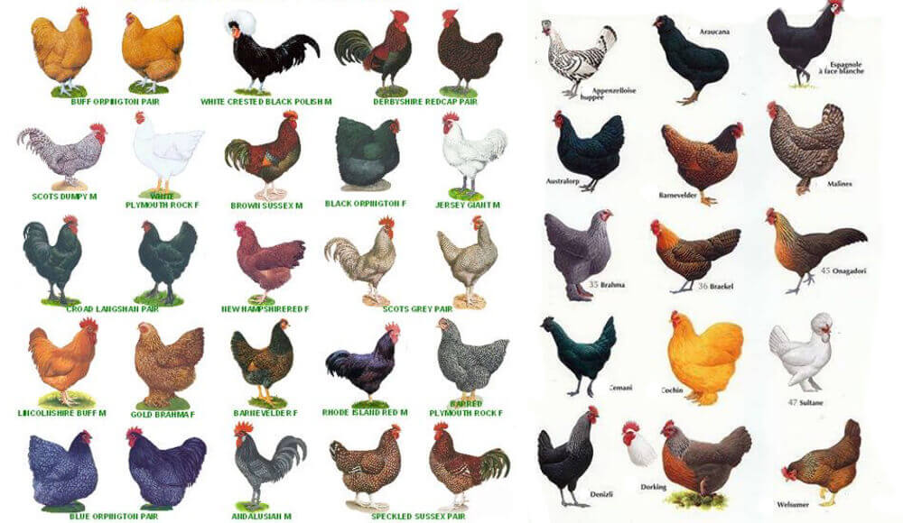
Happy International Respect for Chicken Day!
How many chickens are here?
How can we count them efficiently?
Where do we see arrays?
2.OA.C4

Slide 9
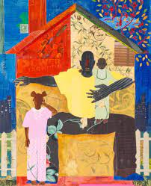
Let’s talk about some of the shapes we see in Progeny by Ekua Holmes.
What would happen if we partitioned some of the shapes into fractions?
Sketch a shape, and partition it!
What do you notice?
2.G.A1

Slide 10
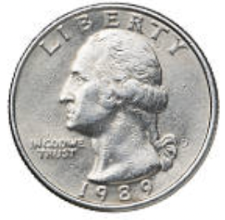
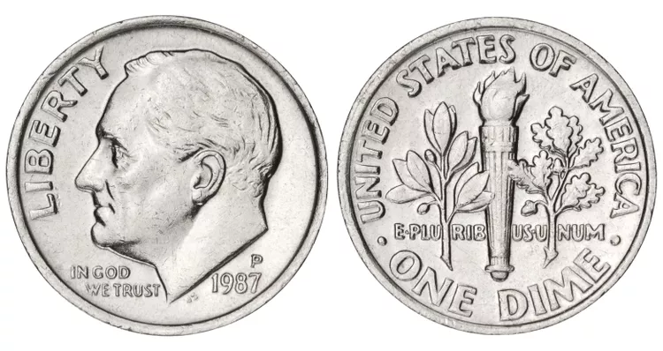
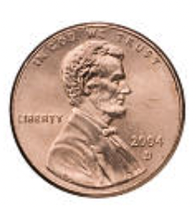
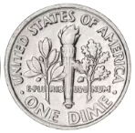
What is the same?
What is different?
2.MD.C8

Slide 11
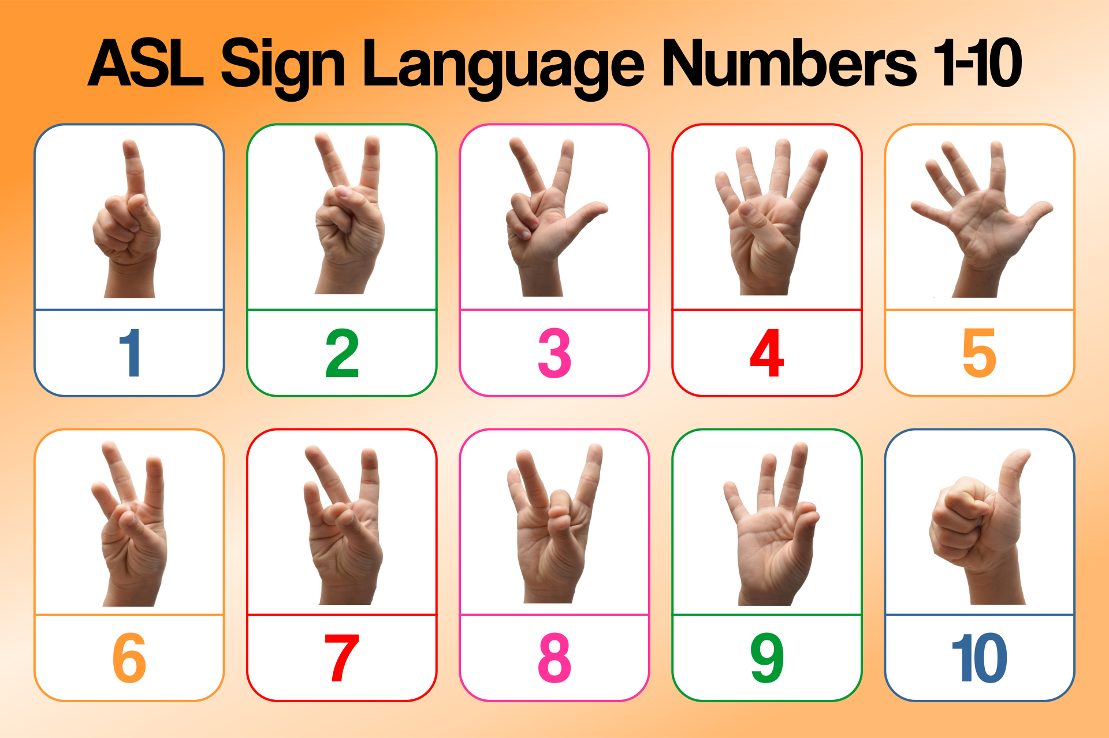
It’s Sign Language Week!
What do you notice?
What do you wonder about the numbers 1-10?
What might the teen numbers look like?
2.SMP.3
Notes:
Week of May 12, 2025

Slide 12
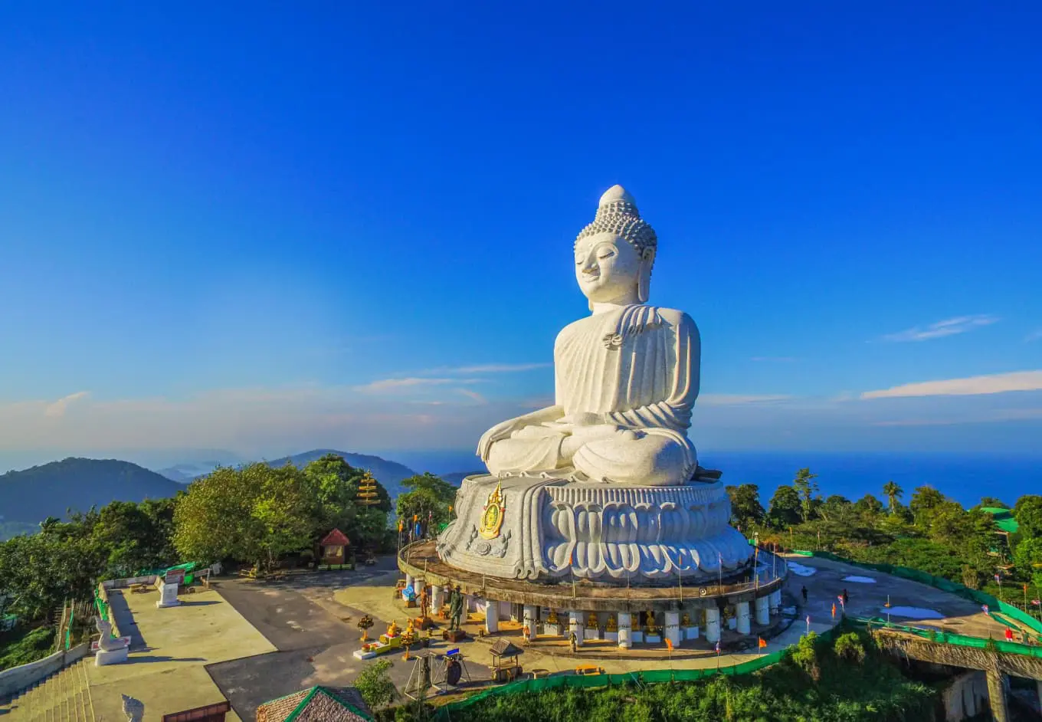
Happy Buddha Day!
The Great Buddha of Phuket is a 45-meter-tall statue made from white marble.
How much bigger is this statue than you?
2.MD.A3

Slide 13
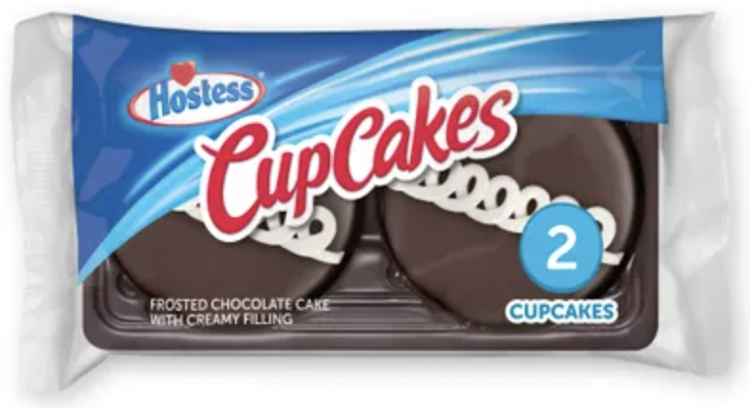
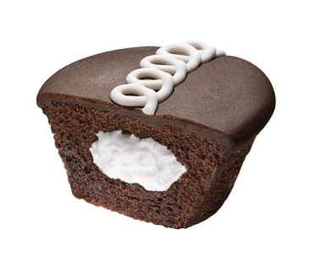
It’s Hostess Cupcake Day!
The first Hostess Cupcake was baked in 1919! How long ago was that?
The cupcake officially went into production in 1925! How long ago was that? How do you know?
2.NBT.B7

Slide 14
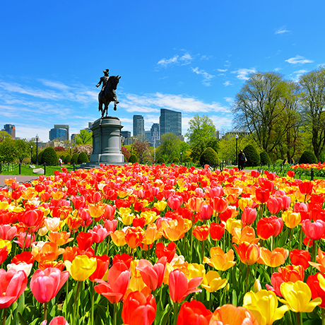
Today is National Public Gardens Day!
Dating back to 1839, the Boston Public Garden is the first public botanical garden in the United States.
How long ago was 1839?
What strategies can we use to solve this?
2.NBT.B7

Slide 15
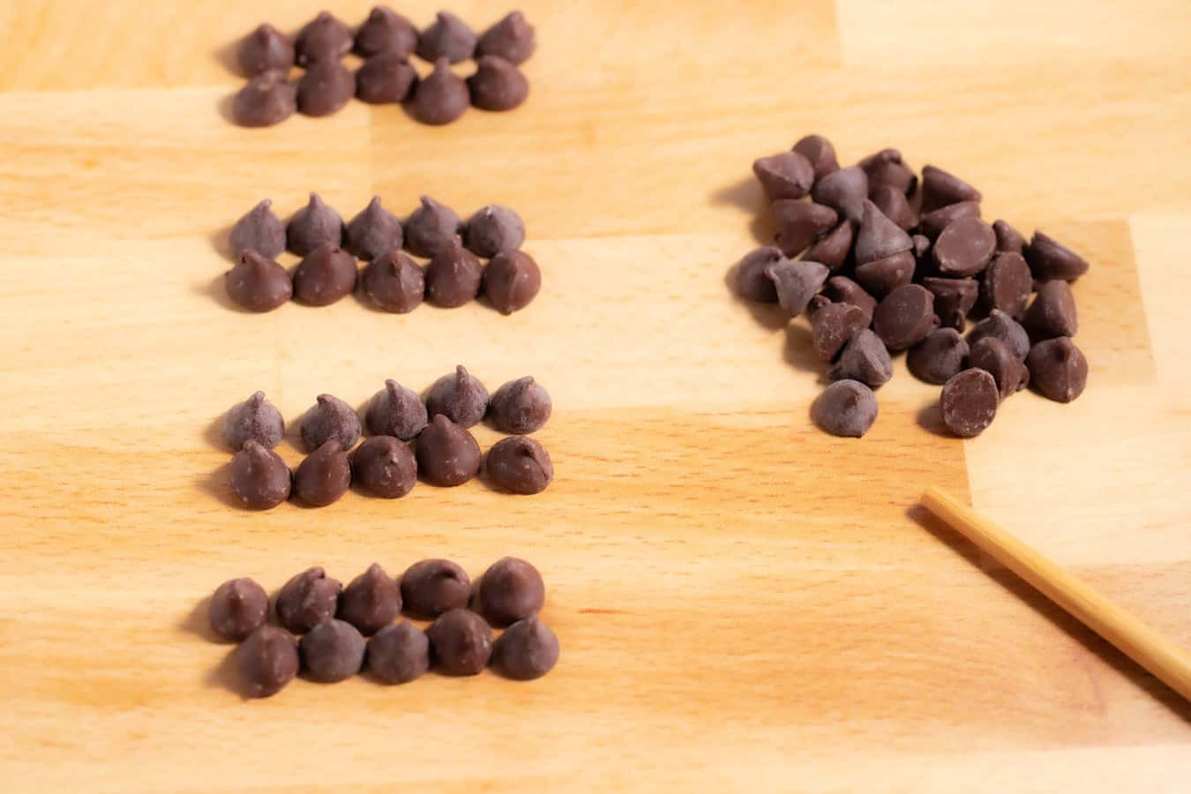
Happy Chocolate Chip Day
How many chocolate chips do we see here?
What is an estimate that is too low?
Too high?
Just right?
2.OA.A1

Slide 16
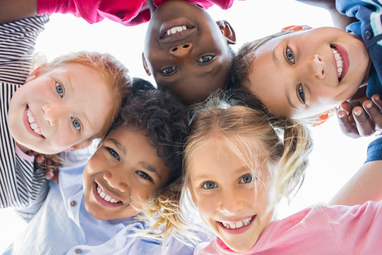
Happy National Smile Day!
Did you know that children smile about 400 times a day!!!
How many different ways can we represent the number 400?
2.NBT.A3
Notes:
Week of May 19, 2025

Slide 17
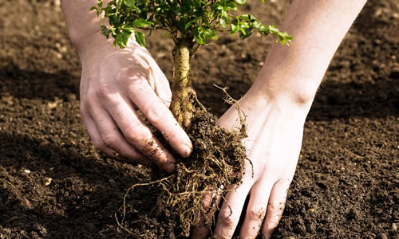
Happy Love a Tree Day
The city of Boston gave away 1,000 trees to residents to plant in their neighborhoods!
Write an expression that has a value of 1,000 with THREE addends.
2.NBT.B7

Slide 18
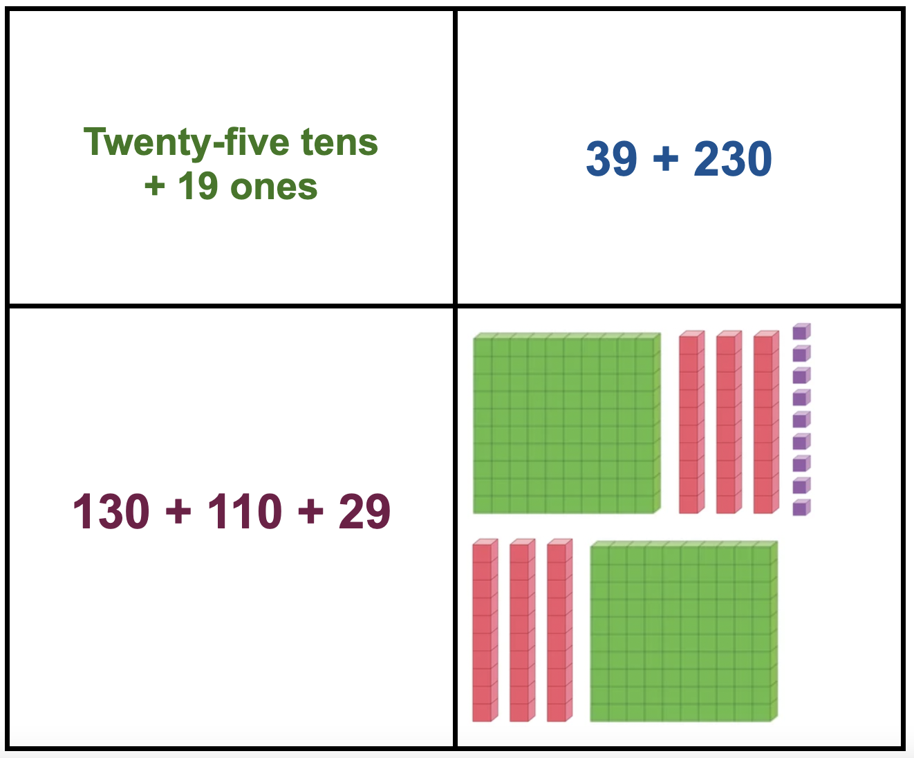
Which ones go together?
What do they have in common?
2.NBT.A1

Slide 19
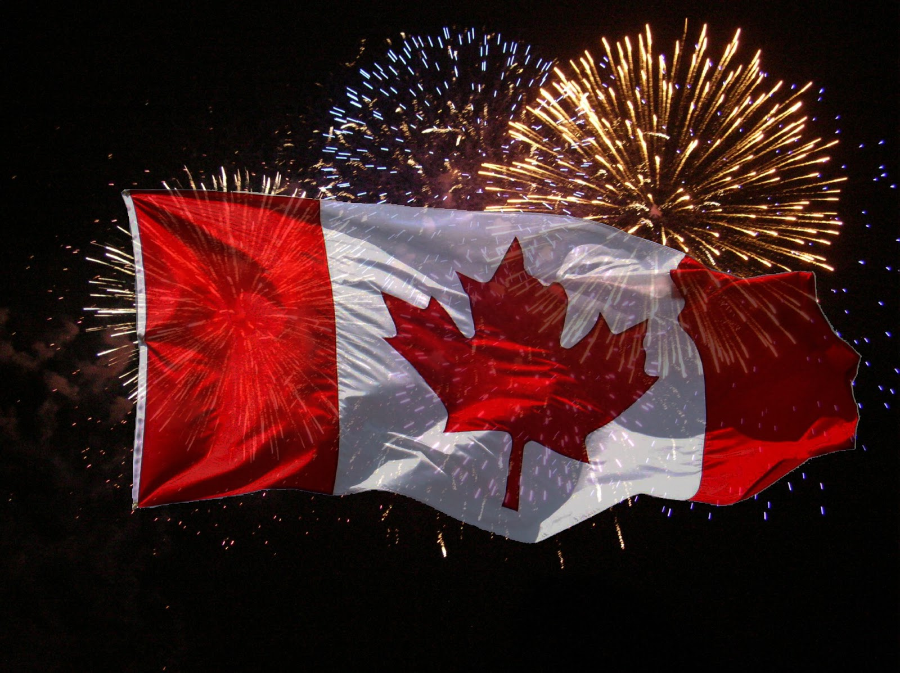
Happy Victoria Day!
May 24, Queen Victoria's birthday, was declared a holiday by the Legislature of the Province of Canada in 1845.
How long ago was that?
What strategies can we use to solve this?
2.NBT.B7

Slide 20

400 - 199 > 200
250 + 349 < 600
295 + 498 > 700
2.NBT.A4

Slide 21
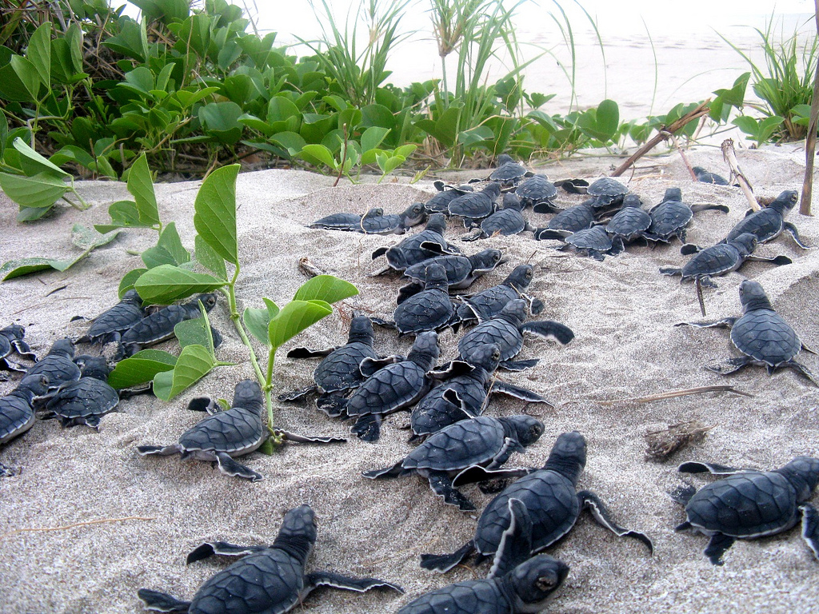
Today is World Turtle Day!
Estimate how many turtles are making their way to the ocean!
Are there more than 20?
How do you know?
2.NBT.A
Notes:
Week of May 27, 2025

Slide 22
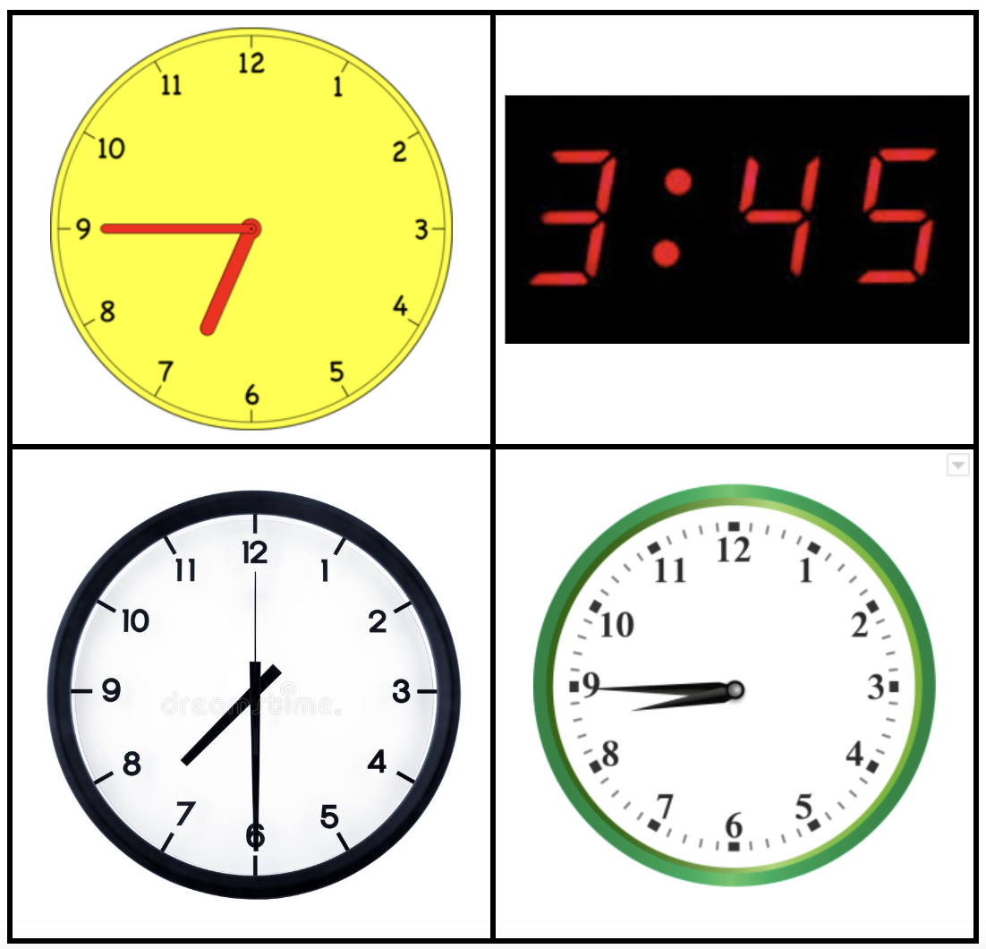
Which one doesn’t belong?
What do they all have in common?
2.MD.C7

Slide 23
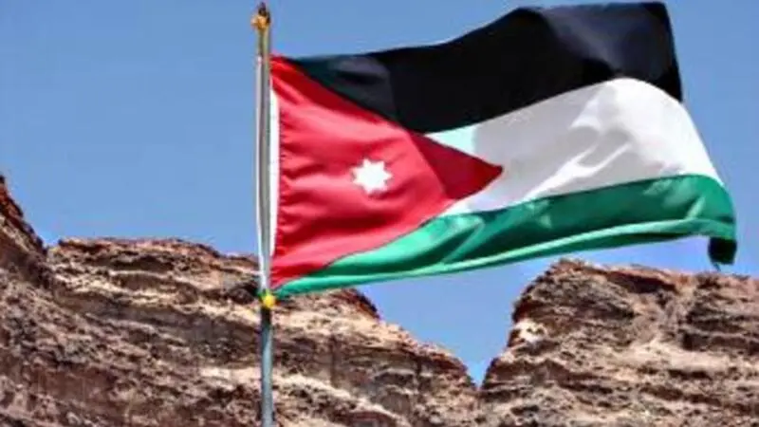
Today is Independence Day in Jordan!
Jordan became independent from the British in 1948.
How long ago was that?
What mental math strategies can we use to solve this?
2.NBT.B7

Slide 24
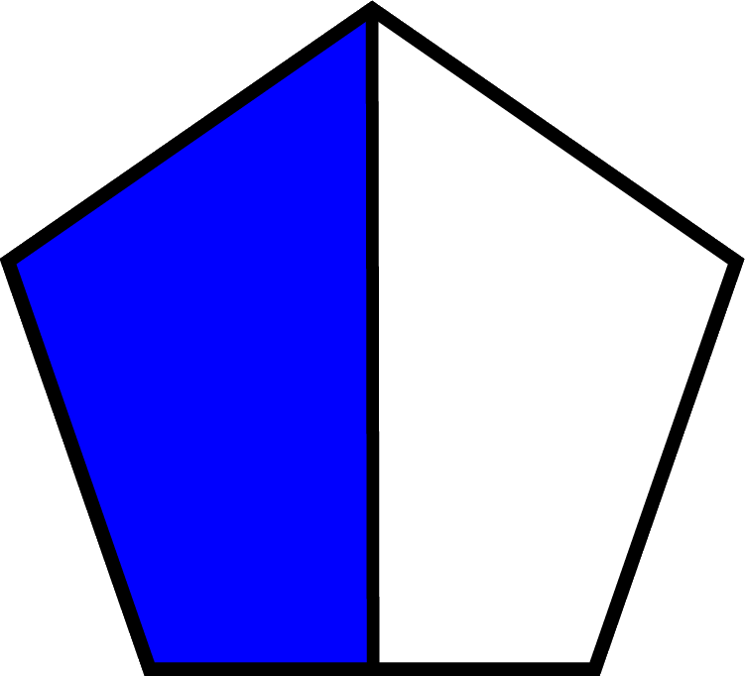
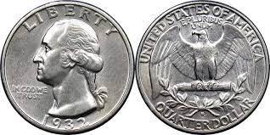
What is the same? What is different?
2.SMP.3

