Slide 1
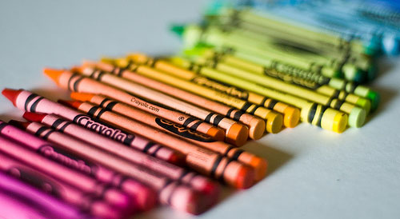
Today is Crayola Crayon Day!
The average student uses up 730 crayons by age 10 and spends an average of 30 minutes a day coloring!
How many minutes is that in a year? How many hours is that?
5.MD.A1
Notes:
Week of March 31, 2025

Slide 2
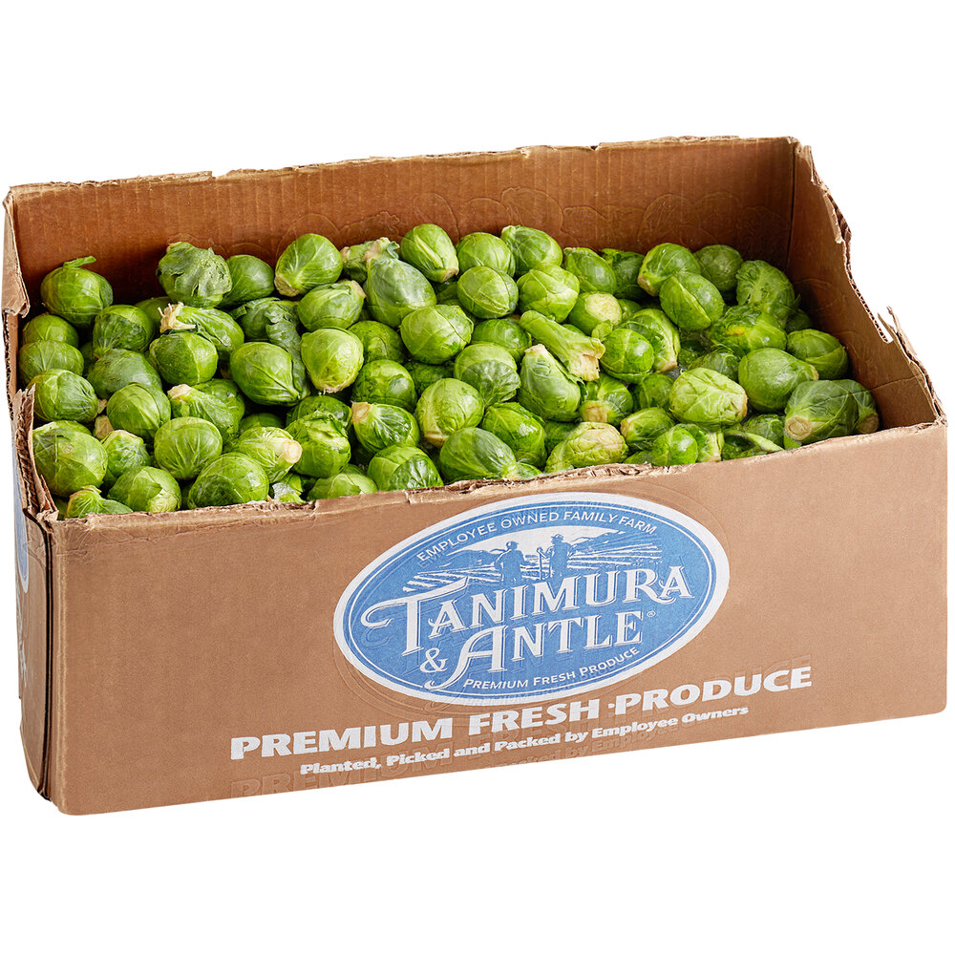
April is National Brussel Sprout Month!
Estimate how many brussel sprouts are in this crate.
If there are about 23 sprouts per pound, and this crate weighs 25 pounds, how many sprouts are here?
How can we use mental math to solve this?
5.NBT.B5

Slide 3
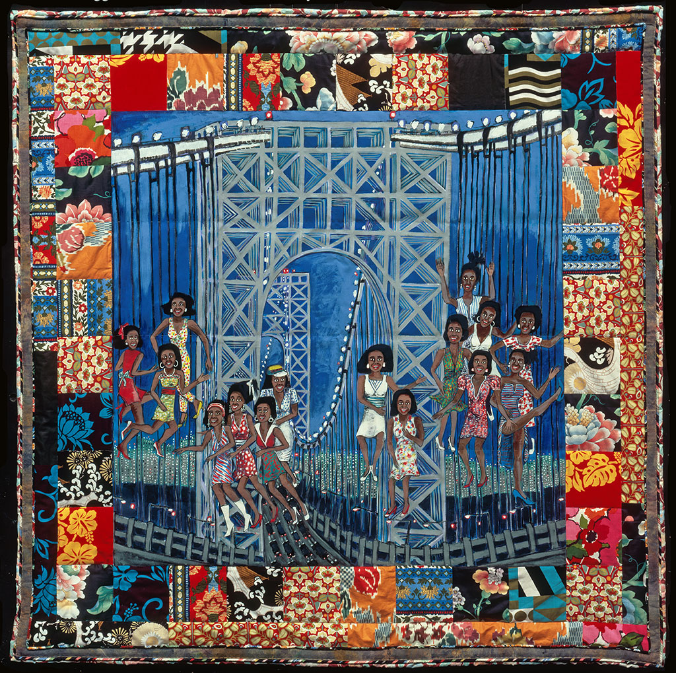
Dancing on the George Washington Bridge II
Faith Ringgold
Faith Ringgold’s quilts tell colorful stories
This quilt is almost a perfect square. It has an area of 2550 square inches.
What might the length and width be?
5.MD.C

Slide 4
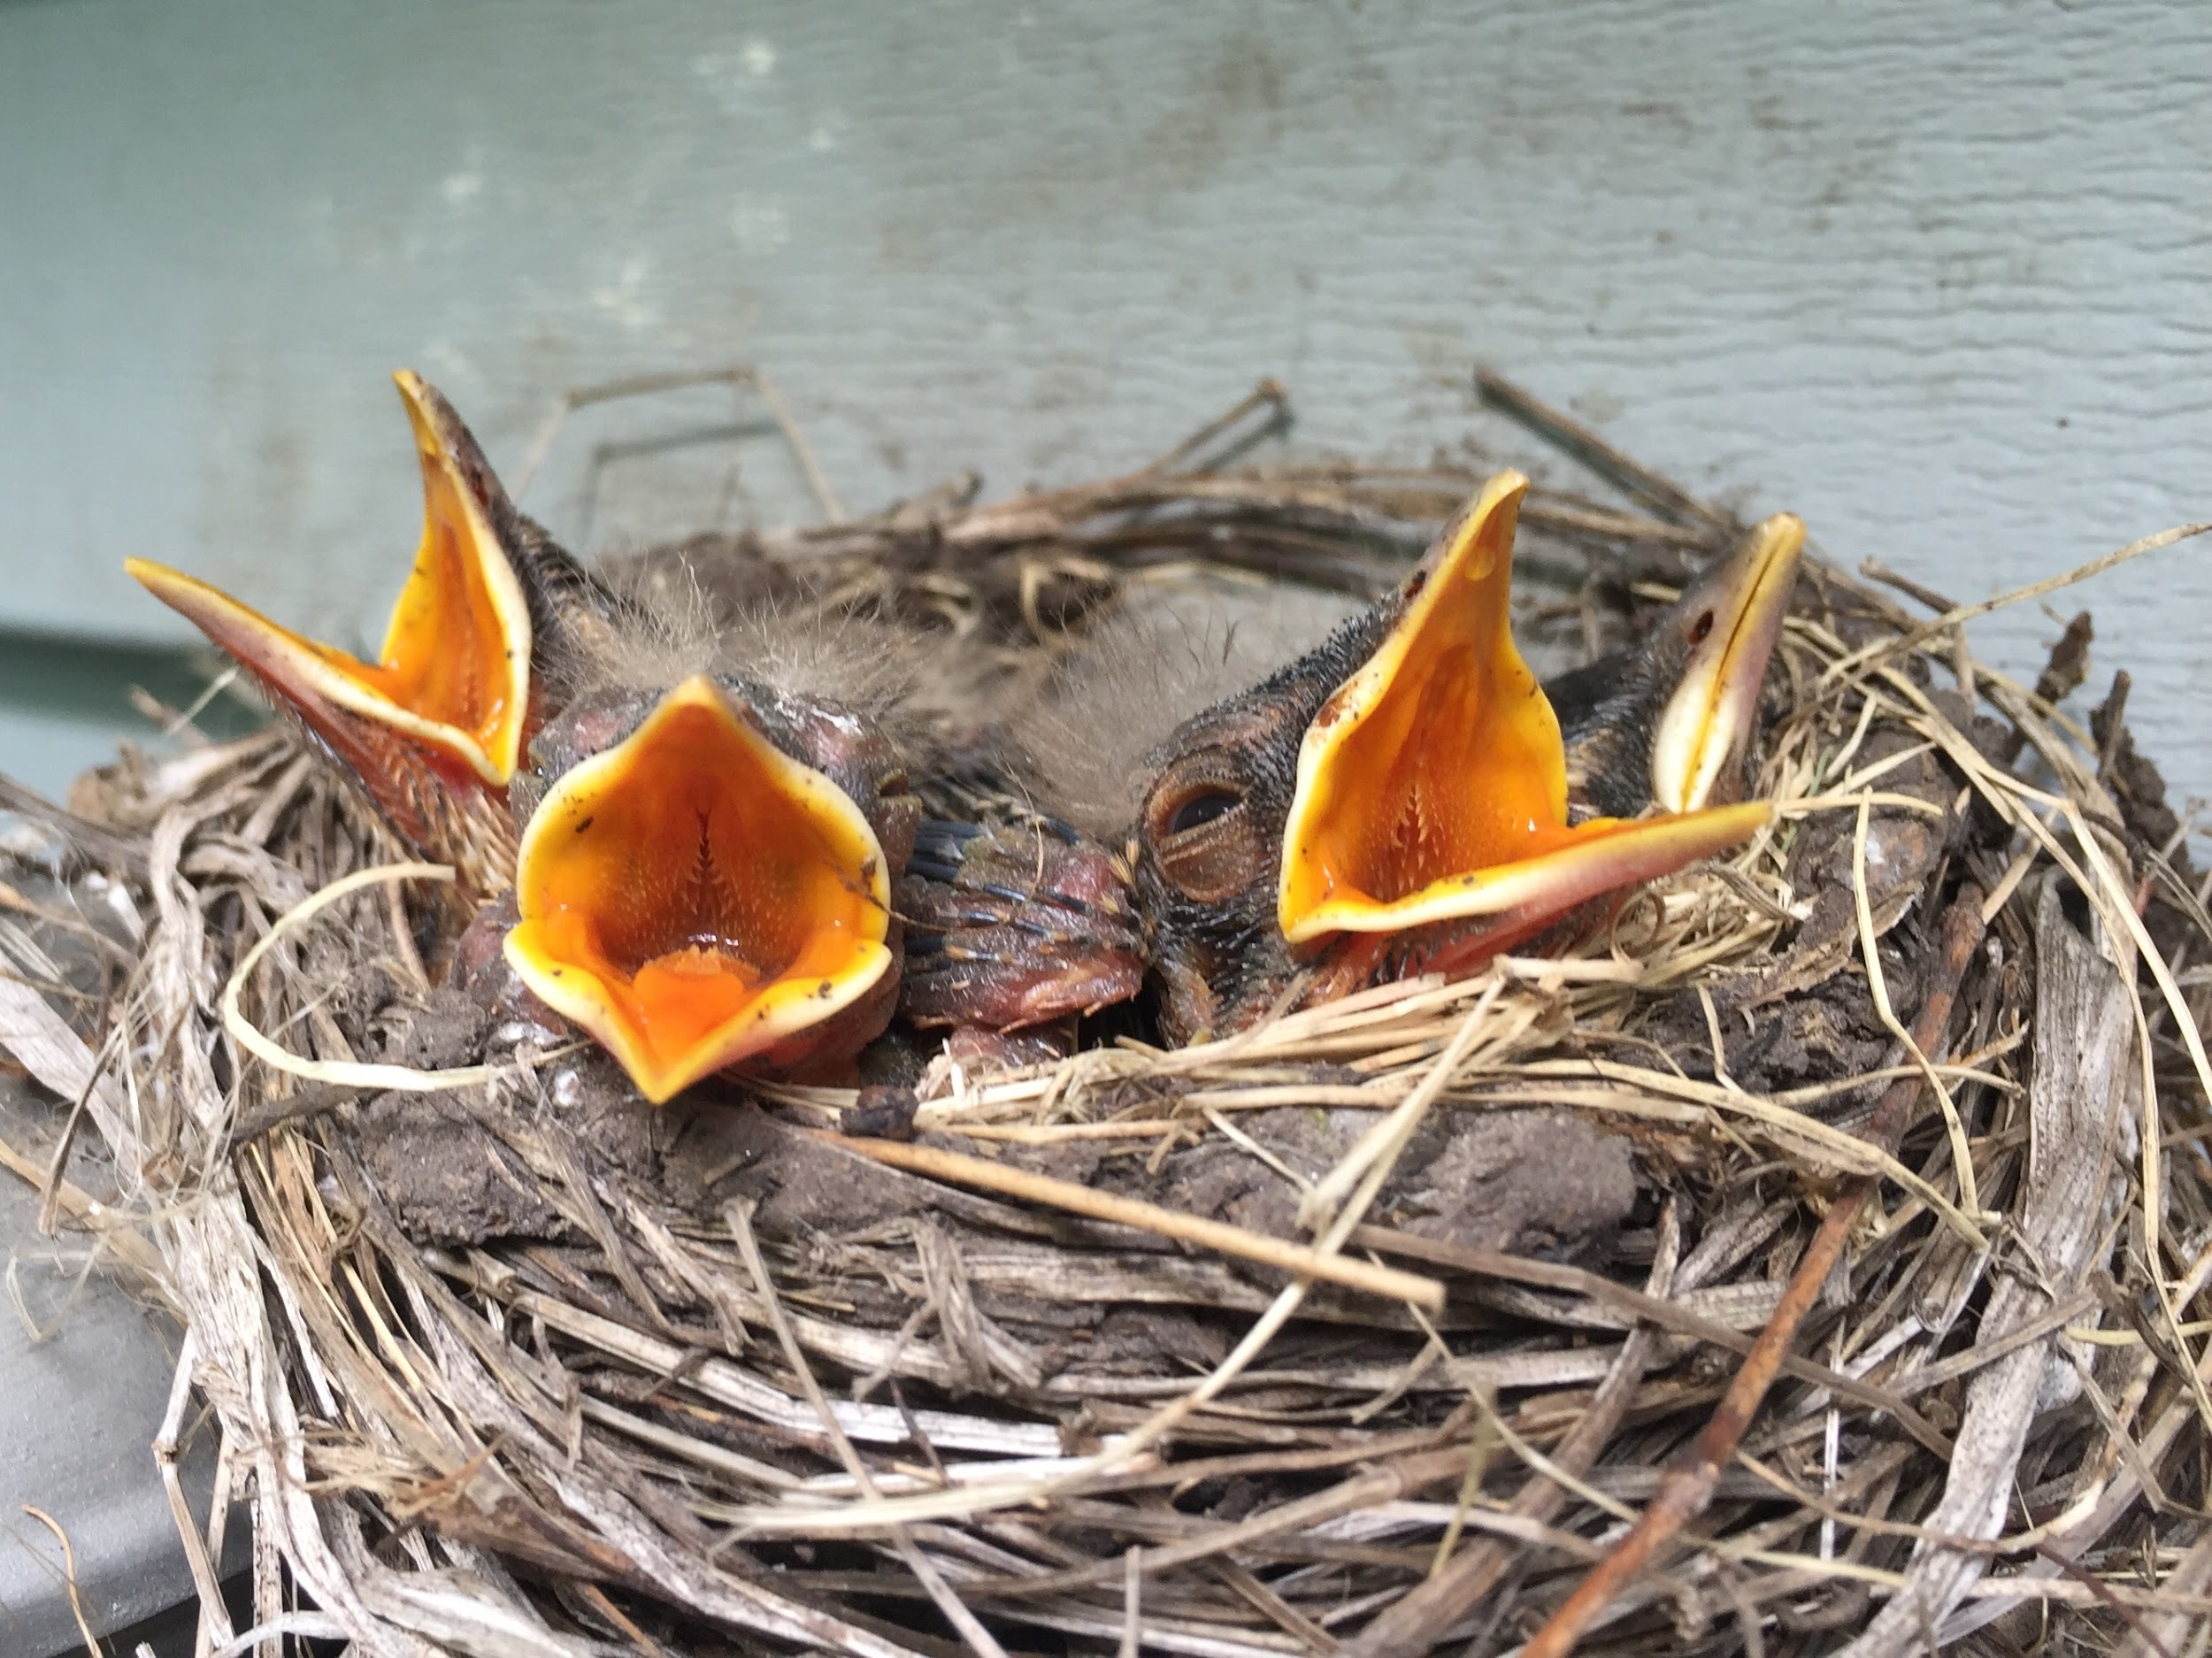
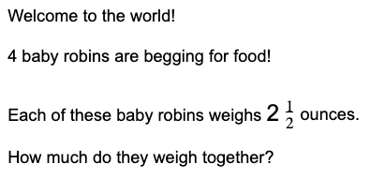
Happy
Spring!
5.NF.A

Slide 5
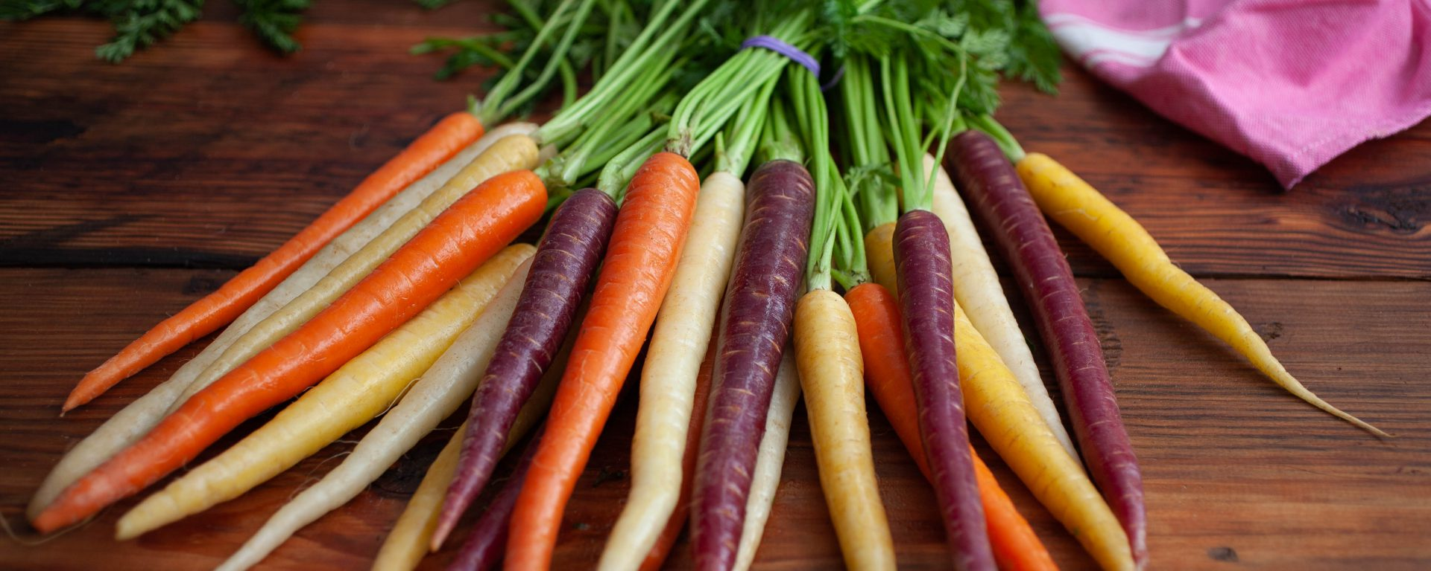
It’s International Carrot Day!
If each of these carrots weighs 6 ounces, how much does the bunch weigh?
How can we use mental math to solve this?
5.NBT.B5

Slide 6
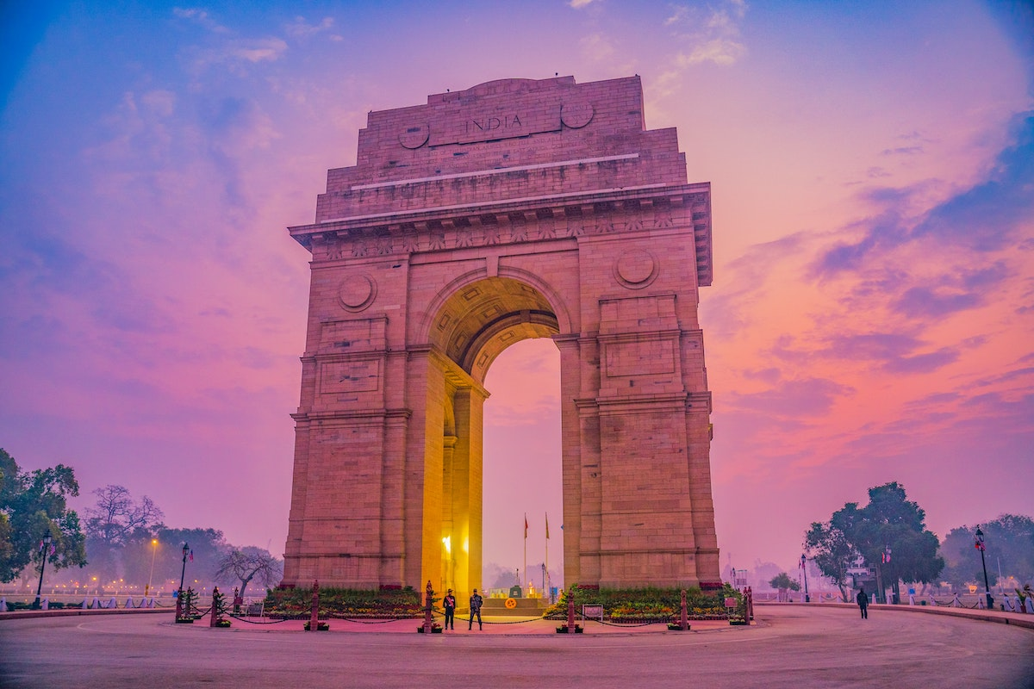
Standing at a staggering 138-feet (42-meters) tall, the India Gate is one of the most recognizable landmarks in India.
How MANY TIMES taller is it than you?
5.OA
Notes:
Week of April 7, 2025

Slide 7
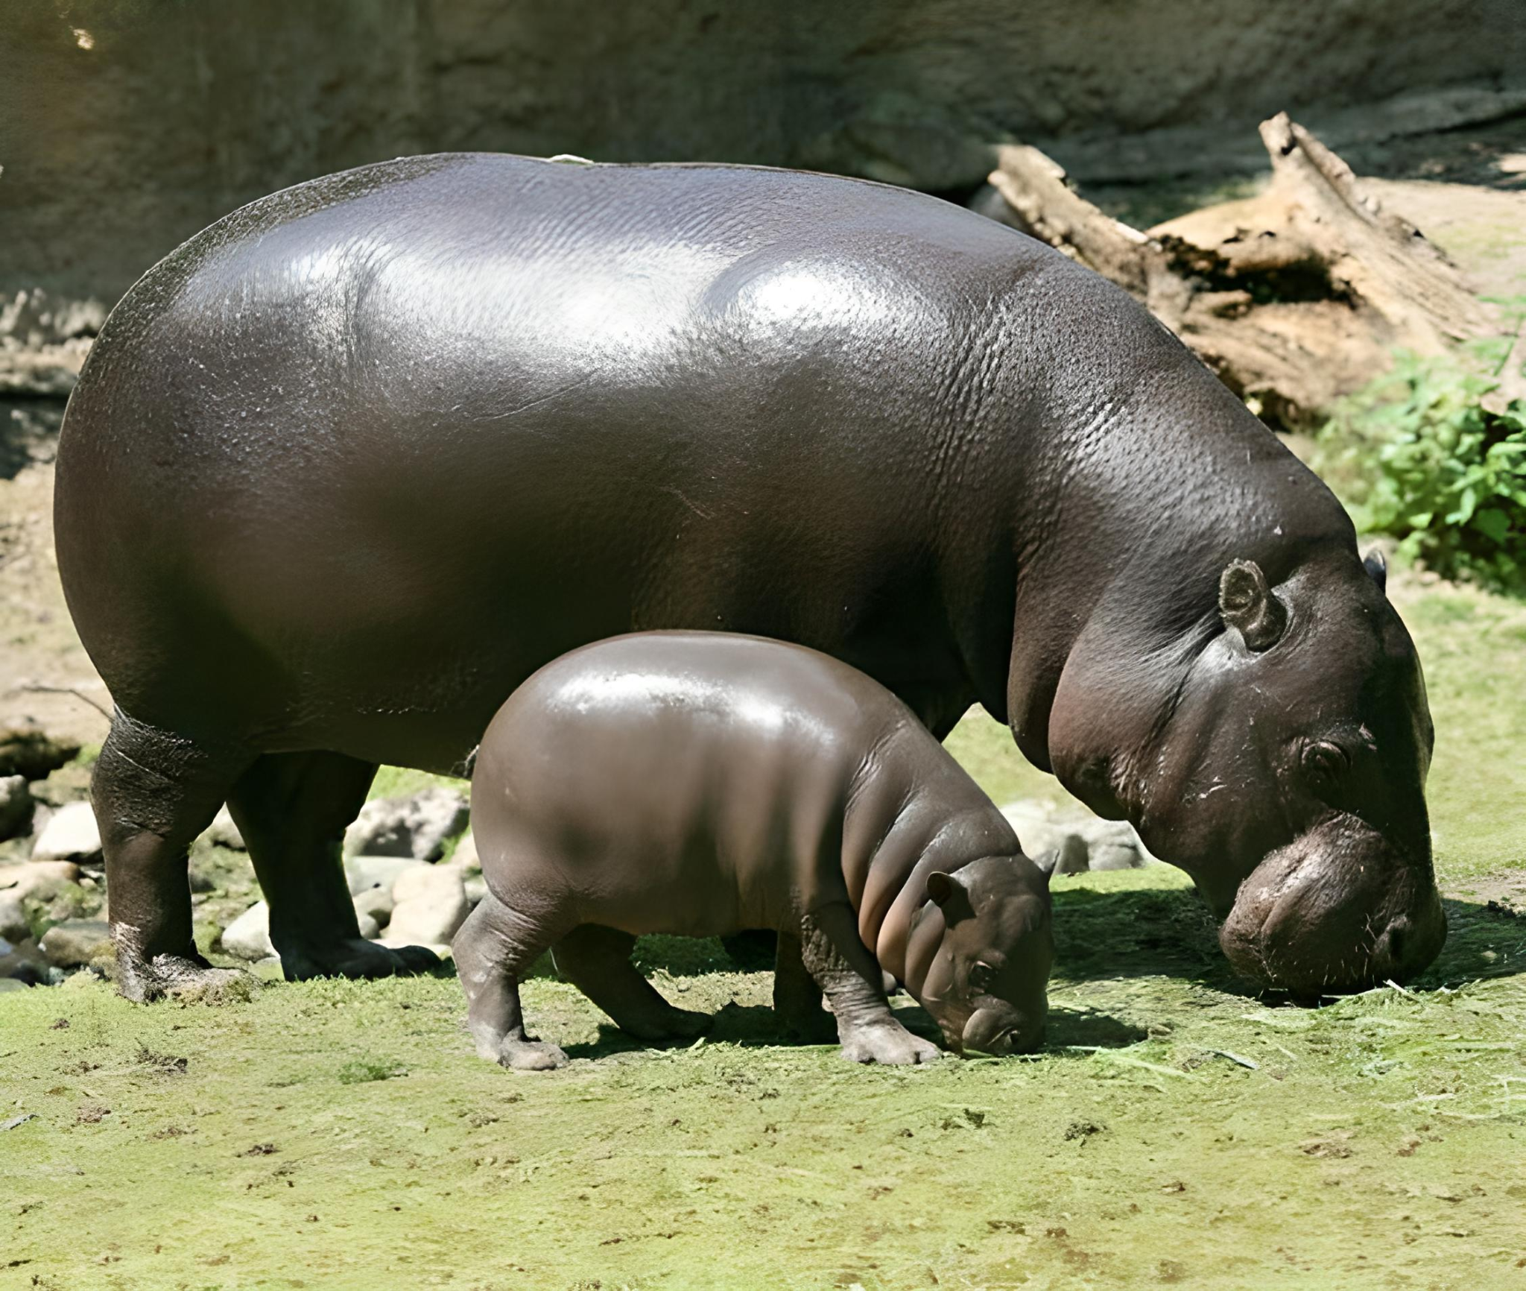
Happy National Pygmy Hippo Day!
This baby pygmy hippo weighed just 14 pounds at birth.
She tripled her weight within the first two months!
If mom pygmy hippo weighs between 400 and 600 pounds, how many times heavier is she than her baby?
5.OA

Slide 8
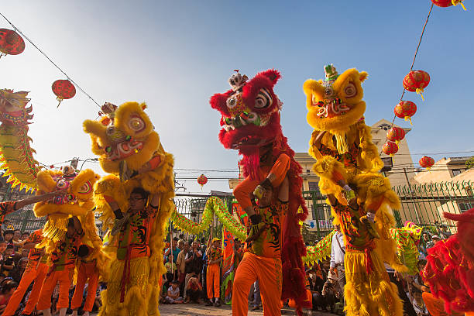
It is the Hung King Festival in Vietnam!
Vietnam declared independence from France in 1945.
How long ago was that?
How can we use mental math to figure it out?
5.NBT.B7

Slide 9
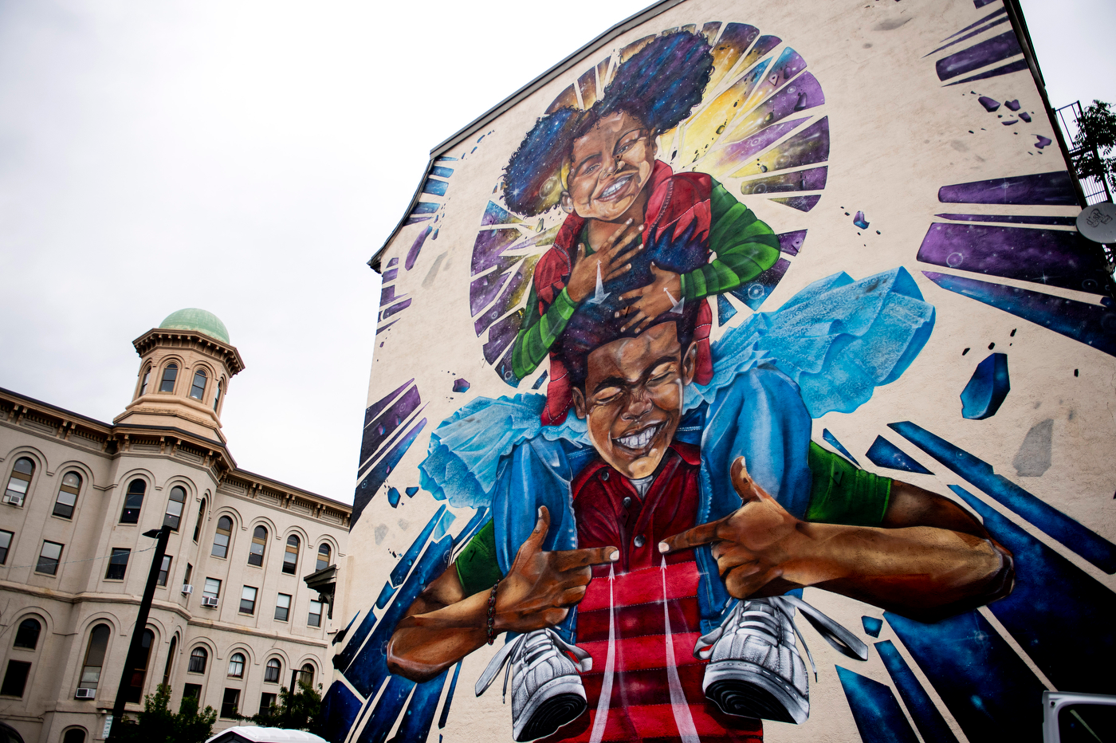
Breathe Life 3 by Rob Gibbs is 3 stories high.
Estimate that height.
Fun Fact: The children in this mural are signing “breathe life.”
5.MD.A

Slide 10
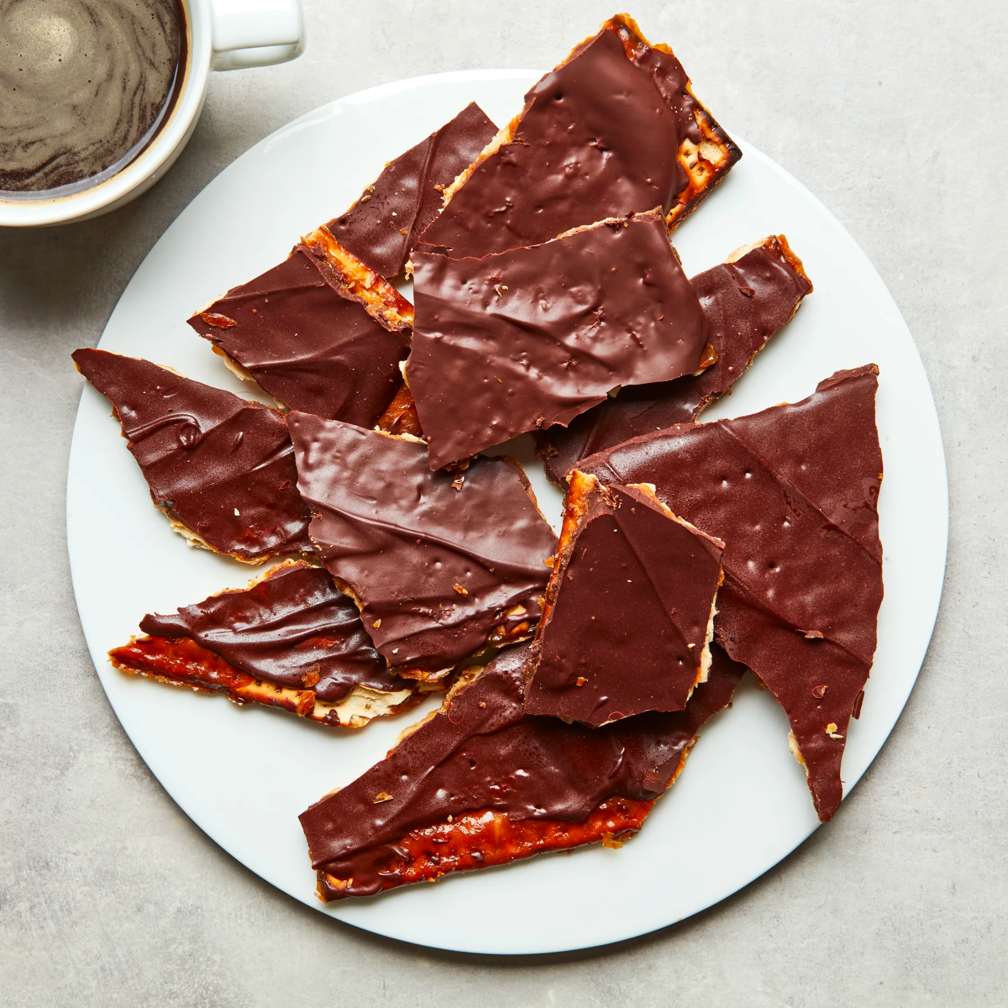
Happy Passover
What shapes do we see in this plate of matzo crunch?
Sketch one of the shapes and partition it.
What shape to you have now?
5.G.B3

Slide 11
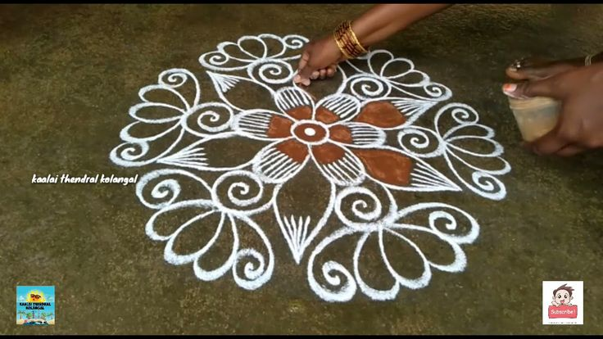
Happy Tamil New Year கோலங்கள்
What do we notice about this Kulam?
What do we wonder?
Where do we see symmetry?
5.G.B
Notes:
Week of April 14, 2025

Slide 12
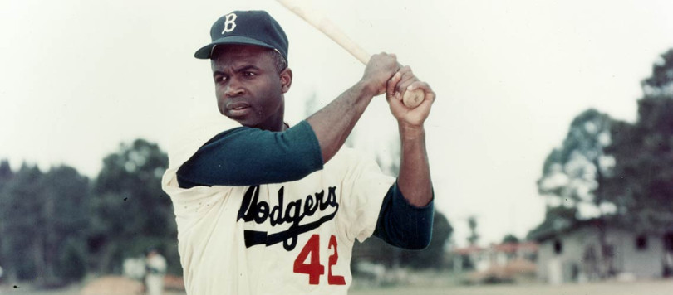
Happy Jackie Robinson Day!
Jackie Robinson broke Major League Baseball's color barrier in 1947 when he debuted with the Brooklyn Dodgers on April 15th. How long ago was that? How many years? How many months? How many days?
5.MD.A1

Slide 13
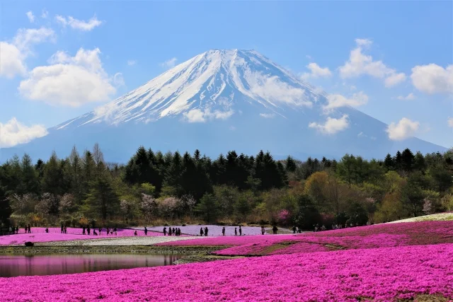
Today is the beginning of
The Fuji Shibazakura Festival 富士芝桜まつ
Approximately 800,000 stalks of shibazakura of five varieties are on display, producing delightful fields of pink, white and purple colors in different hues.
What are some FACTOR PAIRS of 800,000?
5.NBT.A2

Slide 14
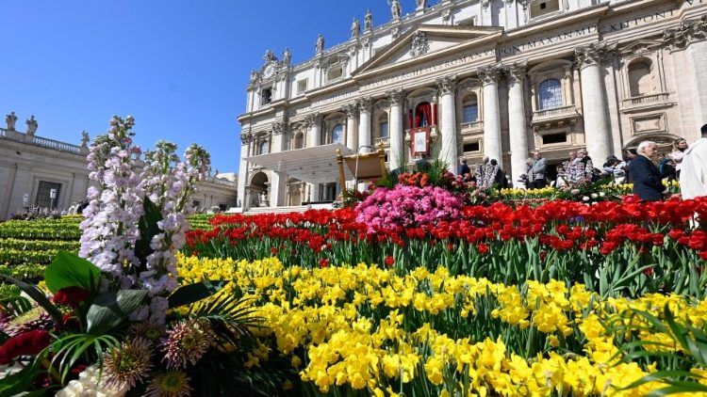
Happy Easter!
The independent state of Vatican City came into existence on February 11, 1929.
How long ago was that?
What are some strategies we can use to figure it out?
5.NBT.B7

