Slide 1
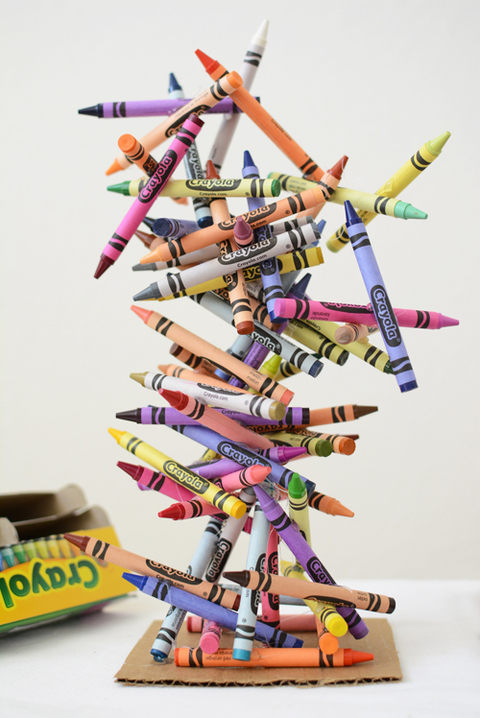
It’s Crayola Crayon Day!
The average student uses up 730 crayons by age 10 and spends an average of 30 minutes a day coloring!
How many minutes is that in a year?
How many hours is that?
4.MD.A2
Notes:
Week of March 31, 2025

Slide 2
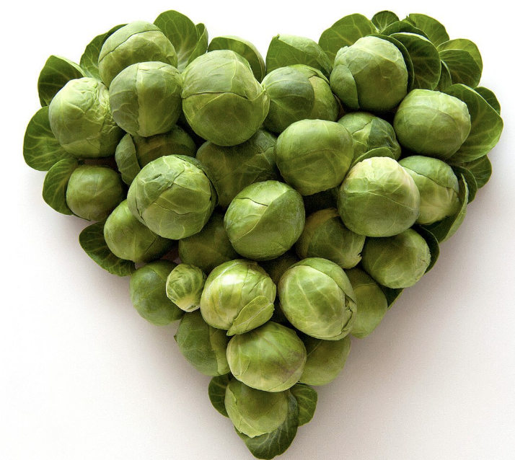
April is National Brussel Sprout Month!
What do we notice?
What do we wonder?
How many sprouts might be here?
If each sprout weighs 1.5 ounces, how much might all of them weigh?
4.MD.A2

Slide 3
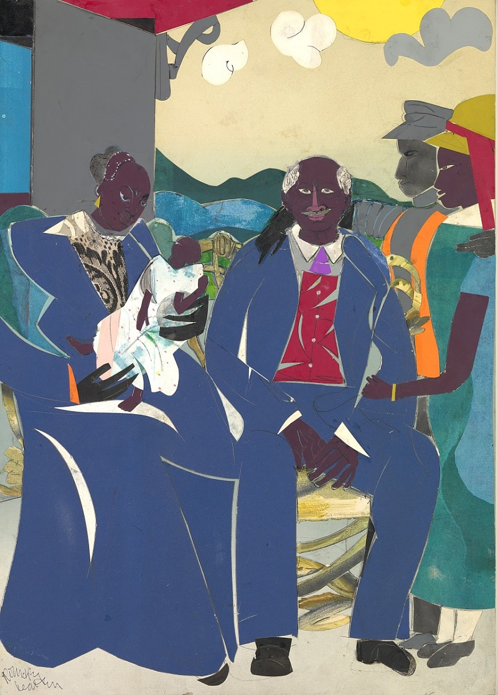
Family
by Romare Bearden
Smithsonian American Art Museum
This painting has an area of 560 square inches.
What is possible?
4.MD.A3

Slide 4
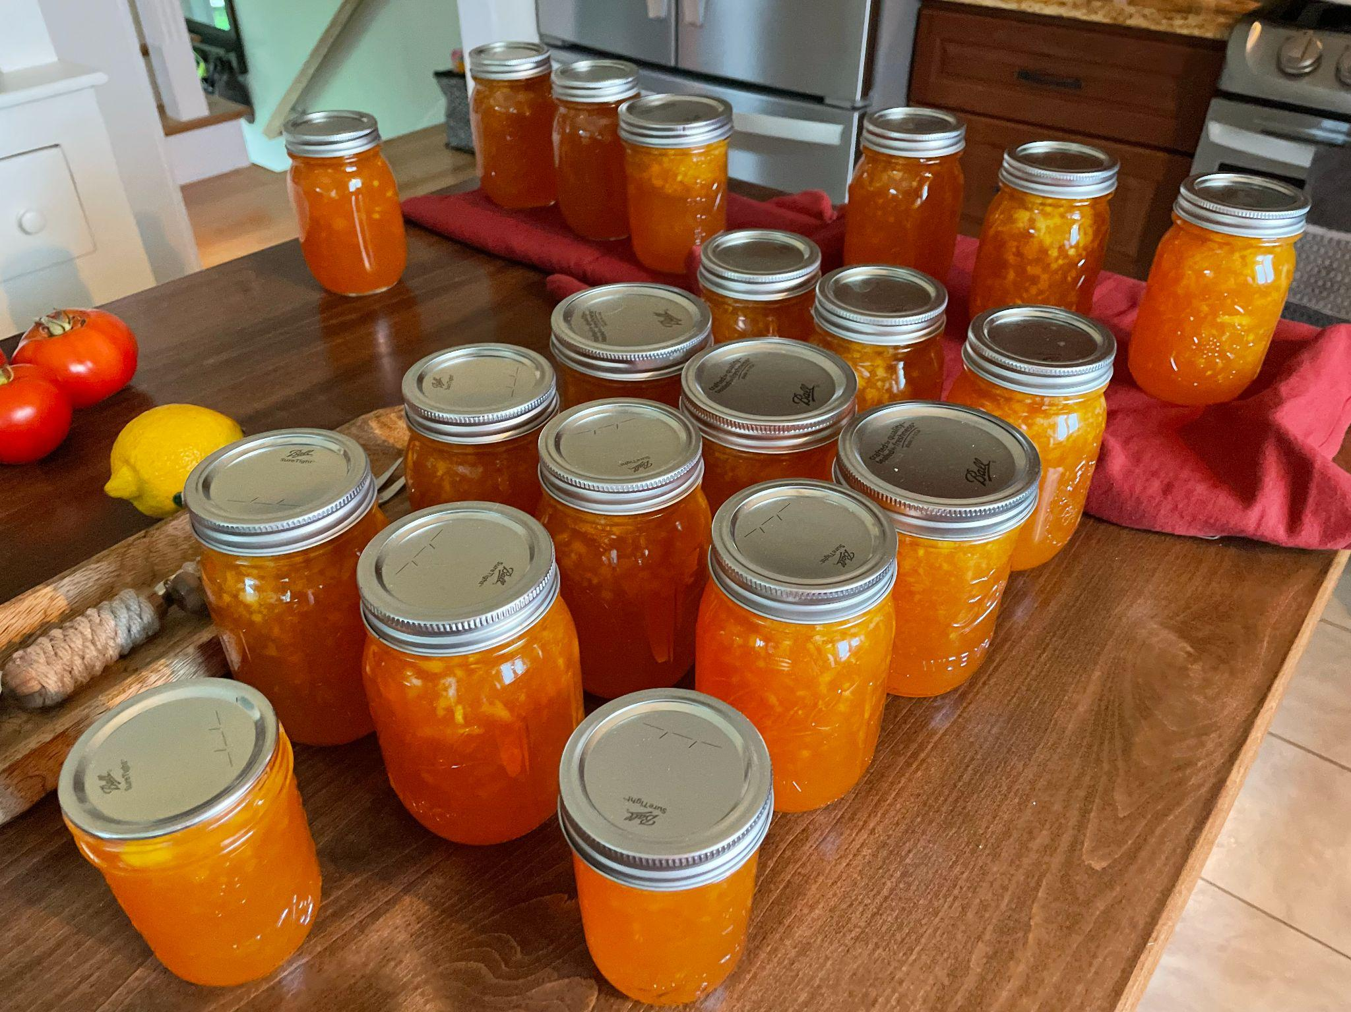
Each one of these jars of jam takes 2 ½ cups of peaches to make.
How many cups of peaches did we use?
How many quarts? Gallons?
4 cups = 1 quart
8 cups = half gallon
16 cups = 1 gallon
4.NF.B4, MD.A1

Slide 5
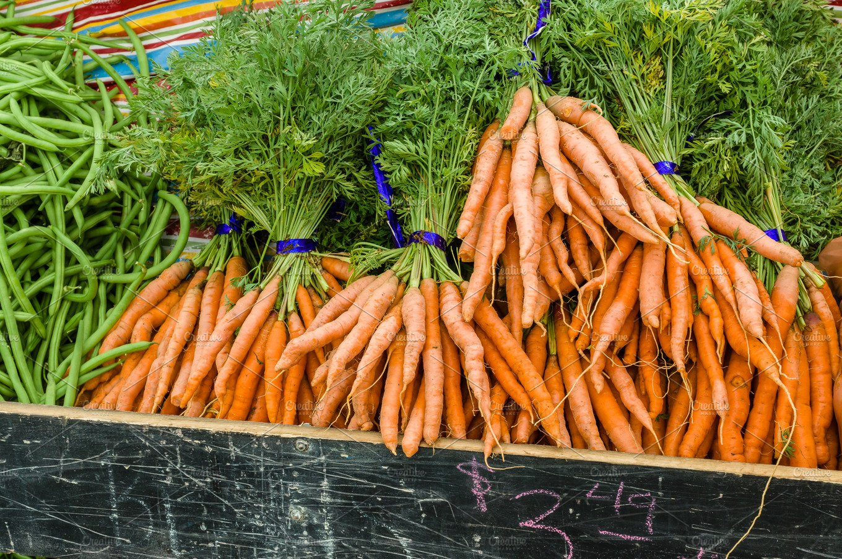
It’s International Carrot Day!
Wow! Estimate how many carrots are here!
If we know that there are about 35 carrots in each bundle, does that help?
4.NBT.B5

Slide 6
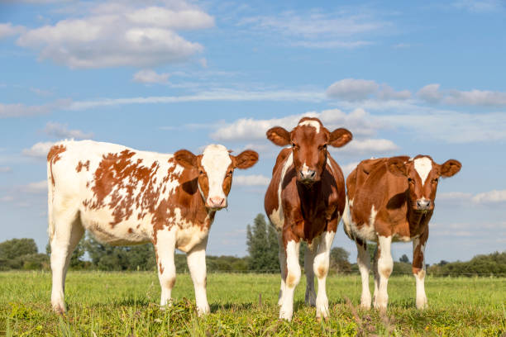
It’s National Farm Animal Week!
Meet Snap, Crackle, and Pop!
Together they weigh 6,700 pounds. They are NOT the same size!
What is possible?
4.NBT.B4
Notes:
Week of April 7, 2025

Slide 7
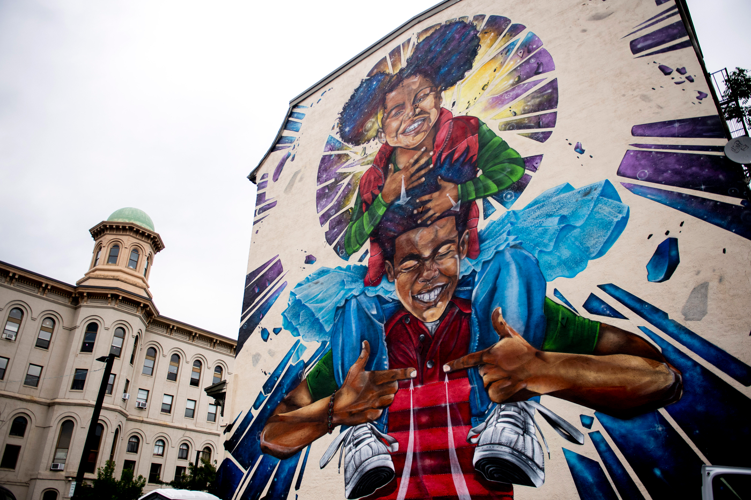
Breathe Life 3 by Rob Gibbs is 3 stories high.
Estimate that height.
Fun Fact: The children in this mural are signing “breathe life.”
4.MD.A1

Slide 8
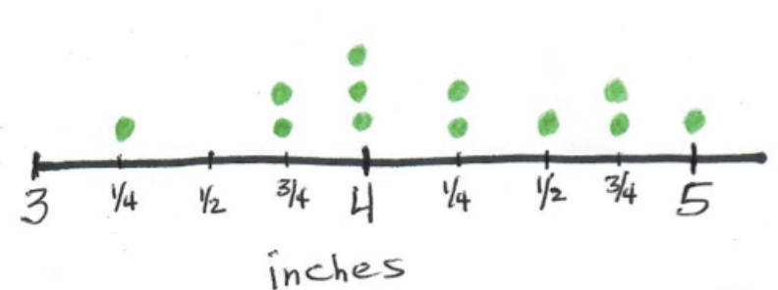
What do we notice?
What do we wonder?
What is possible?
4.MD.B4

Slide 9
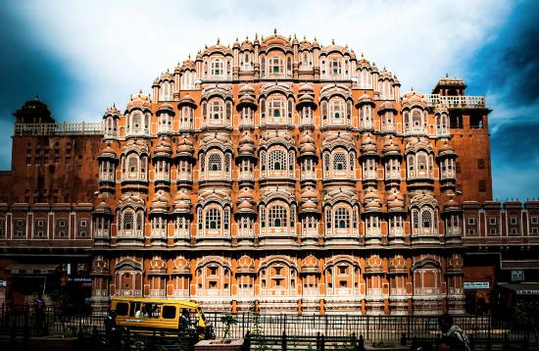
Known as the “Palace of Winds”, the Hawa Mahal is one of the most recognizable landmarks in Jaipur.
Hawa Mahal was built in 1799.
How long ago was that?
How many windows do we think are here?
953!
4.NBT.A

Slide 10
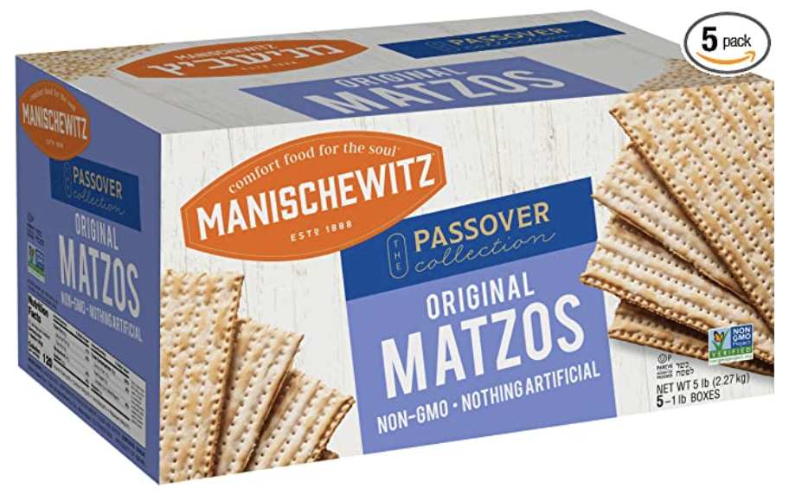
Happy Passover
This is a 5-pack of Matzo.
Each of the 5 boxes has 15 pieces of matzo.
What different strategies can we use to figure out how many matzos are in this huge box?
4.OA.A1

Slide 11
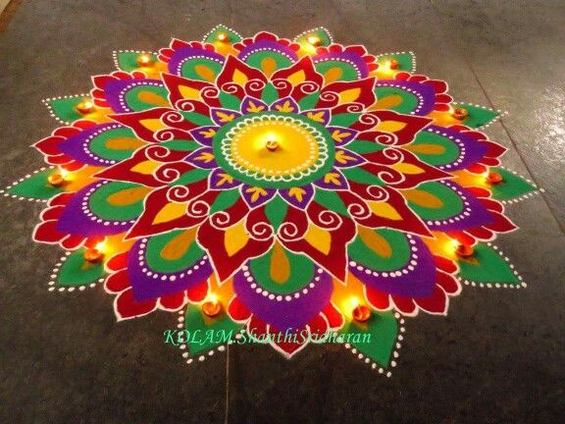
Happy Tamil New Year
கோலங்கள்
What do we notice about this Kulam?
What do we wonder?
Where do we see symmetry?
4.G.A3
Notes:
Week of April 14, 2025

Slide 12
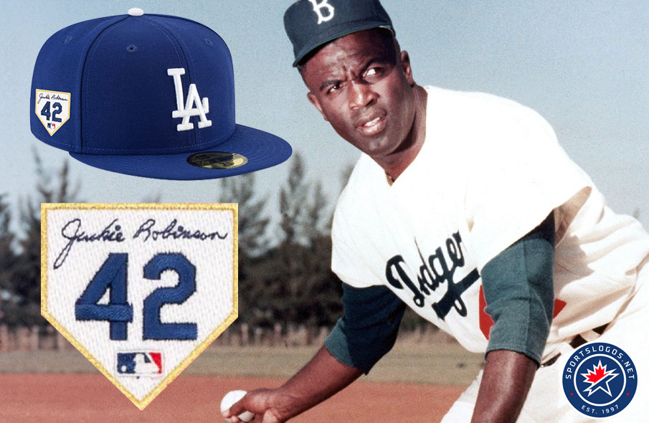
Happy Jackie Robinson Day!
Jackie Robinson broke Major League Baseball's color barrier in 1947 when he debuted with the Brooklyn Dodgers on April 15th.
How long ago was that?
How many years?
How many months?
4.NBT.B4

Slide 13
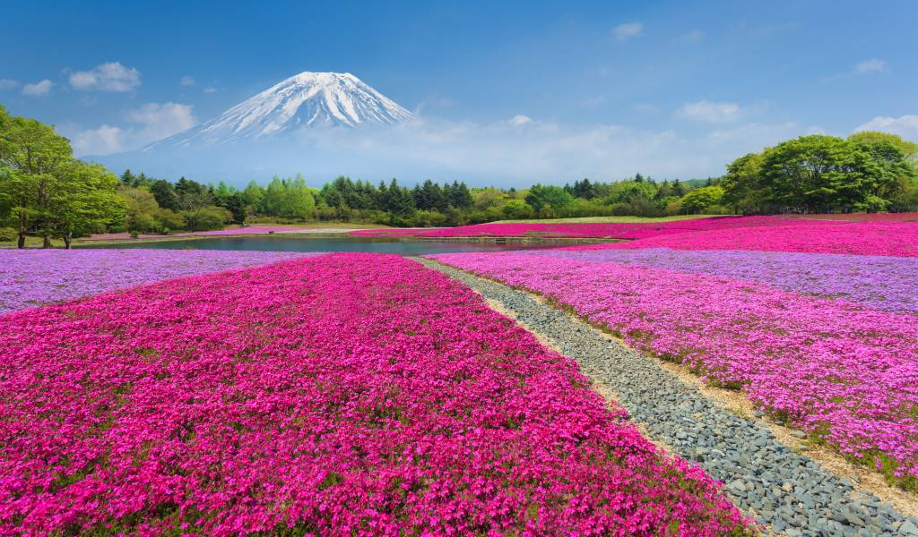
Today is the beginning of
The Fuji Shibazakura Festival 富士芝桜まつ
Approximately 800,000 stalks of shibazakura of five varieties are on display, producing delightful fields of pink, white and purple colors in different hues.
What are some FACTOR PAIRS of 800,000?
4.OA.B4

Slide 14
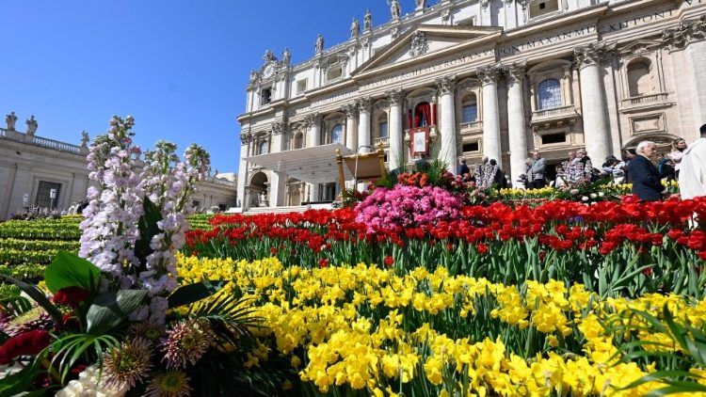
Happy Easter!
The independent state of Vatican City came into existence on February 11, 1929.
How long ago was that?
What are some strategies we can use to figure it out?
4.NBT.B4

