Slide 1
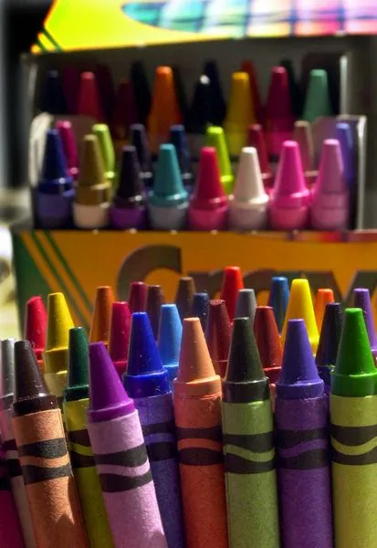
Today is
Crayola Crayon Day!
There are currently 120 different crayola crayon colors.
What are some FACTORS of 120?
How do we know we have them all?
3.NBT.A3
Notes:
Week of March 31, 2025

Slide 2
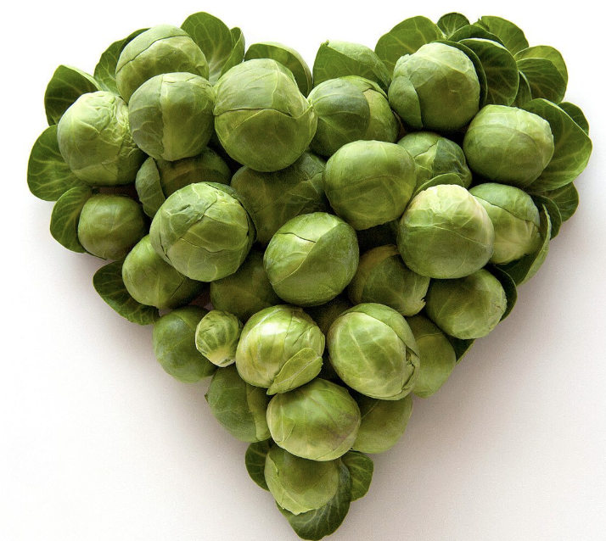
April is National Brussel Sprout Month!
What do we notice?
What do we wonder?
How many sprouts might be here?
What strategies can we use to figure it out?
3.NBT.A

Slide 3
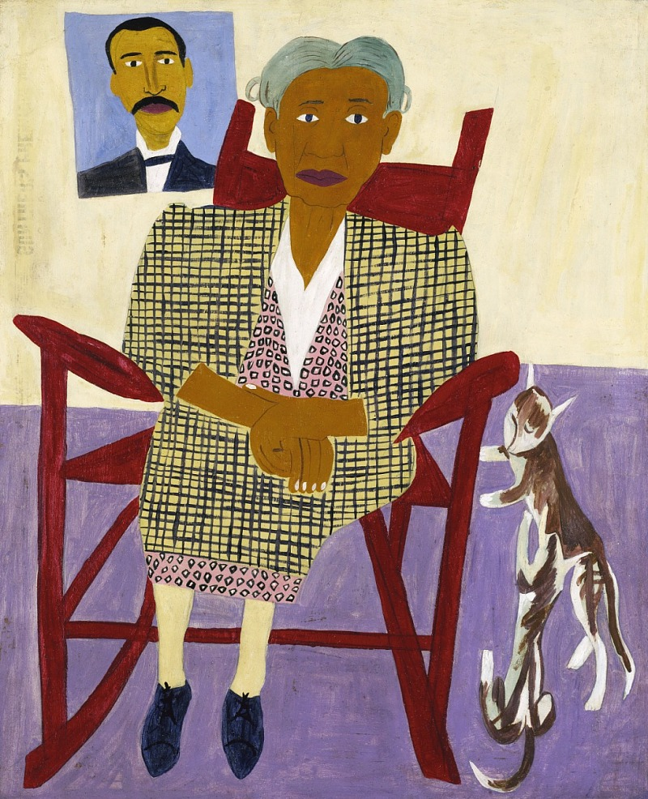
Mom and Dad
by William H. Johnson
This painting in the Smithsonian American Art Museum has an area of 750 square inches.
What might the length and width be?
3.MD.C7

Slide 4
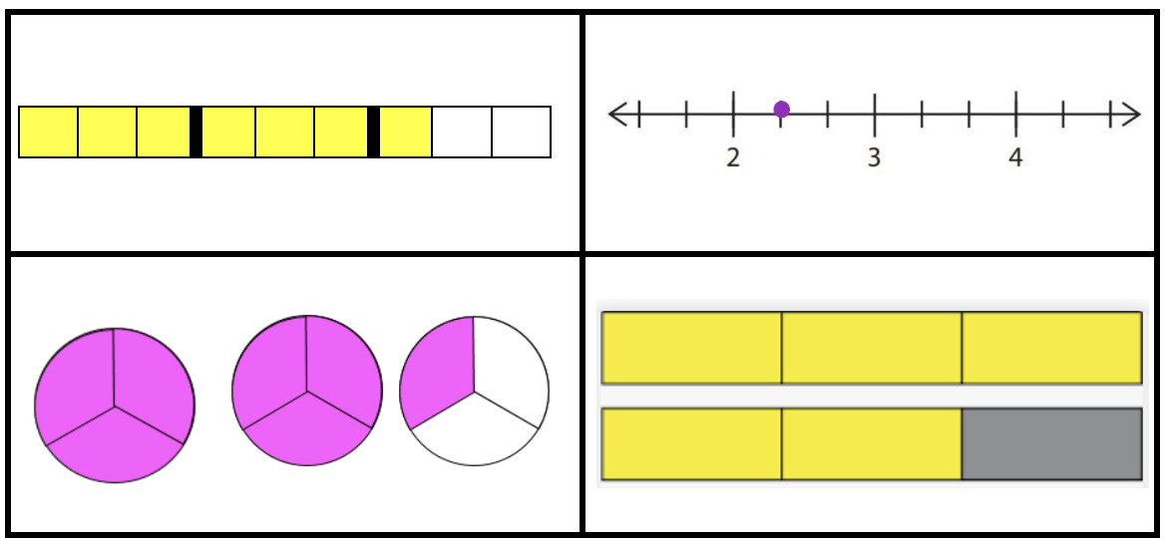
Which one doesn’t belong?
3.NF.A2
A
C
B
D

Slide 5
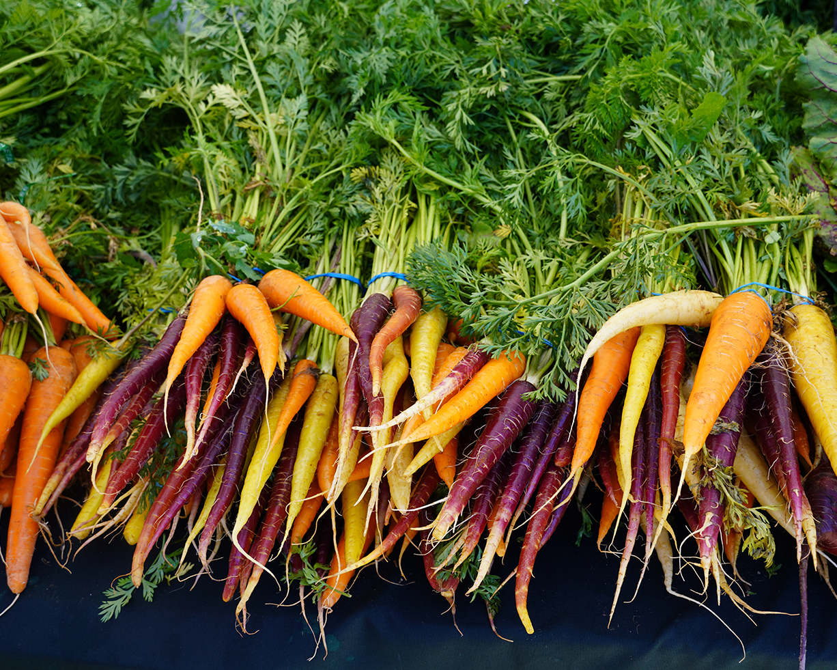
It’s International Carrot Day!
Wow! Estimate how many carrots are here!
If we know that there are 12 carrots in each bundle, does that help?
3.NBT.C7

Slide 6
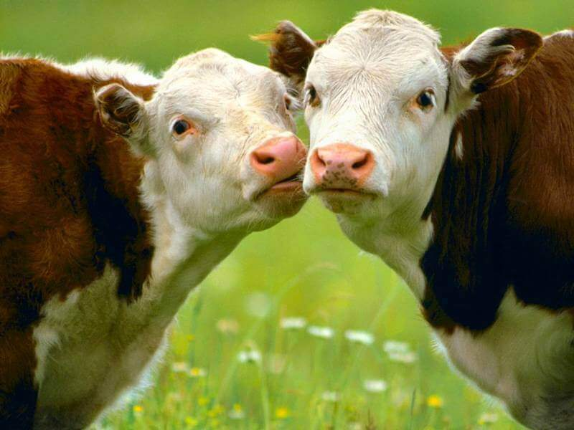
It’s National Farm Animal Week!
Meet Vaca and Toni.
Together they weigh 4,000 pounds. They are NOT the same size!
What is possible?
3.NBT.A2
Notes:
Week of April 7, 2025

Slide 7
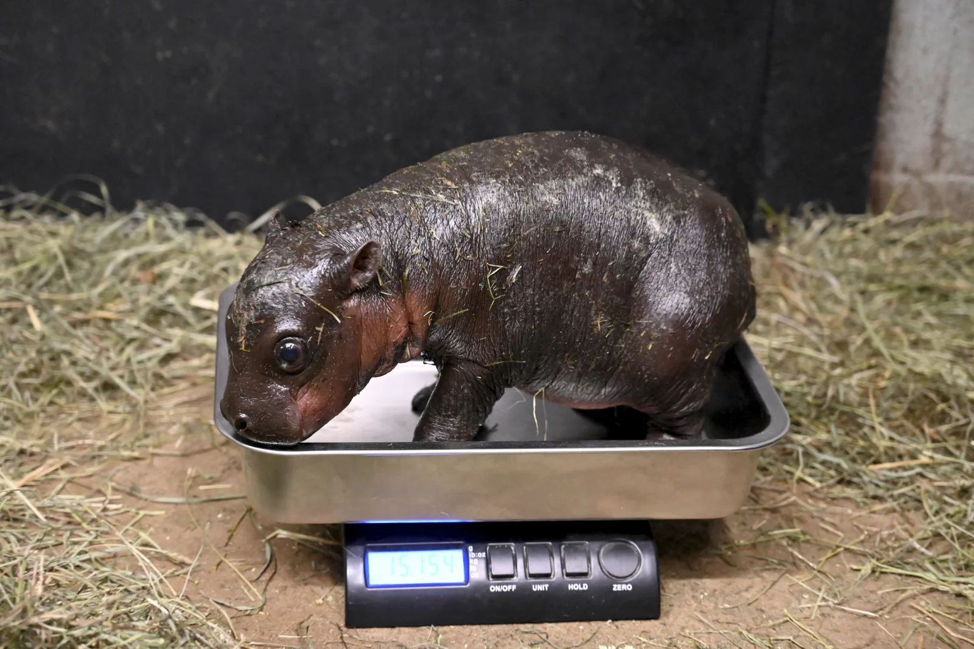
Happy Pygmy Hippo Day!
This newborn pygmy hippo will triple her weight within two months!
What is possible?
3.OA.A3

Slide 8
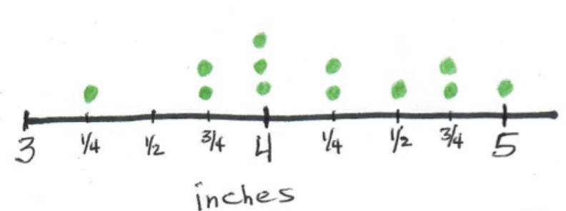
What do we notice?
What do we wonder?
What is possible?
3.NF.A2

Slide 9
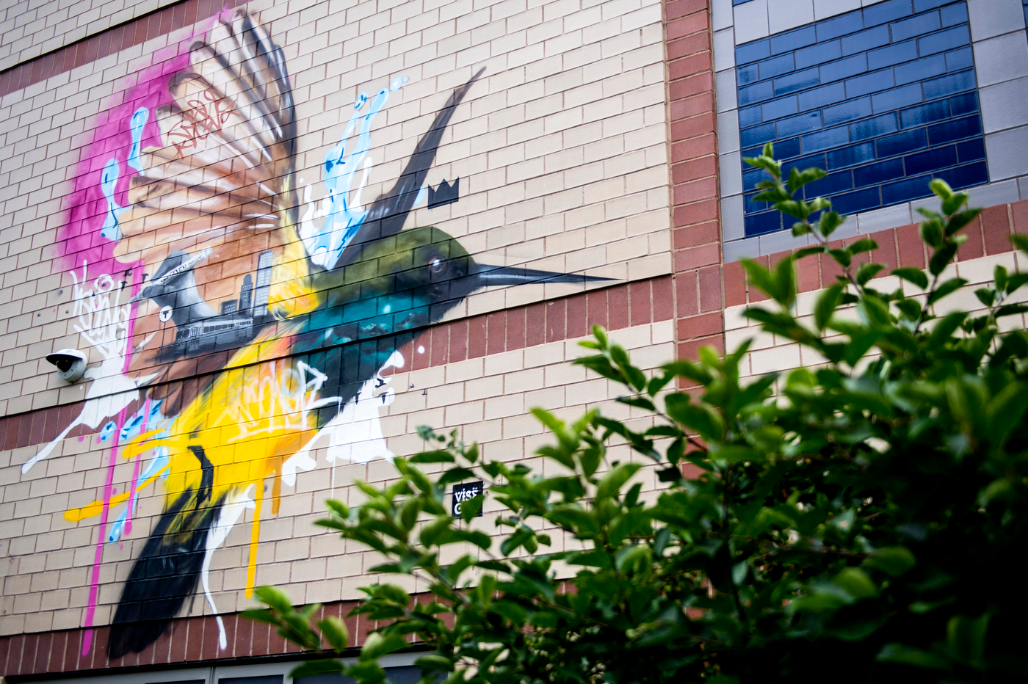
What do we notice in this Mattapan mural?
What do we wonder?
What math ideas can we talk about?
“Dreaming Isn’t So Concrete” by Destiny Palmer
3.OA.B

Slide 10
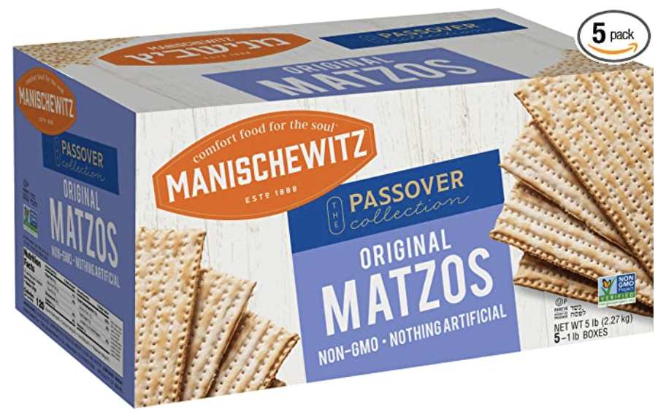
Happy Passover
This is a 5-pack of Matzo.
Each of the 5 boxes has 15 pieces of matzo.
What different strategies can we use to figure out how many matzos are in this huge box?
3.OA.A3

Slide 11
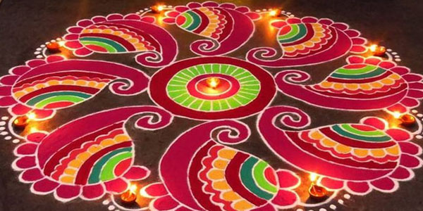
Happy Tamil New Year!
What patterns do we see in this beautiful Kulam?
What can we count?
How can we use multiplication to find out “how many?”
3.OA.A3
Notes:
Week of April 14, 2025

Slide 12
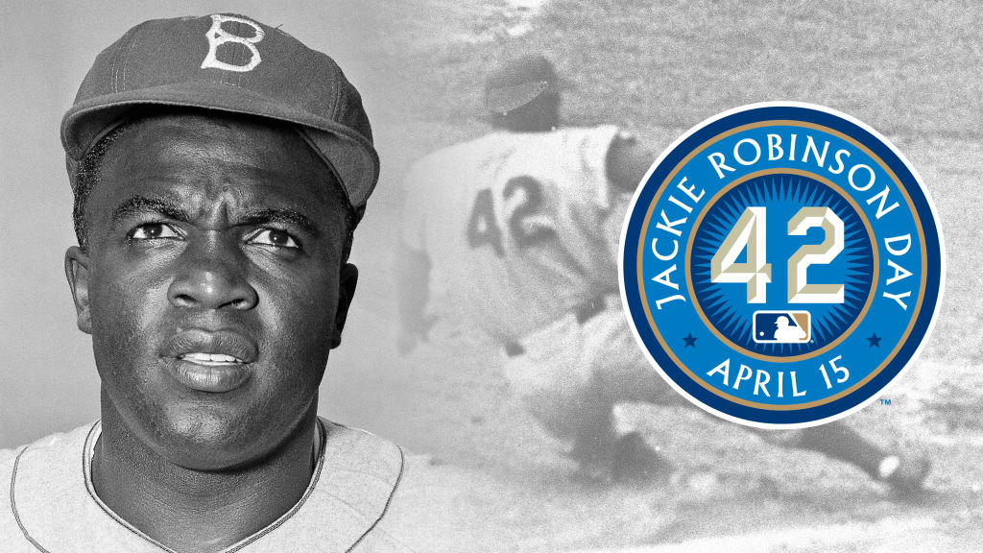
Happy Jackie Robinson Day!
Jackie Robinson broke Major League Baseball's color barrier in 1947 when he debuted with the Brooklyn Dodgers on April 15th.
How long ago was that?
3.NBT.A2

Slide 13
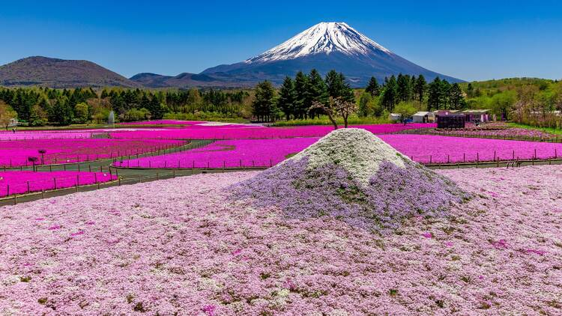
Today is the beginning of
The Fuji Shibazakura Festival 富士芝桜まつ
A ticket to attend this incredibly beautiful festival on Lake Motosuko is 2800 Yen.
What are some FACTOR PAIRS of 2800?
3.NBT.A

Slide 14
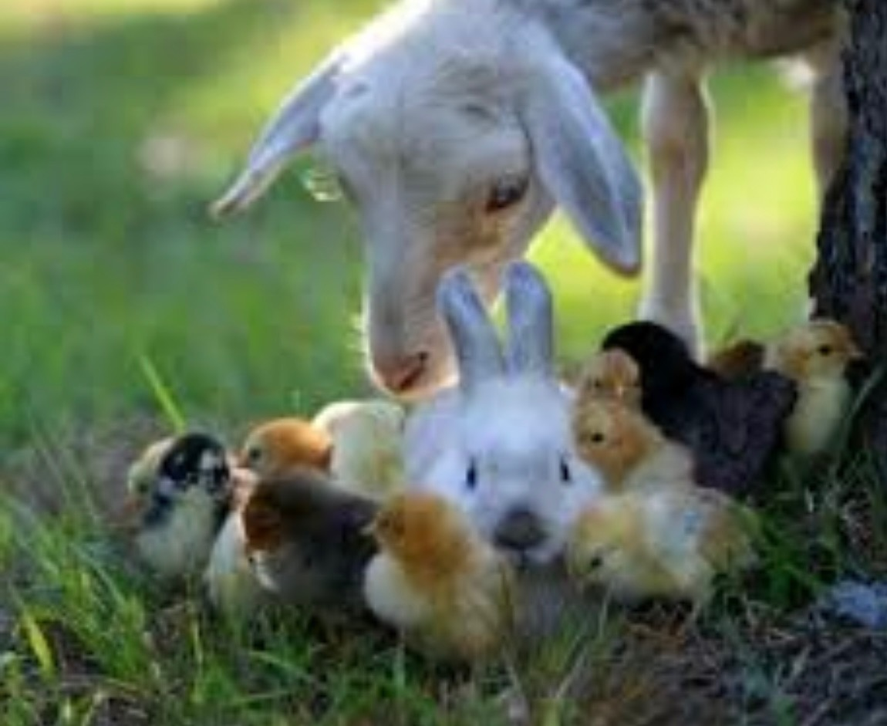
Happy Easter!
1 goat
1 bunny
17 chicks
How many legs?
What creative equations can we write to match our thinking?
3.OA.A3

