Slide 1
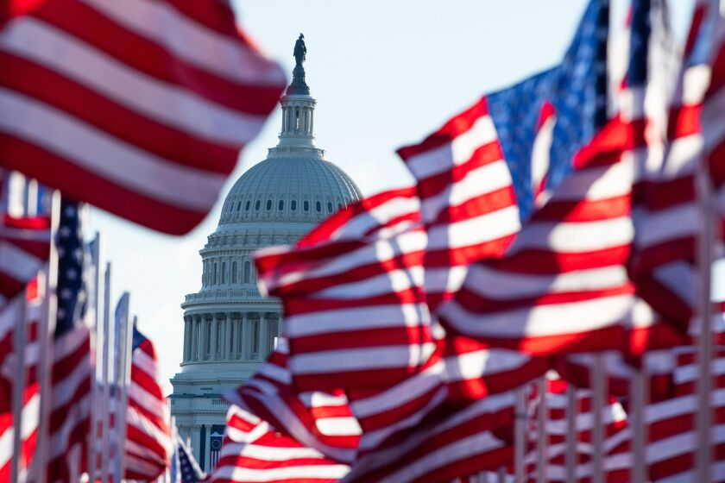
Today is National Anthem Day!
The Star Spangled Banner was written by Francis Scott Key During the War of 1812 on September 13, 1814.
How long ago was that?
The first documented time the Star Spangled Banner was played at the beginning of a sporting event was during a Civil War era baseball game in 1862.
How long ago was that?
The tradition of playing the Star Spangled Banner at sporting events became popular at the 1918 World Series.
How long ago was that?
That was 13 years before it officially became our country’s national anthem.
When did the Star Spangled Banner officially become our national anthem?
4.OA.A3
Notes:
Week of March 3, 2025

Slide 2
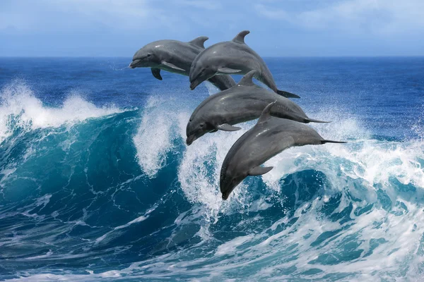
March is Dolphin Awareness Month!
An average adult bottlenose dolphin weighs between 150-200 kg.
Together these four dolphins weigh 725 kg.
What is possible?
4.MD.A1

Slide 3
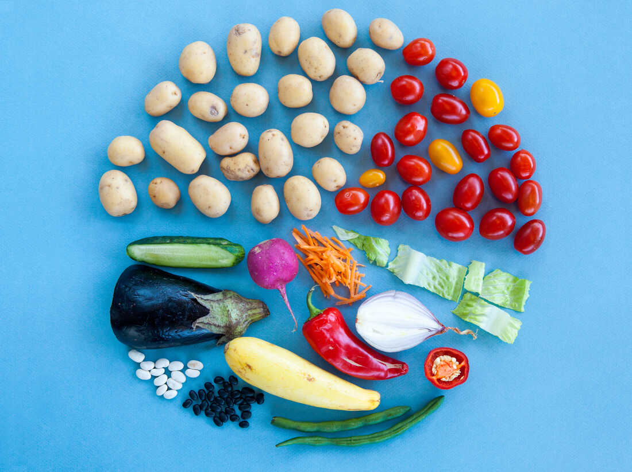
March is also National Veggie Month!
Where do we see fractions in this photo?
Estimate the areas of the fractional parts!
4.NF.A2

Slide 4
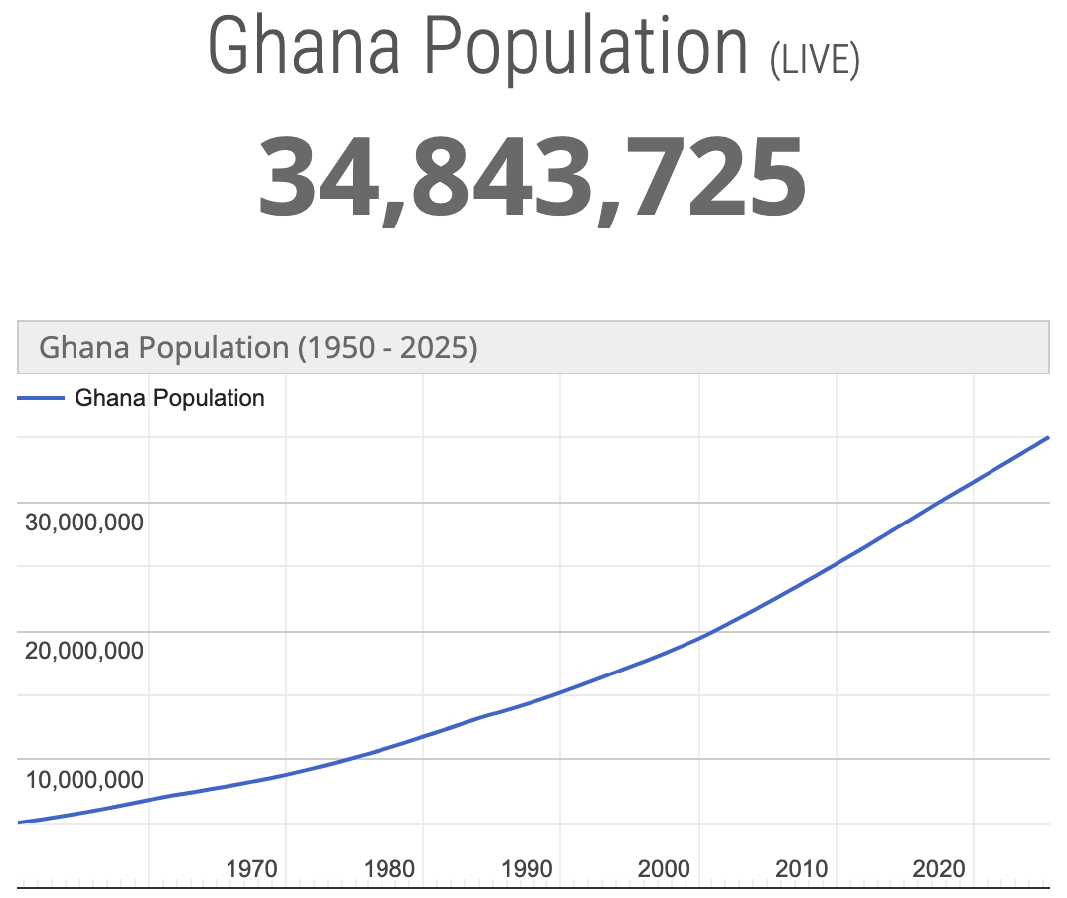

Happy Independence Day Ghana!
Ghana, formerly the Gold Coast, is the first country south of the Sahara to gain independence on March 6, 1957. The feat also inspired other African countries to fight for Independence.
What’s going on in this graph?
Why does it matter?
4.SMP.3

Slide 5
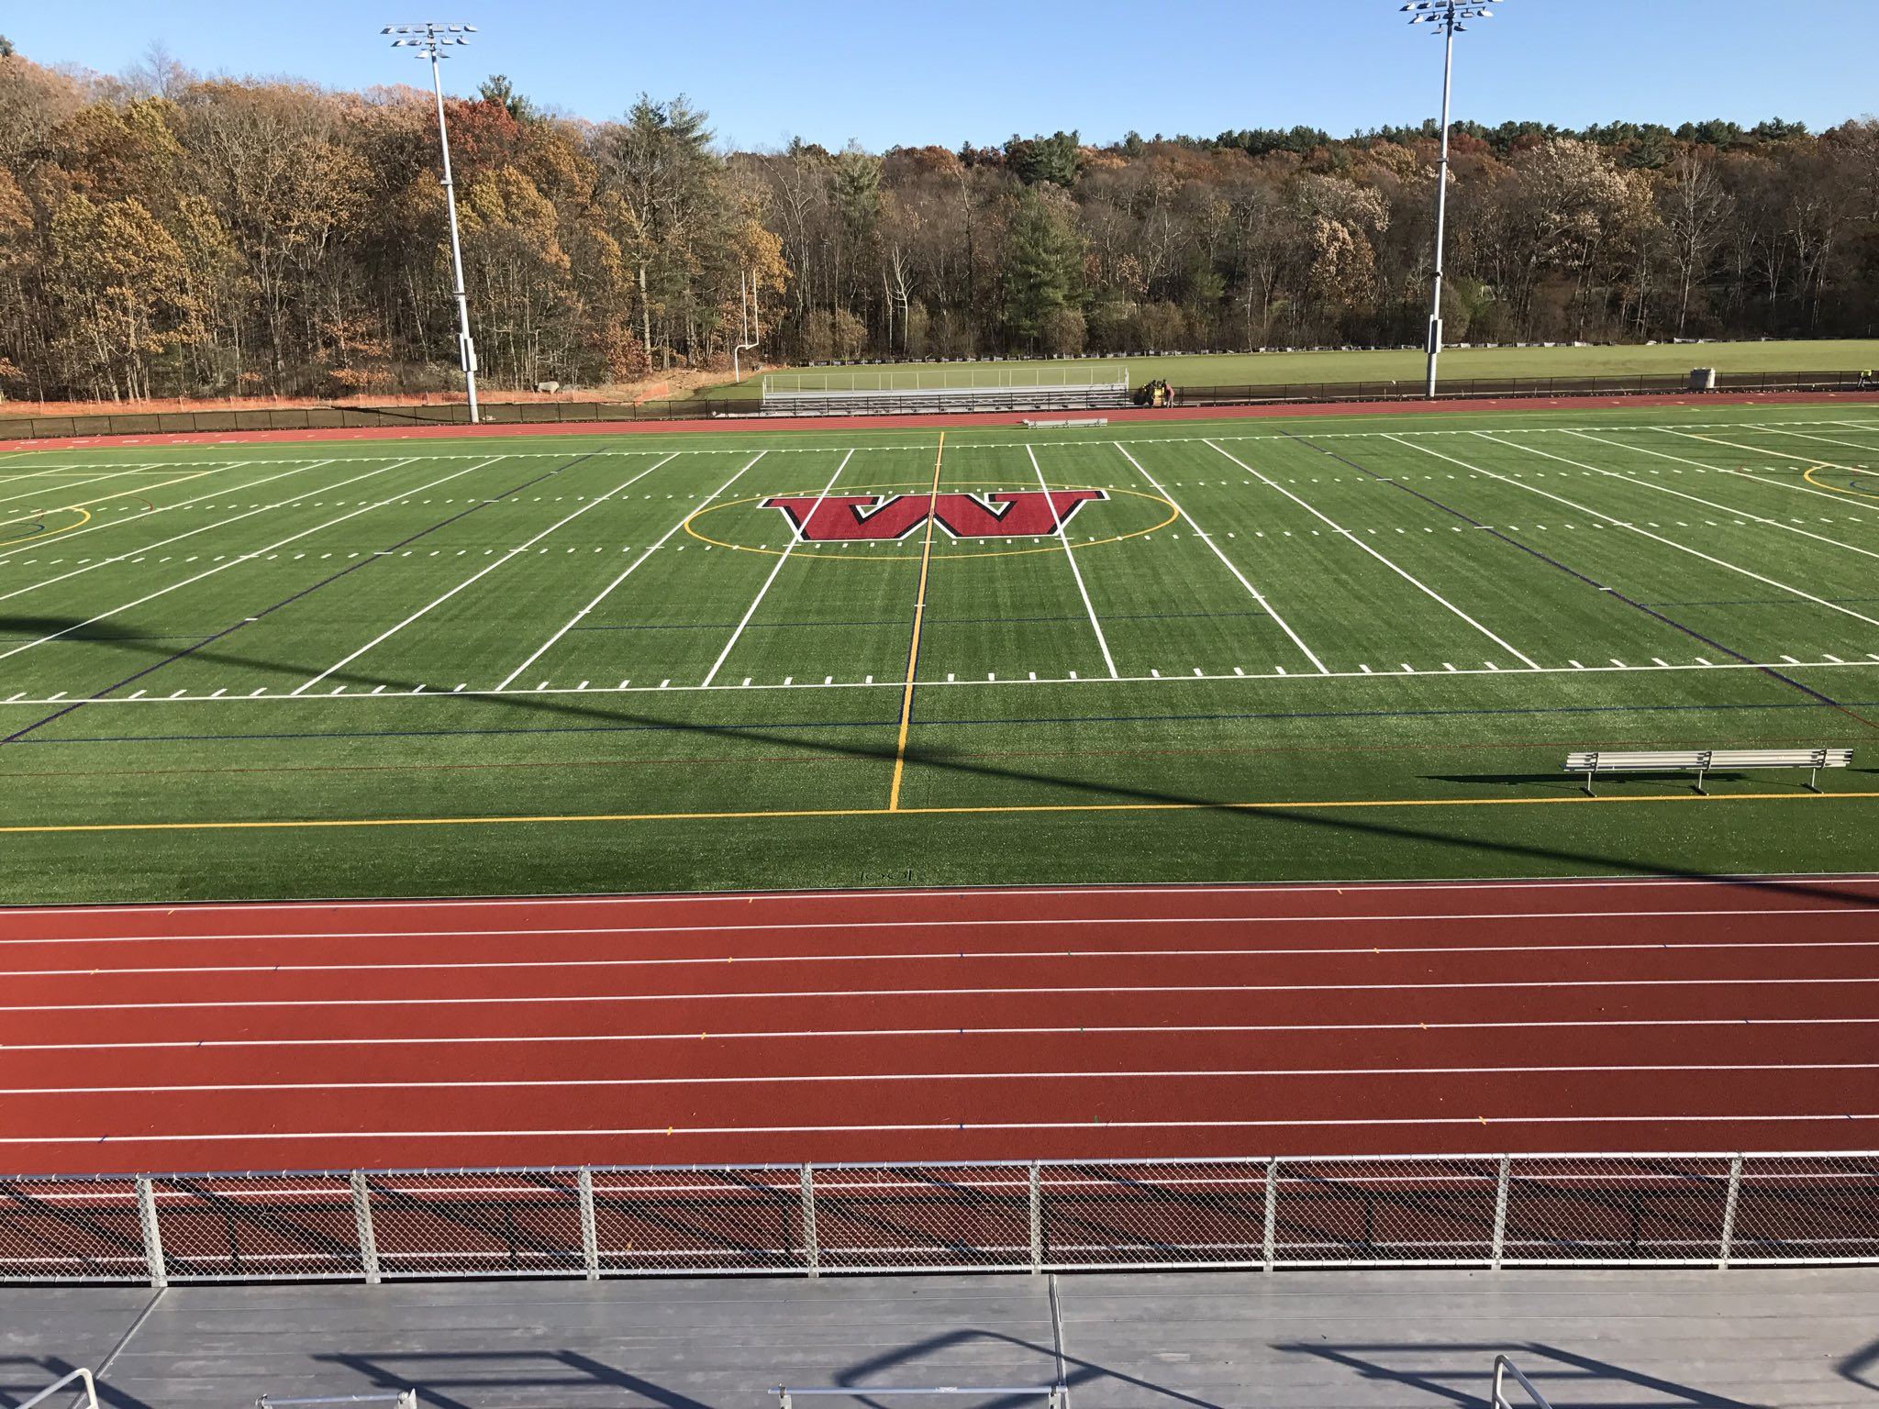
Would you rather …
Run the track at the high school (400 meters) twelve times
or
run a 5K road race?
4.MD.A3

Slide 6
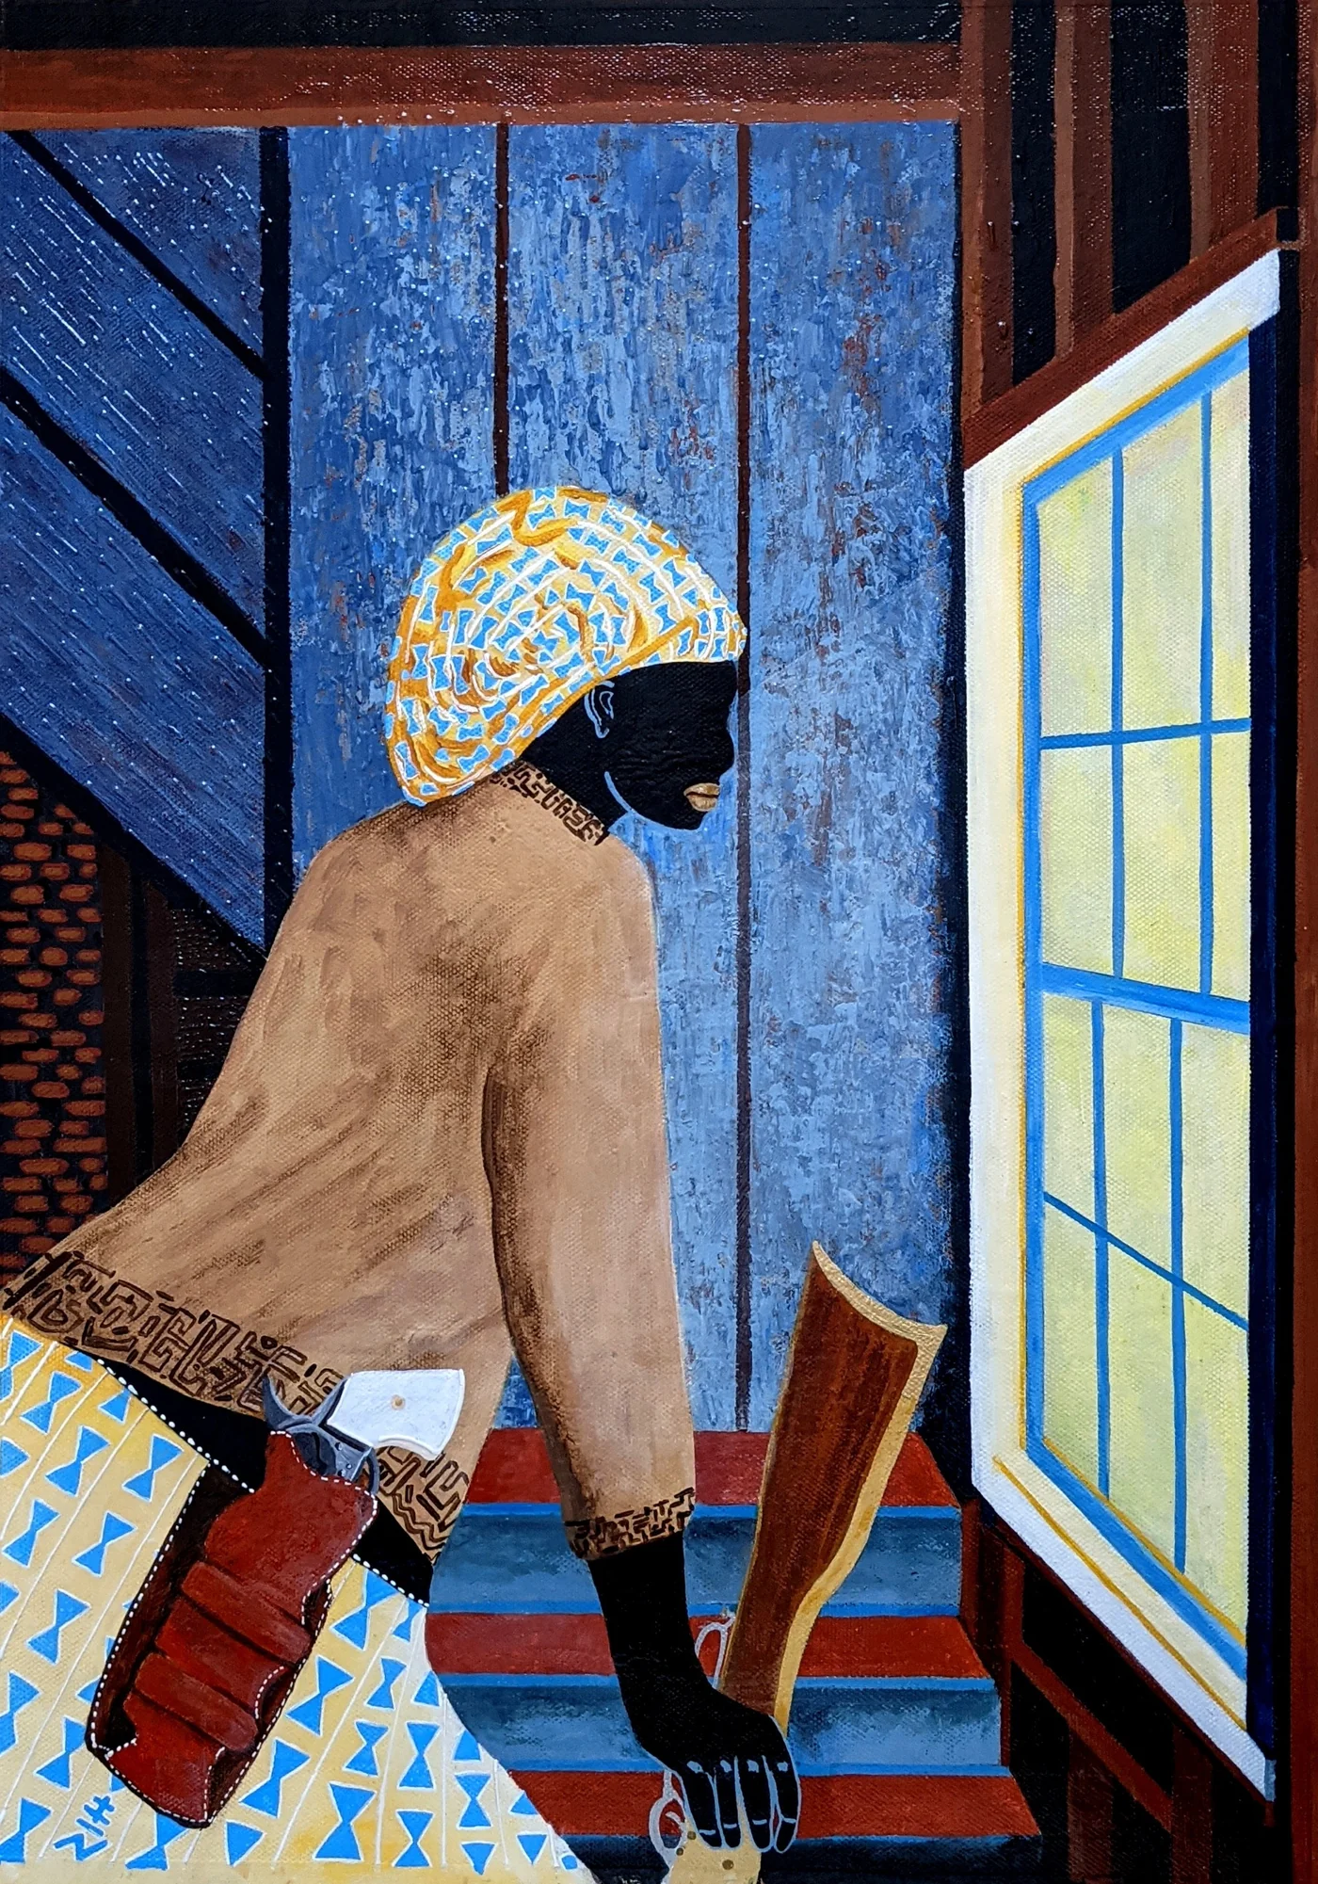
Today is Harriet Tubman Day!
Harriet Tubman was one amazing woman!
It was a 142 miles journey from slavery to freedom. They could only walk at night when the moon was bright and the night was long, covering between 15-20 miles per night. How many nights per month is that?
About how many days of travel is that? How long would the journey take?
4.OA.A3
Vincent Keele “Harriet Moses”
Notes:
Week of March 10, 2025

Slide 7

Today is Canberra Day in Australia!
What do we notice about the architecture here at The John Curtin School of Medical Research in Canberra?
What do we wonder?
Let’s estimate the sizes of the angles we see.
How can we prove our estimates are reasonable?
4.MD.C6

Slide 8
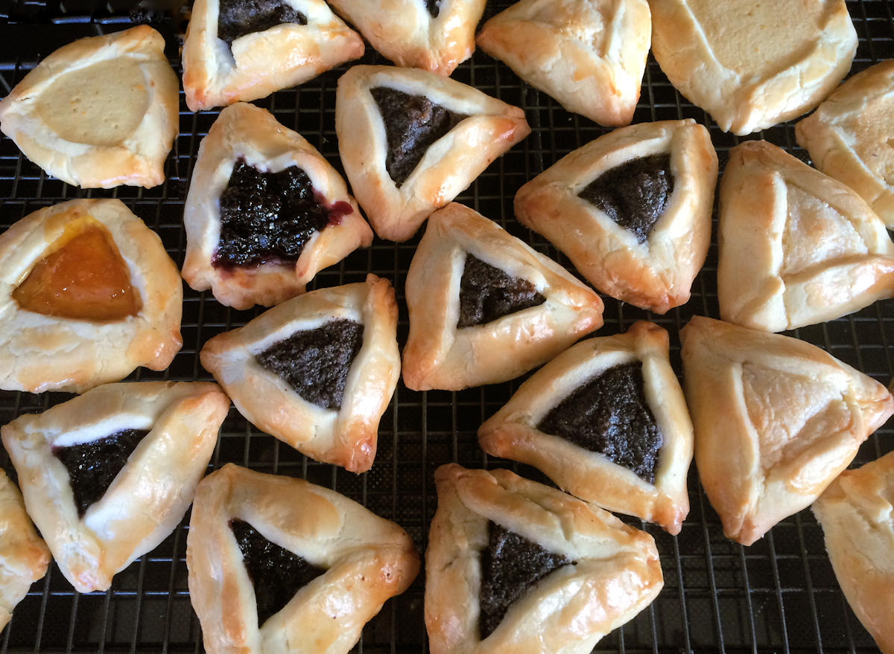
Happy Purim!
It’s time to bake the Hamantaschen!
We need to DOUBLE the recipe!
2/3 cup confectioners' sugar
2¼ cups flour
¾ teaspoon salt
½ pound unsalted butter
3 large egg yolks, divided
¼ cup tablespoons ice cold water
¾ cup apricot jam
How much of each ingredient do we need?
4.NF.B4

Slide 9
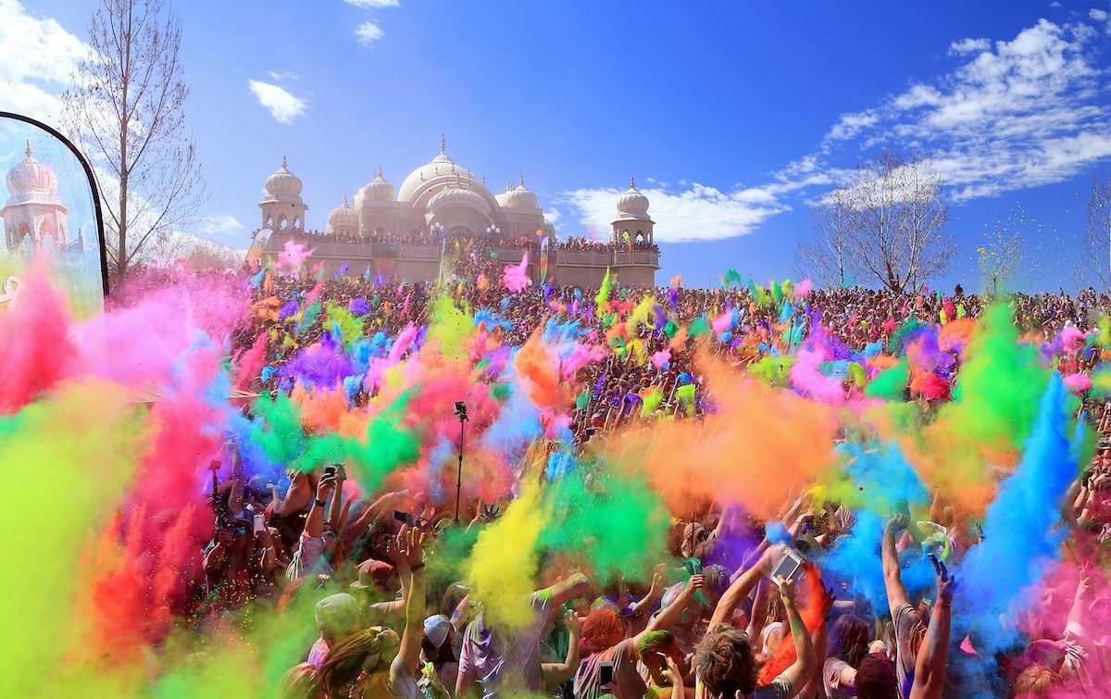
Happy Holi!
Estimate the distance from here to the Temple.
What strategies can we use to estimate?
4.MD.A

Slide 10
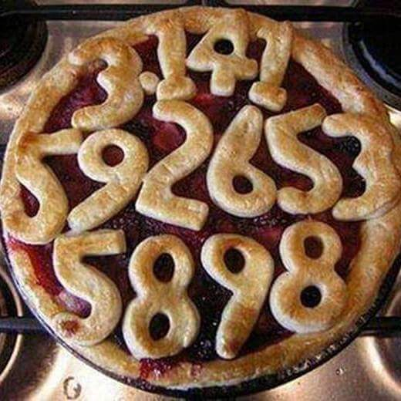
Happy Pi Day!
It’s the BEST, most mathematically delicious day of the year!
What is pi?
About what fraction of the pie is covered by numbers?
4.NF.A

Slide 11
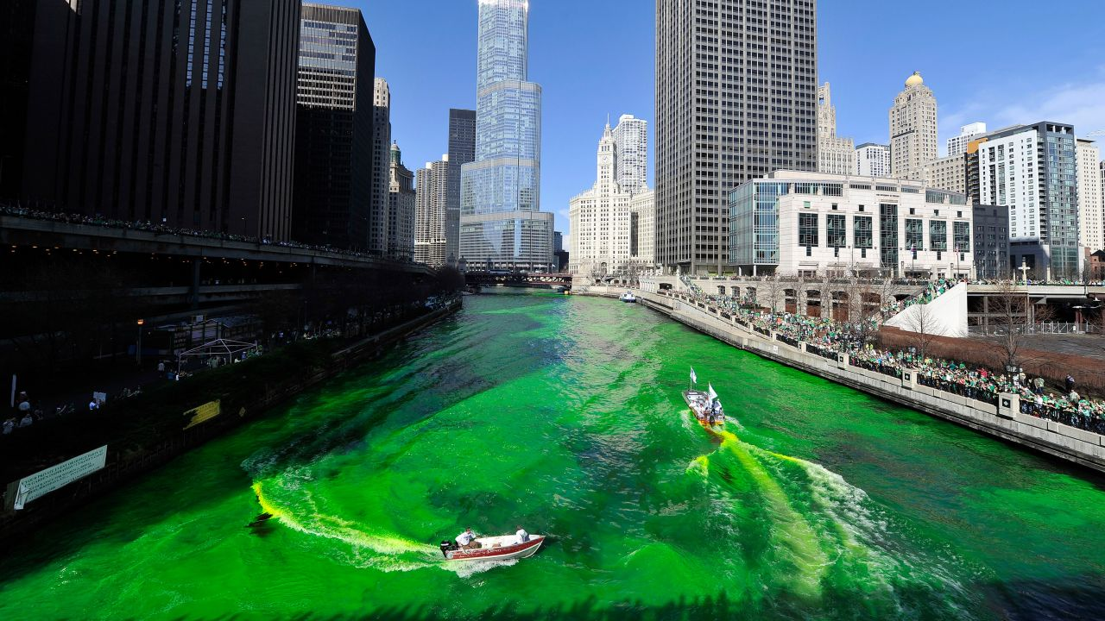
Happy St. Patrick’s Day!
The Plumber’s Union in Chicago dyes their river green every St. Patrick’s Day.
25 pounds of vegetable-based dye colors the river for 5 hours.
How much dye do they need to color the river for whole day?
2 days?
3 days? 4 days?
Check out this 1 minute video!
3.OA.D8
4.OA.A3
Notes:
Week of March 17, 2025

Slide 12
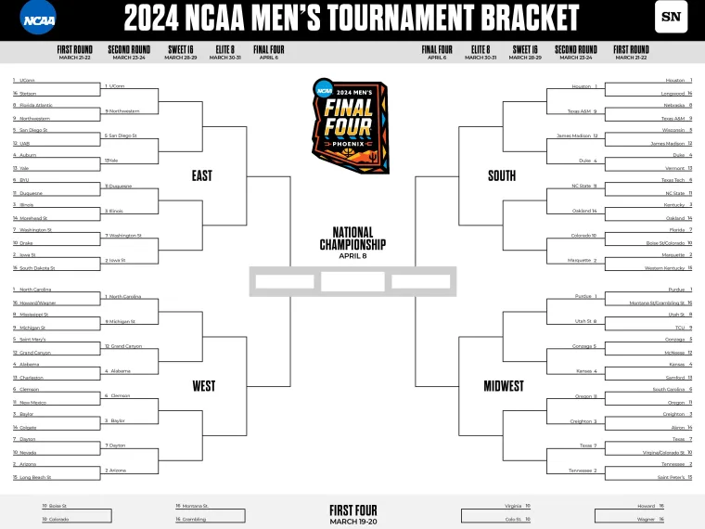
It’s March Madness Season!
We start with 64 teams from 4 regions.
Will your favorite team make it in this year?
How many different number sentences can we write to represent the competition from 64 teams down to the final 4?
4.OA.B4

Slide 13
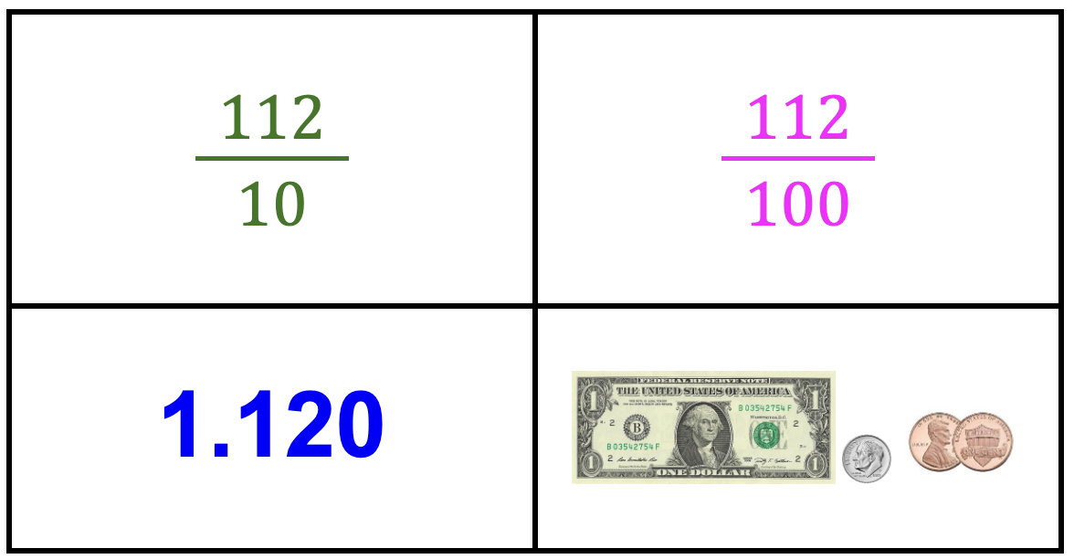
Which ones go together?
4NF.C

Slide 14
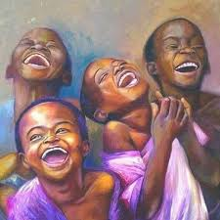
Happy International Day of Happiness!
Research shows that children smile an average of 400 times per day, compared to the typical adult who smiles only 20 times per day.
How many times GREATER is 400 than 20?
What are some FACTOR pairs of 400?
How will we know when we have them all?
4.NBT.A1
Tish Jones “Black Lines Matter”

Slide 15
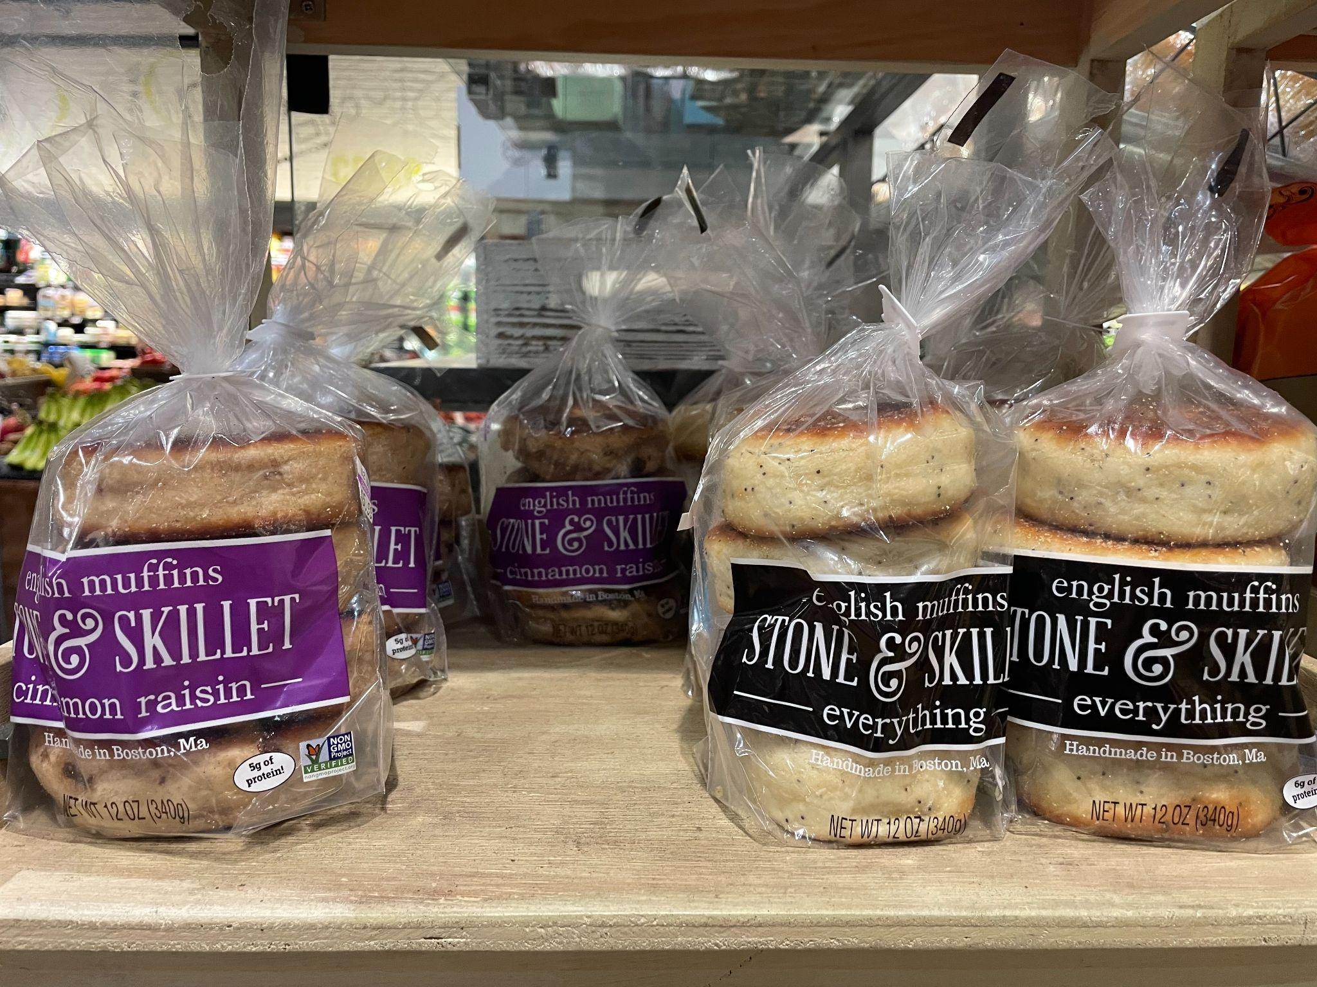
What do we notice?
What do we wonder?
Can we represent this photo as a multiplication sentence?
4.OA.A2

Slide 16
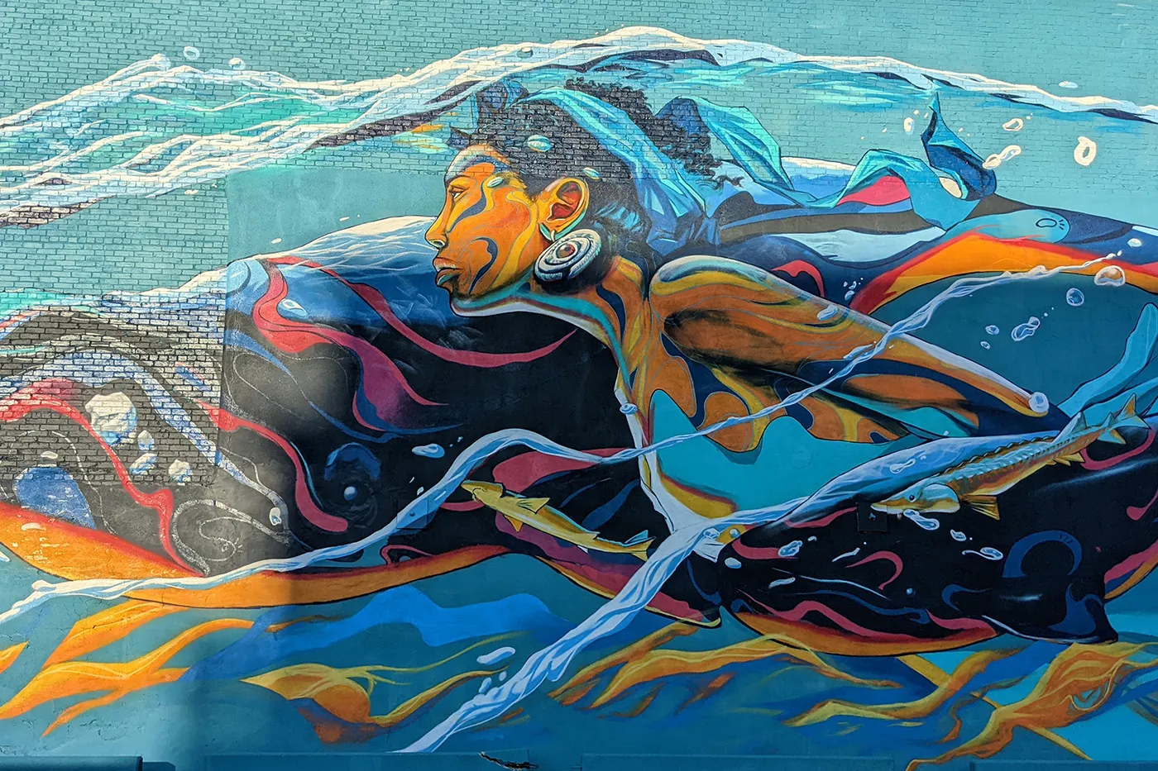
What do we notice?
What do we wonder?
How many bricks?
How can we come close?
Taj Francis
“Guiding Giants”
4.NBT.B5
Notes:
Week of March 24, 2025

Slide 17
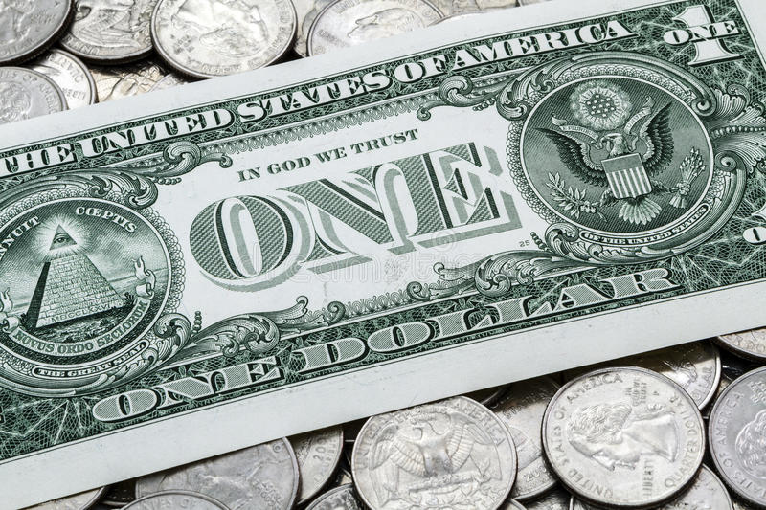
Would you rather get…
75¢ every day for the rest of your life
or
$5.00 a week for the rest of your life?
4.MD.A2

Slide 18
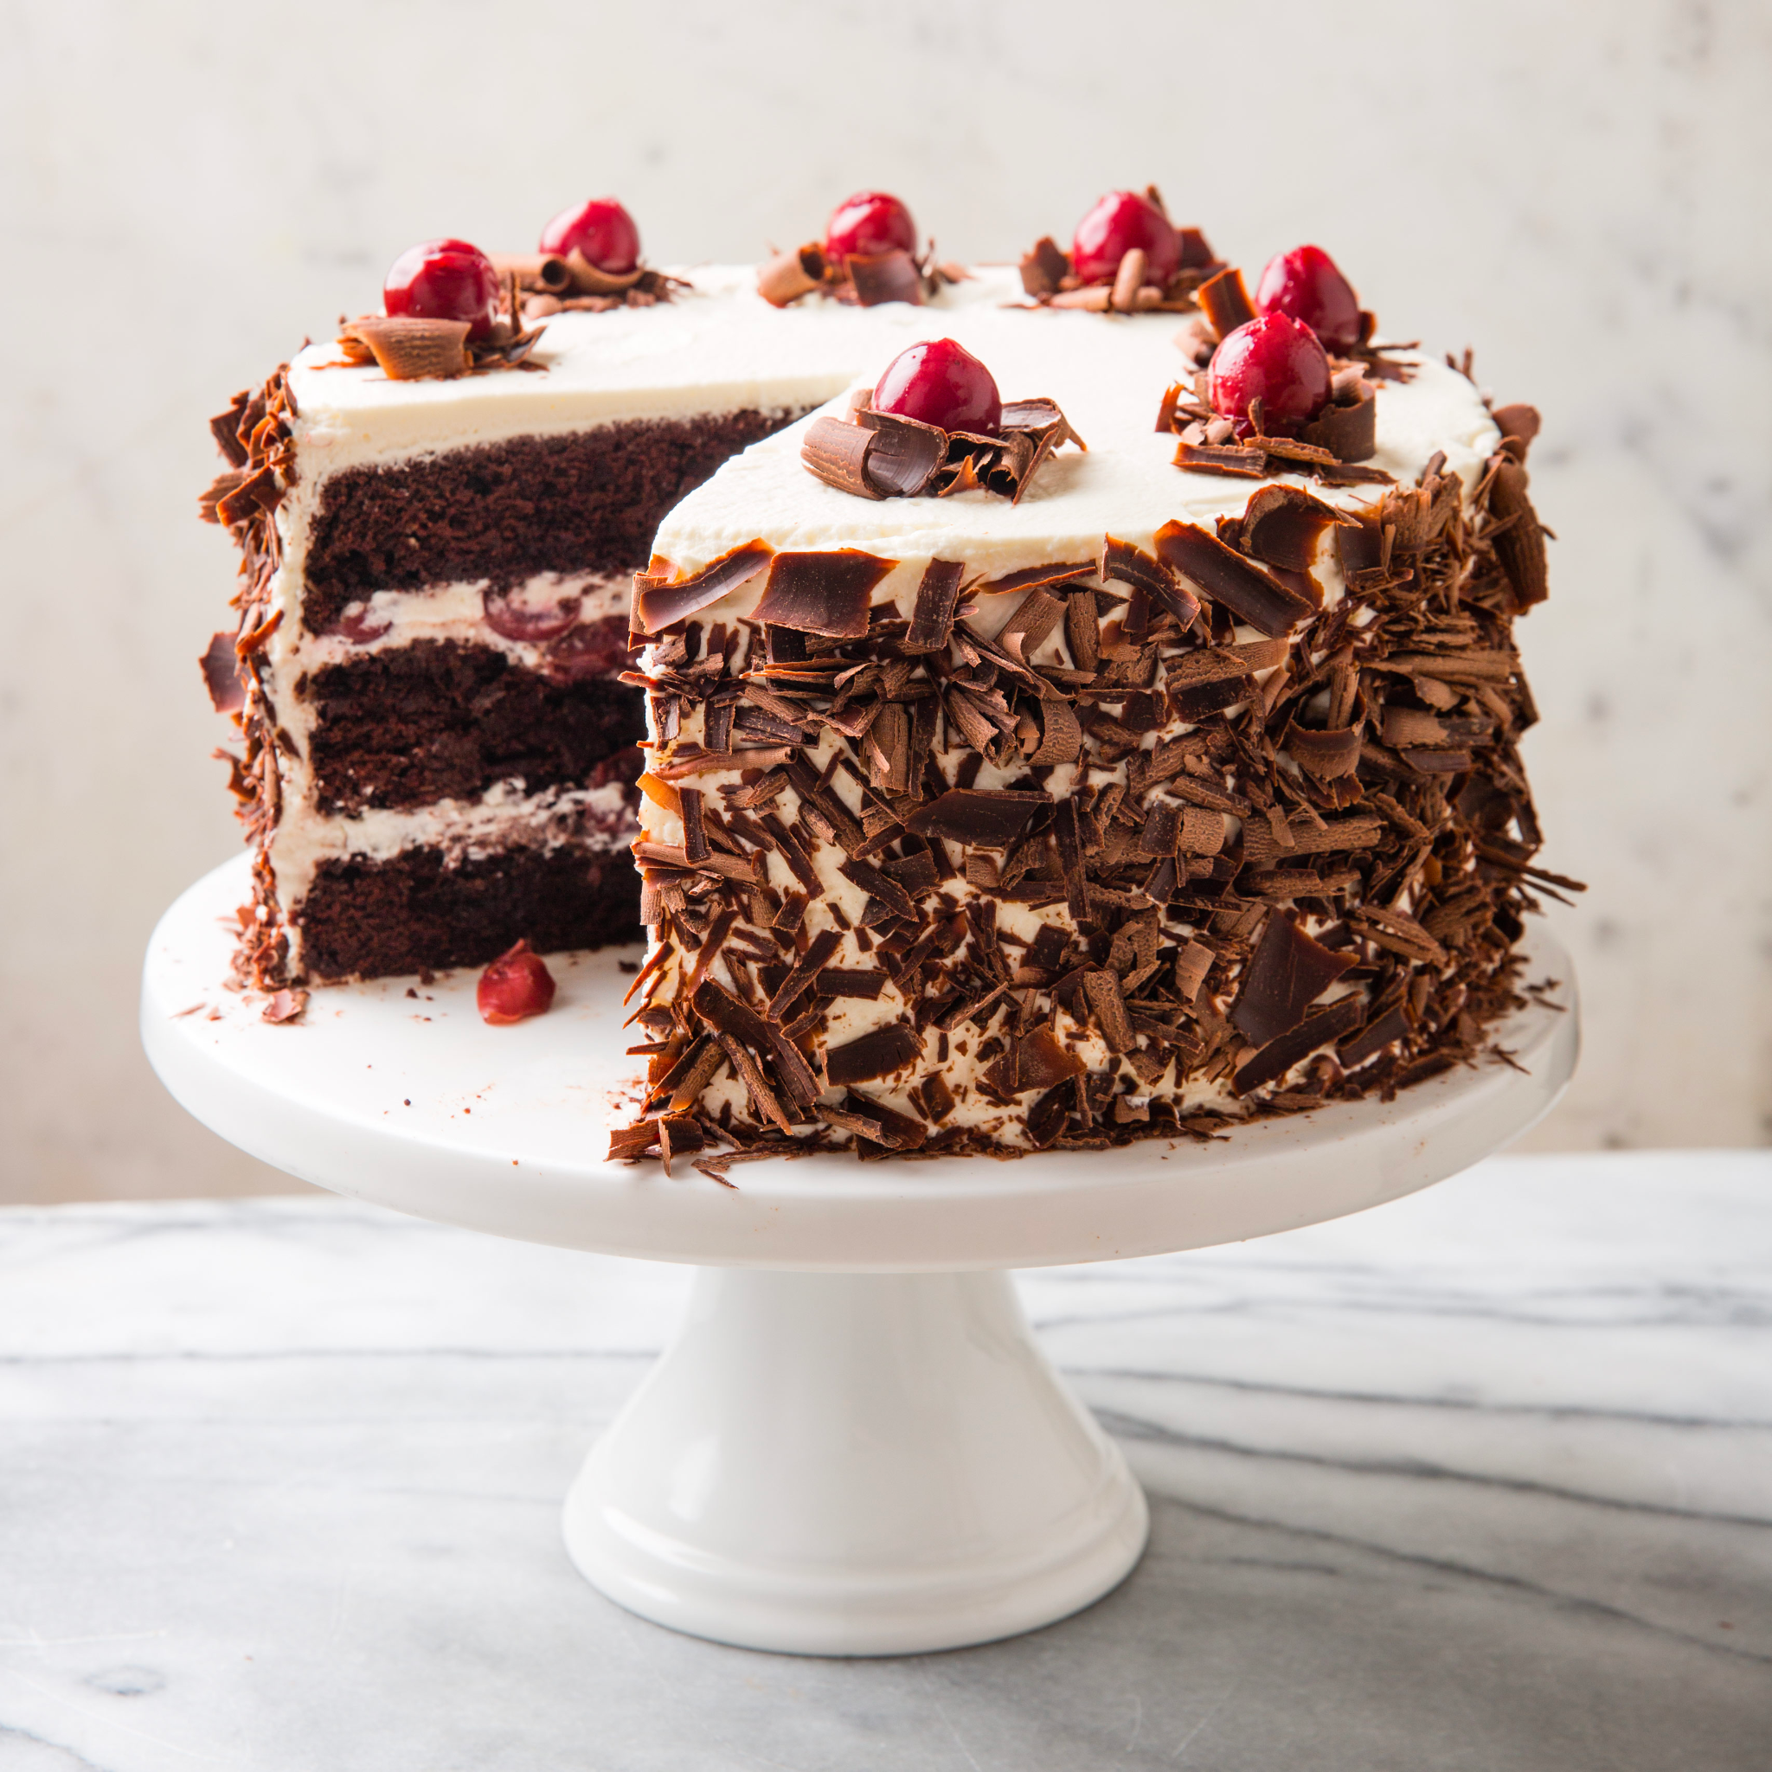
Happy Black Forest Cake Day!
About what fraction of the cake is missing?
Approximately what fraction of the cake remains?
How do you know?
4.NF.A2

Slide 19
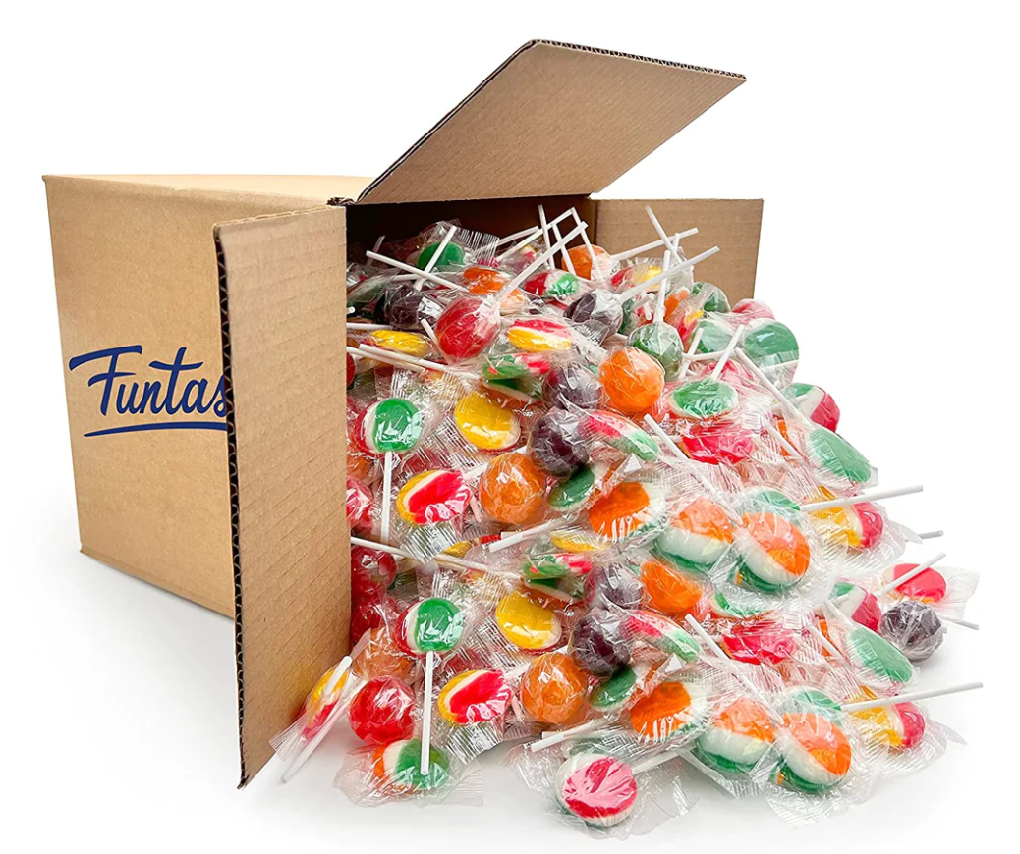
How many different ways can we EQUALLY share this box of 120 lollipops?
How will we know when we have all of the possibilities?
4.OA.B4

Slide 20
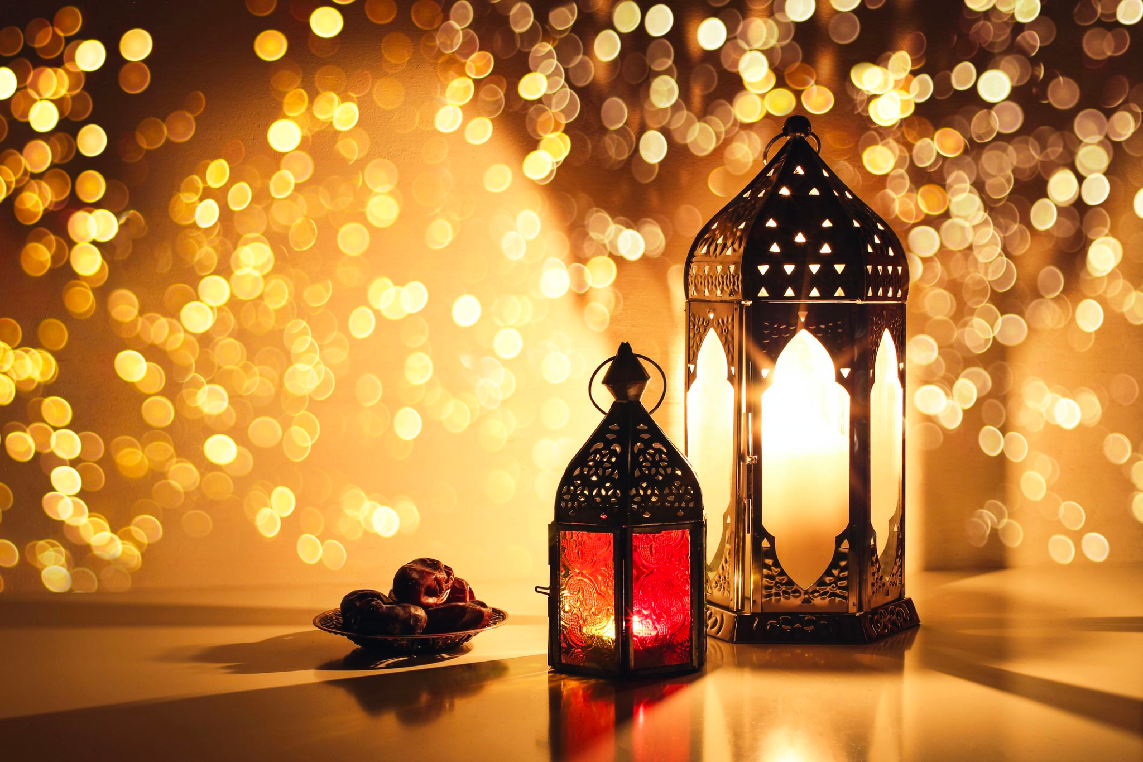
This weekend is Eid al-Fitr عيد مبارك
The month of Ramadan began the Evening of February 28, 2025 - and ends the Evening of March 29, 2025.
How many days is that?
How many hours?
How many minutes?
4.MD.A1

