Slide 1
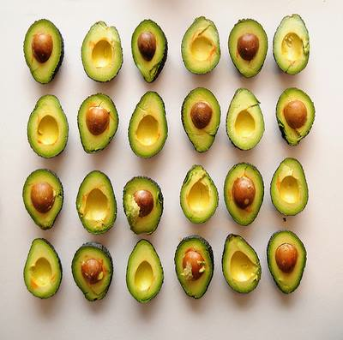
Happy
Veggie Month!
What do we notice?
What do we wonder?
How many different ways do we see the quantity?
How can we see “groups of?”
2.OA.C4
Notes:
Week of March 3, 2025

Slide 2
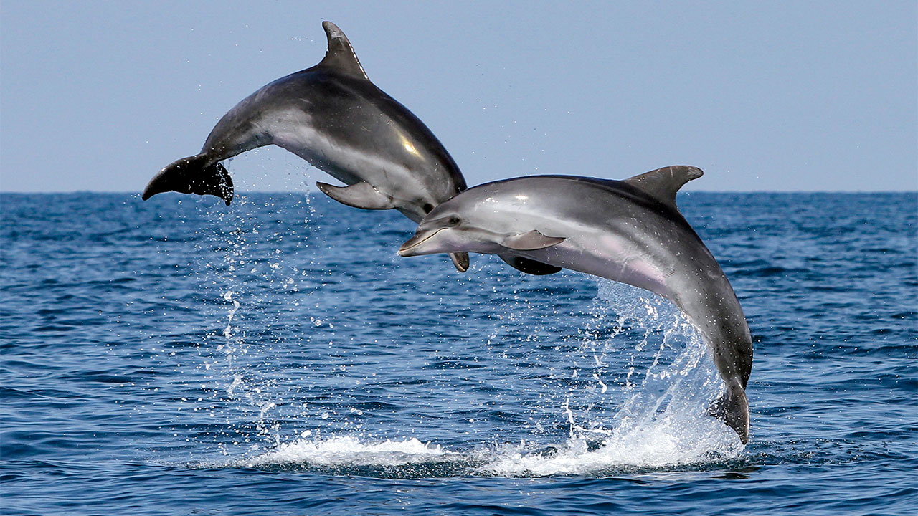
March is Dolphin Month!
There are 38 different species of dolphins!
How many different expressions can we create that equal 38?
2.OA.A1

Slide 3
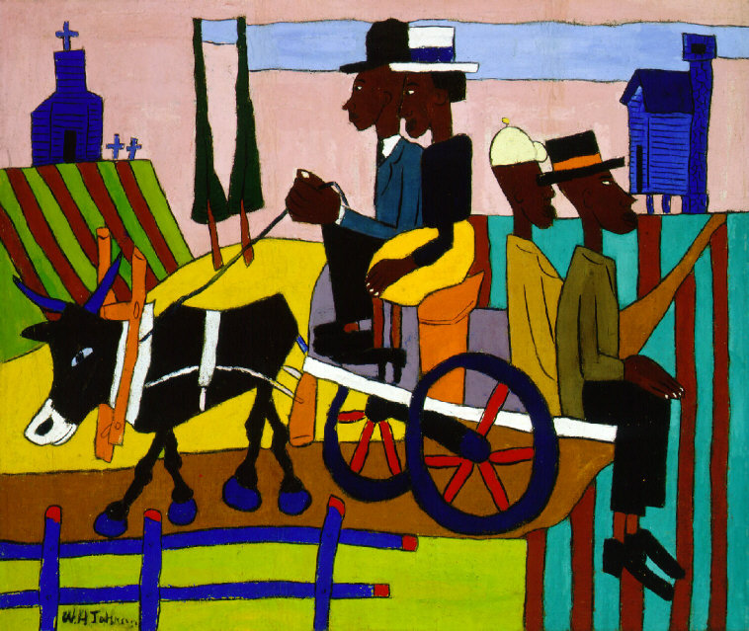
Going to Church
by William H. Johnson
This painting is featured in the Smithsonian American Art Museum in Washington D.C.
It was painted in 1941.
How long ago was that?
What mental math strategies can we use to solve this?
2.NBT.B7

Slide 4
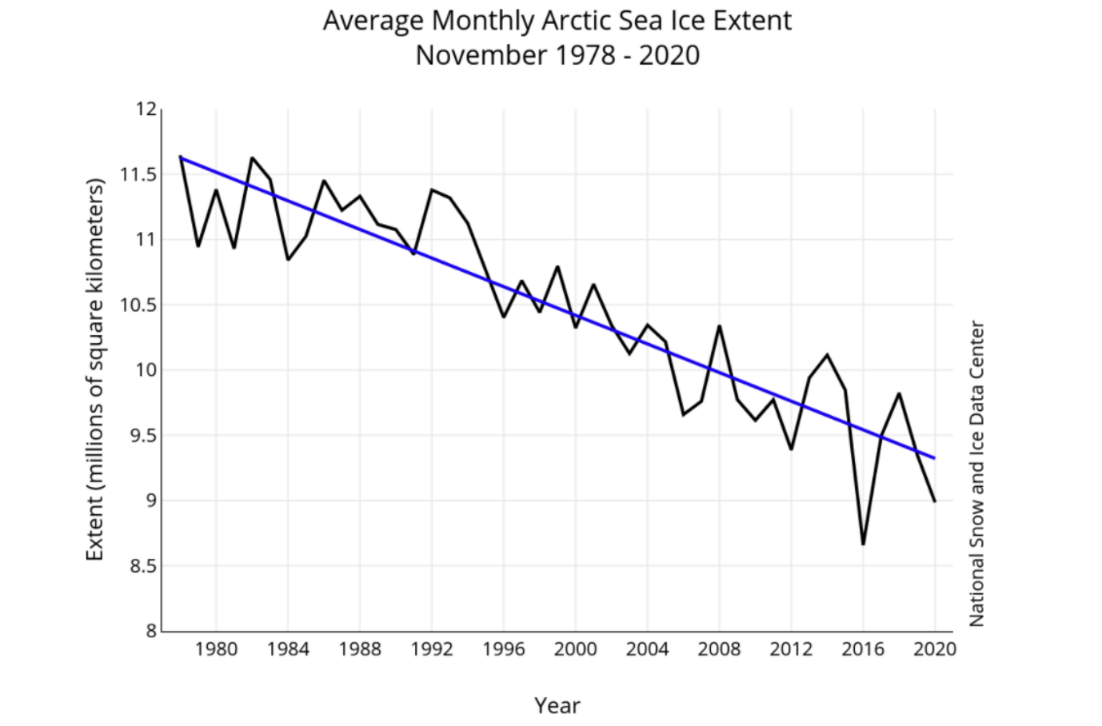

What do you notice?
What do you wonder?
What is going on in this data visualization?
Why does it matter?
2.MD. D

Slide 5
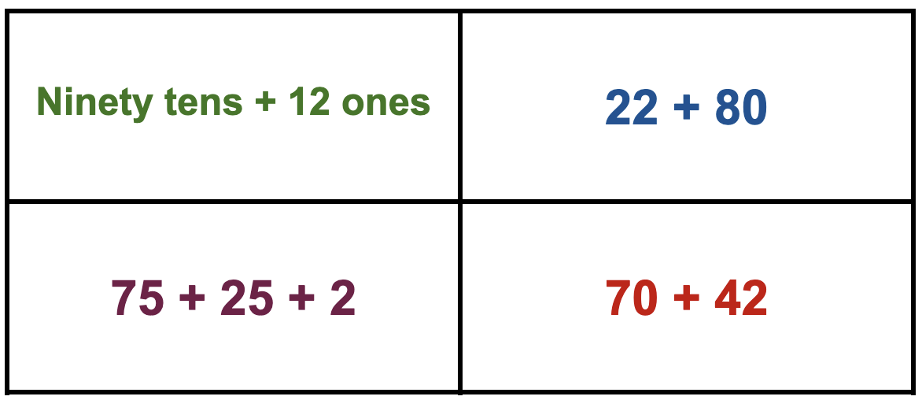
Which ones go together?
2.NBT.B5

Slide 6
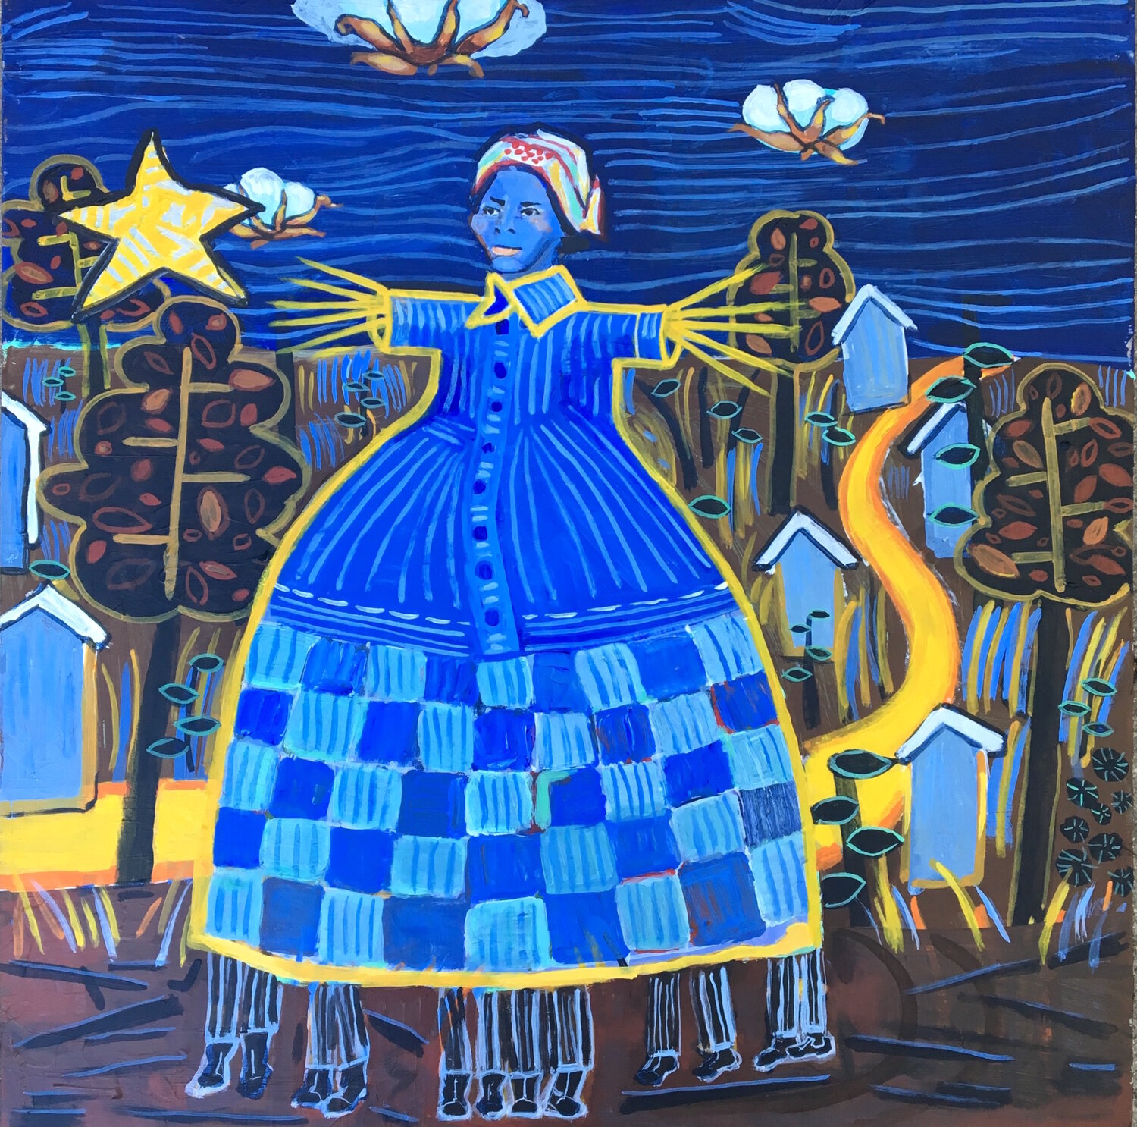
Celebrate Harriet Tubman Day!
What different shapes can we find in this painting by Anne Skok?
Sketch one of the shapes.
Now sketch a shape that is DIFFERENT than your shape in 2 ways!
1.G.A2
Notes:
Week of March 10, 2025
Harriet Tubman Day

Slide 7
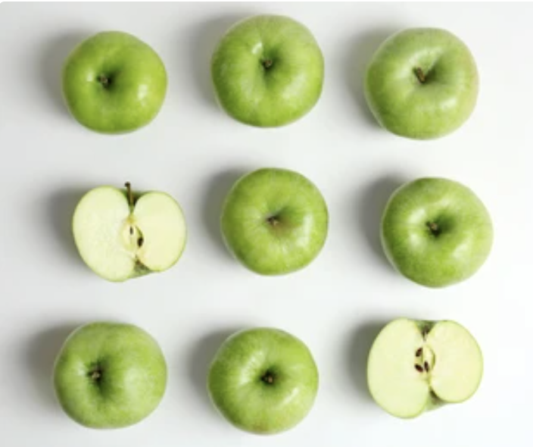
Today is Johnny Appleseed Day!
How many seeds do we think are in ONE apple?
How many seeds are in NINE apples?
2.OA.C4

Slide 8
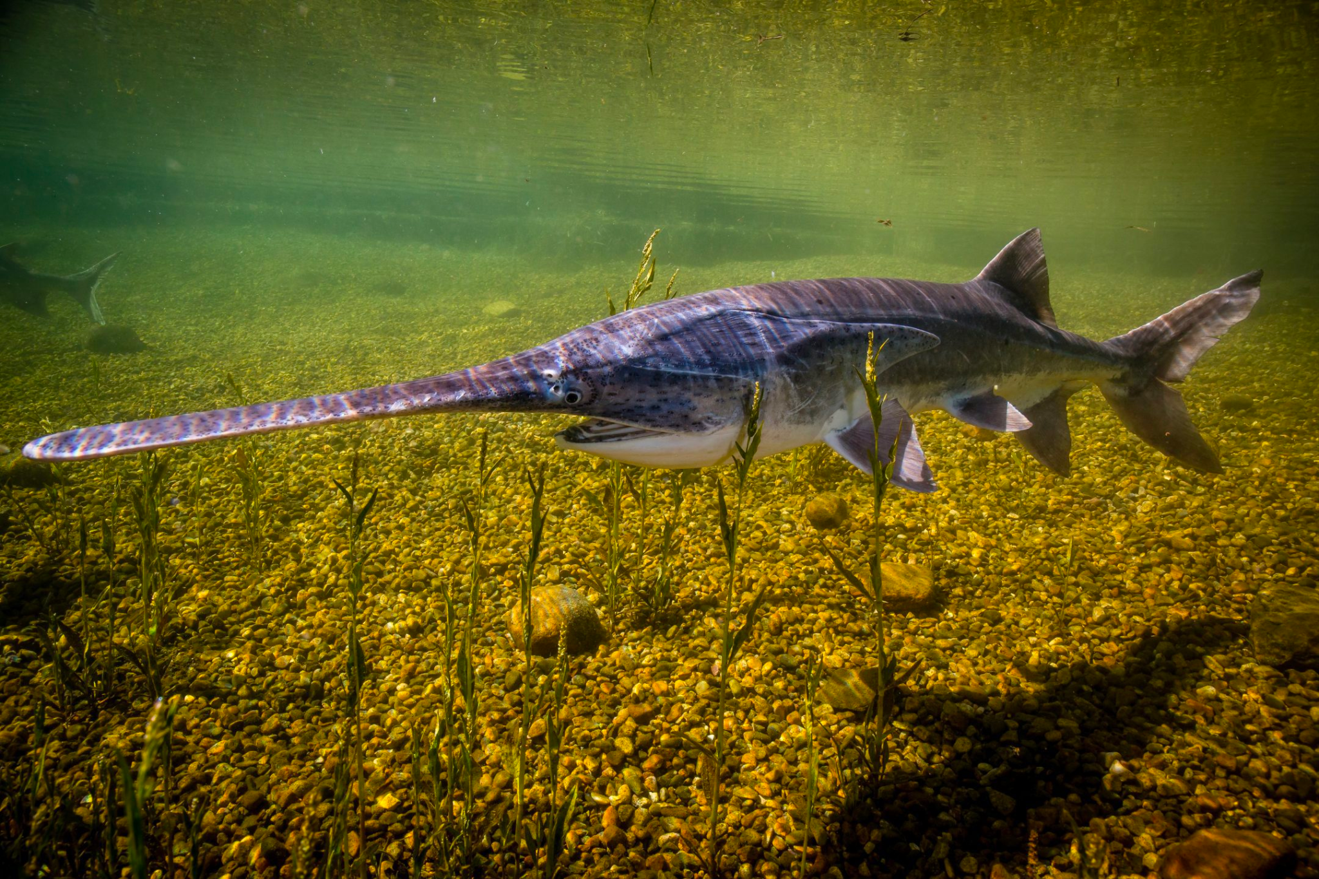
Celebrate American Paddlefish Day!
The American paddlefish is a 125-million year-old prehistoric species of freshwater fish.
The average length of a paddlefish is 8 feet long.
How long is that?
What else is about 8 feet long?
2.MD.A3

Slide 9
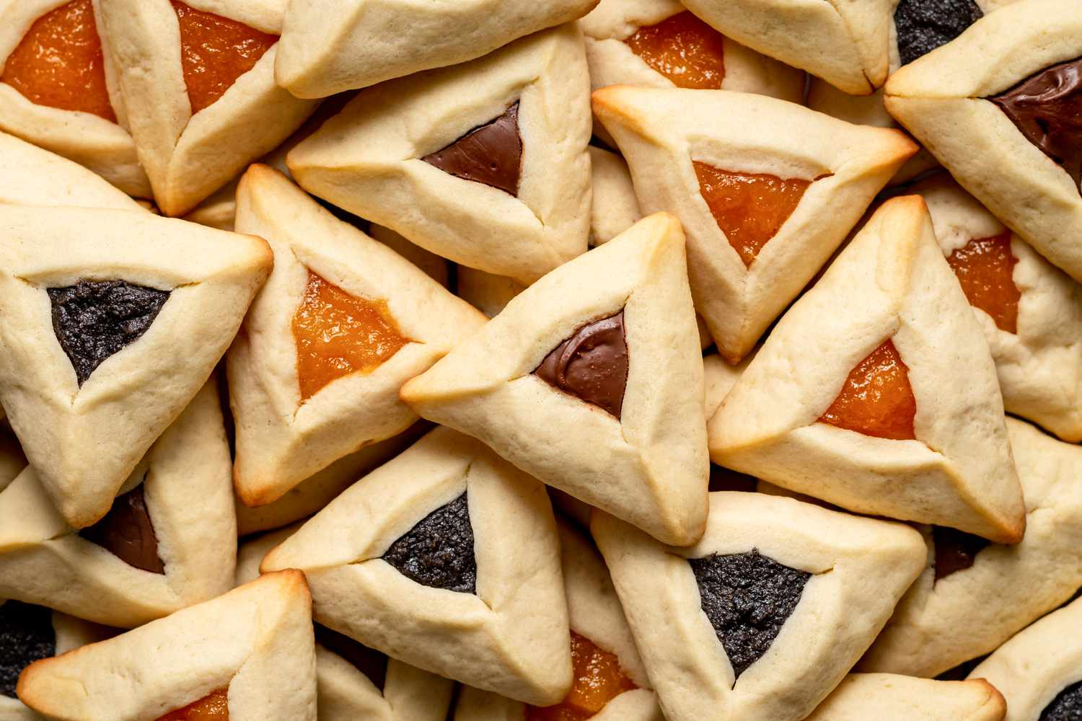
Happy Purim!
What are some different shapes we can make with triangles?
What can we make if we partition triangles?
2.G.A3

Slide 10
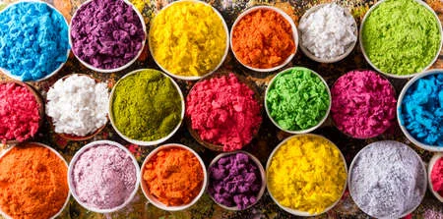
Happy Holi!
How many different equations can we create to match this photo?
2.OA.A1

Slide 11
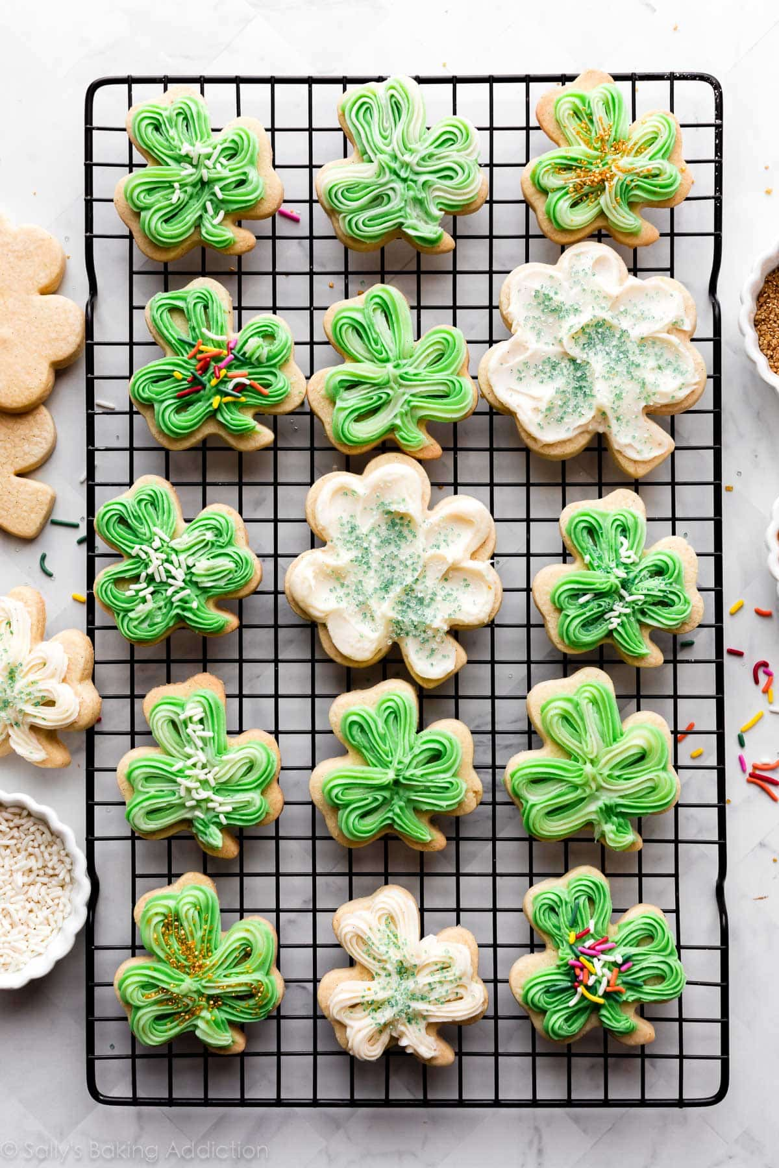
Happy St. Patrick’s Day
Here is 1 batch of cookies!
How many would there be in 2 batches of cookies?
3 batches?
Do we see any patterns?
2.OA.C3
Notes:
Week of March 17, 2025

Slide 12
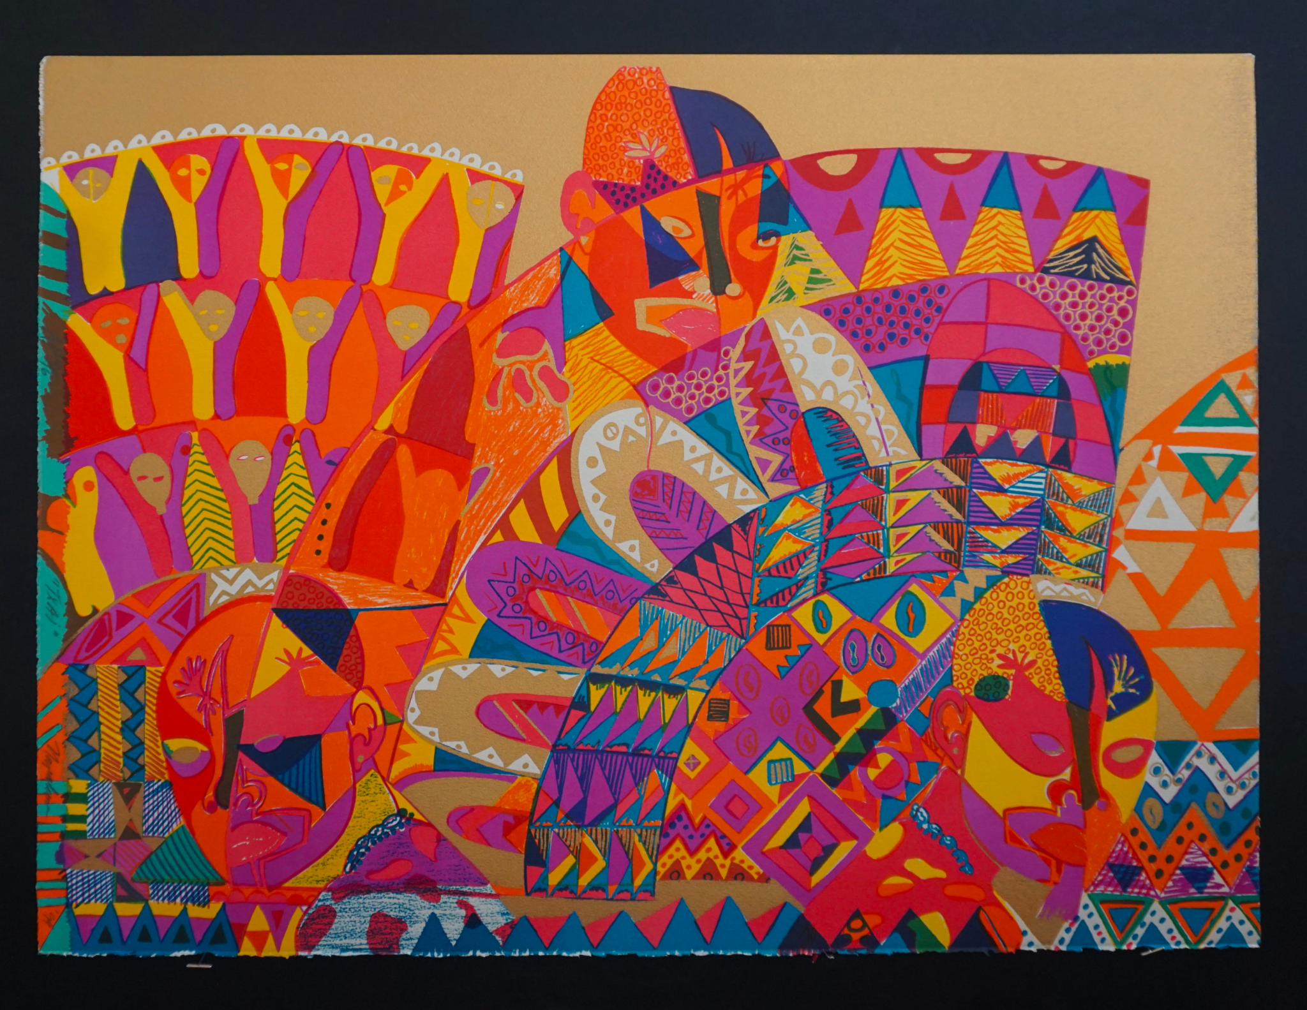
Let’s investigate the shapes we see in “Txai” by Napoleon Jones-Henderson.
Pick a shape and partition it!
What do you have now?
2.G.A3

Slide 13
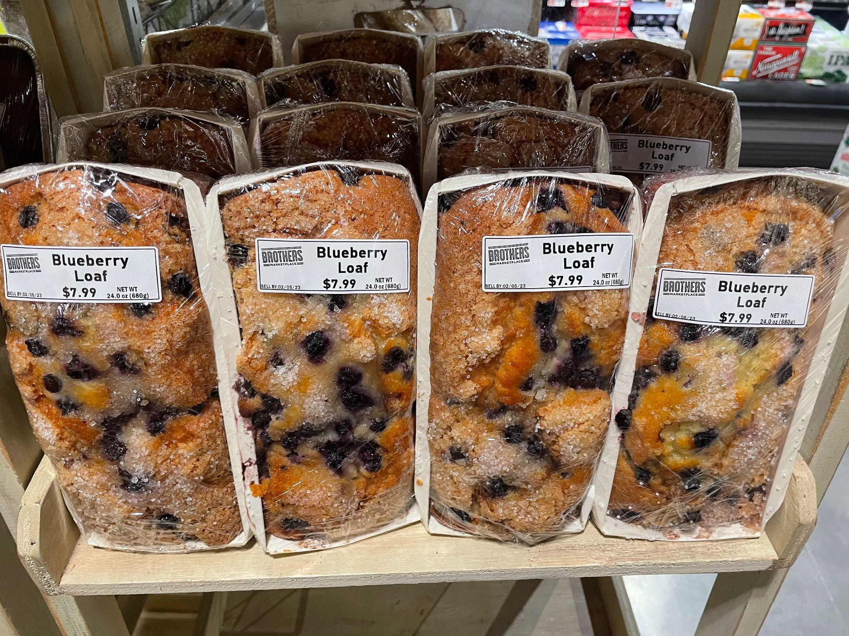
What do we notice?
What do we wonder?
Where’s the math?
2.OA.A4

Slide 14

Today is International Day of Happiness!
Research shows that children smile an average of 400 times per day.
How many times do children smile in one week?
One month?
2.NBT.B8
GO SUGA
“Way to Happiness”

Slide 15
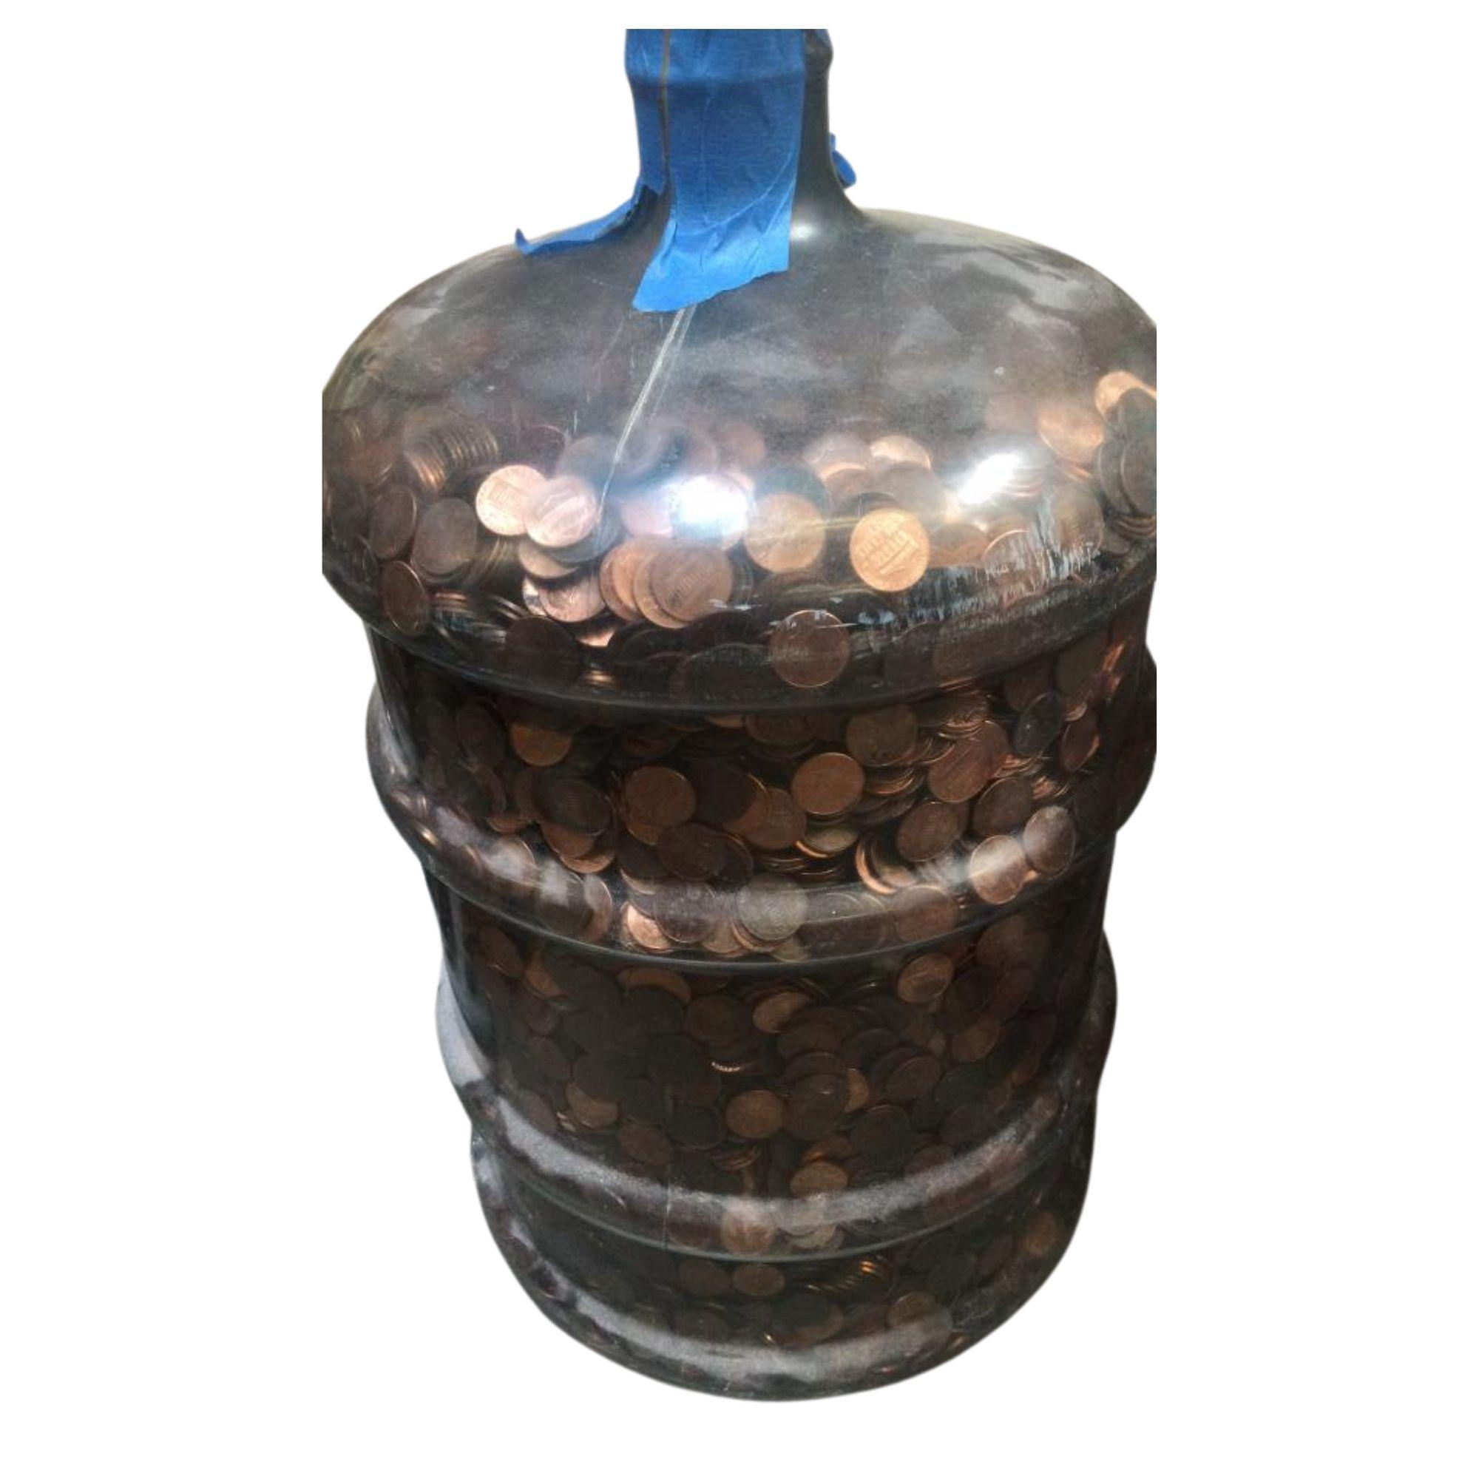
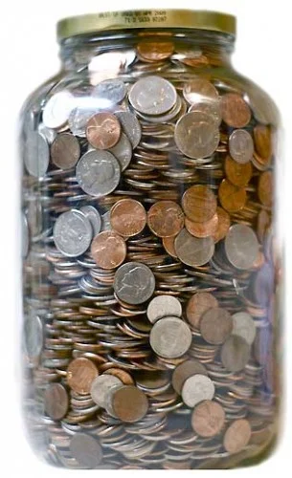
Would you rather …
5-gallon jug of pennies
OR
1-gallon jug of mixed coins?
2.MD.C8

Slide 16
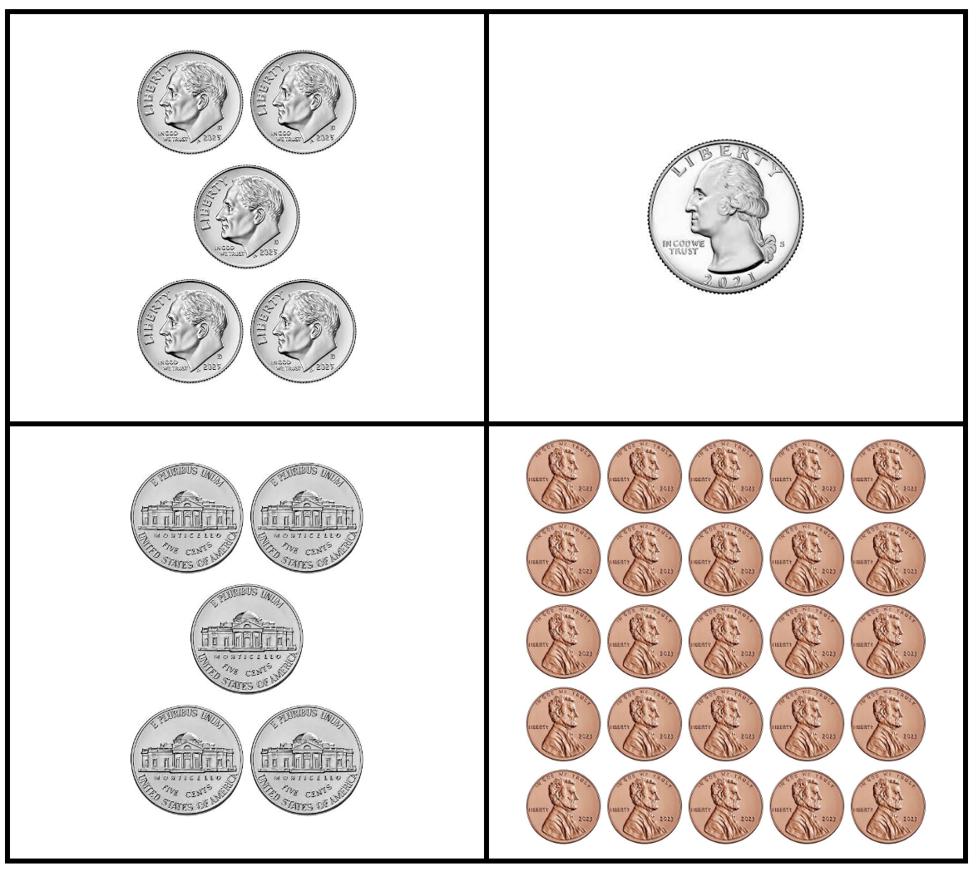
Which ones go together?
2.MD.B8
Notes:
Week of March 24, 2025

Slide 17

500 - 70 < 400 + 30
523 + 100 > 620
750 - 100 < 600
2.NBT.A1

Slide 18

Let’s Celebrate National Pencil Day!
How many pencils are here altogether?
What strategies can we share to figure this out?
2.NBT.B5

Slide 19
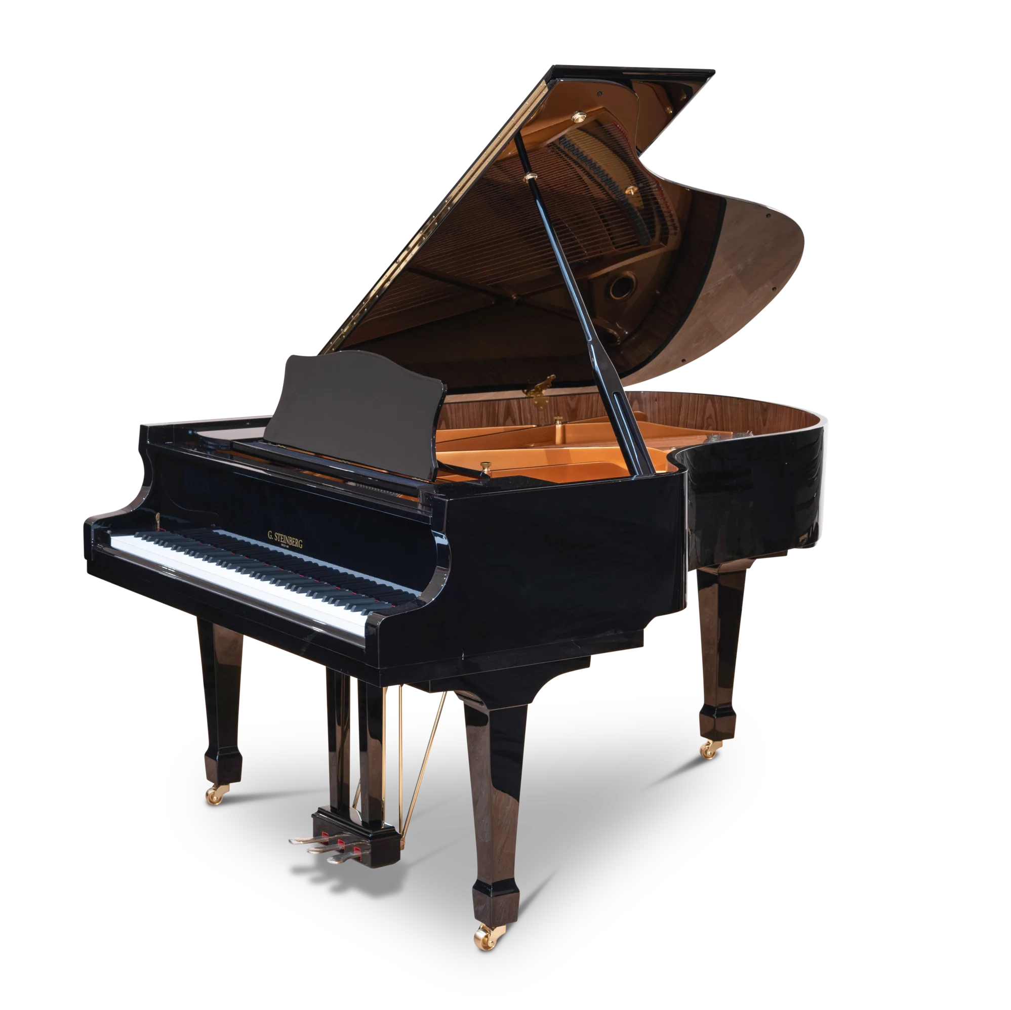
Celebrate World Piano Day!
World Piano Day is celebrated on the 88th day of the year!
Do you wonder why?
There are 88 keys on a piano?
There are 16 more white keys than black keys.
Can we figure out how many there are of each?
2.OA.A1

Slide 20
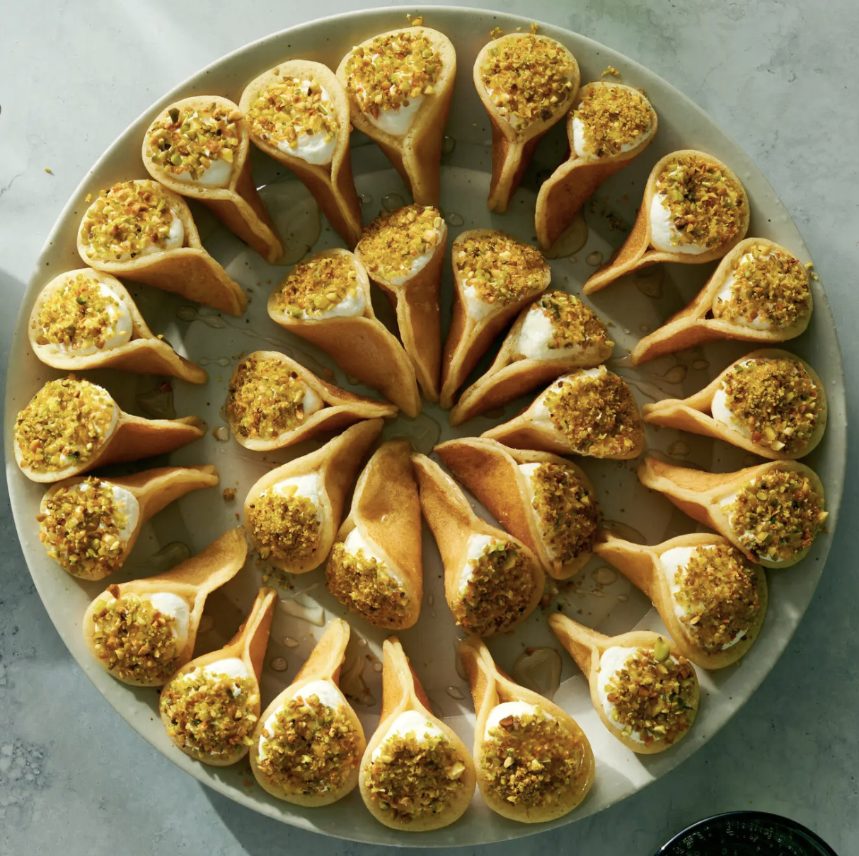
This weekend is Eid al-Fitr
عيد مبارك
How many Qatayef Asafiri do we see here?
Let’s write a number sentence to match this photo.
2.OA.A1

