Slide 1
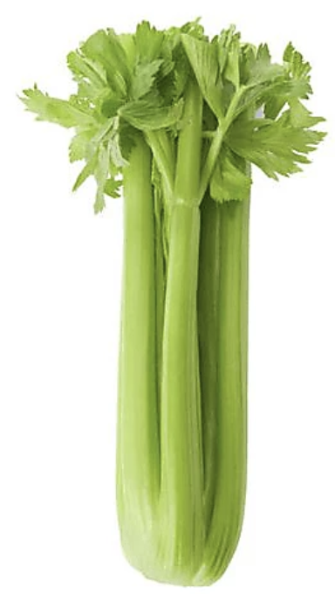
It’s National Celery Month!
How many stalks of celery do you think are here?
9
How many are here?
1.NBT.C4
Notes:
Week of March 3, 2025

Slide 2
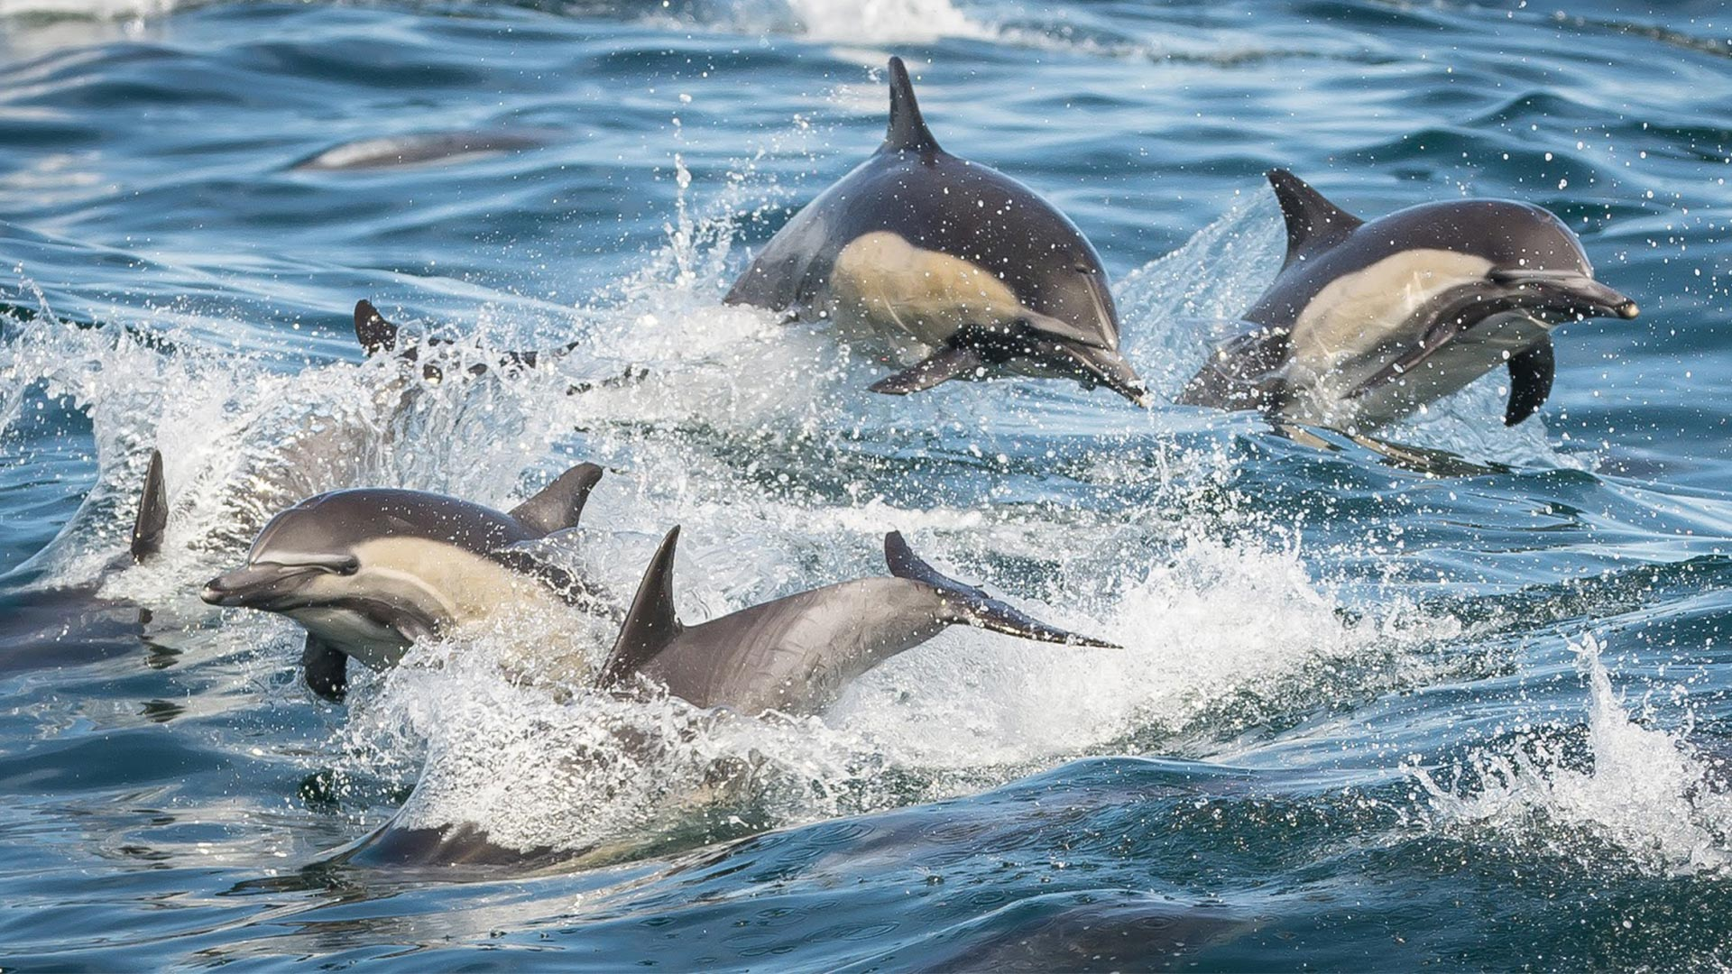
Happy Dolphin Month!
There are 38 different species of dolphins!
How many different expressions can we create that equal 38?
1.NBT.C4

Slide 3
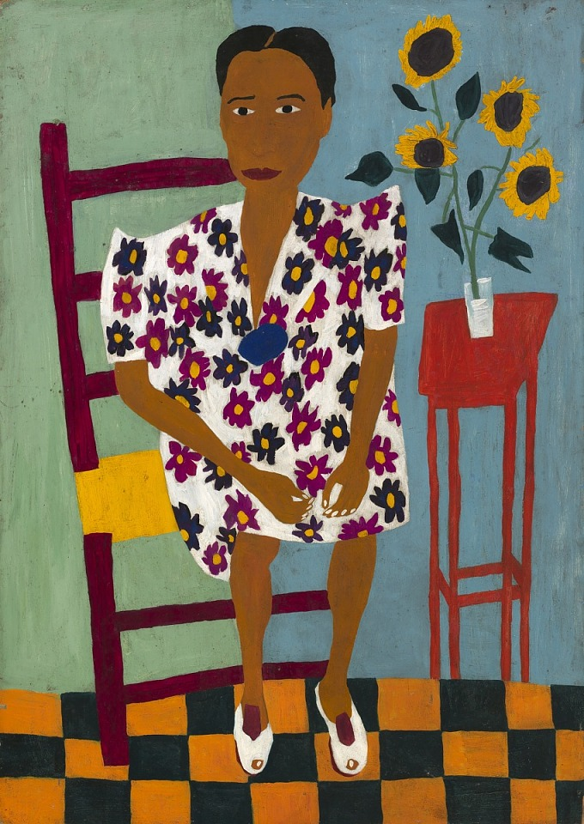
Portrait With Sunflowers
Where do we see patterns in this famous painting by
William H. Johnson?
What can we count in this painting?
What can we estimate?
1.NBT.A1

Slide 4

Happy Independence Day Ghana!
Ghana has been an independent nation since 1957!
Let’s talk about the shapes we see in the flag of Ghana.
What would happen if we partitioned some of the shapes?
1.G.A3

Slide 5
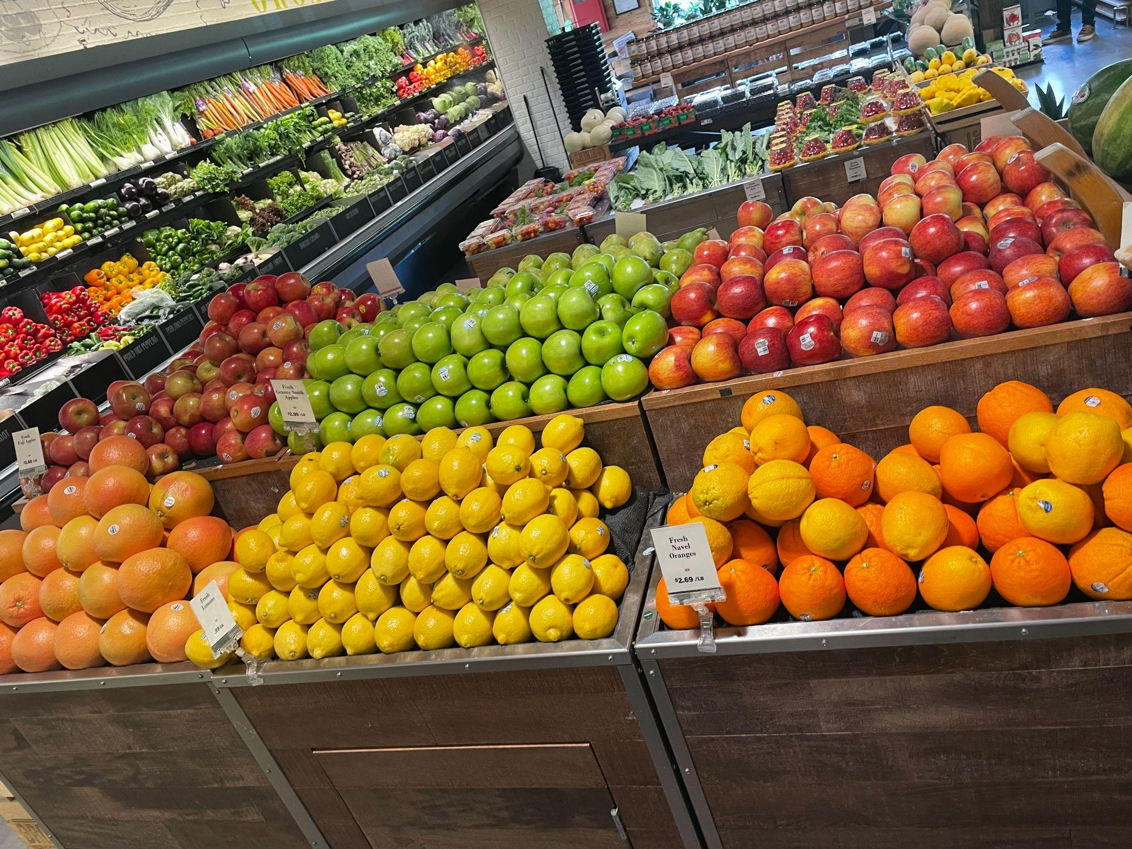
Look at all this fruit at Brother’s Market!
What can we count in this photo?
What can we estimate?
1.NBT.A1

Slide 6
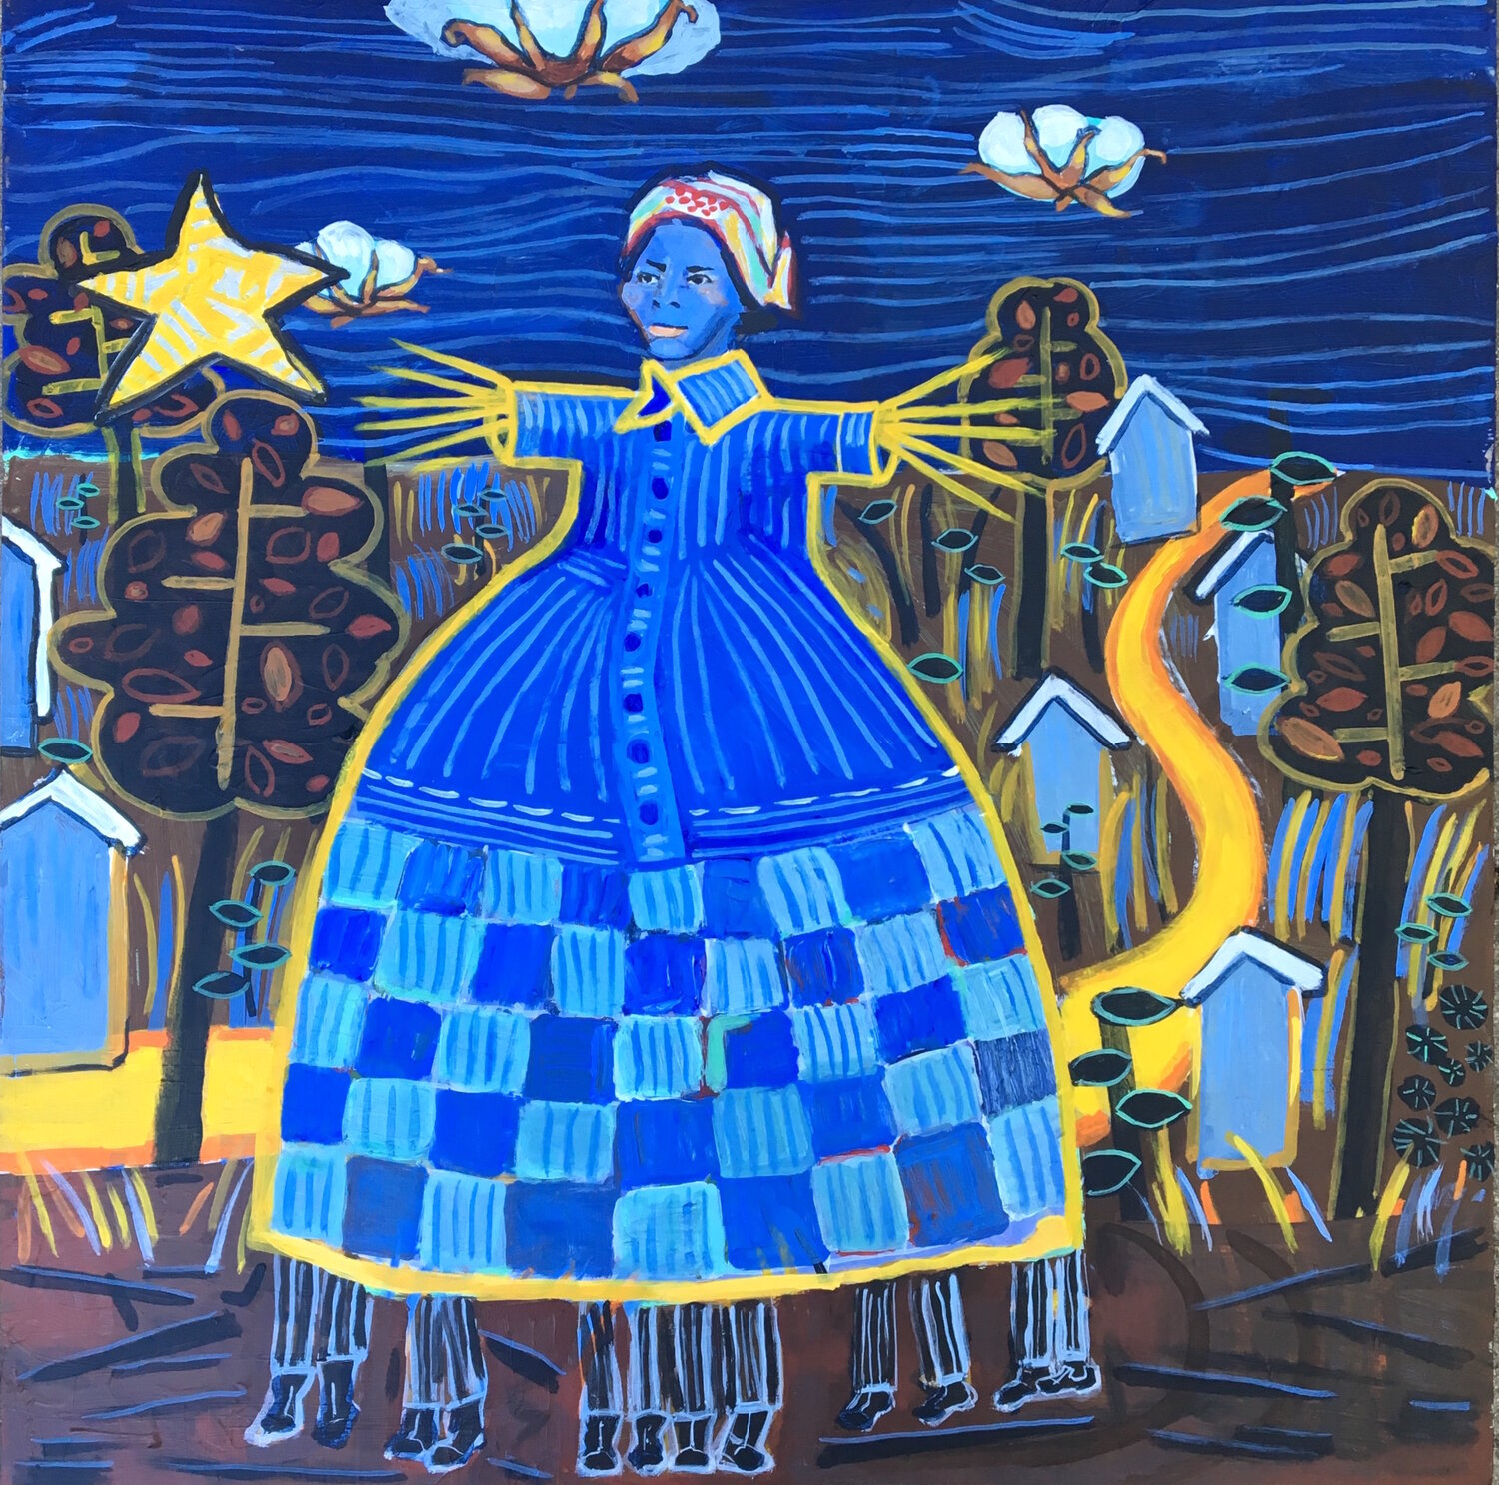
Celebrate Harriet Tubman Day!
What different shapes can we find in this painting by Anne Skok?
Sketch one of the shapes.
Now sketch a shape that is DIFFERENT than your shape in 2 ways!
1.G.A2
Notes:
Week of March 10, 2025
Harriet Tubman Day

Slide 7



What is the same?
What is different?
1.NBT.B2

Slide 8
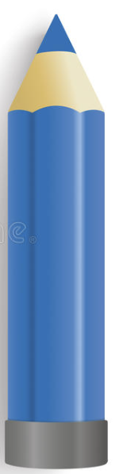
Celebrate National Pencil Day!
How can we compare these pencils?
1.MD.A1

Slide 9
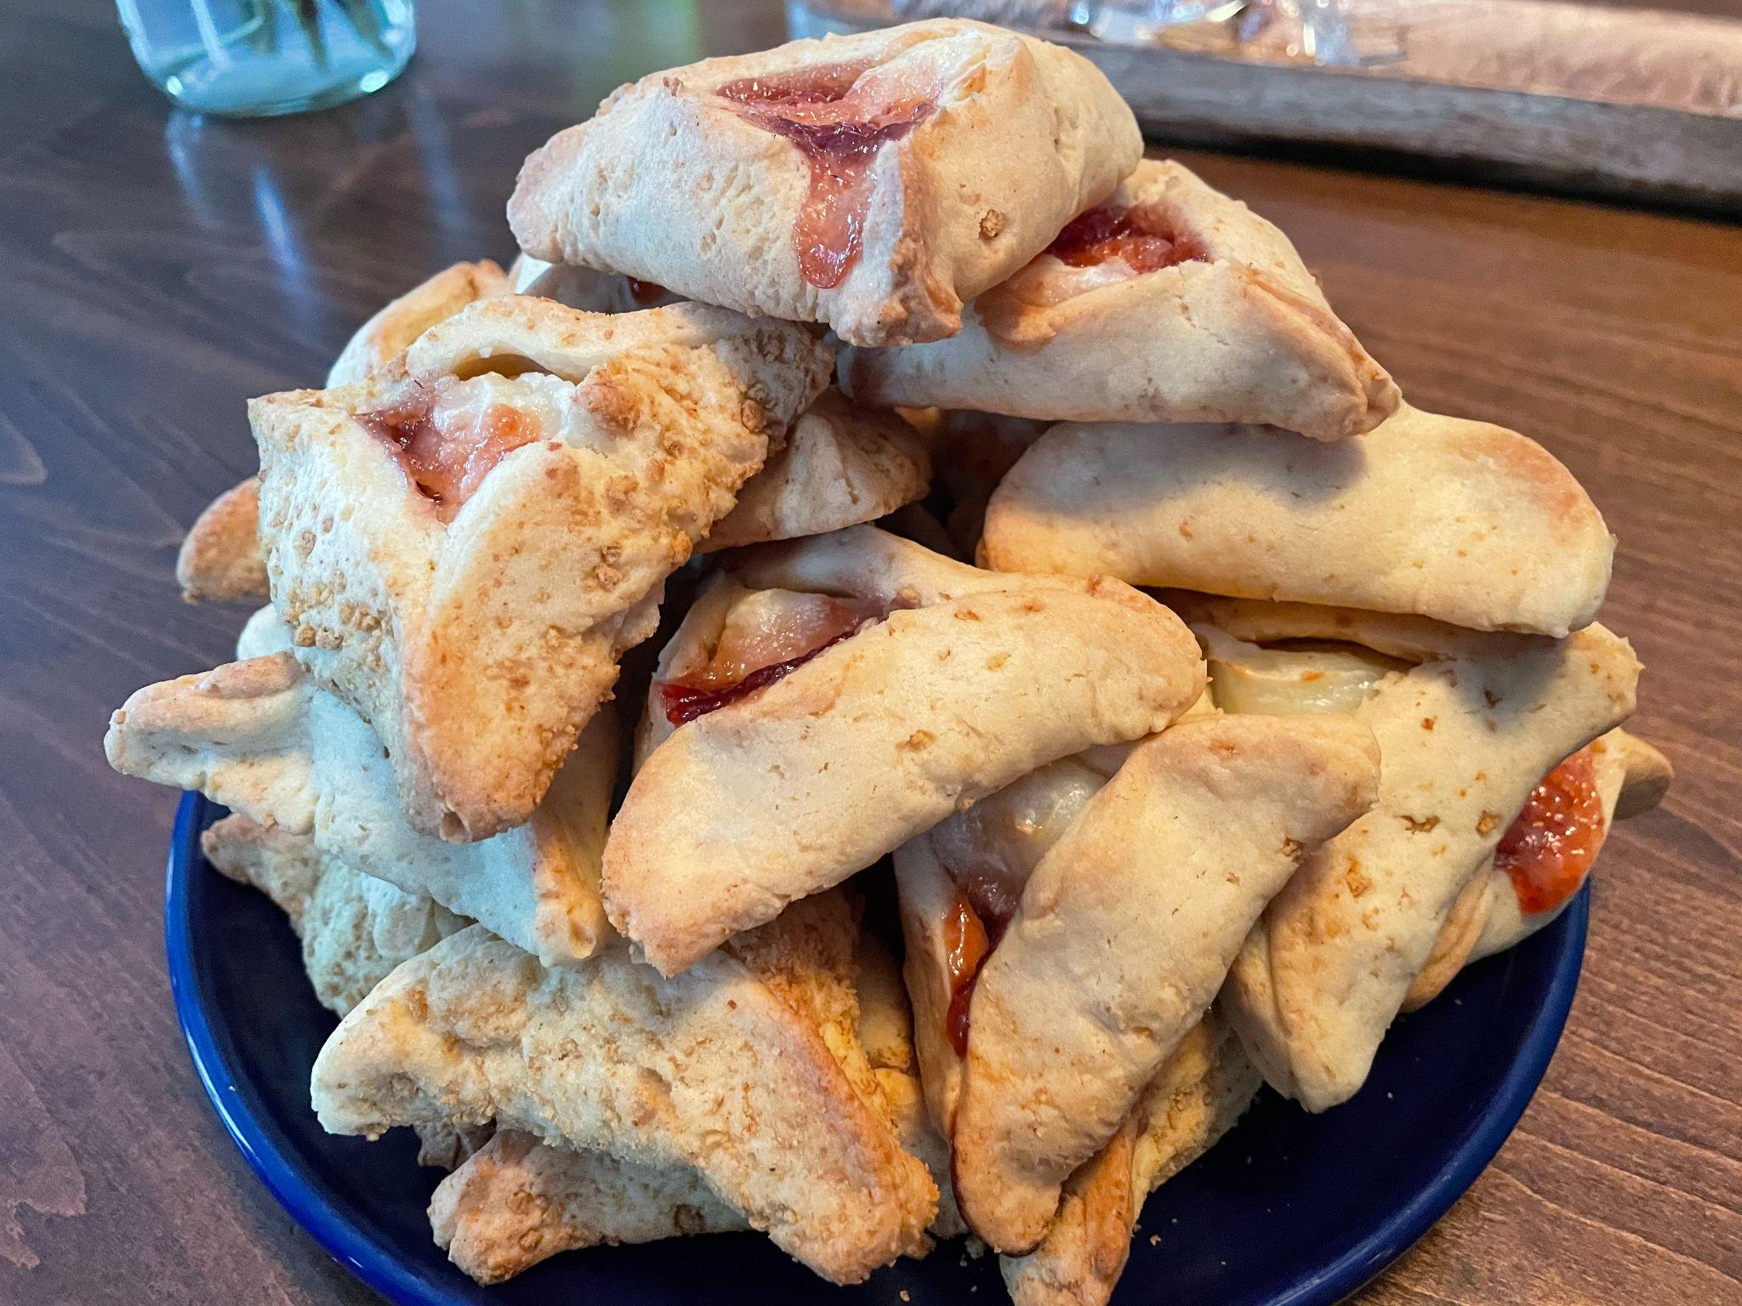
Happy Purim!
How many hamantaschen are here?
What is a good estimate?
Do we think there are more than 20 or less than 20?
1.OA.C5

Slide 10
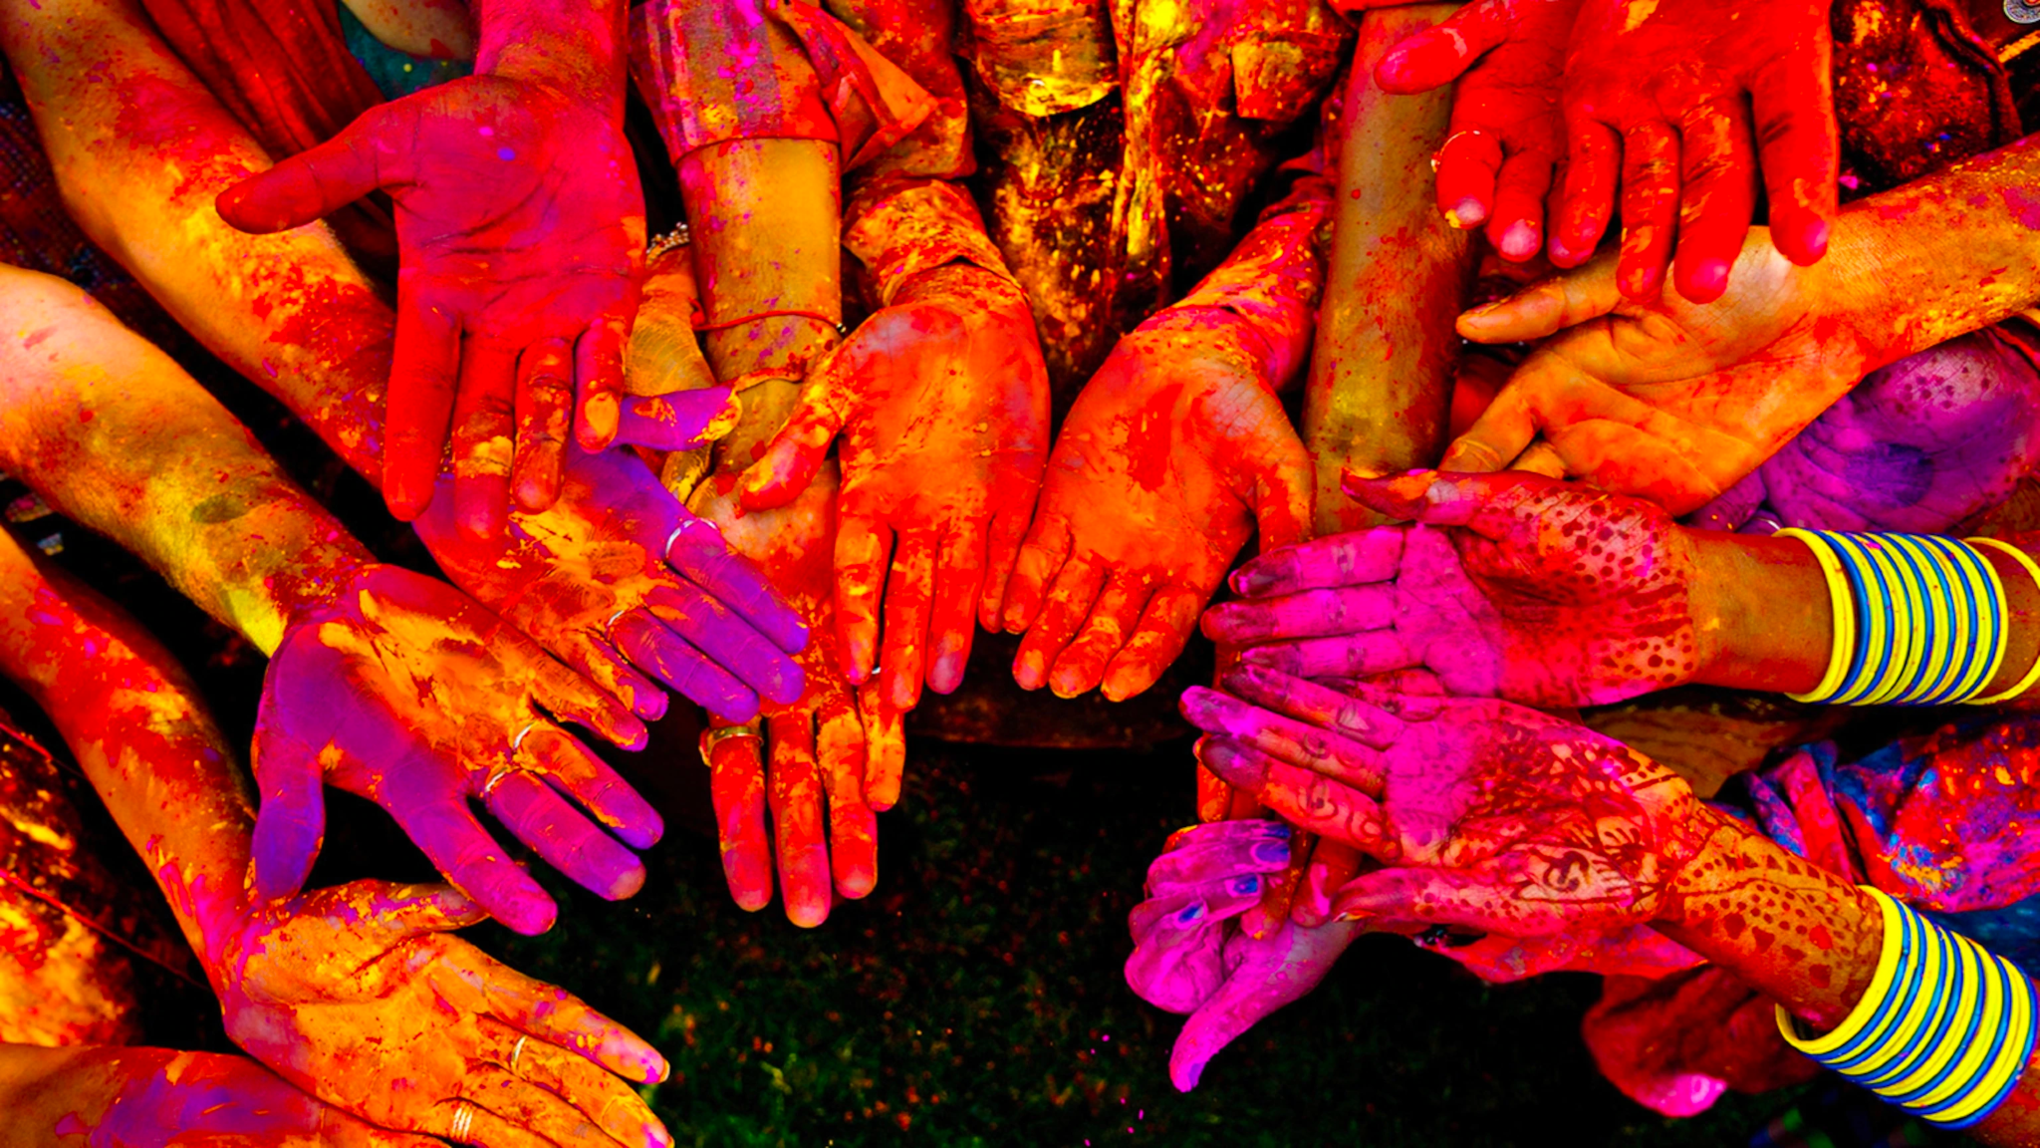
Happy Holi!
How many hands are here?
How many fingers?
1.NBT.A1

Slide 11
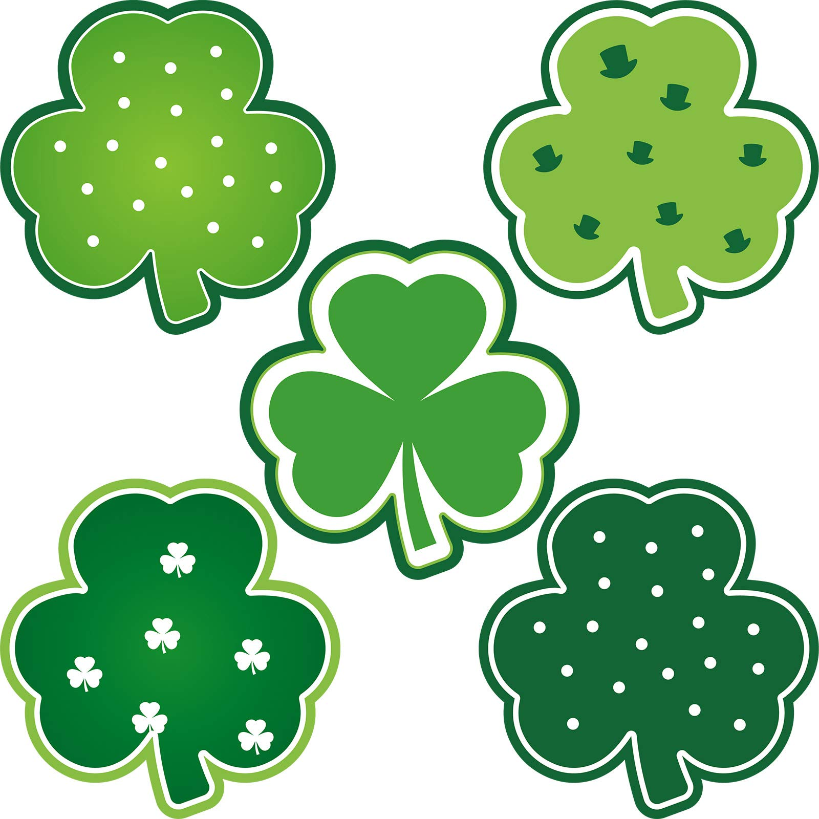
What is the same?
What is different?
Which ones go together?
1.SMP.3
Notes:
Week of March 17, 2025

Slide 12

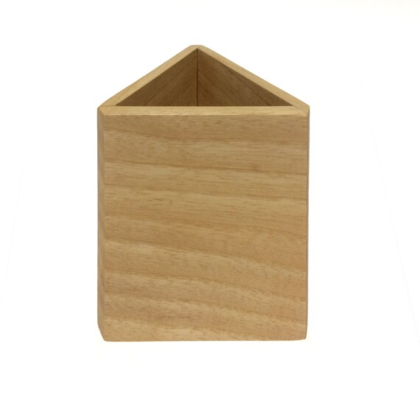
What is the same?
What is different?
1.G.A2

Slide 13
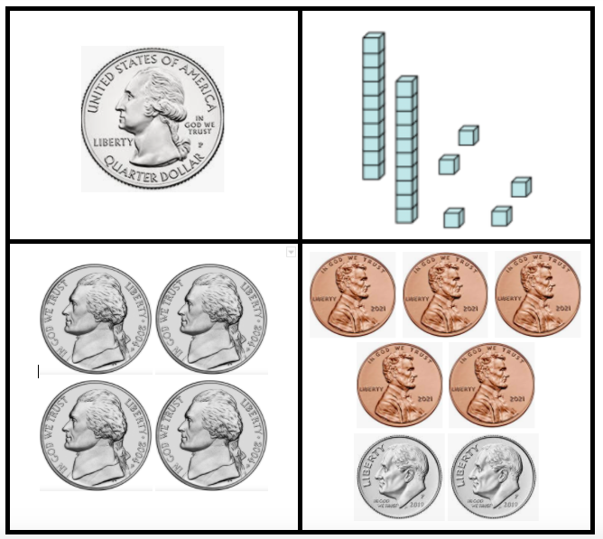
Which ones go together?
1.MD.D5

Slide 14
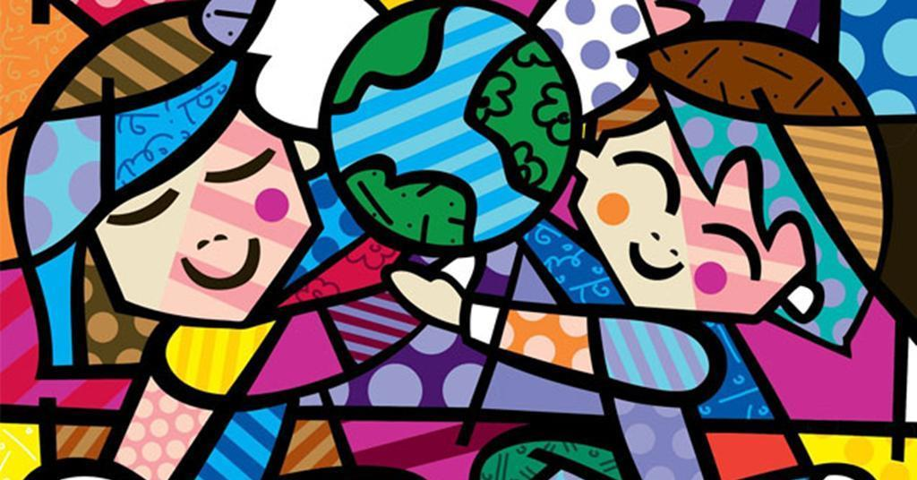
1.G.A1
It’s INTERNATIONAL HAPPINESS DAY! Let’s find some interesting shapes in this happy painting by Romero Britto.

Slide 15
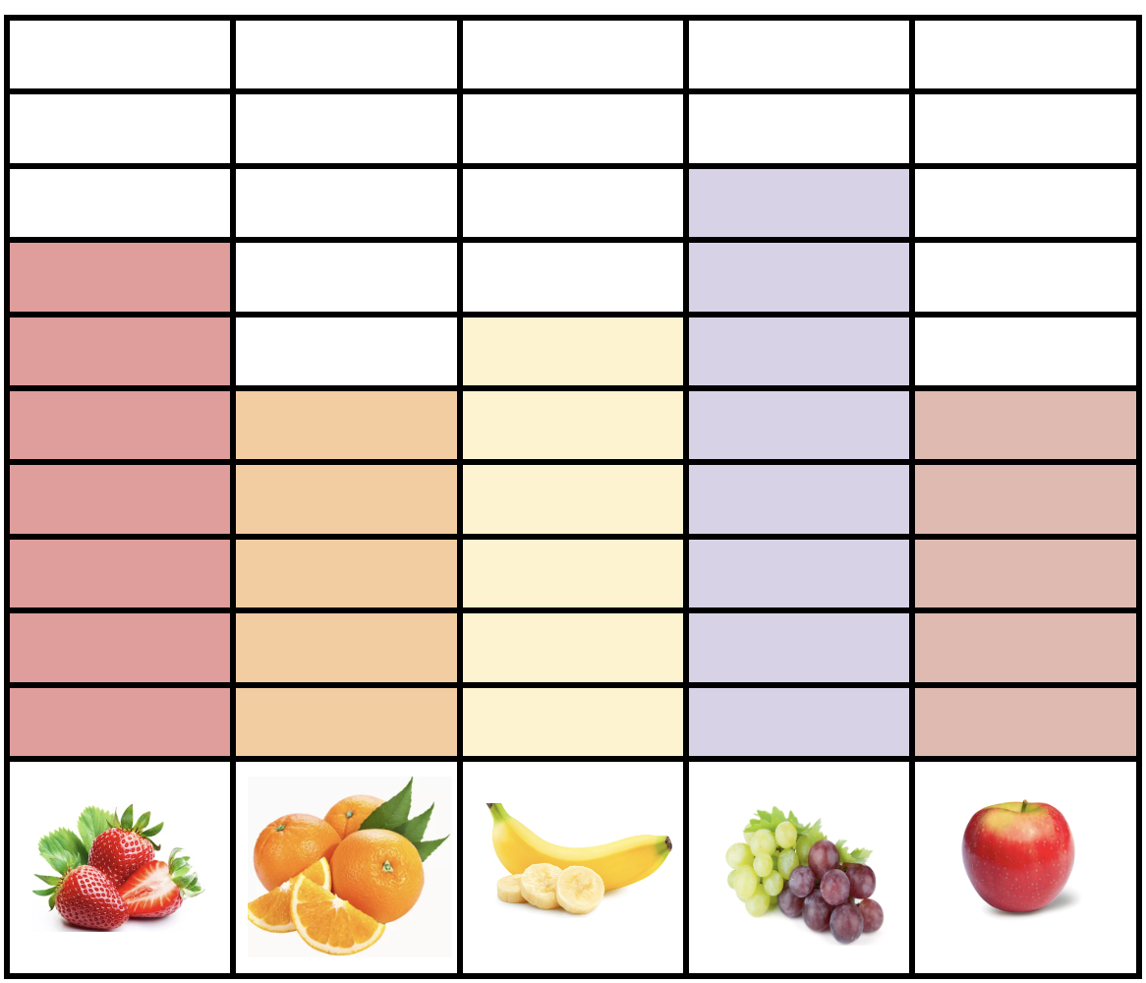
If this graph could talk what would it say?
Let’s create some equations to match this graph!
1.MD.C4

Slide 16
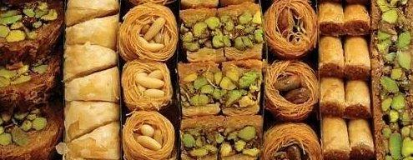
Happy Greek Independence Day!
What do we notice? What do we wonder?
Let’s create equations to match our math thinking!
1.NBT.B1
Notes:
Week of March 24, 2025

Slide 17

34 + 50 = 30 + 54
70 + 9 = 19 + 50
13 + 30 = 20 + 23
1.NBT.B3

Slide 18
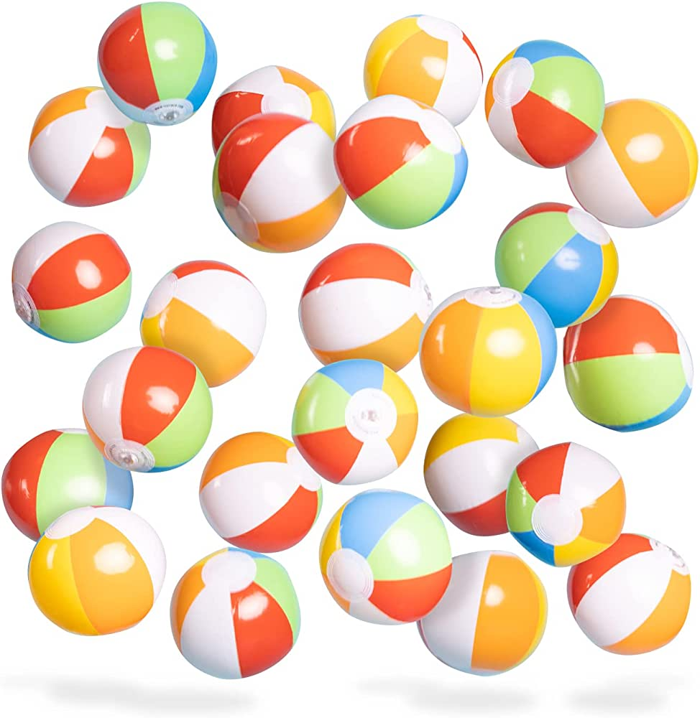
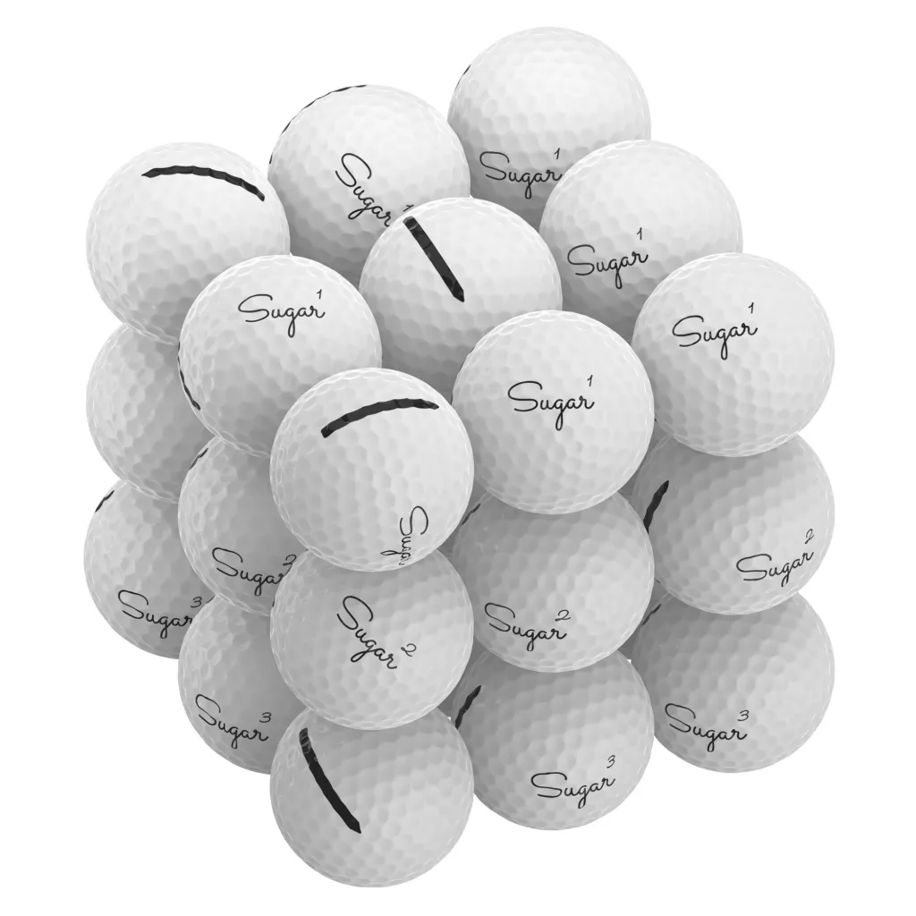
Would you rather ….
100 beach balls or
100 golf balls
Oh, and you have to carry them across the field.
1.MD.A1

Slide 19
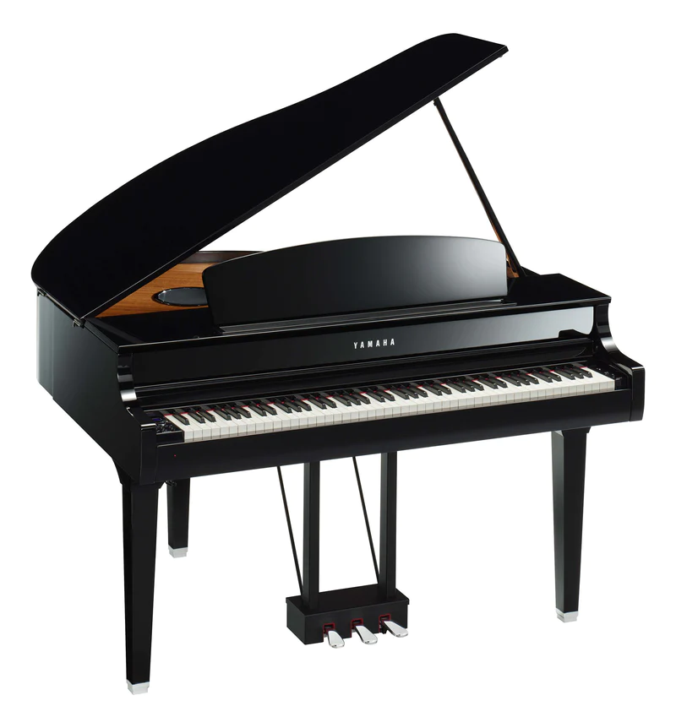
Celebrate World
Piano Day!
There are 88 keys on a piano.
52 of them are white.
How many are black?
How do you know?
1.NBT.C4

Slide 20
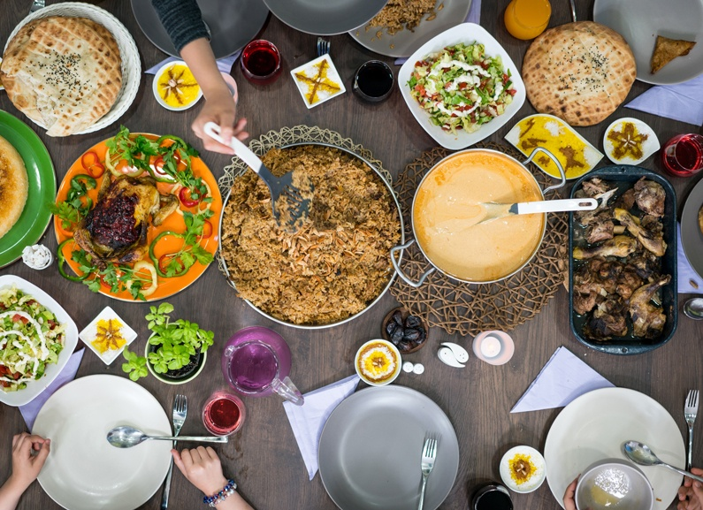
This weekend is Eid al-Fitr
عيد مبارك
What fun shapes can we find hiding in these traditional dishes?
K.G.A2

