Slide 1
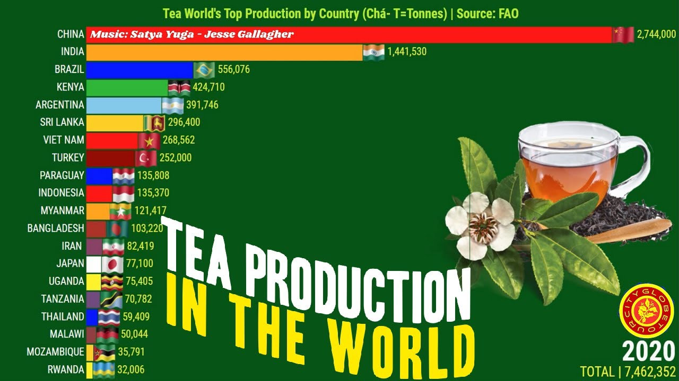
January is Hot Tea Month!
What is going on in this data visualization VIDEO?
Why does it matter?
5.MD.B
Notes:
Week of January 2, 2025
Check out the video!
https://www.youtube.com/watch?v=Mv4ufje2TSk

Slide 2
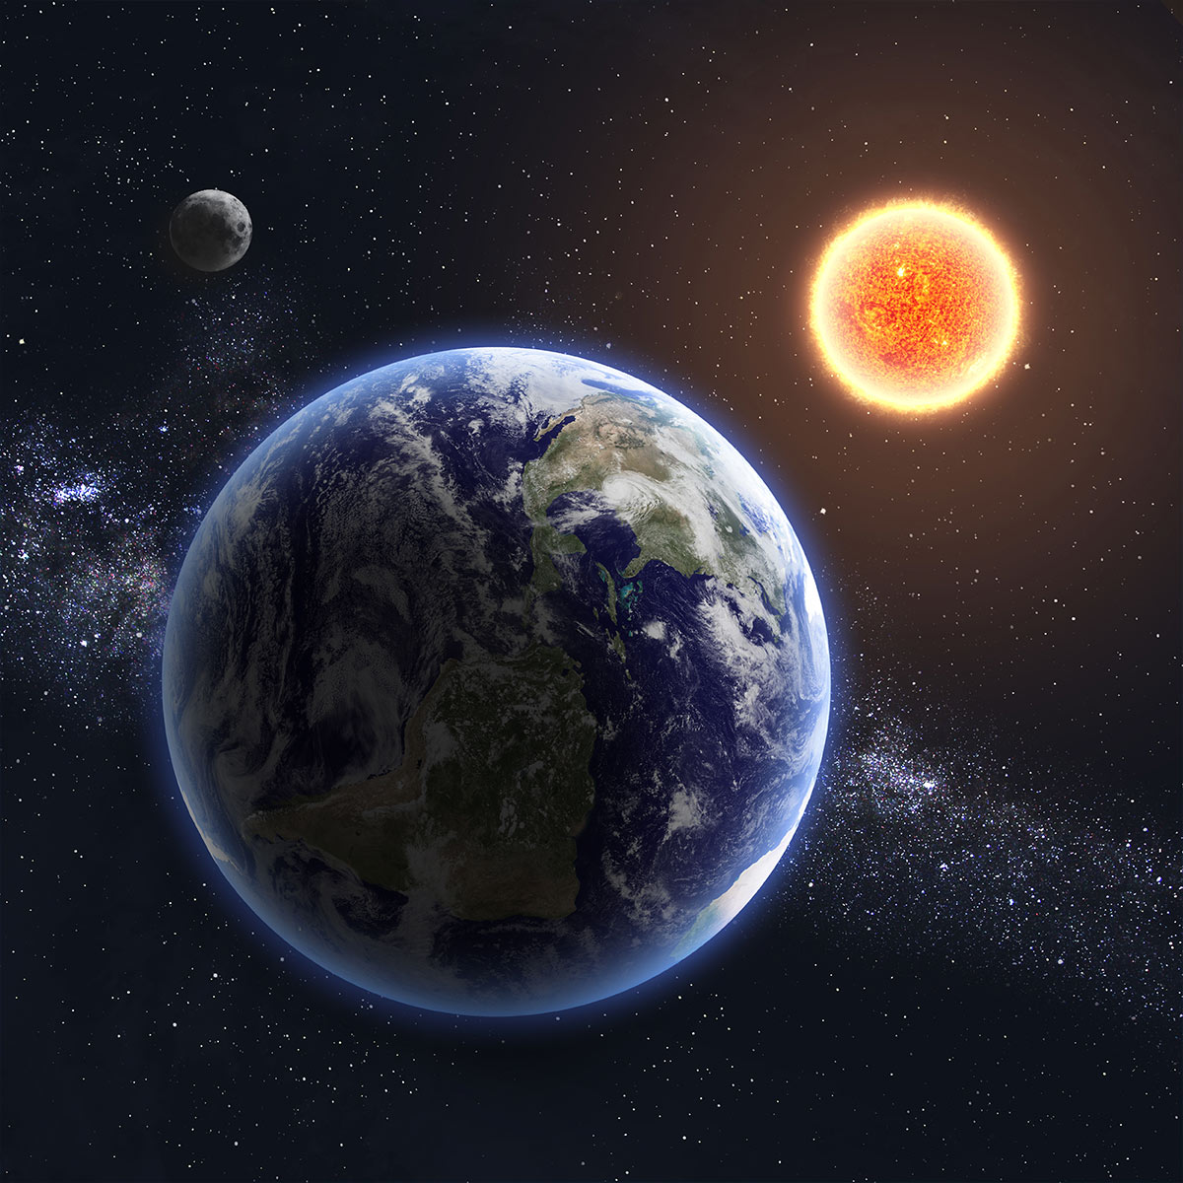
Earth at Perihelion
Tomorrow morning the Earth is at the point in its orbit where it is closest to the Sun.
While Earth at Perihelion is a natural occurrence that does not result in any evident changes in the Earth’s climate, it is a day to understand the planetary phenomenon and the importance of the Sun. The Sun is a yellow dwarf star that is at the center of our solar system. It has existed for more than 4.5 billion years and will continue to exist for about the same length of time. Light from the Sun radiates from its photosphere and reaches the Earth. This is what makes life on Earth possible.
What is 4.5 billion?
What are some factor pair of 4.5 billion?
5.NBT.A2

Slide 3
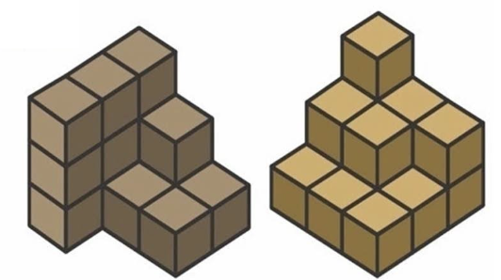
What is the same? What is different?
What can we say about the volume if each cube is 1.5cm³
5.MD.C4
Notes:
Week of January 6, 2025

Slide 4
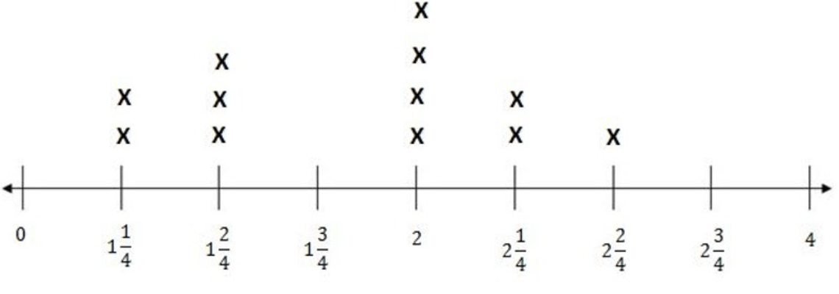
If this line plot could talk, what would it say?
Do you need more information?
Time (hours)
5.MD.B2

Slide 5
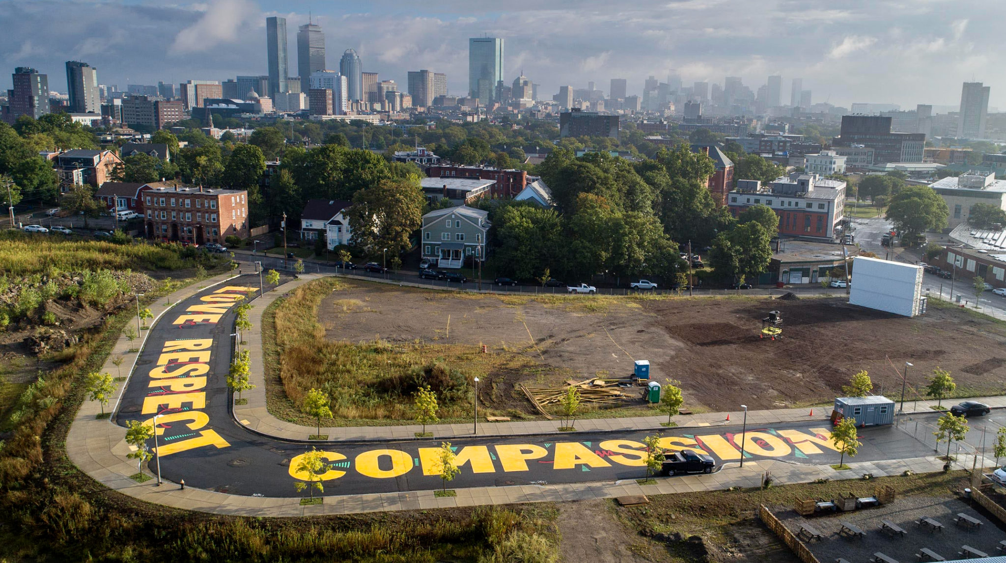
Artist Ricardo Gomez painted this mural on Bartlett Station Drive in Roxbury. Estimate the size of the letters in this mural. If each letter takes 1.5 gallons of paint, how much paint was used?
5.NF.B4

Slide 6
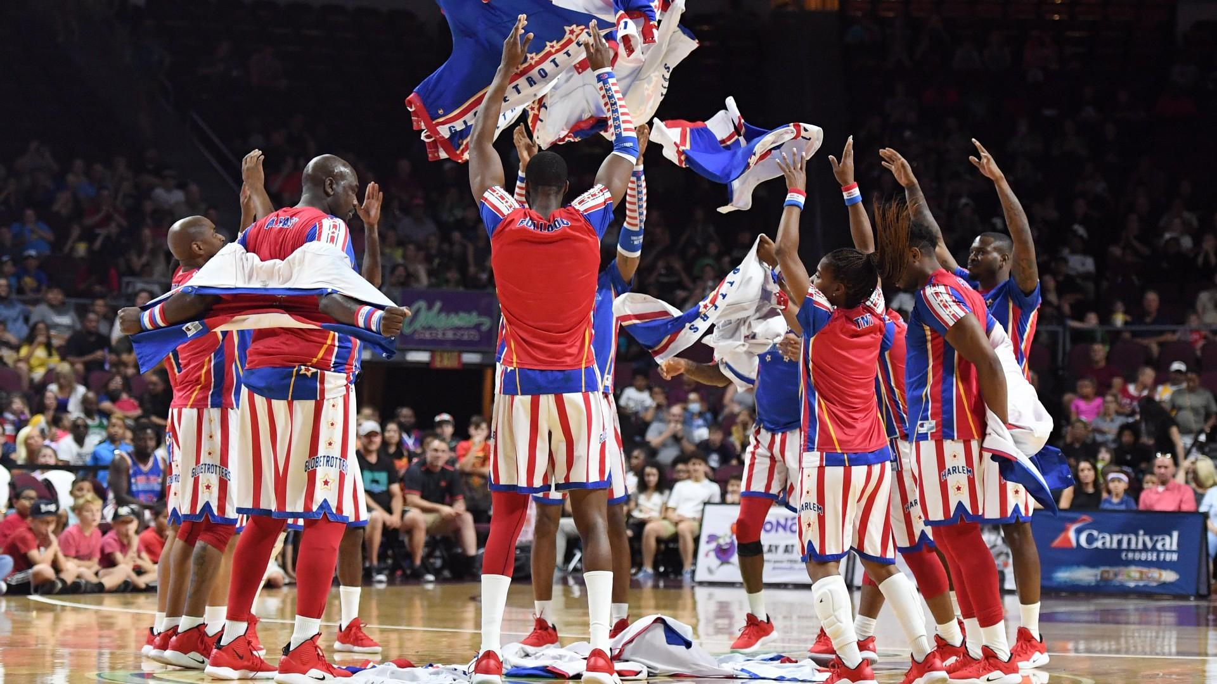
Happy Harlem Globetrotter’s Day!
The Harlem Globetrotters have been entertaining us for close to 100 years!
There have been 750 Harlem Globetrotters!
What are some factor pairs of 750?
How do we know we have them all?
5.NBT.B5

Slide 7
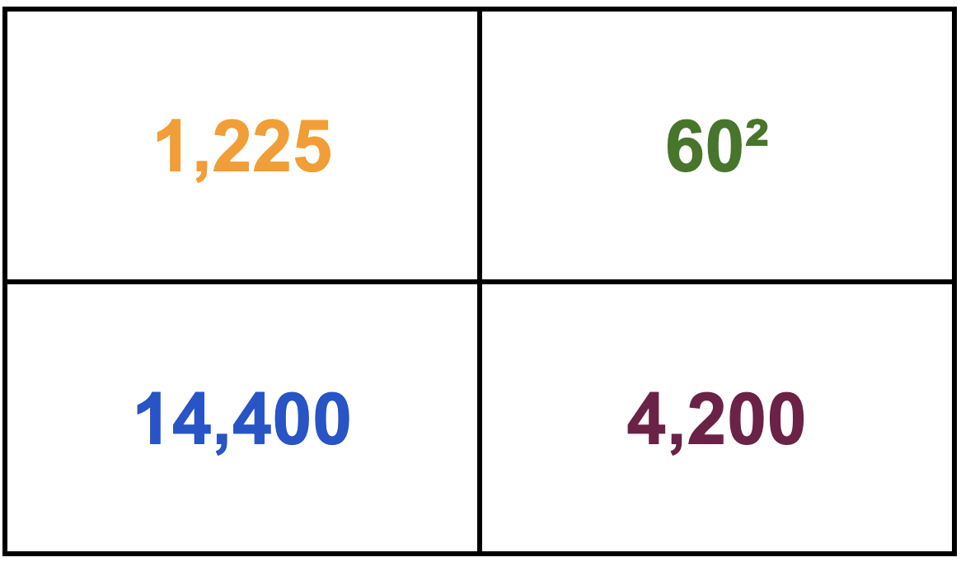
Which one does not belong?
5.NBT.A2
Notes:
Top left: not a square of a ten (35x35)
Top right: only exponent
Bottom left: only square of a 3-digit number (120x120)
Bottom right: not a square number

Slide 8
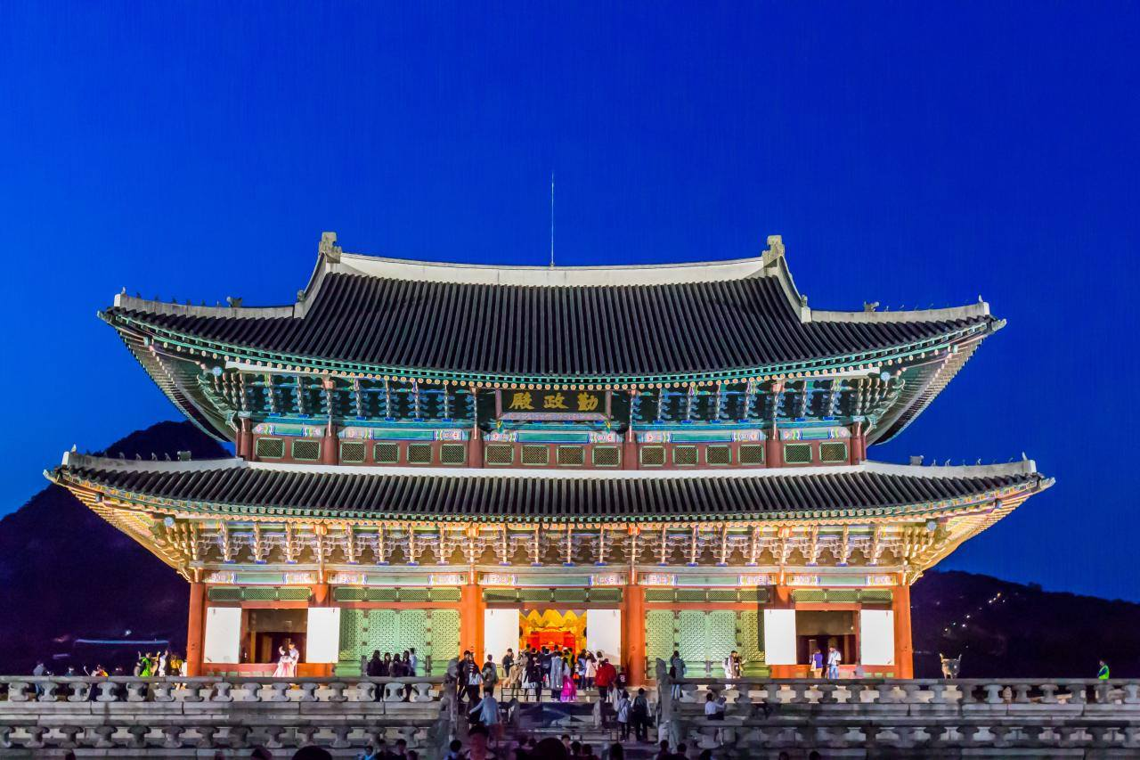
Happy Korean American Day!
Gyeongbokgung Palace was built in 1395, during the fourth year of King Taejo's reign.
How long ago was that?
What mental math strategies can we use to solve this?
5.NBT.B7
Notes:
Week of January 13, 2025

Slide 9
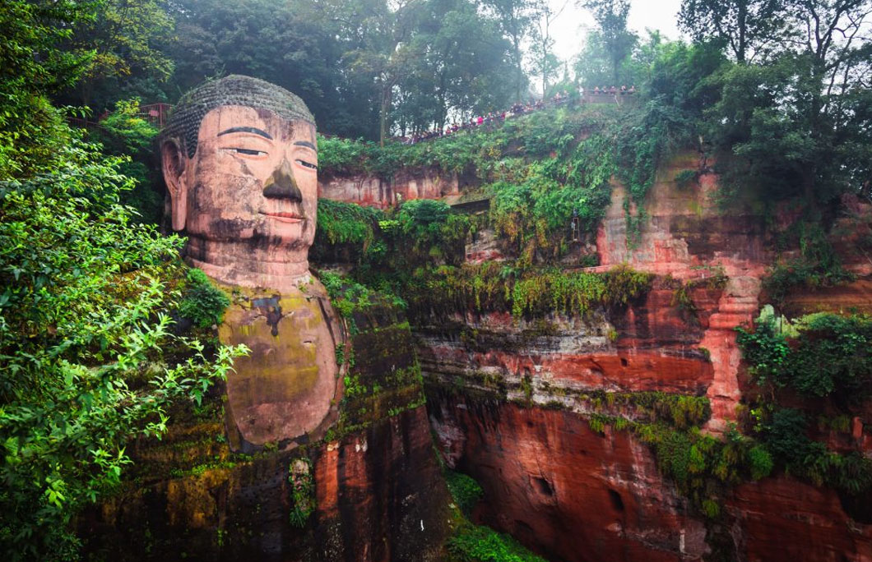

The Giant Buddha in Leshan, China
Towering at 71 metres and constructed 1300 years ago, the Leshan Giant Buddha is one of China’s most remarkable monuments. It’s carved from a copper-red coloured cliff that dominates the confluence of the Min and Dadu rivers in Sichuan.
Write an expression that equals 1300 using an exponent!
Let’s see how many different expressions we can create!
5.NBT.A2

Slide 10
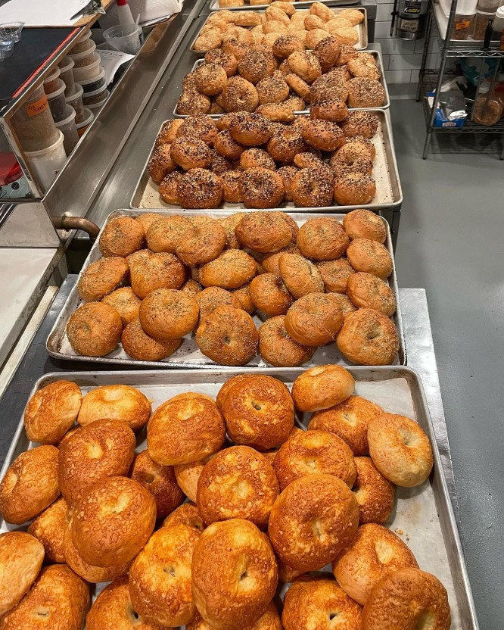
Happy National
Bagel Day!
Brick Street Bagels, a Boston Pop-up, bakes about 975 bagels each weekend.
About how many bagels is that each month?
Estimate, then solve!
Share your strategies!
5.NBT.B7

Slide 11
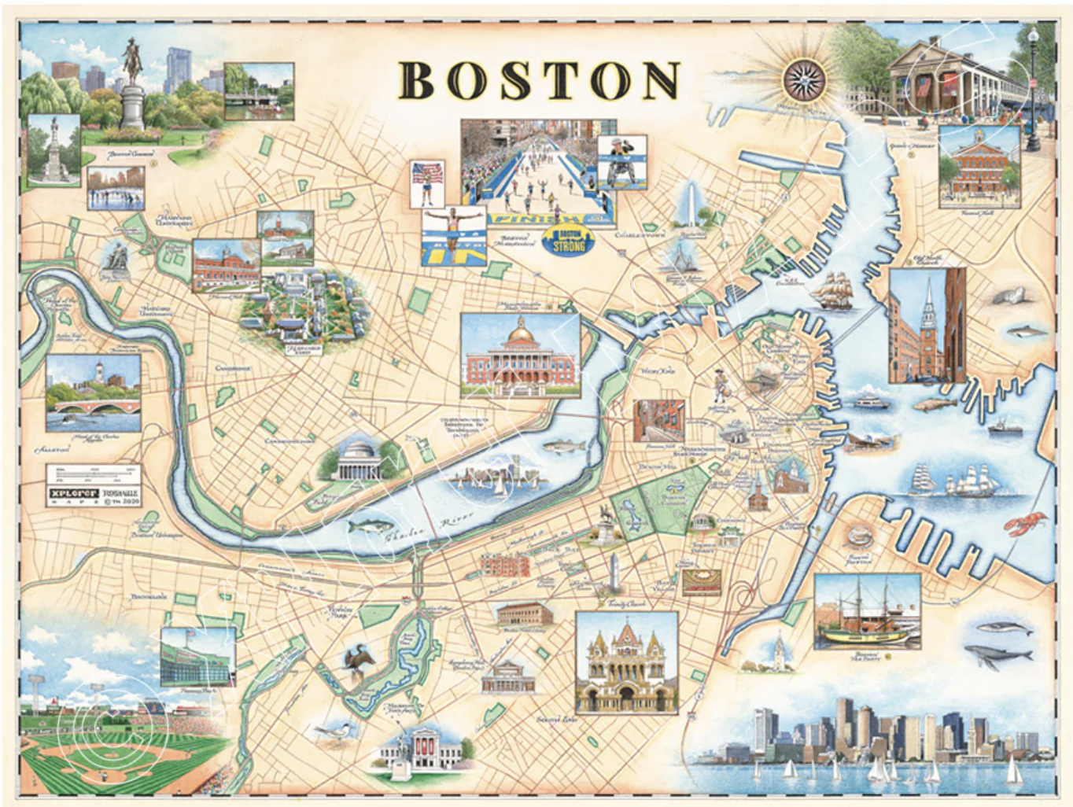
Happy National Boston Day!
Can you find Fenway Park on this map?
It would take 1 hour and 27 minutes to bike from here to Fenway Park!
How many minutes is that? How many seconds?
How long would it take to ride there and back?
5.MD.A1

Slide 12
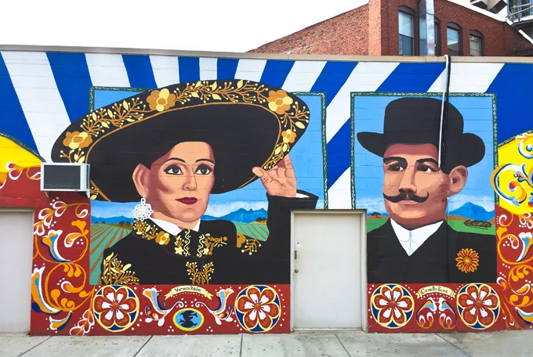
We are all Immigrants!
How can we tell how tall this Boston mural is?
It is 14 feet tall by 19 feet 8 inches wide.
What is the area of this mural?
5.NF.B6

Slide 13
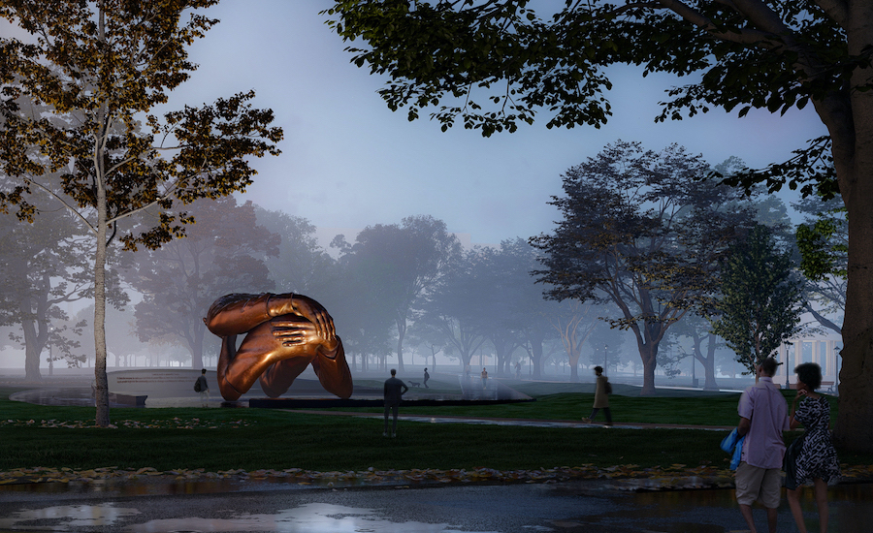
“Embrace” is the new monument in the Boston Common, a tribute to Dr. Martin Luther King and Coretta Scott King.
Embrace stands 20 feet tall and 40 feet wide.
How many times taller is it than you?
What FRACTION are YOU of this monument?
5.NF.B6
Notes:
Week of January 21, 2025

Slide 14
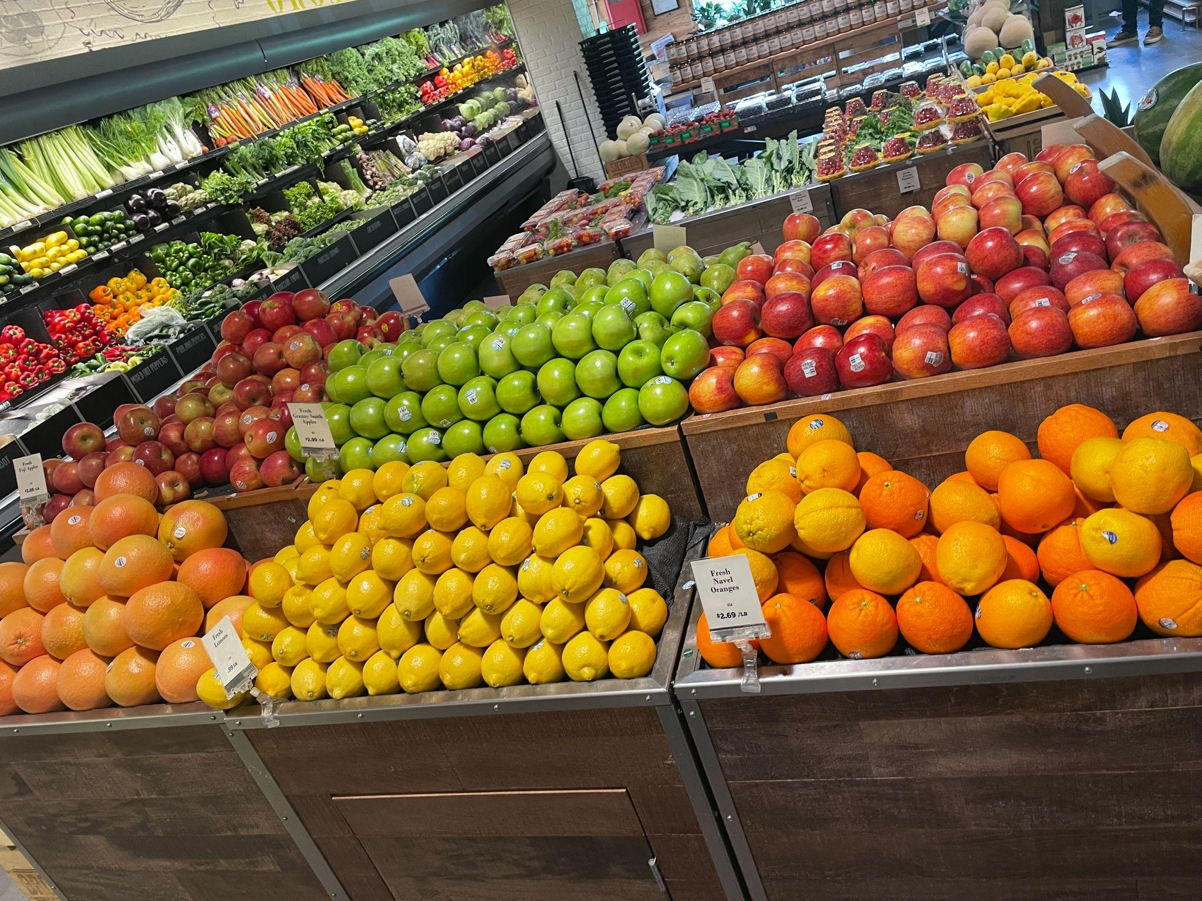
Fresh fruit at Brother’s Market!
Estimate how many lemons are here?
Oranges? Apples?
How can we use MATH to make an estimate?
5.NBT.B5

Slide 15
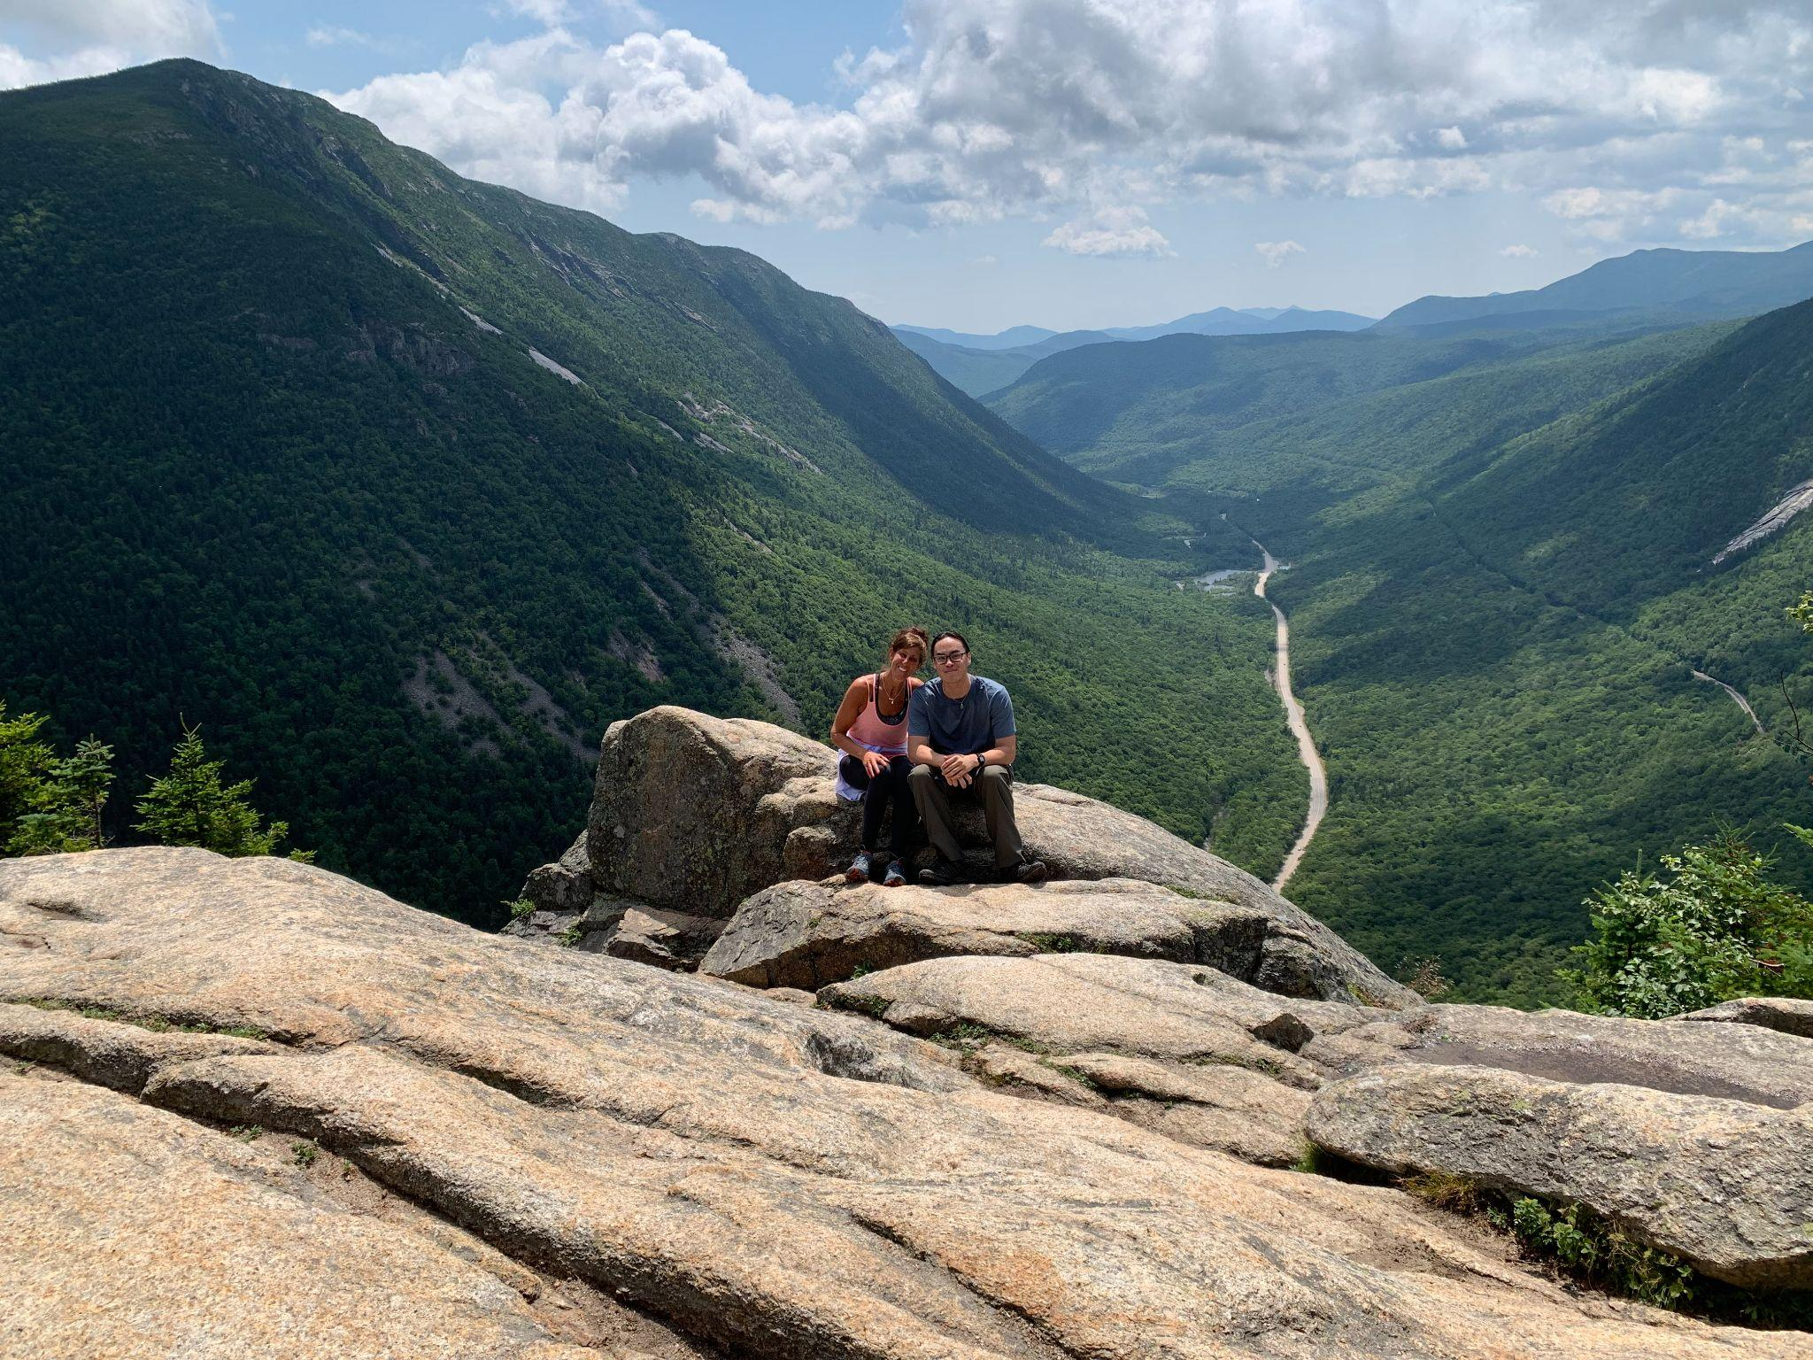
The Summit of Mt. Willard
The summit of Mt. Willard in NH is 2,865 feet!
What are some factors of 2,865?
What if we used fractions?
5.NBT.B6

Slide 16

554 > 0.9 x 554
775 x 0.5 < 75 x 5
300 ÷ 0.6 > 30 ÷ 0.06
5.NBT.A1

Slide 17
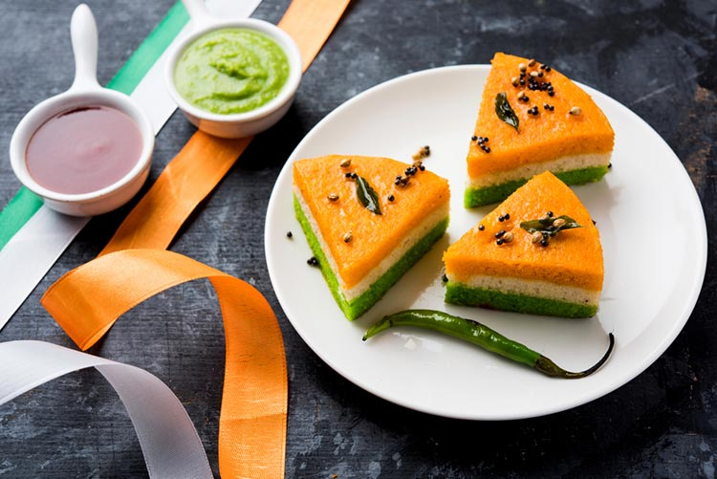
Today is India Republic Day!
What fraction of the whole are these slices of dhokla?
What are they together?
How much dhokla is left?
5.NF.A2
Notes:
Week of January 27, 2025

Slide 18
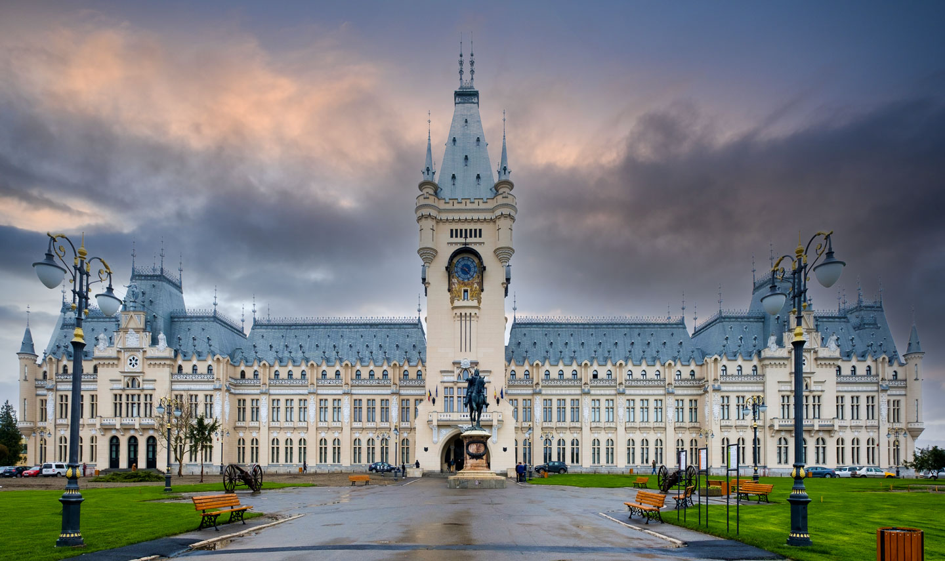
Today is Unification Day in Romania
The Palace of Culture in Iasi was built in 1906-1925.
Sketch one of the shapes you see here.
Change ONE attribute of the shape, what do you have now?
Change ONE attribute again. What shape do you have?
Where do you see symmetry?
5.G.B3

Slide 19
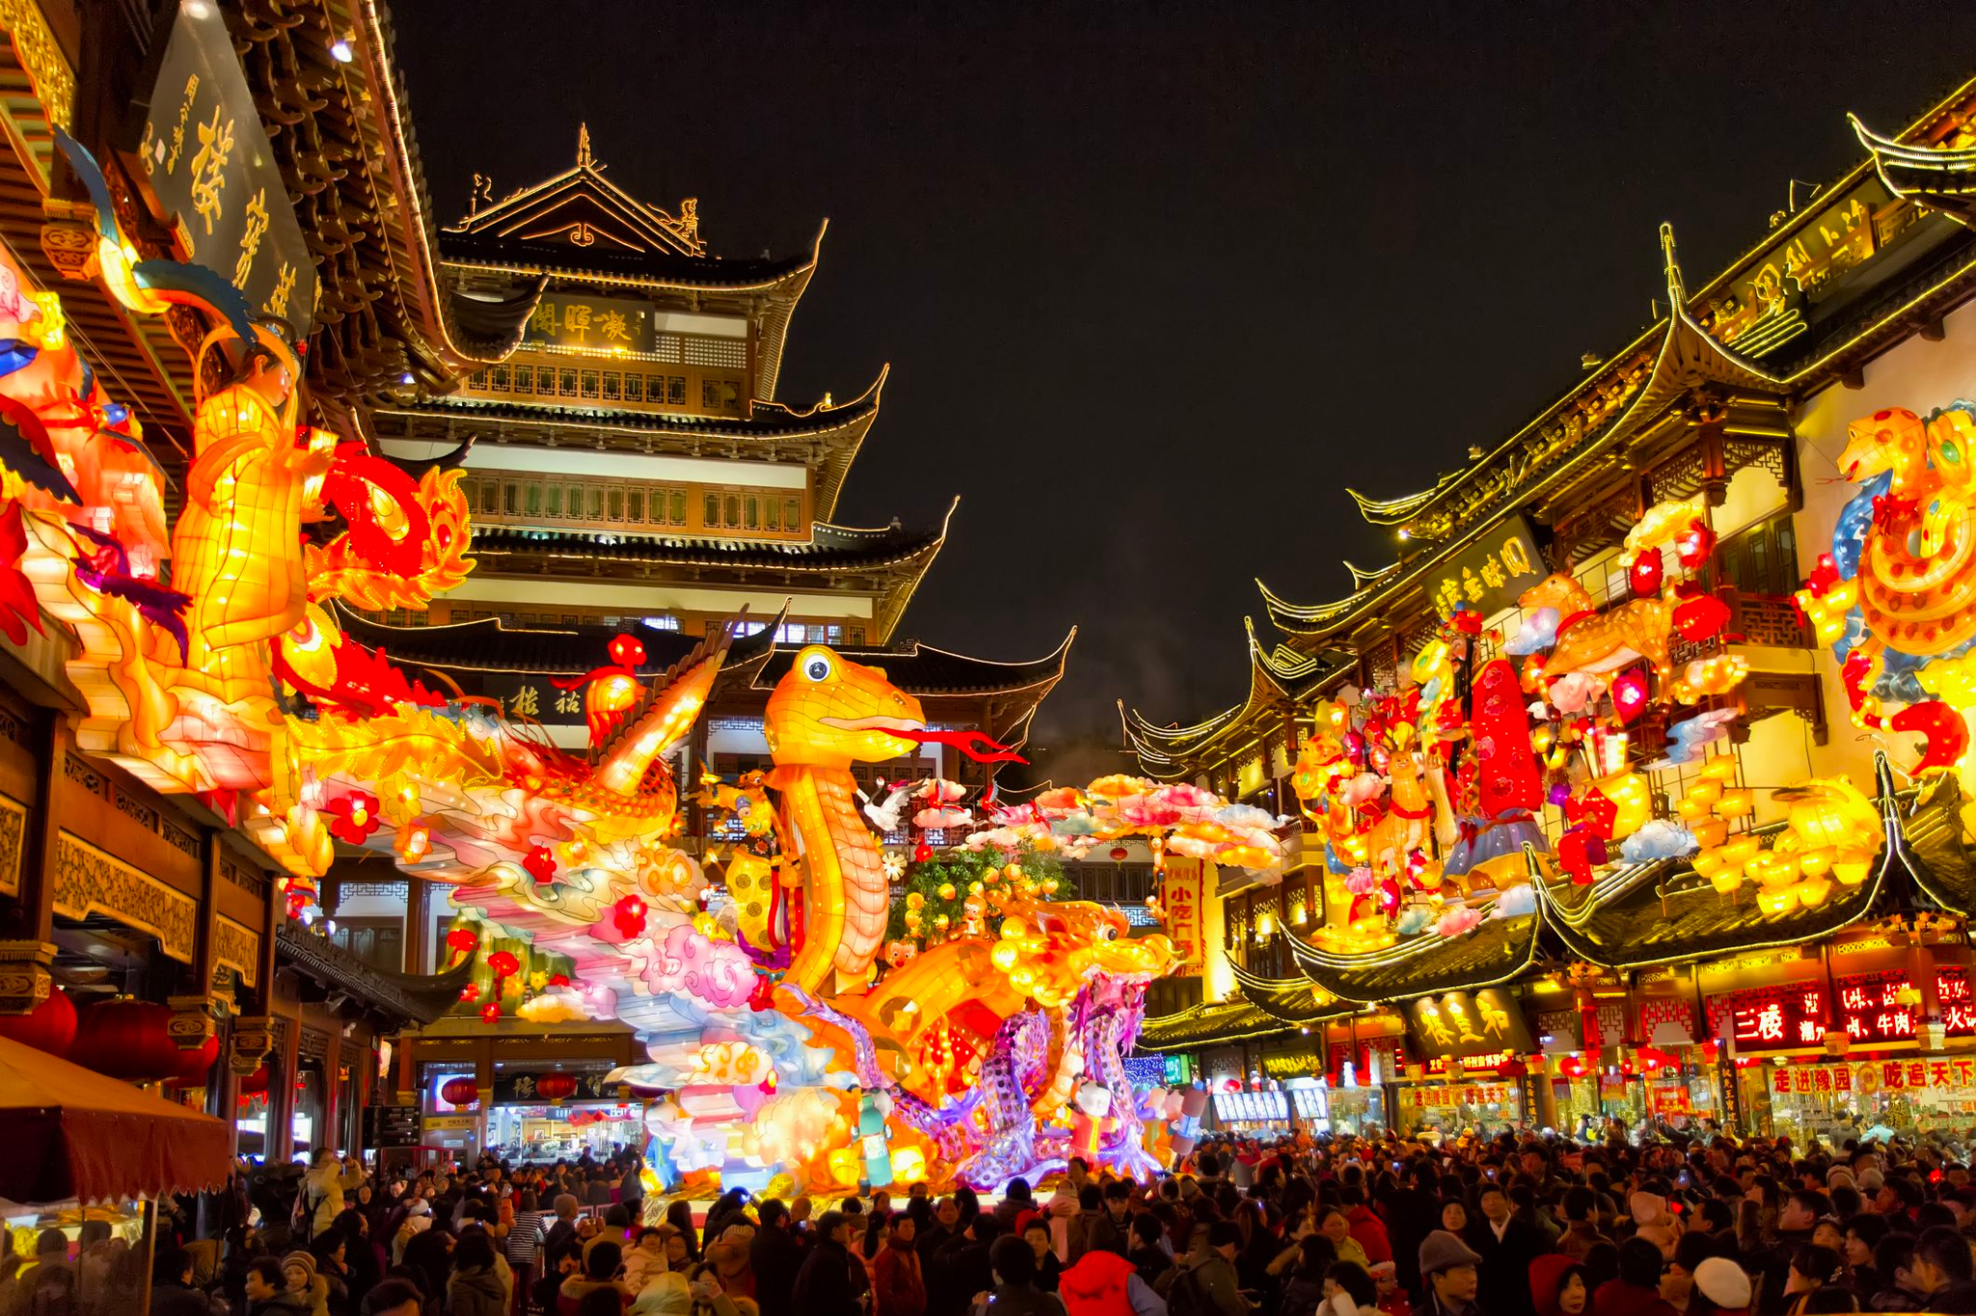
Happy Lunar New Year!
恭喜发财
This is the year of the snake!
Chinese New Year became a BIG celebration in the Jin Dynasty, in the years 266-420.
How long ago was that?
5.NBT.B

Slide 20
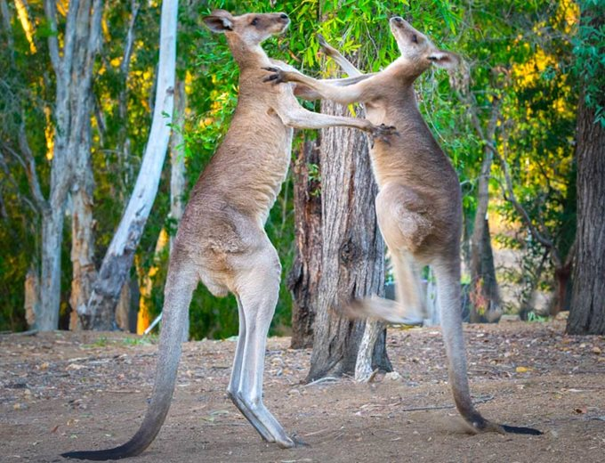
Happy Australia Day!
Did you know that an average adult kangaroo weighs between 35 - 90 kg?
Males can weigh up to twice as much as females!
If these female kangaroos weigh between 35 and 50 kg, how much might the males weigh?
5.NBT.B5

