Slide 1
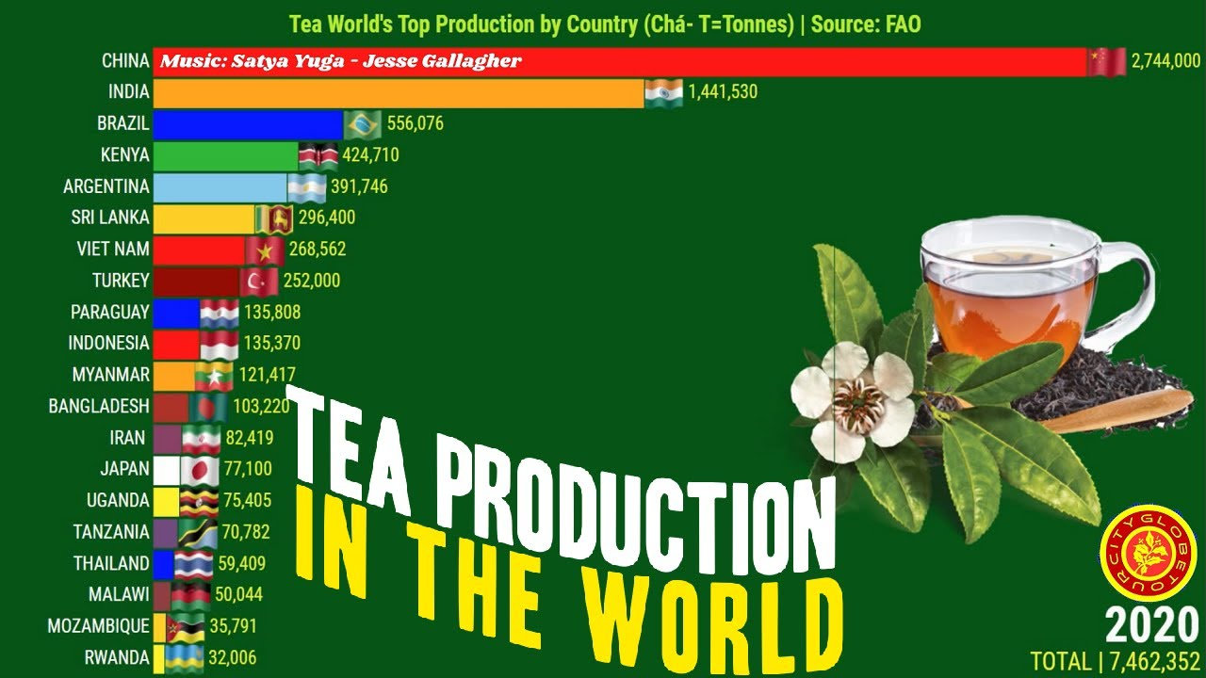
January is Hot Tea Month!
What is going on in this data visualization VIDEO?
Why does it matter?
4.MD.B
Notes:
Week of January 2, 2025
Check out the video!
https://www.youtube.com/watch?v=Mv4ufje2TSk

Slide 2
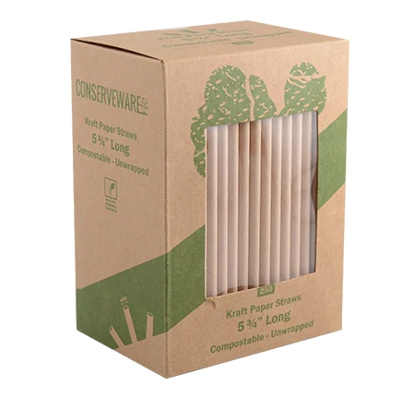
Happy National Drinking Straw Day!
These straws come in packs of 250.
3 packs?
5 packs?
7 packs?
9 packs?
Do we see a pattern?
How many straws in 2 packs?
4 packs?
6 packs?
8 packs?
4.NBT.B5

Slide 3
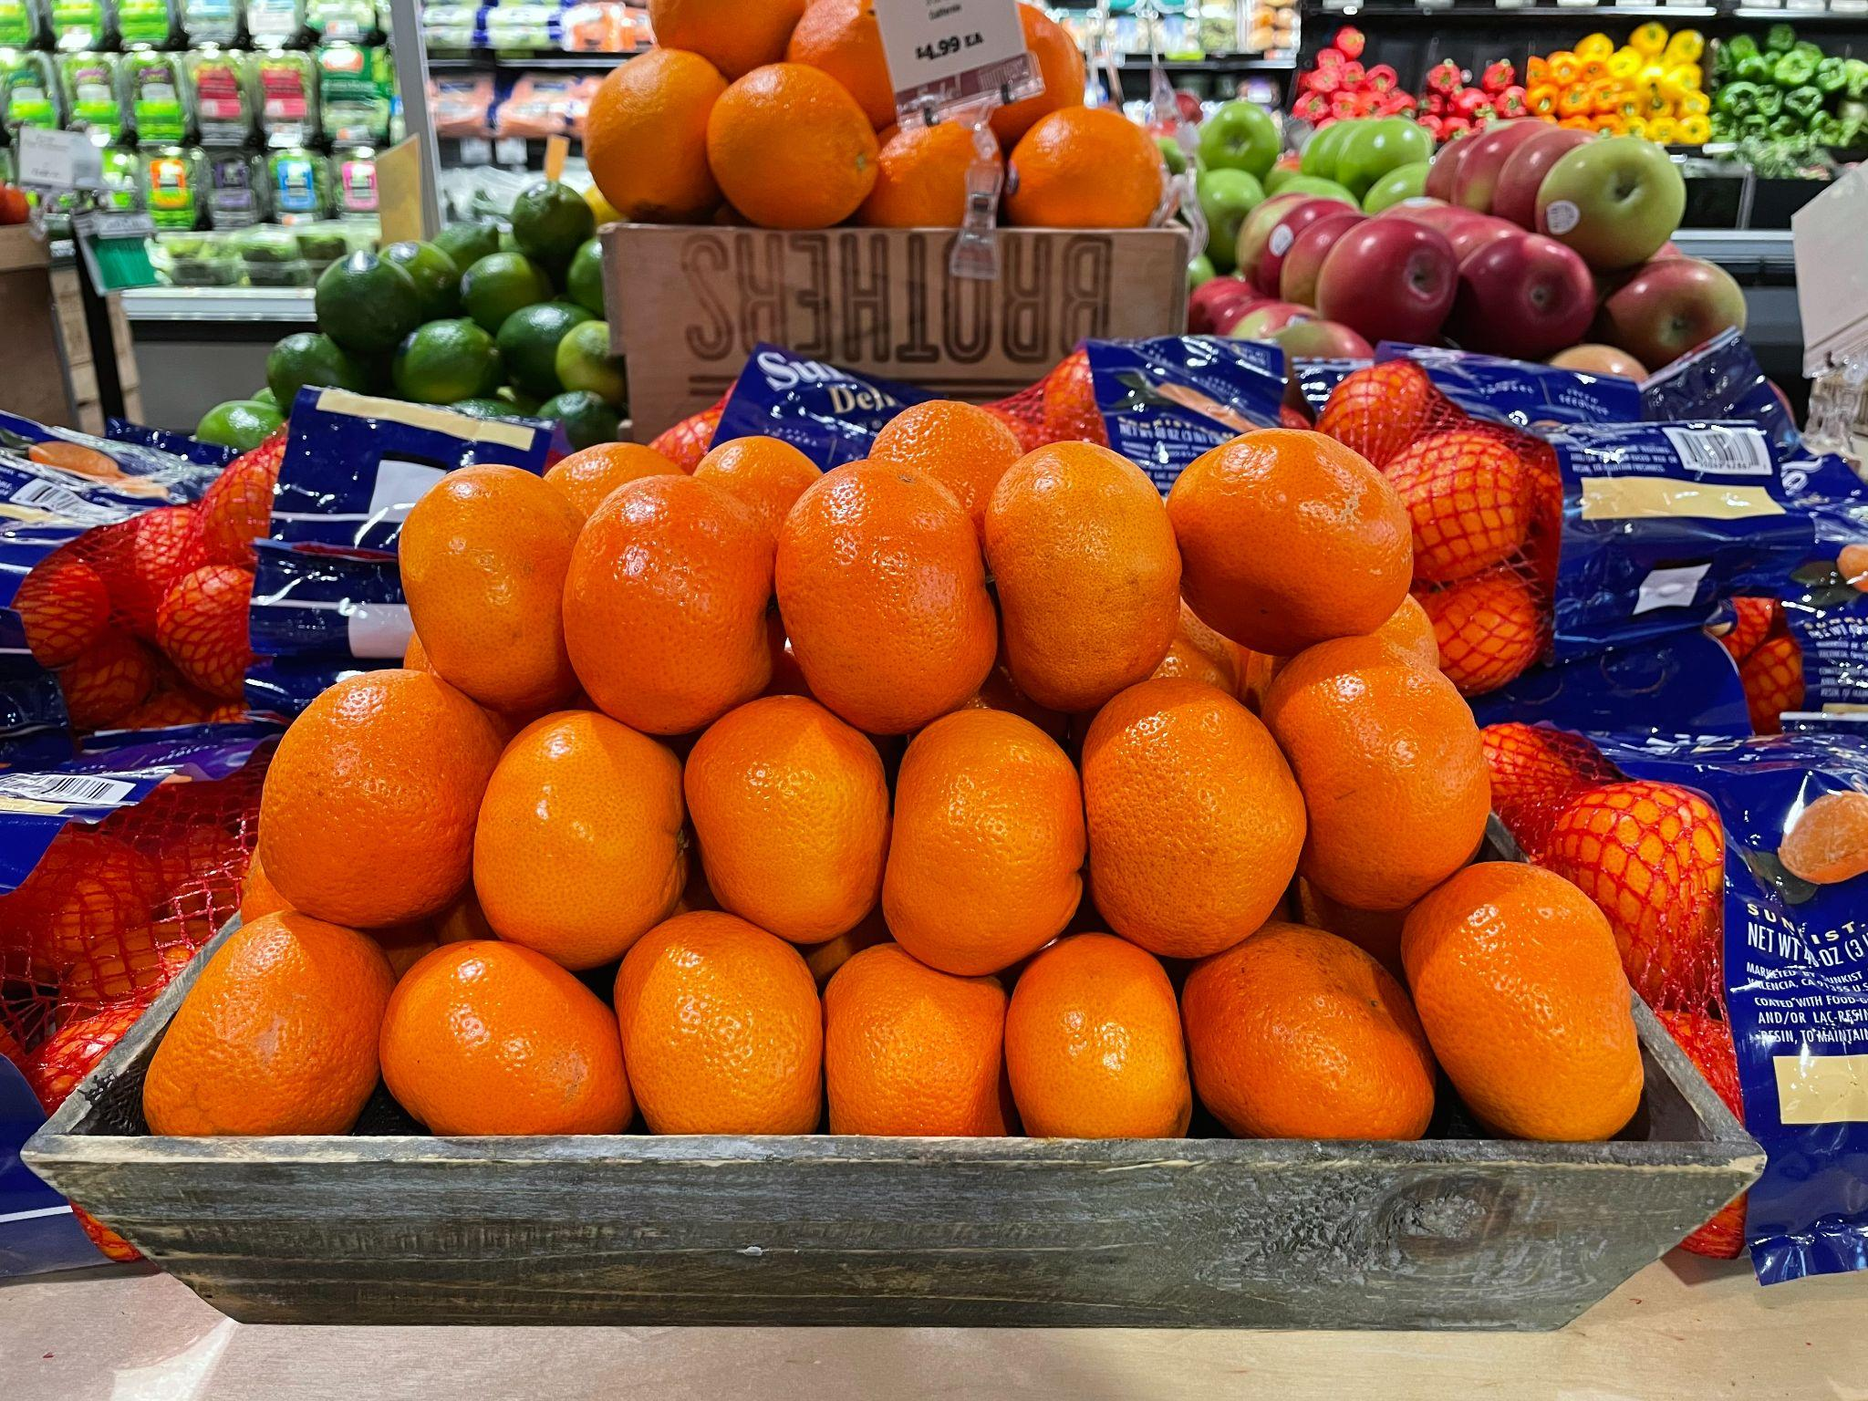
What do you notice?
What do you wonder?
How many oranges might be in this crate?
How can we use math to figure it out?
4.OA.C
Notes:
Week of January 6, 2025

Slide 4
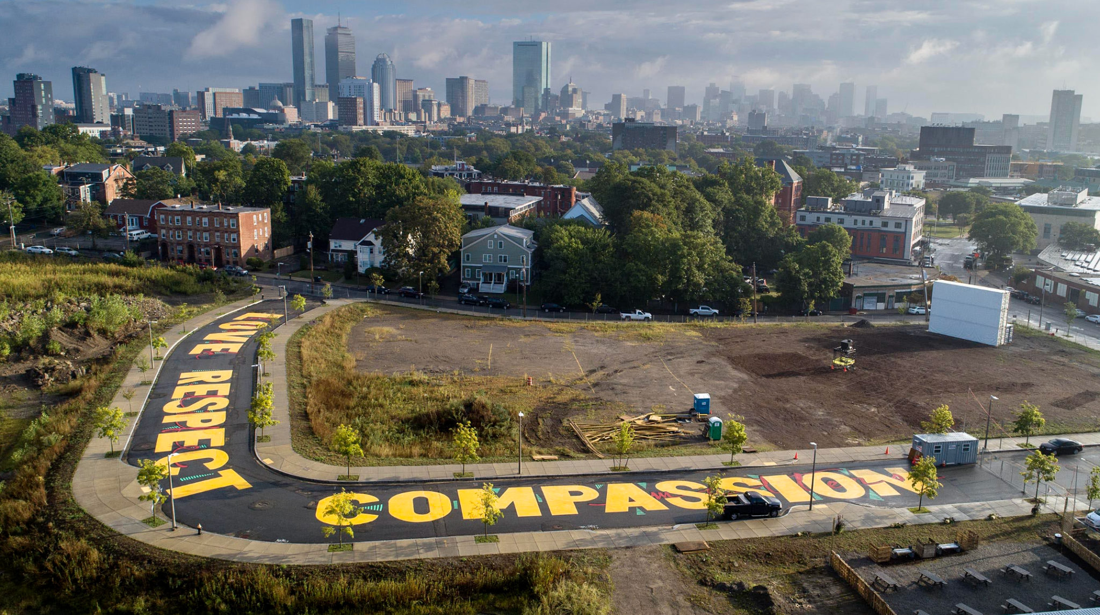
Artist Ricardo Gomez painted this mural on Bartlett Station Drive in Roxbury. Estimate the size of the letters in this mural.
4.MD.A2

Slide 5
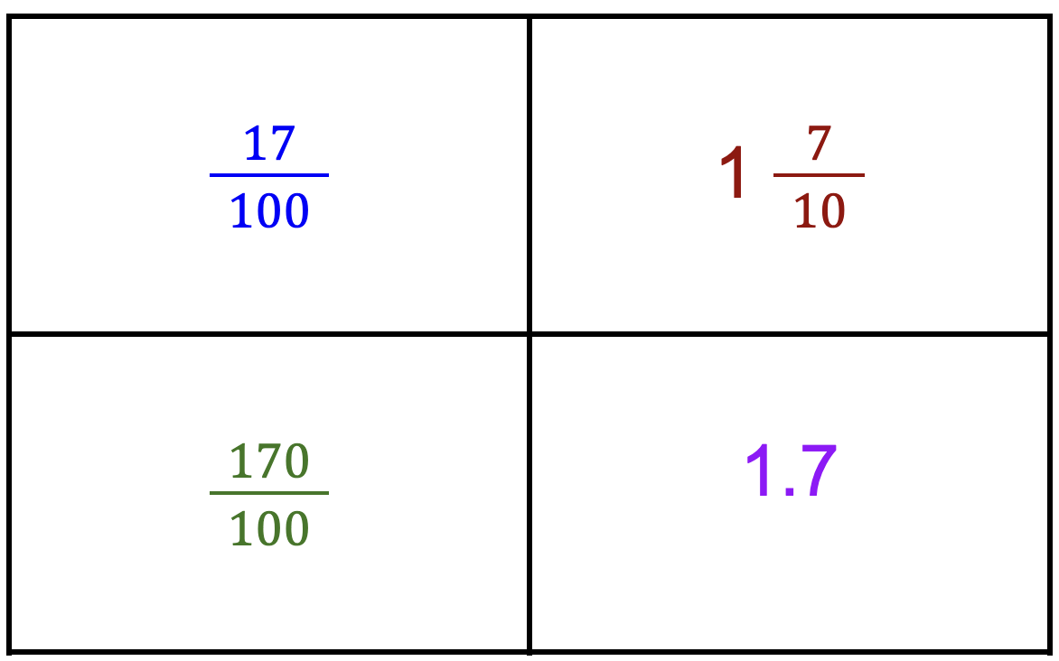
Which one does not belong?
4.NF.C6
Notes:
WHAT DO THEY ALL HAVE IN COMMON?
Top left: not 17 tenths
Top right: only mixed number
Bottom left: only fraction greater than 1
Bottom right: not a fraction (decimal)

Slide 6
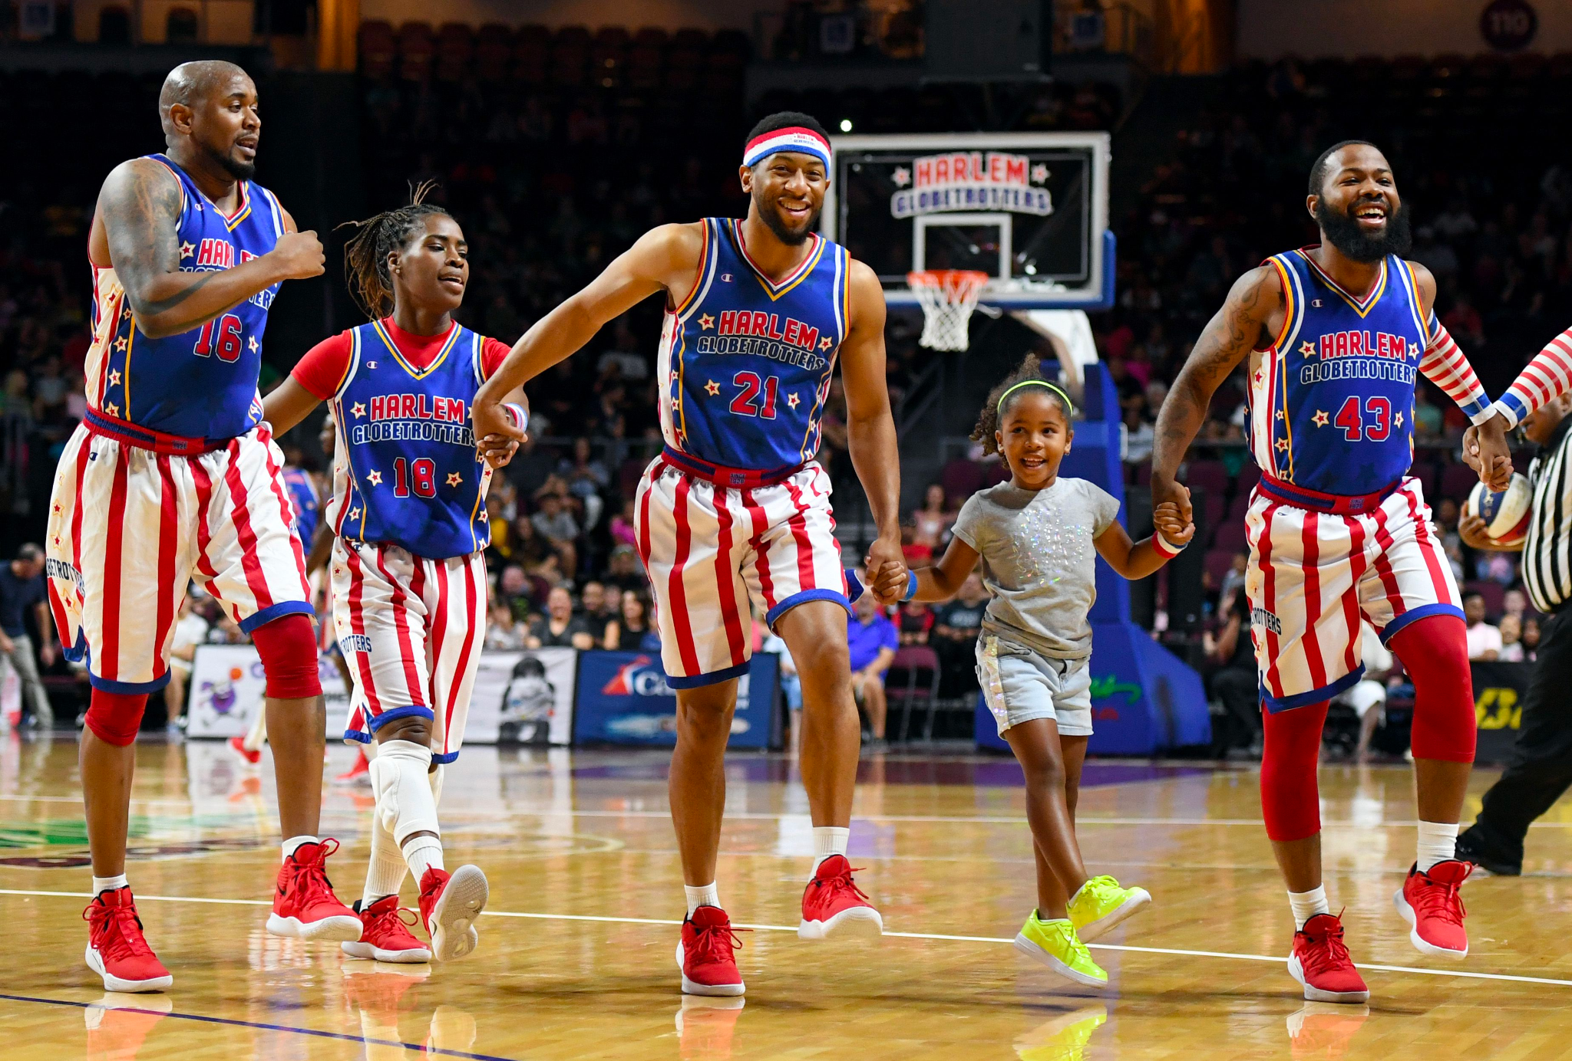
It’s Harlem Globetrotter’s Day!
The Globetrotters played their first road game in Hinckley, Illinois, on January 7, 1927.
How long ago was that?
4.NBT.B4

Slide 7
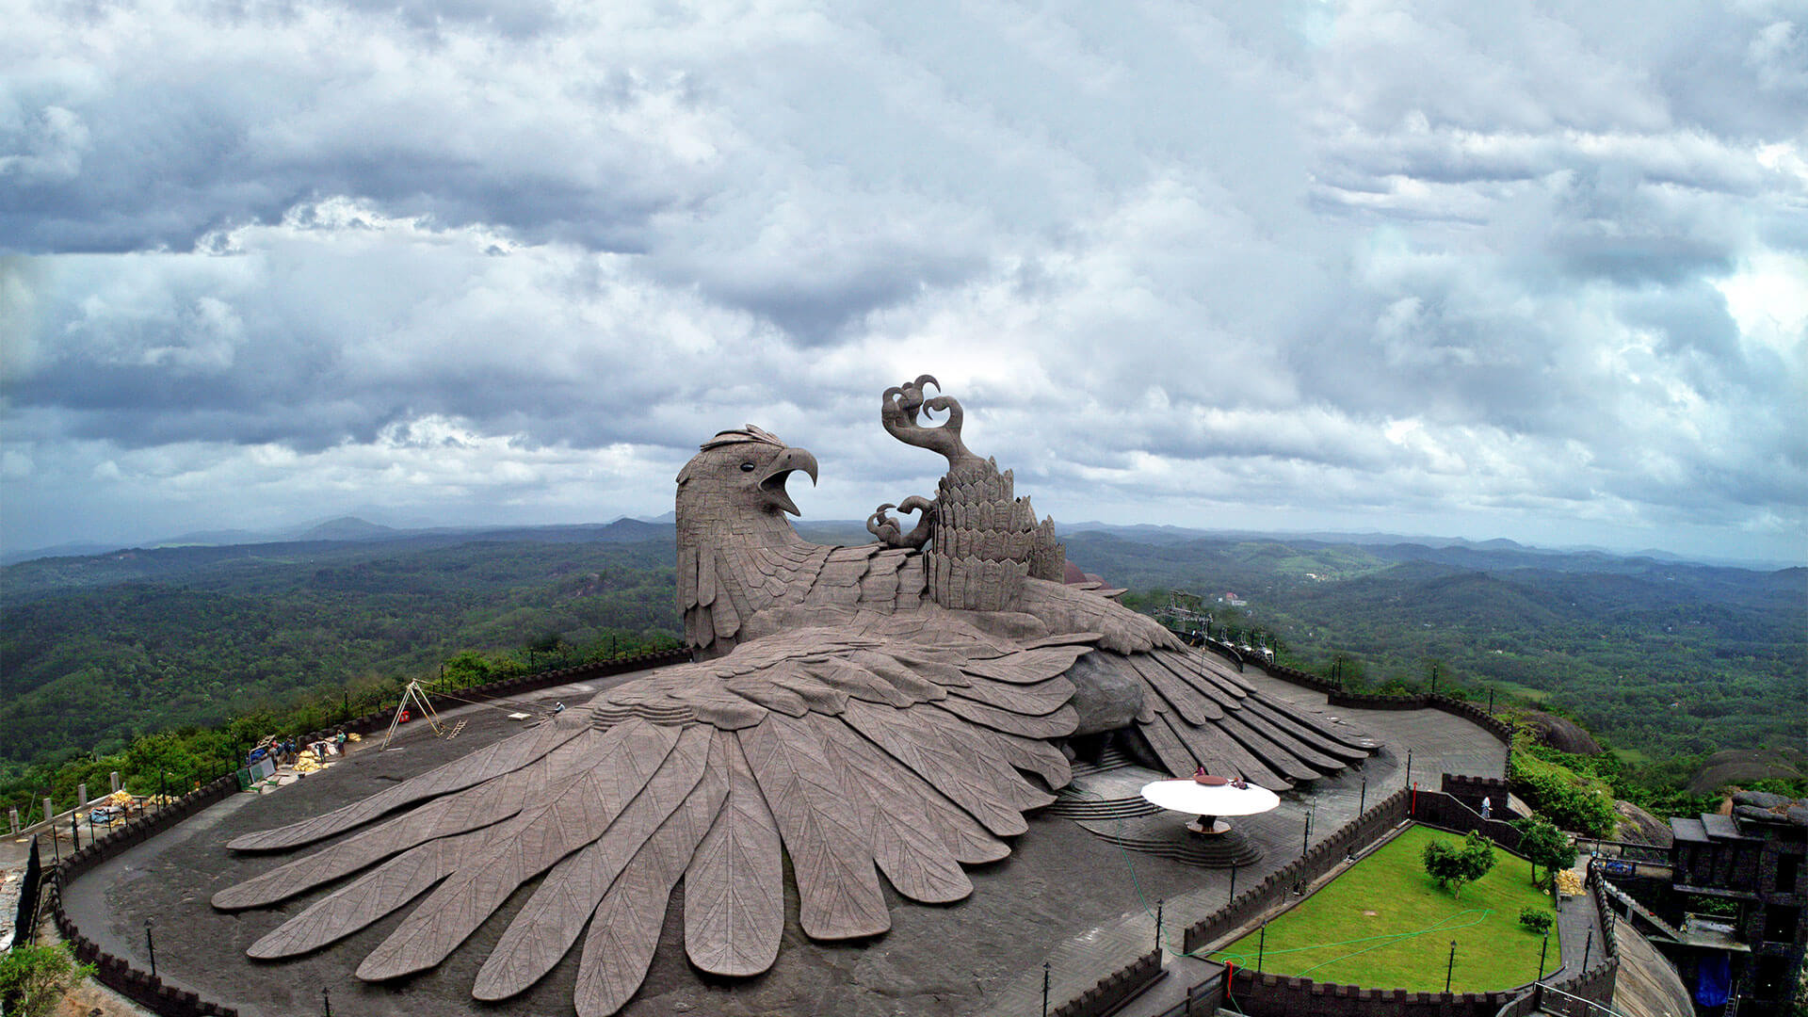
The World’s Largest Bird Sculpture Sits Atop a Rolling Hillside in Kollam, India in the Jetayu Nature Park.
This giant bird is 200 feet long, 150 feet wide, and 70 feet high!
How long is that? How many times longer, or higher is it than you?
4.NBT.B

Slide 8
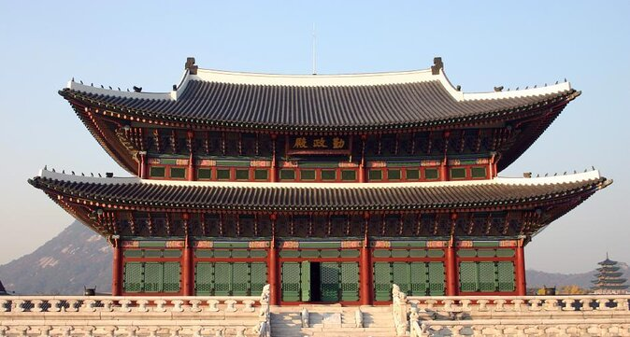
Happy Korean American Day!
Gyeongbokgung Palace was built in 1395, during the fourth year of King Taejo's reign.
How long ago was that?
What mental math strategies can we use to solve this?
4.NBT.B4
Notes:
Week of January 13, 2025

Slide 9
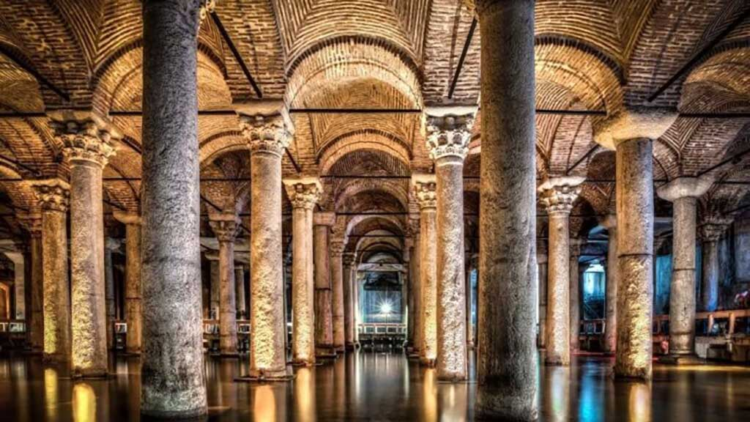
The Basilica Cistern in Istanbul!
With more than 300 marble columns, each 9 meters high and arranged in 12 rows of 28 columns, it is one of Turkey’s most beautiful landmarks.
Where is the math here?
4.OA.A3

Slide 10
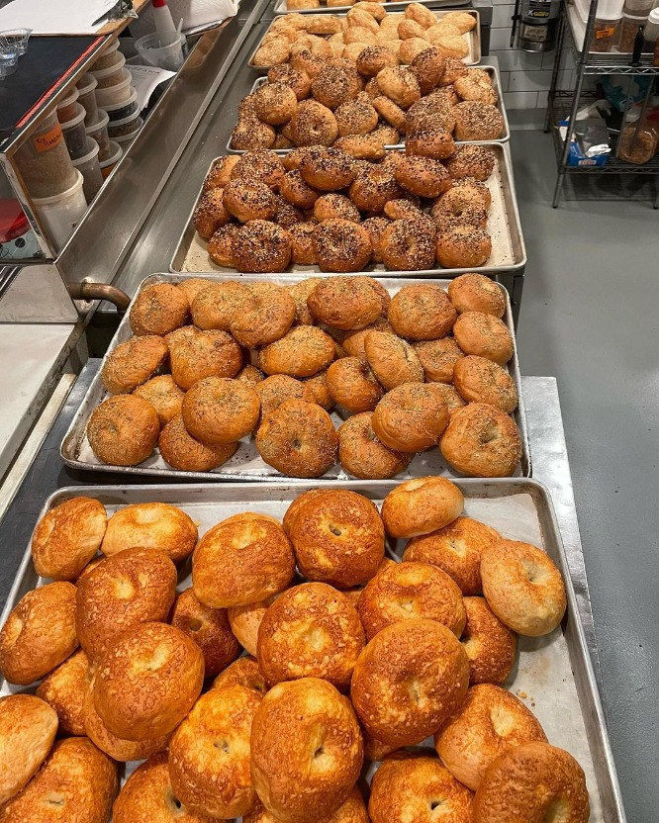
Happy National
Bagel Day!
Brick Street Bagels, a Boston Pop-up, bakes about 975 bagels each weekend.
About how many bagels is that each month?
Estimate, then solve!
Share your strategies!
4.NBT.B5

Slide 11
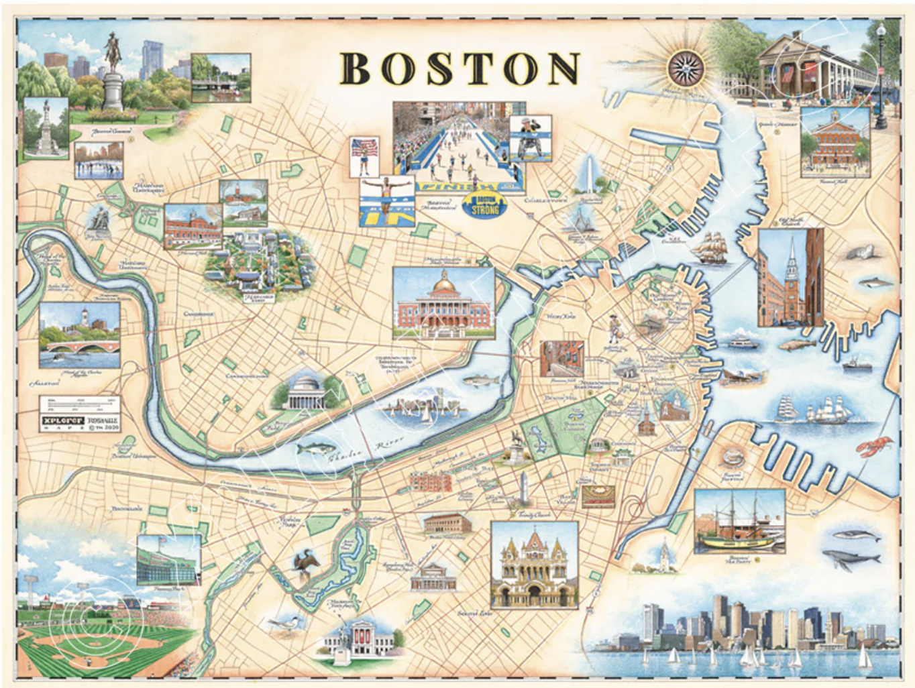
Happy National Boston Day!
Can you find Fenway Park on this map?
It would take 1 hour and 27 minutes to bike from here to Fenway Park!
How many minutes is that? How many seconds?
How long would it take to ride there and back?
4.MD.A2

Slide 12
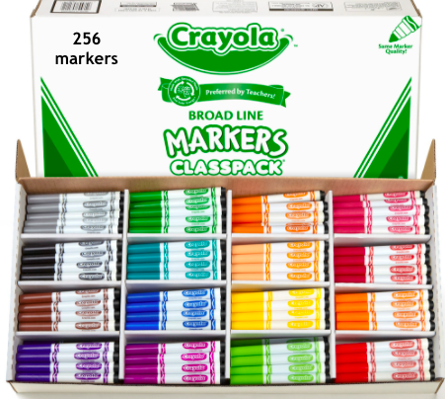
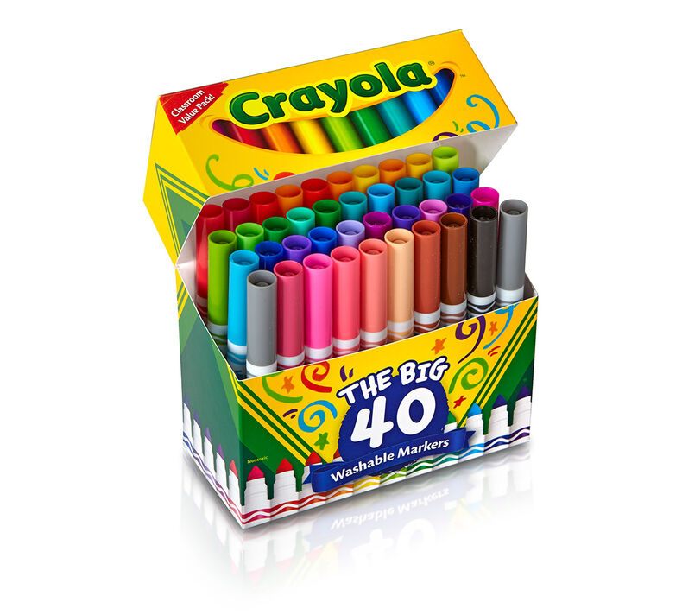
Would you rather have
7 small boxes of markers OR 1 big box?
4.OA.A2

Slide 13
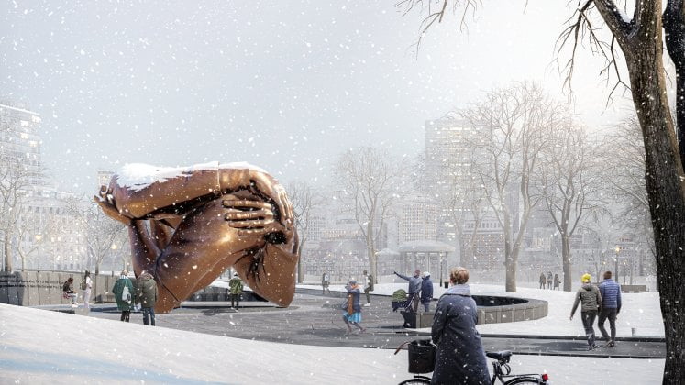
“Embrace” is the new monument in the Boston Common, a tribute to Dr. Martin Luther King and Coretta Scott King.
Embrace stands 20 feet tall and 40 feet wide.
How many times taller is it than you?
What FRACTION are YOU of this monument?
4.NF.A
Notes:
Week of January 21, 2025

Slide 14
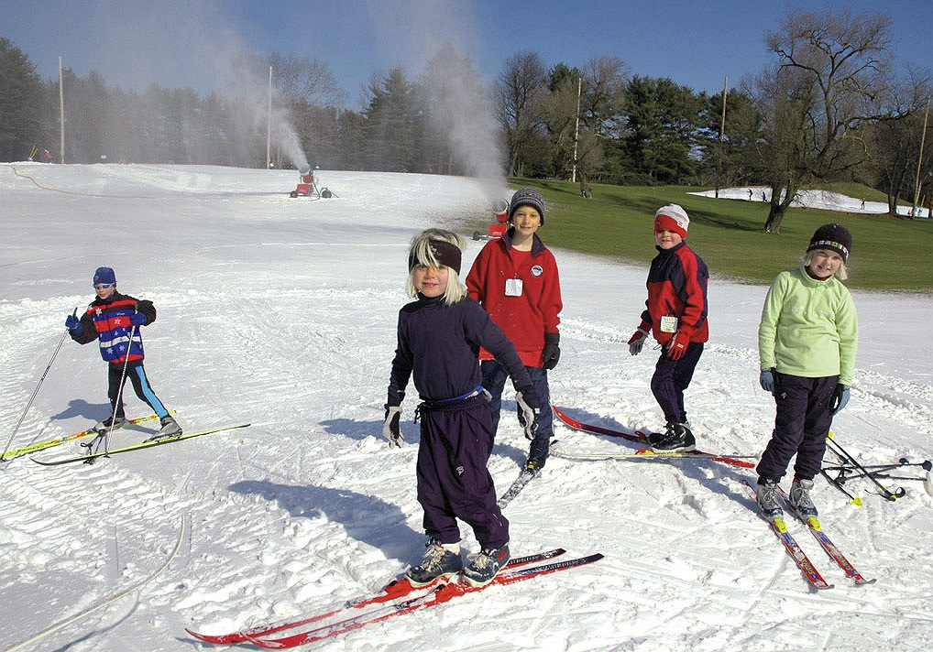
Cross Country Skiing in Weston!
The ski track in Weston is 2.5 km.
How long is that?
How many meters?
Centimeters?
What do you notice?
4.MD.A1

Slide 15
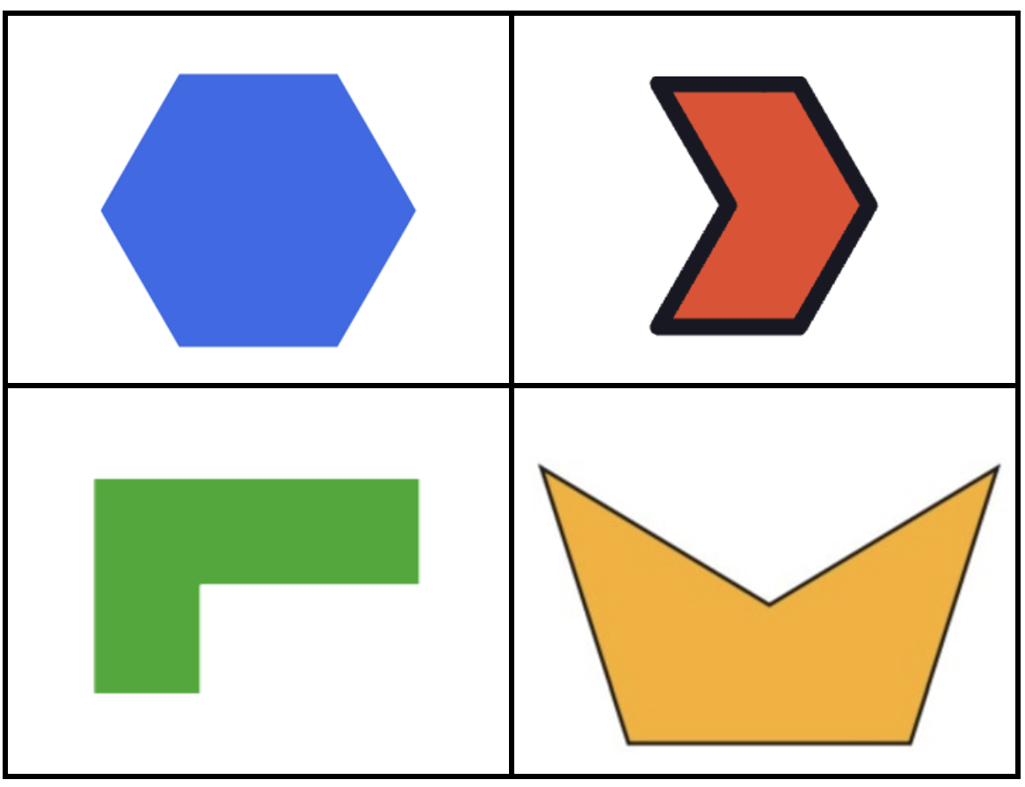
Which one does not belong?
4.G.A2
Notes:
Top leftt: most lines of symmetry, only regular polygon
Top right: only polygon with outline
Bottom left: no symmetry
Bottom right: not hexagon

Slide 16
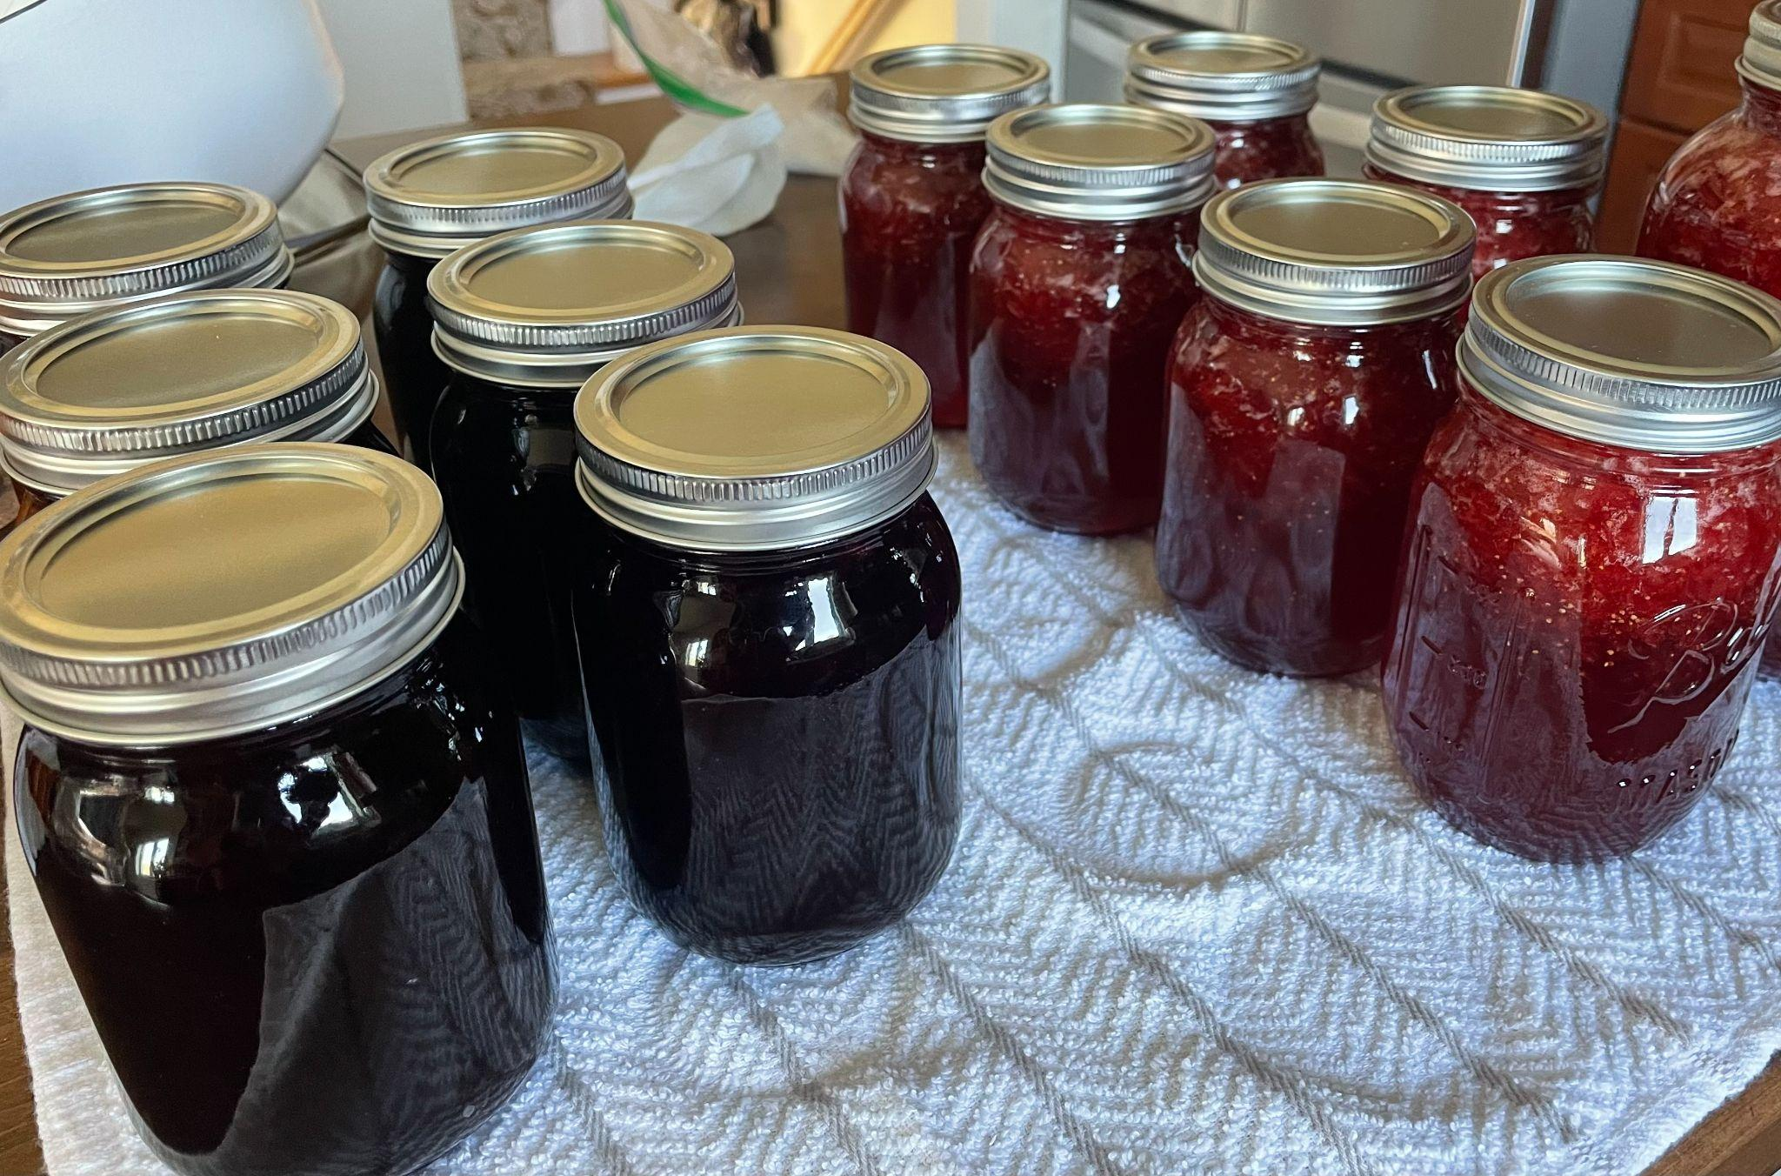
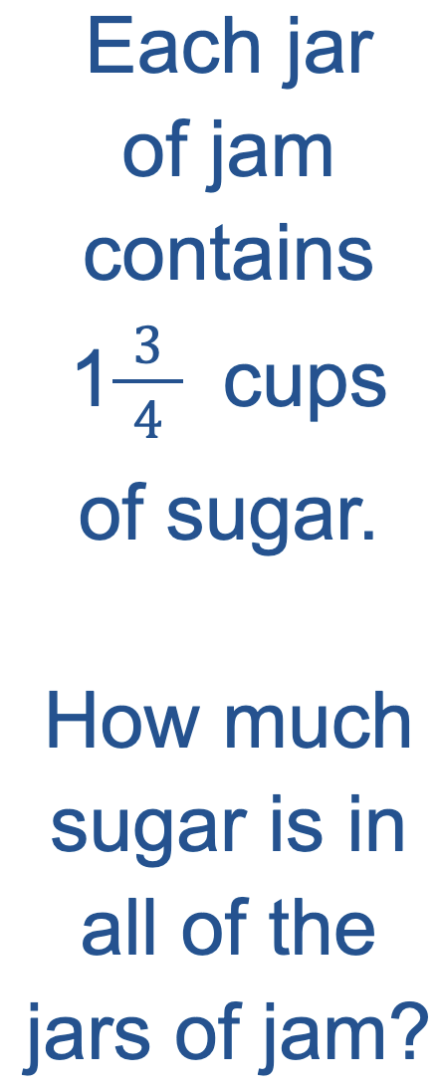
Homemade Jam!
Yum!
4.NF.B4

Slide 17
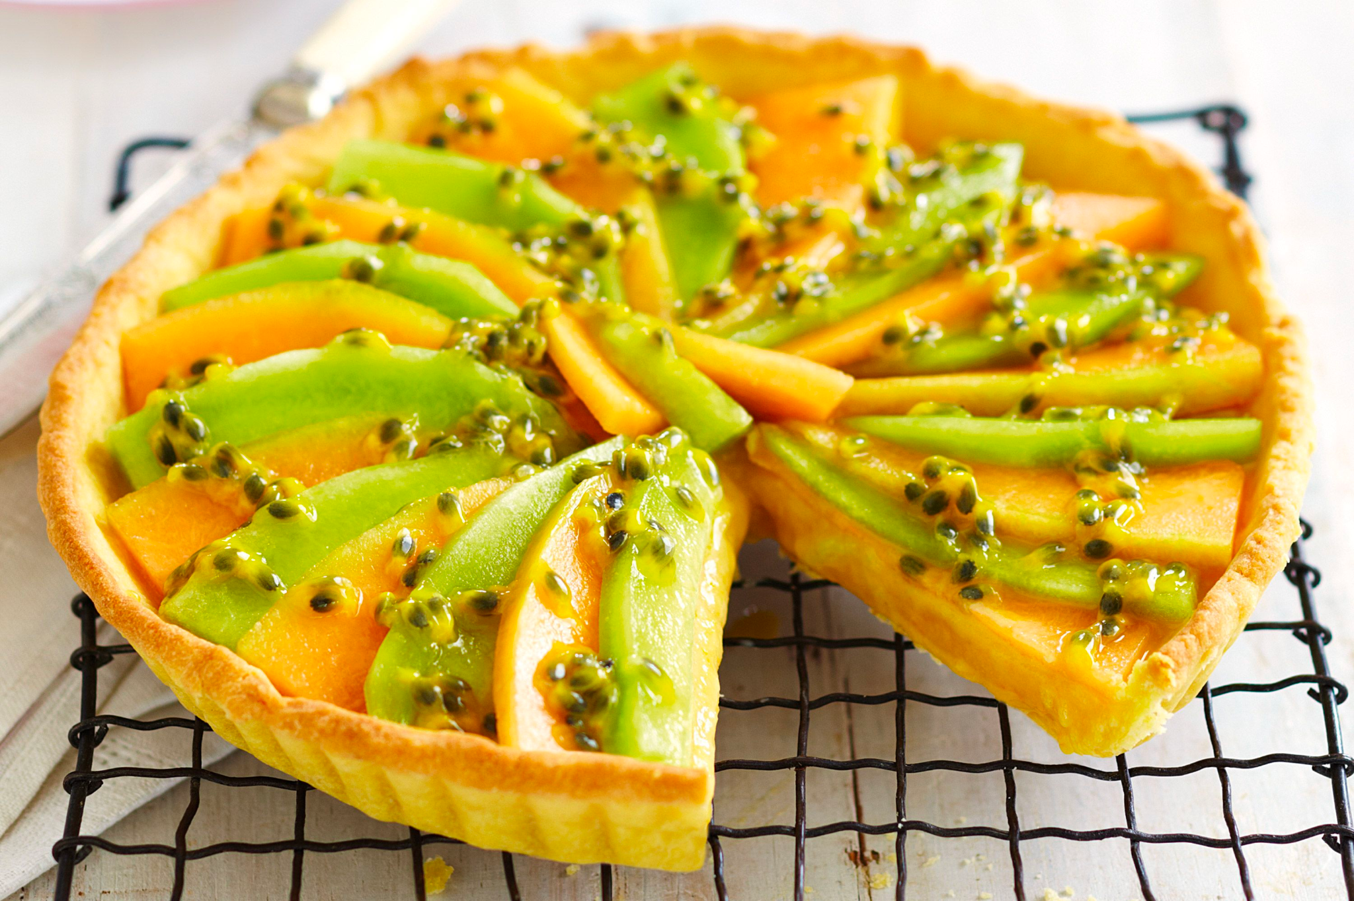
Celebrate India Republic Day!
What fraction of this melon tart has been eaten?
What fraction remains?
4.NF.B3
Notes:
Week of January 27, 2025

Slide 18
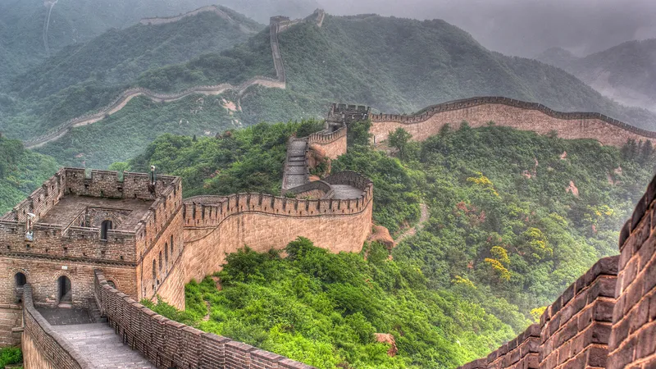
The Great Wall of China is 21,196 kilometers!
How long is that?
How many meters?
How long would it take you to walk that far?
4.MD.A2

Slide 19
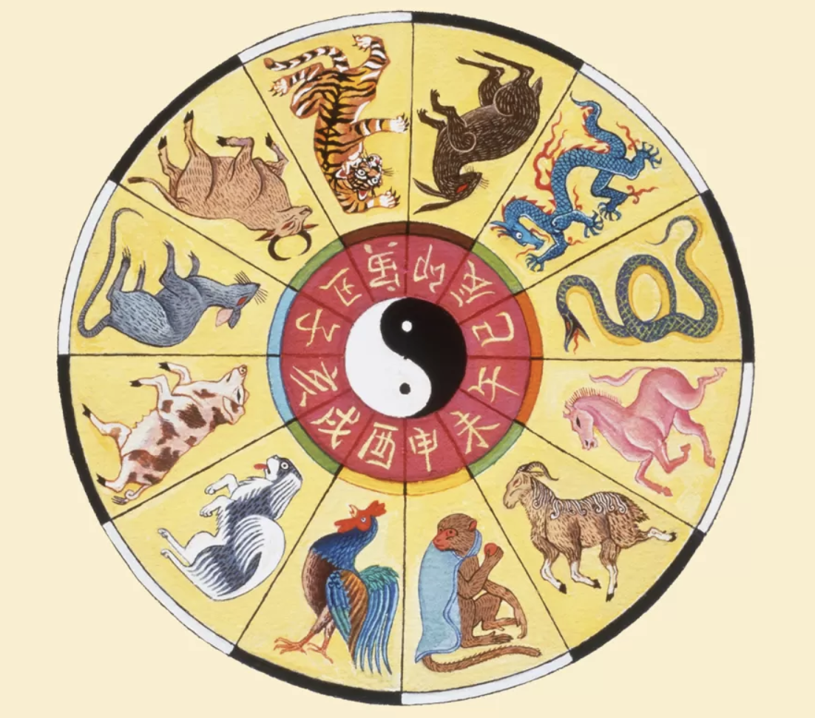
Happy Lunar New Year!
恭喜发财
It’s the Year of the Snake!
The Chinese Zodiac is a 12 year cycle.
When is the next Year of the Rabbit?
The next, and the next? What patterns do we see in the years?
4.OA.C5

Slide 20
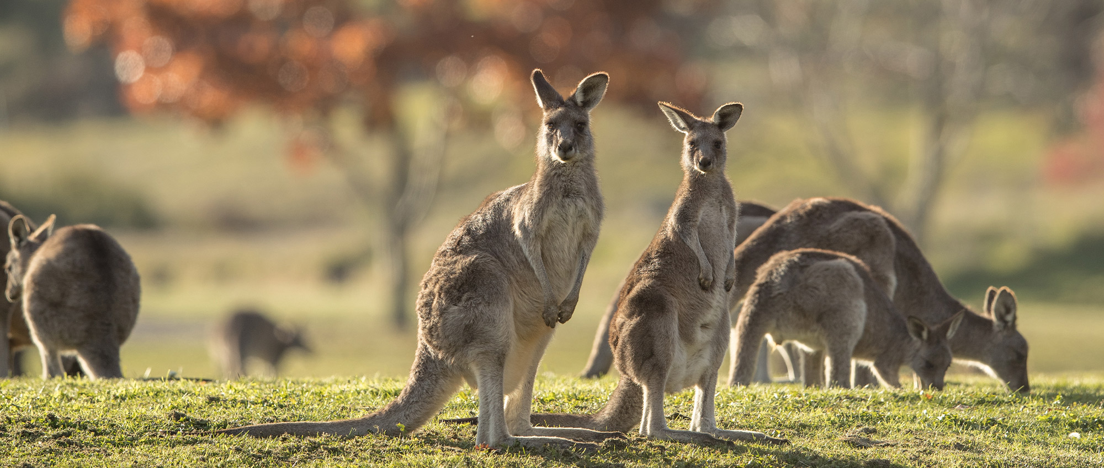
4.MD.A2
Happy Australia Day!
Did you know that an average adult kangaroo weighs between 35 - 90 kg?
Males can weigh up to twice as much as females!
If these female kangaroos weigh between 35 and 50 kg, how much might the males weigh?
Notes:
Australia Day

