Slide 1
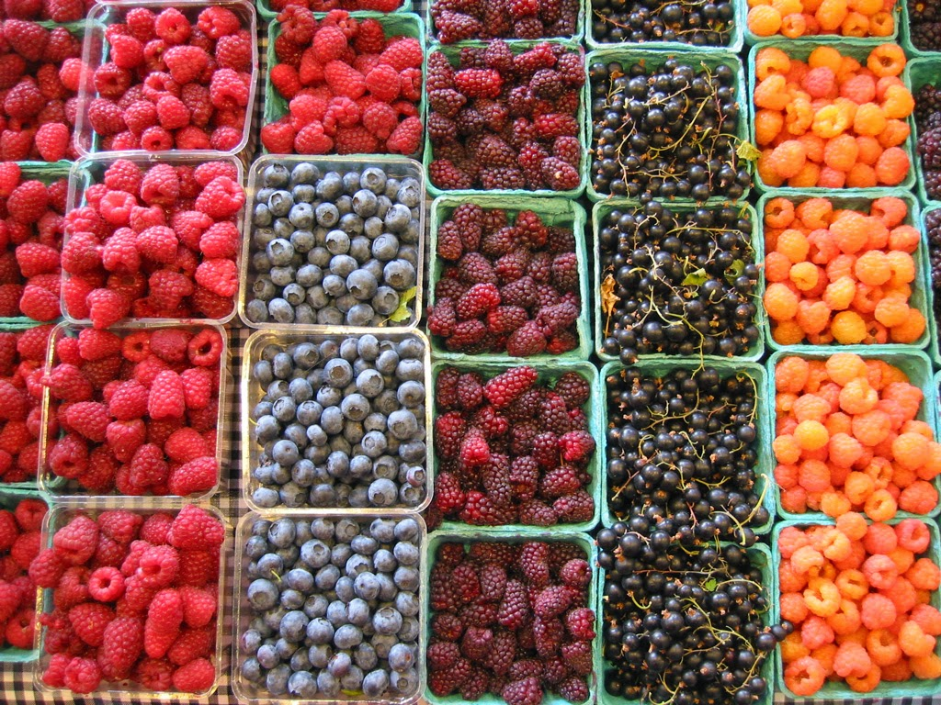
February is Berries Month!
What math do we notice?
Where do we see fractions?
3.NF.A1
Notes:
Week of February 3, 2025

Slide 2
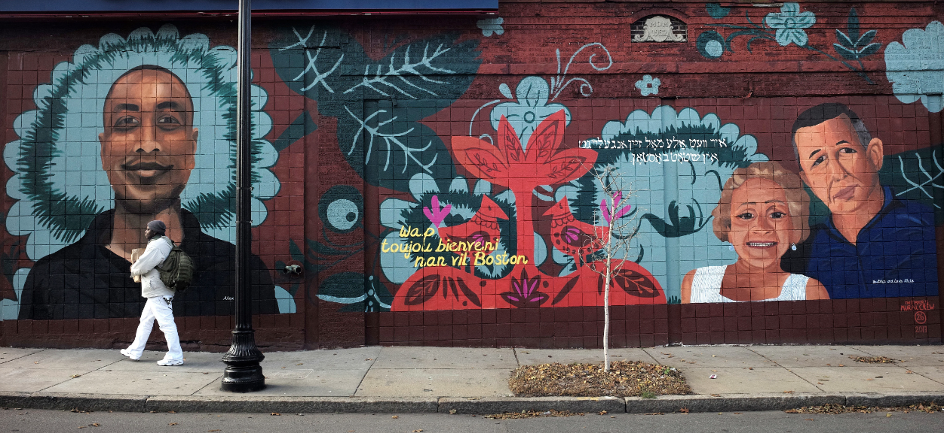
Estimate the area of this Roslindale mural.
How do we know our estimate is reasonable?
3.MD.A2

Slide 3
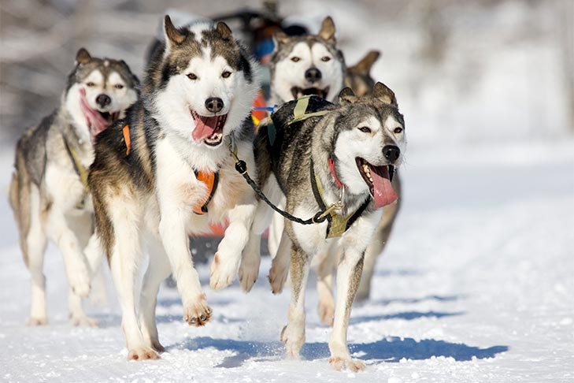
It’s Sled Dog Day!
The first formal sled-dog race was held in 1850, from Winnipeg, Manitoba, to St. Paul, Minnesota.
How long ago was that?
How can we use mental math to figure it out?
3.NBT.A2

Slide 4
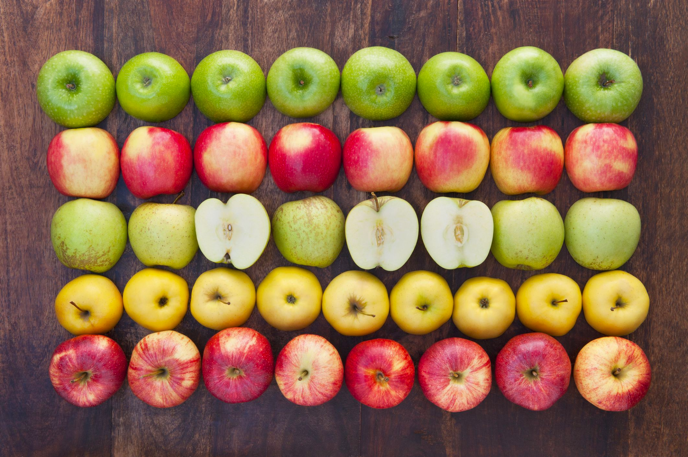
What can we say about this fruit array?
Create an equation to match this photo.
3.OA.A3

Slide 5
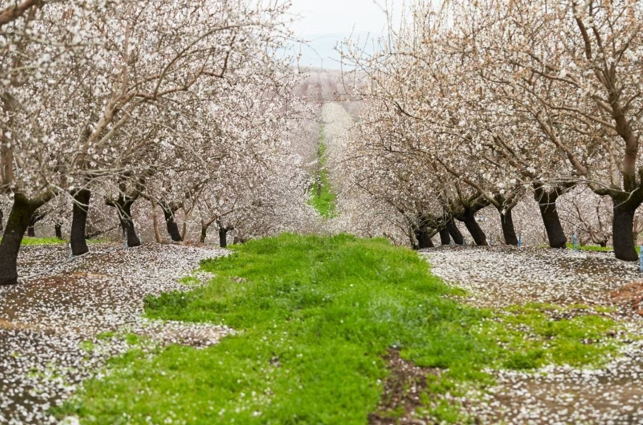
Happy Tu B’Shevat ~ טו בשבת שמח
The New Year of the Trees!
These almond trees in Northern Israel can produce between 50-65 pounds of almonds each year.
How many almonds might ONE tree produce in 5 years?
What is possible?
3.OA.D8

Slide 6

3 x 5 x 2 = 6 x 5
8 x (5 + 2) = 40 + 16
2 x 3 x 10 = 10 x 5
3.OA.B5
Notes:
Week of February 10, 2025

Slide 7
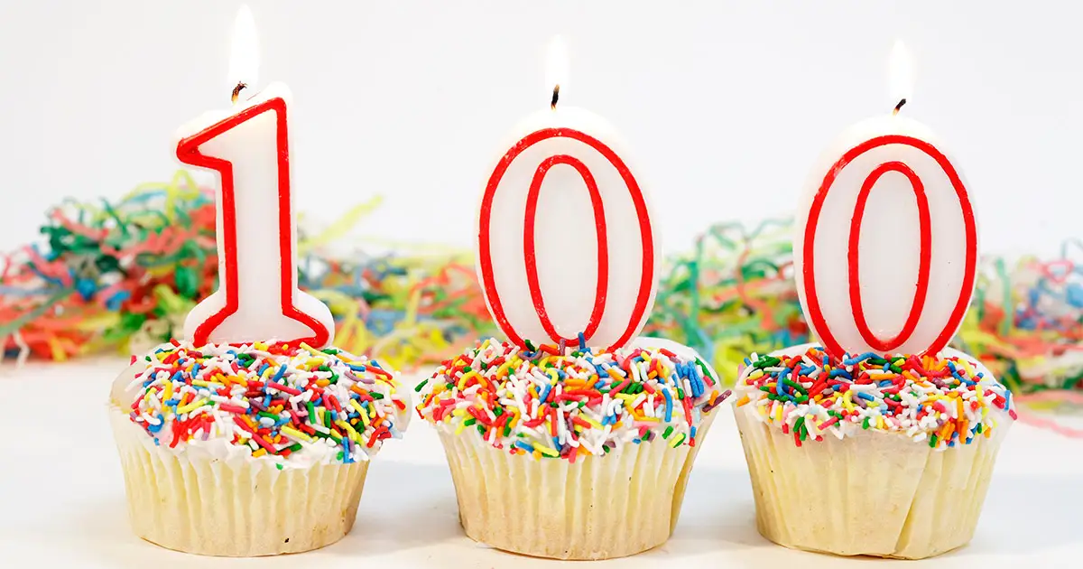
Happy 100 Day of School!
What are some FACTORS of 100?
How do we know we have them all?
3.OA.C7

Slide 8
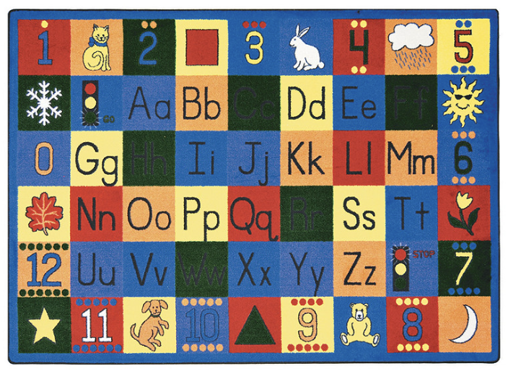
What a nice classroom rug!
This rug has a perimeter of 28 square feet.
What is possible?
Think about area!
3.MD.D8

Slide 9
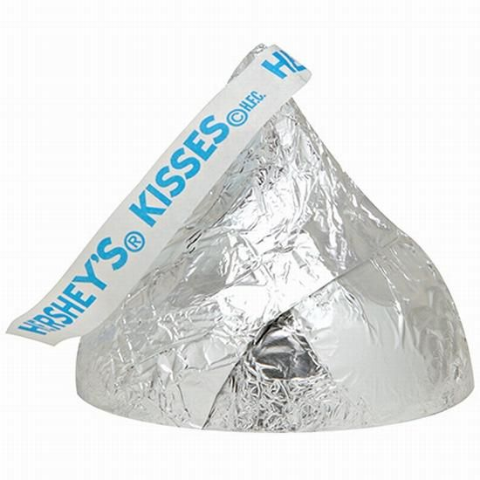
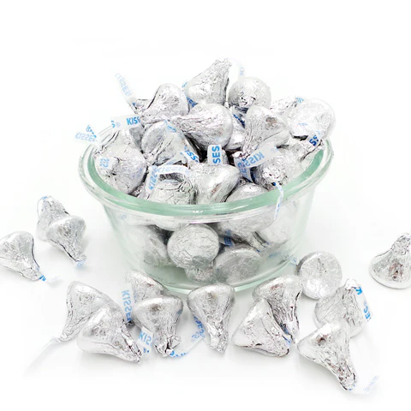
Would you rather have an overflowing bowl of Hershey’s Kisses or One giant Hershey’s Kiss?
3.SMP.3

Slide 10
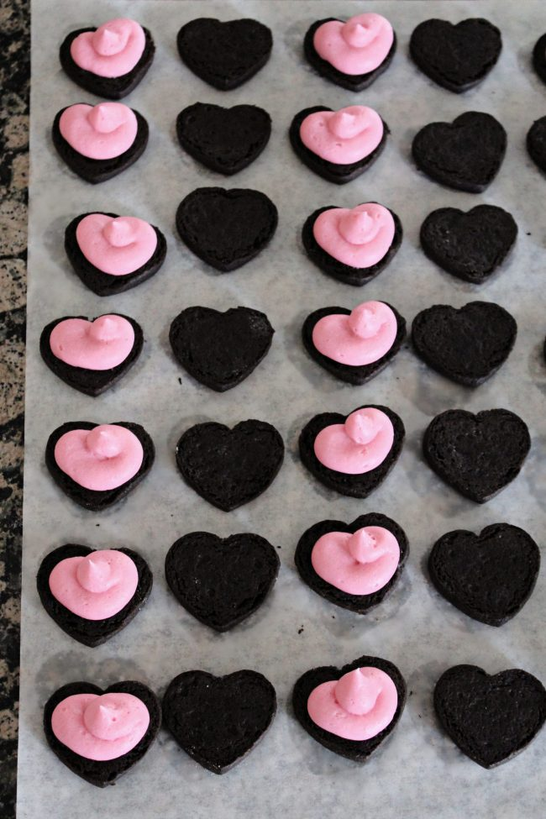
What do we notice?
What do we wonder?
What can we say about this array of cookies?
How many are here?
Can we write an equation to match our thinking?
3.OA.A3

Slide 11
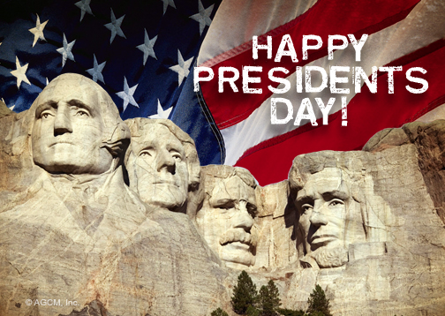
We celebrated President’s Day last week.
In 1879, President Rutherford B. Hayes signed Washington’s Birthday into law.
How long ago was that?
How do you know?
3.NBT.A2
Notes:
Week of February 24, 2025

Slide 12
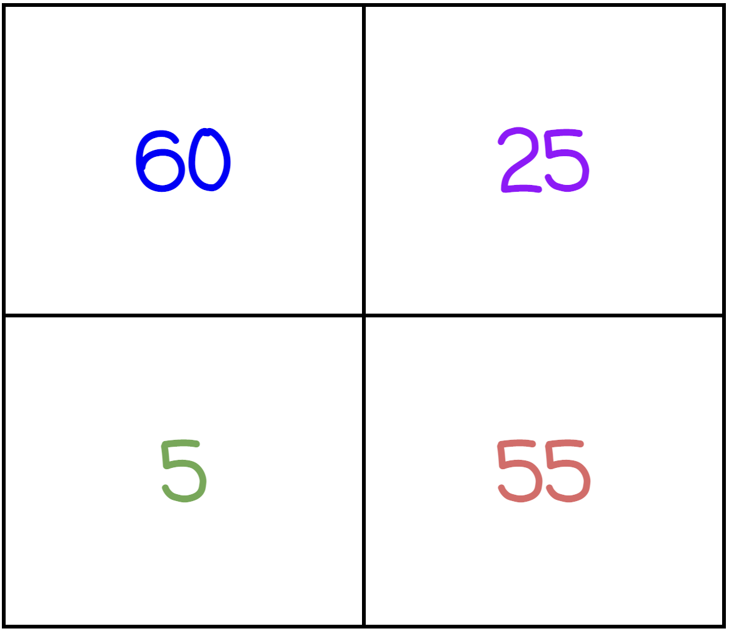
Which one does not belong?
What do they all have in common?
3.OA.D9
Notes:
Top left: only even, multiple of ten
Top right: only square number
Bottom left: only single-digit
Bottom right: only palindrome

Slide 13
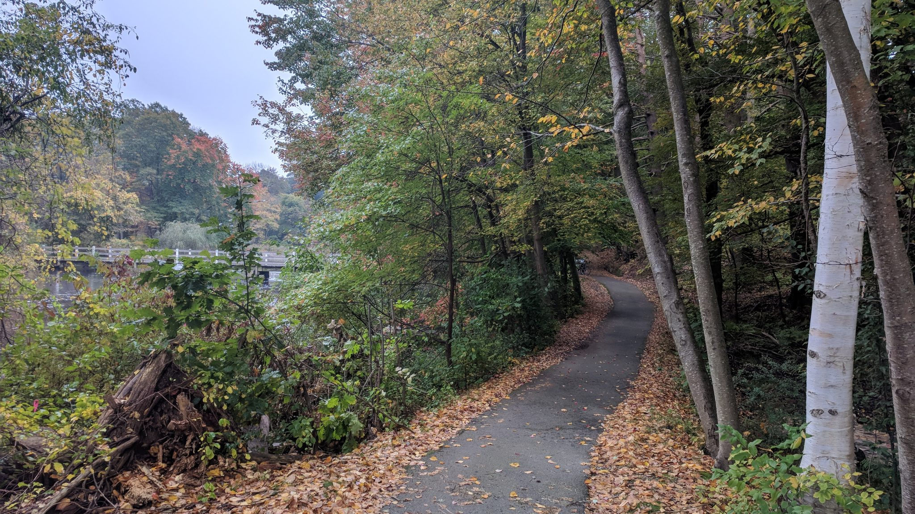
There are over 90 miles of trails in Weston.
What can we say about the number 90?
How many different expressions, using TWO operations, can we create that have a value of 90?
2.NBT.B5

Slide 14
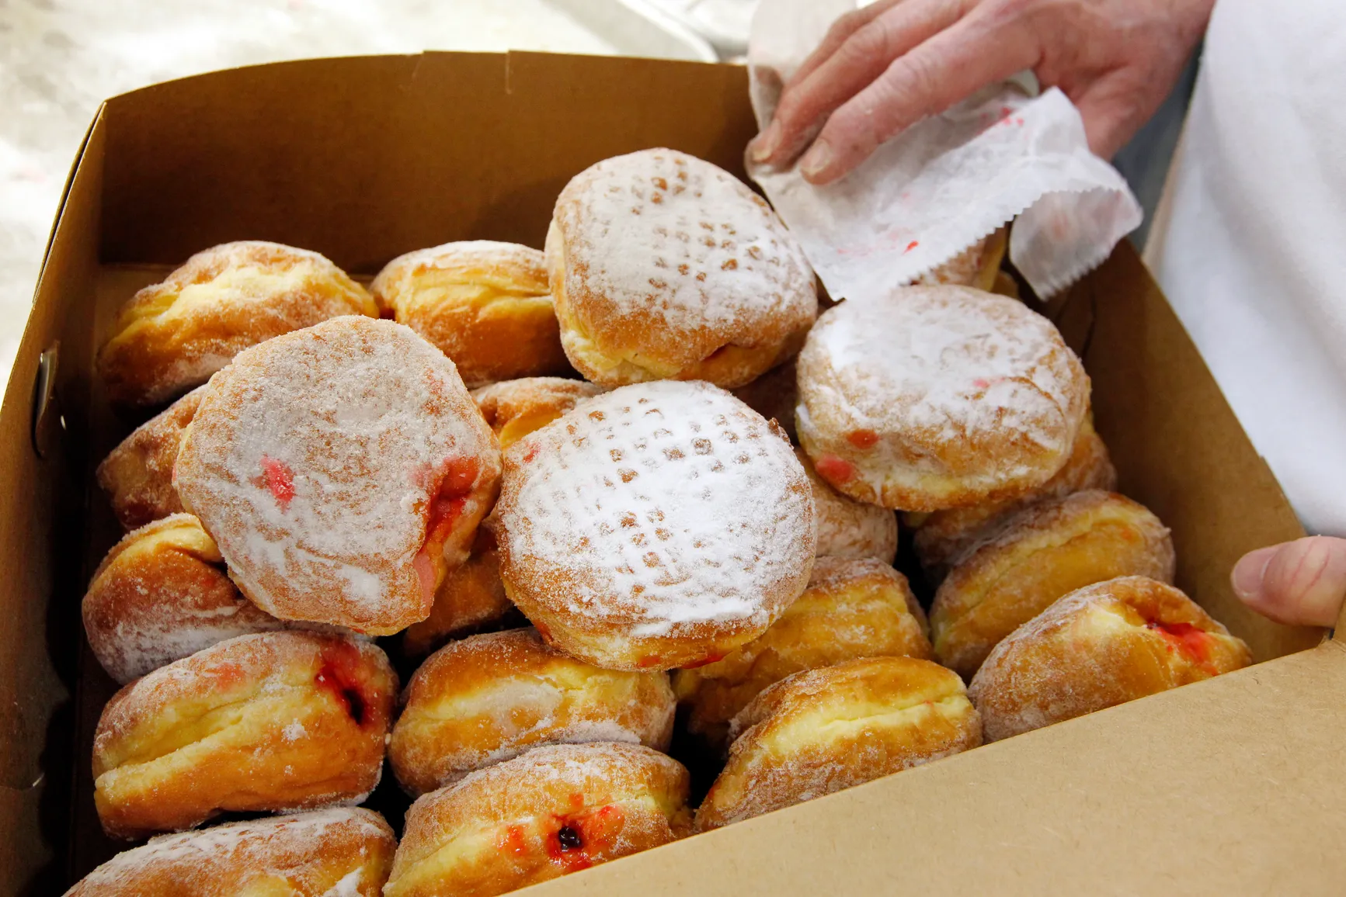
Fat Thursday is celebrated with yummy paczki in Poland!
How many different equations can we create to match the paczki at this Polish Bakery?
3.OA.D8

Slide 15
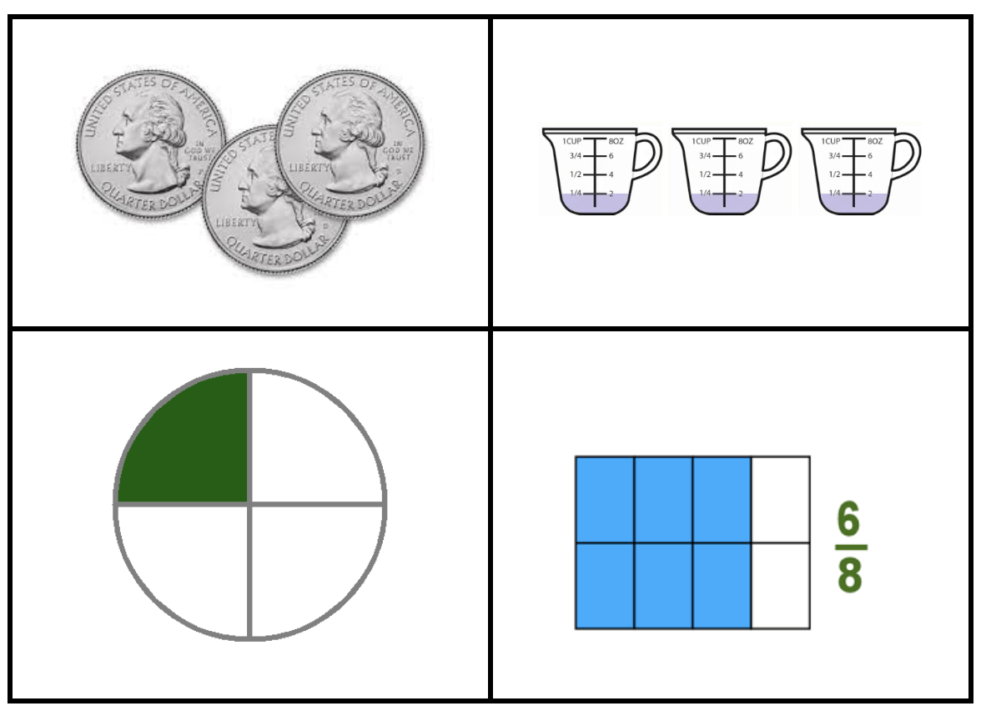
Which one does not belong?
What do they all have in common?
3.NF.A3
Notes:
Top left: only coins
Top right: only addends
Bottom left: one-fourth, three-fourths missing
Bottom right: only equivalent fraction

