Slide 1
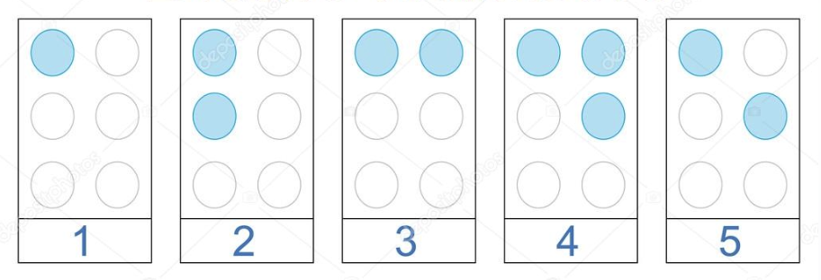
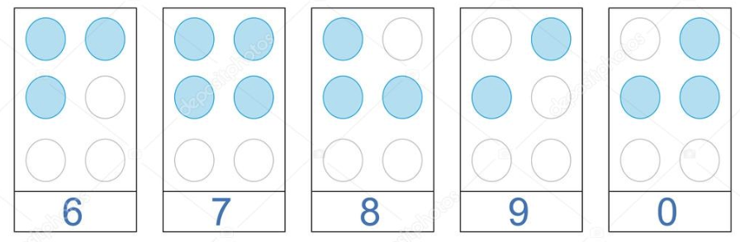
January is National Braille Literacy Month
What do we notice about the numbers 1-5?
What do we think the numbers 6-10 will look like?
Are we surprised?
1.NBT.A
Notes:
Week of January 2, 2025

Slide 2
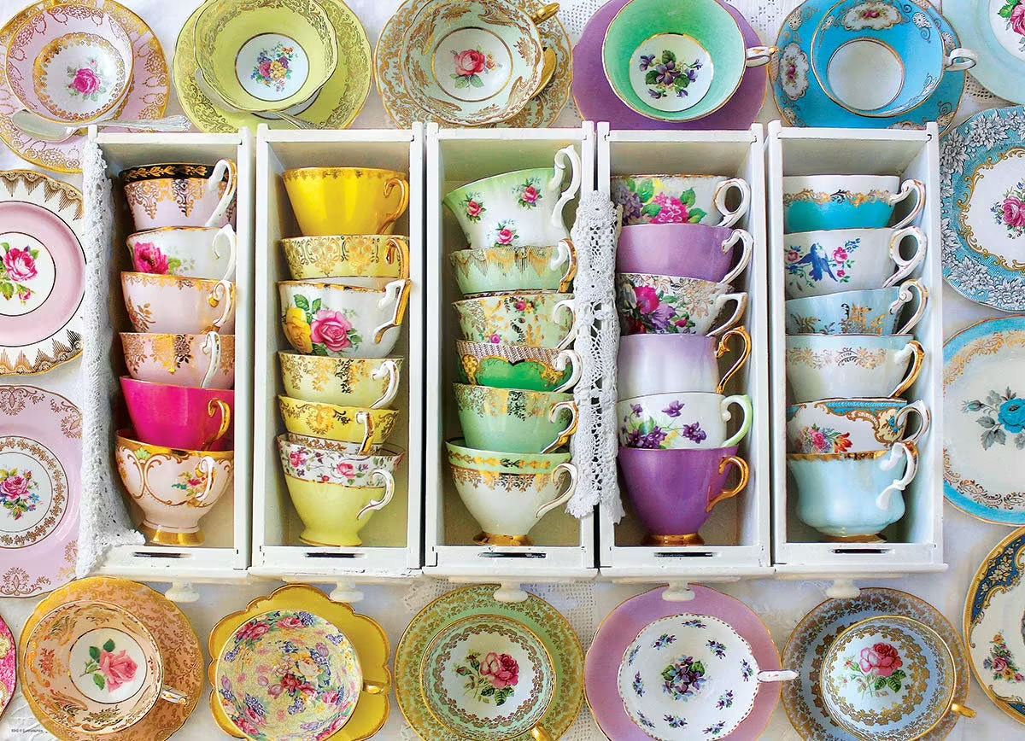
Happy Hot Tea Month!
How many tea cups are here?
How can we count them?
Can we create an expression to match our thinking?
1.OA.C5

Slide 3

Today is Children’s Day in Uruguay
How do we see the rays of the sun on Uruguay’s flag?
Create an expression to match your thinking.
1.OA.A1
Notes:
Week of January 6, 2025

Slide 4
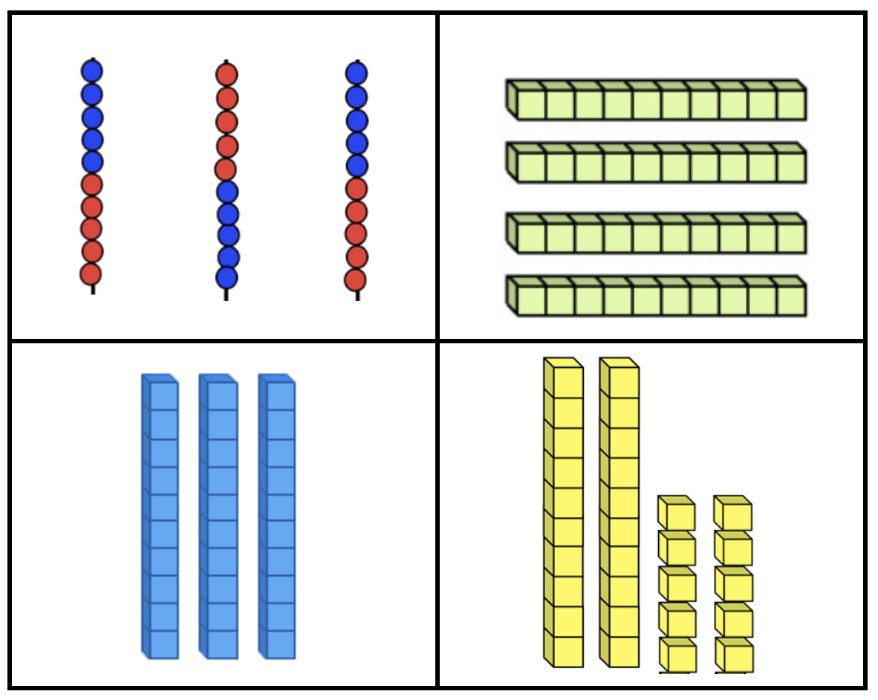
Which one does not belong?
1.NBT.B2
Notes:
Top left: not base ten blocks
Top right: not vertical
Bottom left: not 30
Bottom right: not bundled ten

Slide 5
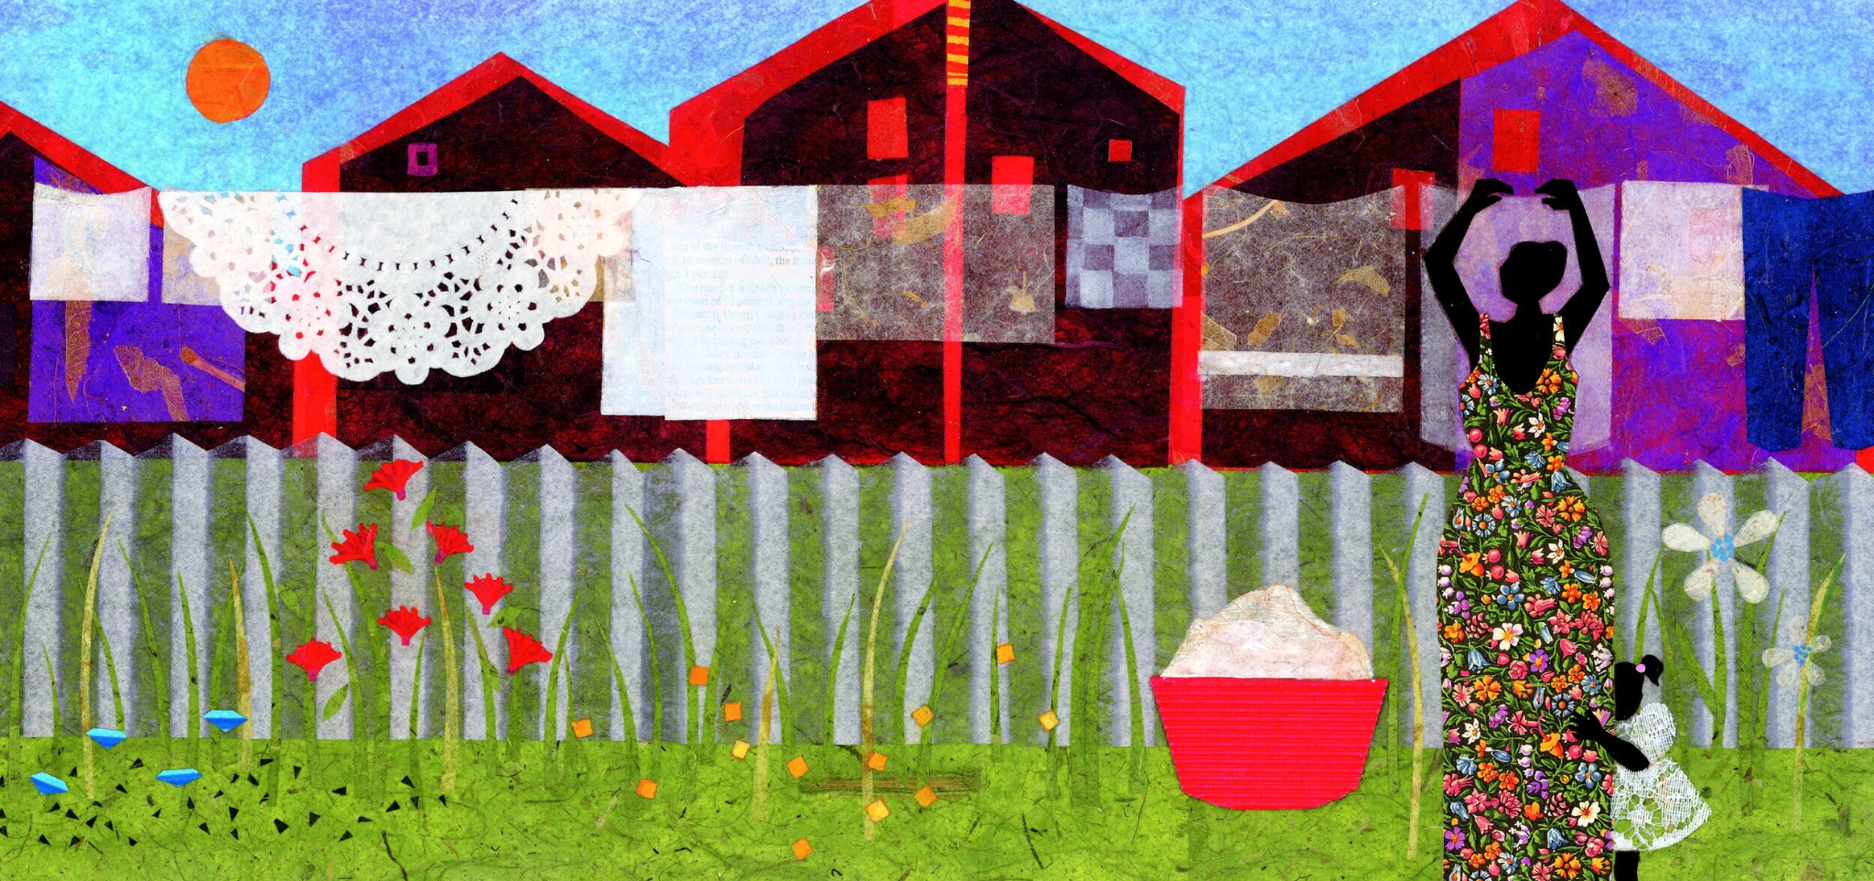
Let’s name some of the shapes we see in this painting
by Roxbury artist Ekua Holmes?
1.G.A1

Slide 6
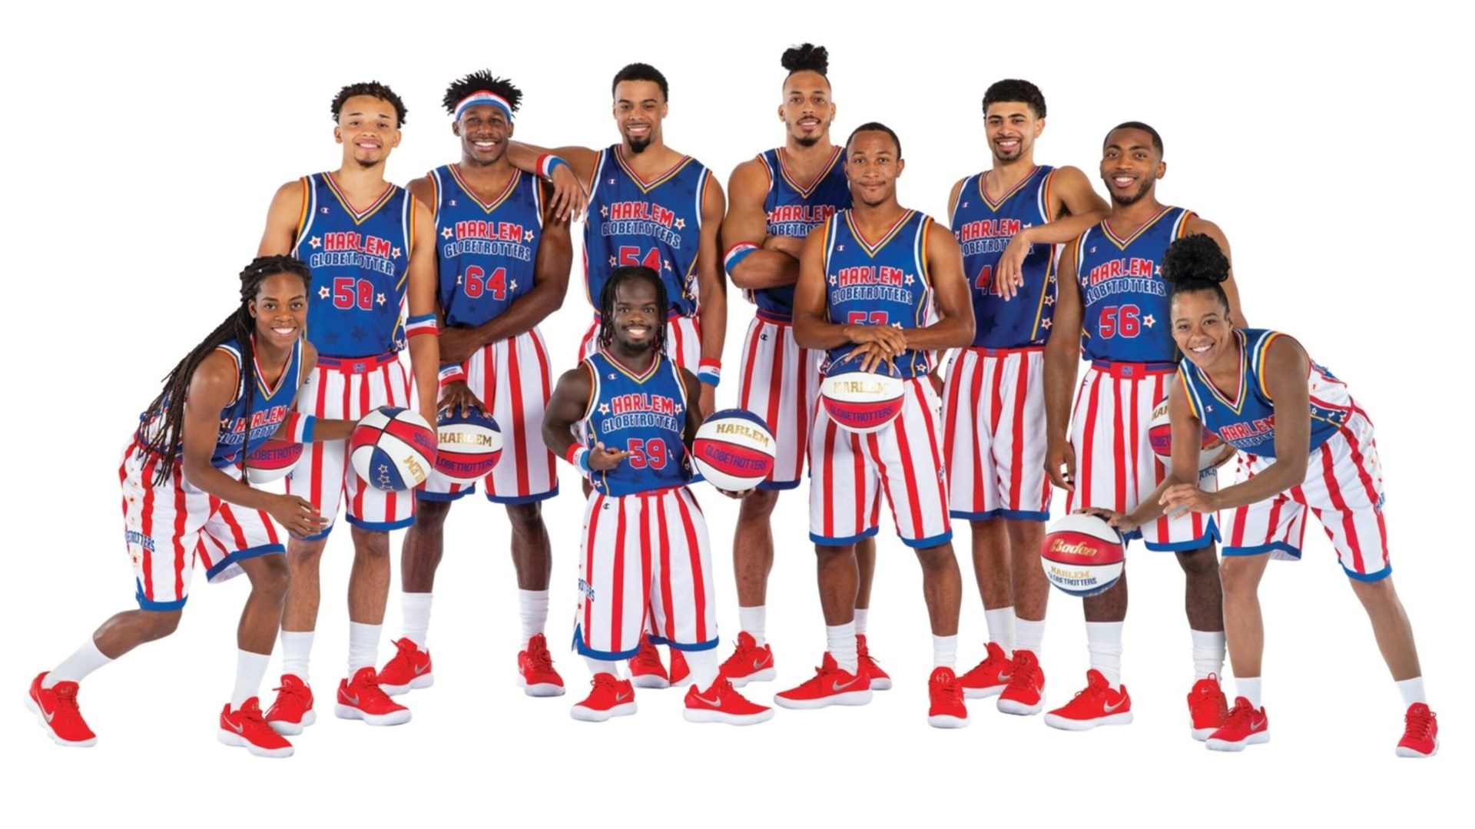
It’s Harlem Globetrotters Day!
What can we count in this photo?
What interesting equations can we create to match our thinking?
1.OA.C6

Slide 7
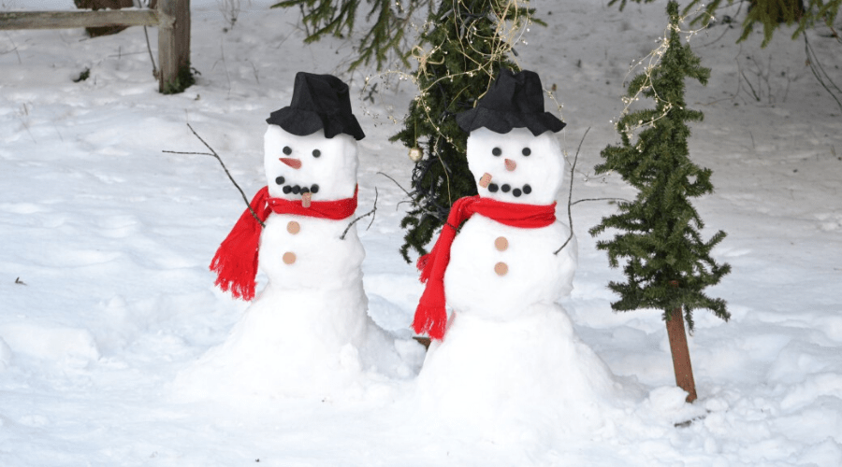
What unit of measure would you use to measure the heights of these snow people?
If the snow person on the left is 30” high, estimate the height of the one on the right.
1.MD.A2

Slide 8
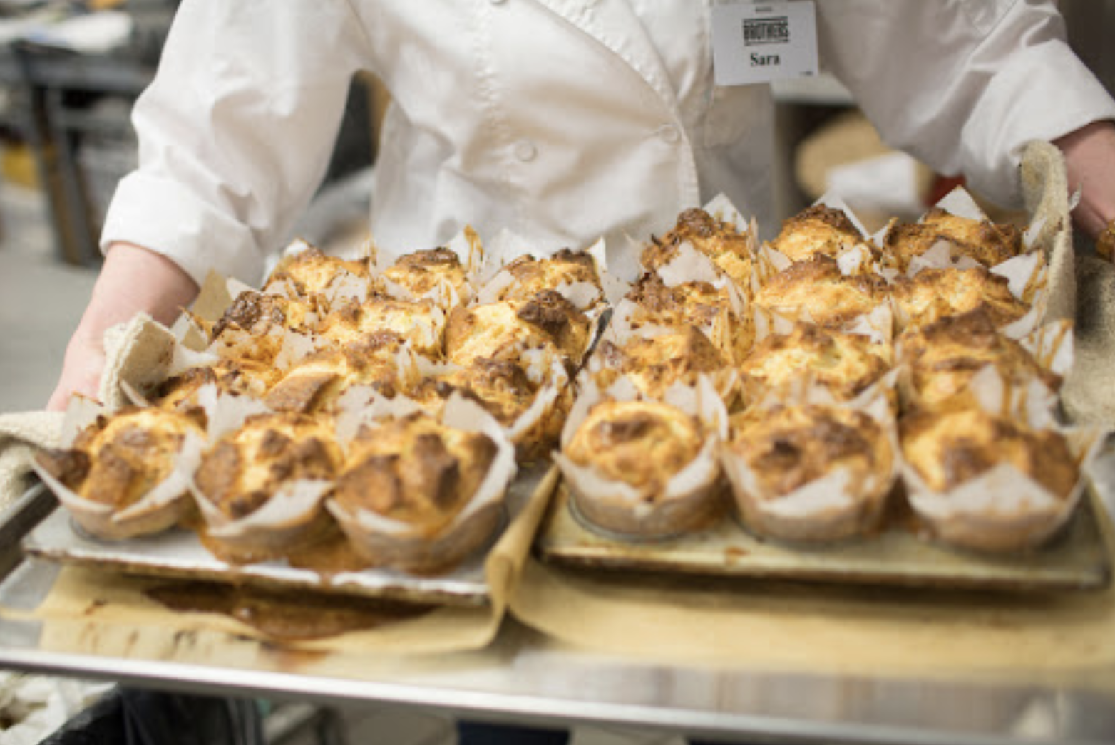
How many muffins are on these two trays at Brother’s Market?
Let’s create an expression to match our math thinking!
1.OA.C5
Notes:
Week of January 13, 2025

Slide 9
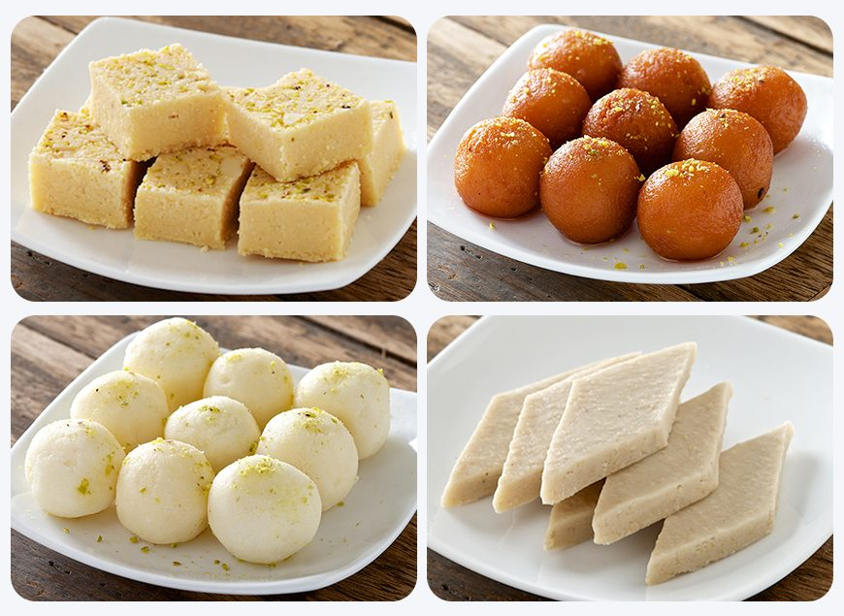
Today we celebrate Makar Sankranti in India
Let’s create some interesting number sentences with these traditional Indian sweets!
1.OA.C6

Slide 10
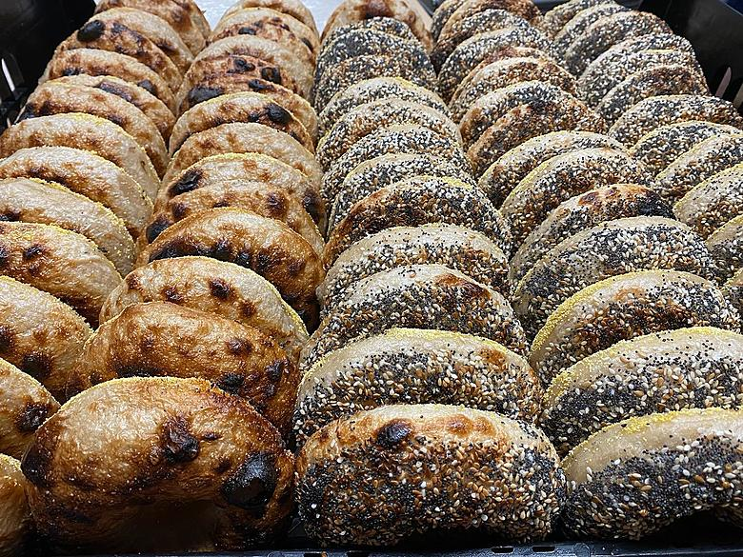
Today is National Bagel Day!
Estimate how many bagels are on this tray!
How can we use skip-counting in our estimate?
1.NBT.A1

Slide 11
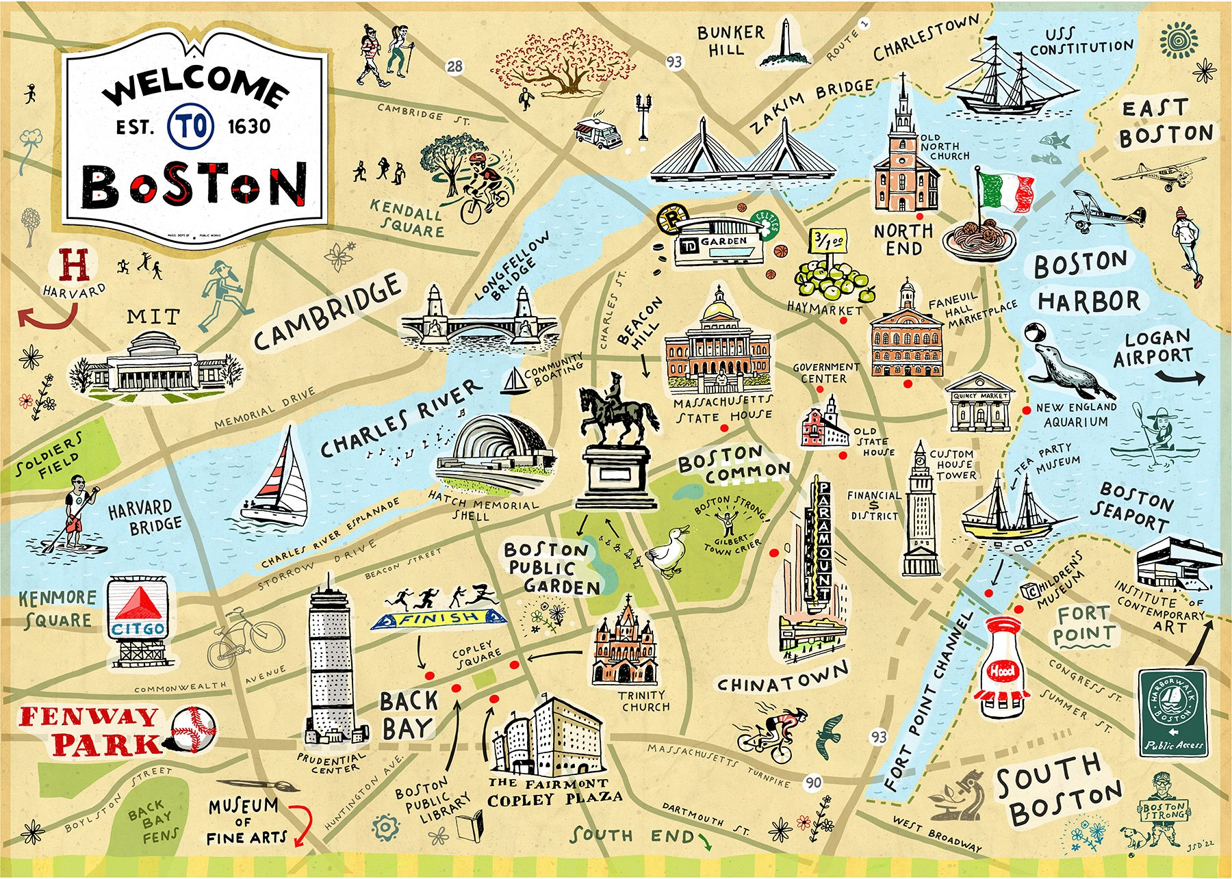
Happy National Boston Day!
Did you know that it is 13 miles from school to Fenway Park!
How many different expressions can you create that equal 13?
1.OA.C6

Slide 12
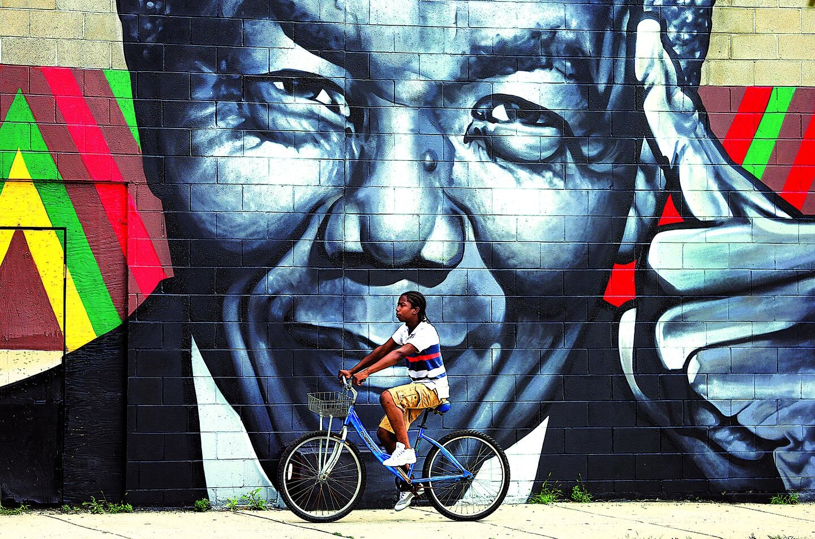
Estimate the height of this mural in Roxbury of Nelson Mandela.
1.MD.A2

Slide 13
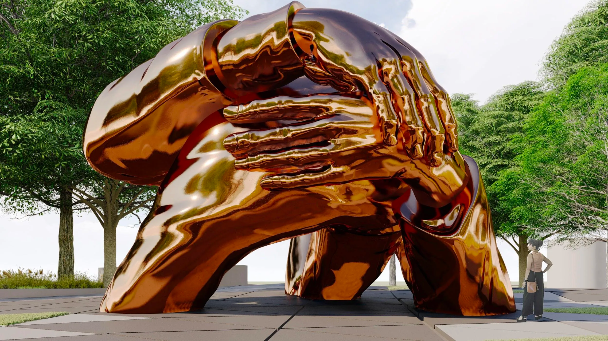
This new sculpture “Embrace” in Boston is a tribute to
Dr. Martin Luther King and his wife Coretta Scott King.
It is 22 feet tall. How many different expression can we create that equal 22?
1.NBT.C4
Notes:
Week of January 21, 2025
Celebrate Dr. Martin Luther King Day

Slide 14
What is the same?
What is the different?
What other shapes have 4 sides?
1.G.A1

Slide 15
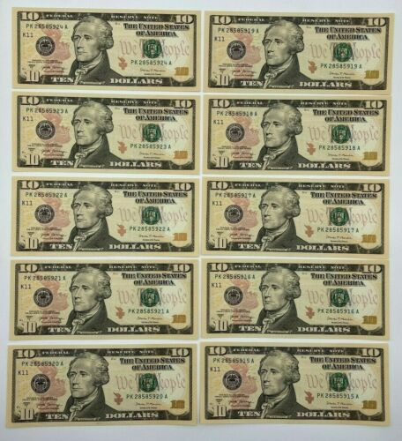
Ten Dollar Bills!
How many are here?
How much money is that?
How much money would be here if there was one more?
Two more?
Three more?
Ten more?
Ten less?
1.NBT.C5

Slide 16
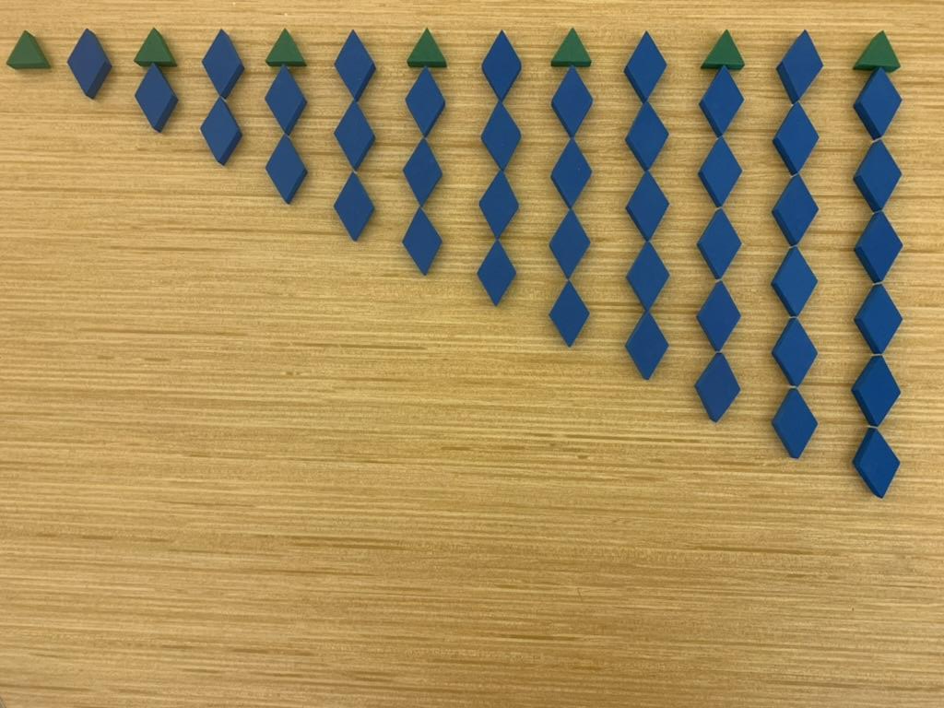
What do you notice?
What do you wonder?
What could this be?
1.OA.C6

Slide 17
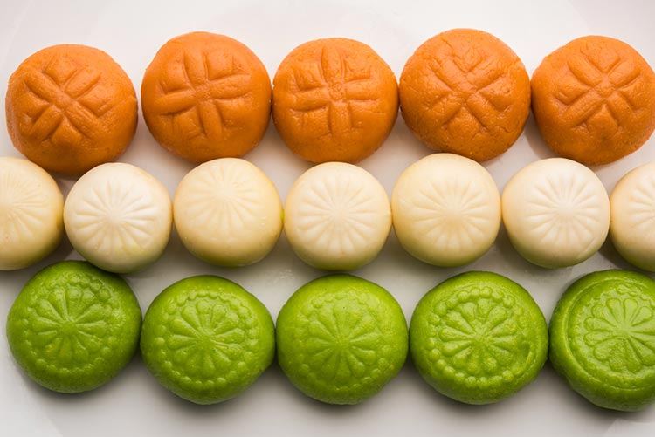
Celebrate India Republic Day!
How many Idlis do we see here?
Let’s create expressions to match our math thinking?
1.OA.C5
Notes:
Week of January 27, 2025

Slide 18
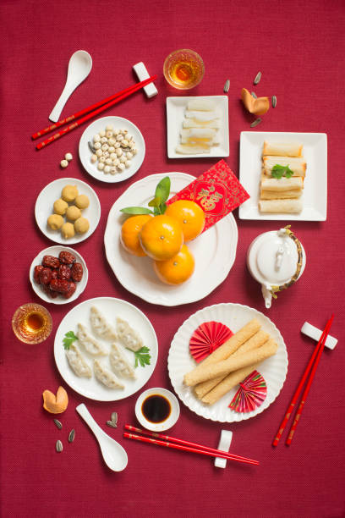
Happy Lunar New Year!
恭喜发财
2025 is the Year of the Snake!
What interesting shapes do we see here?
What would happen if we partition some of the shapes?
What would the shapes look like if we put them together?
1.G.A3

Slide 19
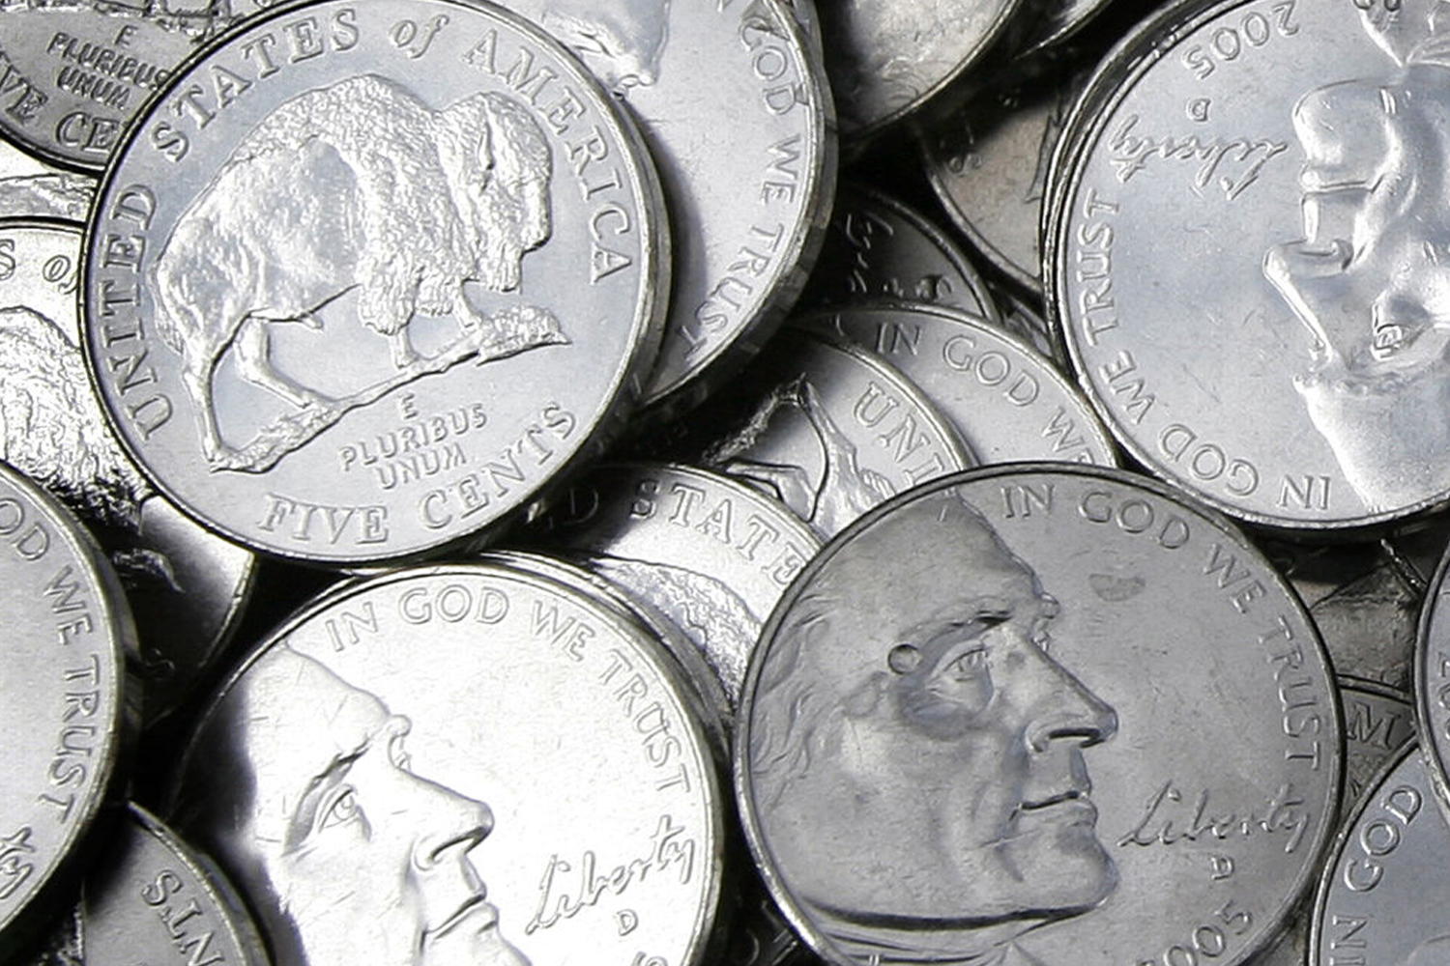
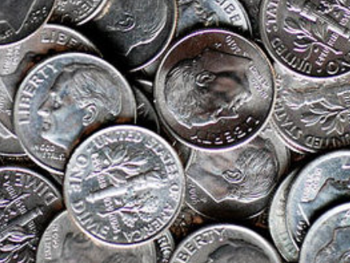
Would you rather have….
2 handfuls of nickels
Or 1 handful of dimes?
1.MD.D5

Slide 20
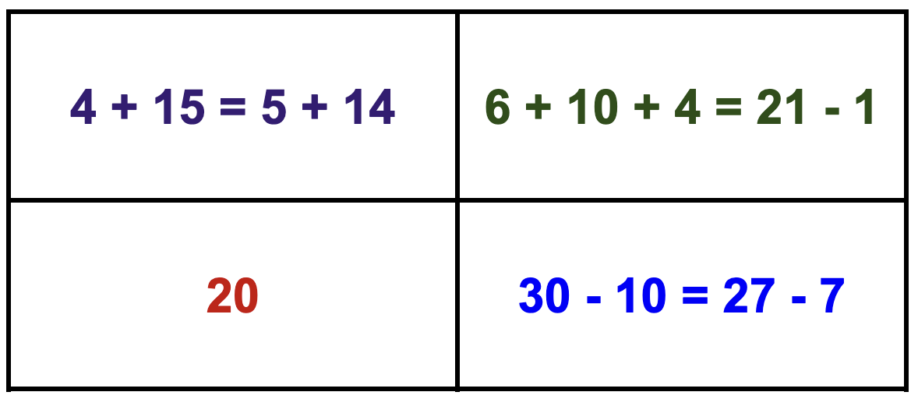
Which one does not belong?
1.OA.D7
Notes:
Top left: not 20, all addition
Top right: equation with addition and subtraction
Bottom left: not an equation
Bottom right: only equation with only subtraction

