Slide 1

Today we honor Civil Rights Leader Rosa Parks!
What can we count?
How many different ways can we count?
K.CC.B5
Notes:
Week of December 2, 2024

Slide 2
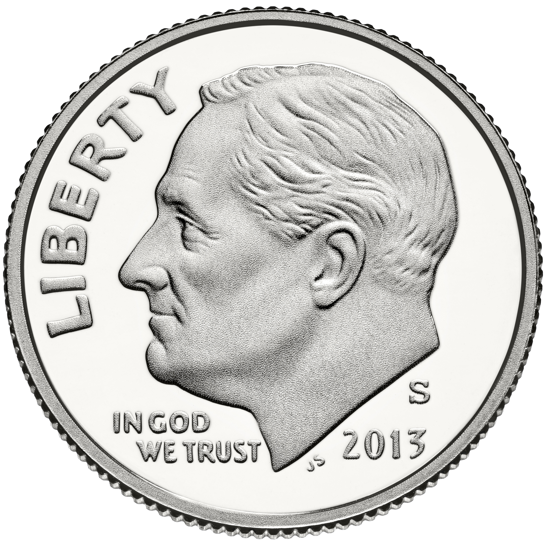
Today is GIVING TUESDAY!
What do we think GIVING TUESDAY is?
How many dimes are here? How do we see them?
How many more will make 10? How much money is here?
K.CC.A1,OA.A2

Slide 3
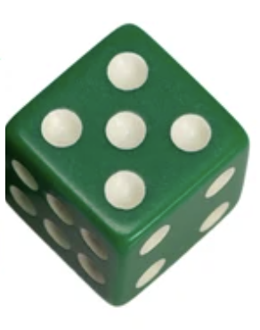
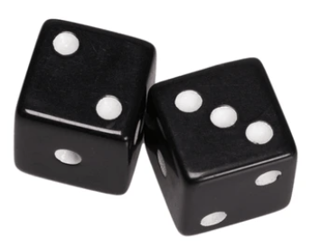
Today is National Dice Day!
What is the same?
What is different?
K.CC.C6

Slide 4
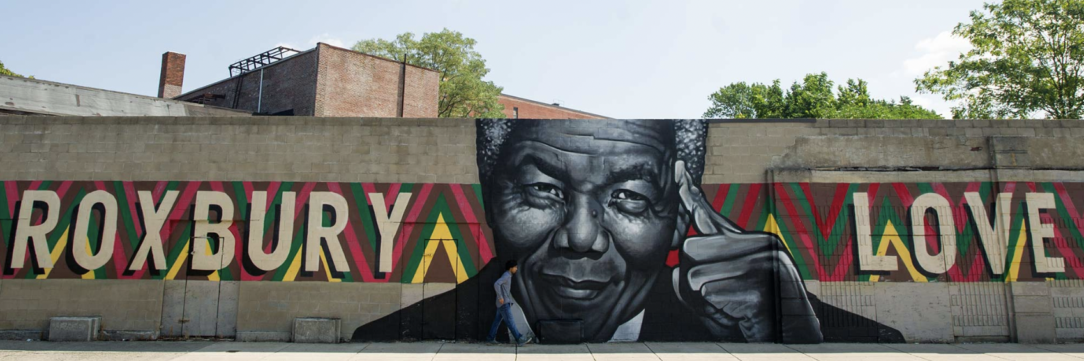
What are some of the shapes we see in this mural?
How many different shapes can we find?
K.G.A2

Slide 5
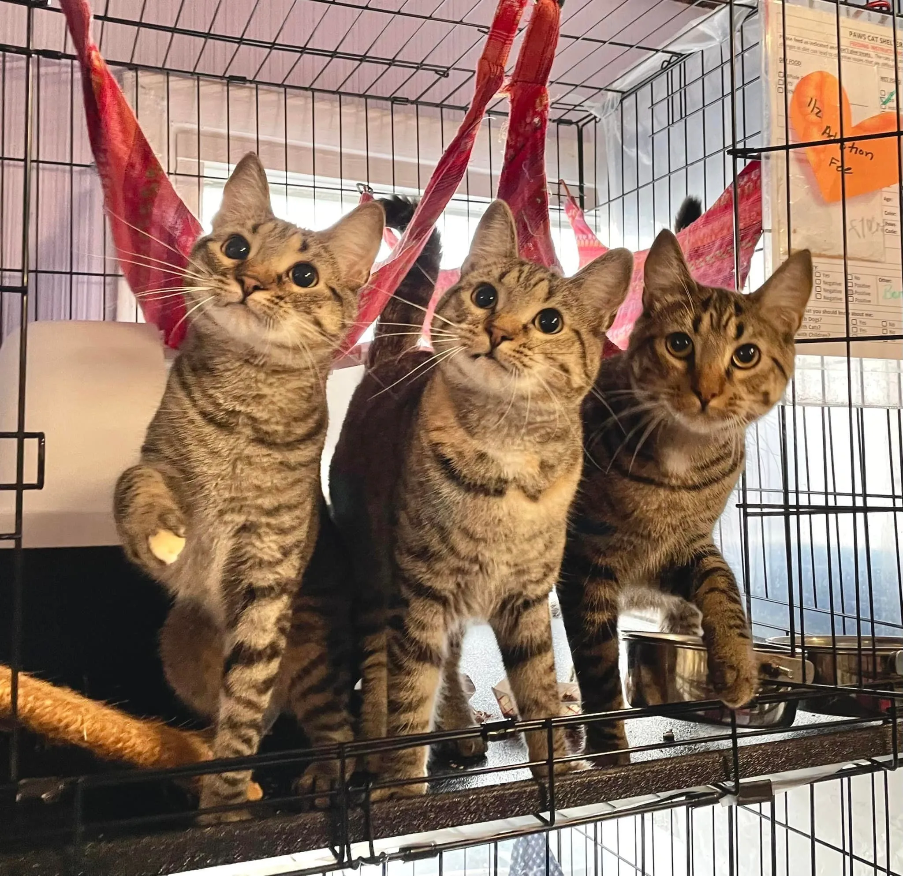
Today is National Shelter Pets Day!
These 3 adorable kittens are being adopted today!
How many kitten eyes?
How many kitten paws?
How do we know?
K.OA.A2

Slide 6

Happy Independence Day Tanzania!
Shape Detectives…
What shapes do we see in this flag?
How many?
K.G.A2
Notes:
Week of December 9, 2024

Slide 7
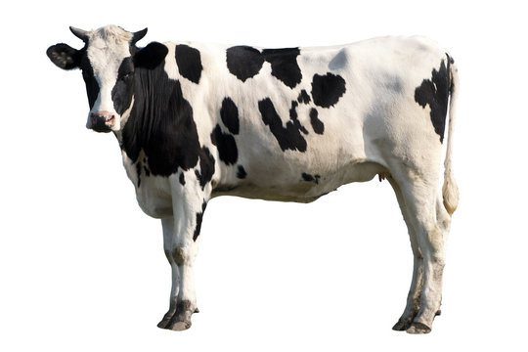
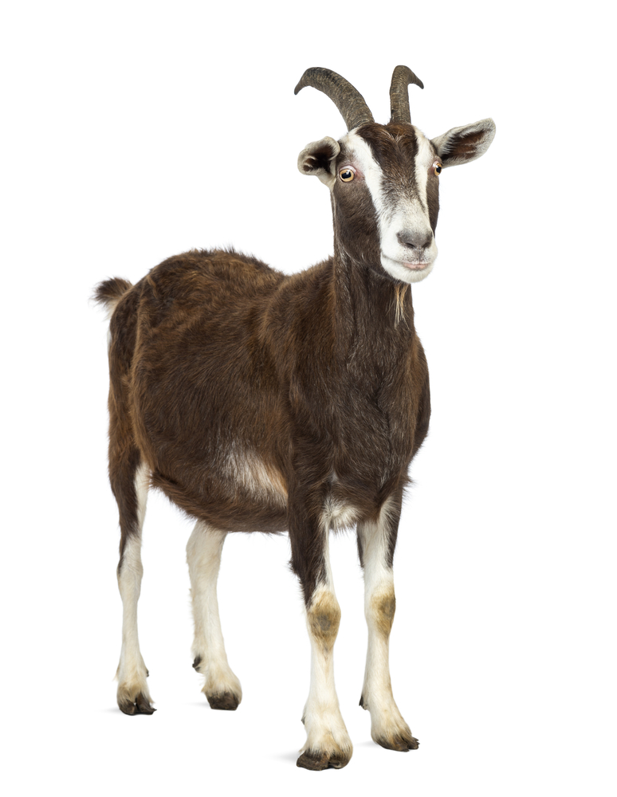
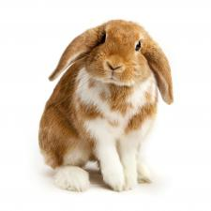
How can we compare these farm animals?
K.MD.A2

Slide 8
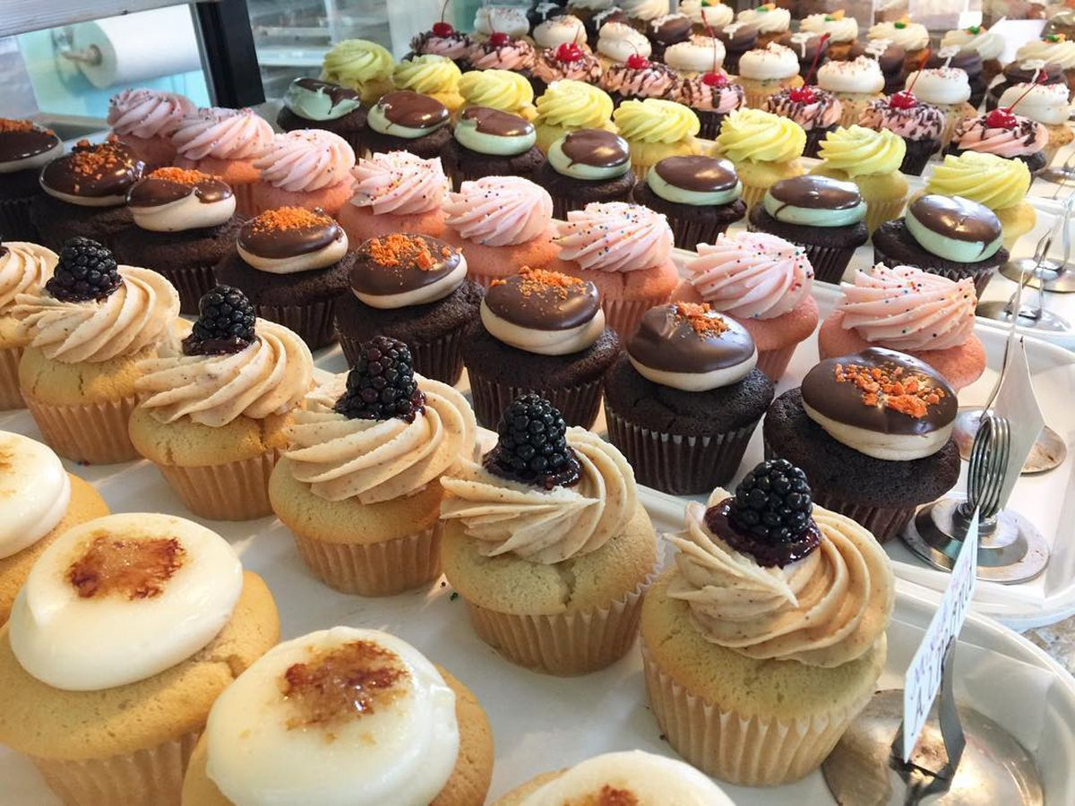
Look at all of these yummy cupcakes at Market Basket!
What do we notice?
Let’s describe the cupcakes using …
Next to
Above
Below
Beside
In front of
behind
K.G.A1

Slide 9
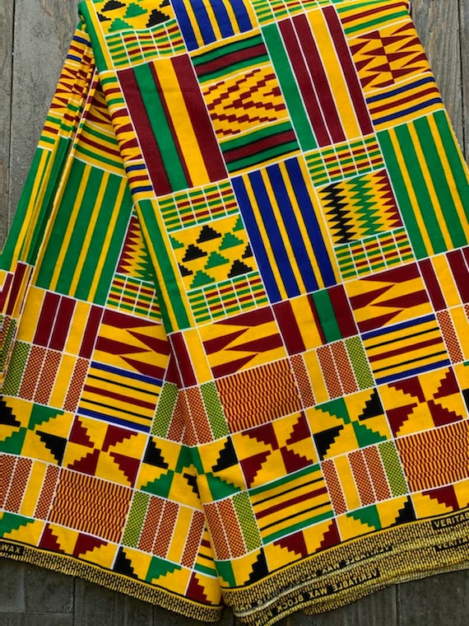
Today is Jamhuri Day
in Kenya
What shapes do we see in this kente cloth from Kenya?
How can we describe them?
K.G.A2

Slide 10
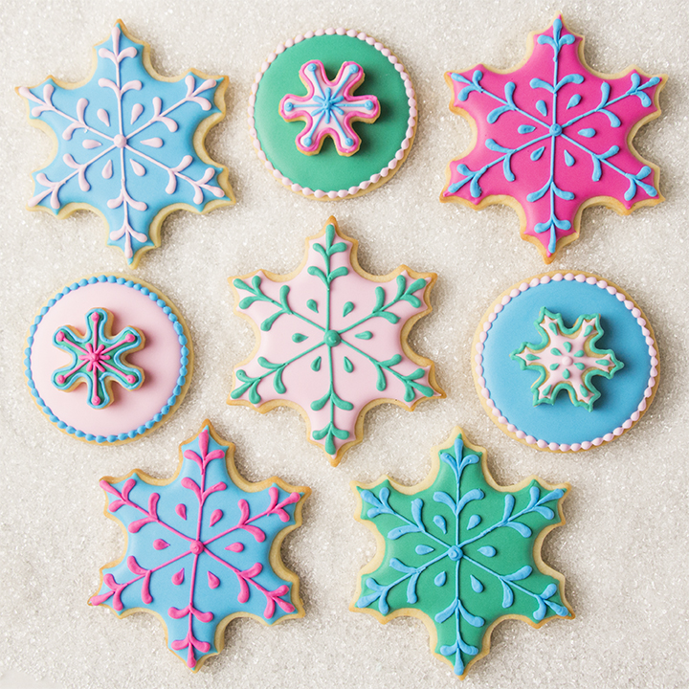
What do we notice?
What do we wonder?
How many different ways do we see the cookies?
How might we sort them?
K.SMP.3

Slide 11
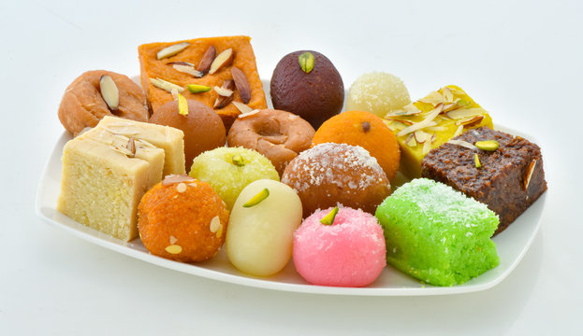
Today in India we celebrate Vijay Diwas
How many traditional Indian sweets do we see here?
How would you sort them?
K.MD.B3
Notes:
Week of December 16, 2024

Slide 12
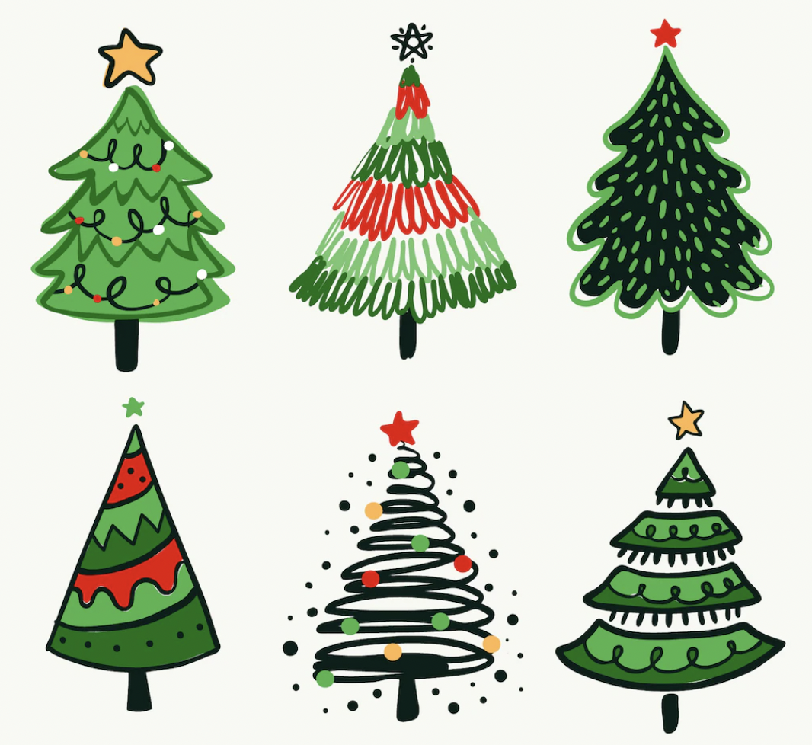
What can we say about these trees?
How are they the same?
How are they different?
K.SMP.3

Slide 13
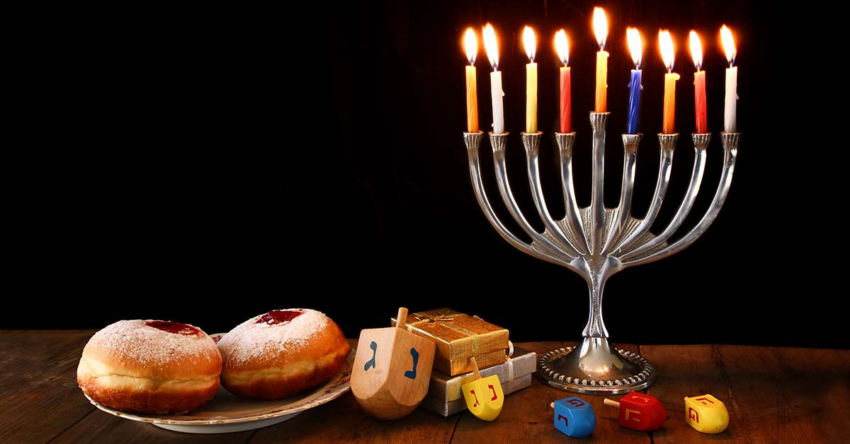
Next Week We Celebrate Hanukkah!
What do we notice?
What do we wonder?
What can we count?
K.CC.B5

Slide 14
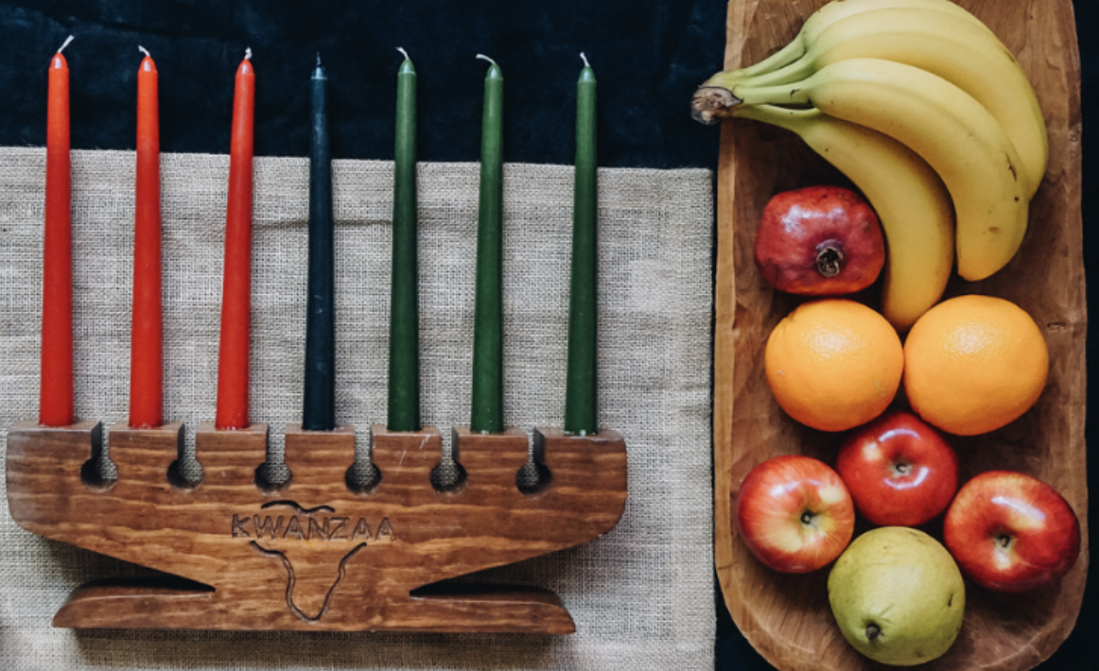
We Celebrate KWANZAA Next Week!
What can we count?
How can we count?
How can we sort?
K.MD.B3

Slide 15
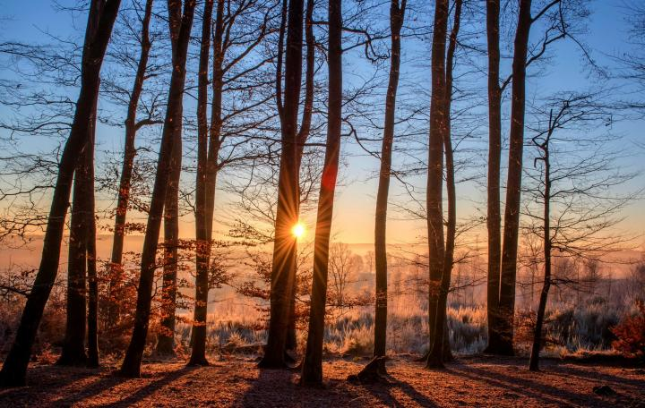
Tomorrow is the Winter Solstice!
It is the shortest day of the year!
We will have 9 hours of daylight and 15 hours of night.
What can we say about these two numbers?
K.NBT.A1

