Slide 1
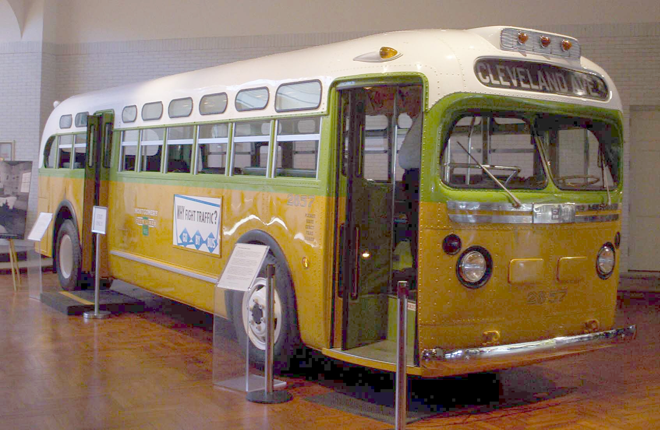
Today is Rosa Parks Day!
Rosa Parks was a civil rights leader.
This is the bus she rode in 1955 where she refused to move her seat.
How long ago was 1955?
Is that a long time?
Why does it matter?
2.NBT.B7
Notes:
Week of December 2, 2024

Slide 2
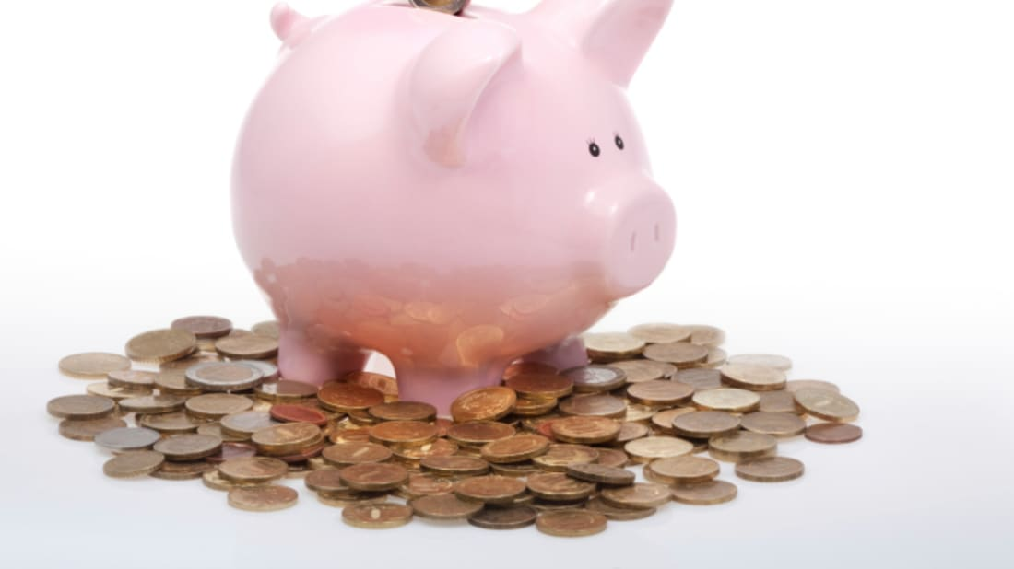
Today is GIVING TUESDAY
What do we think that means?
If we donated a nickel to our favorite charity EVERY DAY for a week, how much money would that be?
What about 2 weeks?
3 weeks?
4 weeks?
Do we see any patterns?
2.MD.C8

Slide 3
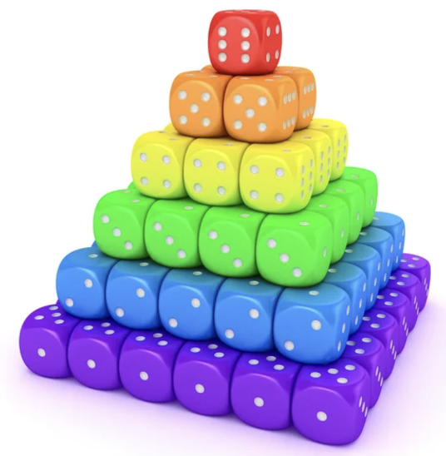
Happy National Dice Day!
What do we notice?
What do we wonder?
What mathematical statements can we make about this dice pyramid?
2.OA. C4

Slide 4
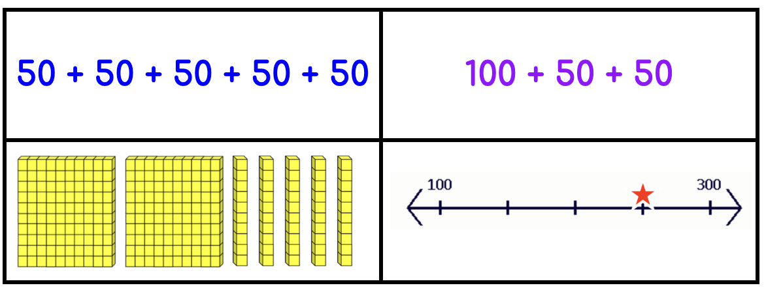
Which one does not belong?
2.NBT.A1
Notes:
Top left: only one with the same addend (five addends)
Top right: not 250
Bottom left: only one with base ten block model
Bottom right: only number line representation

Slide 5
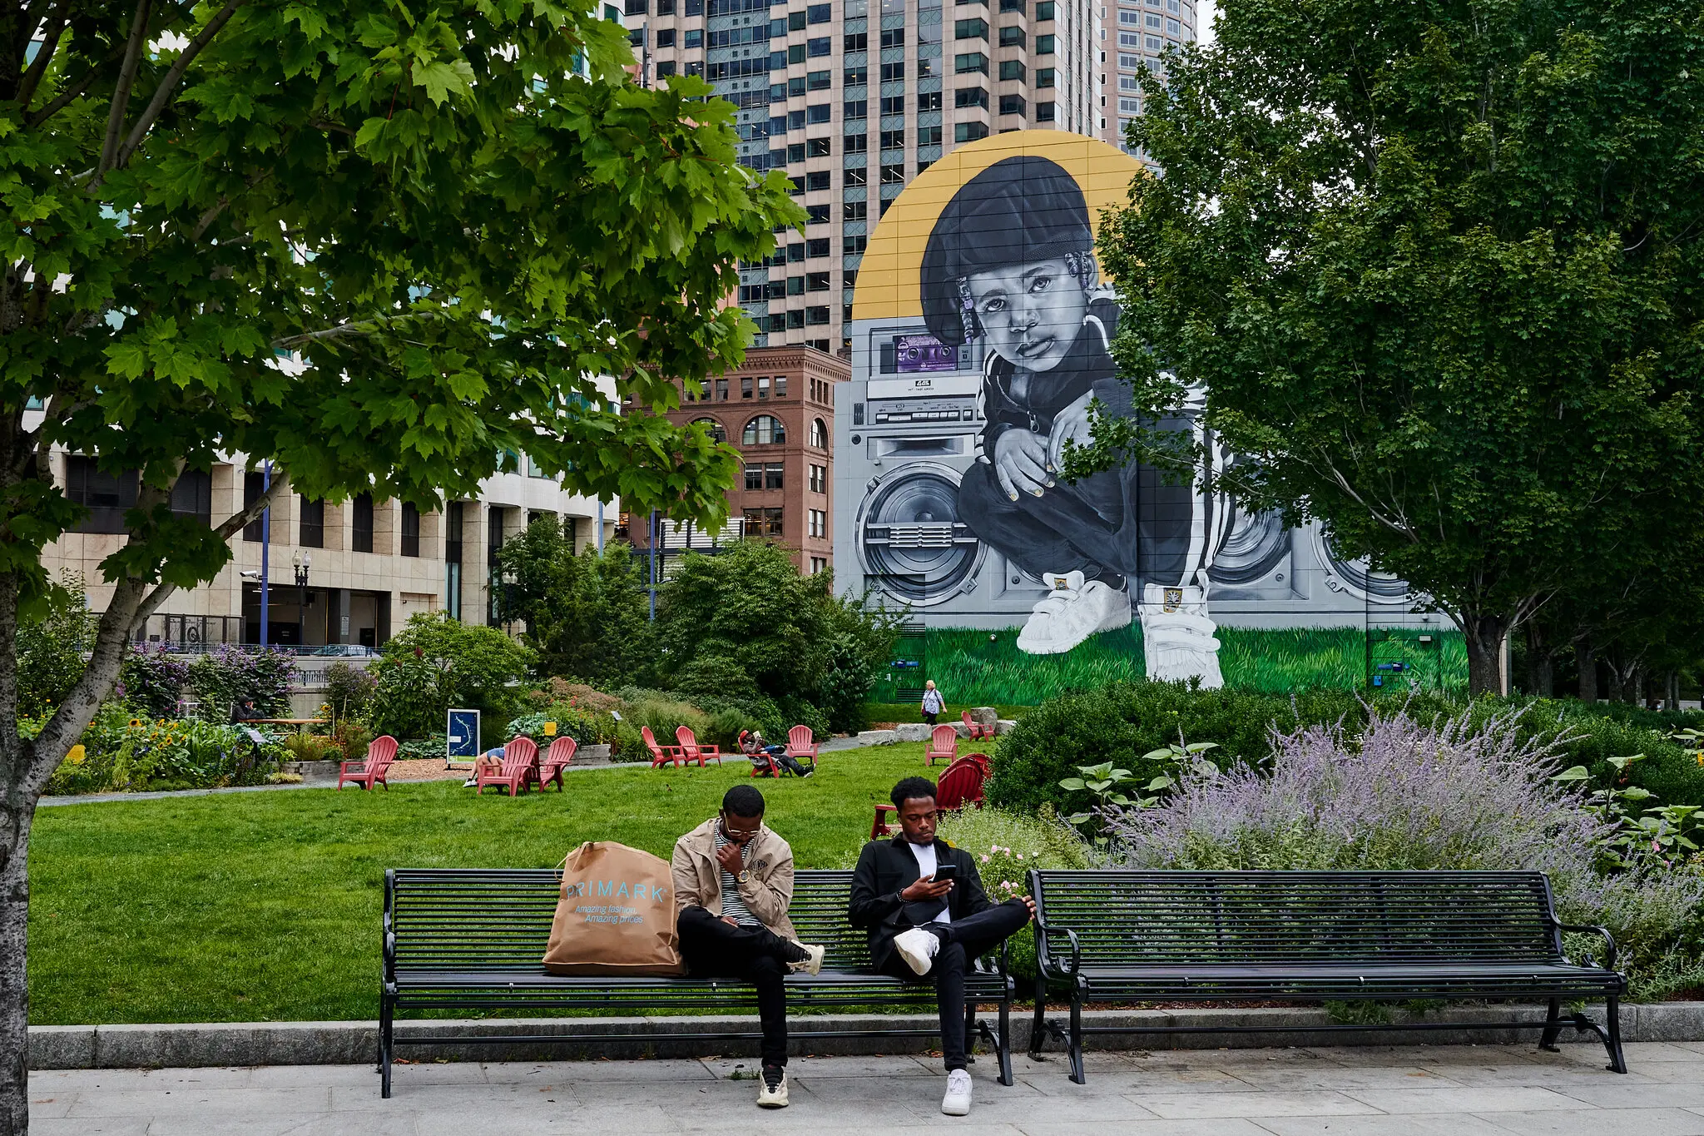
Look at this amazing mural in South Boston!
What do we think the height of this mural is?
Estimate!
2.MD.A3

Slide 6
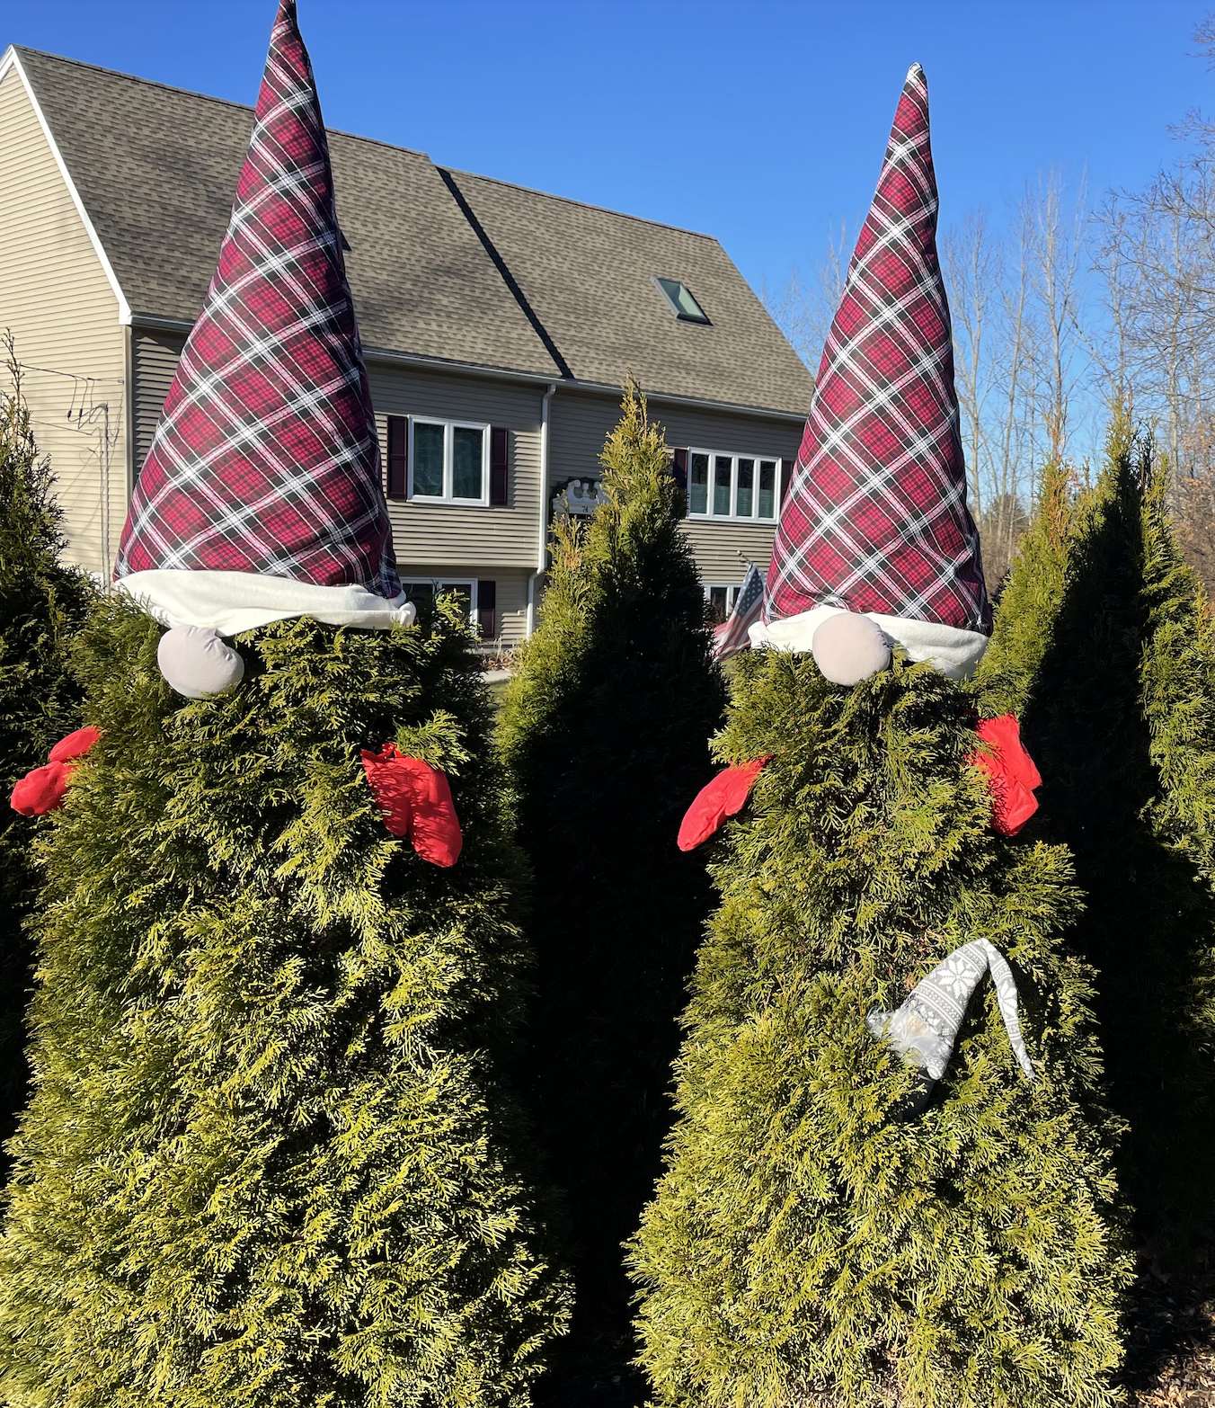
Yes, it’s gnome season!
If the Al
(the little gray gnome)
is 14 inches tall,
how tall do you think
the tree is?
How tall would both trees be?
2.MD.A3
Notes:
Week of December 9, 2024

Slide 7
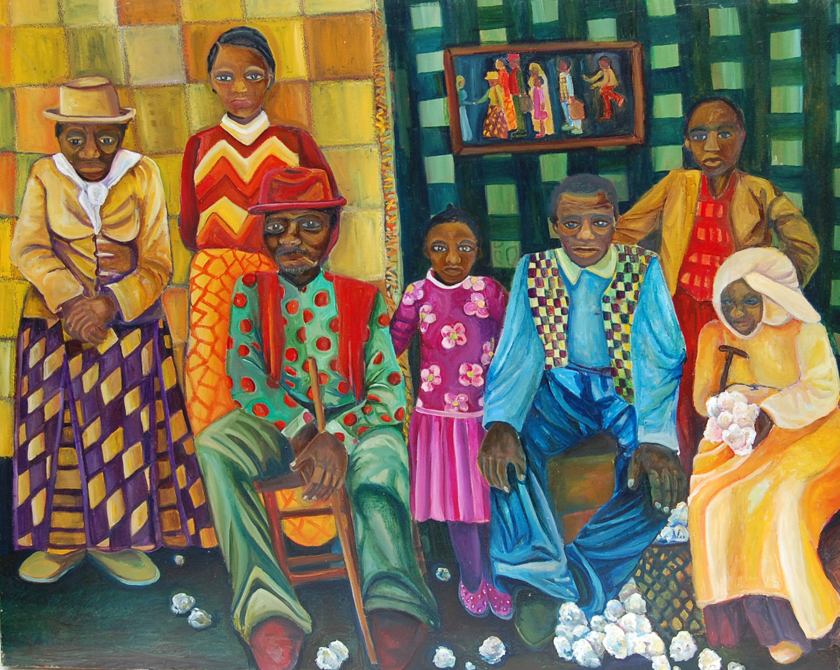
What math do we notice in this painting by South End artist Marilyn Jan Casey?
Sketch one of the shapes you see.
What does HALF of that shape look like?
What does a THIRD of the shape look like?
2.G.A3

Slide 8
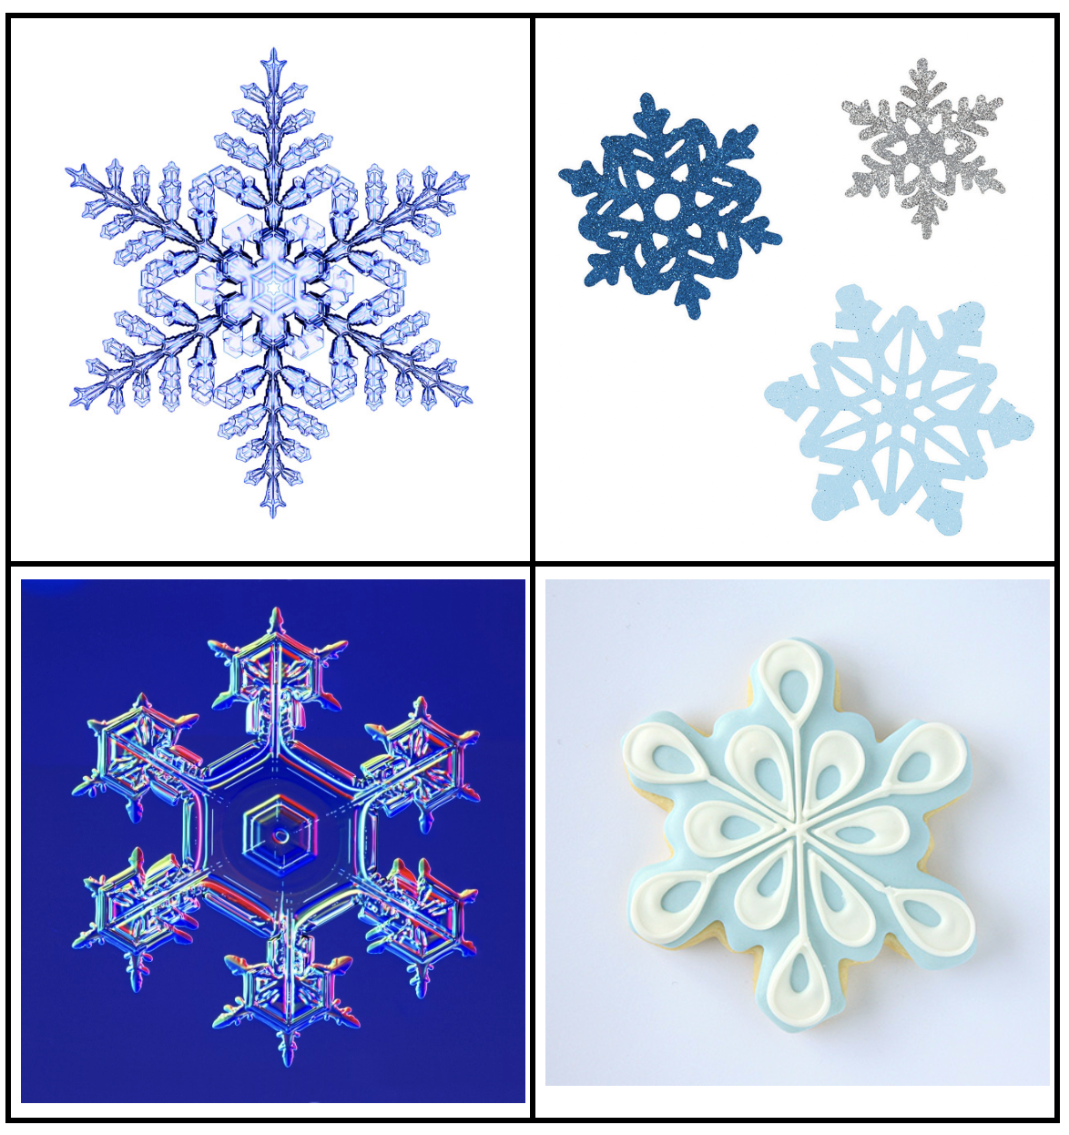
Which one doesn’t belong?
2.SMP.3

Slide 9
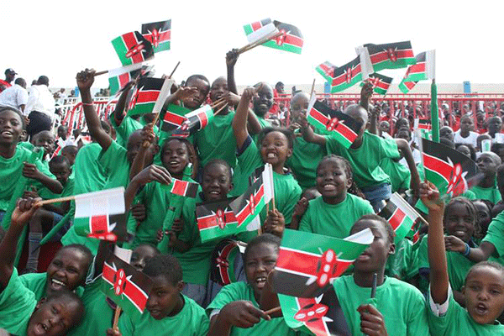
It’s Independence (Jamhuri) Day in Kenya!
On this day in 1964 Kenya became a republic!
How long ago was that?
Is that surprising to you?
2.NBT.B7

Slide 10

145 + 200 = 199 + 146
351 = 200 + 150 + 1
34 tens + 13 = 343
2.NBT.A4

Slide 11
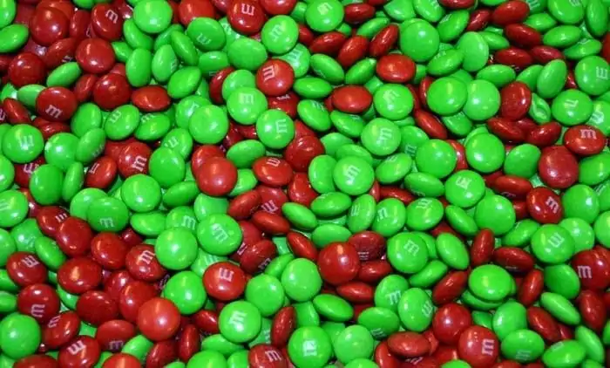
There are about 480 m&m’s per pound.
If there are 2 pounds of m&m’s here, what is possible?
2.NBT.B7
Notes:
Week of December 16, 2024

Slide 12
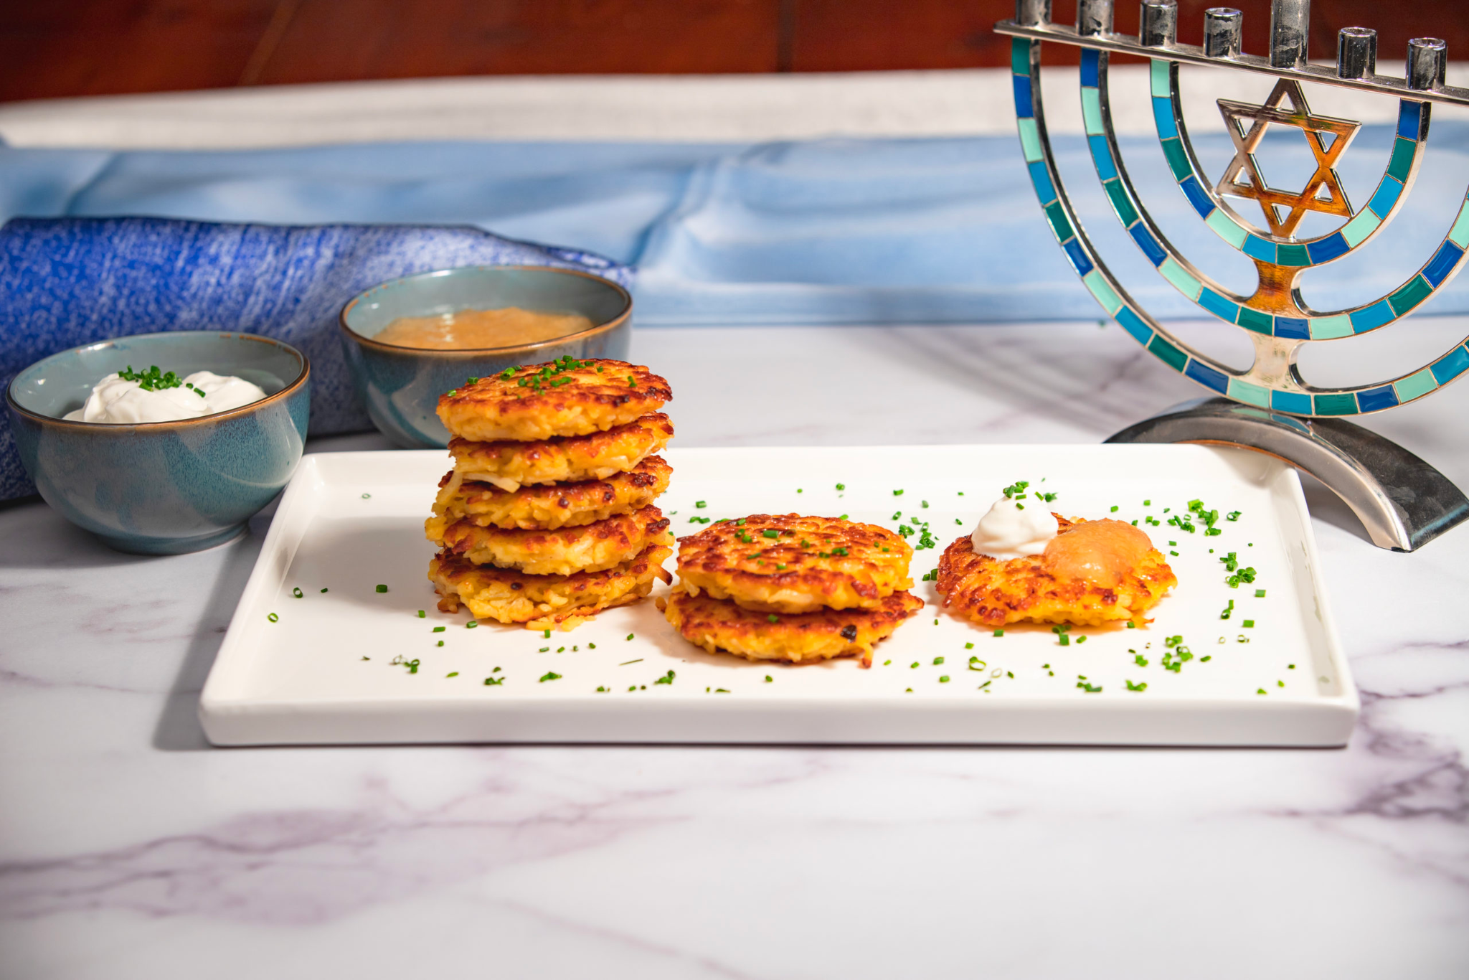
Hanukkah is next week!
What do we notice?
What do we wonder?
How many potato latkes would be on 2 plates?
3 plates? 4?
Do we see a pattern?
2.NBT.B5

Slide 13
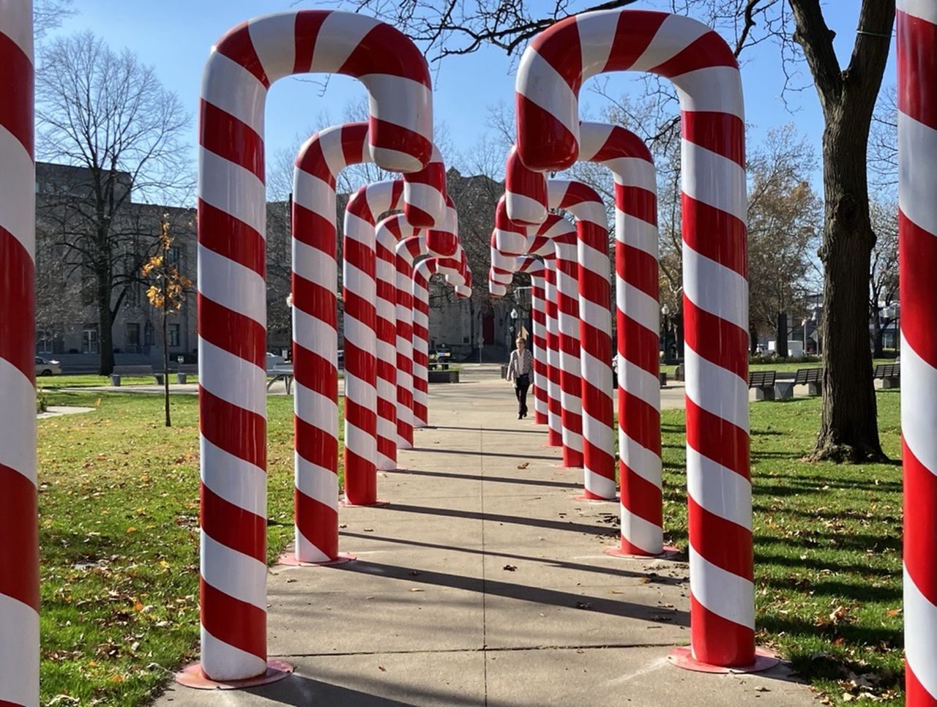
Estimate the height of one of these candy canes.
How do you know you’re close?
What strategy did you use?
2.MD.A3

Slide 14
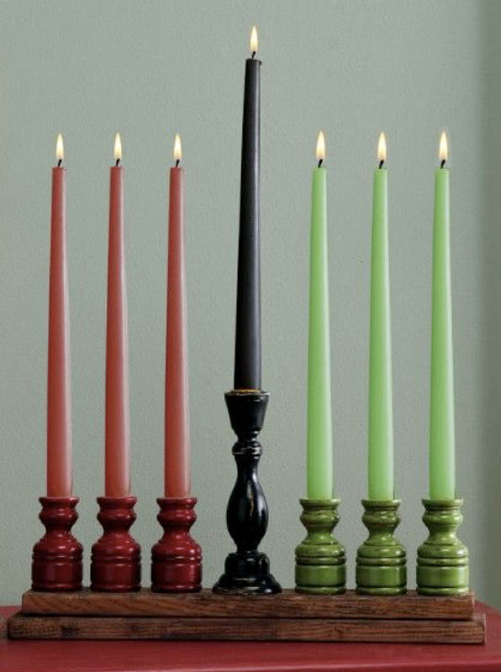
Happy Kwanzaa
(next week!)
Kwanzaa is celebrated for 7 nights.
To light the kinara, we will need:
7 black candles
15 red candles
6 green candles
How many candles is that altogether?
2.NBT.B6

Slide 15
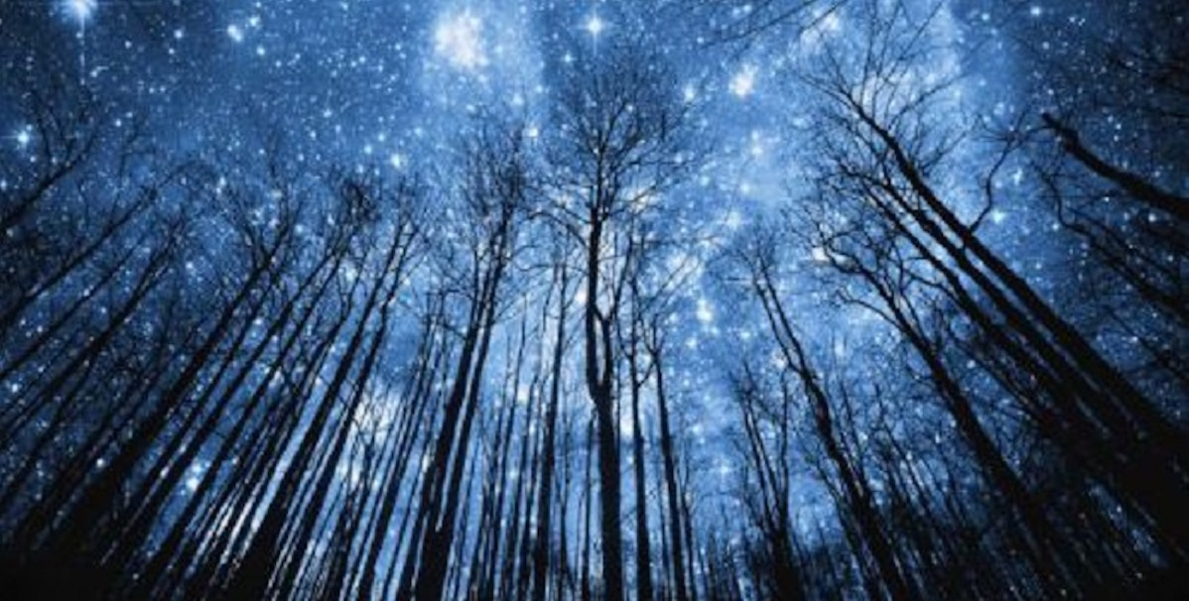
Tomorrow is the winter solstice!
It is the longest night of the year!
Today we have 15 hours of darkness!
So how many hours of daylight will we have?
2.OA.B2

