Slide 1

Today we honor Civil Rights Leader Rosa Parks!
What can we count?
How many different ways can we count?
1.NBT.A1
Notes:
Week of December 2, 2024

Slide 2
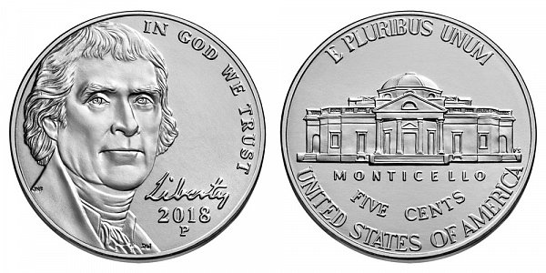
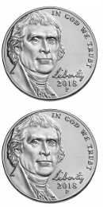
Today is GIVING TUESDAY!
What do we think GIVING TUESDAY is?
How many nickels are here?
How do we see them?
How many more will make 20?
What is the value of these nickels?
1.NBT.B2, MD.D5

Slide 3
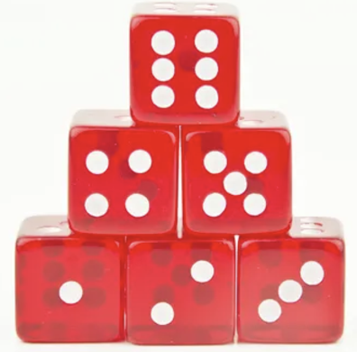
Happy National Dice Day
What do we notice?
What do we wonder?
How many dice are here?
How many dots do we see?
1.OA.C5

Slide 4
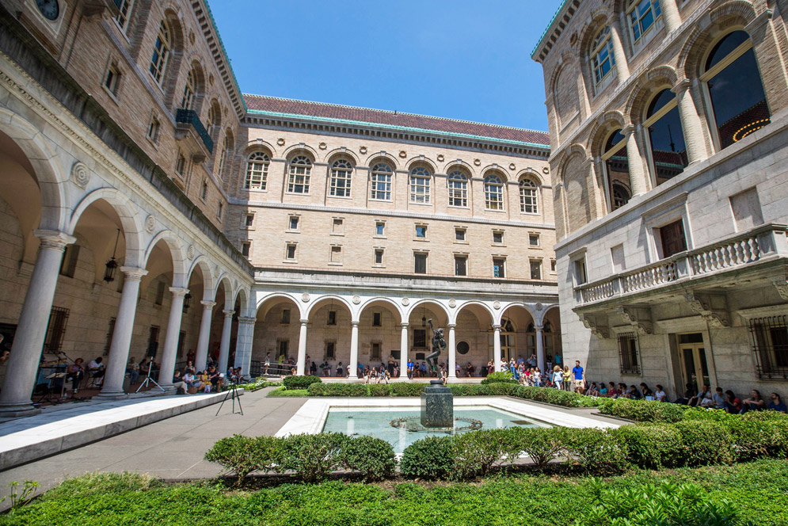
This is the courtyard in the Boston Public Library.
How many windows do we see?
How many don’t we see?
1.NBT.A1

Slide 5
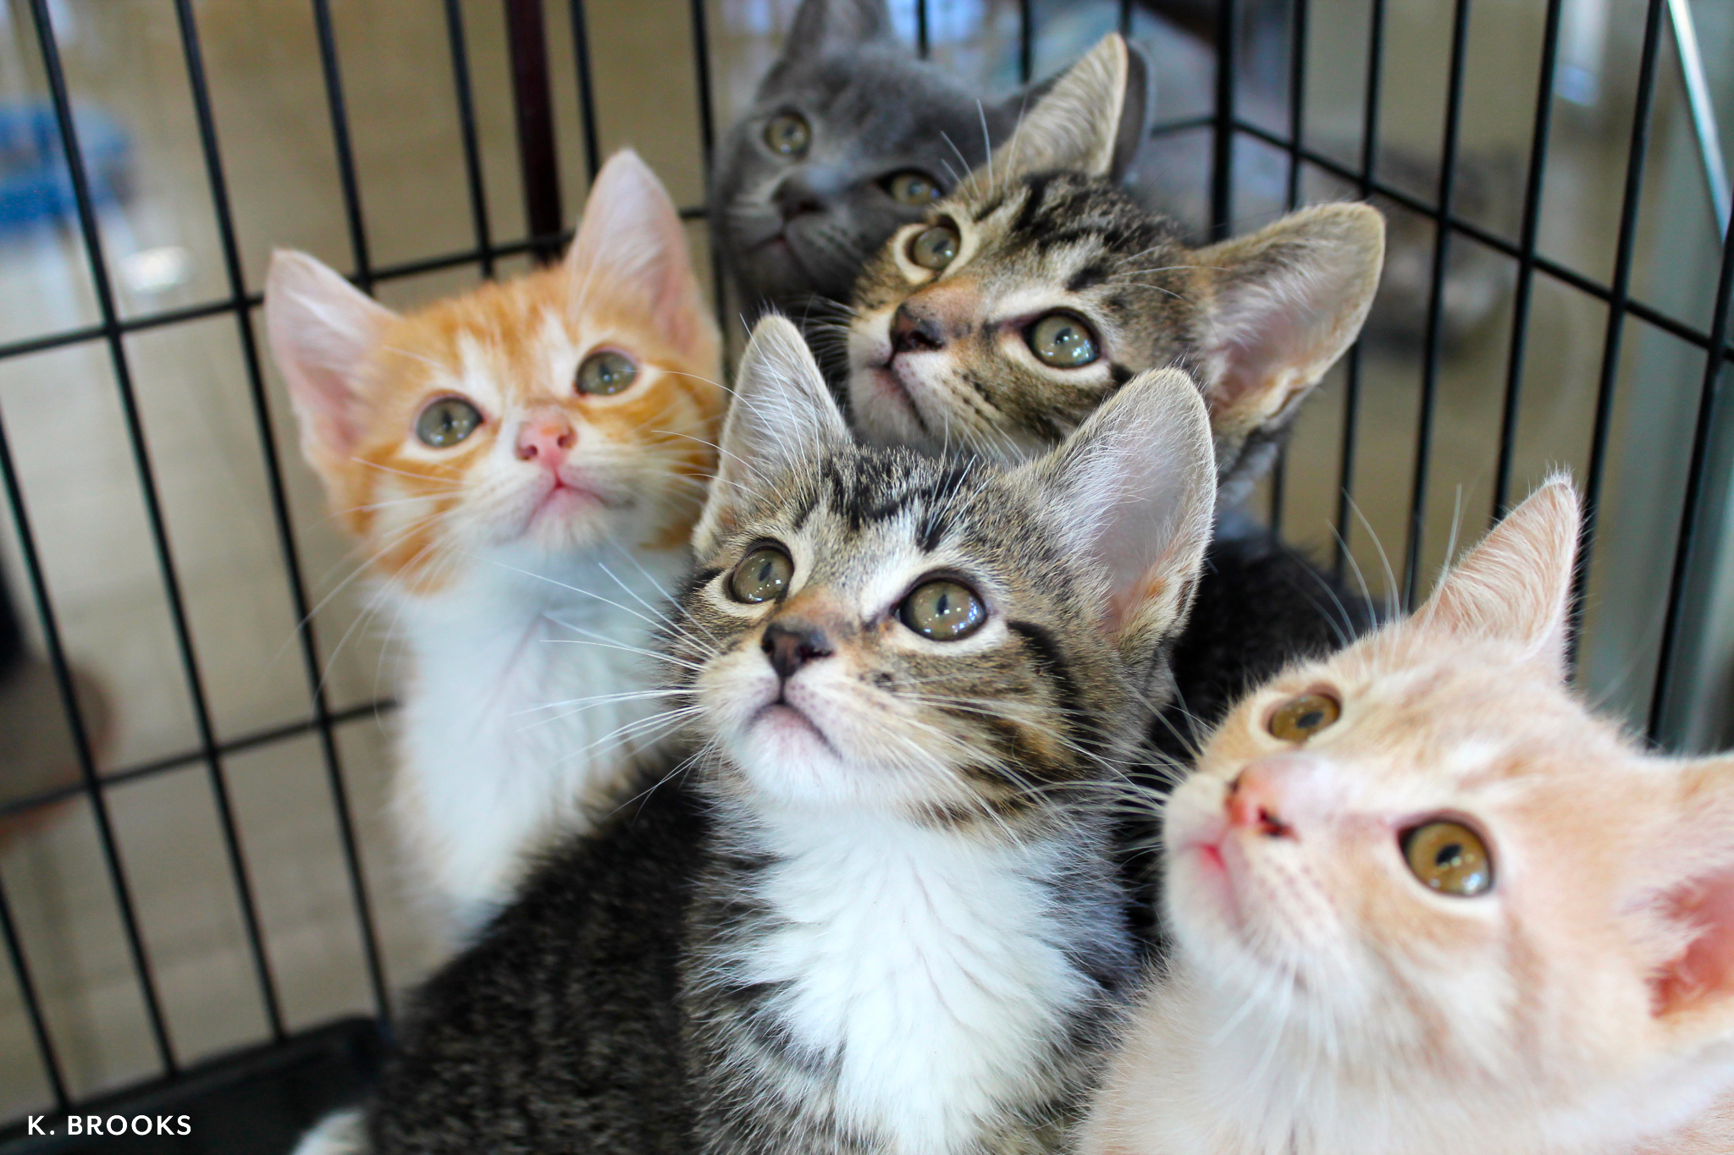
Today is National Shelter Pets Day!
These 5 adorable kittens are being adopted today!
How many kitten eyes?
How many kitten paws?
How do we know?
1.OA.C6

Slide 6

Happy Independence Day Tanzania!
Shape Detectives…
What shapes do we see in this flag?
Can we combine some of them to make a new shape?
1.G.A2
Notes:
Week of December 9, 2024

Slide 7
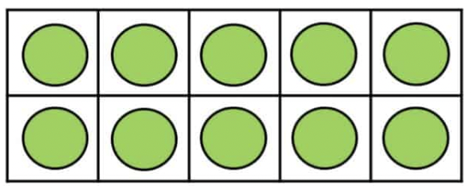
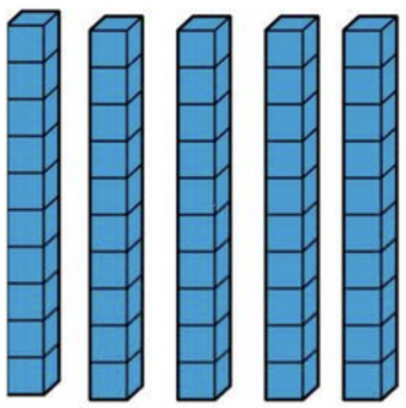

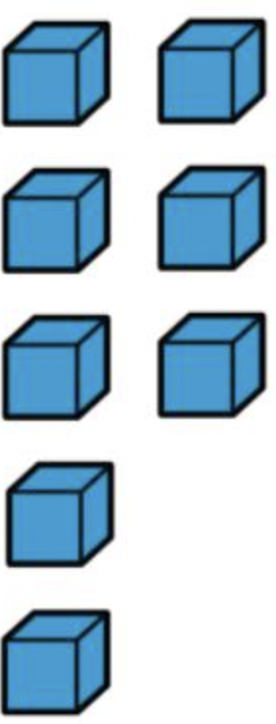
What is the same?
What is different?
1.NBT.B3

Slide 8
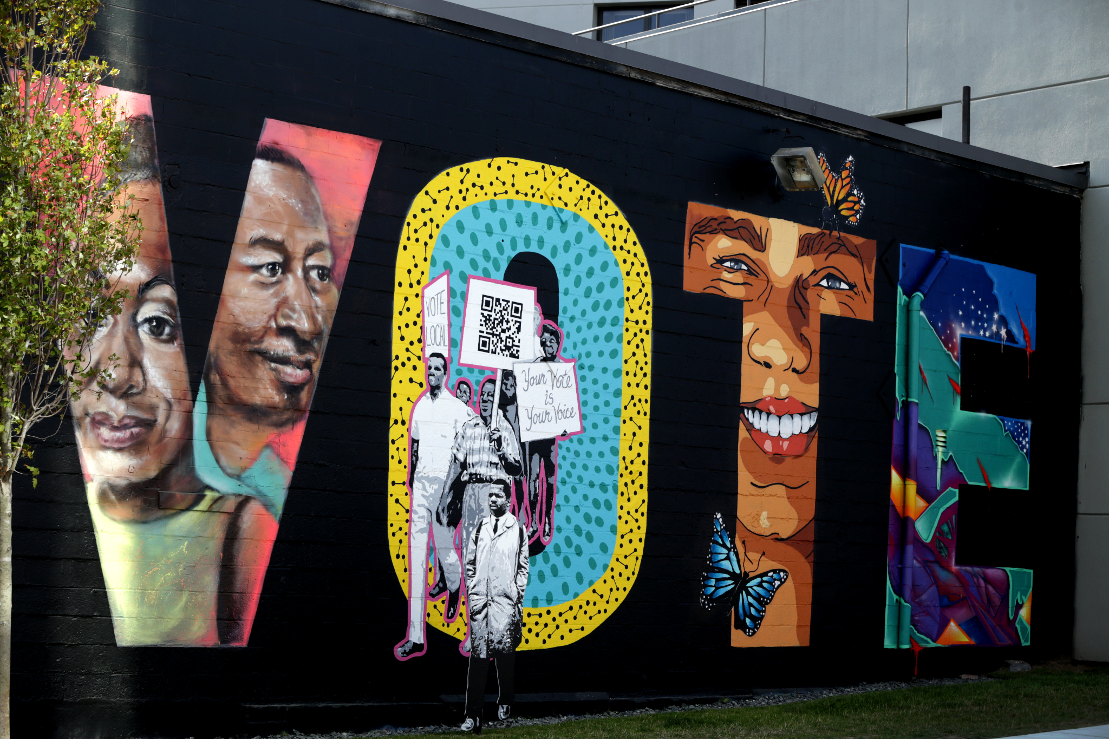
What do we notice?
What are some shapes we see in this mural?
What would happen if we cut some of the shapes in half?
1.G.A2

Slide 9
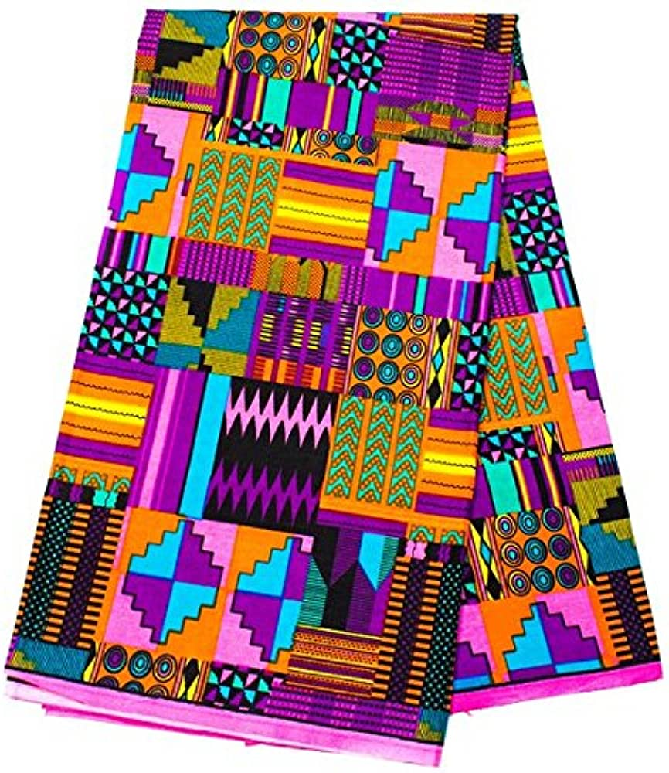
Today is Jamhuri Day
in Kenya
What shapes do we see in this kente cloth?
How can we describe them?
1.G.A1

Slide 10
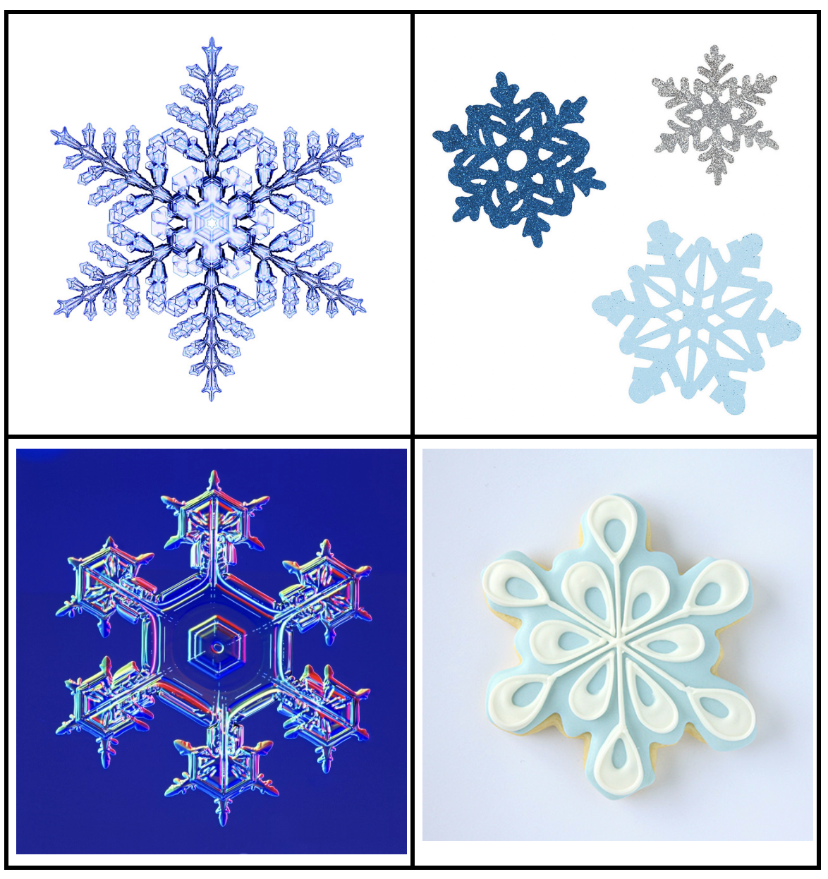
Which one doesn’t belong?
1.SMP.3

Slide 11
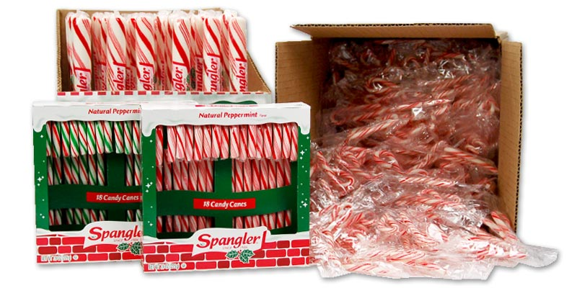
Would you rather . . .
18 giant candy canes, 2 boxes of regular candy canes,
or a case of tiny ones?
1.SMP.3
Notes:
Week of December 16, 2024

Slide 12
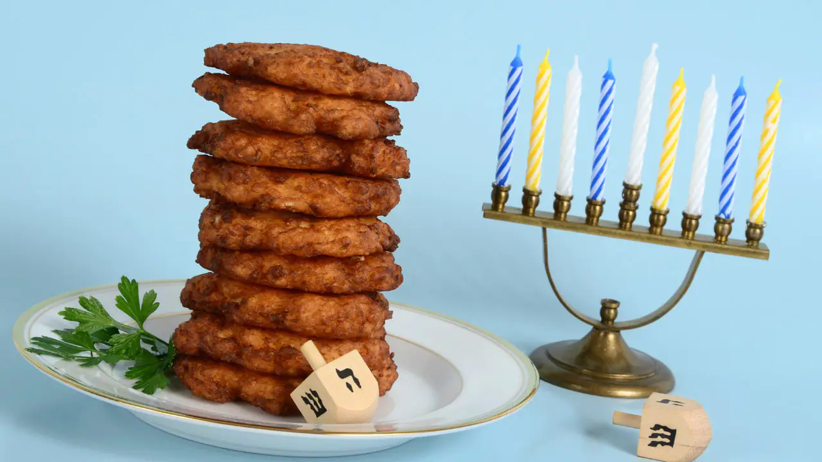
Hanukkah is next week!
What do we notice?
What do we wonder?
How many potato latkes would be on 2 plates?
3 plates? 4?
Do we see a pattern?
1.NBT.C4

Slide 13
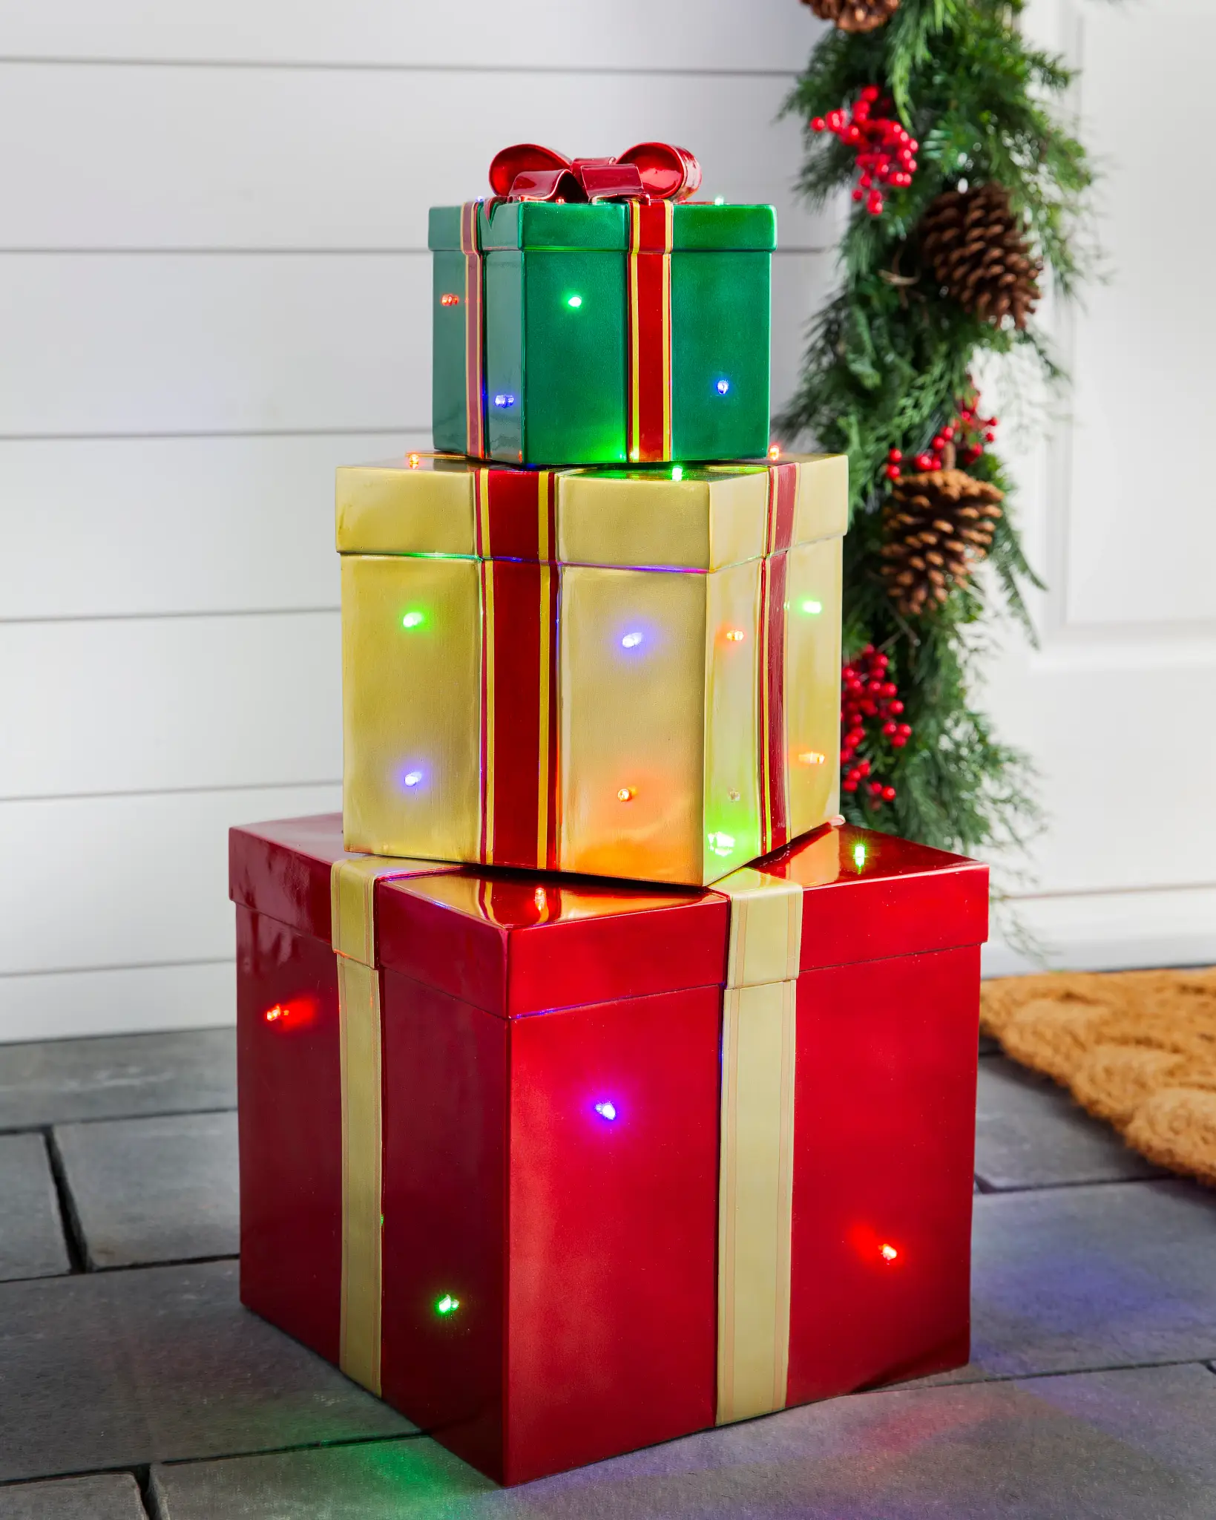
These 3 gifts weigh 20 pounds altogether.
What is possible?
1.OA.A2

Slide 14
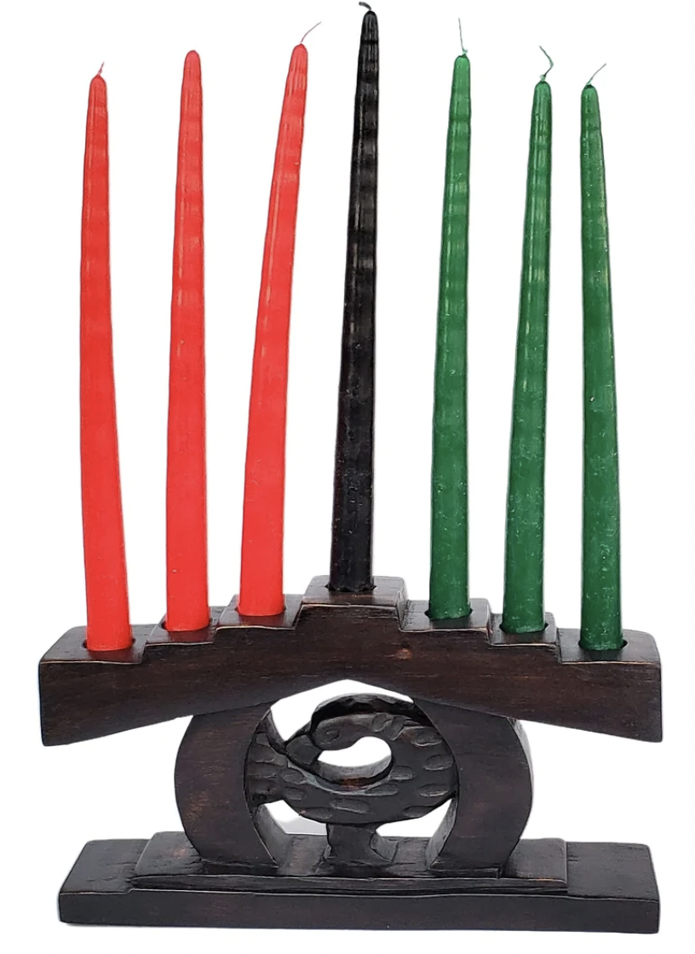
We Celebrate Kwanzaa next week!
Kwanzaa is celebrated for 7 nights.
To light the kinara, we will need:
7 black candles
15 red candles
6 green candles
How many candles is that altogether?
1.NBT.A4

Slide 15
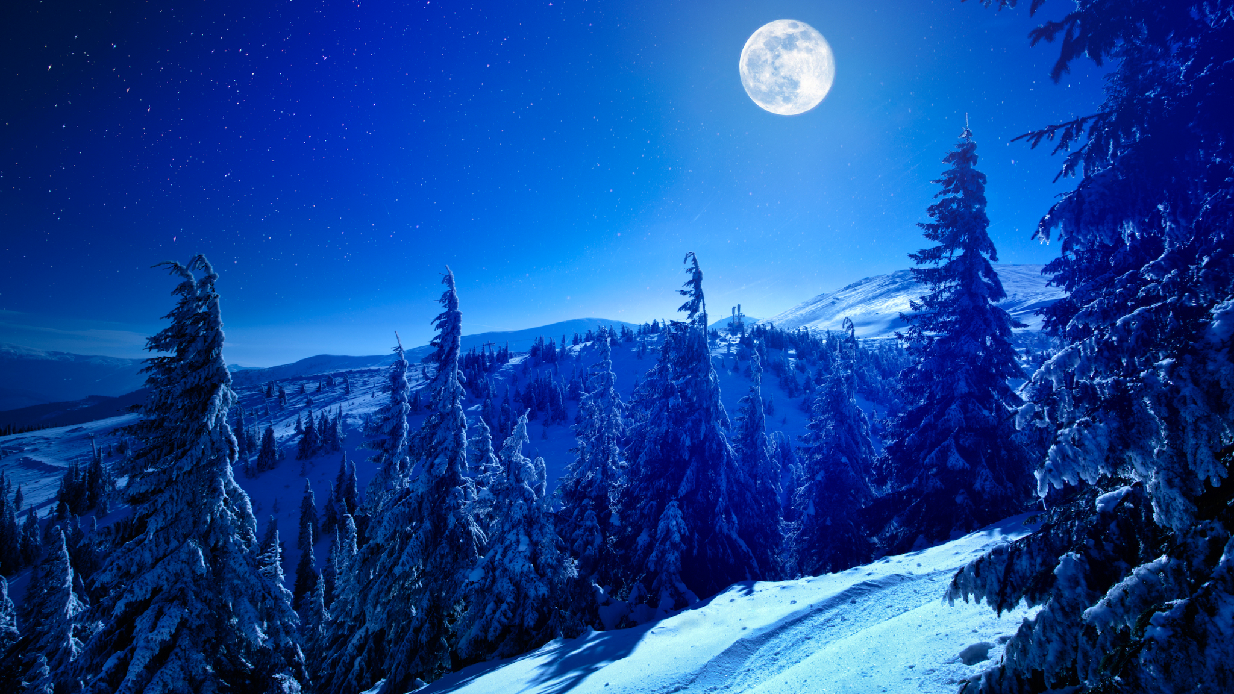
Tomorrow is the winter solstice!
It is the longest night of the year!
Today we have 15 hours of darkness!
So how many hours of daylight will we have?
1.OA.A1

