Slide 1
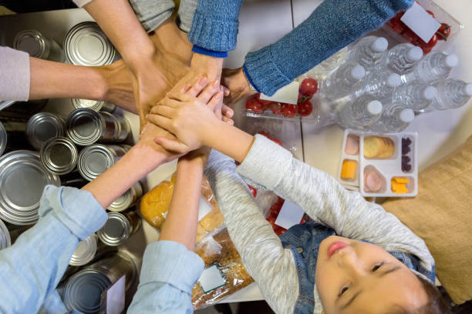
Today is the National Day of Community Service
These students spent an entire school day packing boxes to donate to the food pantry.
They packed over 100 boxes.
Each box weighed more than 20 pounds.
How many pounds of food might that be altogether?
Why does it matter?
5.NBT.A2
Notes:
Week of November 4, 2024

Slide 2
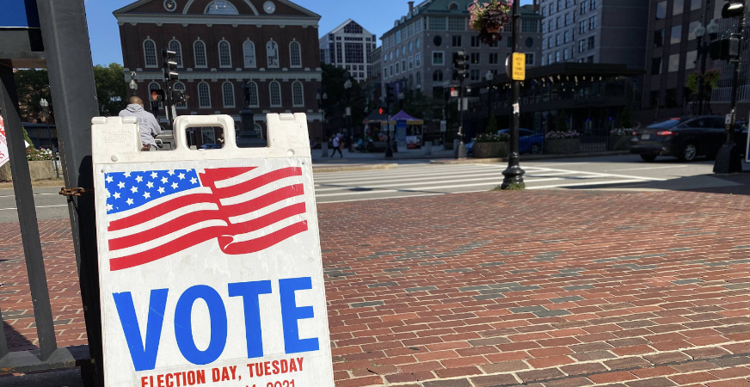
Today is Election Day!
Americans first began the custom of weekday voting in 1845, when Congress passed a federal law designating the first Tuesday following the first Monday in November as Election Day.
Before then, states were allowed to hold elections any time they pleased within a 34-day window before the first Wednesday in December.
What is a 34-day window?
When did people vote before 1845?
5.NBT.B7

Slide 3
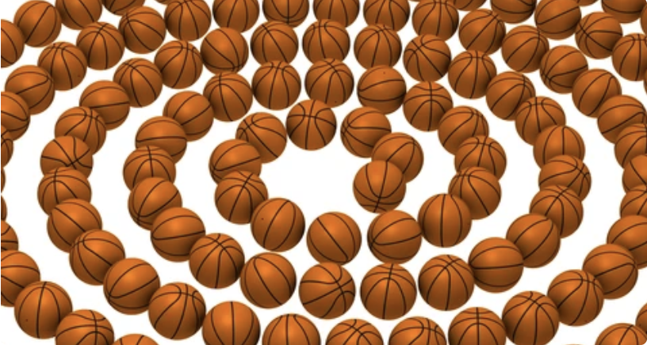
It’s National Basketball Day!
How can we figure out how many balls are here, without counting them?
5.OA.B3

Slide 4
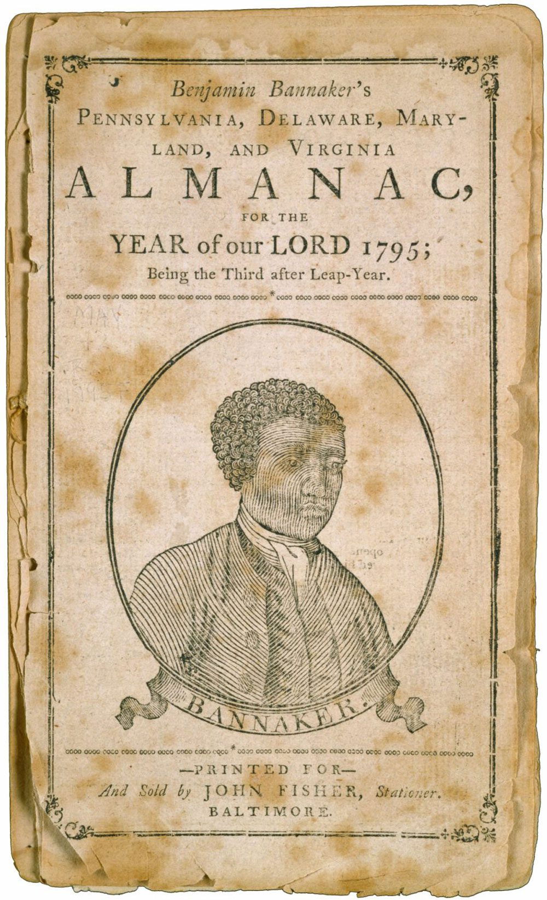
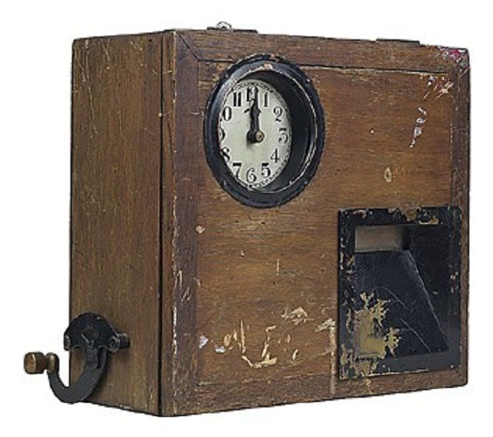
Celebrate Benjamin Banneker Week
Benjamin Banneker was a mathematician, astronomer, almanac compiler, inventor, and writer who was one of the first prominent African American thinkers.
The Banneker clock was the first clock built in America in 1753.
How long ago was that?
How can we figure it out?
If Banneker was born in 1731, how old was he when he invented this clock?
5.NBT.B7

Slide 5
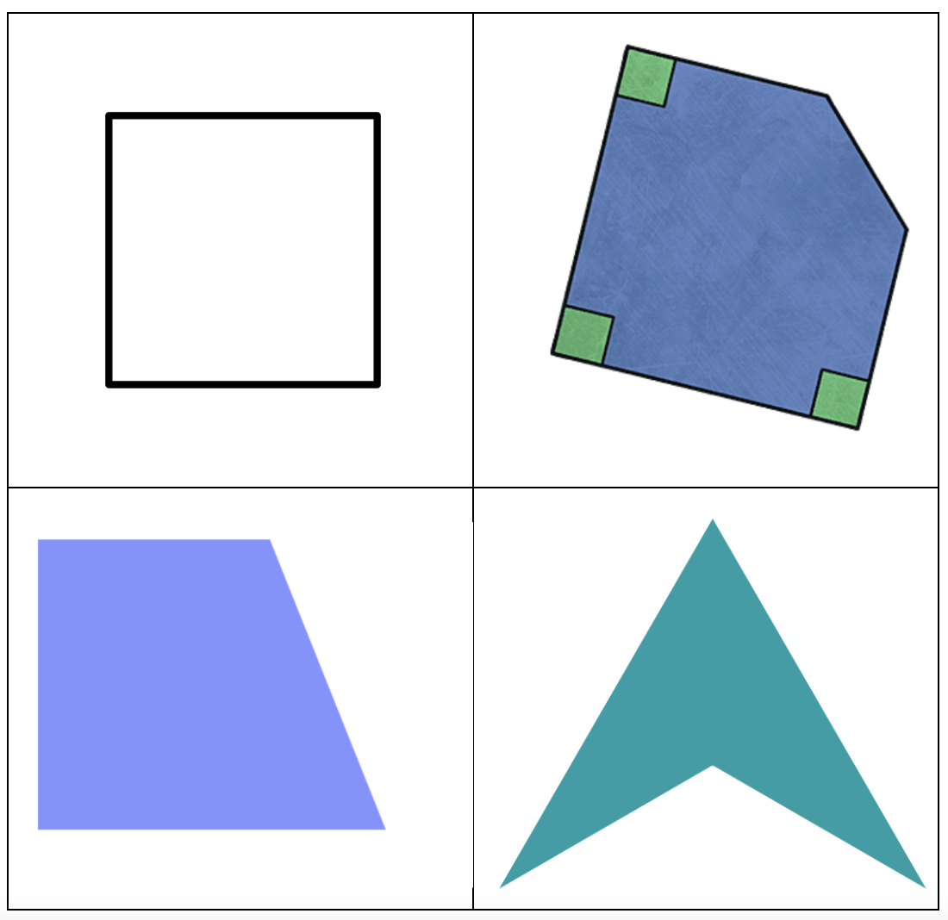
Which one doesn’t belong?
5.G.B3
Notes:
Top left: only regular polygon, all four sides and angles are equal
Top right: not a quadrilateral
Bottom left: 4 sides, none them equal
Bottom right: only concave quadrilateral

Slide 6
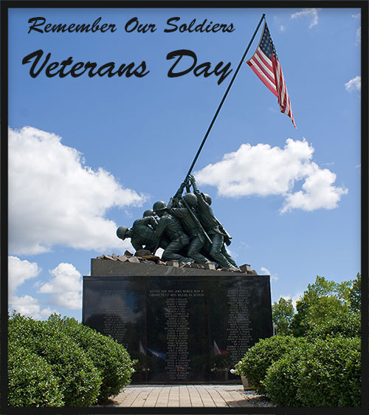
Veteran’s Day, originally Armistice Day (1921), began as a universal recognition to the ending of World War I fighting at 11 a.m., November 11, 1918.
The 11th hour of the 11th day of the 11th month.
What can we say about 11?
Is there a divisibility rule for 11? How and why does it work?
5.NBT.B6
Notes:
Week of November 12, 2024

Slide 7
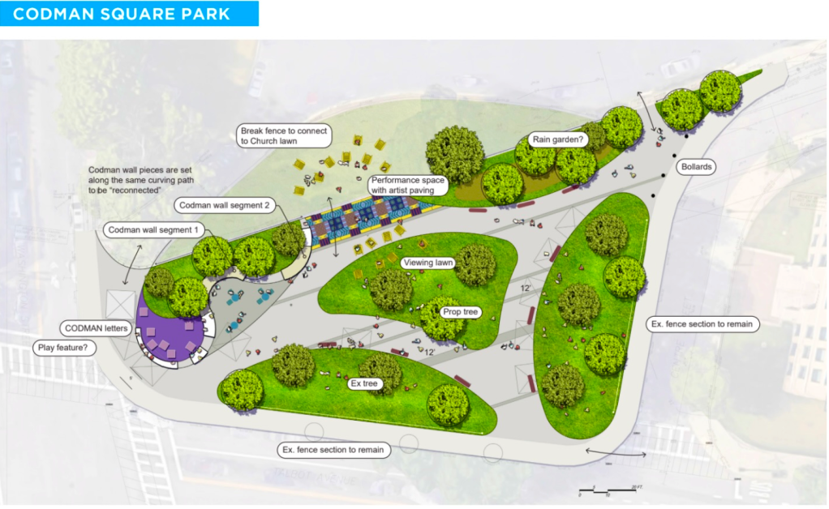
What can we say about the perimeter of this park?
How about the area?
35 feet
5.MD.C

Slide 8

Happy Puzzle Week!
What’s possible here?
What arrays could this puzzle be?
5.NBT.B5

Slide 9
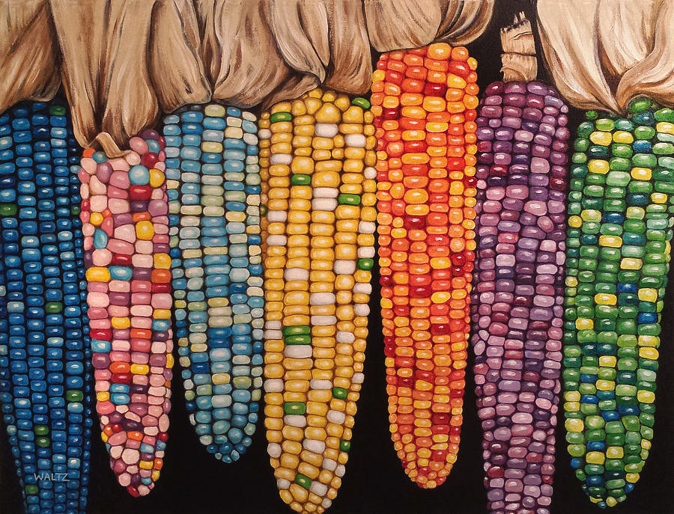
It’s Native Corn Season!
Estimate how many kernels on one ear of corn!
How many on seven ears?
100 ears?
200 ears?
Do we see any patterns here?
5.NBT.A2

Slide 10

Today is the Yi Peng Lantern Festival in Thailand
Estimate the number of lanterns.
How can we use math to come really close?
5.NBT.A2

Slide 11

Bats are totally awesome!
5.NBT.B6
Did you know … there are over 1,400 species of bats worldwide?
Let’s find factor pairs of 1,400! Can we find all of them?
Notes:
Week of November 18, 2024

Slide 12
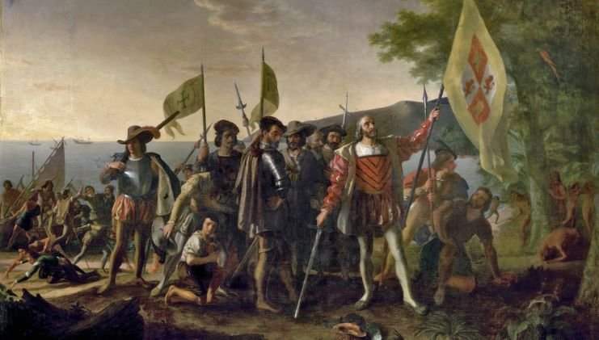
Happy Discovery of Puerto Rico Day!
In 1493, Christopher Columbus embarked on his second voyage to the New World, taking with him over 1,200 soldiers and 17 ships.
About how many soldiers were on each ship?
5.NBT.B6

Slide 13
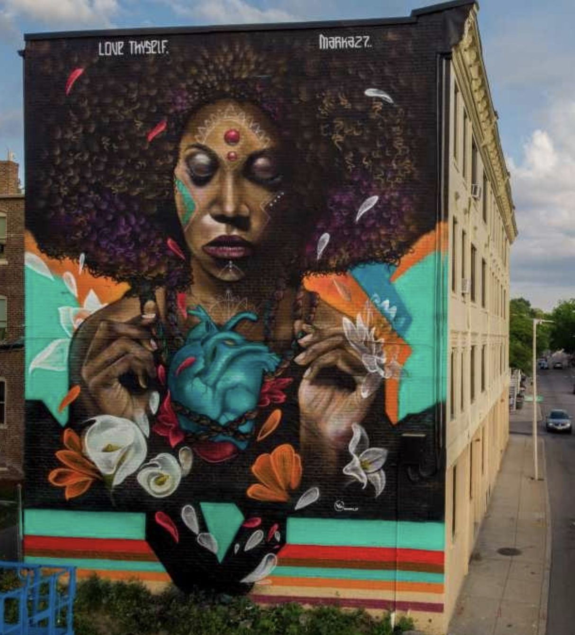
Love Thyself,
by Victor "Marka27" Quiñonez
is painted on the side of 4-story building in Dorchester.
How high is this building? Estimate.
The mural is 43.5 feet high!
How many inches would that be?
About how many meters is that?
5.MD.A1

Slide 14

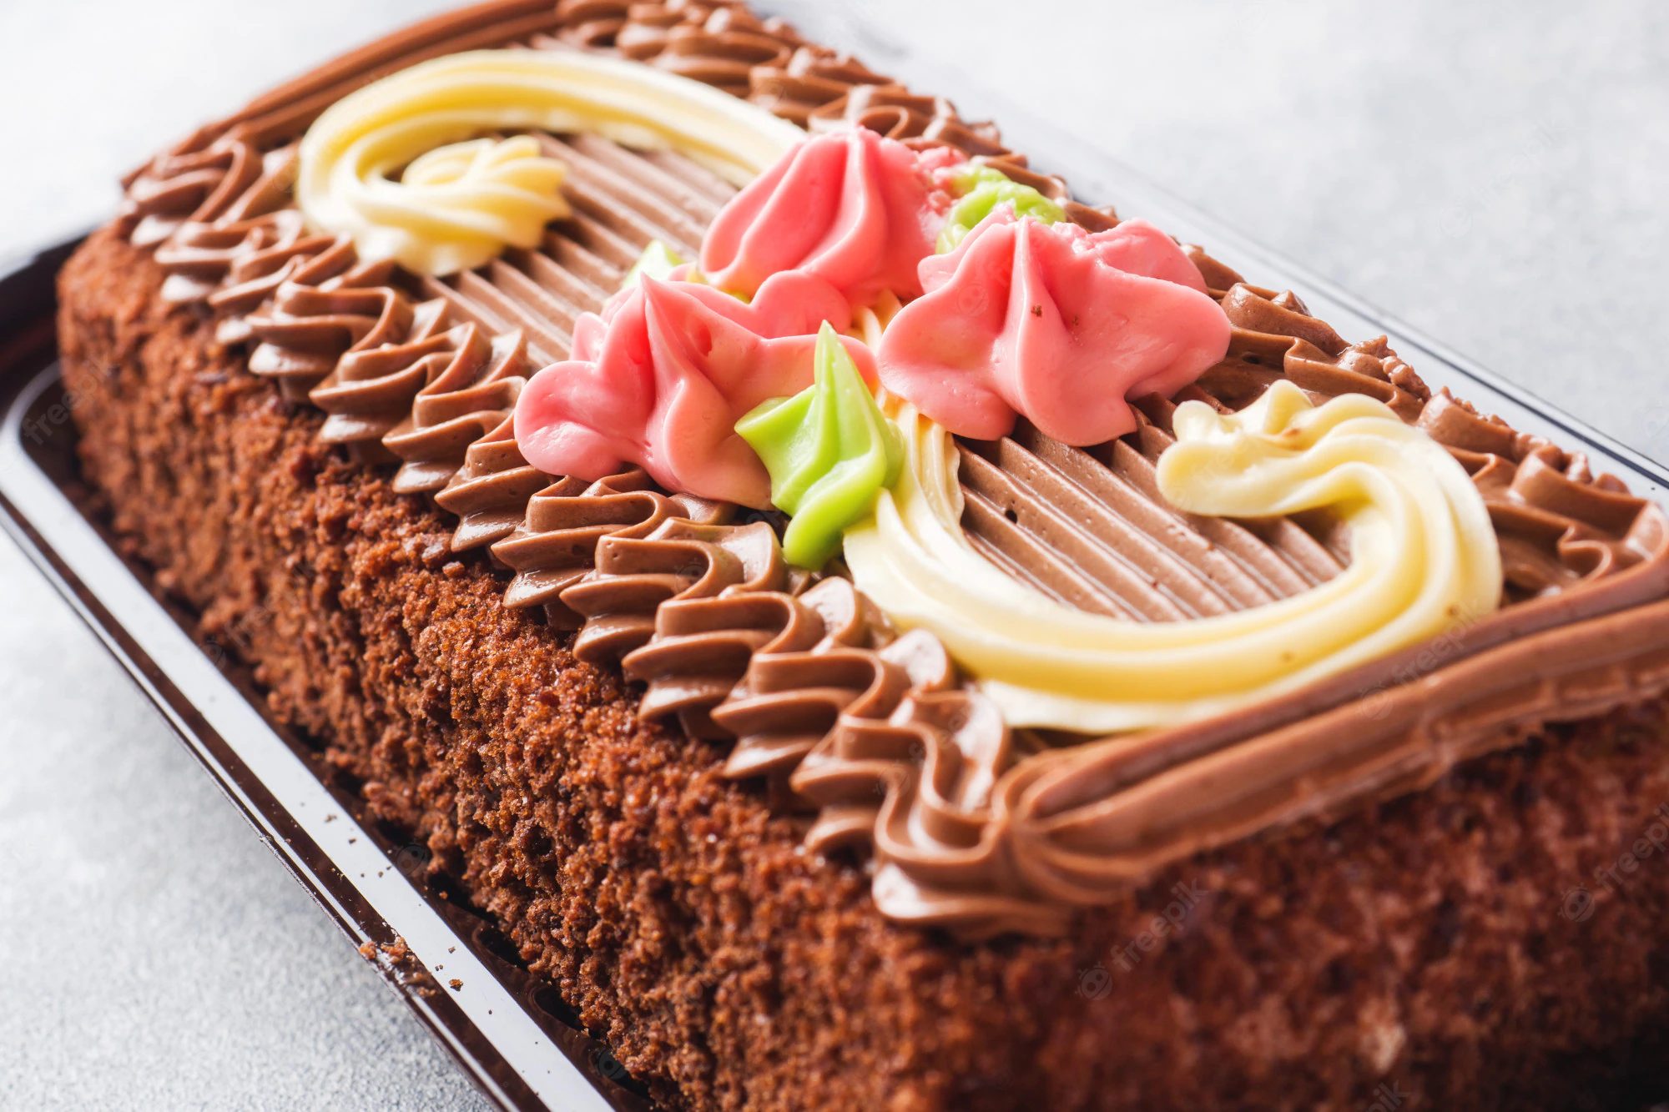
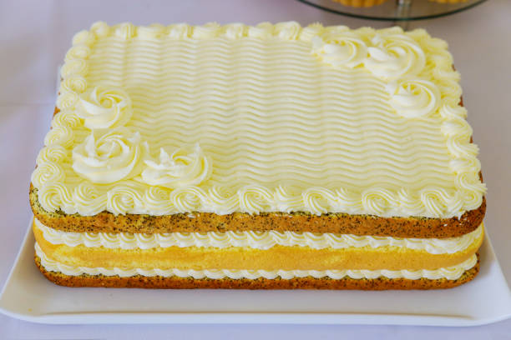
Would you rather have a birthday cake
that is 1 ft. x ft.
Or
8 in. x 12 in.
5.NF.B6

Slide 15
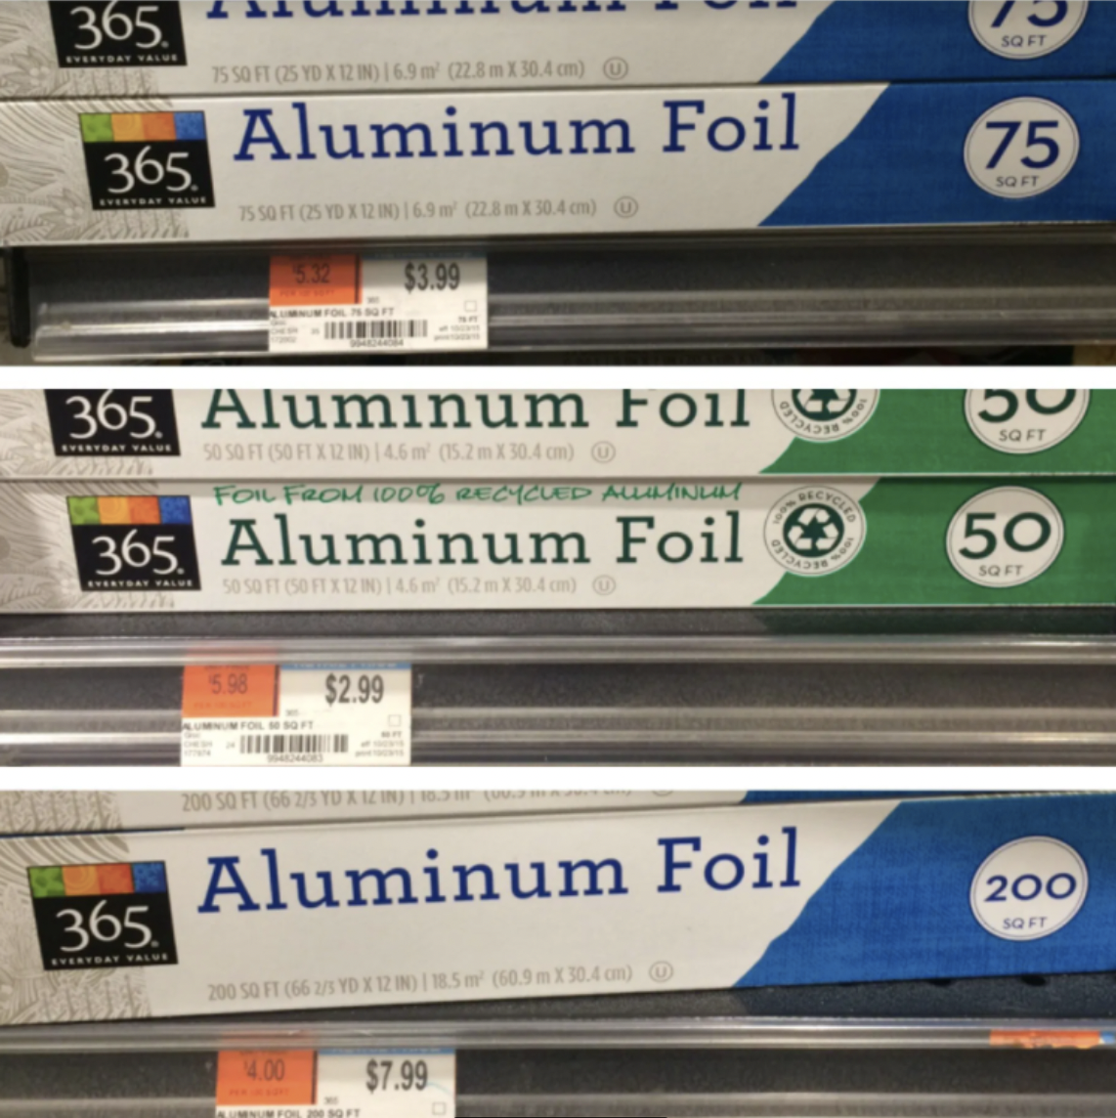
Would you rather…
Which is the better foil buy?
How do we know?
5.NF.B5

Slide 16
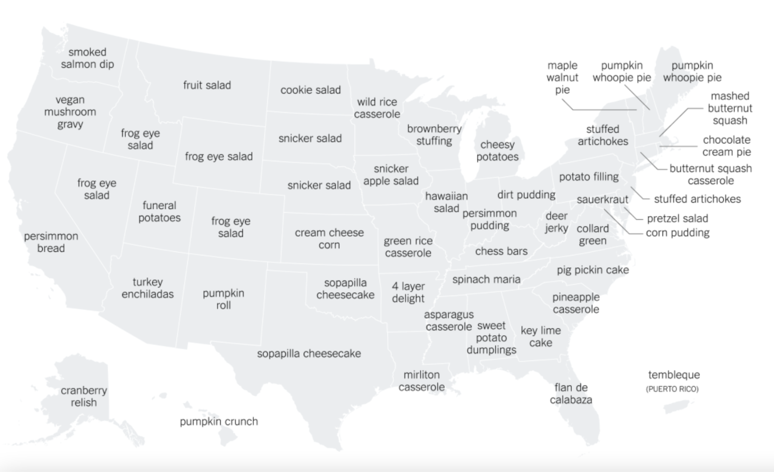
This map shows the most “distinct” Thanksgiving side dish by state as determined by the number of Google searches during the week of Thanksgiving.
What’s going on in this data visualization?
Source: New York Times
5.MD.B
Notes:
Week of November 25, 2024

Slide 17
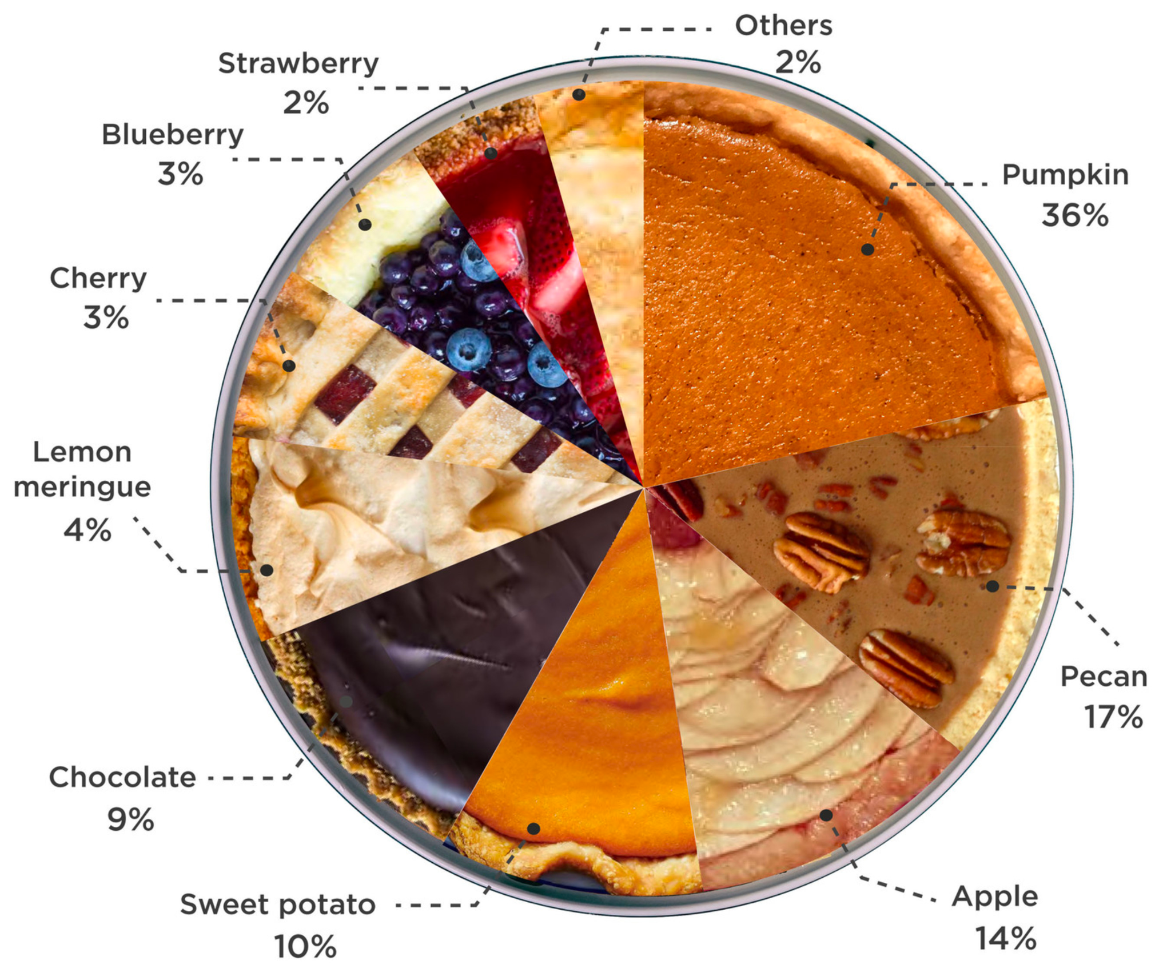
If this “pie” chart could talk, what would it say?
5.NF.A

Slide 18

“Guardian Owl”
Jake Ginga
Let’s talk about the geometry we see here.
Do we see any symmetry?
Choose an interesting shape in this piece.
Sketch it.
Now sketch a shape that shares ONE attribute, and is different in another way.
5.G.B3

