Slide 1
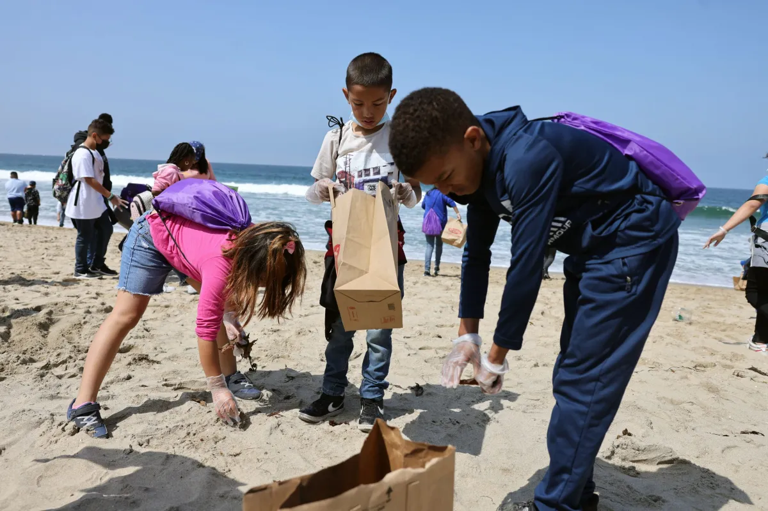
Today is the National Day of Community Service
These students spent an entire school day cleaning Revere Beach.
The classes collected about 75 pounds of trash each hour.
What is possible?
Why does it matter?
4.NBT.B5
Notes:
Week of November 4, 2024

Slide 2
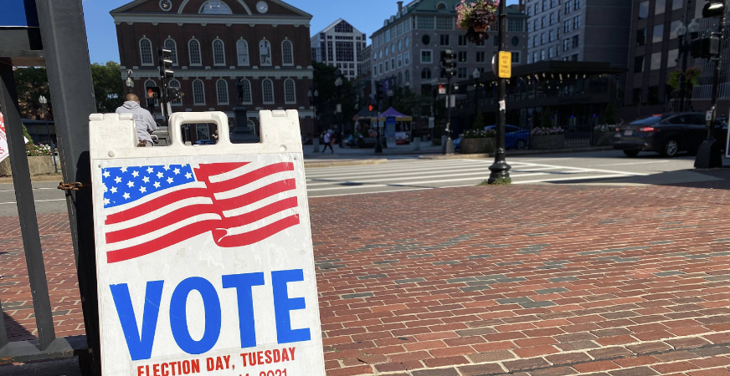
Today is Election Day!
Americans first began the custom of weekday voting in 1845, when Congress passed a federal law designating the first Tuesday following the first Monday in November as Election Day.
Before then, states were allowed to hold elections any time they pleased within a 34-day window before the first Wednesday in December.
What is a 34-day window?
When did people vote before 1845?
4.NBT.B4

Slide 3
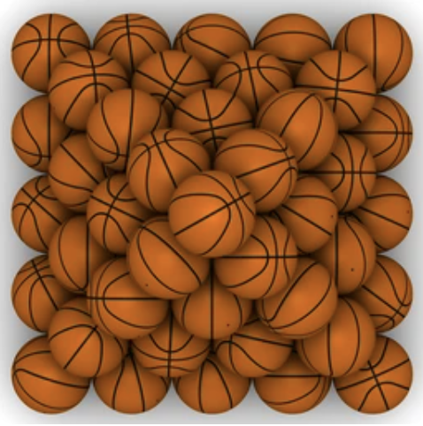
Happy National Basketball Day!
What do we notice?
What do we wonder?
Where do we see a pattern?
Use this pattern to determine how many basketballs are in the pyramid.
4.OA.C5

Slide 4
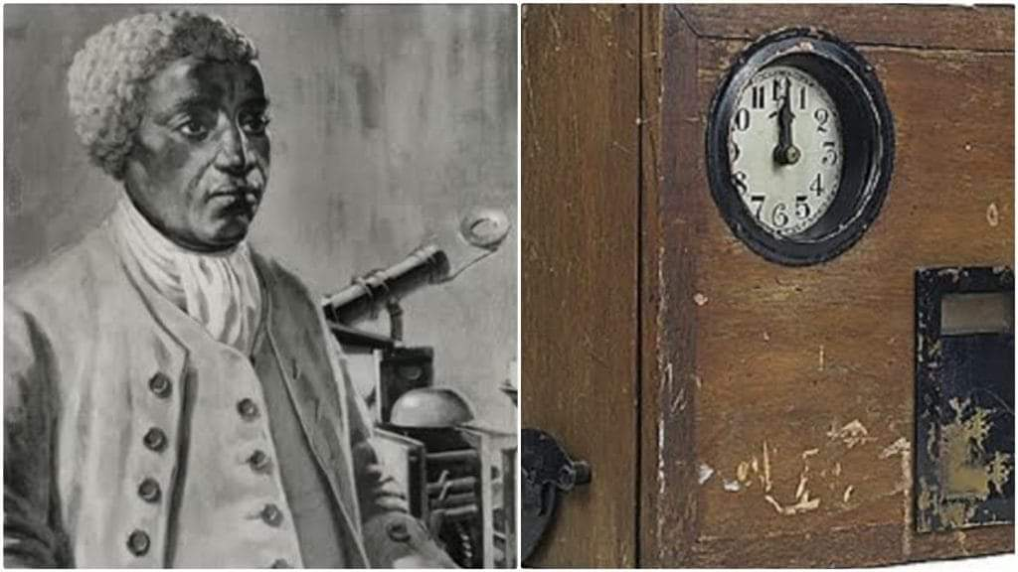
Celebrate Benjamin Banneker Week
Benjamin Banneker was a mathematician, astronomer, almanac compiler, inventor, and writer who was one of the first prominent African American thinkers.
The Banneker clock was the first clock built in America in 1753.
How long ago was that?
How can we figure it out?
If Banneker was born in 1731, how old was he when he invented this clock?
4.NBT.B4

Slide 5
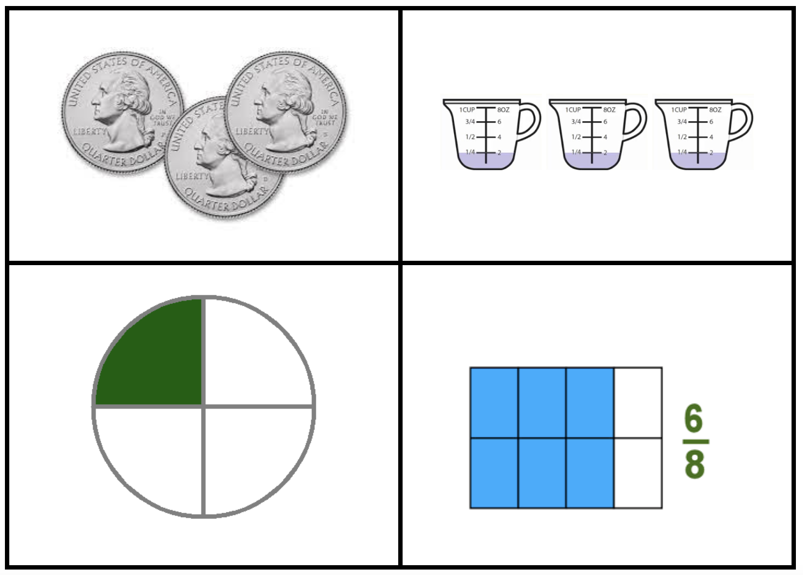
Which one doesn’t belong?
What do they all have in common?
4.NF.B3
Notes:
Top left: only coins
Top right: only addends
Bottom left: one-fourth, three-fourths missing
Bottom right: only equivalent fraction

Slide 6
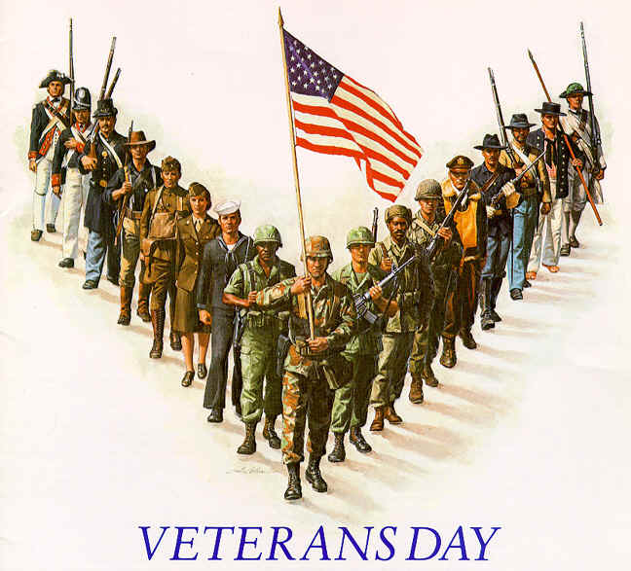
Veteran’s Day, originally Armistice Day (1921), began as a universal recognition to the ending of World War I fighting at 11 a.m., November 11, 1918.
The 11th hour of the 11th day of the 11th month.
What can we say about 11?
How can we multiply any number by 11 quickly and efficiently?
4.OA.C5
Notes:
Week of November 12, 2024

Slide 7
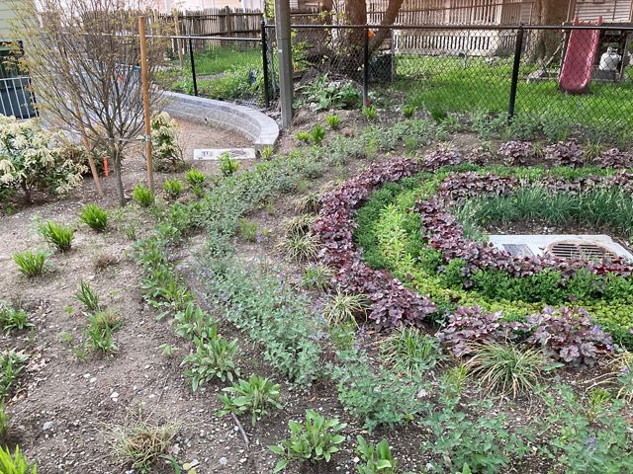
Codman Square Neighborhood Garden
There are at least 2,000 public and private green infrastructure projects in the city of Boston.
What are some factor pairs of 2,000?
How will we know when we have all of the pairs?
4.OA.B4

Slide 8
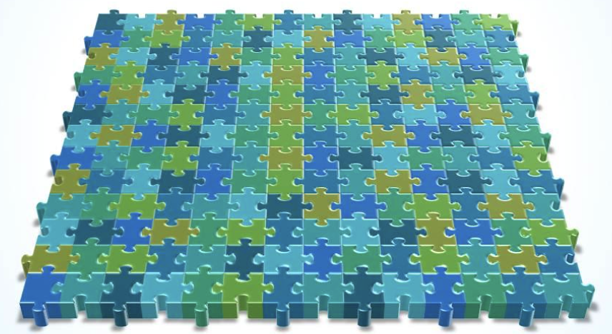
Happy National Puzzle Week!
What do we notice? What do we wonder? Where’s the math?
4.OA.B4

Slide 9

Today is the Yi Peng Lantern Festival in Thailand
Estimate the number of lanterns.
How can we use math to come really close?
4.NBT.A

Slide 10
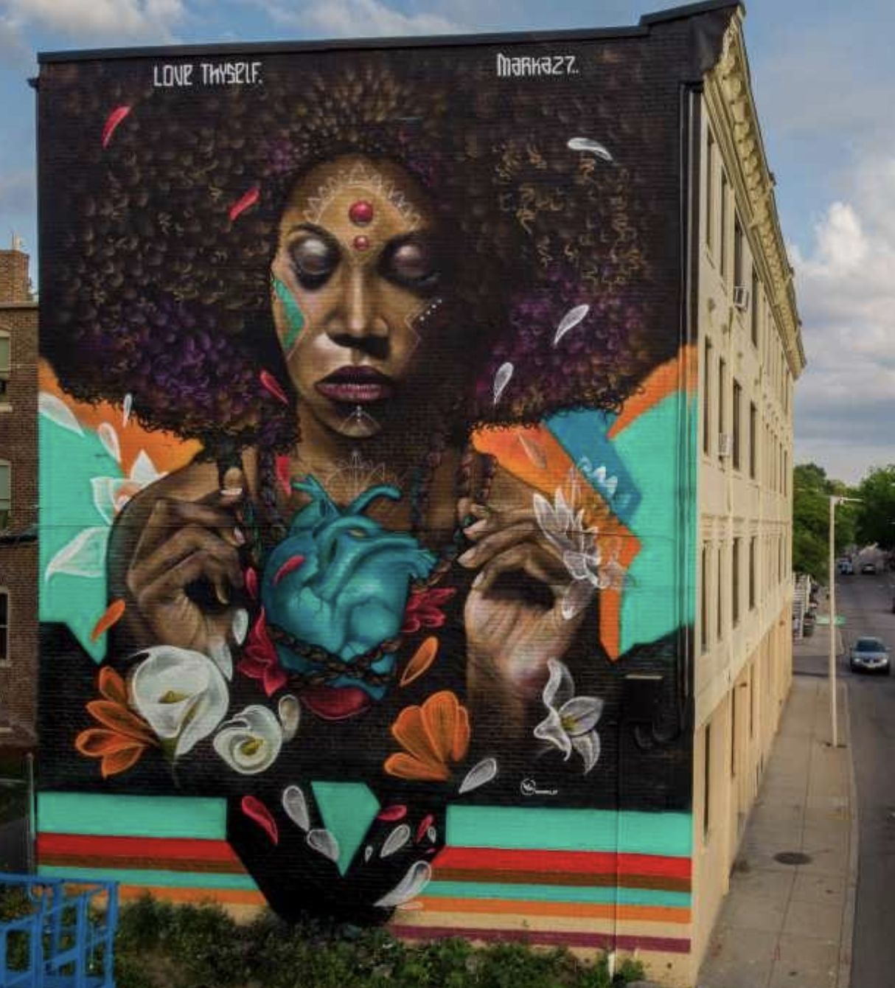
Love Thyself,
by Victor "Marka27" Quiñonez
is painted on the side of 4-story building in Dorchester.
How high is this building? Estimate.
The mural is 43.5 feet high!
How many inches would that be?
About how many meters is that?
4.MD.A1
Notes:
Week of November 18, 2024

Slide 11
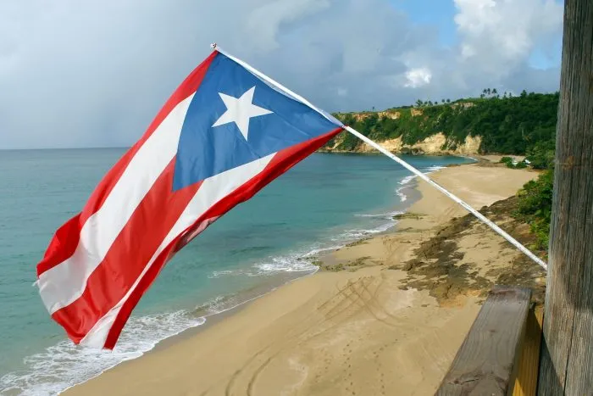
On November 19th, 531 years ago, Christopher Columbus anchored in a bay on the northwest coast of what is now known as Puerto Rico. He named the island in honor of Saint John the Baptist by calling it San Juan Bautista.
What year was that?
How can we figure it out efficiently?
Happy Discovery of Puerto Rico Day!
4.NBT.B4

Slide 12
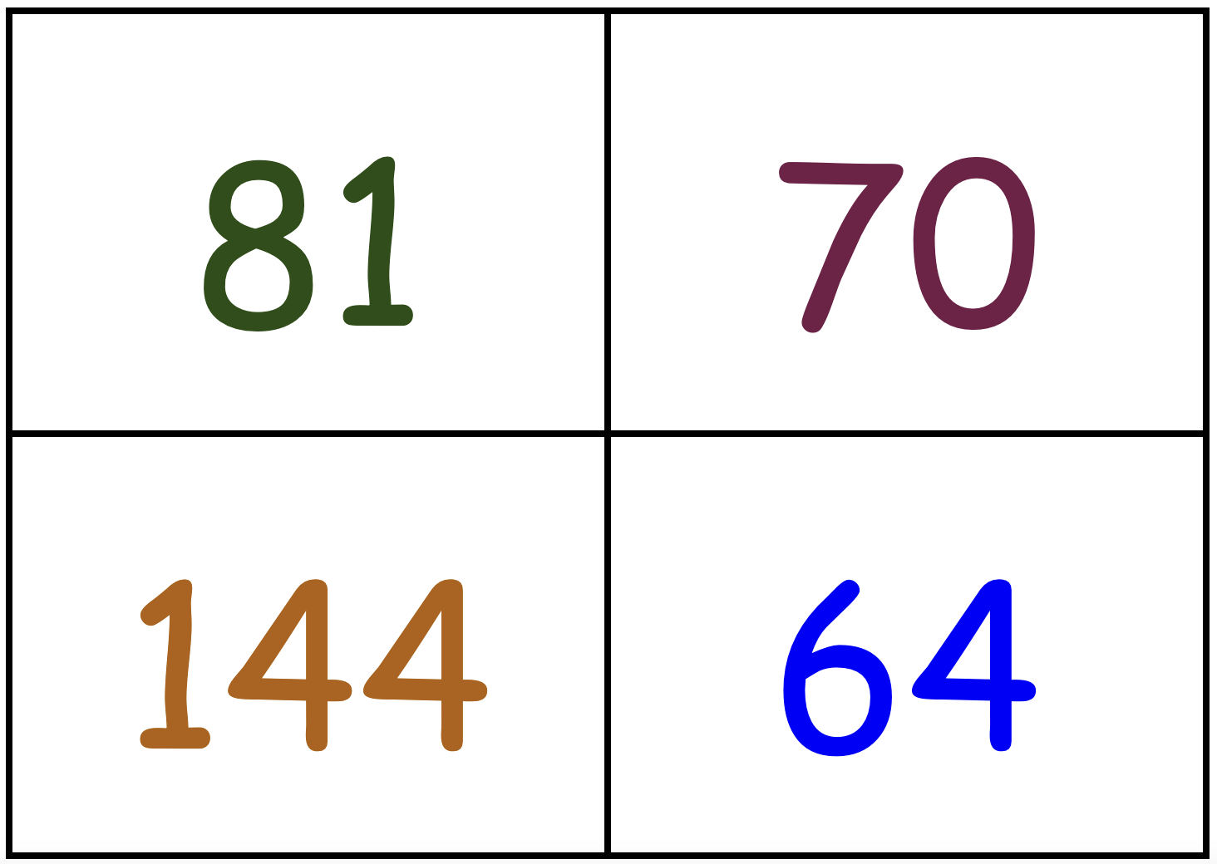
Which one doesn’t belong?
4.OA.B4
Notes:
Top left: not even
Top right: not square
Bottom left: not 2-digits
Bottom right: not a multiple of 9

Slide 13
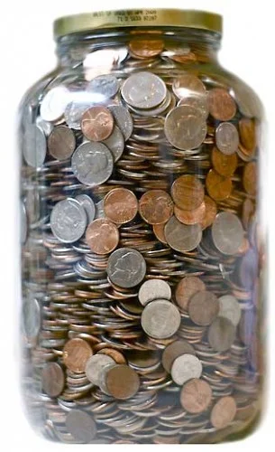
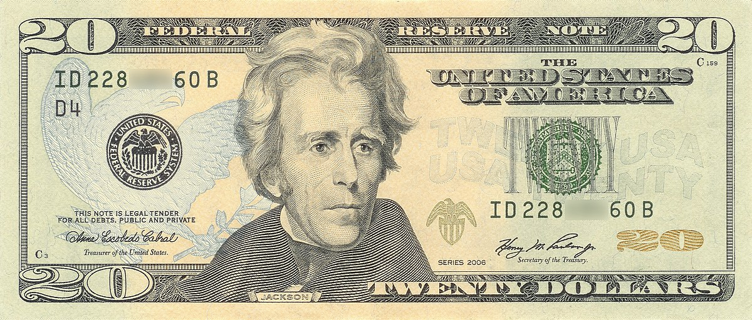
Would you rather …
Half of the jar of coins
or
a twenty-dollar bill?
4.MD.A2

Slide 14
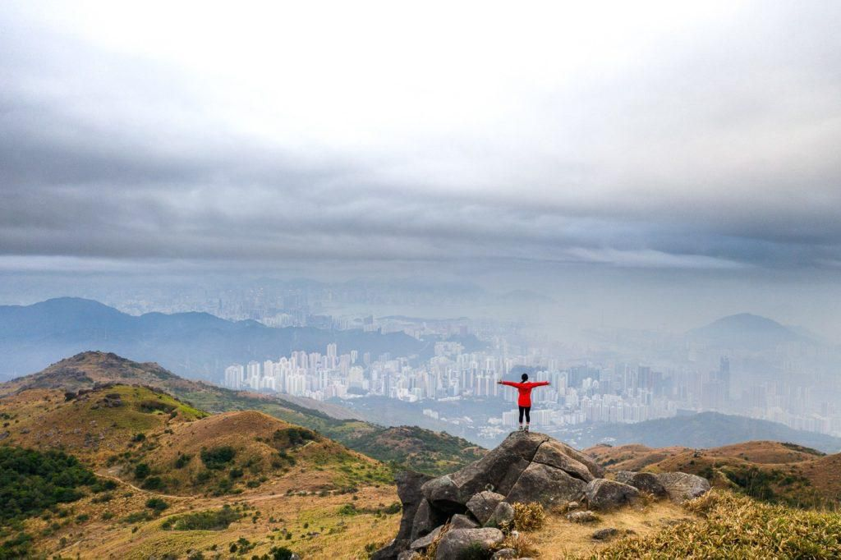
TAI MO SHAN HIKE: THE HIGHEST PEAK IN HONG KONG
3,140 feet!
Wow, how high is that?
How many times taller is the peak than you?
How can we figure this out?
4.NBT.B6

Slide 15
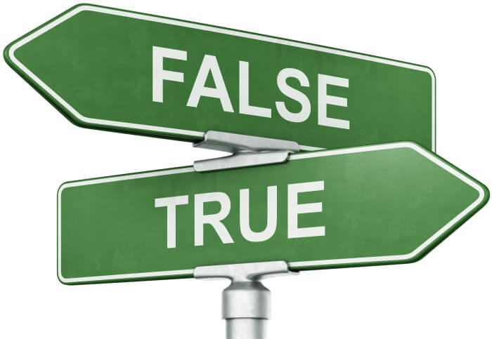
(20 x 8) + (7 x 8) = 8 x 27
45 x 3 = 27 x 5
135 ÷ 15 = 45 ÷ 9
4.OA.A1

Slide 16
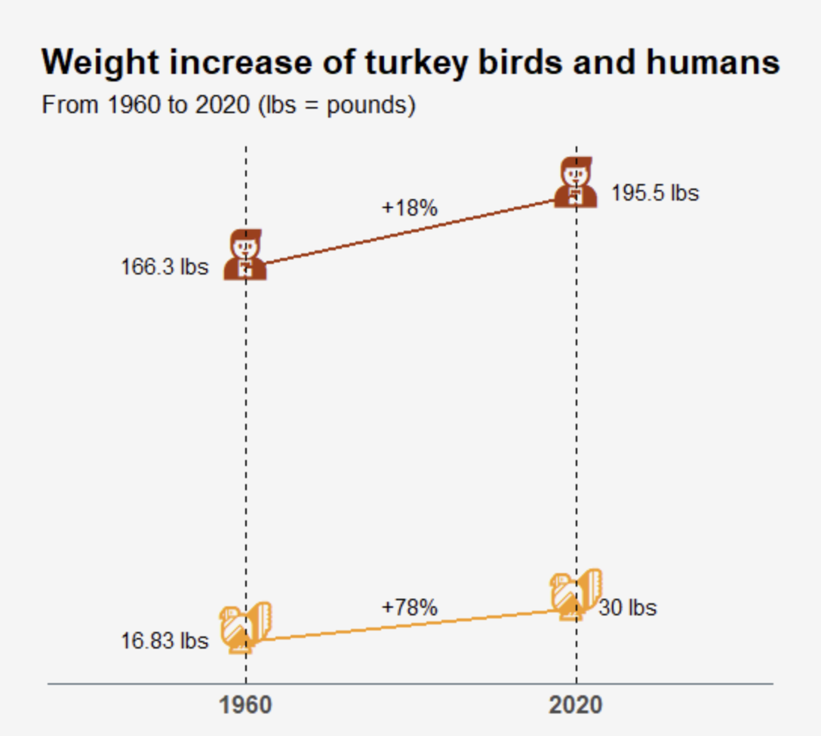
If this infographic could talk, what would it say?
Why does it matter?
4.MD.B
Source: Wall Street Journal
Notes:
Week of November 25, 2024

Slide 17
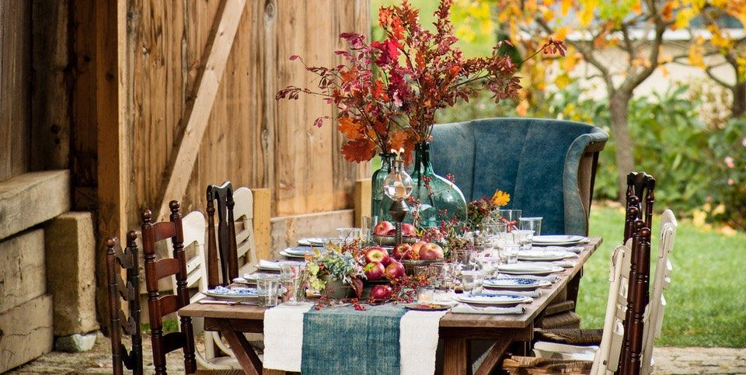
This Thanksgiving table has an AREA of 24 square feet.
What might the perimeter be?
4.MD.A3

Slide 18
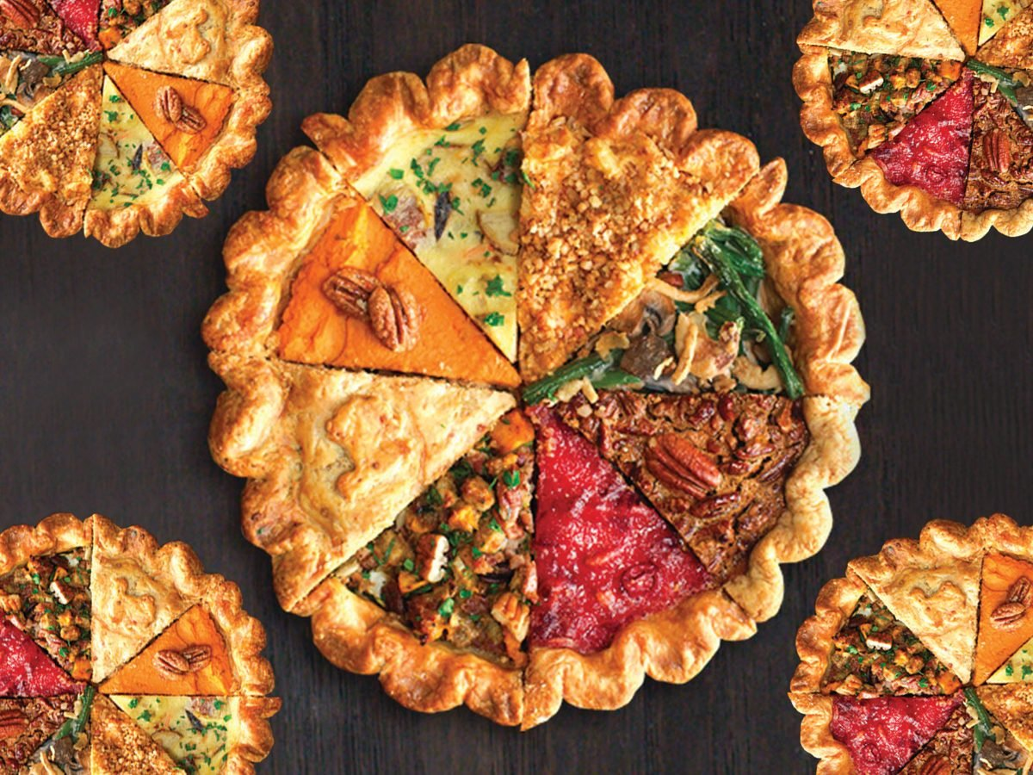
Pie! Yum!
Fractions!!!!
What can we say about the fractions we see here?
4.NF.B3

