Slide 1
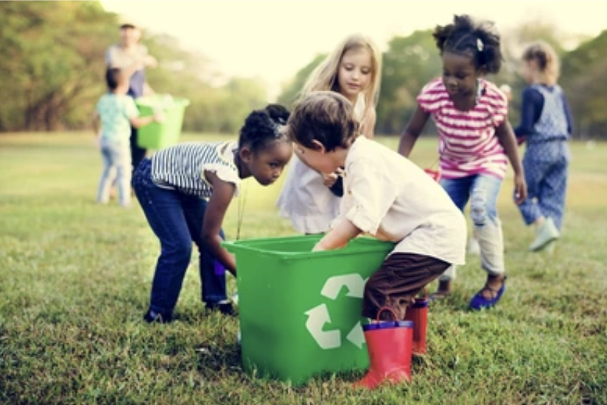
Today is the National Day of Community Service
Together, these two students recycled 20 water bottles!
What is possible?
Why does it matter?
1.OA.A1
Notes:
Week of November 4, 2024

Slide 2
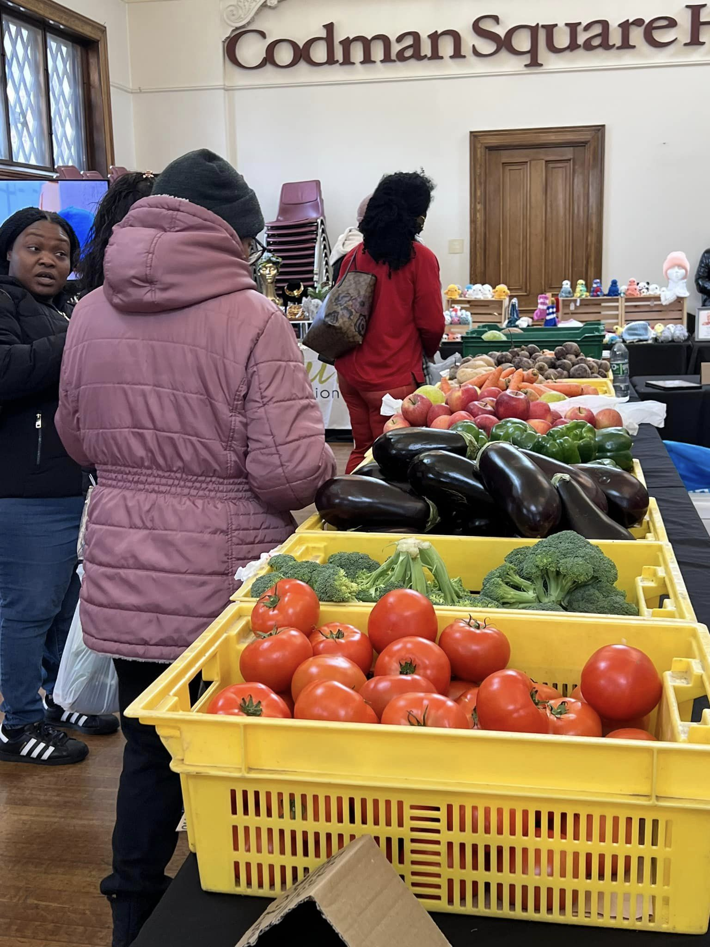
Have you ever been to the Farmer’s Market?
What do we notice?
What do we wonder?
Let’s talk about the tomatoes?
How many do you think are in the bin?
Is it more than 20?
More than 50?
More than 100?
1.NBT.B

Slide 3
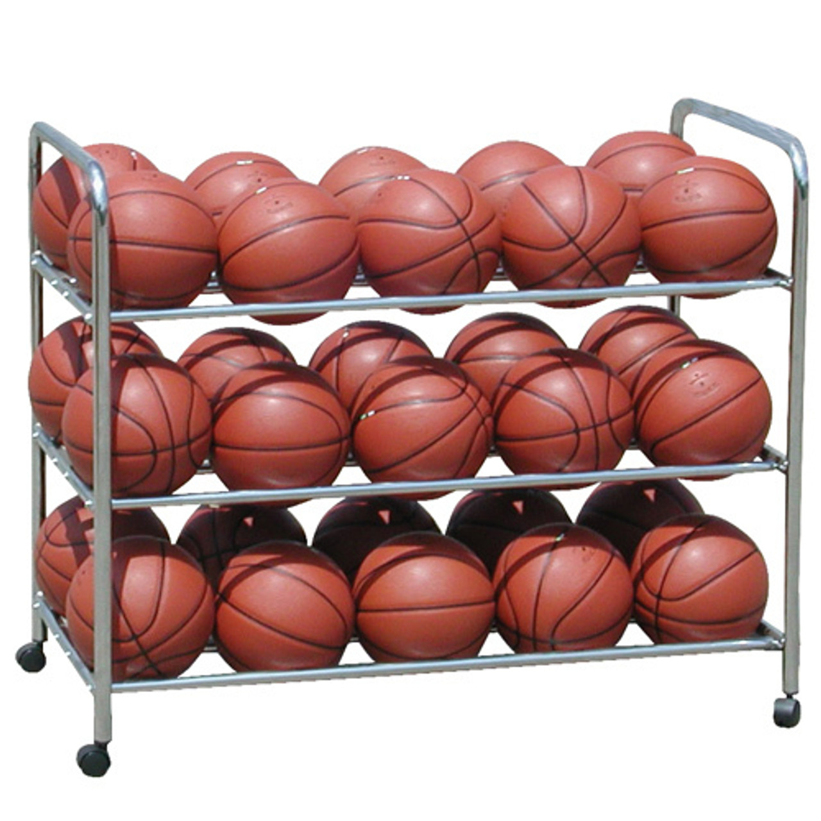
Happy National Basketball Day!
What do we notice?
How many basketballs are here?
How do we know?
How can we count them?
1.NBT.A1

Slide 4
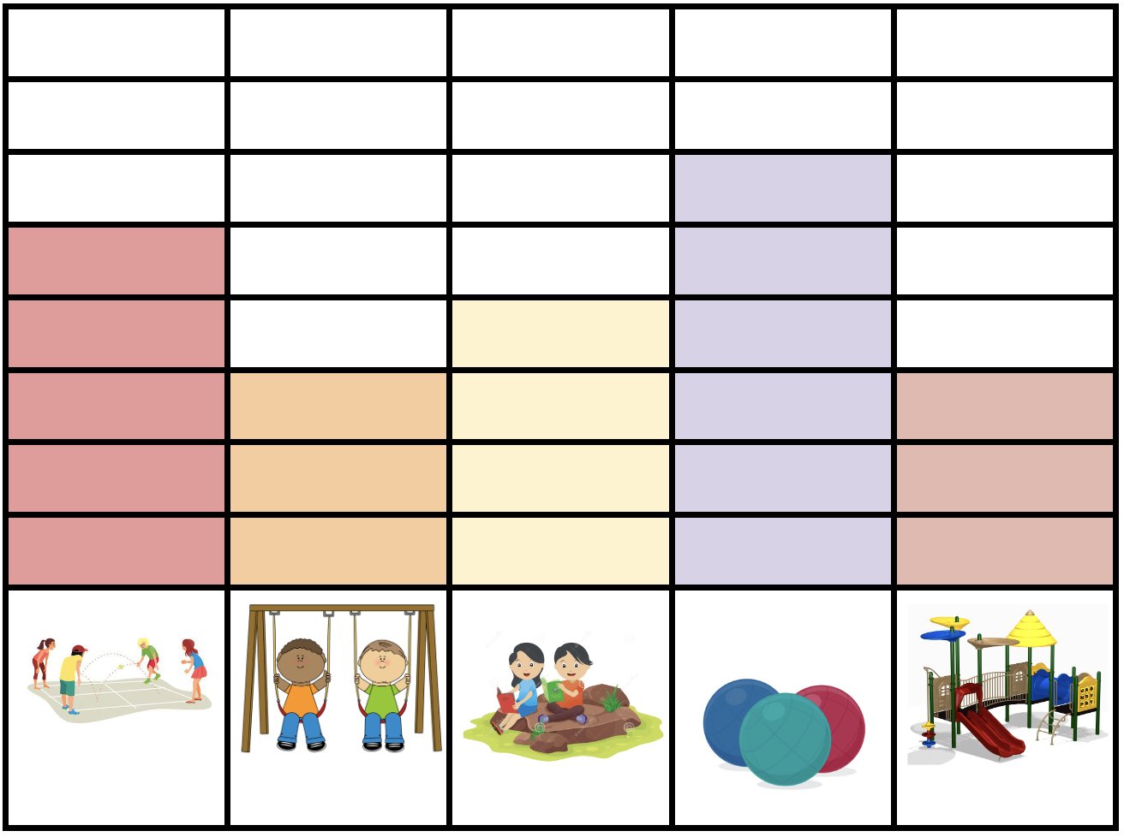
If this graph could talk, what would it say?
1.MD.C4

Slide 5
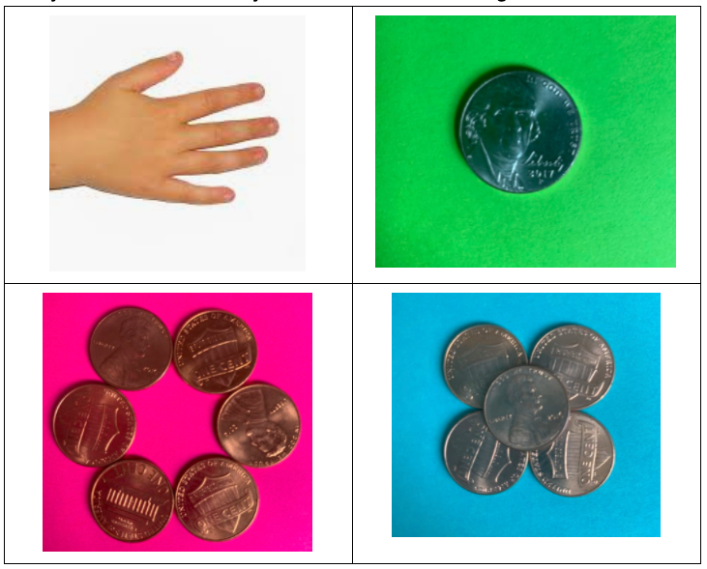
Which one doesn’t belong?
1.MD.D5

Slide 6

How many flags are here?
How many stars?
How many stripes?
How can we solve this?
1.NBT.C4
Notes:
Week of November 12, 2024

Slide 7
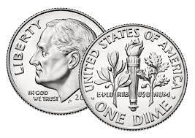
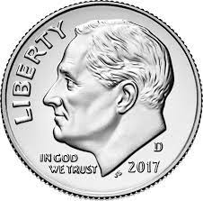
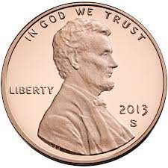

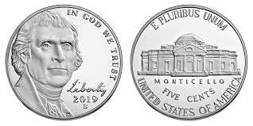
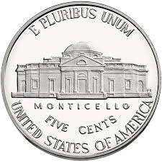
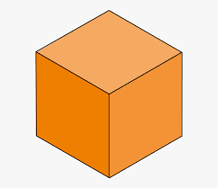
Which one doesn’t belong?
20 + 10 + 10 + 10 + 1
1.MD.D5

Slide 8
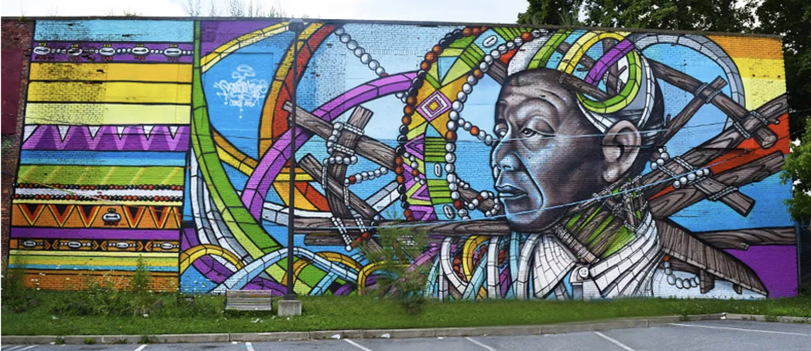
What shapes do we see in Powerful Knowledge?
What would happen if we put two of the shapes together?
1.G.A1

Slide 9
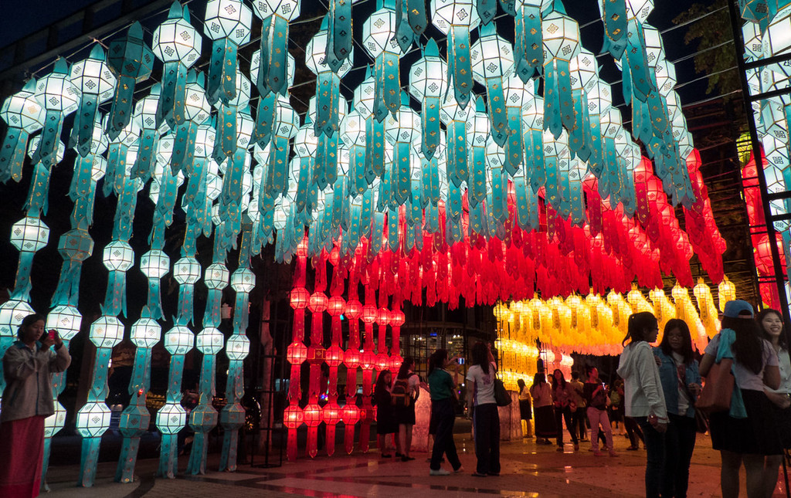
Today is the Yi Peng Lantern Festival in Thailand
What do we notice?
What do we wonder?
Are there more blue lanterns than red ones?
Let’s estimate how many lanterns we see.
1.NBT.B3

Slide 10
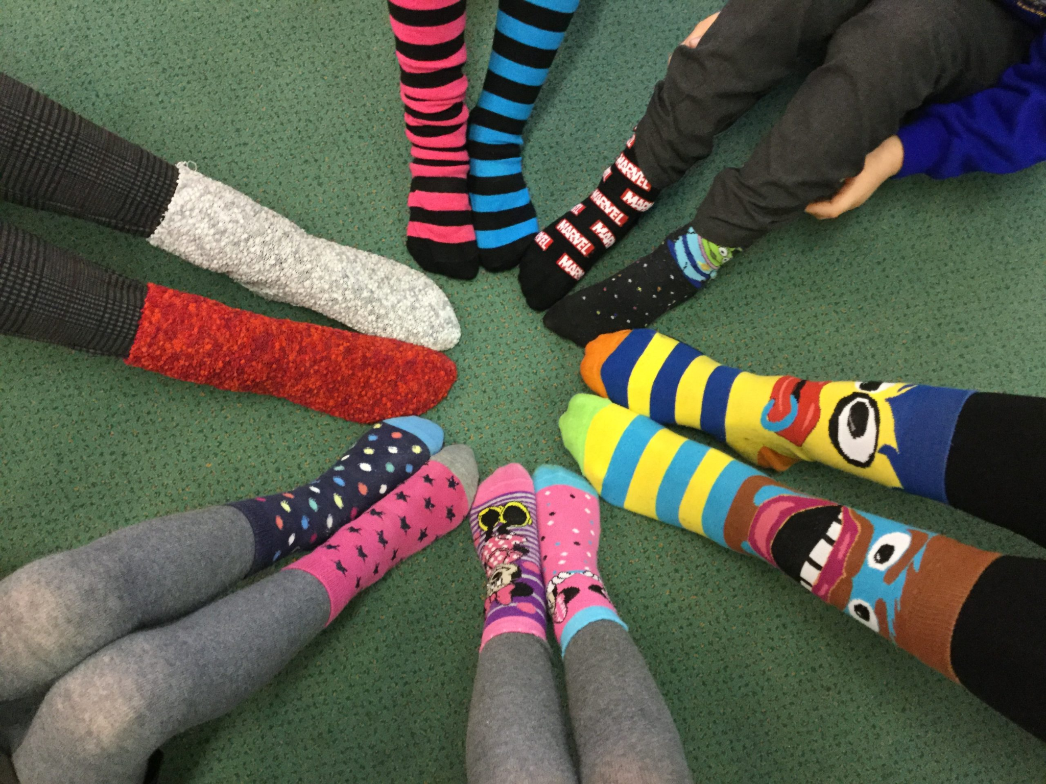
Happy Odd Socks Day!
How many socks do we see?
How many toes are inside of all these socks?
1.NBT.A1
Notes:
Week of November 18, 2024

Slide 11
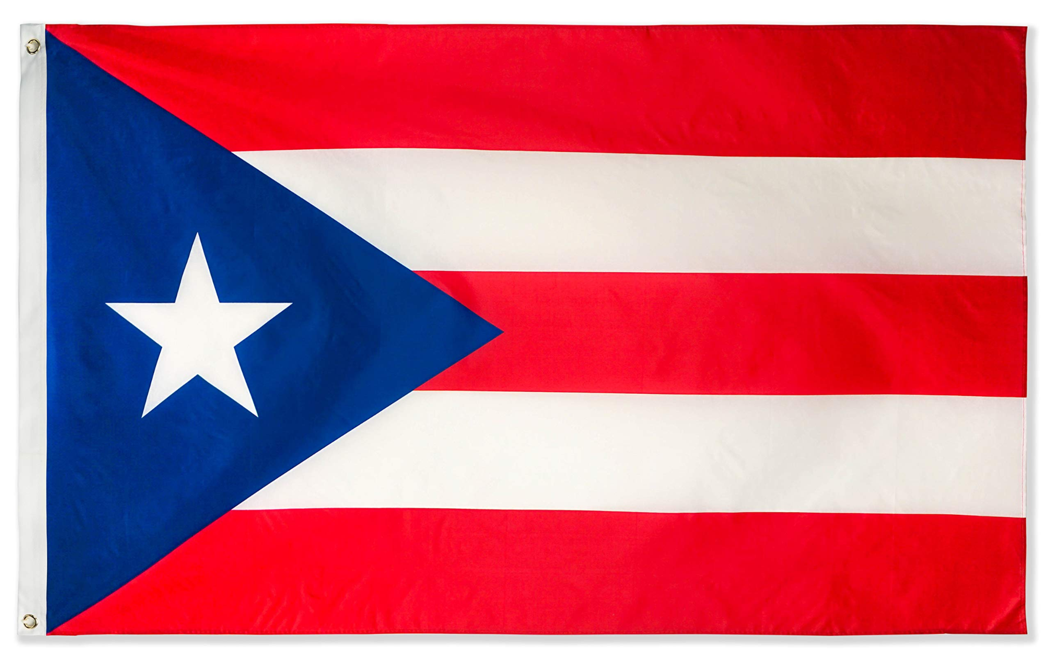
Happy Discovery of Puerto Rico Day!
What can we count on the flag of Puerto Rico?
What fun shapes do we see?
Pick two shapes, how are they the same?
How are they different?
1.G.A2

Slide 12
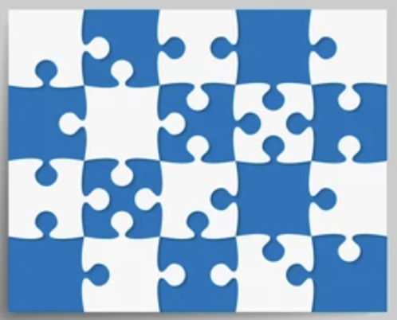
Happy National Puzzle Week!
What do we notice?
What do we wonder?
How many pieces are here?
How do we know?
1.NBT.A1

Slide 13
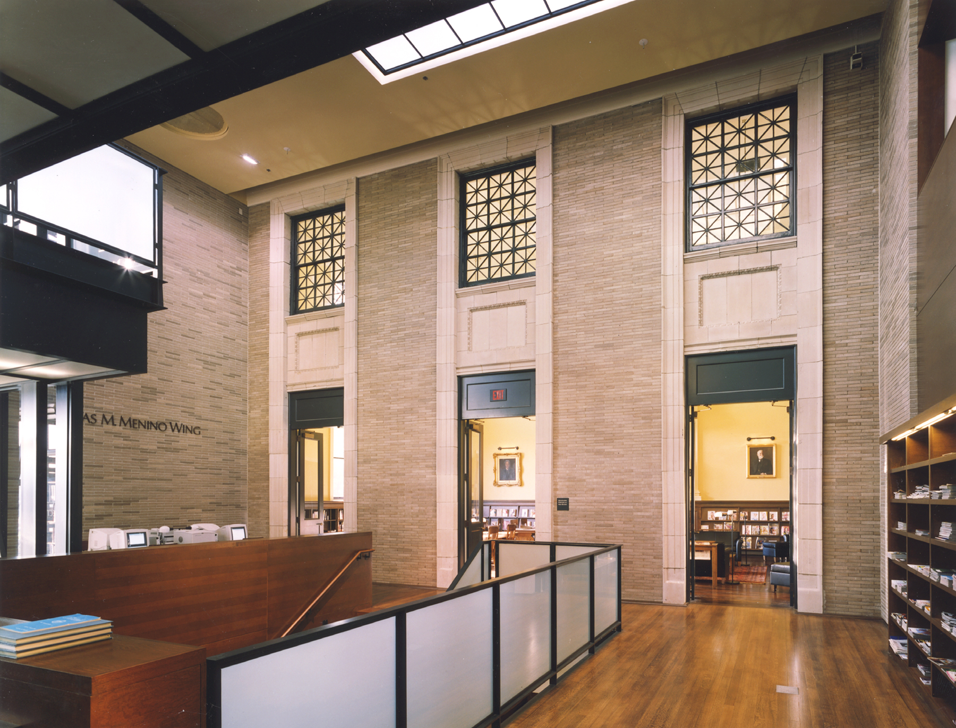
Welcome to the Hyde Park Branch of the Boston Public Library
Let’s be shape detectives!
What interesting shapes do we see?
How many do we see?
1.G.A1

Slide 14

10 + 5 = 5 + 10
10 + 6 = 9 + 7
10 + 8 = 9 + 8 + 1
10 + 10 = 8 + 2 + 1
1.OA.D7

Slide 15
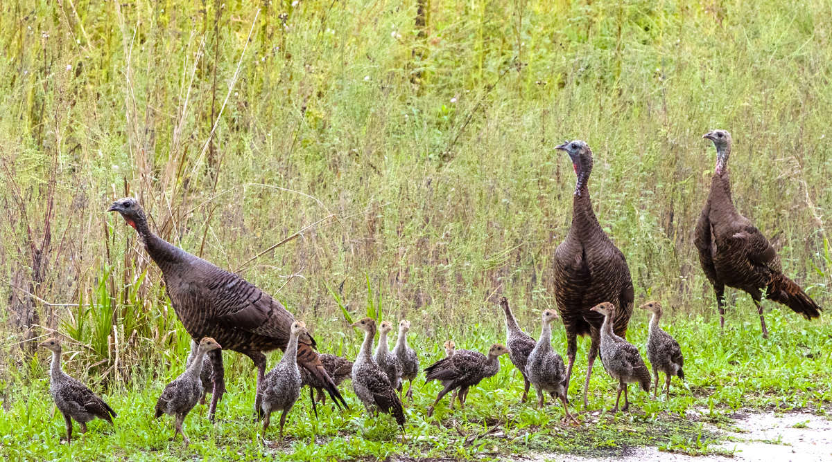
Look at all of these turkeys on the Rail Trail!
Let’s write an equation to match this photo!
1.OA.D8
Notes:
Week of November 25, 2024

Slide 16
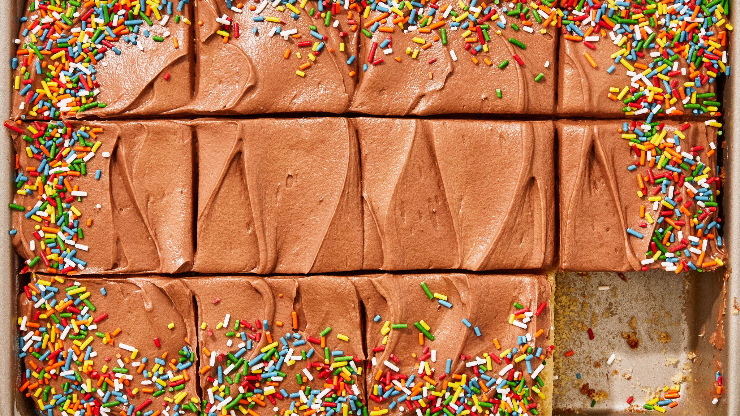
Happy National Cake Day!
What do we notice?
What do we wonder?
Write an equation to match your math thinking.
1.OA.A1

Slide 17
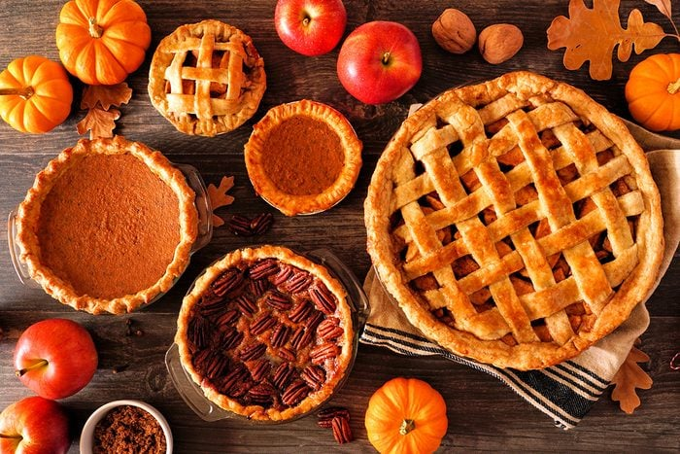
Happy Thanksgiving
What can be counted?
What shapes do we see?
1.G.A1

