Slide 1
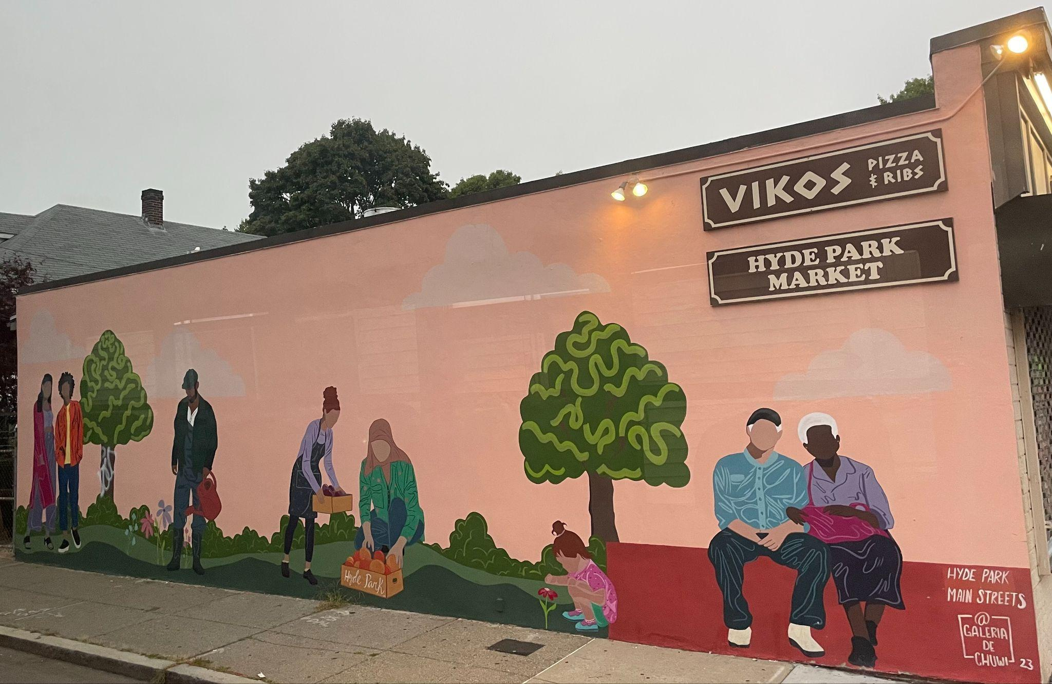
What do we notice?
What do we wonder?
What can we count?
K.CC.B5
Notes:
Week of September 31, 2024

Slide 2

Happy National Day of China!
Let’s be shape detectives! Find as many shapes as you can!
K.G.A2

Slide 3
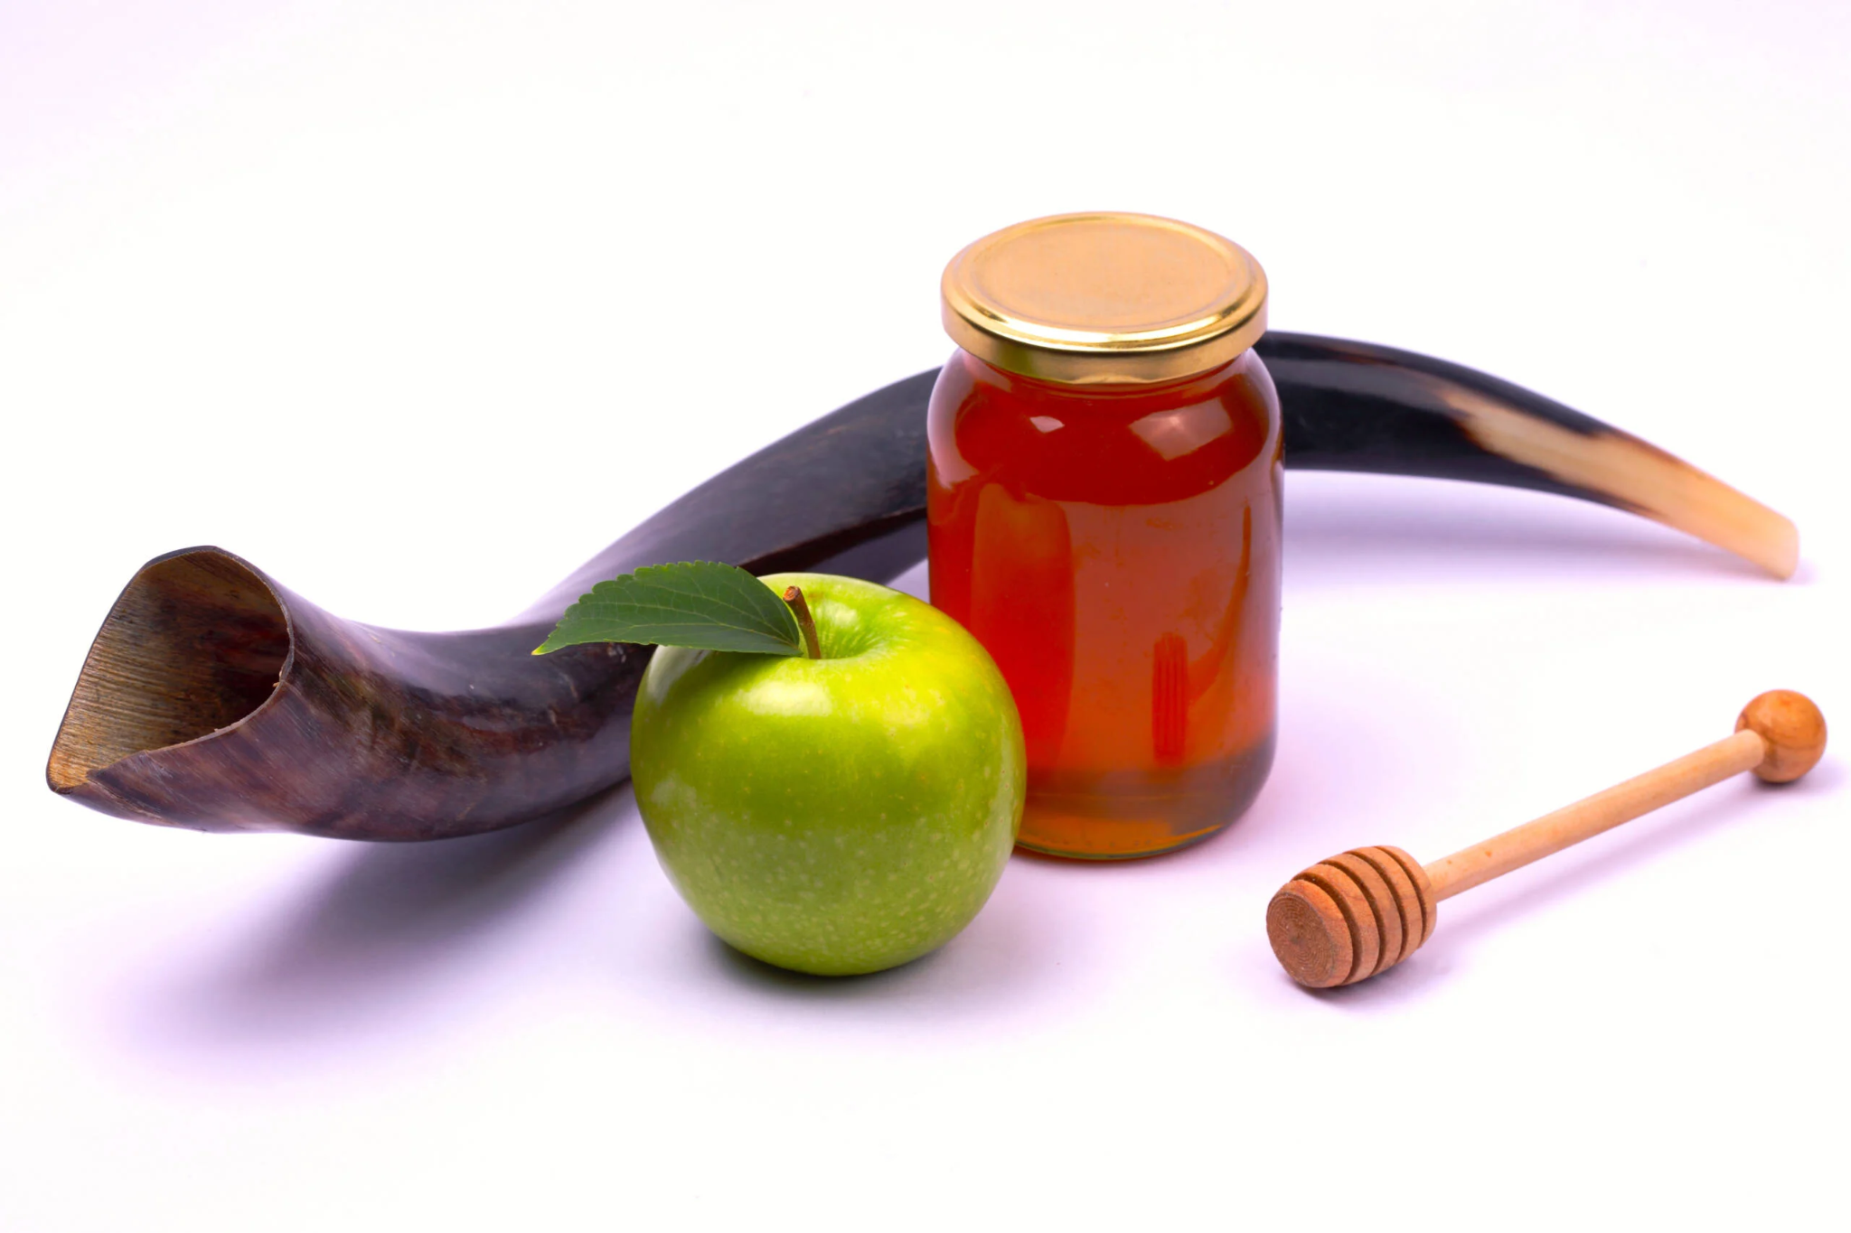
Happy Rosh Hashanah!
שנה טובה
What do we notice?
What do we wonder?
How many objects do we see?
How can we compare them?
K.MD.A2

Slide 4
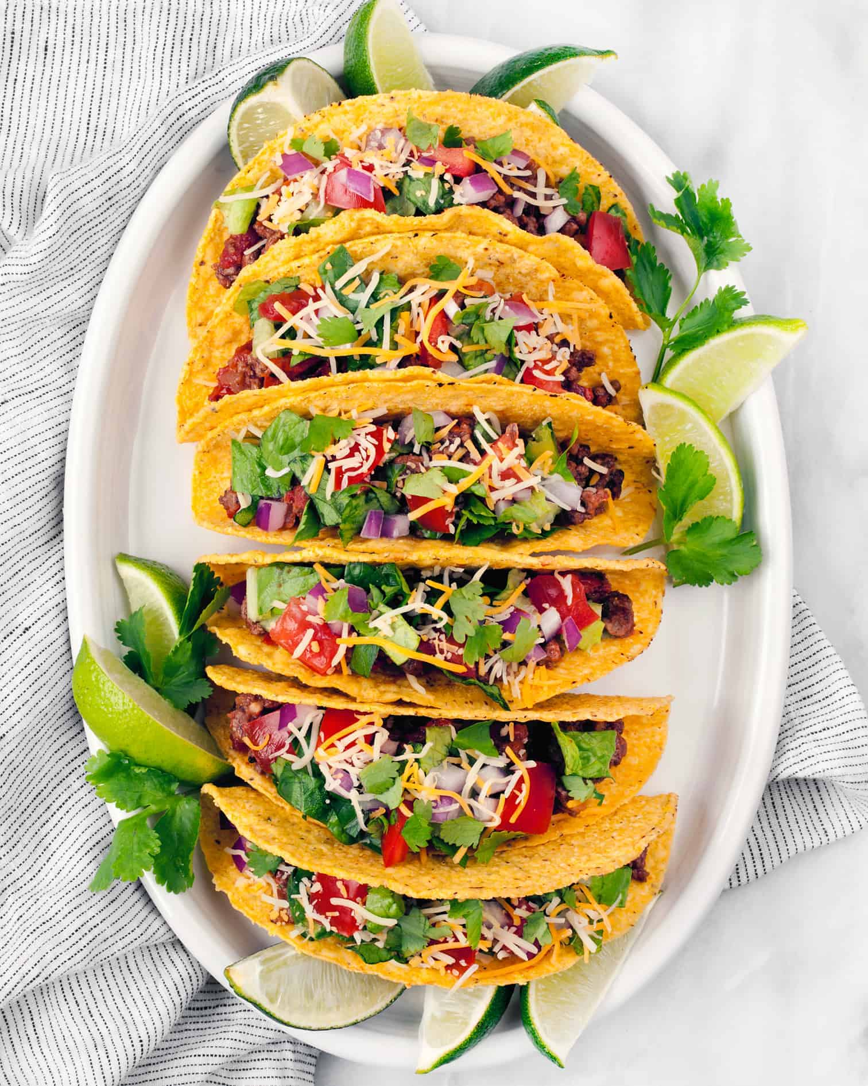
Today is National
Taco Day!
How many tacos are on the plate?
How many different ways can we represent the number 6?
K.OA.A3

Slide 5
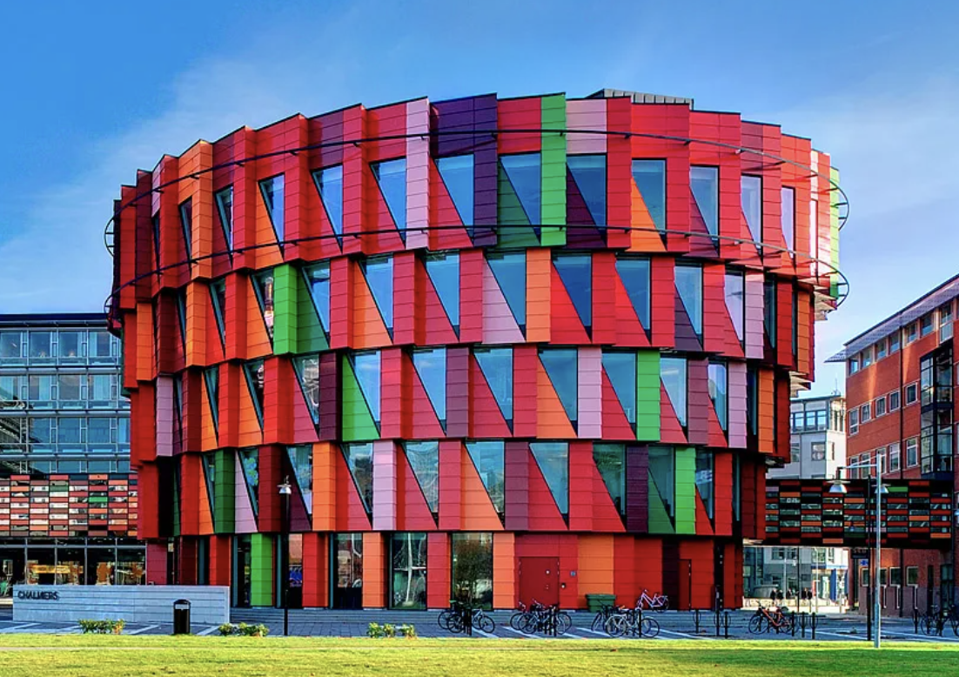
Today is International Architecture Day!
Let’s be shape detectives!
What shapes do we see in this building that is in Sweden?
K.G.B4
Notes:
Week of October 7, 2024

Slide 6
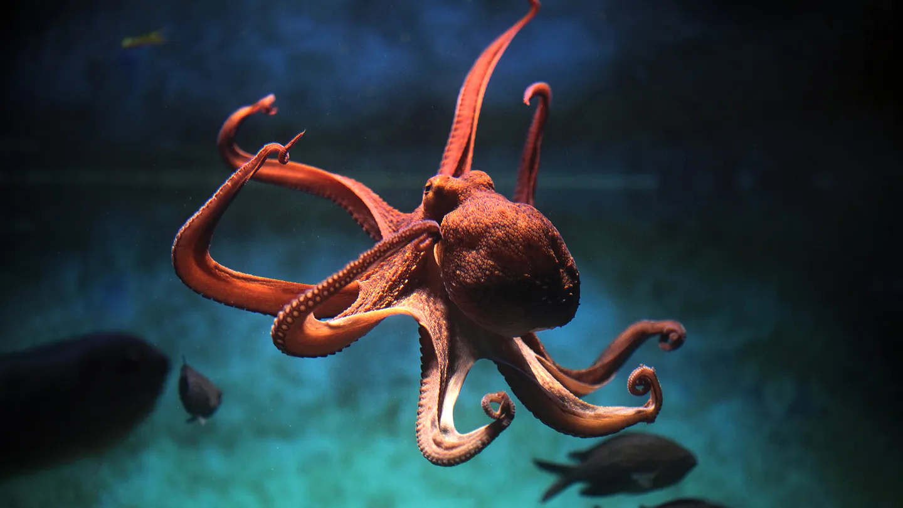
Happy World Octopus Day
How many arms does an octopus have?
How many different ways can we represent the number 8?
K.OA.A3
Notes:
Week of October 7, 2024

Slide 7
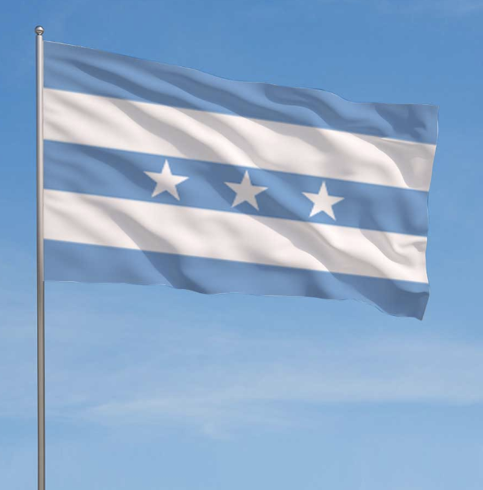
Today is Guayaquil Independence Day
What can we count on this flag of Guayaquil, Ecuador?
What shapes do we see?
K.G.A2

Slide 8
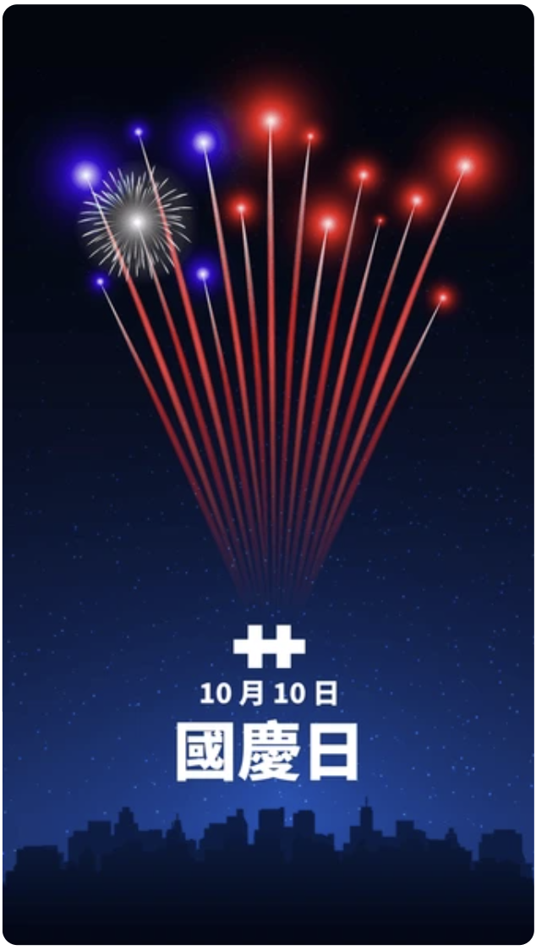
Today we celebrate National Double Ten Day in Taiwan.
Do we wonder why it is called
Double Ten Day?
How many different ways can we represent 10?
K.OA.A4

Slide 9
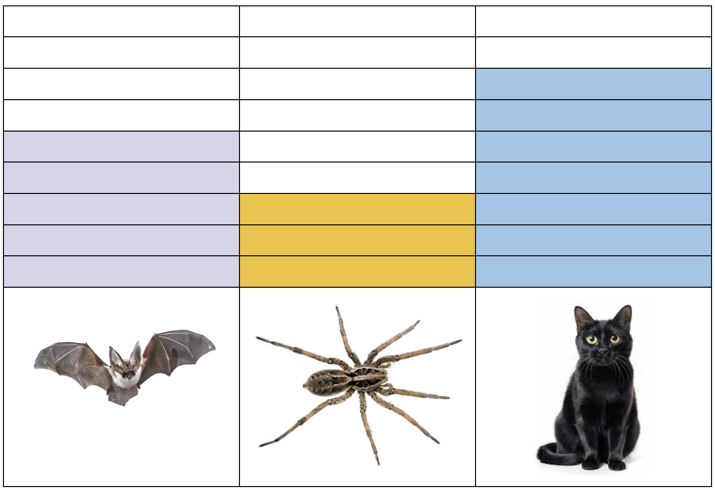
It’s National Bat Month!
If this graph could talk, what would it say?
K.MD.B3

Slide 10
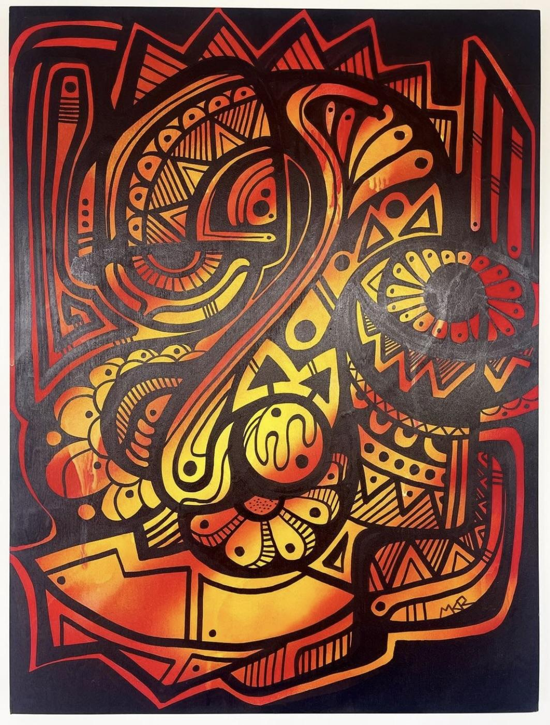
Let’s Celebrate Indigenous Peoples’, Day with Mr. Ginga’s beautiful “Gather 001”
Let’s talk about the shapes we see.
K.G.A2
Notes:
Week of October 15, 2024

Slide 11
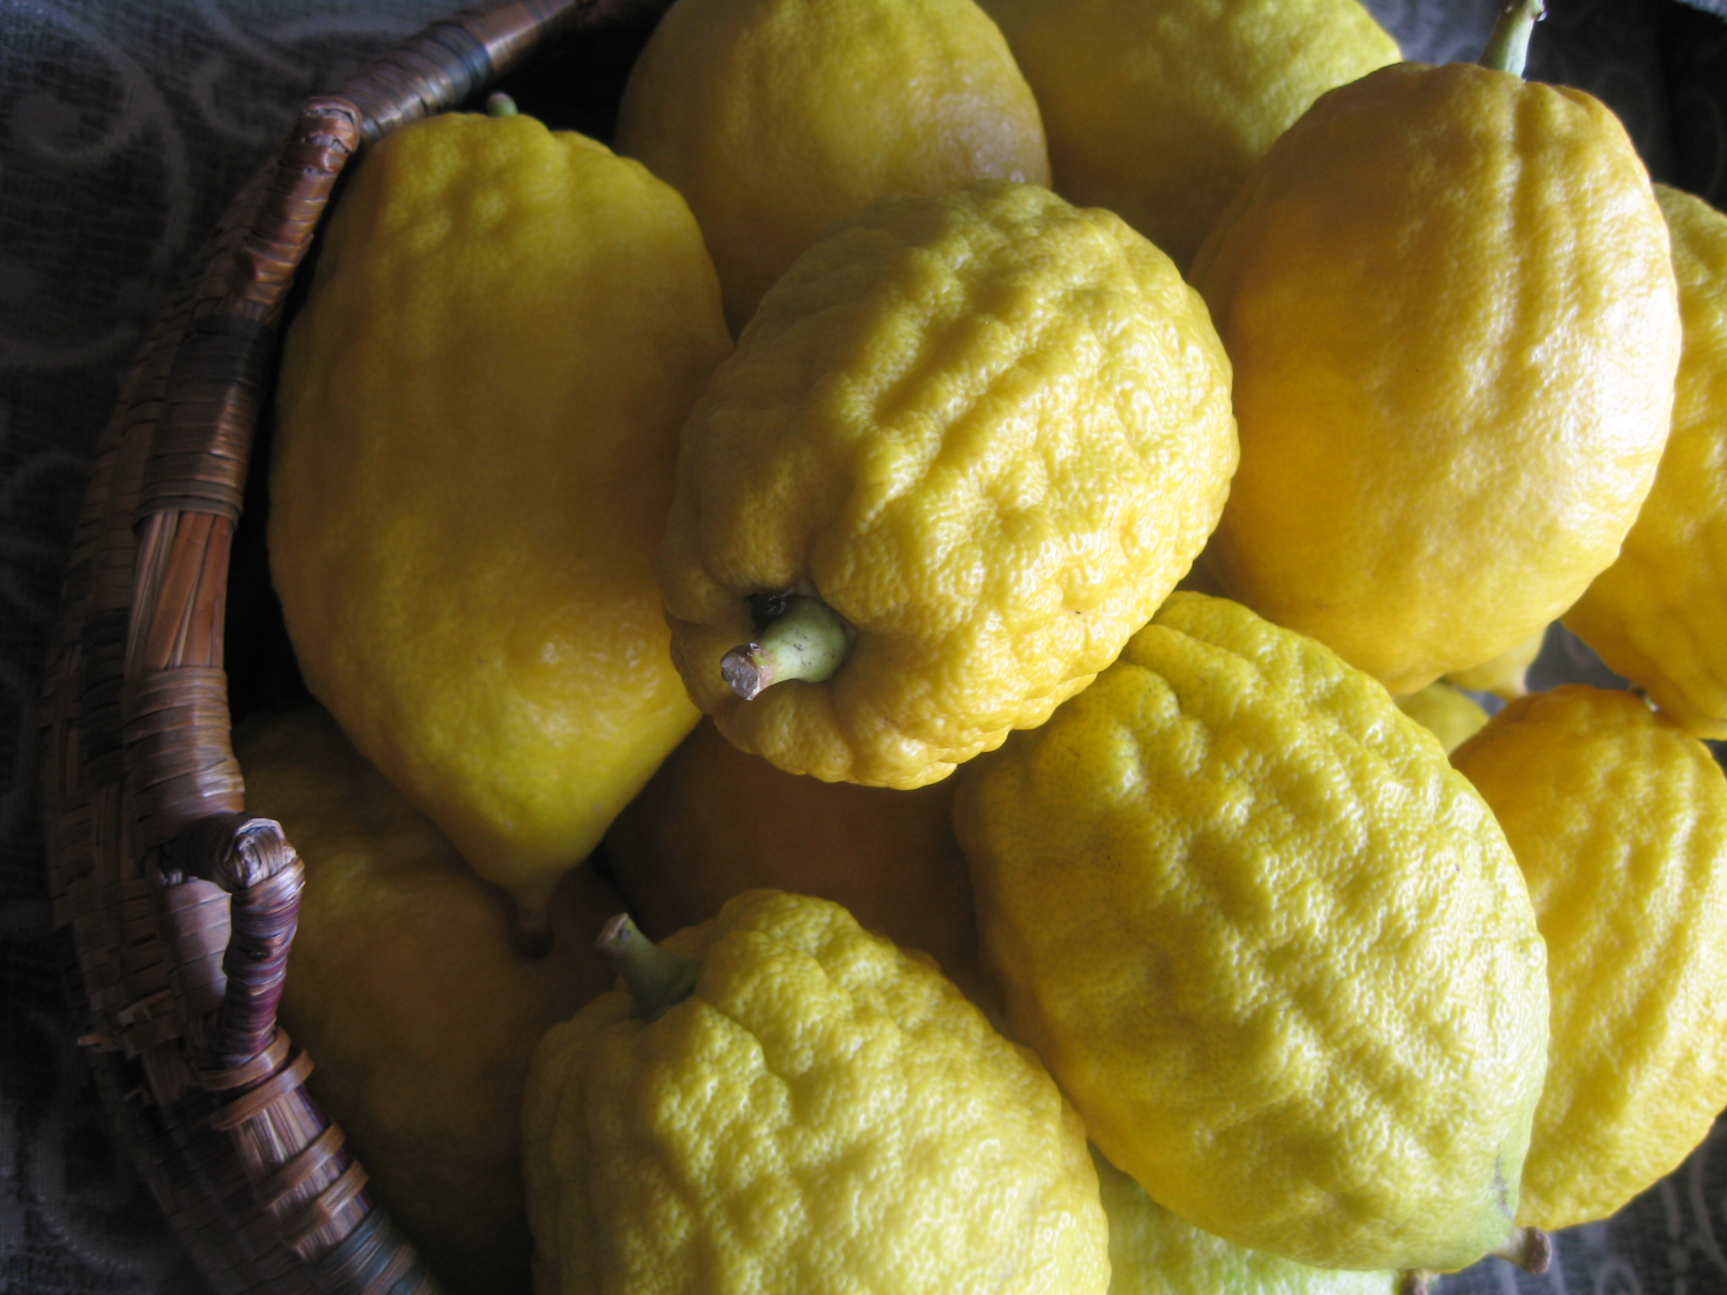
Happy Sukkot
How many etrogim are in the basket?
How many do we see?
How many don’t we see?
K.CC.B5

Slide 12
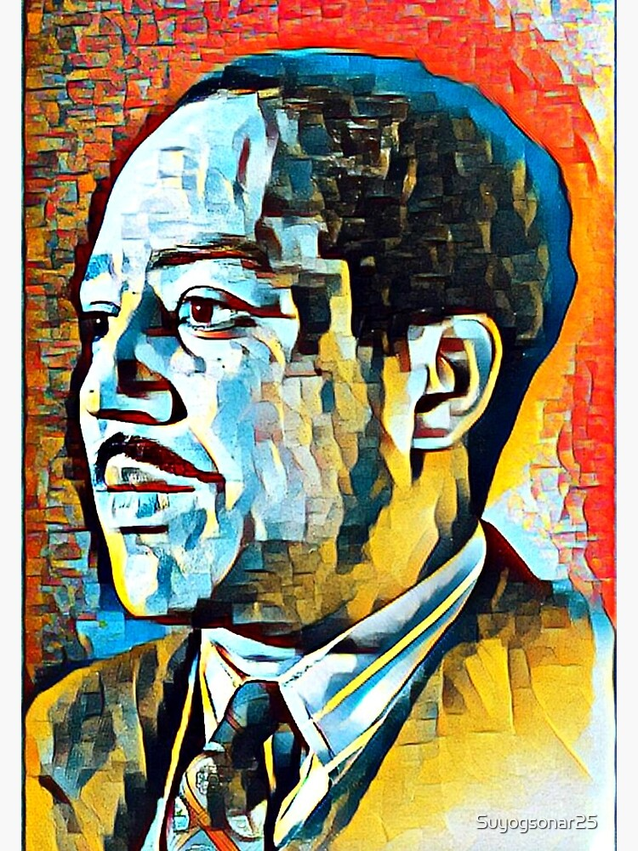
Today is National Black Poetry Day.
Let’s celebrate with a poem
by Langston Hughes
My People
The night is beautiful,
So the faces of my people.
The stars are beautiful.
So the eyes of my people.
Beautiful also, is the sun.
Beautiful, also, are the souls of my people?
What can we count in the poem?
What do we notice?
K.CC.B4

Slide 13
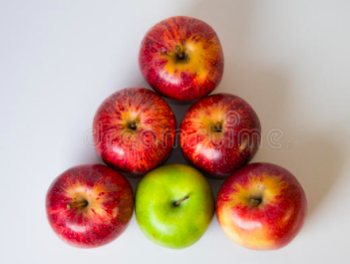
It’s National Apple Day!
How do we see these apples?
K.OA.A3

Slide 14
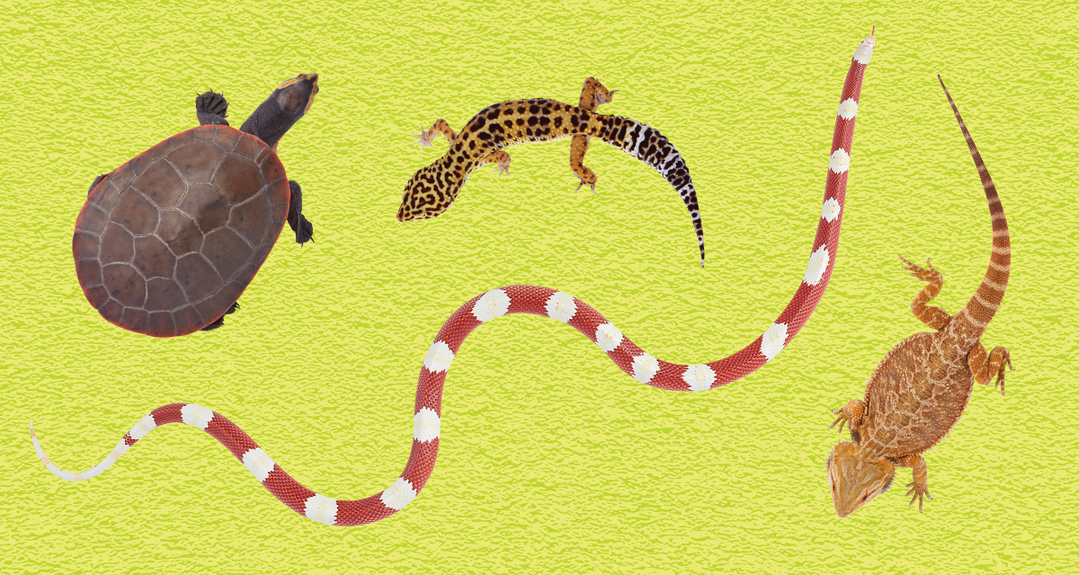
Today is National Reptile Day!
How many reptiles are here?
How can we compare them?
K.MD.A2
Notes:
Week of October 21, 2024

Slide 15
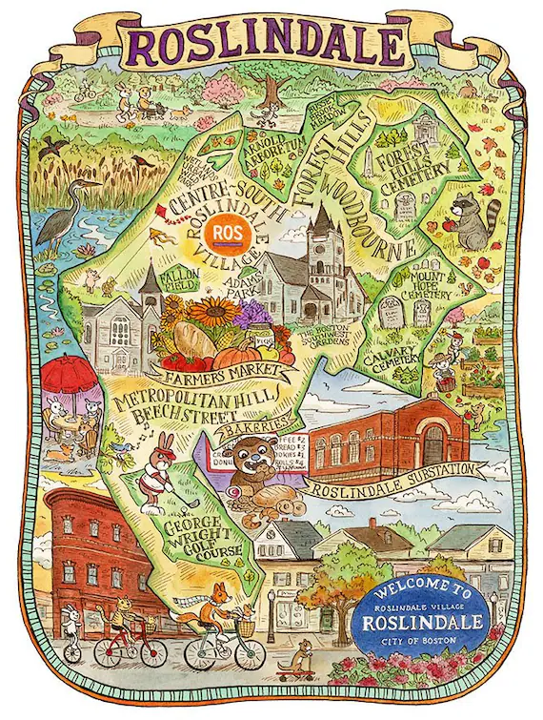
What do we notice?
What do we wonder?
What can we say about what we see?
Let’s use the words
above, below
and next to
K.G.A1

Slide 16

Today we celebrate Liberation Day in Libya
What do we notice about the flag of Libya?
How can we compare the shapes we see?
K.G.B4

Slide 17
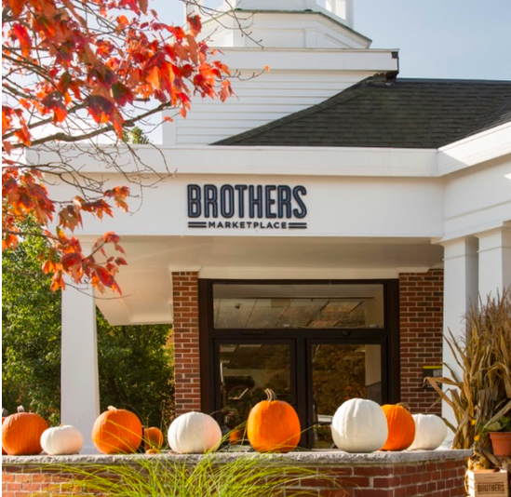
How many pumpkins do we see?
What if we took
1 away?
What if we took
2 away?
K.OA.A1

Slide 18
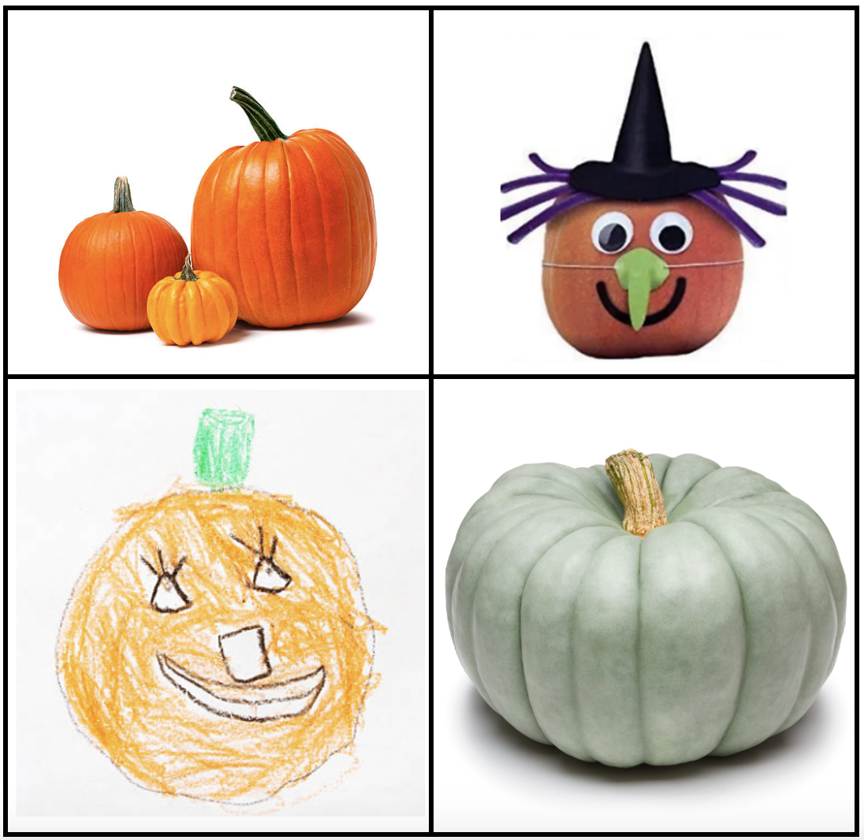
Which one doesn’t belong?
K.SMP.3
Notes:
Top left: not one pumpkin
Top right: decorated
Bottom left: drawing
Bottom right: not orange

Slide 19
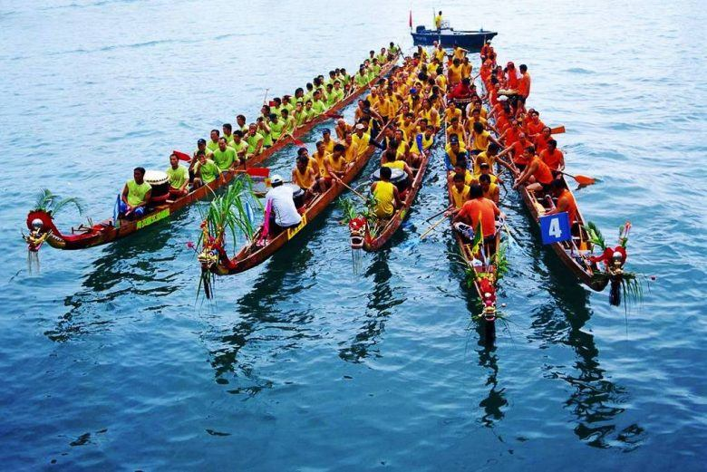
Today is the Boat Racing Festival in Laos!
What do we notice?
What do we wonder?
How many boats?
How many people are in each boat?
Can we estimate?
K.CC.B5
Notes:
Week of October 28, 2024

Slide 20
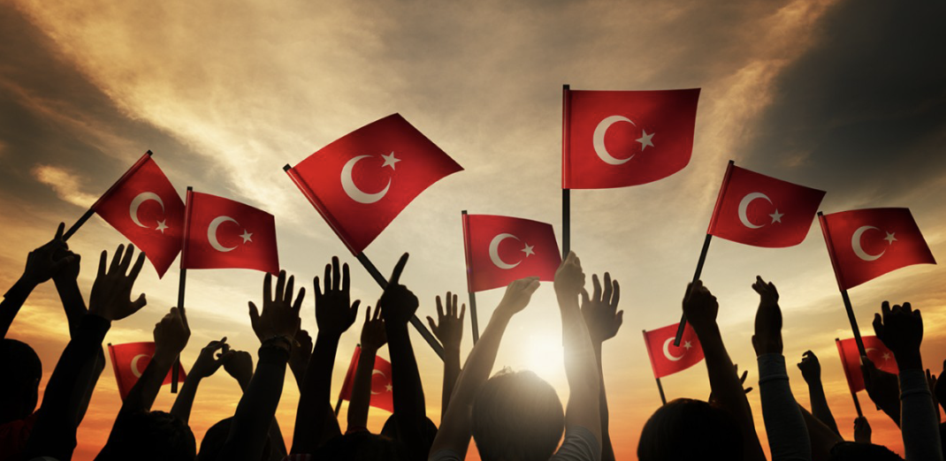
Happy Republic Day to our friends in Turkey!
What can we count in this photo?
K.CC.B4

Slide 21
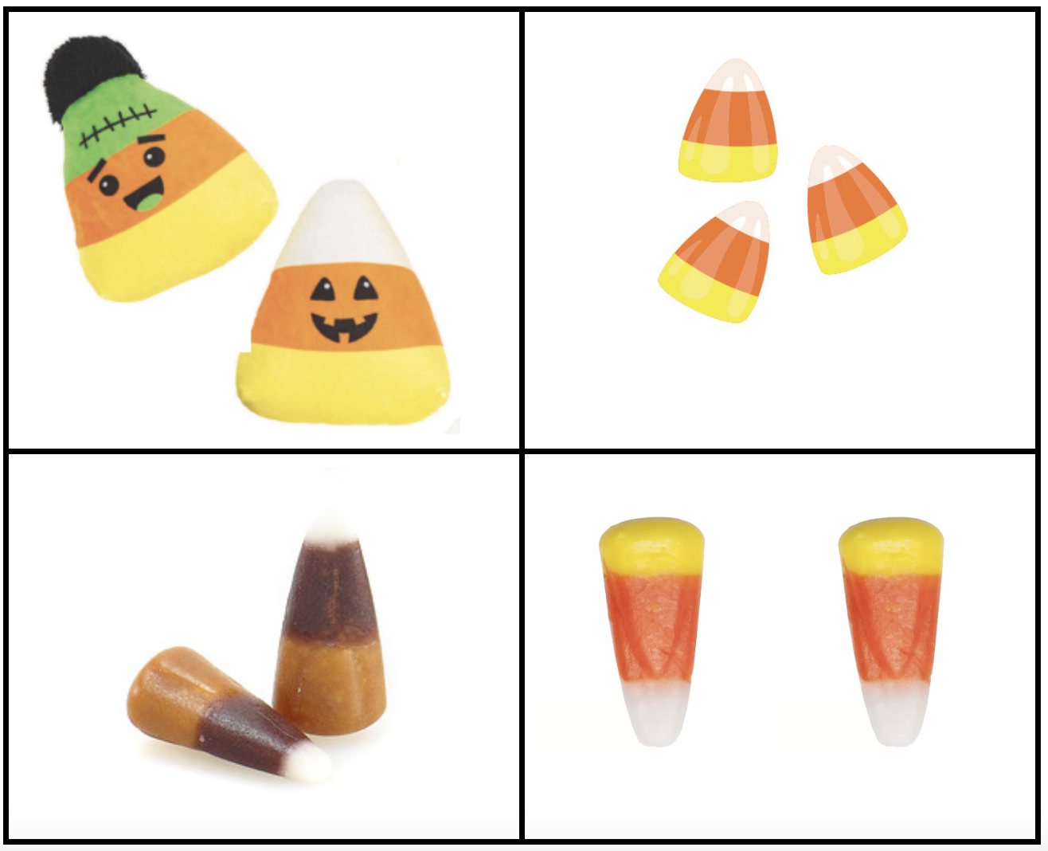
Happy National Candy Corn Day!
Which one doesn’t belong?
K.SMP.3
Notes:
Top Left faces
Top Right not 2
Bottom Left not orange/yellow
Bottom Right upside down

Slide 22
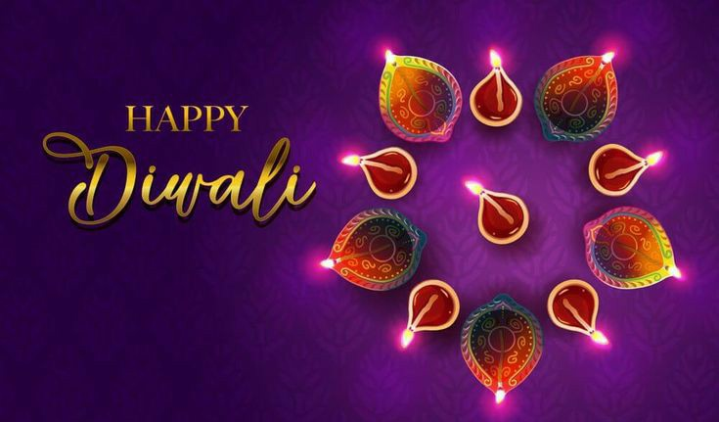
What can we count?
How can we count them?
K.CC.B4

Slide 23
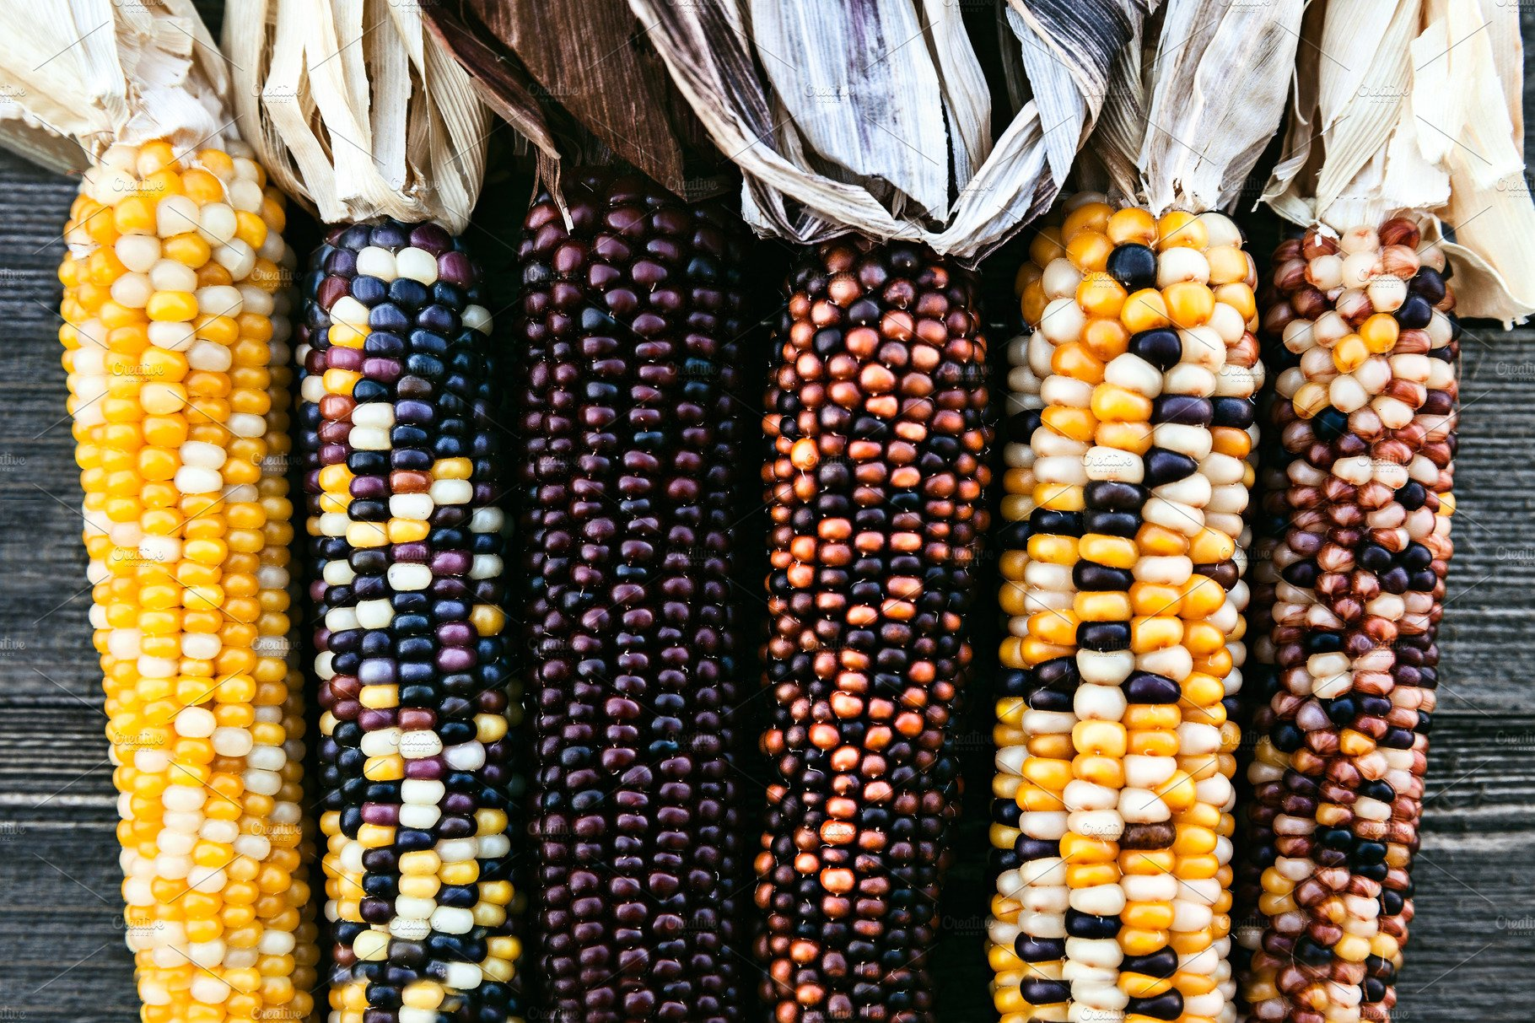
How many ears of Indian corn do we see?
How many more would we need to have 10?
K.OA.A2

