Slide 1
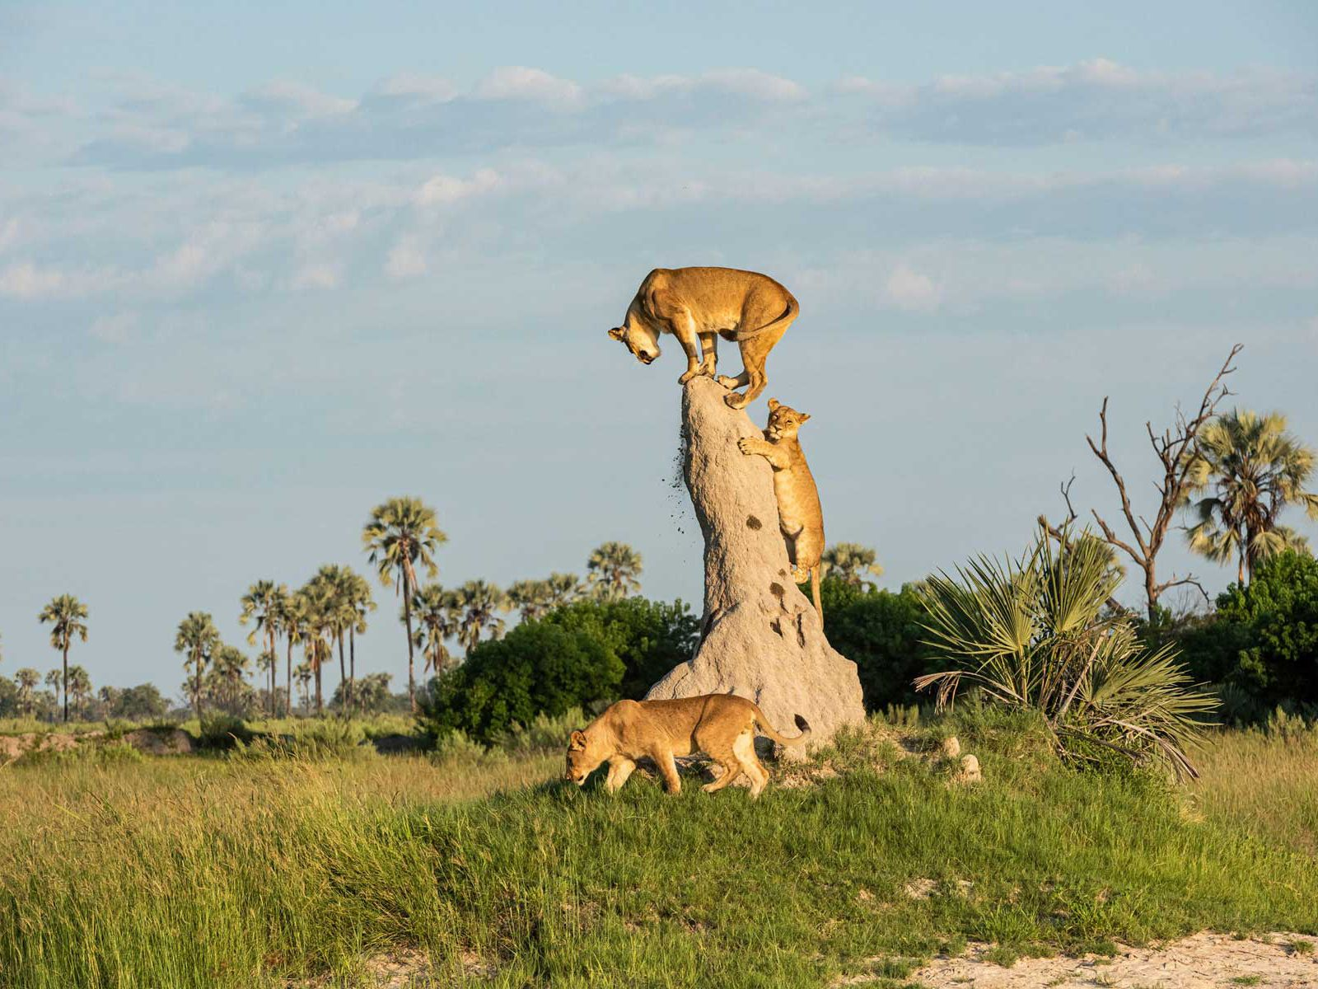
Happy Independence Day Botswana!
The current population of Botswana is 2,351,700
What can we say about this number?
What are some factors of 2,351,700
5.NBT.B6
Notes:
September 30, 2024
Botswana Day

Slide 2
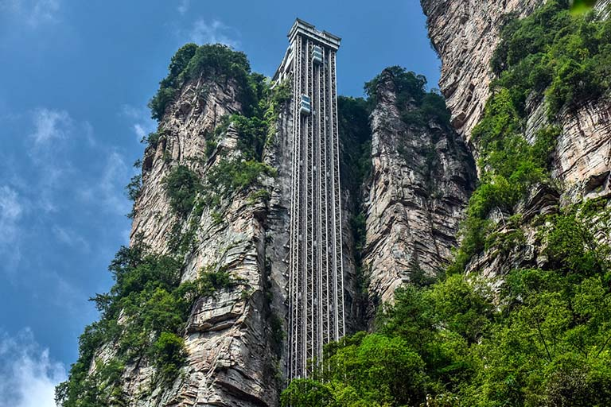
Happy National Day of China!
China’s Bailong Elevator carries visitors more than 300m up a cliff’s edge. The Bailong, also known as the "Elevator of the Hundred Dragons", is located on the wall of Wulingyuan Mountain, it is the highest and fastest external elevator in the world!
How high is 300 meters?
How long is 1 meter?
How many centimeters is that?
Millimeters? Kilometers?
5.MD.A1

Slide 3
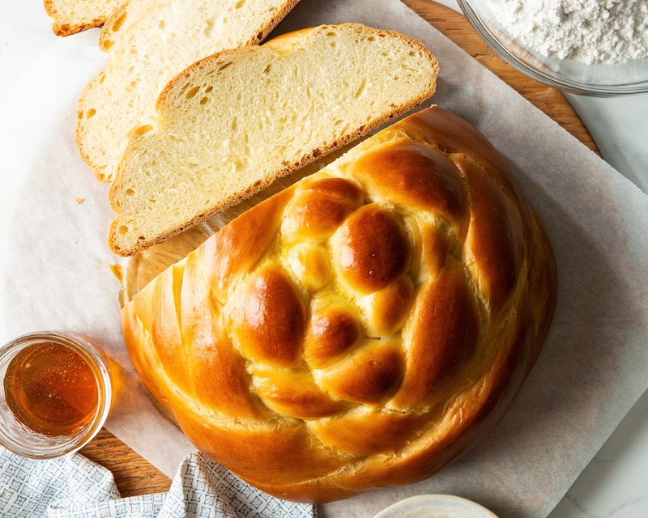
Happy Rosh Hashanah!
שָׁנָה טוֹבָה וּמְתוּקָה
What fraction of the round Challah has been cut away?
What fraction of the Challah remains on the board?
How do you know?
5.NF.A2

Slide 4

Happy National Taco Day!
A red chili weights between 15 and 20 ounces. What is possible for the total weight of 8 chilis?
5.NBT.B5

Slide 5

It is National Bathtub Day!
Estimate the volume of this bathtub.
What measurement tool would you use?
Do you know how many gallons of water are in a cubic foot?
7.5
So, how many gallons of water will fit in this tub?
5.MD.A1
Notes:
Week of October 7, 2024

Slide 6
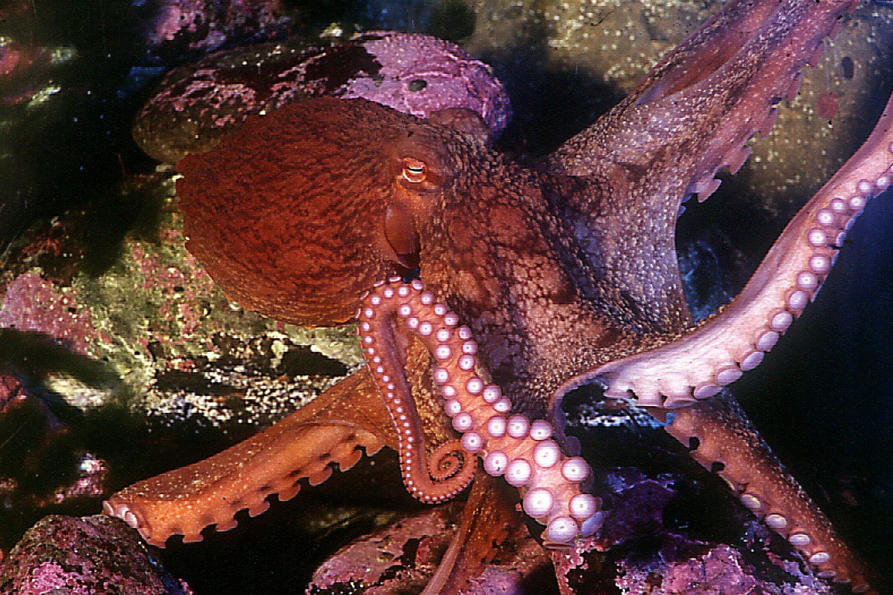
Happy World Octopus Day!
Octopuses generally have a double row of suckers (biserial) running down each arm from their mouth. The Giant Pacific Octopus is most impressive, with around 280 suckers PER ARM.
How many suckers on all 8 arms?
How can we use mental math to solve this?
5.NBT.B5

Slide 7
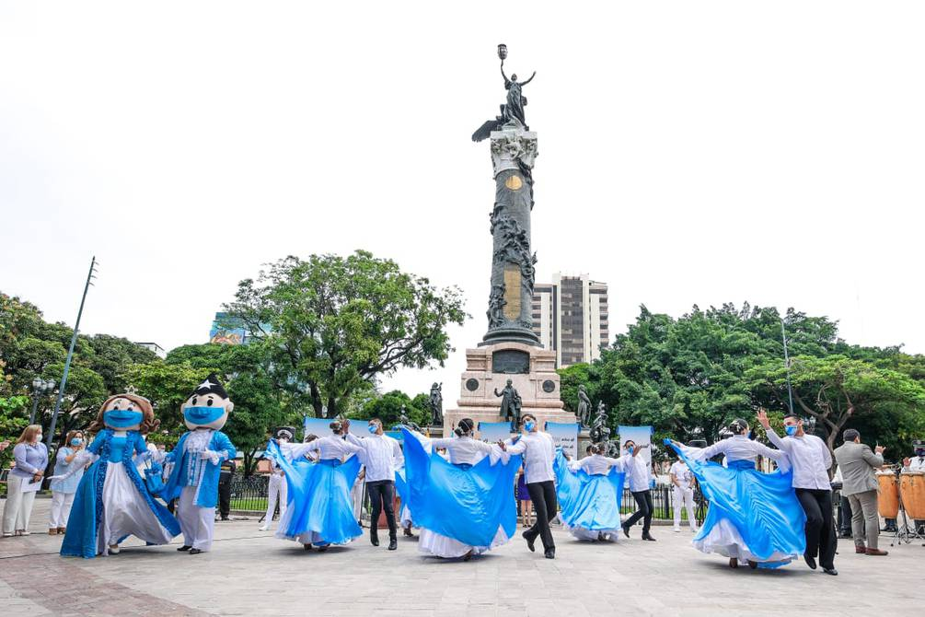
It is Guayaquil Independence Day in Ecuador!
What do we know about Ecuador?
Ecuador’s coastline is 2,237 km. Massachusetts’ coastline is
309 km.
How do they compare?
5.MD.A

Slide 8
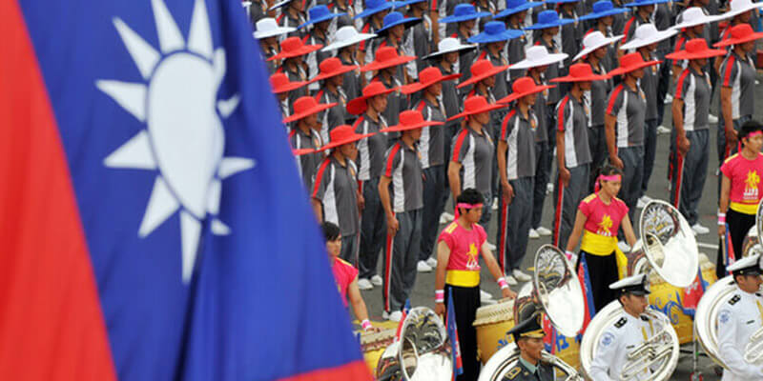

It’s Double Ten Day in Taiwan!
雙十節
Do you wonder why?
What happens when we keep doubling ten?
Let’s try it!
5.NBT.B5
A combination of two 十 ('ten') characters

Slide 9
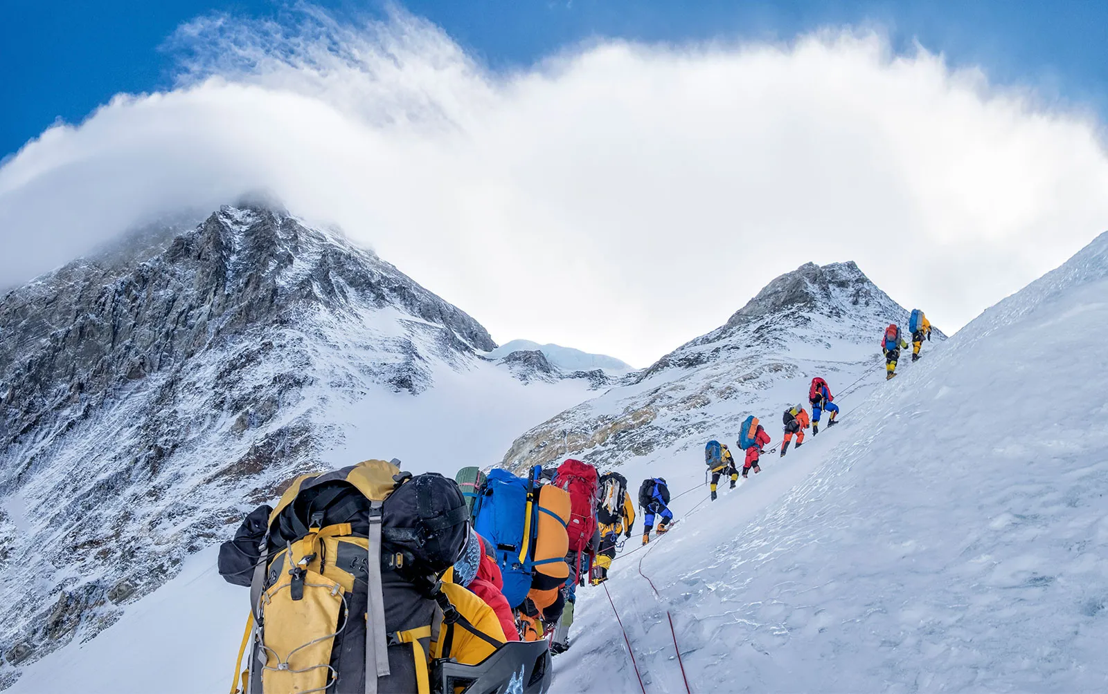
Today we celebrate Maha Ashtami in Nepal
Mount Everest, Sagarmatha, is the highest mountain above sea level in the world.
Do you know how high it is?
8,850 meters!
What are some factor pairs of 8,850?
How will we know when we have found them all?
5.NBT.A2

Slide 10

Celebrate Indigenous Peoples’ Day with art created by Mr. Ginga!
Where is the math here?
Do we see any symmetry?
How about angles?
Fractions?
5.MD, 5.G
Notes:
Week of October 15, 2024

Slide 11
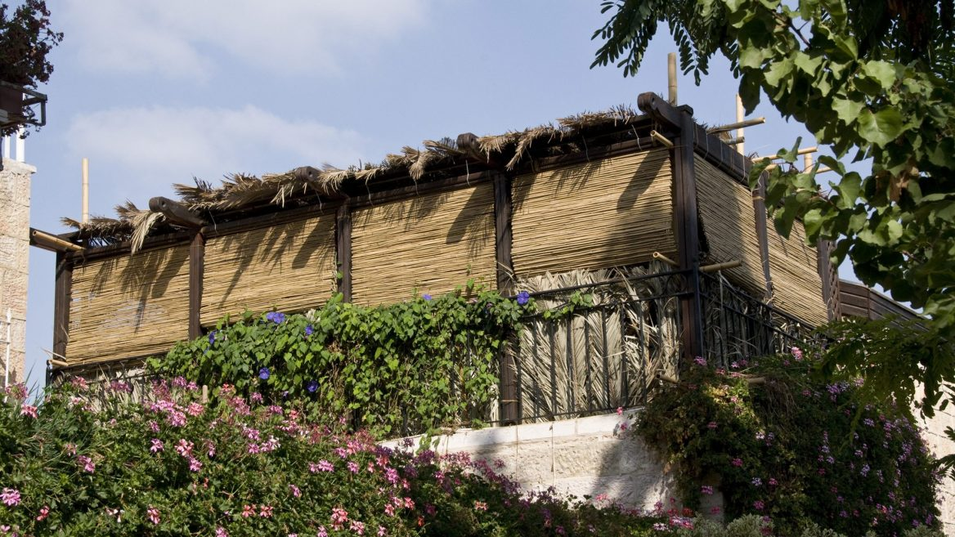
Happy Sukkot!
This Sukkah on the roof of a home in Jerusalem has a perimeter of 36 meters.
What dimensions (length and width) are possible?
5.MD.C

Slide 12
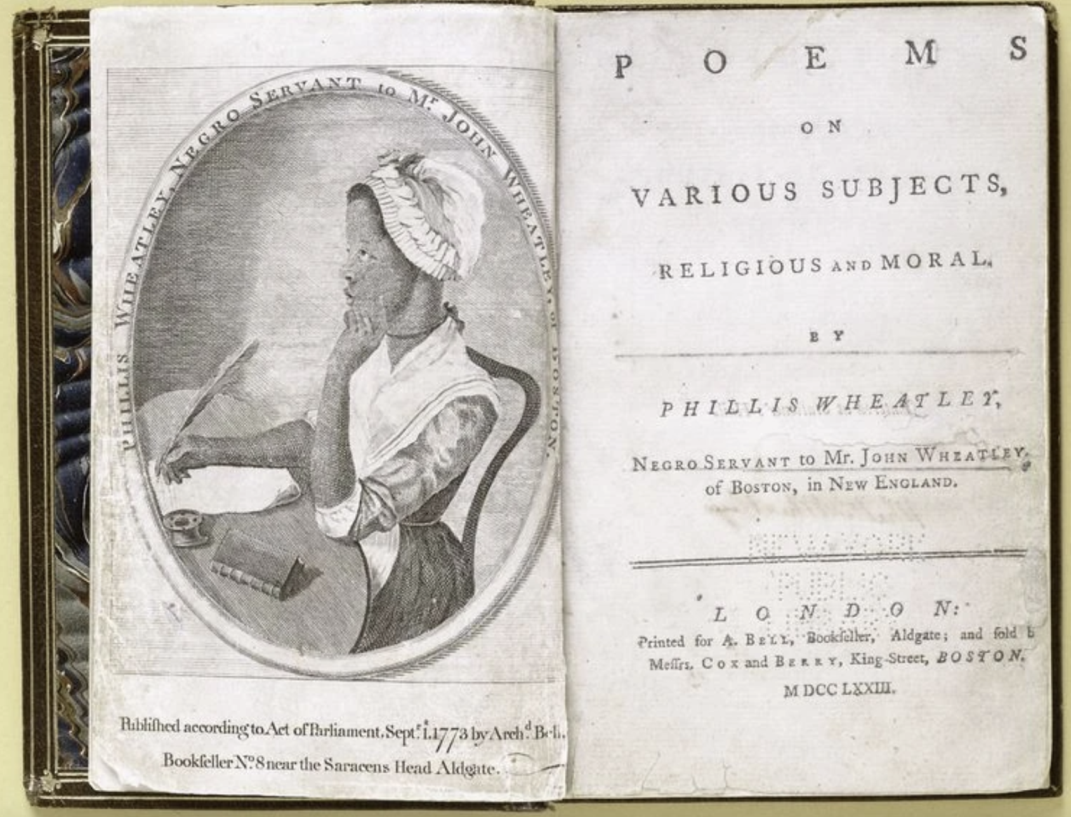
Today we celebrate Black Poetry Day
Phillis Wheatley, the first African American to publish a book of poems, was a slave to a wealthy Boston family.
Her book was published in 1773.
How long ago was that?
What are some strategies we can use to solve this?
5.NBT.B

Slide 13
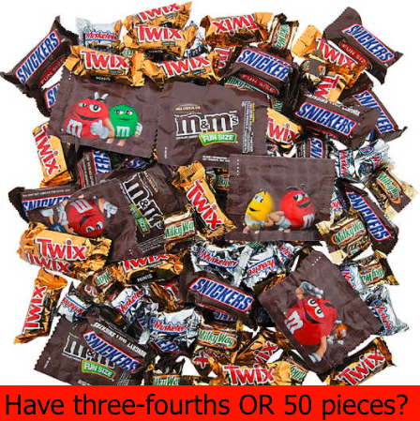
Would you rather . . .
5.NF.A

Slide 14
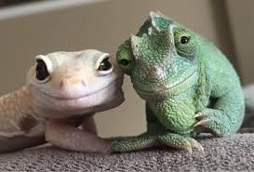
Happy National Reptile Day!
There are approximately 12,000 species of reptiles. Reptiles are the second most diverse class of tetrapods after birds, and are more diverse than mammals and amphibians.
What can we say about the number 12,000?
Let’s find factor pairs of 12,000.
Do we see any patterns?
5.NBT.A2
Notes:
Week of October 21, 2024

Slide 15
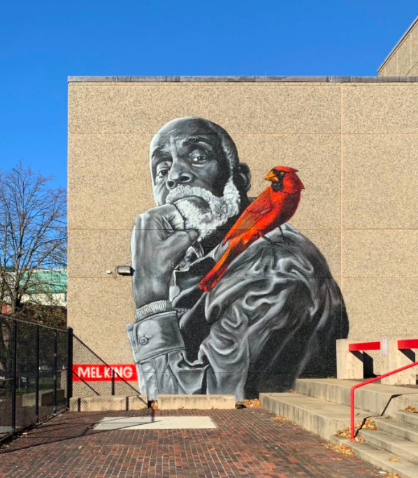
The cardinal, in this Roxbury mural, is about 10 feet long from his tail feathers to the tip of his head.
An actual cardinal is between 8 and 9 inches long.
How many times bigger is the one in the mural?
5.MD.A1
75 Malcolm X Boulevard in Roxbury photo by @happastreetart

Slide 16
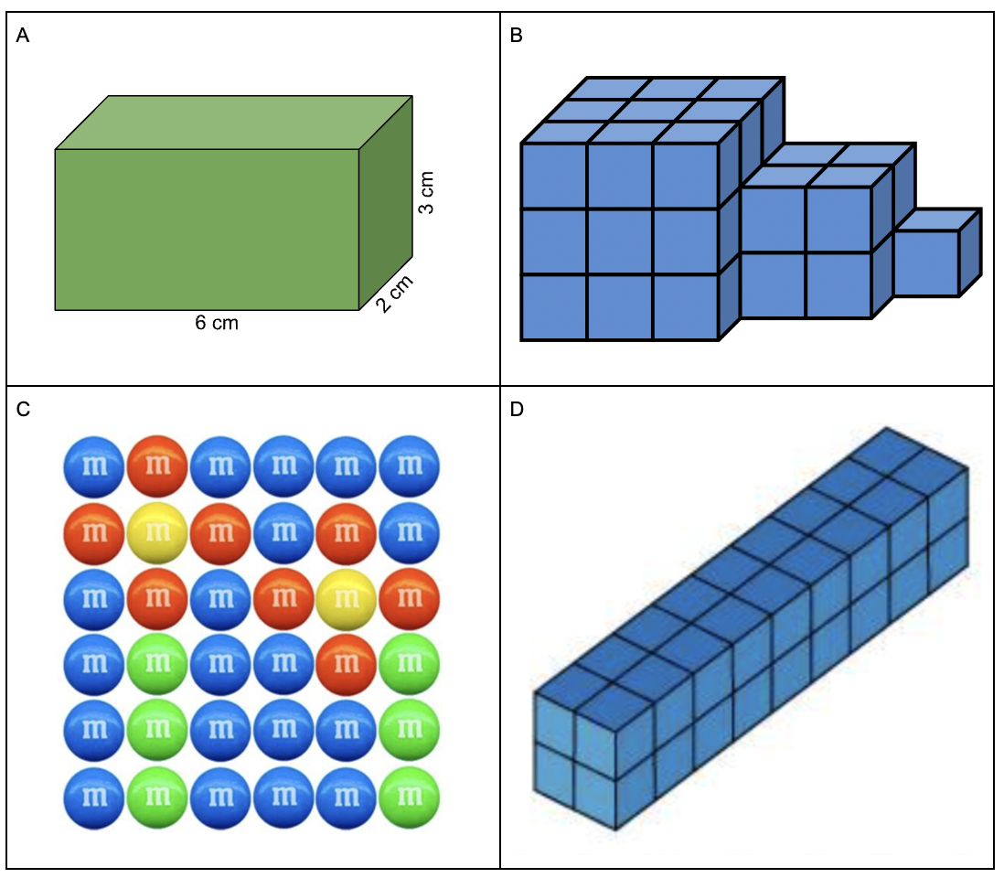
Which one doesn’t belong?
5.MD.C3

Slide 17
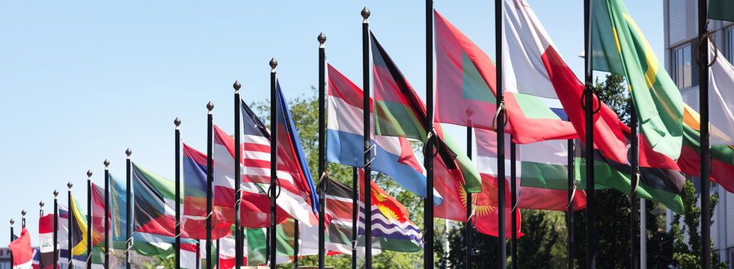
5.MD.A1
Happy United Nations Day!
It was on October 24,1945 that the foundational treaty of the United Nations brought the organization into existence. The aim was to encourage cooperation between all the governments of the world.
How long ago was October 24, 1945? How many years? How many months? How many days?

Slide 18
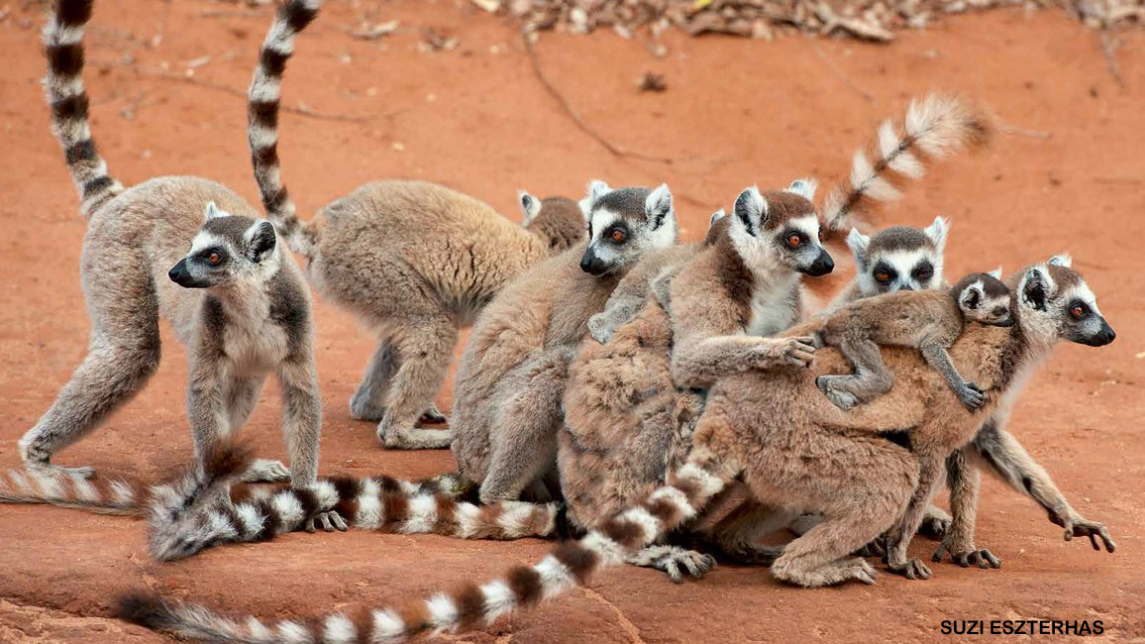
Happy World Lemur Day!
An adult lemur can weight between 5.5 and 6 pounds. The baby weighs less than a pound!
What can we say about the combined weights of these lemurs?
What is possible?
5.NBT.B7

Slide 19
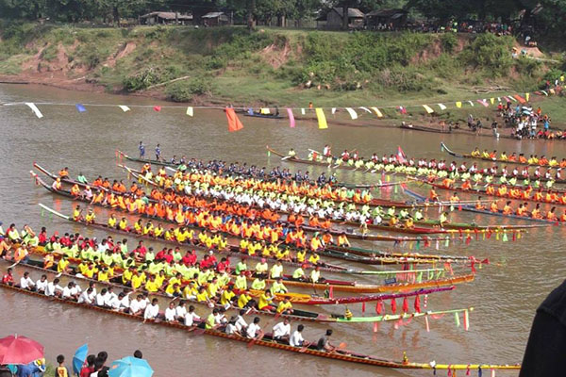
Today is the Boat Racing Festival in Laos!
The history of boat racing in Laos, also known as Boun Xuang Heua, dates back hundreds of years and is deeply rooted in Lao culture and spirituality.
Estimate how many boats are here.
Estimate how many rowers on each boat.
Estimate how many rowers altogether!
5.NBT
Notes:
Week of October 28, 2024

Slide 20
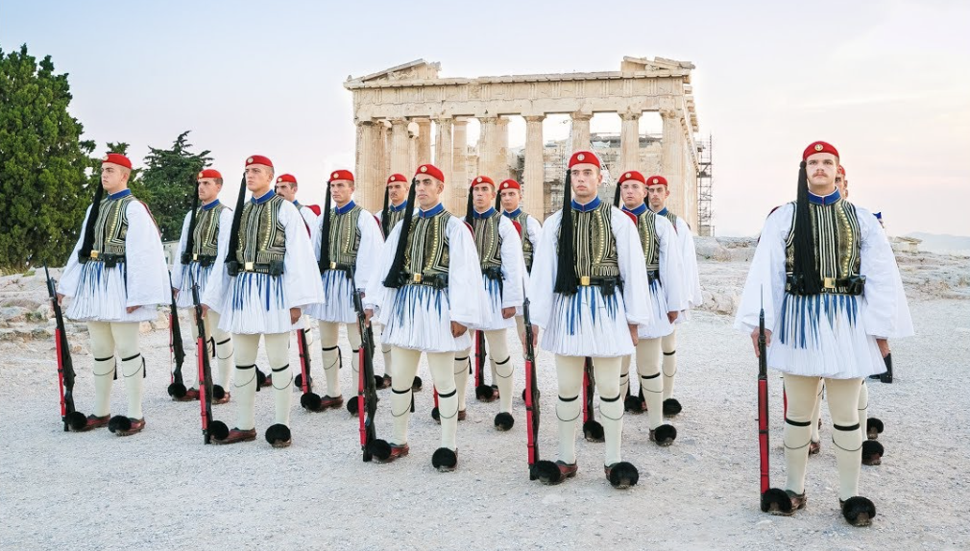
Happy οχι (say Ohi) Day in Greece!
It takes 9 hours and 18 minutes to fly from Boston to Athens.
How many minutes is that?
About what fraction of a day is it?
5.MD.A1

Slide 21
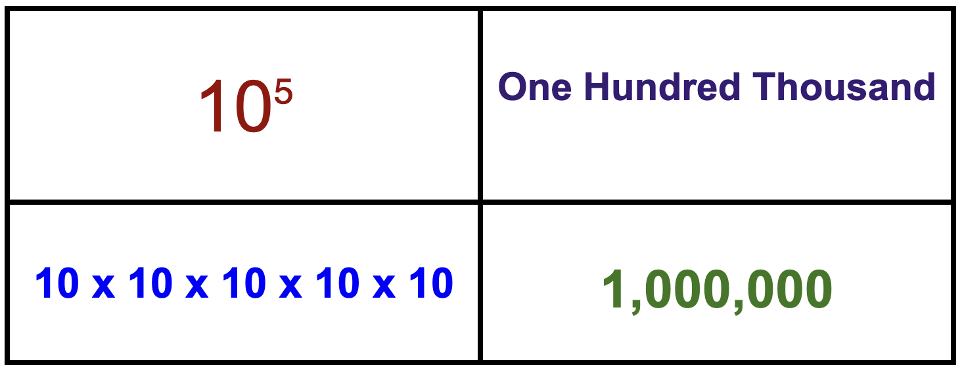
Which one does not belong?
A
B
C
D
5.NBT.A2
Notes:
Top Left: only one with an exponent
Top Right: not numerals
Bottom Left: only expanded
Bottom Right: not 100,000

Slide 22
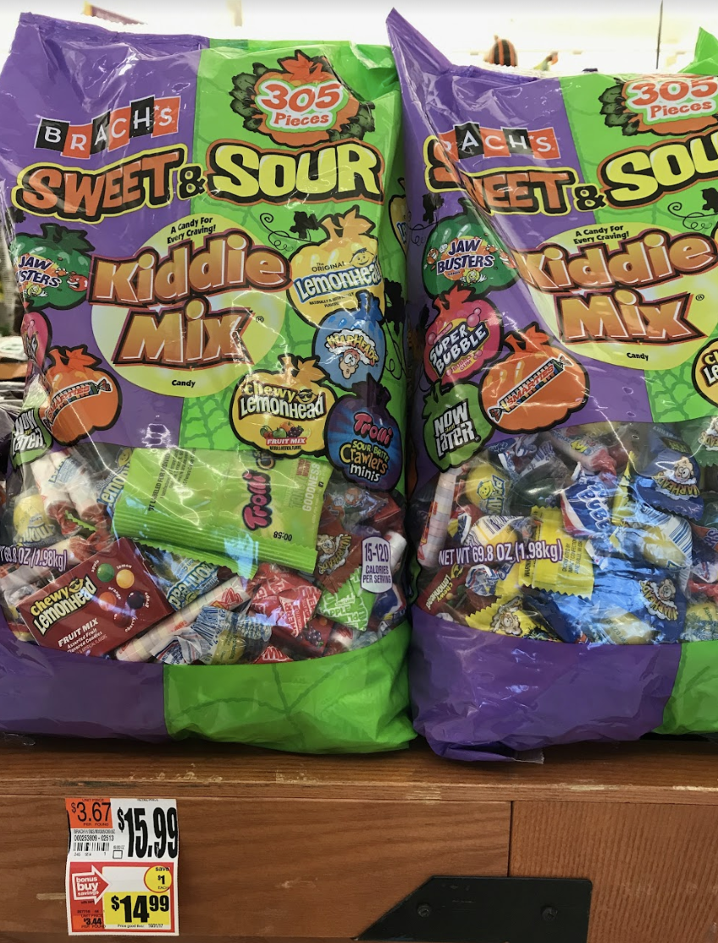
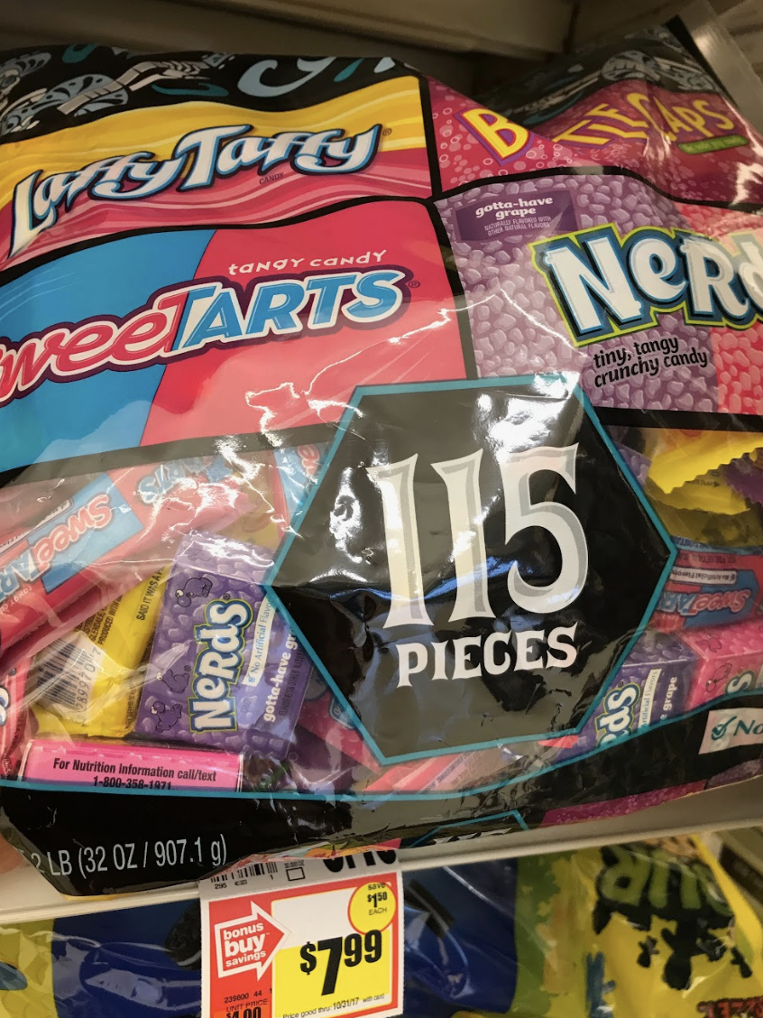
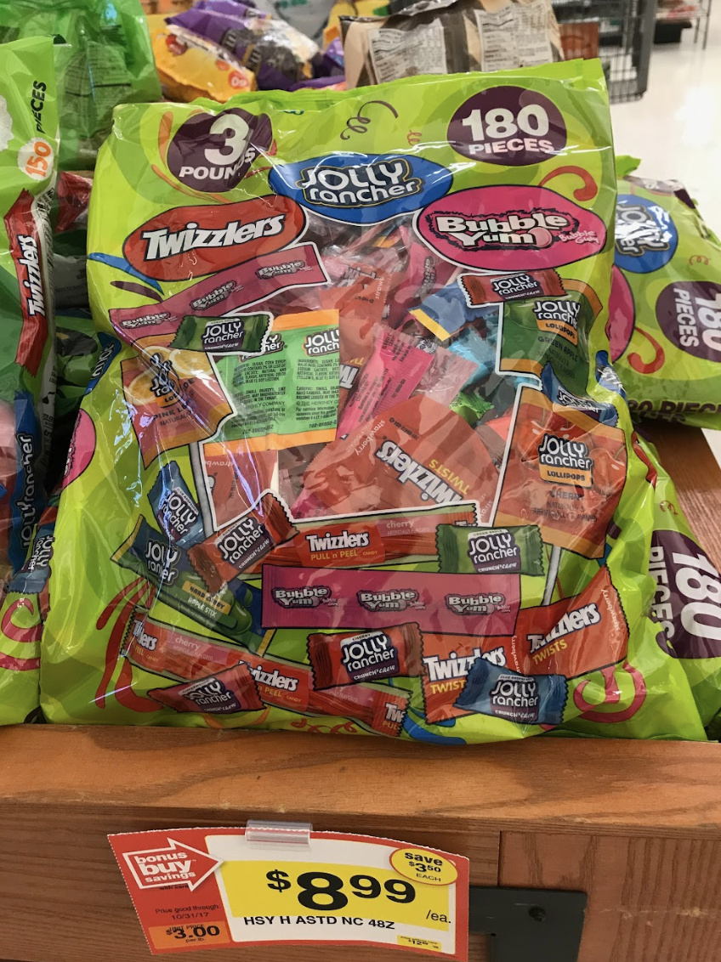
Would you rather … ?
5.NBT.B7

Slide 23
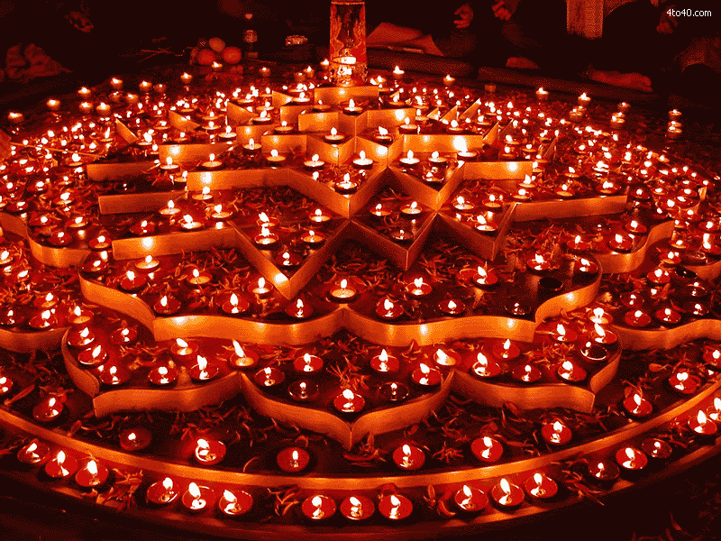
Happy Diwali!
What do we notice?
What do we wonder?
Estimate how many lights are here!
How can we solve this using MATH?
5.NBT.B5

