Slide 1
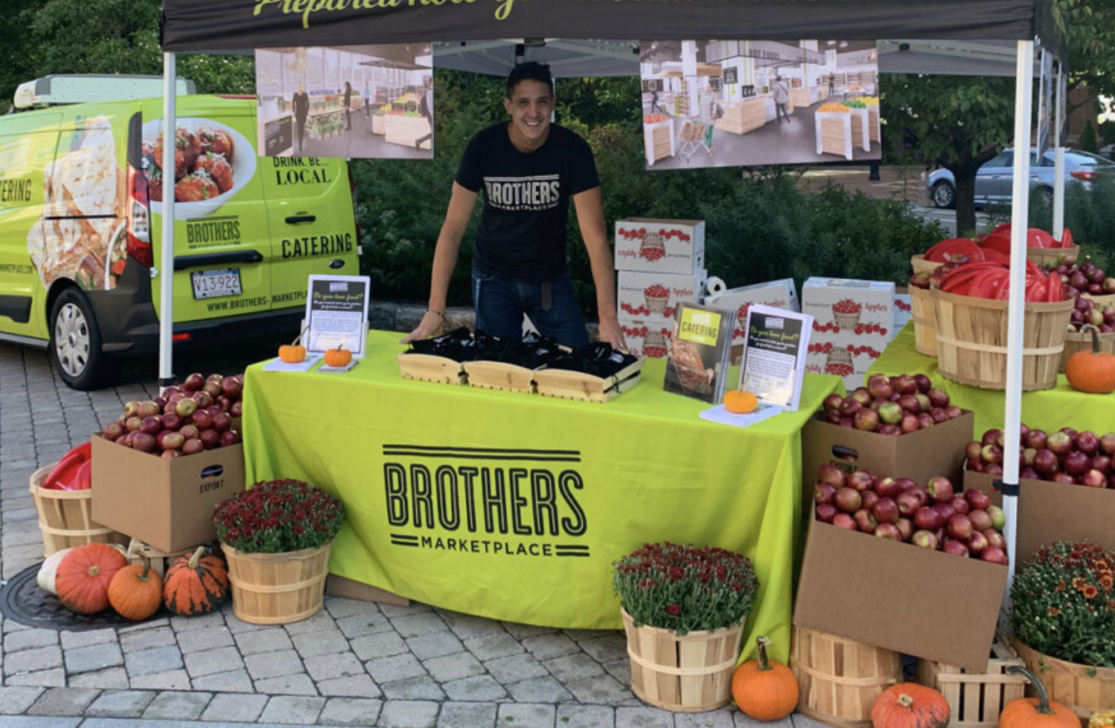
What can we estimate in this photo?
How can we use math to help us estimate?
2.NBT.A3

Slide 2
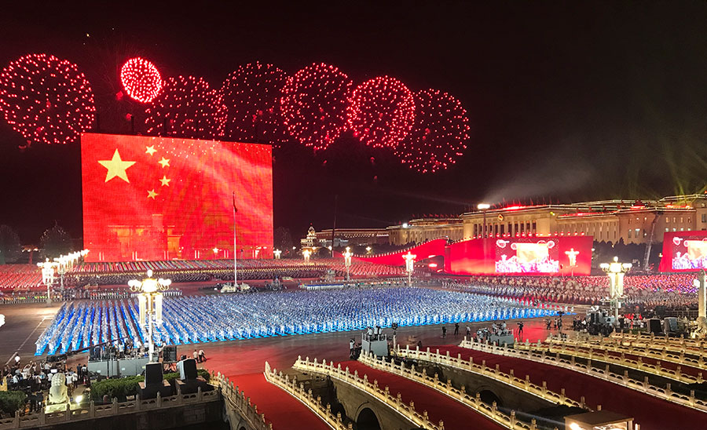
Happy National Day of China! 国庆节
China is made of 34 province level administrative divisions!
How many different expressions can we create that have a value of 34,
without using addition?
2.OA.A1

Slide 3
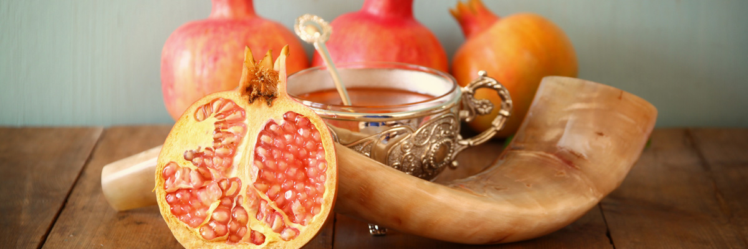
Happy Rosh Hashanah! שָׁנָה טוֹבָה וּמְתוּקָה‎
Legend says that a pomegranate has 613 seeds.
What can we say about the number 613?
How many seeds in 2 pomegranates?
2.OA.B7

Slide 4
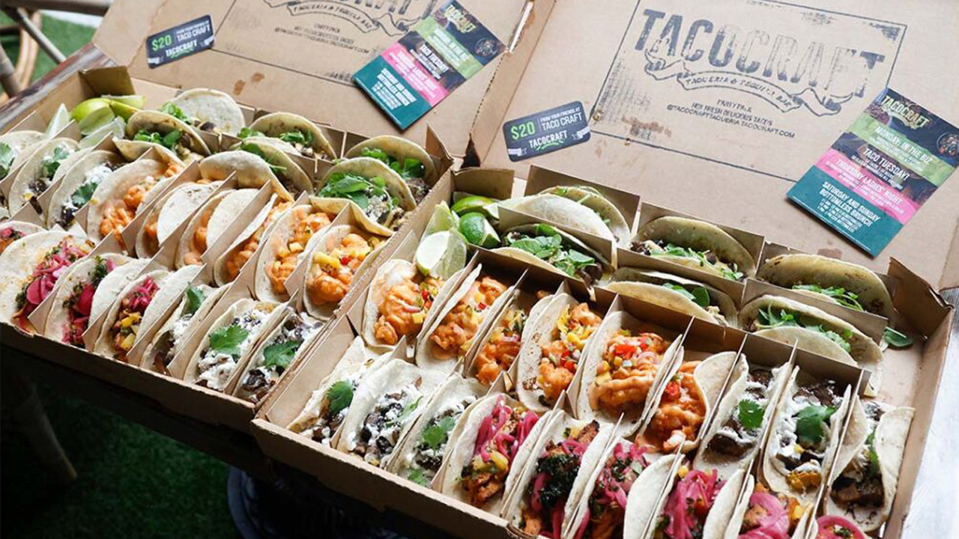
Happy National Taco Day!
How can we determine how many tacos are in the box without counting all?
How many tacos in both boxes?
2.OA.C4

Slide 5
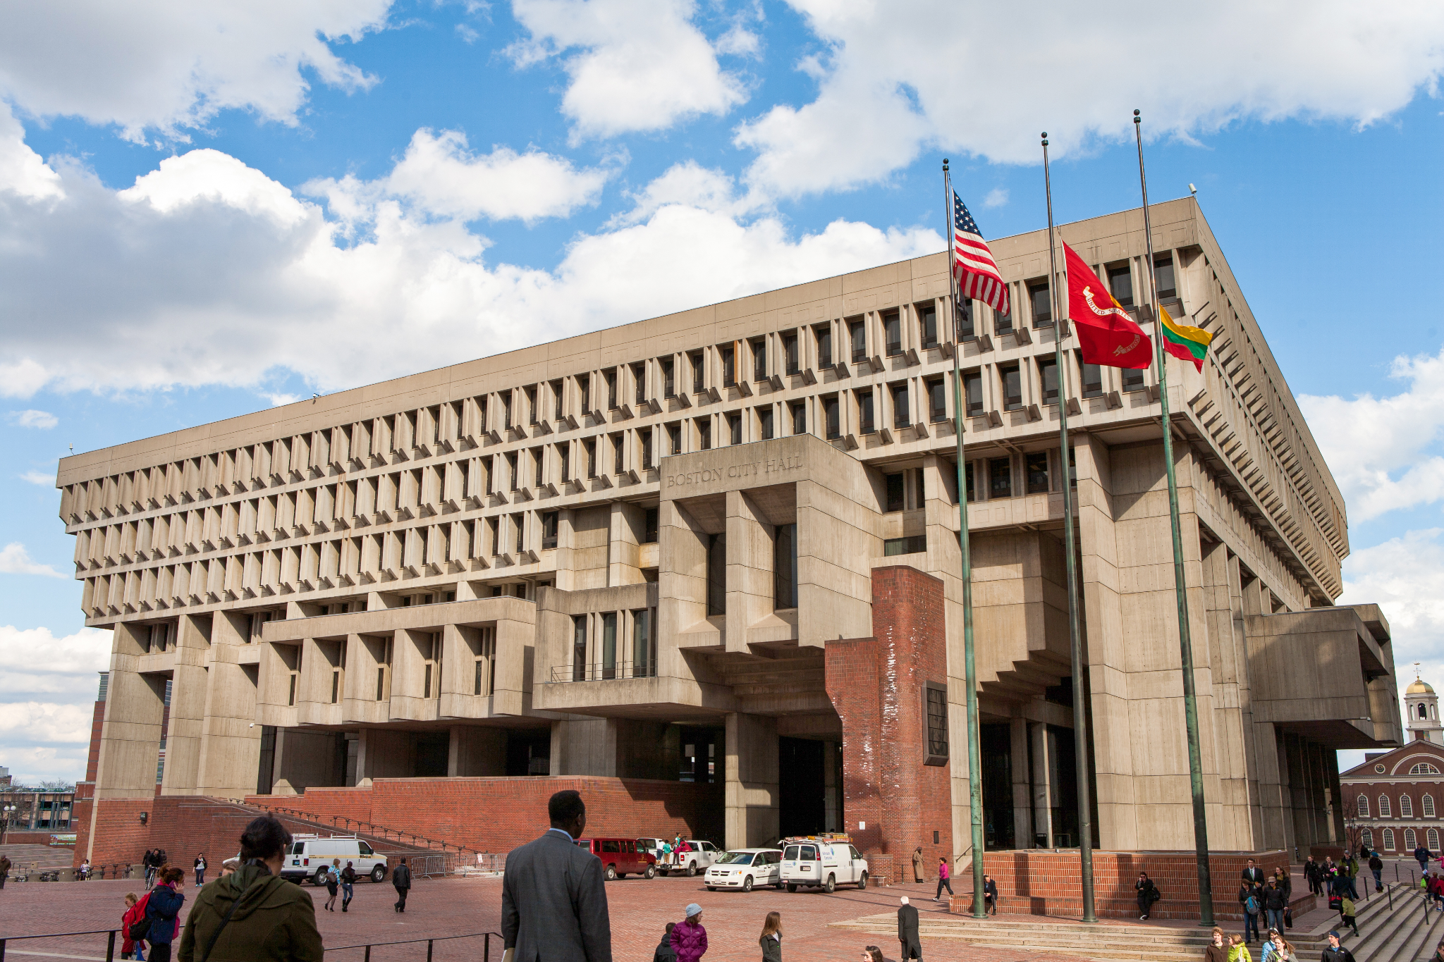
Happy World Architecture Day!
What can we count on Boston City Hall?
How can we use math to help us?
2.NBT.A2
Notes:
Week of October 7, 2024

Slide 6
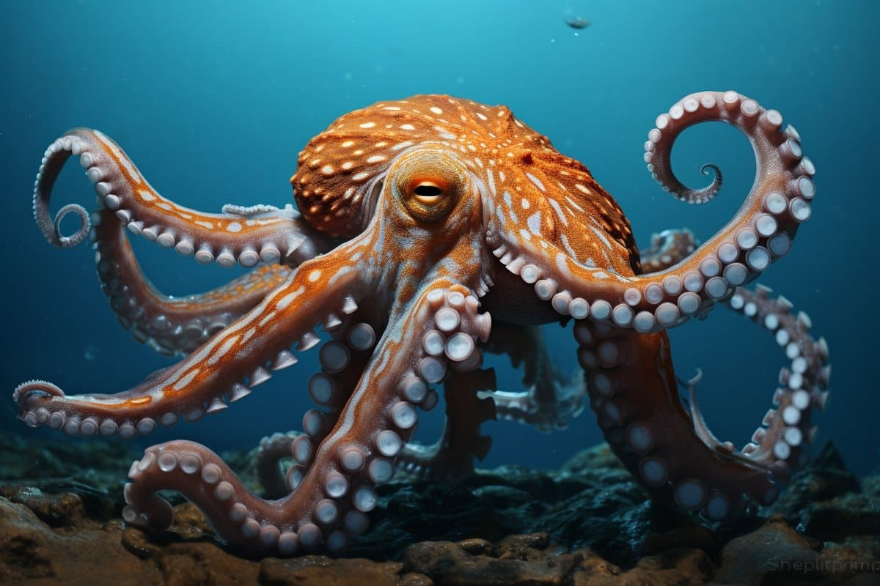
Happy World Octopus Day!
Did you know that an octopus has 9 brains?
How many brains would 2 octopuses have?
How about 3?
4? 5? 6?
Do we see a pattern?
2.NBT.B5

Slide 7
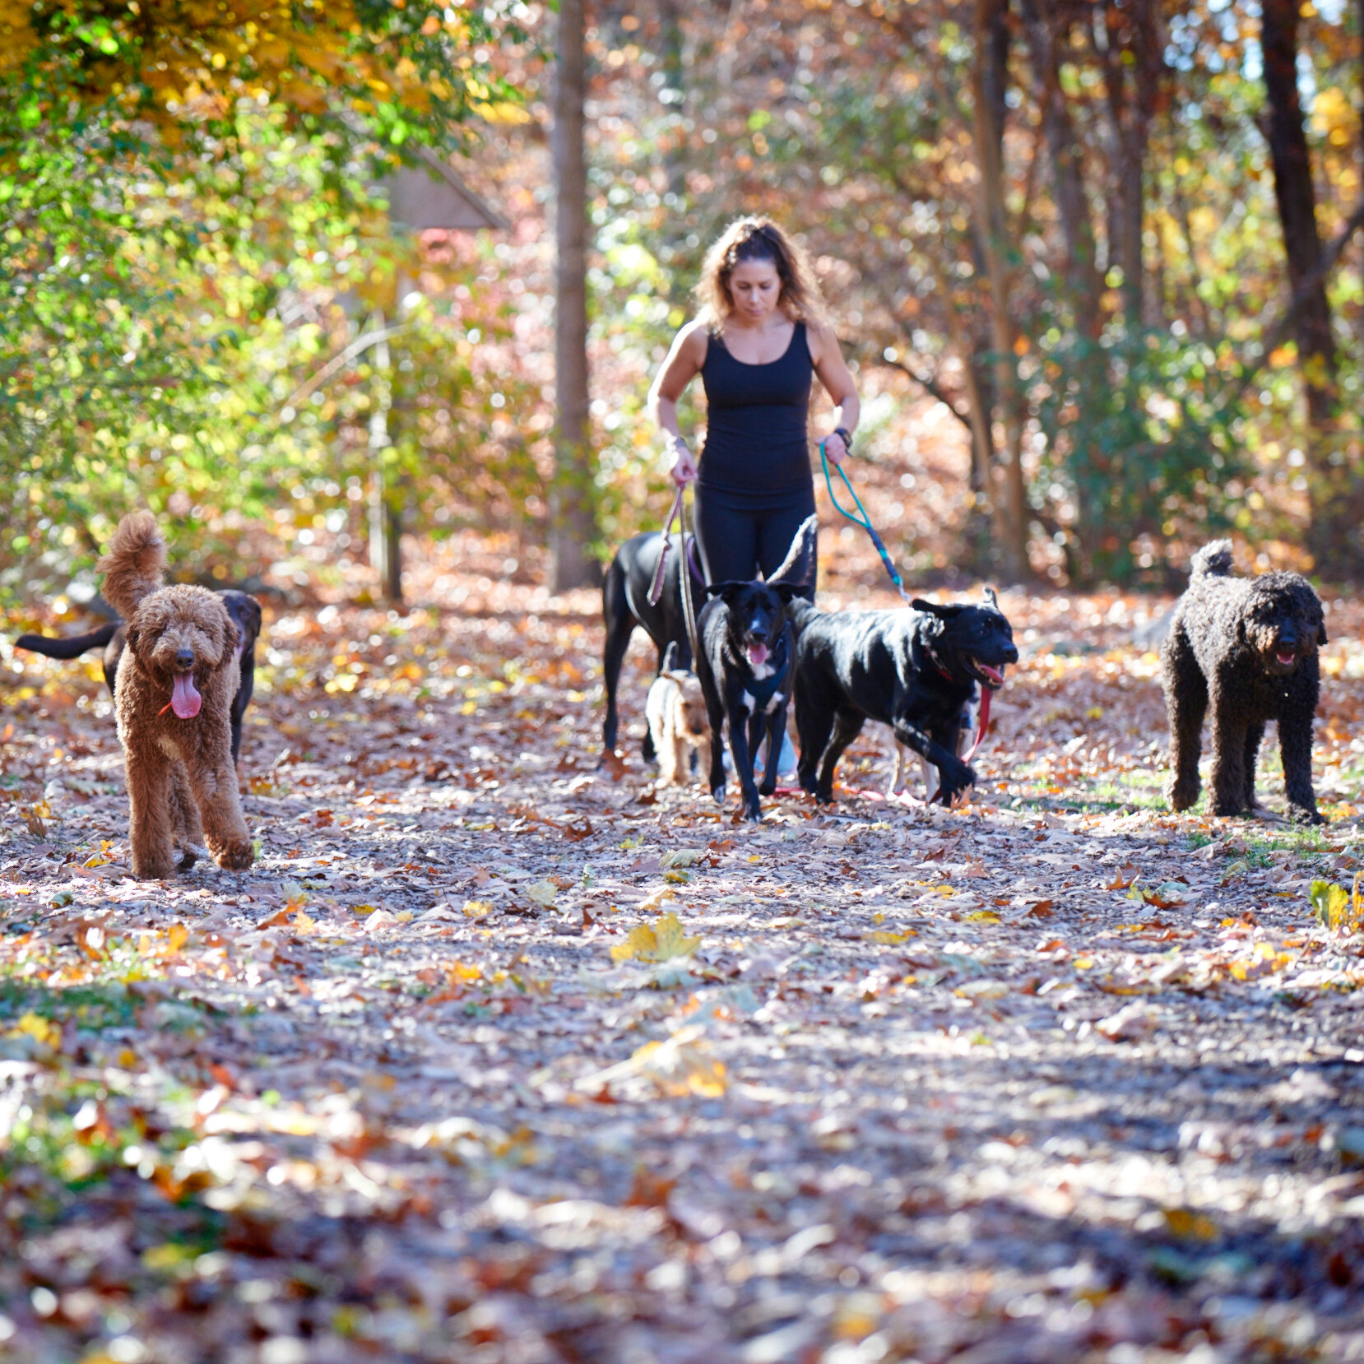
Dog walkers are on the Reservoir Walking Trail every day.
If 14 feet walk by, how many dogs and people could there be?
2.OA.A1

Slide 8
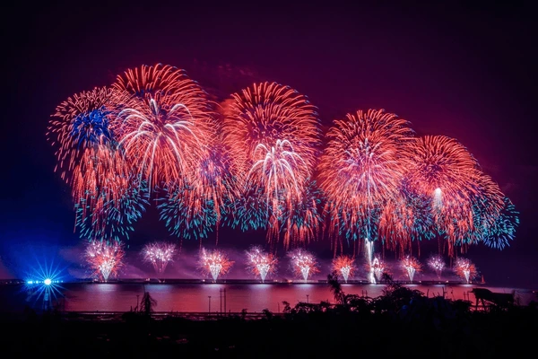
It’s Double Ten Day in Taiwan!
Do you wonder why?
What happens when we keep doubling ten?
2.NBT.B8

Slide 9
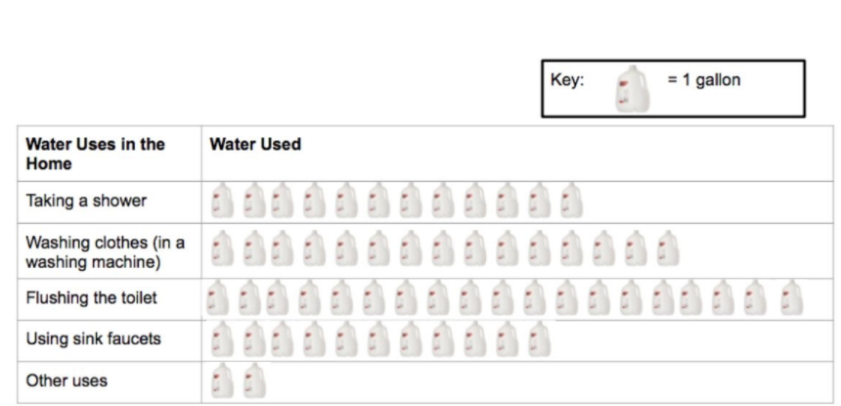
If this pictograph could talk,
what would it say?
Why does it matter?
2.MD.D10

Slide 10
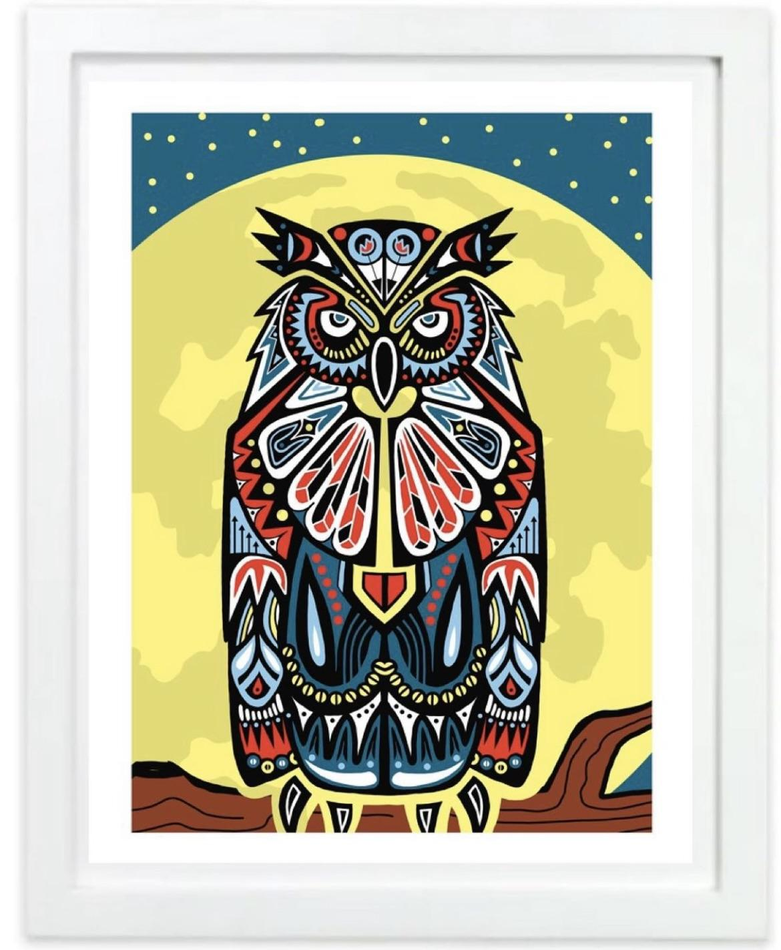
Let’s celebrate Indigenous Peoples’ Day with some of Mr. Ginga’s beautiful art!
Look at all of the amazing shapes in “The Guardian Owl.”
Sketch one of them.
Now sketch a shape that is like it in ONE way.
What shape do you have?
2.G.A1
Notes:
Week of October 15, 2024

Slide 11
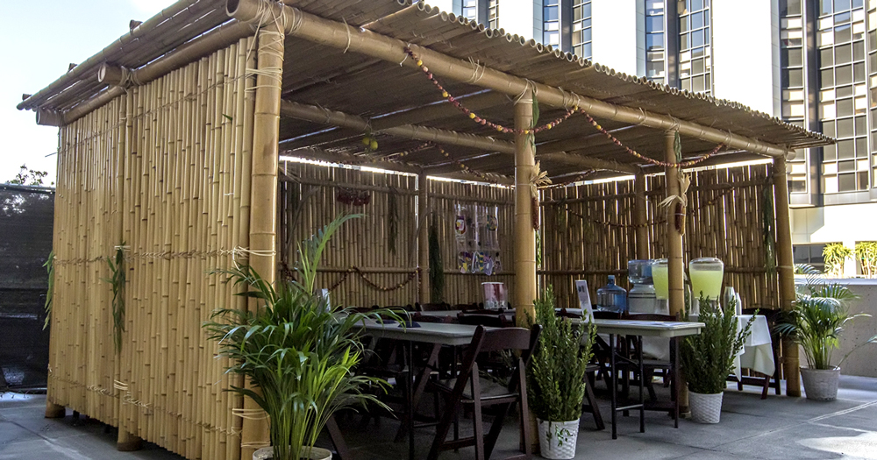
Happy Sukkot! What do you notice? What do you wonder?
What math questions can we ask?
Estimate how many stalks of bamboo are here!
2.NBT.A

Slide 12
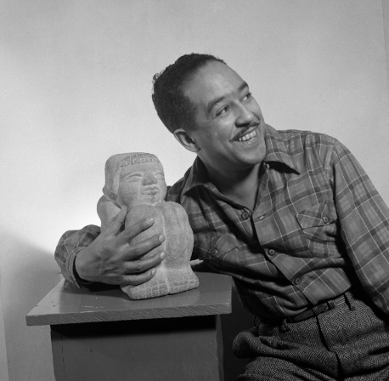
Today is National Black Poetry Day.
Let’s celebrate with a poem
by Langston Hughes
The Dream Keeper
Bring me all of your dreams,
You dreamers,
Bring me all of your
Heart melodies
That I may wrap them
In a blue cloud-cloth
Away from the too-rough fingers
Of the world.
Langston Hughes wrote this poem in 1925.
How long ago was that?
More than 100 years? Less?
2.OA.B7

Slide 13
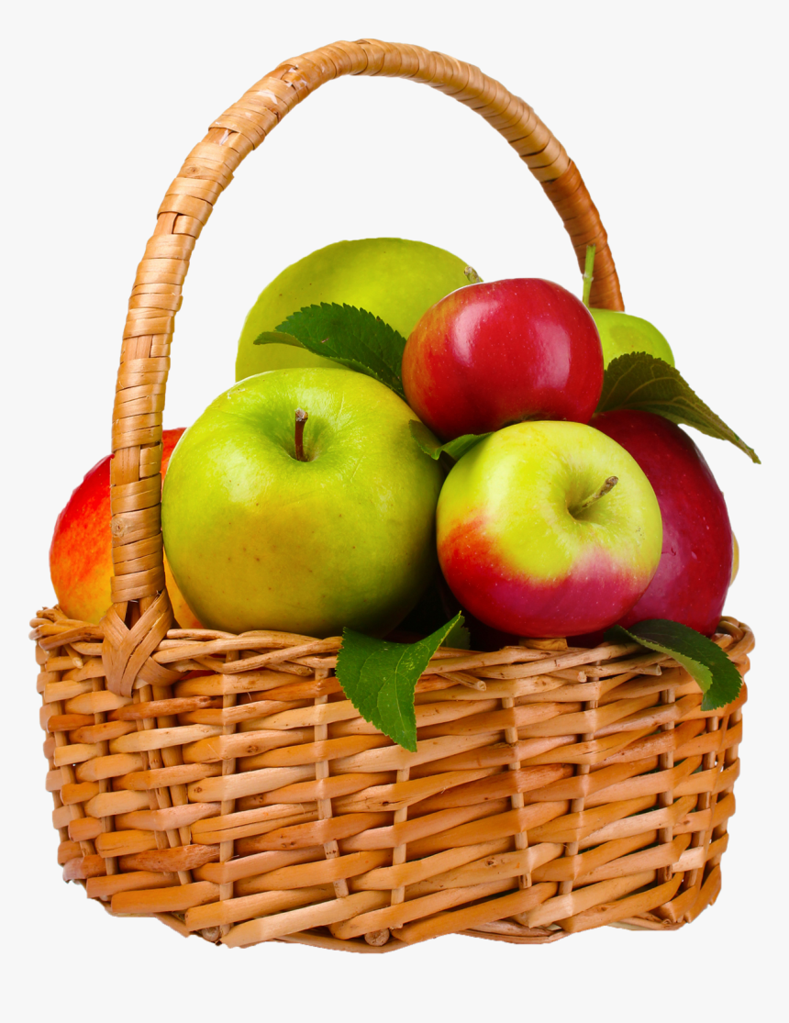
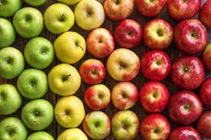
WOULD YOU RATHER carry 2 baskets of 10 apples
or
30 apples without a basket?
2.SMP.3

Slide 14
Which one doesn’t belong?
45 | 90
54 | 75
2.NBT.A
Notes:
Week of October 21, 2024

Slide 15
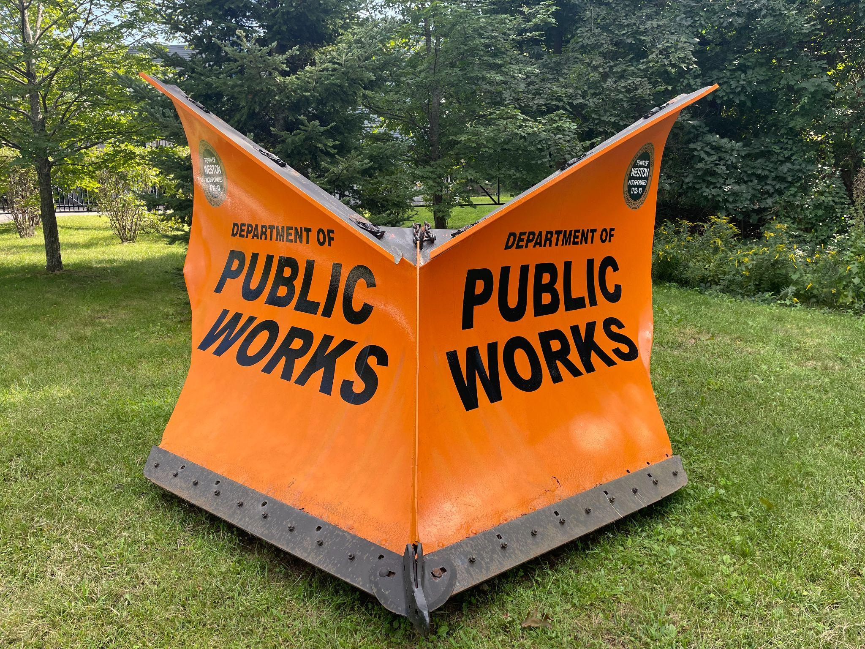
How much do you think this plow weighs?
3,217 pounds.
What is the value of the 2 in this number?
The 1?
7?
3?
2.NBT.A1

Slide 16
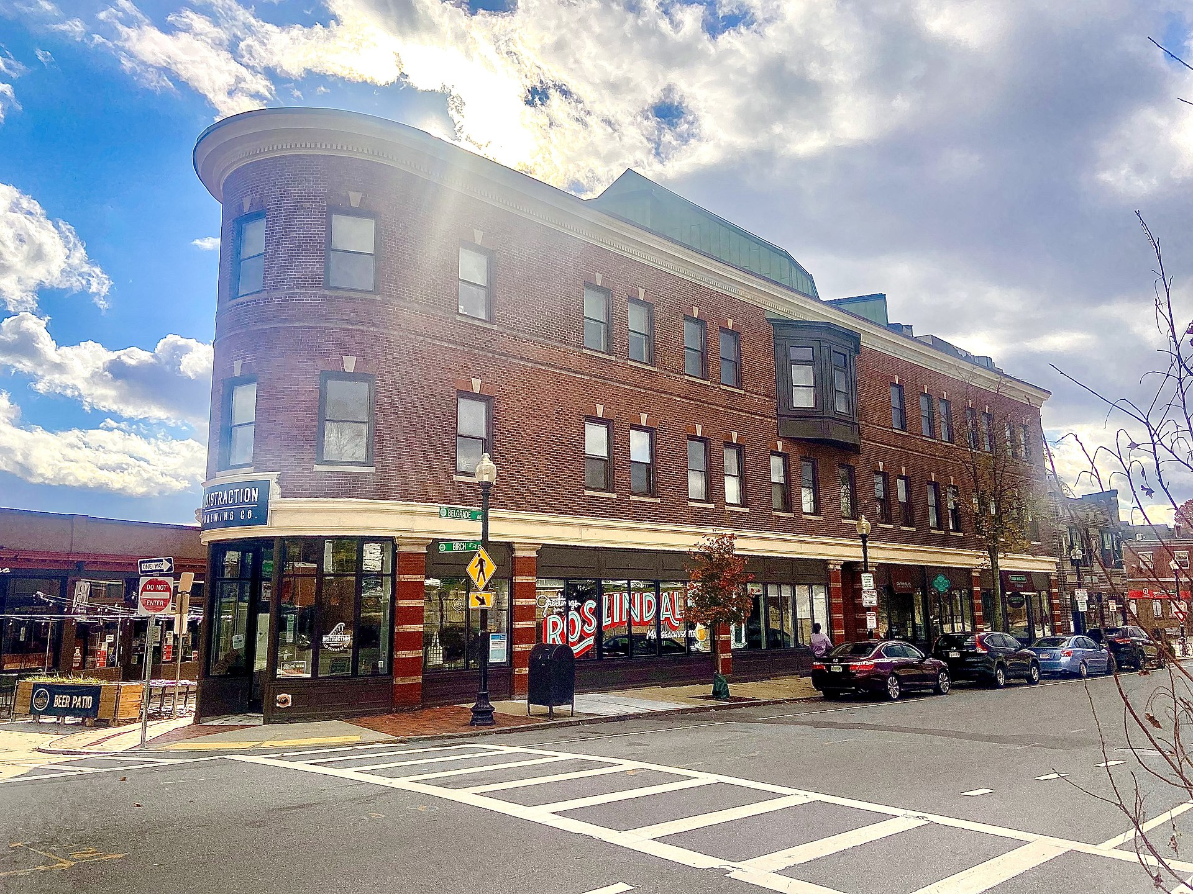
This building is a famous landmark in Roslindale Square
How many windows do we see?
How many don’t we see?
How do we know?
2.NBT.A2

Slide 17
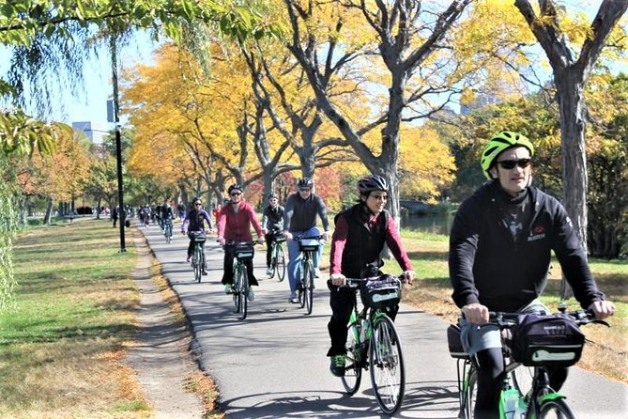
Biking in Boston!
If we counted 64 WHEELS go by, how many BIKERS were there?
If we counted 64 BIKERS, how many WHEELS were there?
2.NBT.B5

Slide 18
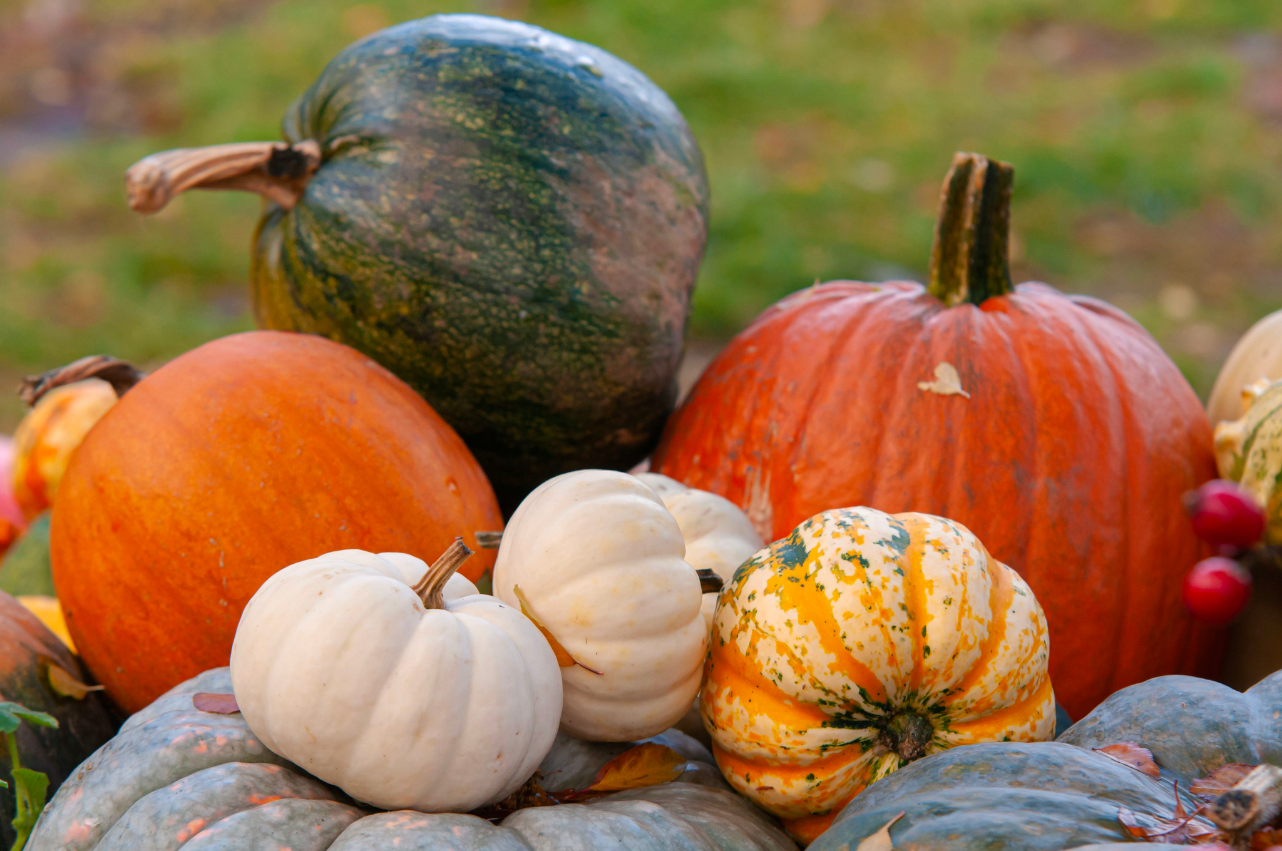
If the green pumpkin weighs 4 pounds, what might the other pumpkins weigh?
4 pounds
2.MD.A

Slide 19
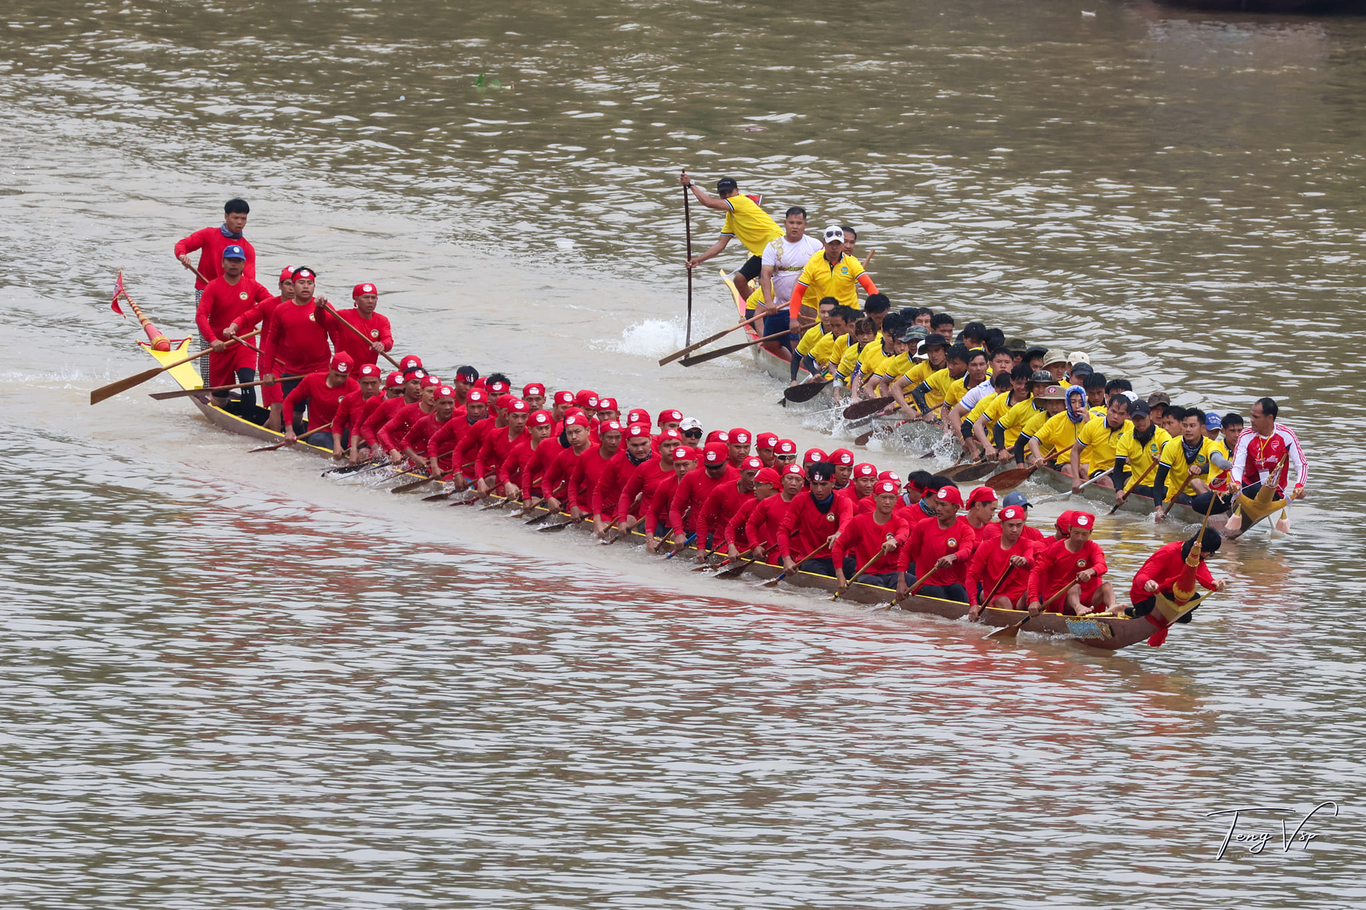
Today is Boat Racing Day in Laos
How many boats?
How many people in each boat?
What is a good estimate?
2.NBT.A
Notes:
Week of October 28, 2024

Slide 20
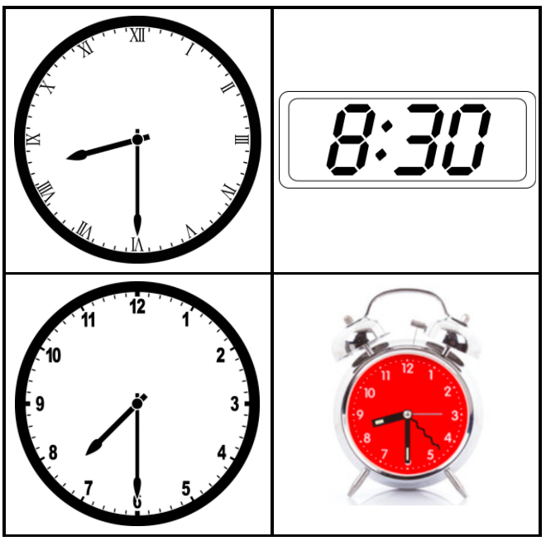
Which one doesn’t belong?
2.MD.C7

Slide 21
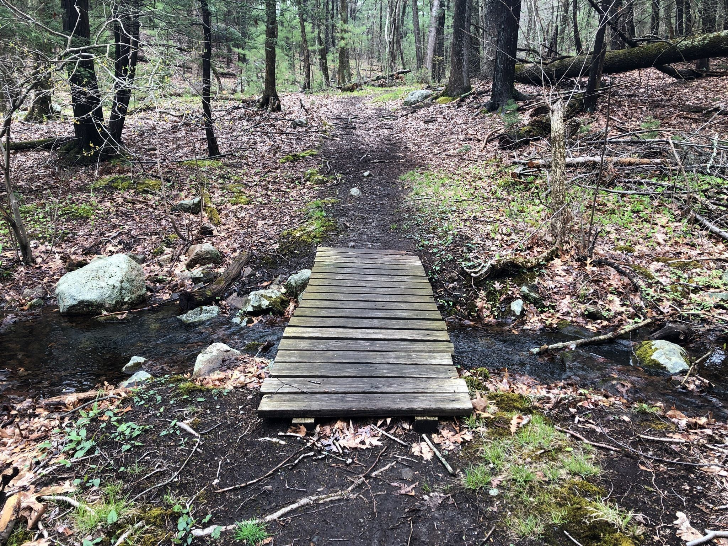
The Doublet Hill Loop is a 2 mile trail in Weston.
Have you ever hiked it?
How long did it take?
If you can hike 1 mile in 20 minutes, how long would it take?
How close is that to 1 hour?
2.MD.C7

Slide 22
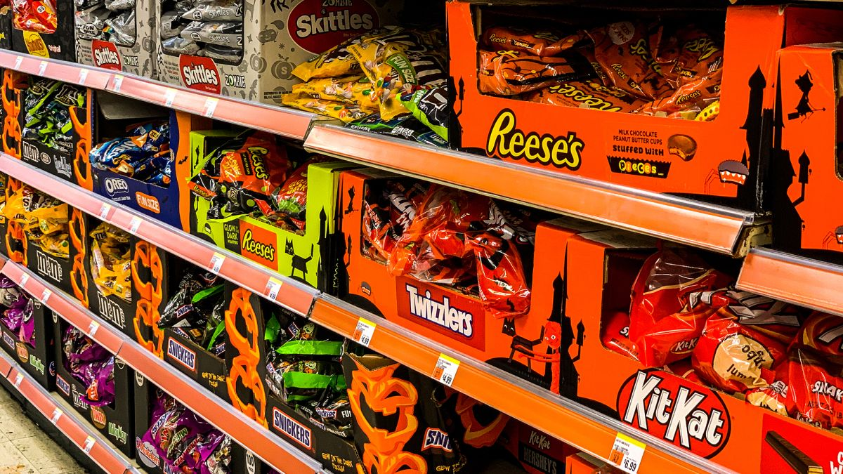
Happy Halloween!
What can we say about the quantities here?
If there are 25 bags in each box, how many might be here altogether?
2.NBT.B7

Slide 23
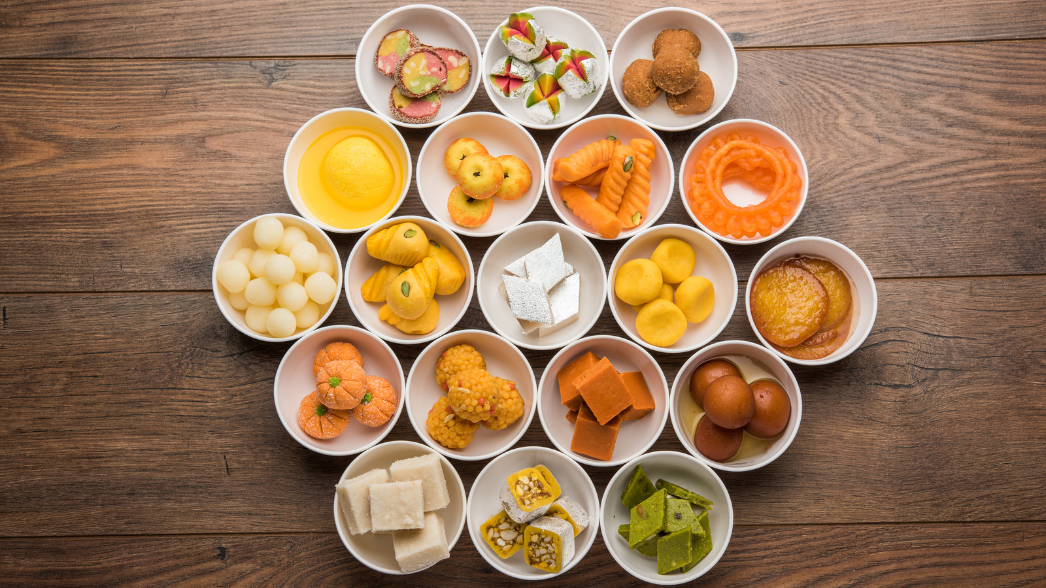
Happy Diwali!
Wow! There’s a lot of math we can see in these traditional Diwali sweets.
Write an expression to match your math thinking.
2.OA.A1

