Slide 1
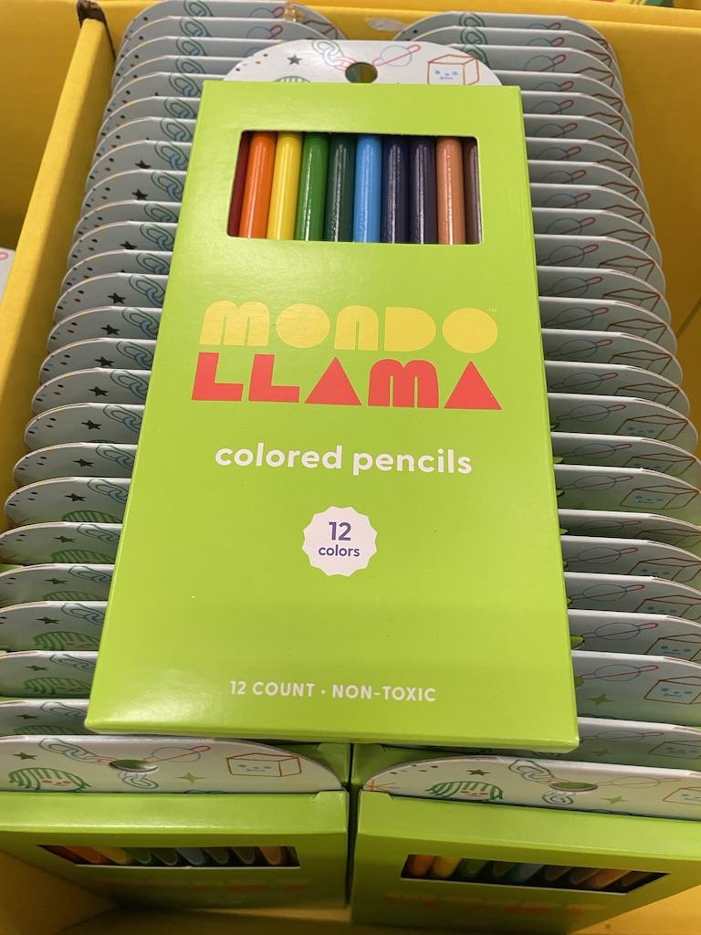
What can we say about these packs of pencils
Estimate how many packs are on display.
Estimate how many pencils.
How can we use mental MATH to solve this?
4.OA.A2
Notes:
Week of September 3, 2024

Slide 2
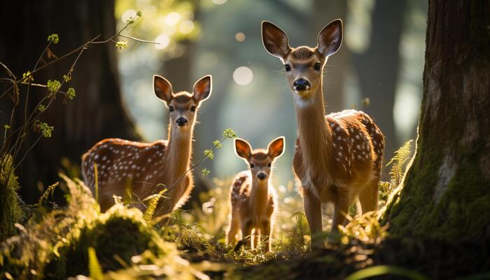
Happy National Wildlife Day!
The doe is three times the weight of the middle deer.
The fawn is one-half the weight of the middle deer.
What is possible?
4.OA.A3

Slide 3
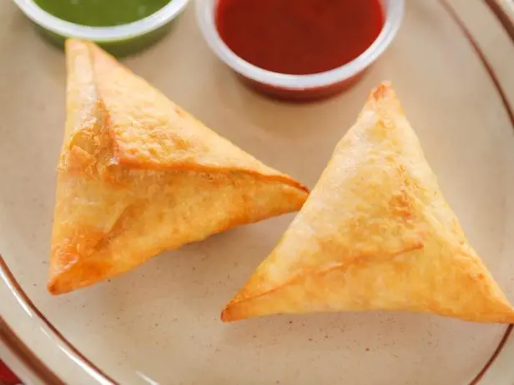
Happy World Samosa Day!
What shape is a samosa?
What kind of triangle?
Sketch an equilateral triangle.
How many different ways can you share a samosa equally with 2 people?
3 people?
4 people?
4.G.A

Slide 4

It’s National Guide Dog Month!
This guide dog puppy in training weighs only 9 pounds.
How many ounces is that?
What are some strategies we can use to solve this?
There are 16 ounces in a pound!
4.MD.A1

Slide 5
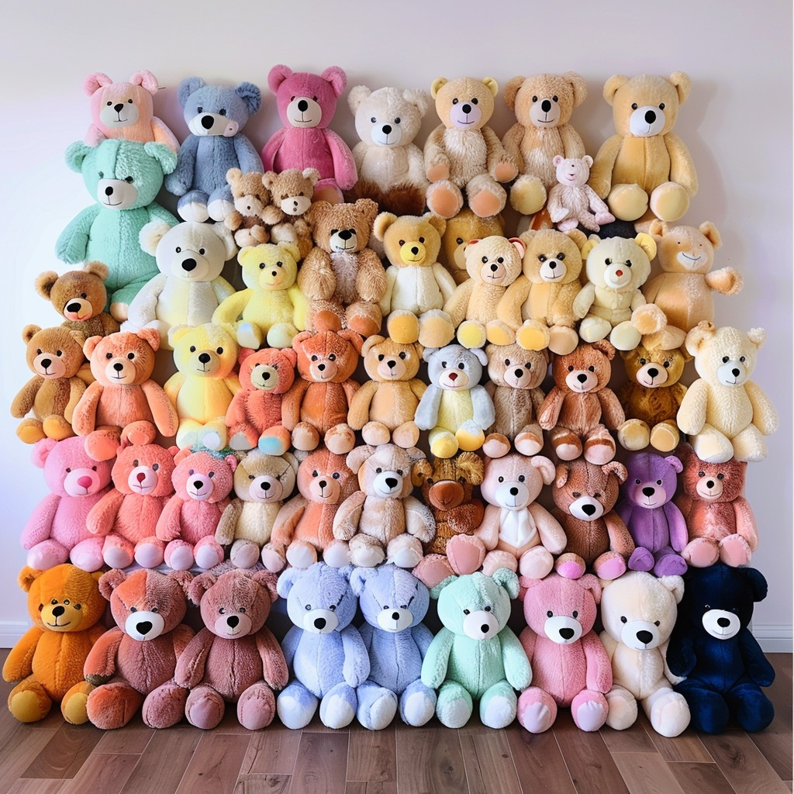
Happy Teddy Bear Day!
How many bears are here?
How can we figure it out without counting all of them?
Share your strategies and create an equation to match your thinking.
4.OA.A3
Notes:
Week of September 9, 2024

Slide 6
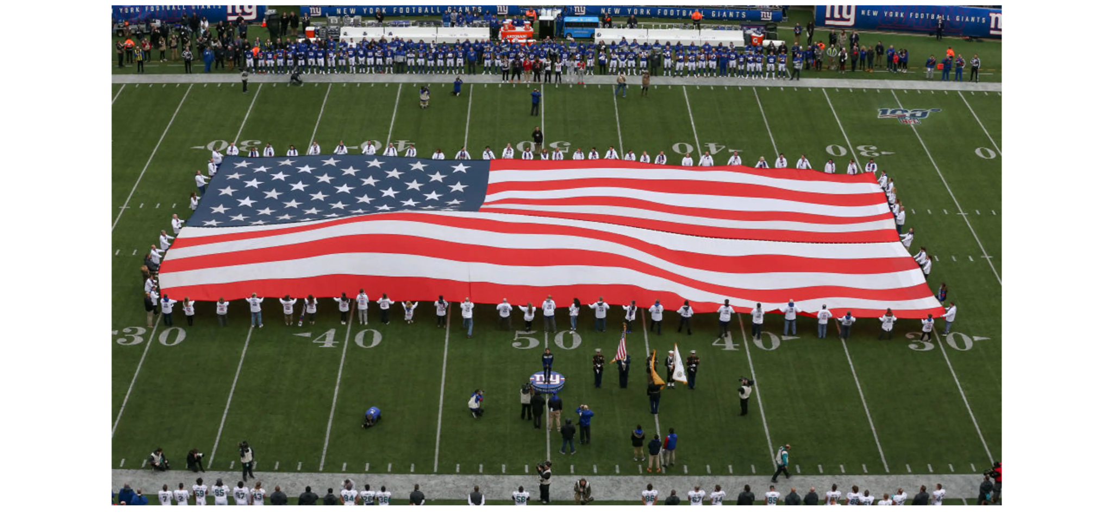
Wow! Look at this amazing American flag at the NY Giants game!
I wonder how big it is?
What might the perimeter be? How about the area?
4.MD.A3

Slide 7
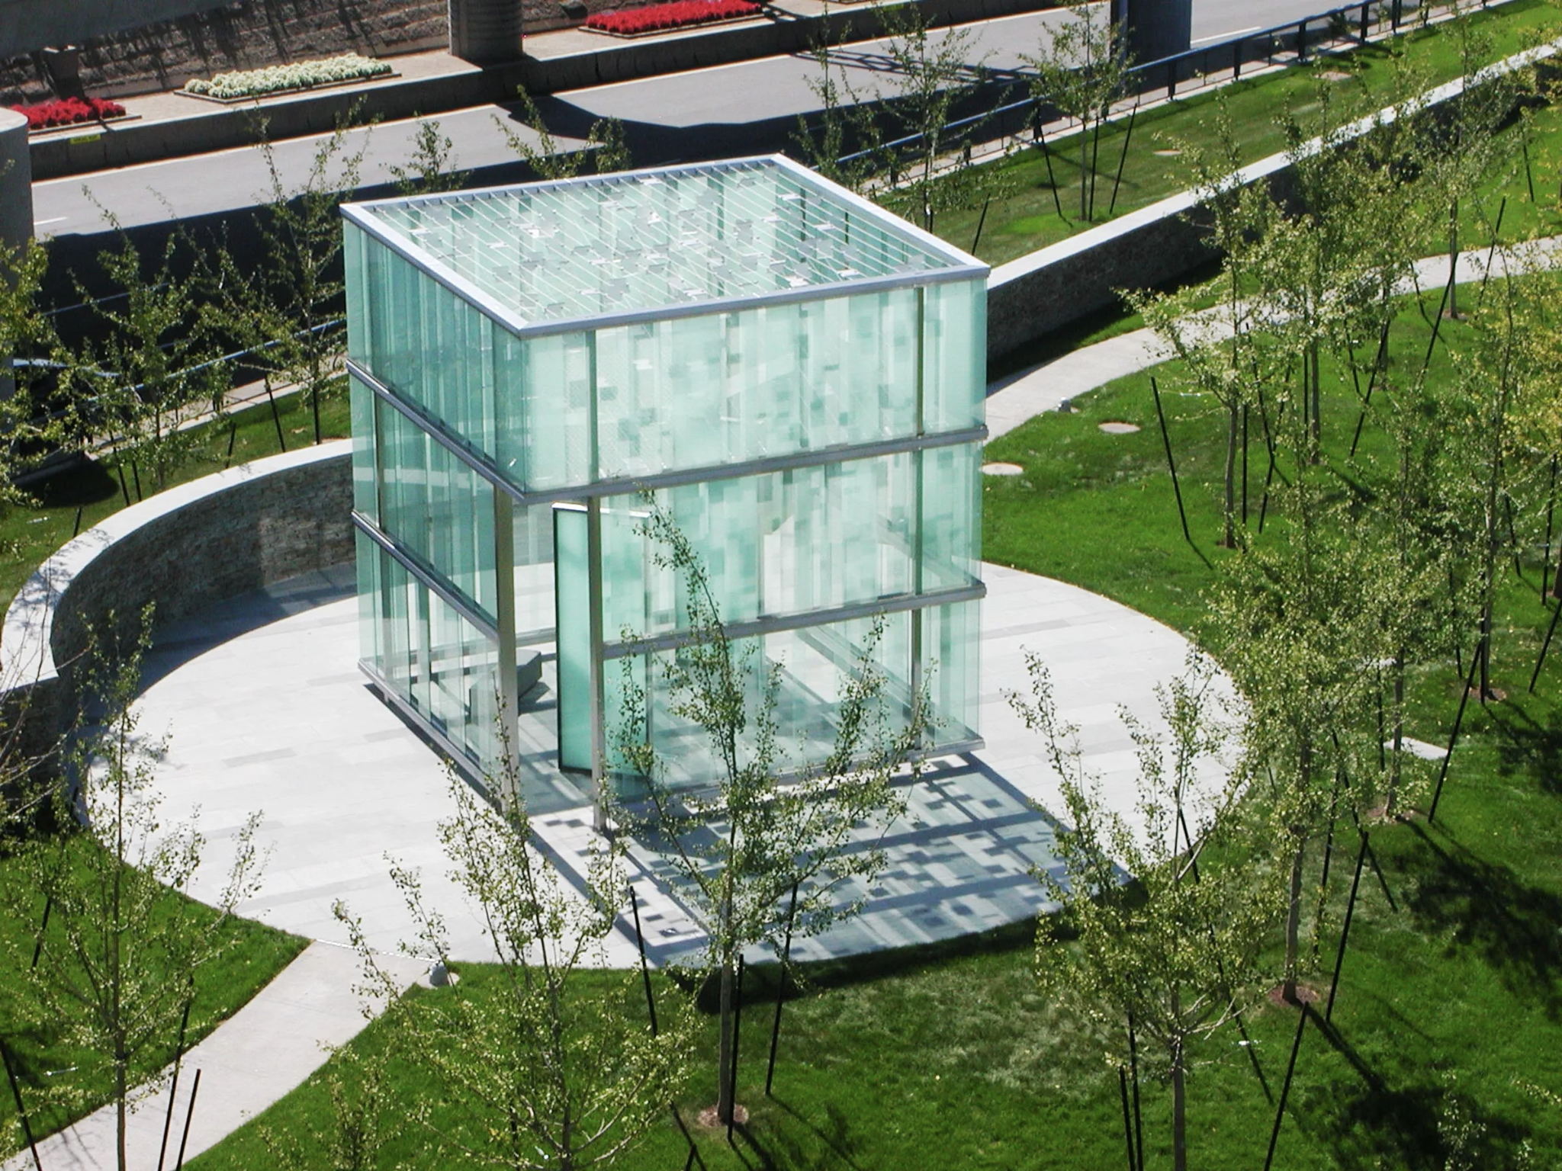
This is the 911 Memorial at Logan Airport
The memorial takes the shape of a 20-by-20 foot glass cube.
What is the perimeter of the memorial?
In feet?
In inches?
4.MD.A3
Notes:
September 11th Memorial

Slide 8
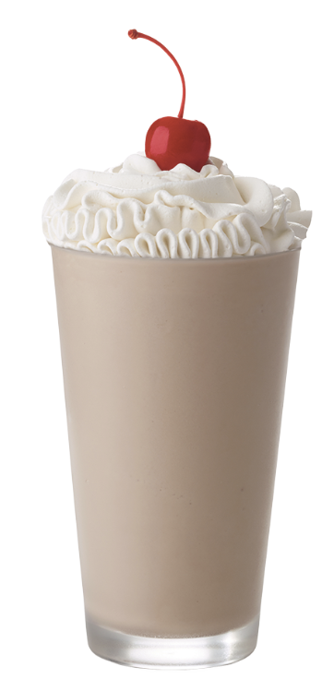

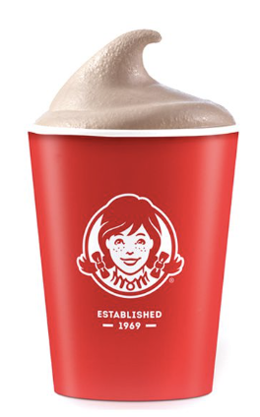

Happy Chocolate Milkshake Day!
Would you rather …
8 ounce $1.00 22 ounces $2.89 20 ounces $3.95
4.SMP.3

Slide 9
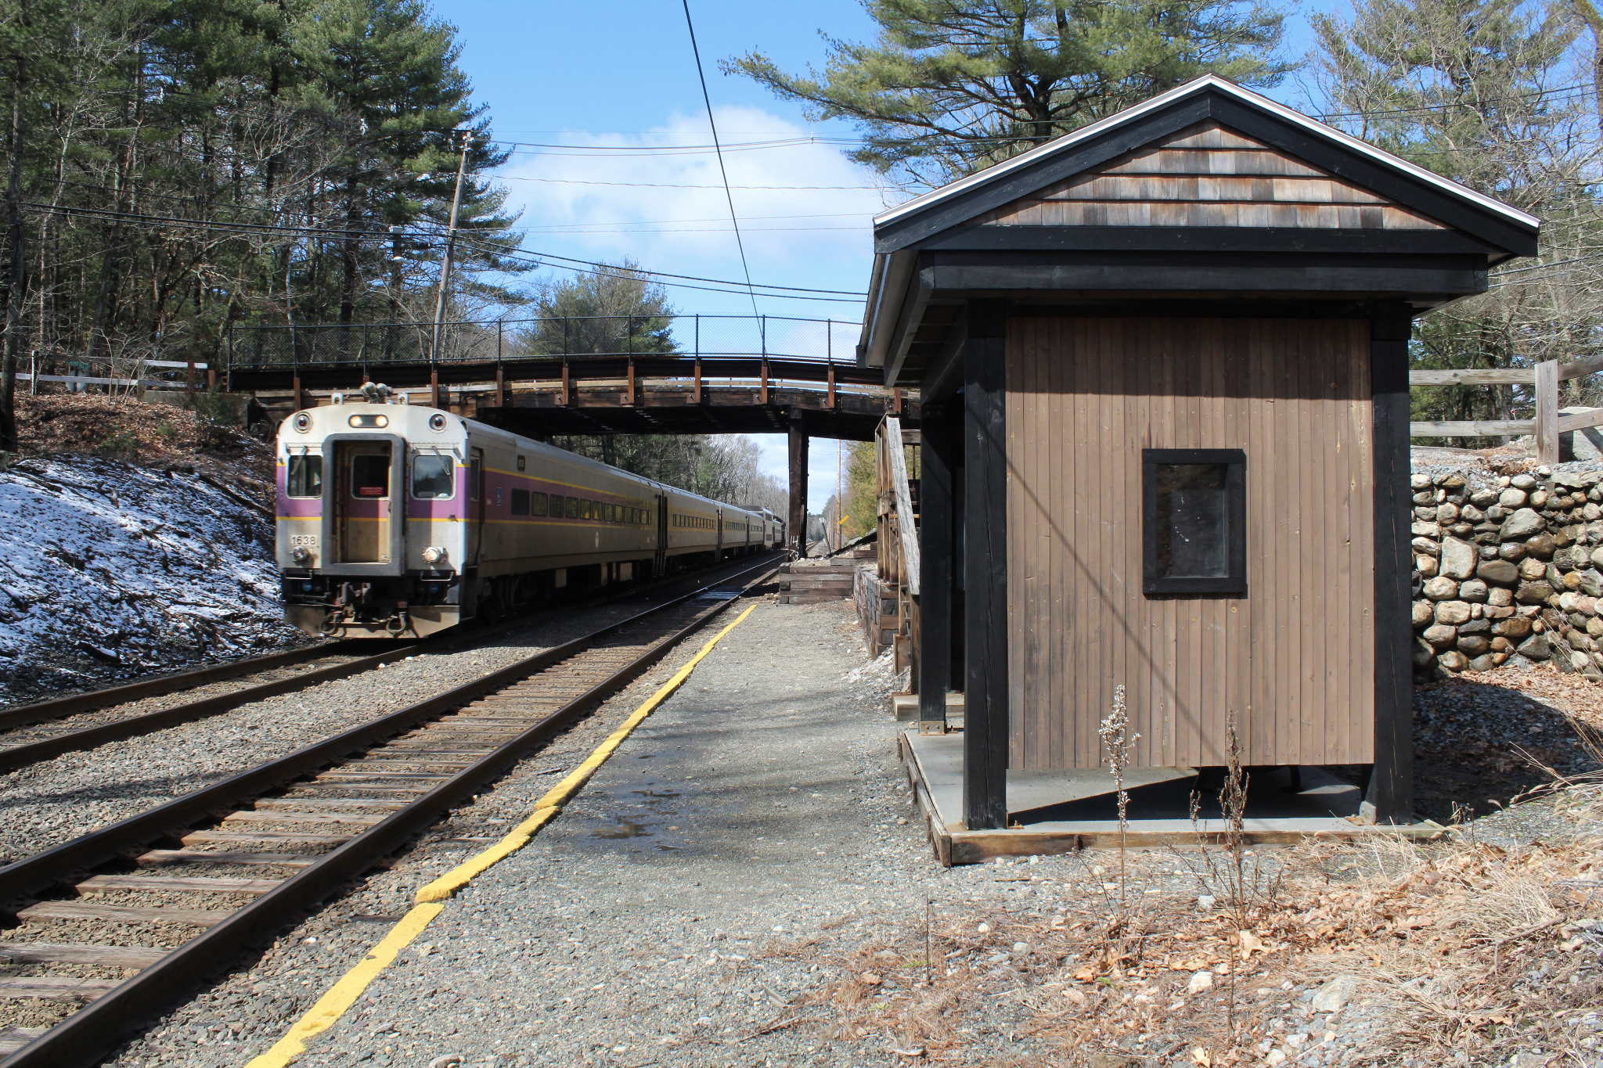
It takes 42 minutes to get from Weston to Boston via the MBTA, it is an 18 ½ mile ride and was $9.75 one way.
How long would the round-trip ride take?
How many miles is that?
How much would it cost?
The Silver Hill Commuter Rail Station was closed in 2020.
4.MD.A1

Slide 10

Today is Chuseok
Korean Thanksgiving
The population of South Korea is 51,709,968.
What can we say about this number?
What is the value of each of the digits?
What might it round to?
4.OA.A2
Notes:
Week of September 16, 2024

Slide 11
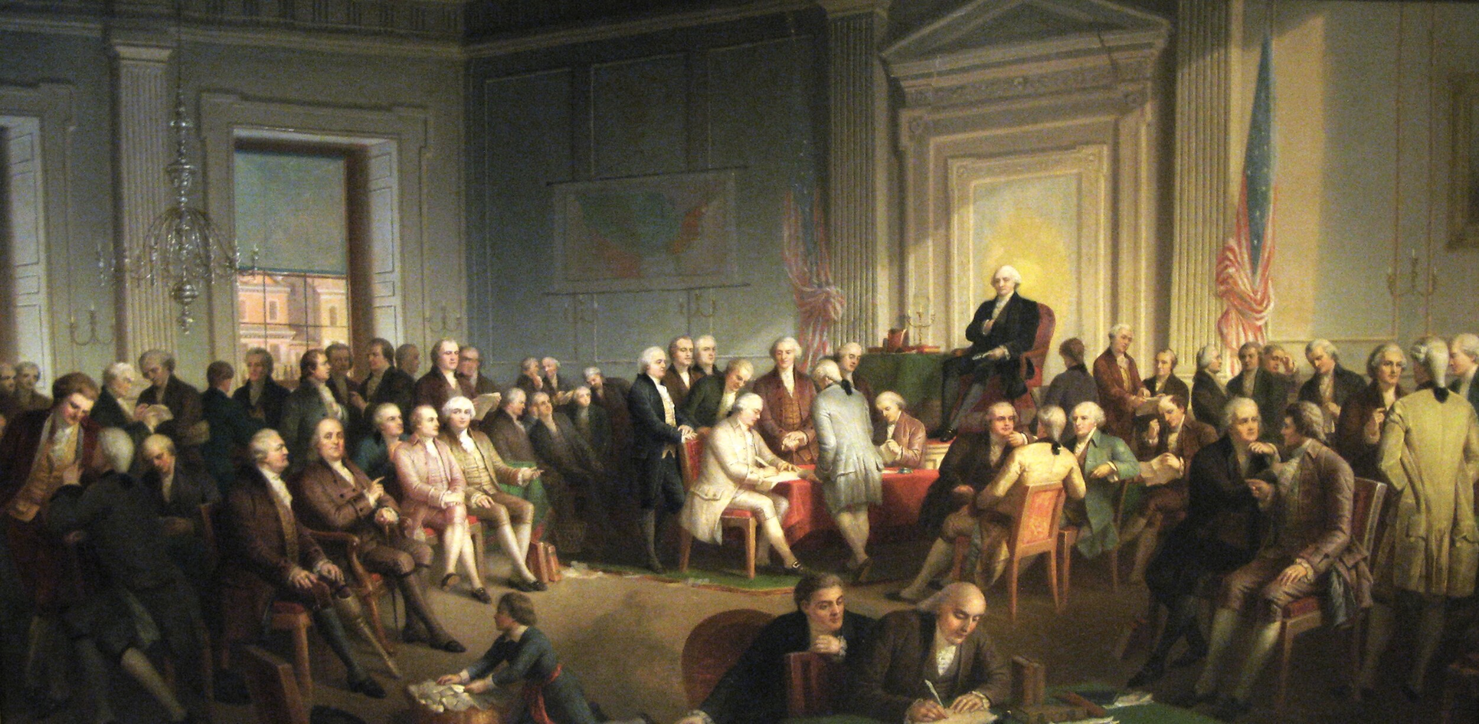
4.NBT.A4, MD.A1
The Constitution was signed at the Constitutional Convention in Philadelphia in 1787. How long ago was that? How can we use mental math to figure it out? How many years? How many months?
Notes:
Constitution Day Celebration

Slide 12
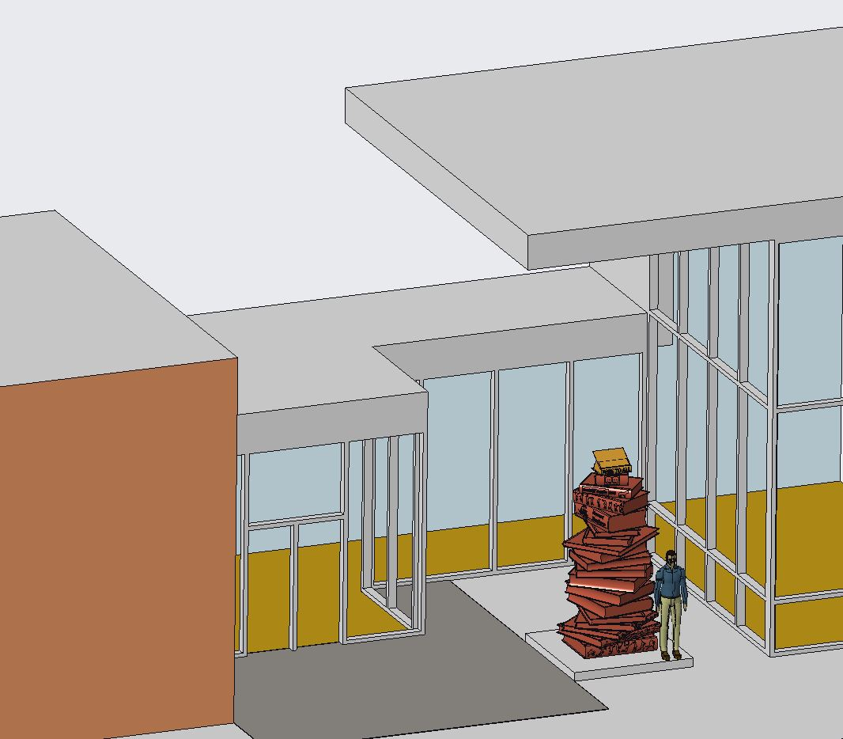
Book Mark’d
by Stu Schechter
Book Mark’d is a community-initiated public art project for the Mattapan Branch of the Boston Public Library.
The bronze statue will be a tall spiral of books and is expected to be installed in 2024.
Estimate the height of this statue!
11 feet tall
4.OA.A3

Slide 13
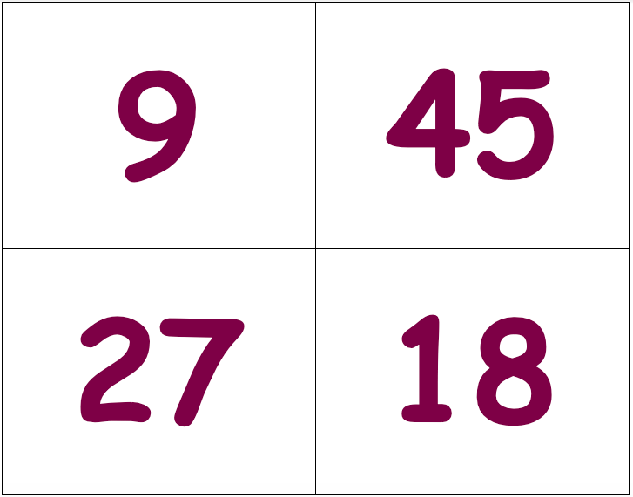
Which one doesn’t belong?
4.OA.A4

Slide 14
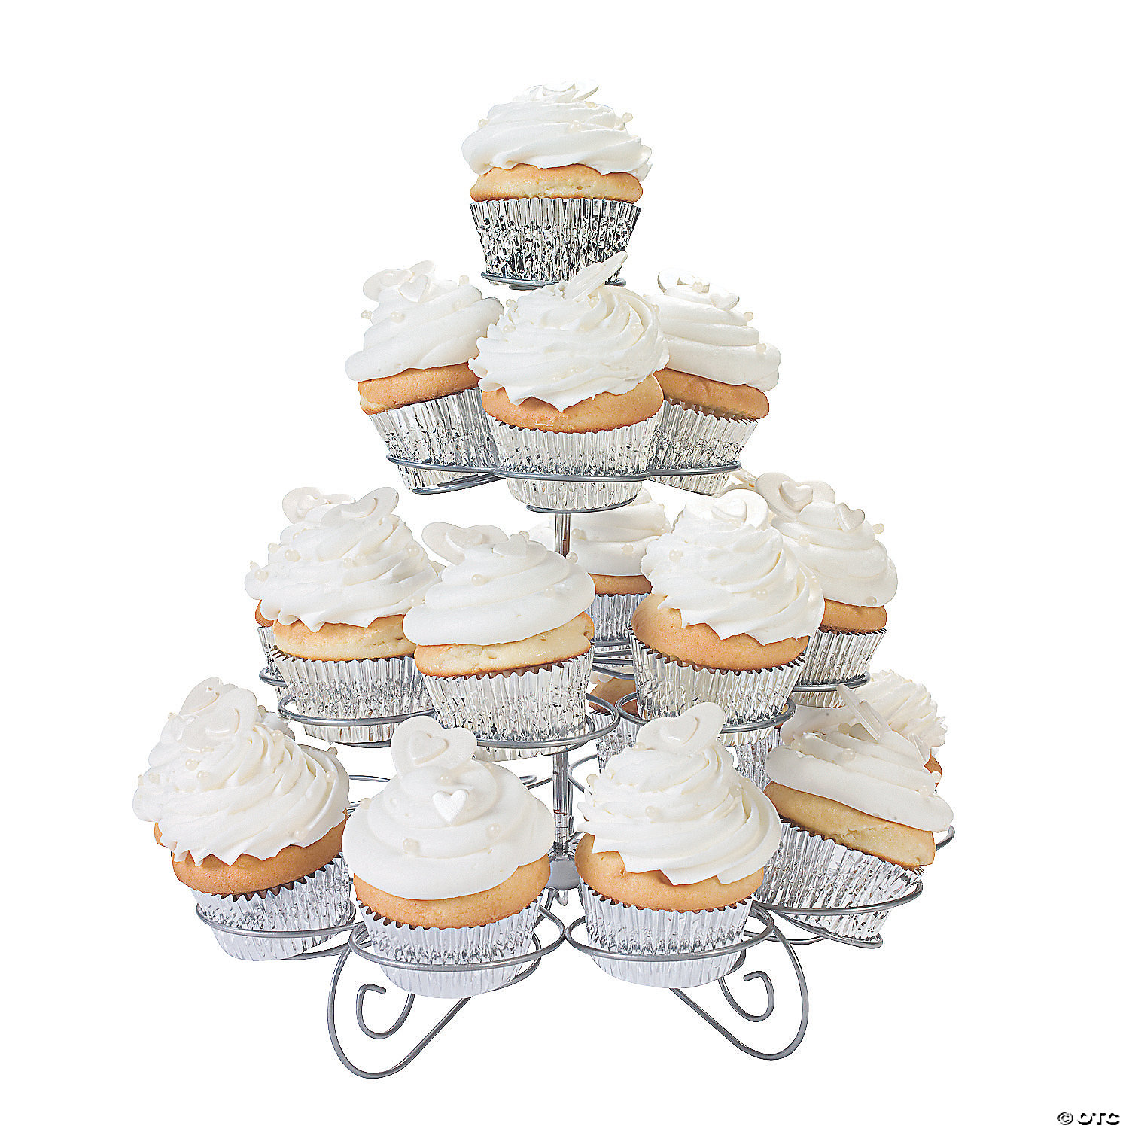
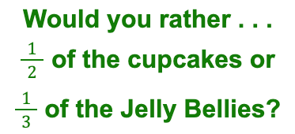
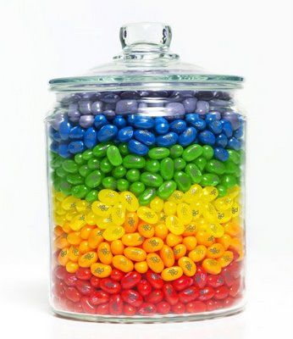
3.NF.A1

Slide 15
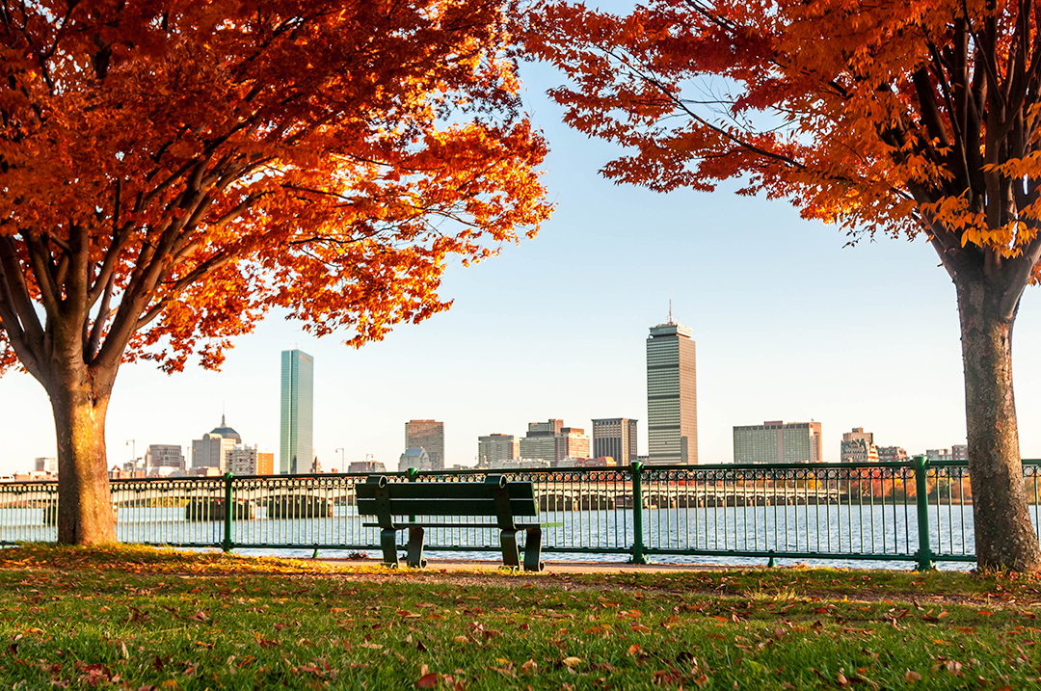
It’s the Fall equinox!
What does EQUINOX mean?
The Spring Equinox is only 6 months away?
About how many days is that?
Estimate how many hours that would be!
4.MD.A1
Notes:
Week of September 23, 2024
Fall Equinox

Slide 16
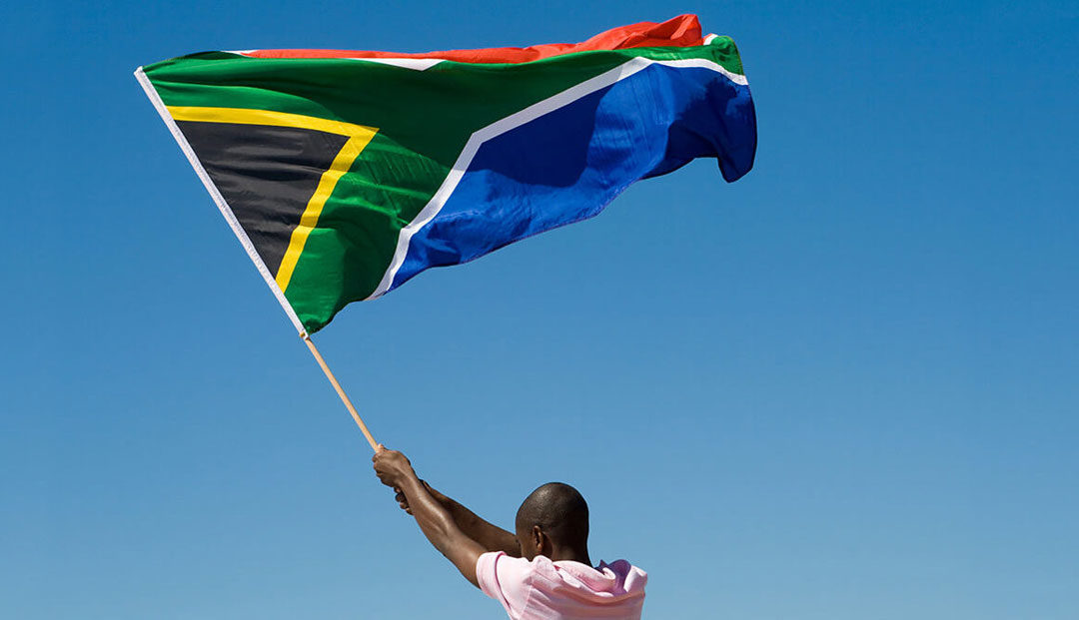
Today is Heritage Day in South Africa!
Estimate the length and width of the flag of South Africa.
Use clues in the photo!
4.MD.A3

Slide 17
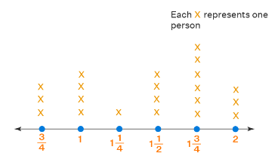
What do we notice?
What do we wonder?
What is possible?
4.MD.B4

Slide 18
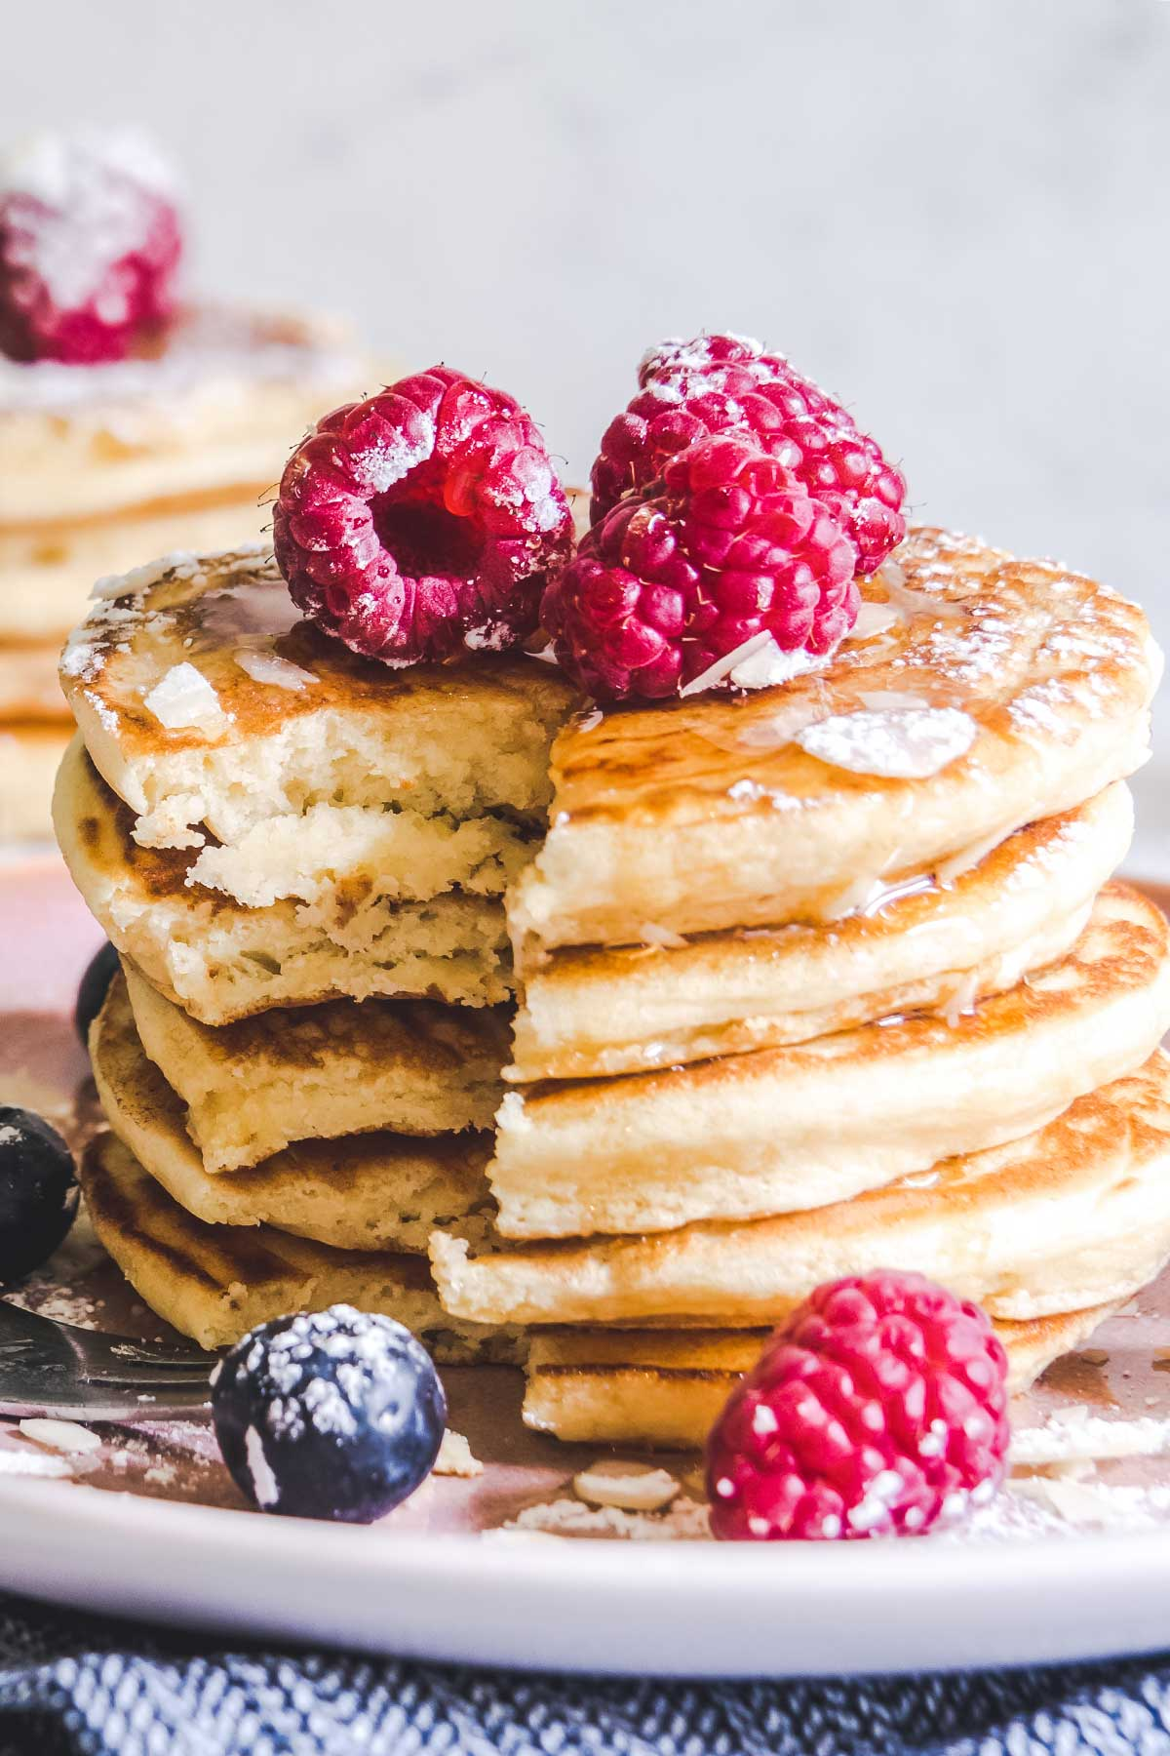
Happy National Pancake Day!
What can be quantified in this photo?
Estimate the fraction of the pancake stack that is missing.
How do you know?
4.NF.B3

Slide 19
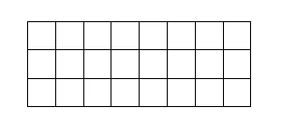


Which one doesn’t belong?
4.OA.B4
Notes:
Top left: only odd factor (3)
Top right: only distributive (2x10)(2x2)
Bottom left: not 24, not rectangle
Bottom right: not array of squares

