Slide 1
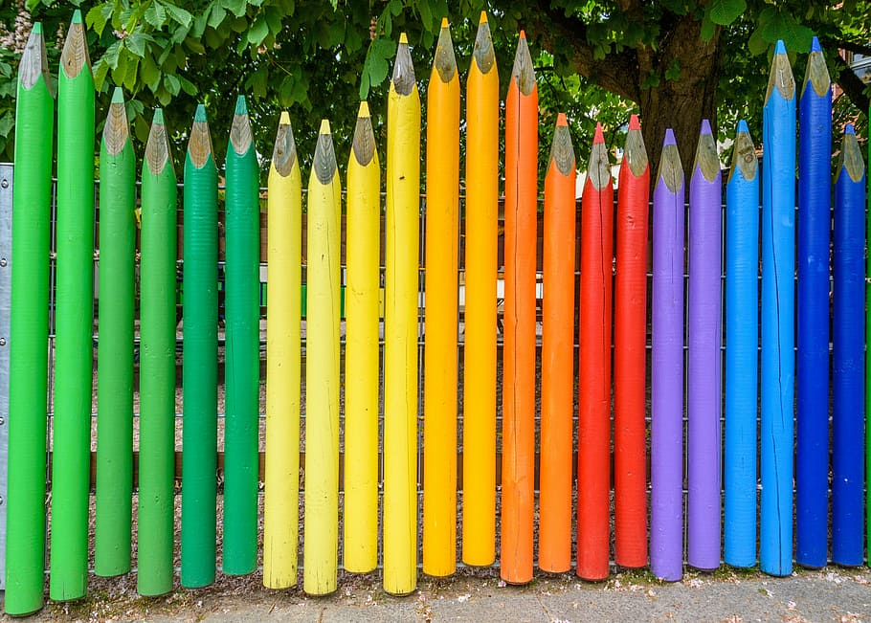
What do we notice?
How many pencils do we see?
How do we see them?
Create an equation to match your thinking.
1.NBT.A1
Notes:
Week of September 3, 2024

Slide 2
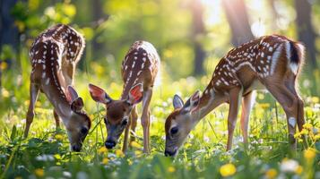
Happy National Wildlife Day!
What can we count in this photo?
How many deer eyes?
How many deer legs?
1.NBT.A1

Slide 3
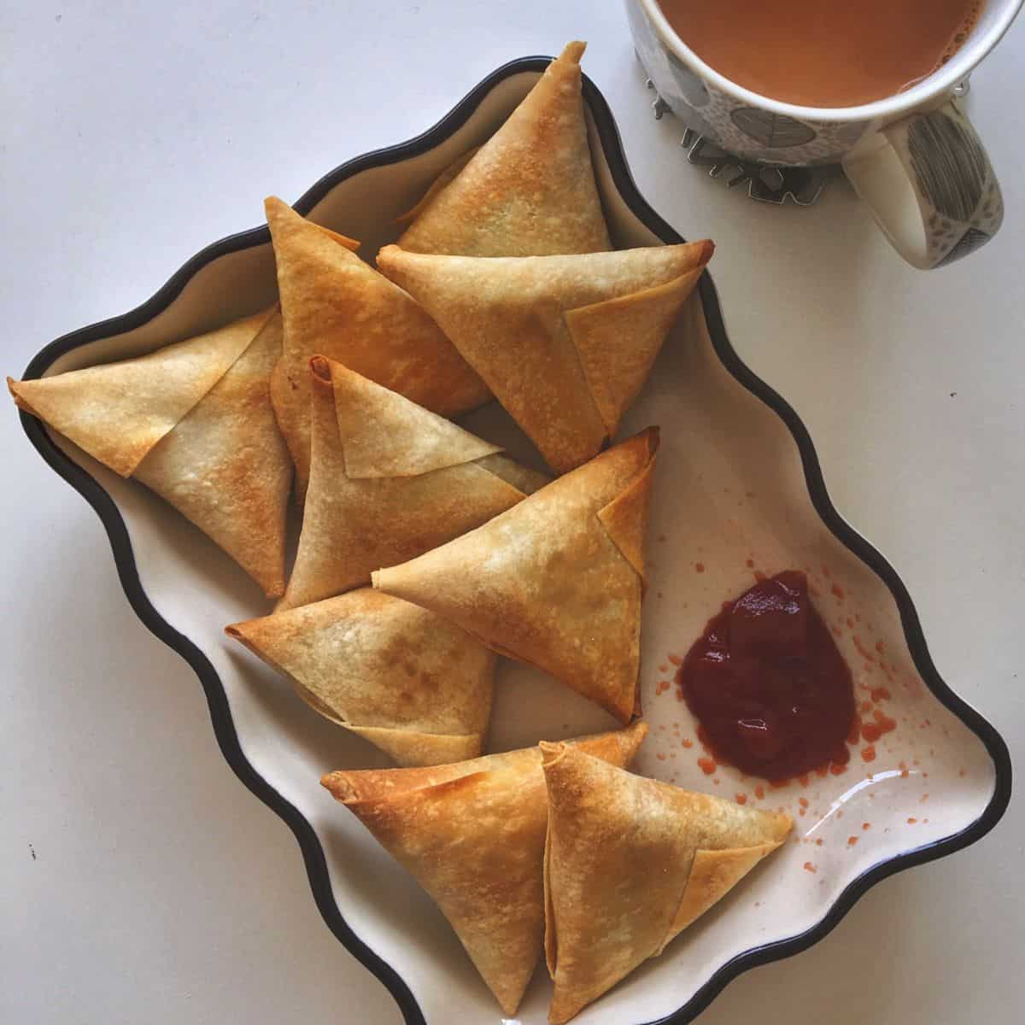
Happy World Samosa Day!
What shape is a samosa?
What shape can we make if we put two of them together?
Do we see any other interesting shapes in this photo?
1.G.A2

Slide 4
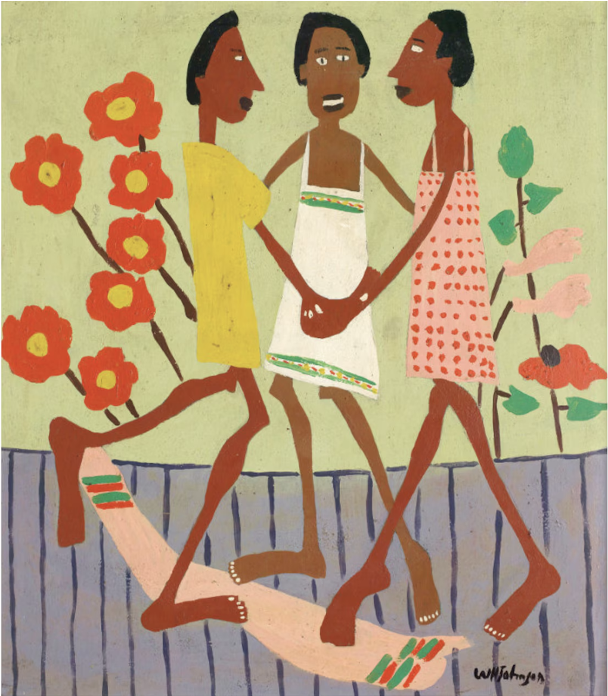
What can we count in this painting?
How many different ways can we count?
Let’s create an equation to match our thinking.
1.OA.C5

Slide 5
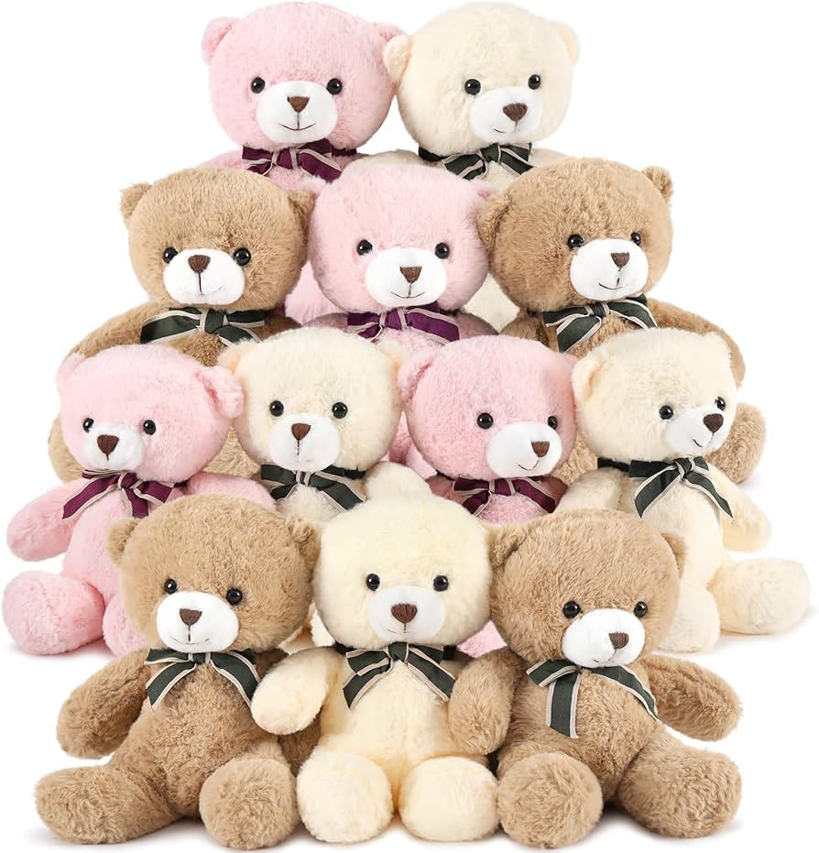
Today is National Teddy Bear Day!
Celebrate by donating a teddy bear!
How can we count these bears?
Create an equation to match your mathematical thinking.
1.OA.C4
Notes:
Week of September 9, 2024

Slide 6
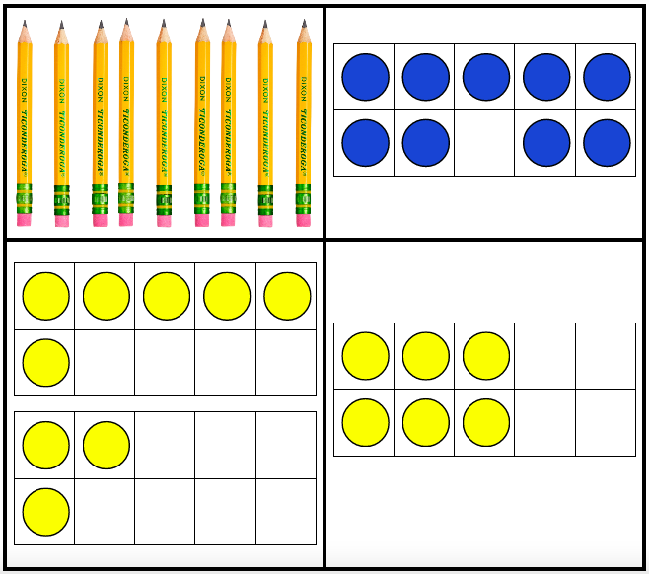
Which one does not belong?
1.OA.C5
Notes:
Top left: not ten frame
Top right: not yellow
Bottom left: two addends
Bottom right: not 9

Slide 7
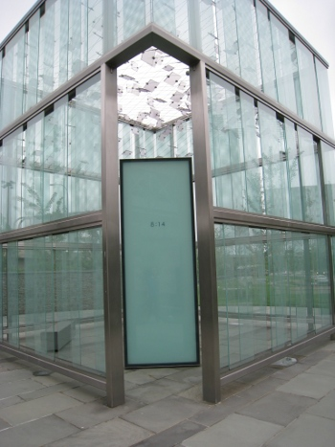
This is the 911 Memorial at Logan Airport
Describe the shapes we see here.
Sketch one of them, what is it?
1.G.A2
Notes:
September 11th Memorial

Slide 8
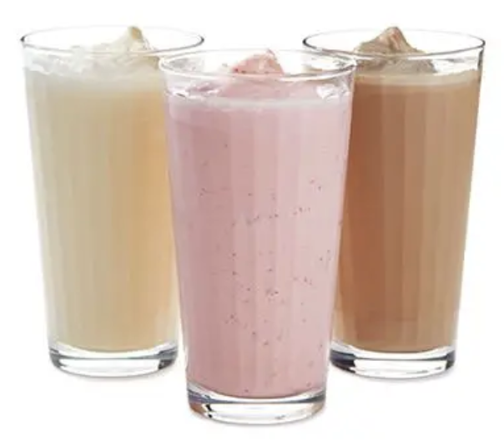
Happy Milkshake Day!
Together these 3 milkshakes weigh
20 ounces.
What is possible?
1.OA.A2

Slide 9
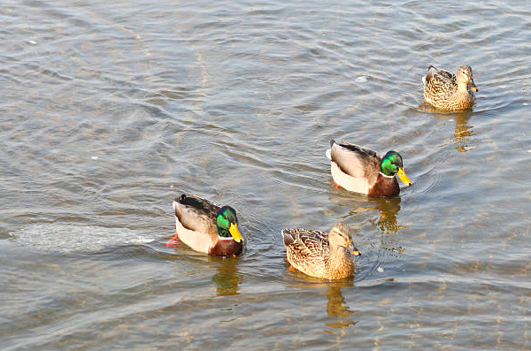
These ducks are swimming in the pond at the Boston Common.
There were 10.
How many swam away?
Write an expression to match your thinking.
1.OA.B4

Slide 10
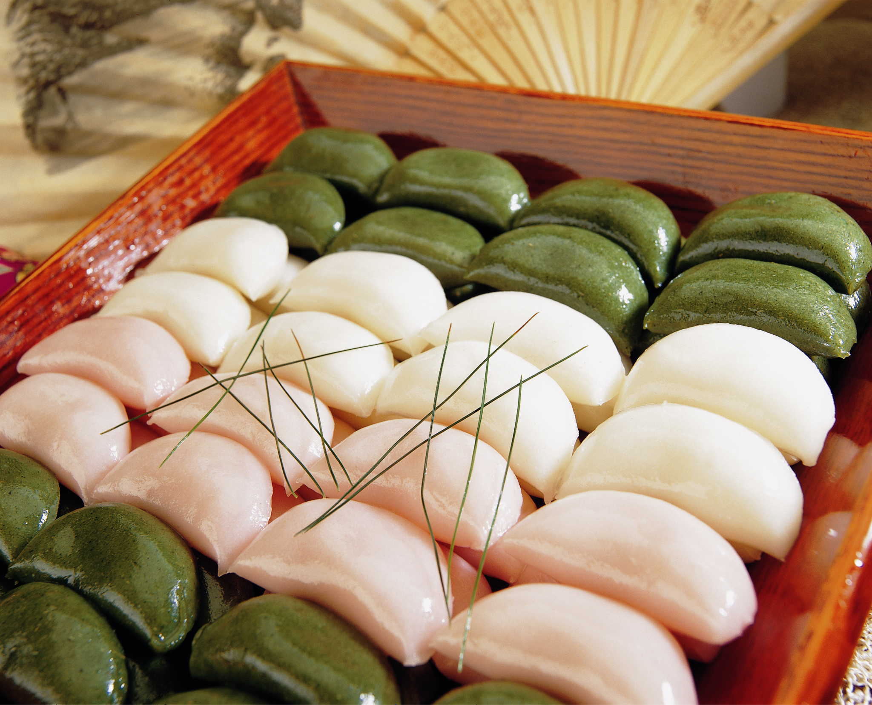
Today is Chuseok
Thanksgiving, in South Korea
How many rice cakes do we see?
How many don’t we see?
How can we count them?
1.NBT.A1
Notes:
Week of September 16, 2024

Slide 11
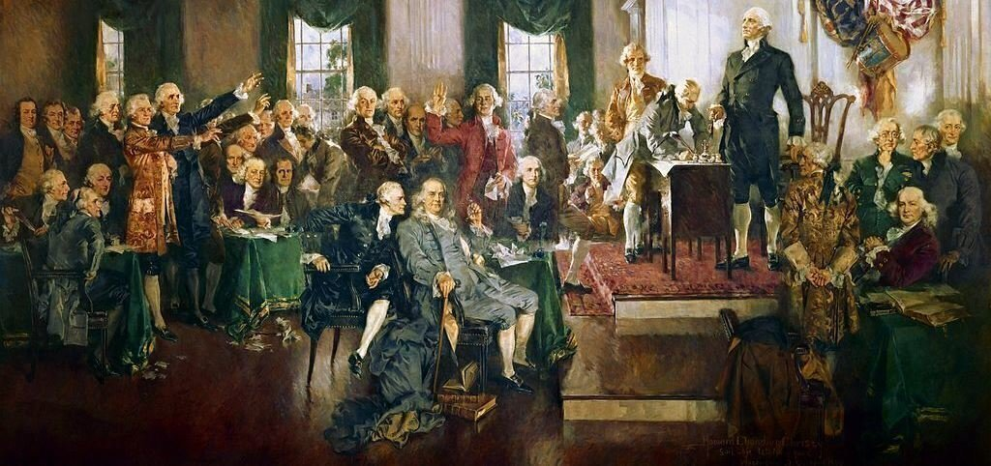
1.NBT.B2
Let’s celebrate Constitution Day!
There are 27 amendments to the Constitution What can we say about the number 27?
Notes:
Constitution Day Celebration

Slide 12
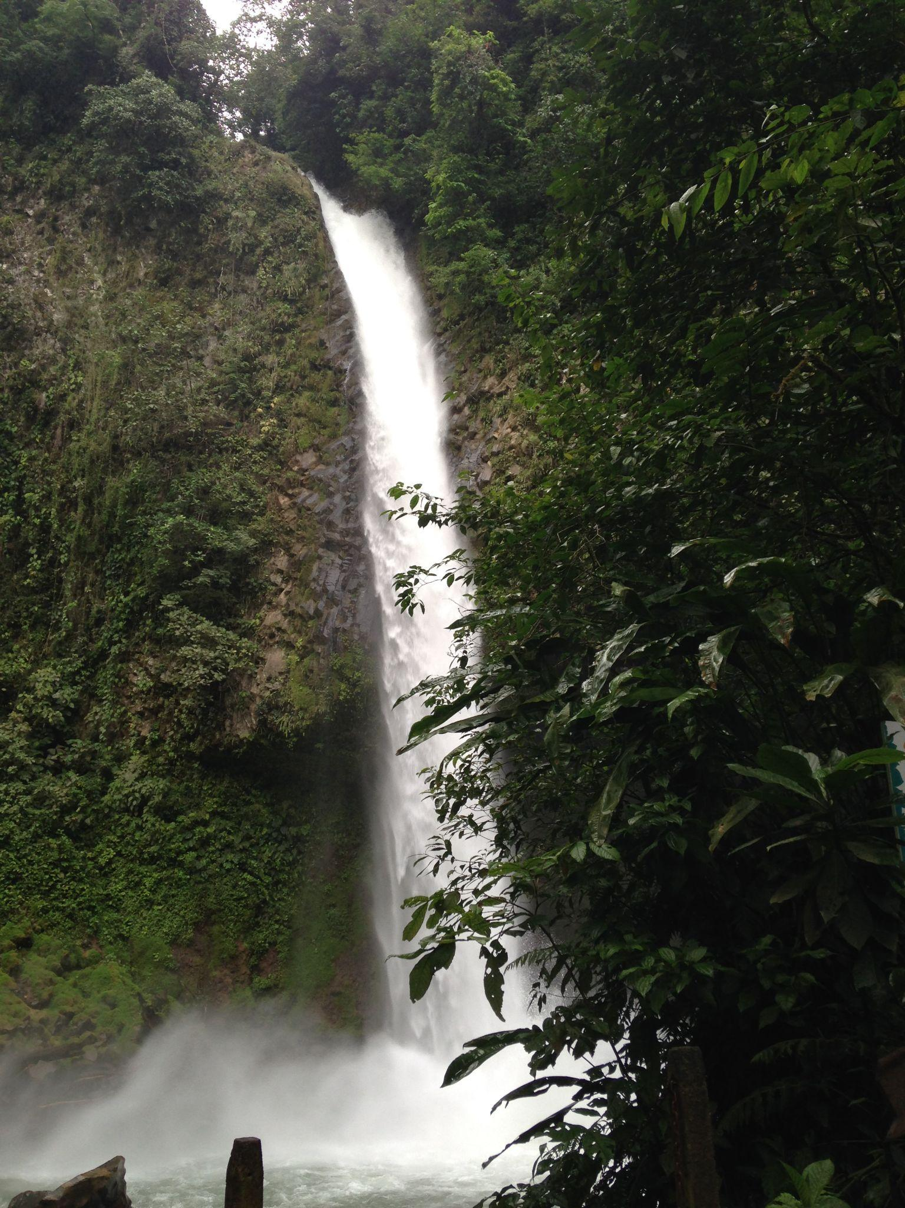
Happy Independence Day Costa Rica!
Costa Rica is one of 7 countries in Central America.
How many expressions can we create to equal 7?
1.OA.C6

Slide 13
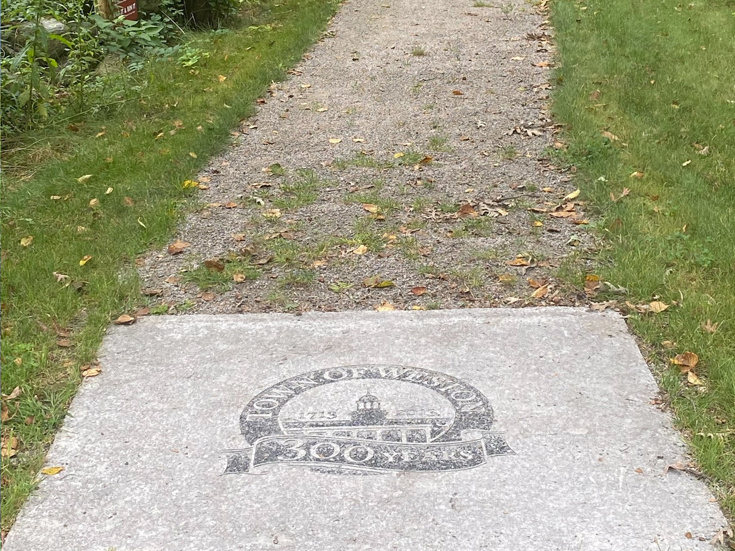
The Legacy Trail is just over 100 meters in length.
How can we skip count to 100?
1.NBT.A1

Slide 14
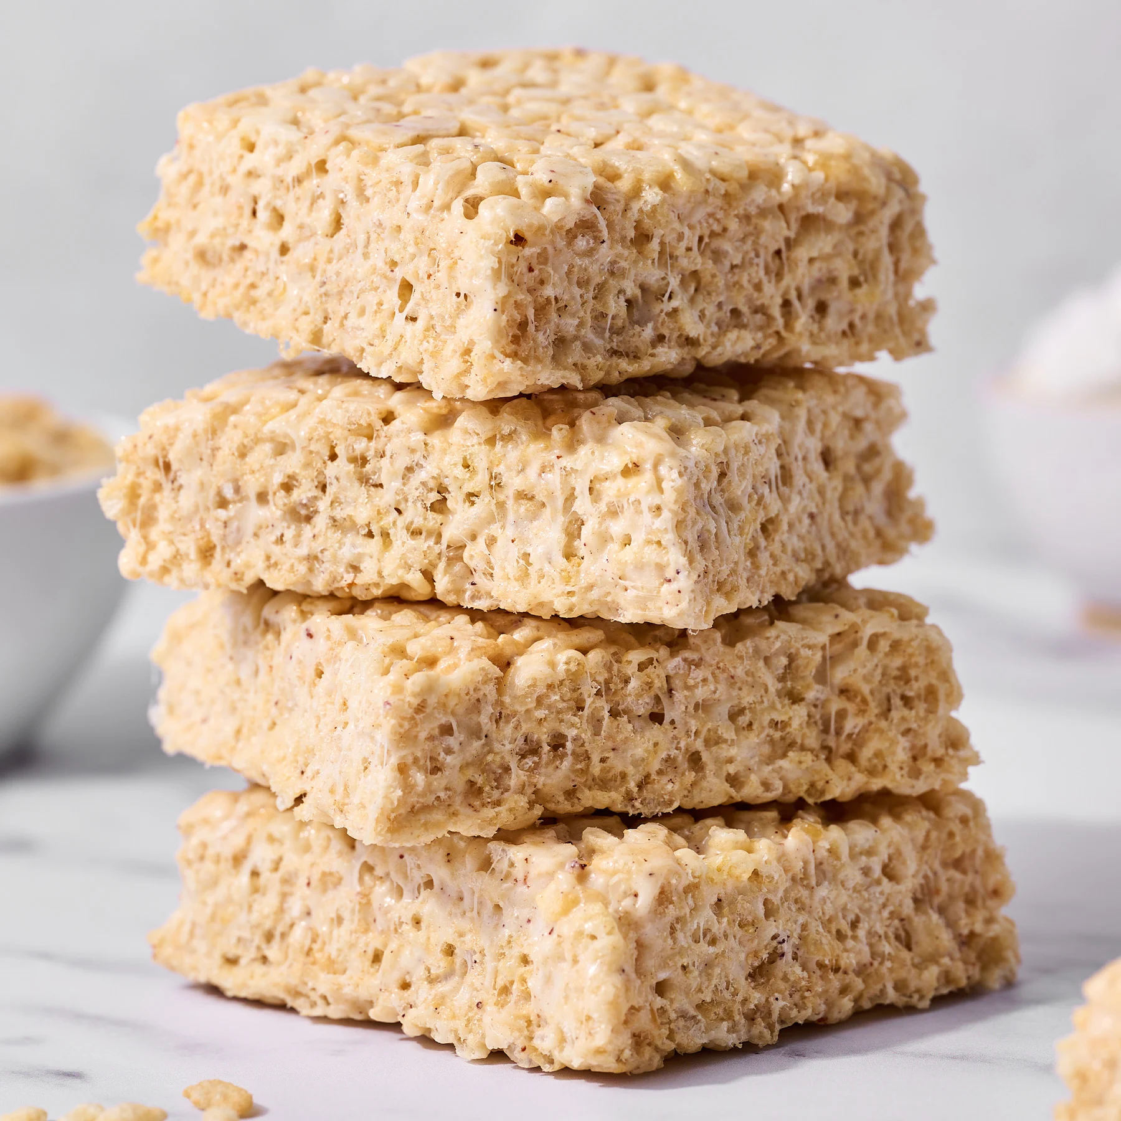
Happy National Rice Krispie Treat Day!
How many treats are here?
There were 20.
How many are missing?
Could you share them equally with a friend?
1.OA.C6

Slide 15

Today is the Fall Equinox, we have 12 hours of day and 12 hours of night.
How many different expressions can we think of that equal 12?
1.OA.C6
Notes:
September 23, 2024
Fall Equinox

Slide 16
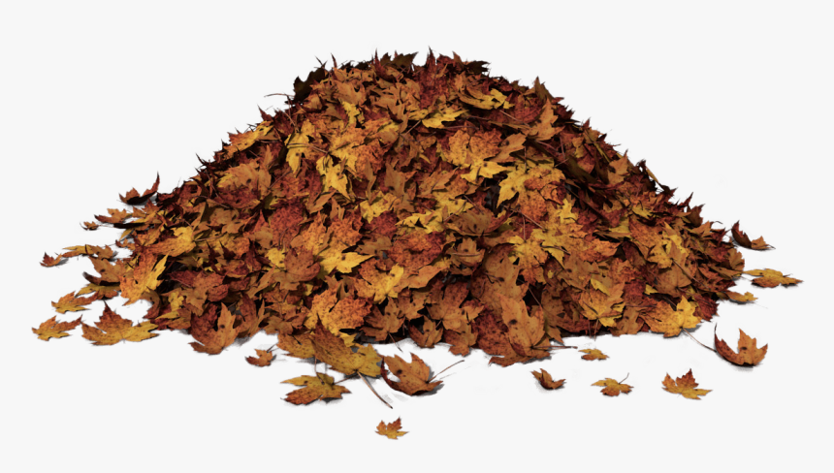
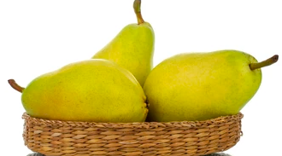
Would you rather …
Carry 1,000 leaves or 3 pears across the playground?
1.MD.A1

Slide 17
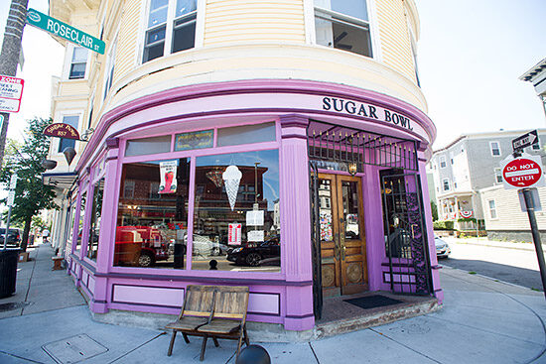
Describe some of the SHAPES you see in this photo.
J. Mann
1.G.A1

Slide 18
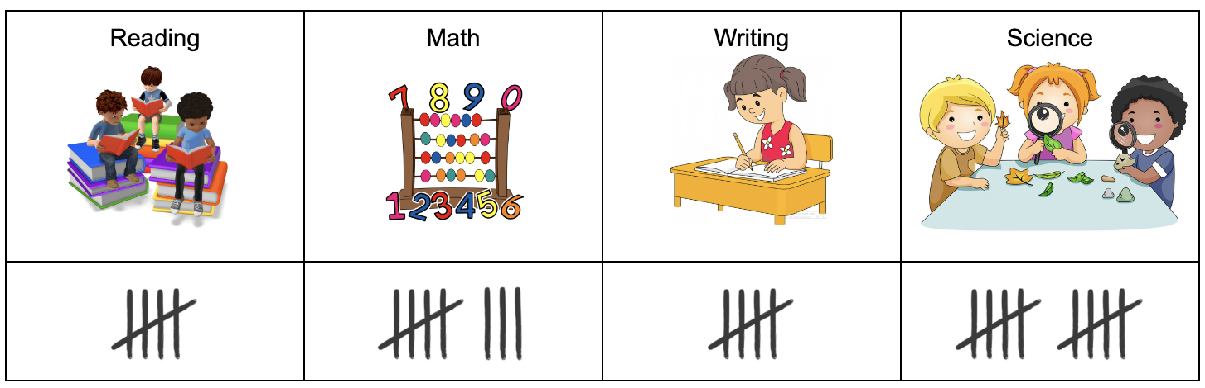
If this chart could talk, what would it say?
Why does it matter?
1.MD.C4

Slide 19
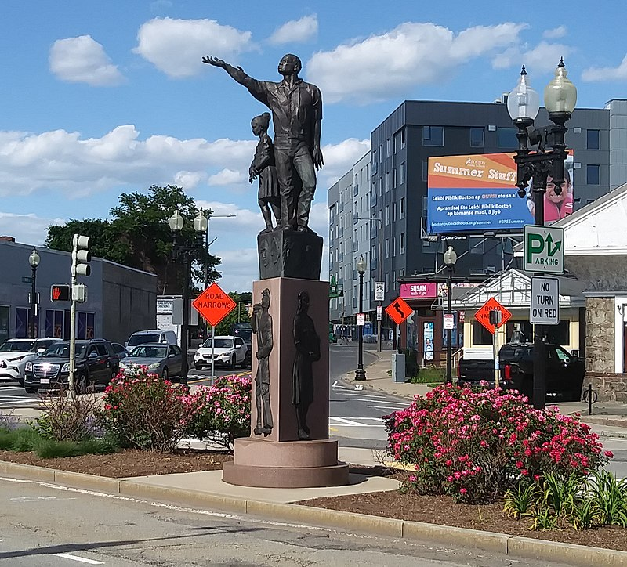
This 19 foot sculpture in Mattapan called RISE was created by 2 local women!
What we do know about the number 19? What do we know about a foot?
How many different expressions can we create to equal 19?
1.NBT.A2

