Slide 1
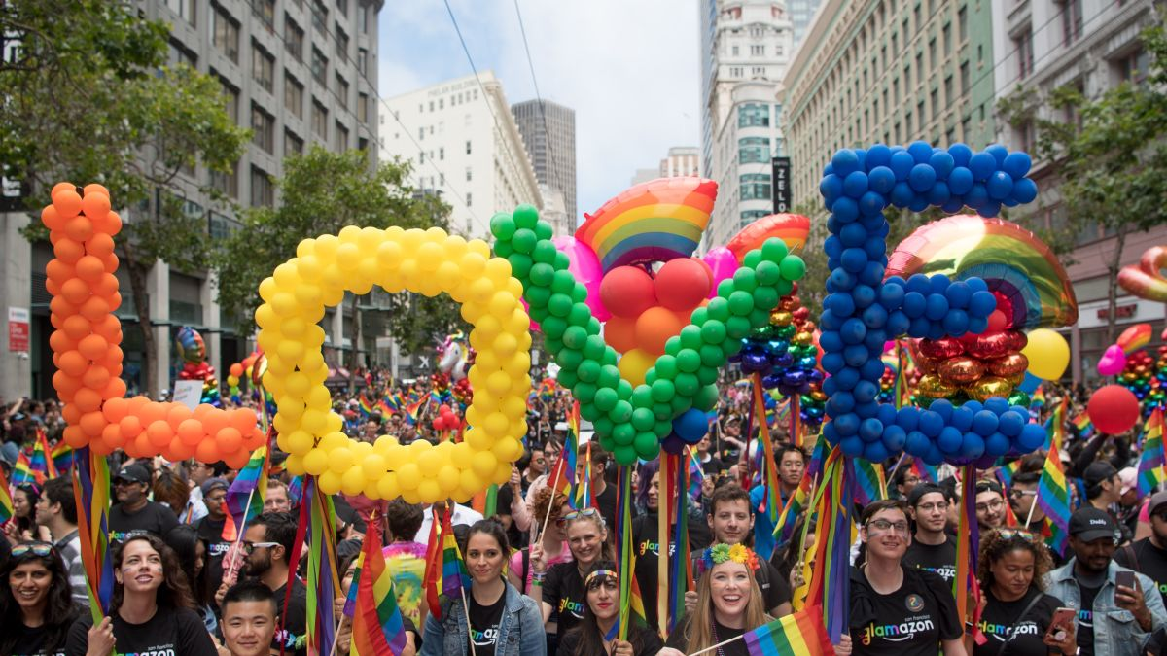
There are more than 100 balloons in each letter of LOVE!
How many ways can we count to 100?
What is the fastest way?
What is the slowest way?
K.CC.A1
Notes:
June is Pride Month!
Week of June 3, 2024

Slide 2
Which one doesn’t belong?
K.G.A2,3

Slide 3
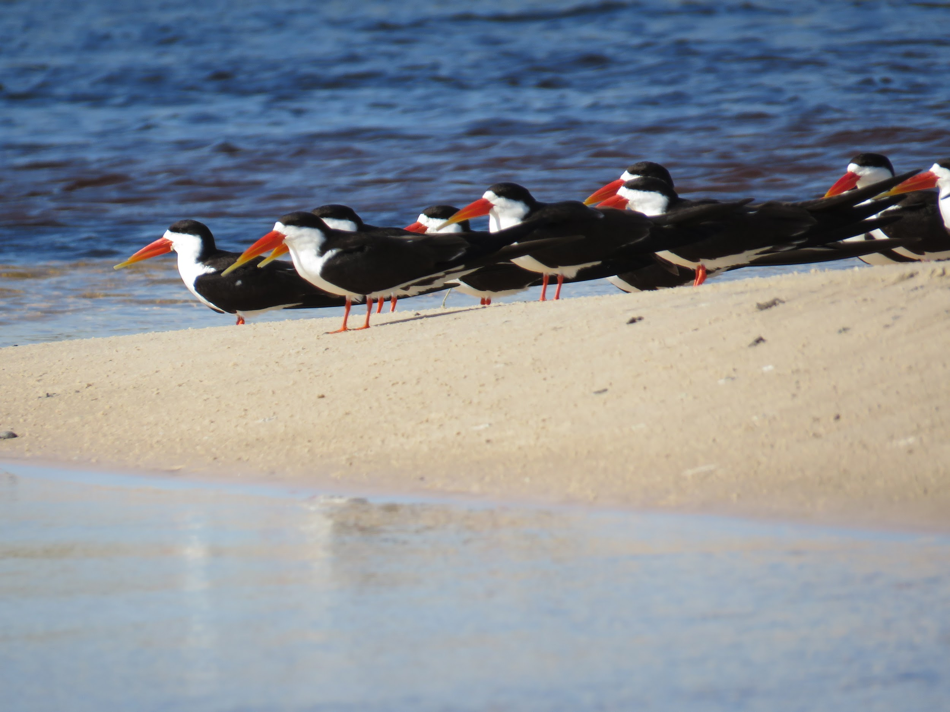
These are African Skimmers.
There are 9 you can see.
There are 20 altogether.
How many are missing from the picture?
Okavango Delta, Botwswana (C.Manousaridis)
K.OA.A2

Slide 4
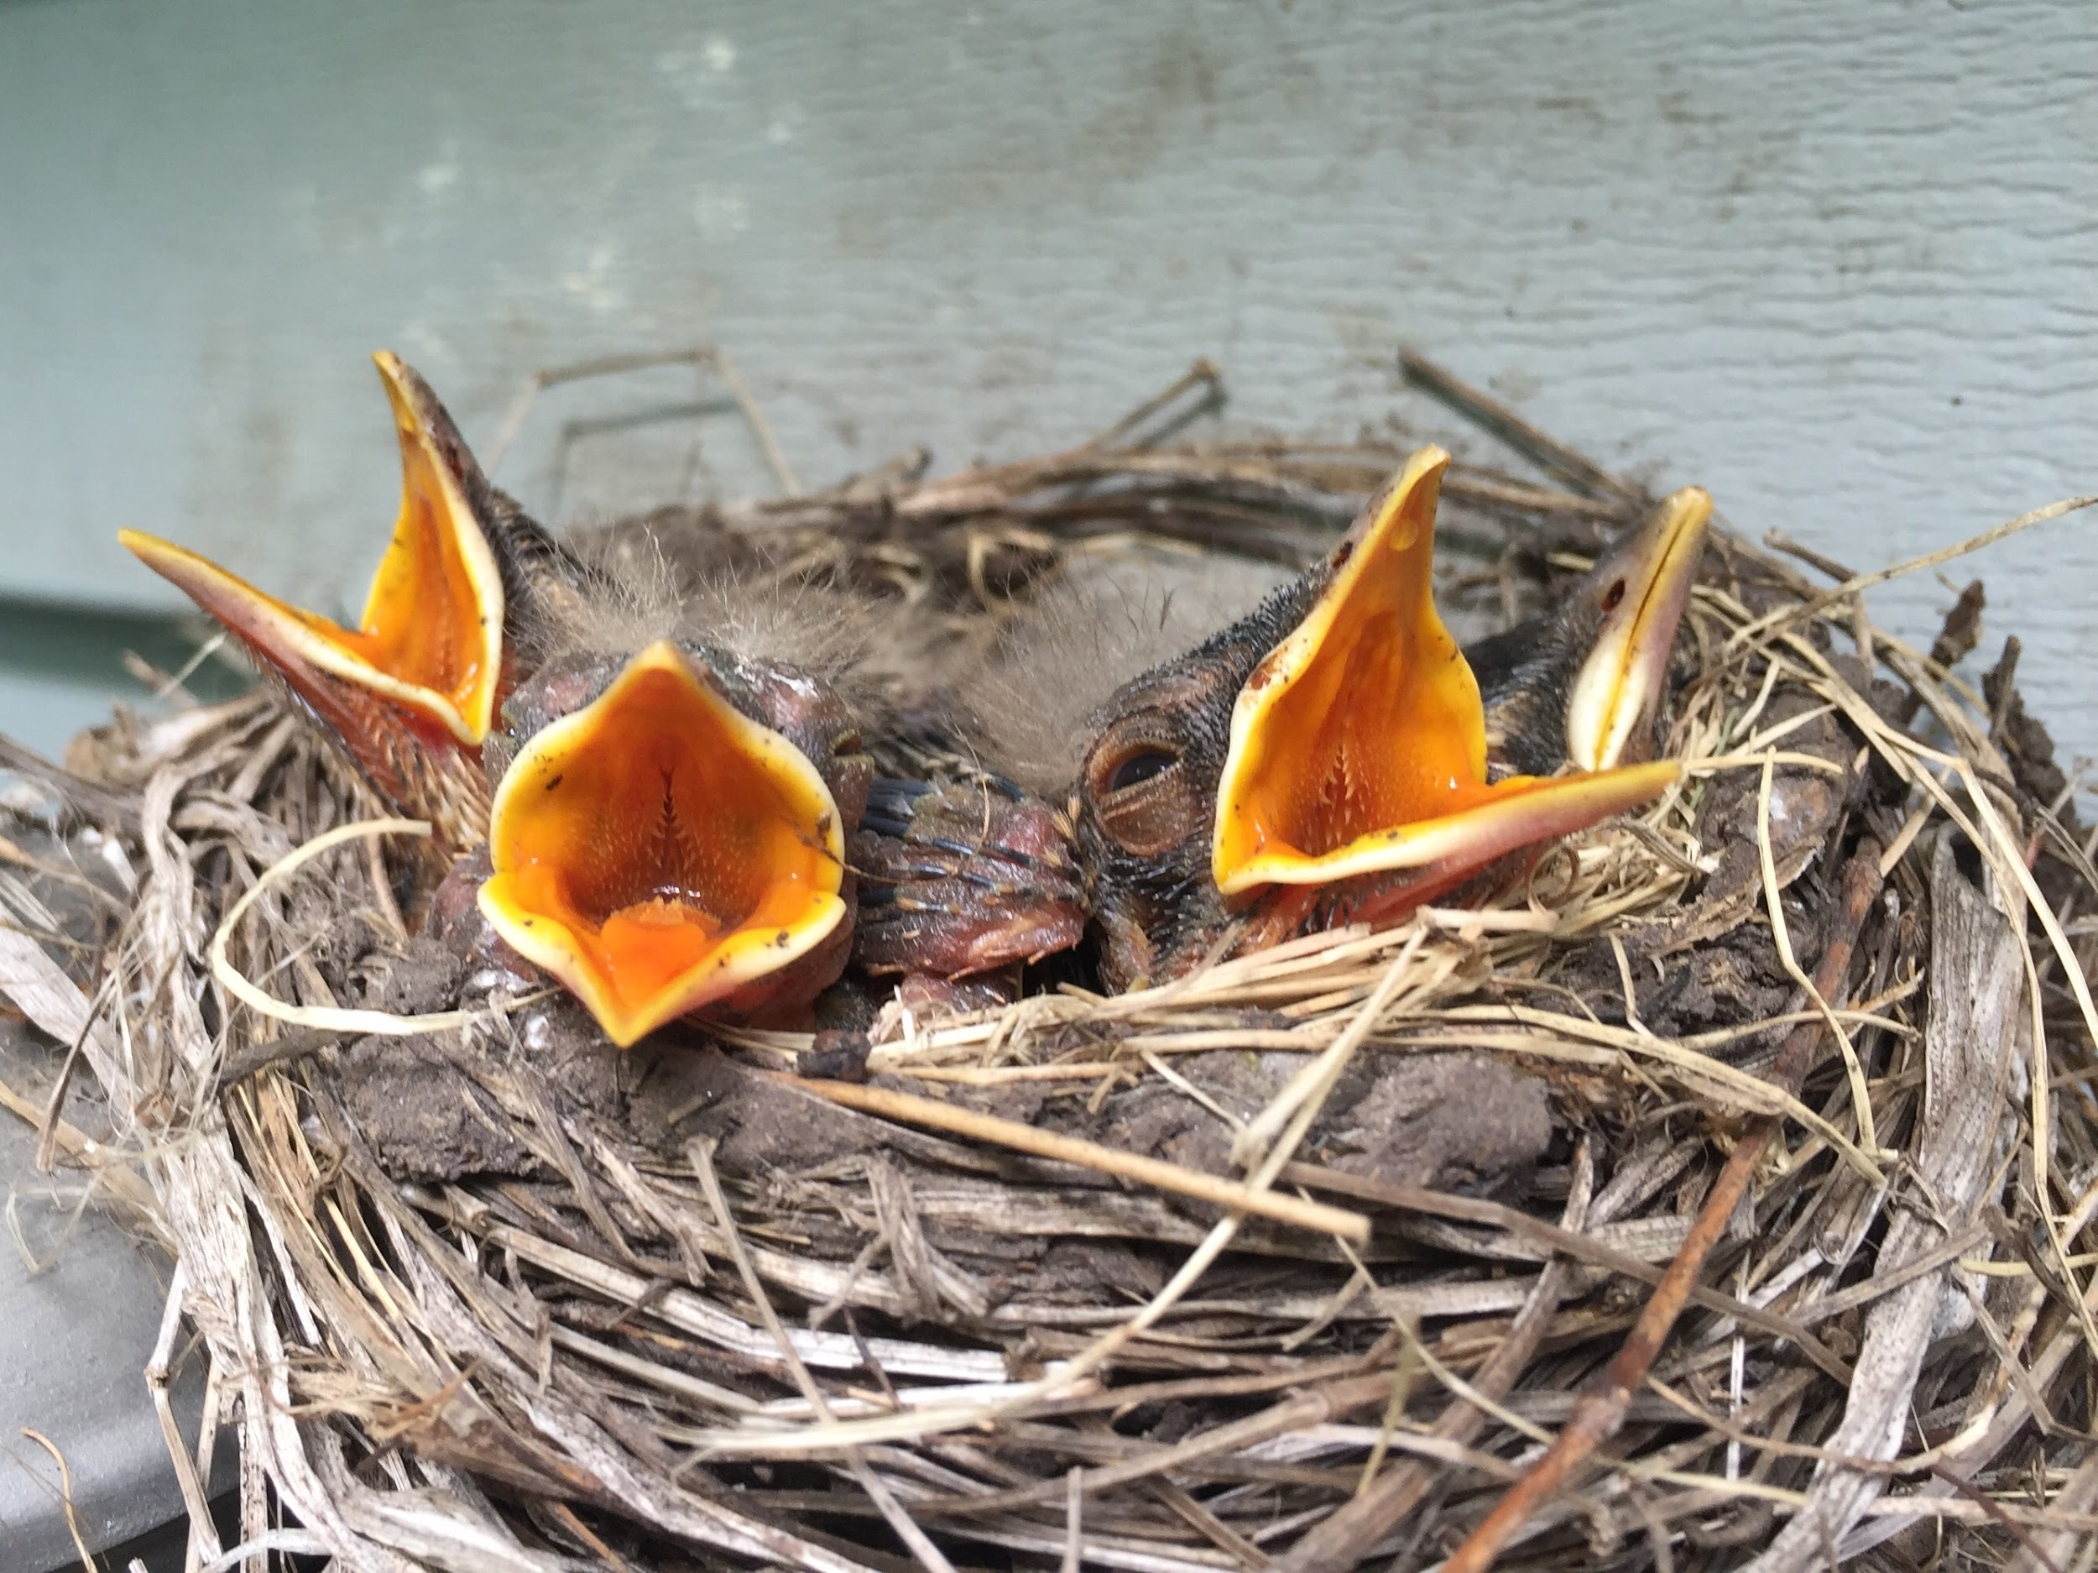
4 Baby Robins are in the nest!
If they each eat 2 worms every day, how many worms does Mama Robin need to get?
K.OA.A2

Slide 5
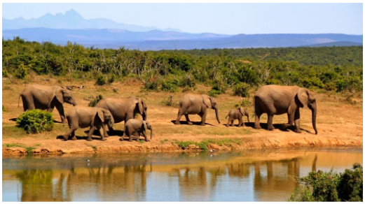
How many elephants are in the picture? How many more would make 10?
Can you write a number sentence to show that?
K.OA.A4

Slide 6

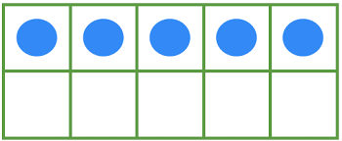
What is the same? What is different?
+ 5
K.NBT.A1
Notes:
Week of June 10, 2024

Slide 7
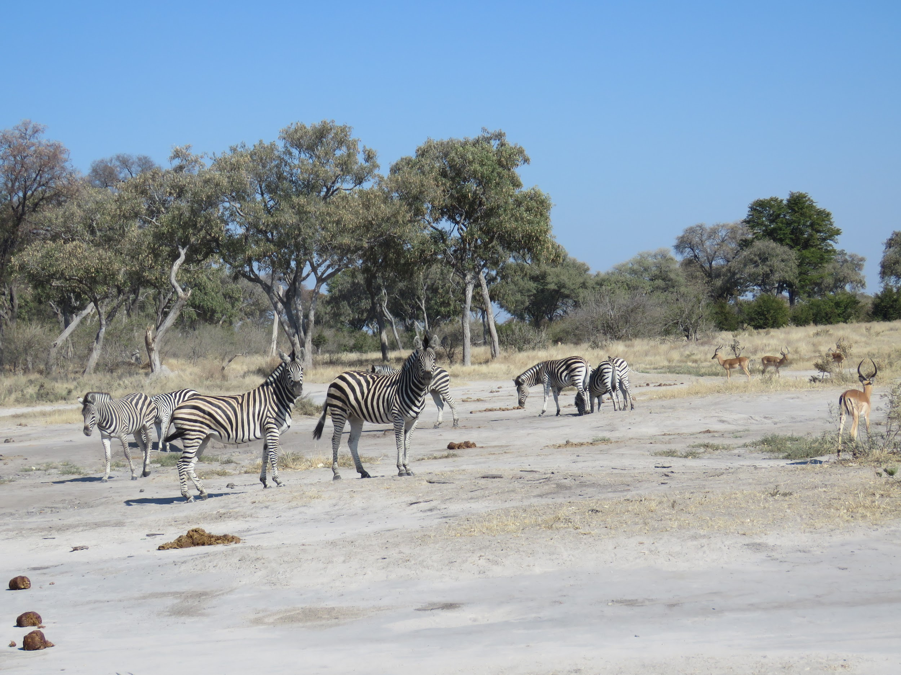
How many zebras do you see?
How many gazelles do you see?
Write a number sentence to show how many animals are here.
K.OA.A1
Moremi Wildlife Reserve, Botswana (C.Manousaridis)

Slide 8
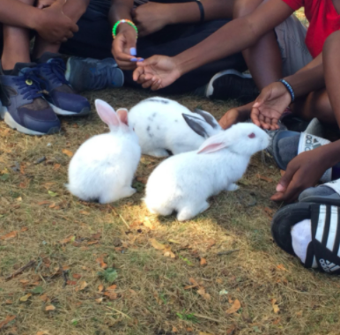
Bunnies at Land’s Sake Farm!
If there are 3 bunnies, how many legs do they have altogether?
What if 2 more bunnies hopped in?
What if there were 10 bunnies?
K.OA.A1

Slide 9
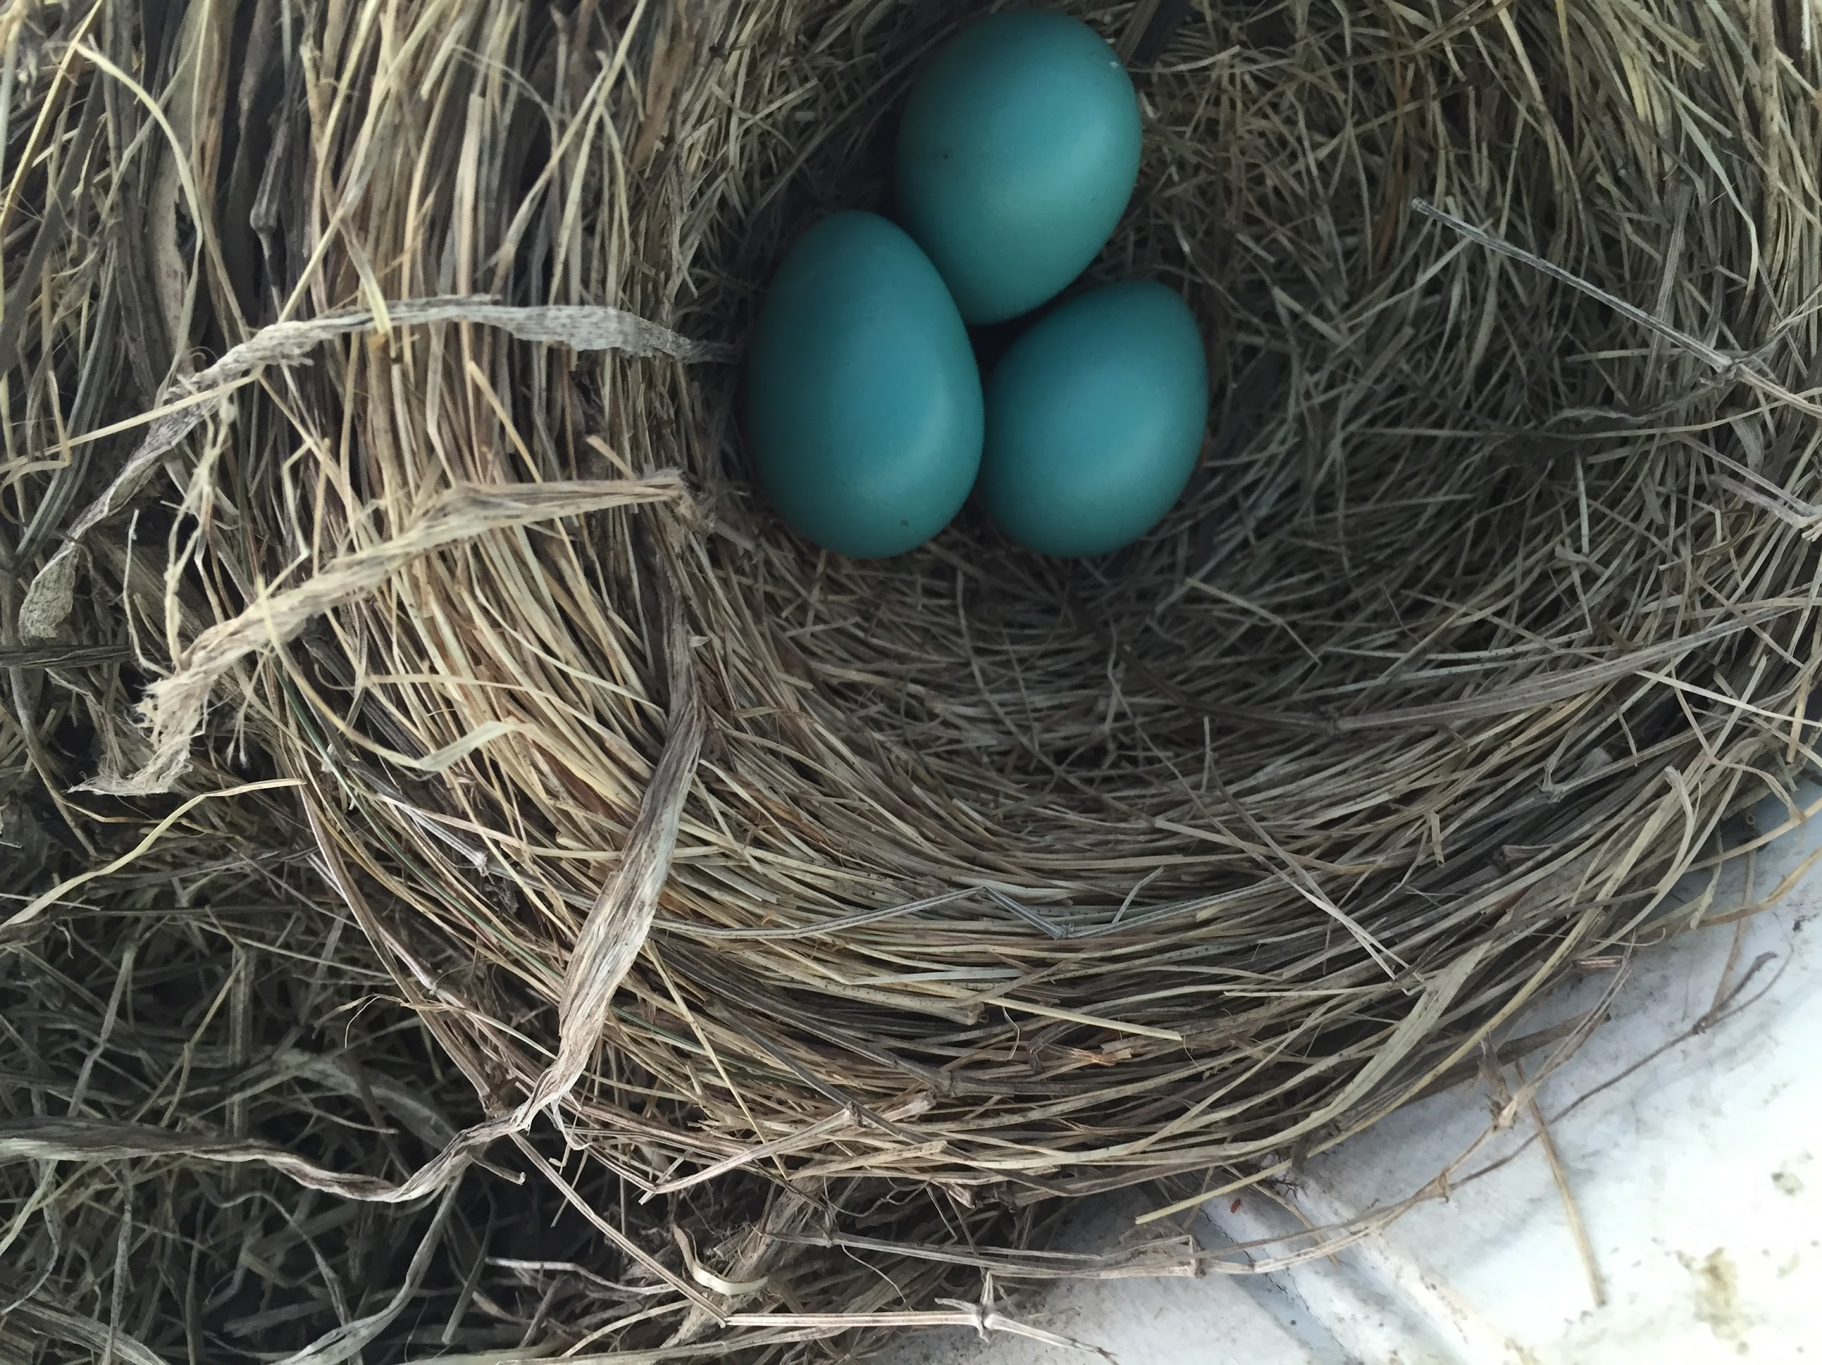
Mama Robin has a nest in our tree!
How many eggs?
Each robin egg weighs 3 grams,
how many grams do they weigh together
K.OA.A3

Slide 10

Happy Flag Day!
What can we count?
How many red stripes? How many white ones?
How many stars?
How can we count them?
K.CC.B4
Notes:
June 14, 2024
Flag Day

Slide 11
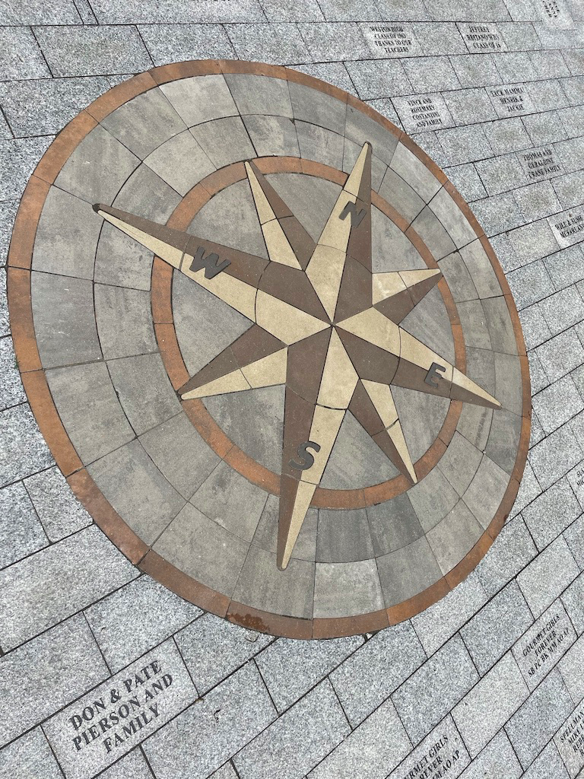
What fun shapes do you see in this compass rose along the Legacy Trail?
Can you sketch them?
K.G.A2
Notes:
Week of June 17, 2024

Slide 12

6 + 6 = 10 + 1
13 = 10 + 3
5 + 6 = 10 - 4
K.OA.A3

Slide 13
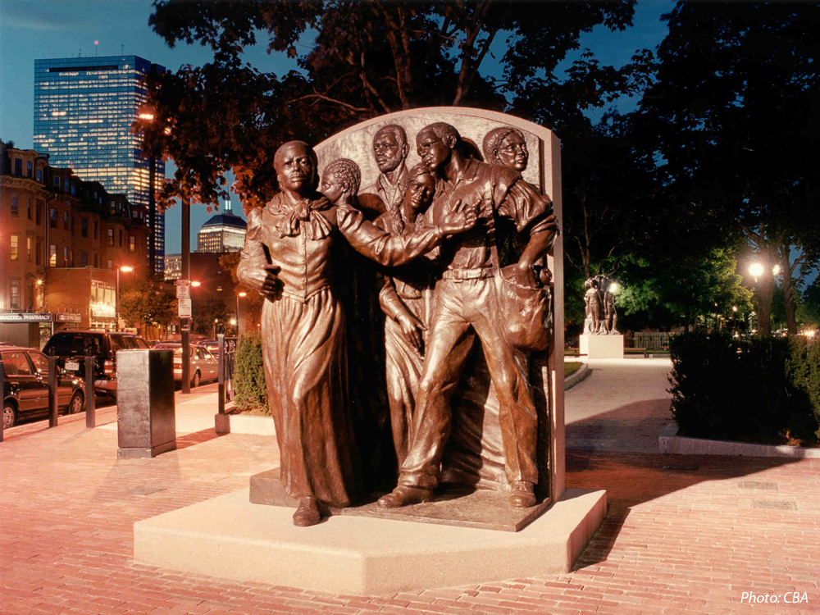
Harriet Tubman is leading 5 people North to freedom in this monument.
How many different ways can we make 6?
How many different number sentences can we create to show what we know?
Harriet Tubman Park, South Boston
K.OA.A3
Notes:
Juneteenth (tomorrow)

Slide 14
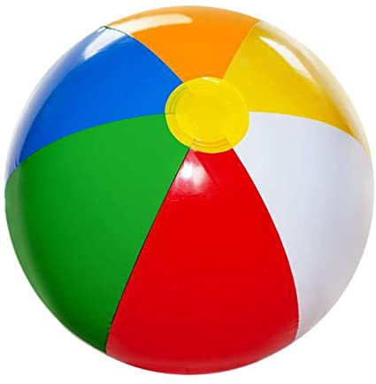
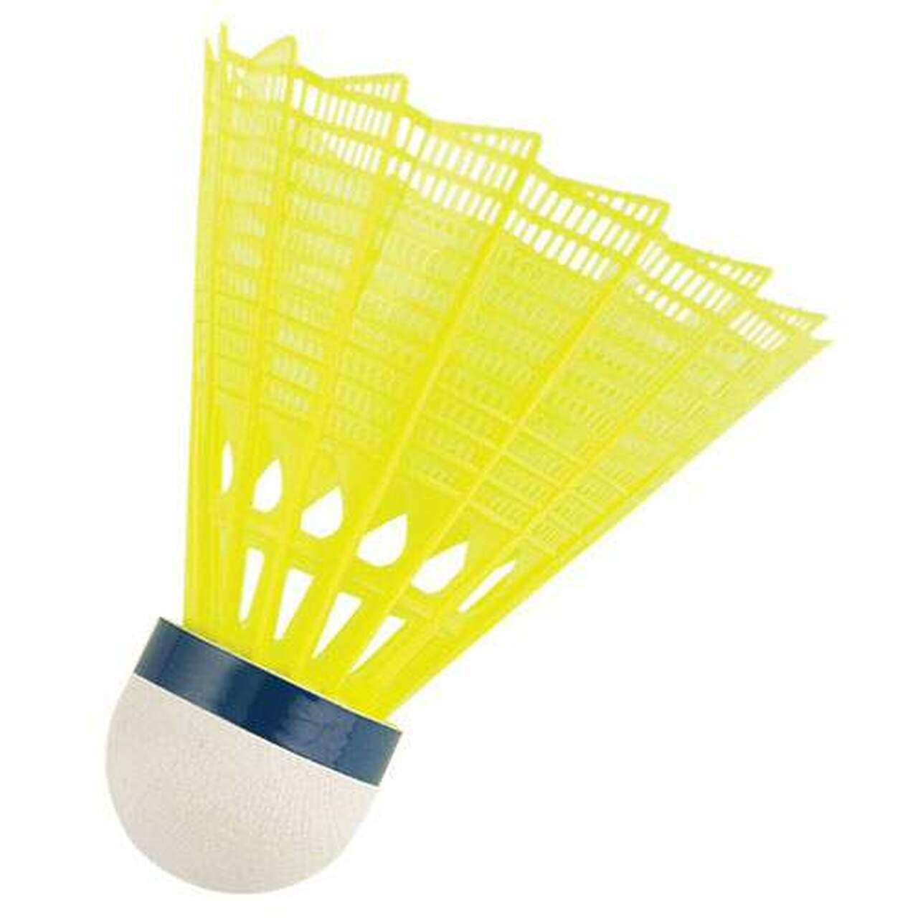
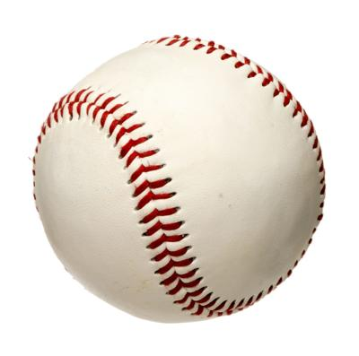
What can we say about these three?
K.MD.A2

Slide 15
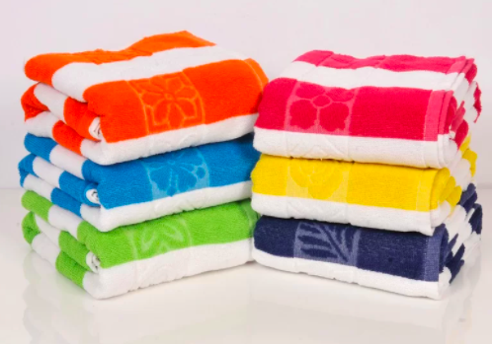
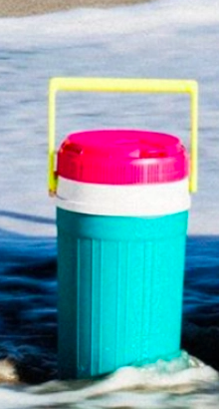
Would you rather….
Carry the giant beach towels or the jug of lemonade?
K.SMP.3

