Slide 1
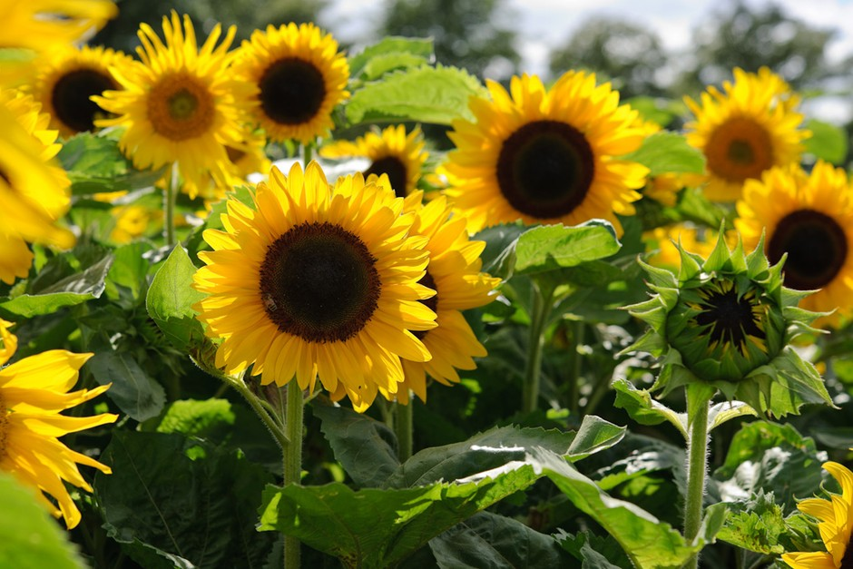
Happy National Sunflower Day!
Did you know that each of these sunflowers has around 1,250 seeds?
How many seeds in this whole garden?
Notes:
Week of April 29, 2024

Slide 2
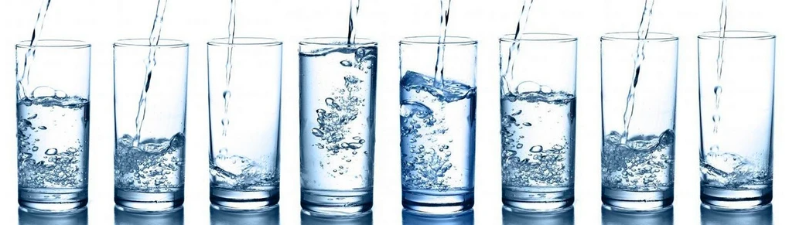
About how many FULL glasses of water
are here?
Write an addition sentence with fractions
to prove it!
5.NF.A2

Slide 3
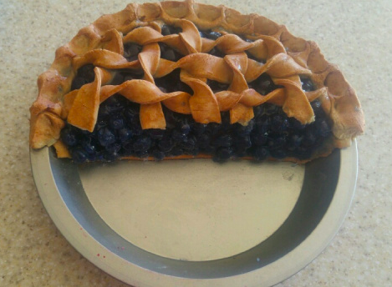
There’s half of the pie left over! Yay!
I have to share it with 3 of my friends.
What fraction of the WHOLE PIE are we each going to get?
5.NF.B7

Slide 4
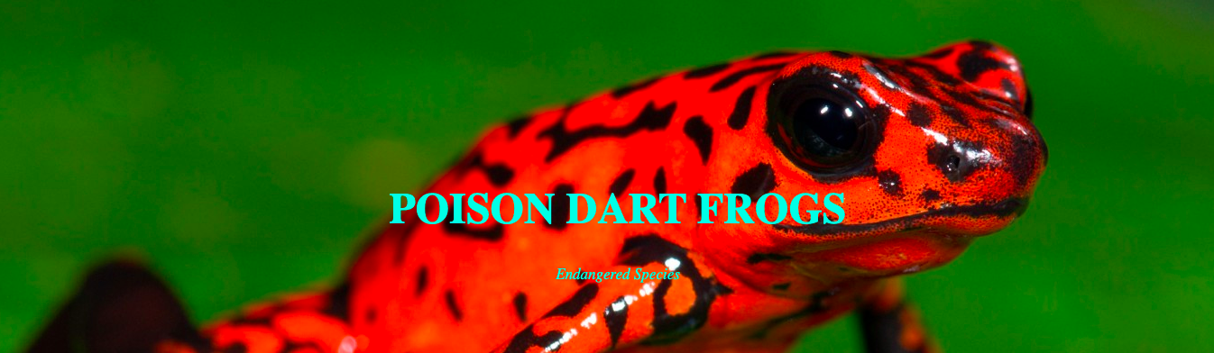
More than a quarter of the 200 plus poison dart frog species are listed as threatened or critically endangered.
What does this mean mathematically? ABOUT how many species are endangered?
5.NF.A2

Slide 5
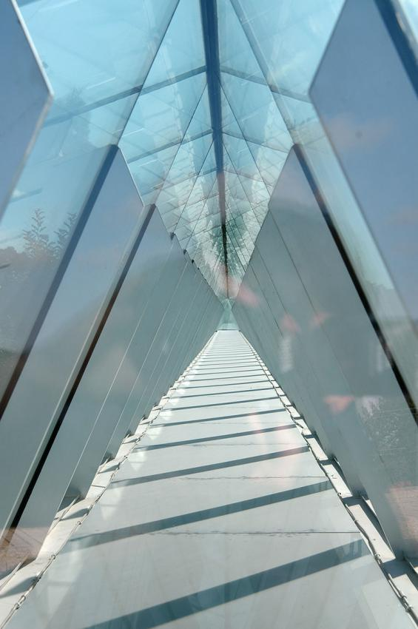
Yad Vashem ~ יָד וַשֵׁם
A Memorial and a Name
Established in 1953, Yad Vashem is the second most visited site in Israel.
It is located on the western slope of Mount Herzl, also known as the Mount of Remembrance, a height in western Jerusalem, 804 meters above sea level.
About how many feet is 804 meters?
How do you know?
5.MD.A1
Notes:
Yom Hashoah

Slide 6
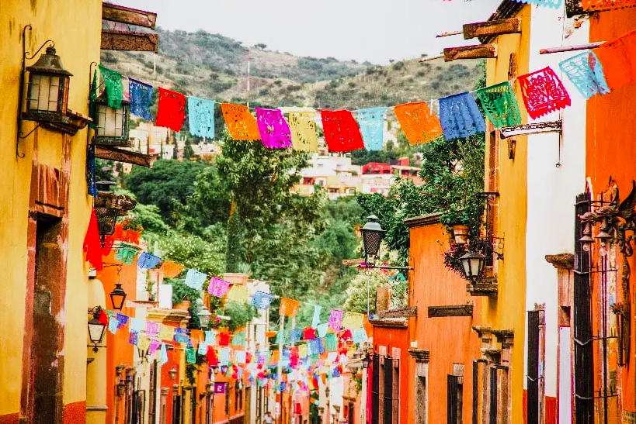
Happy Cinco de Mayo!
How many Los Papeles Picados do we see?
How can we estimate using math?
5.NBT
Notes:
Week of May 6, 2024

Slide 7
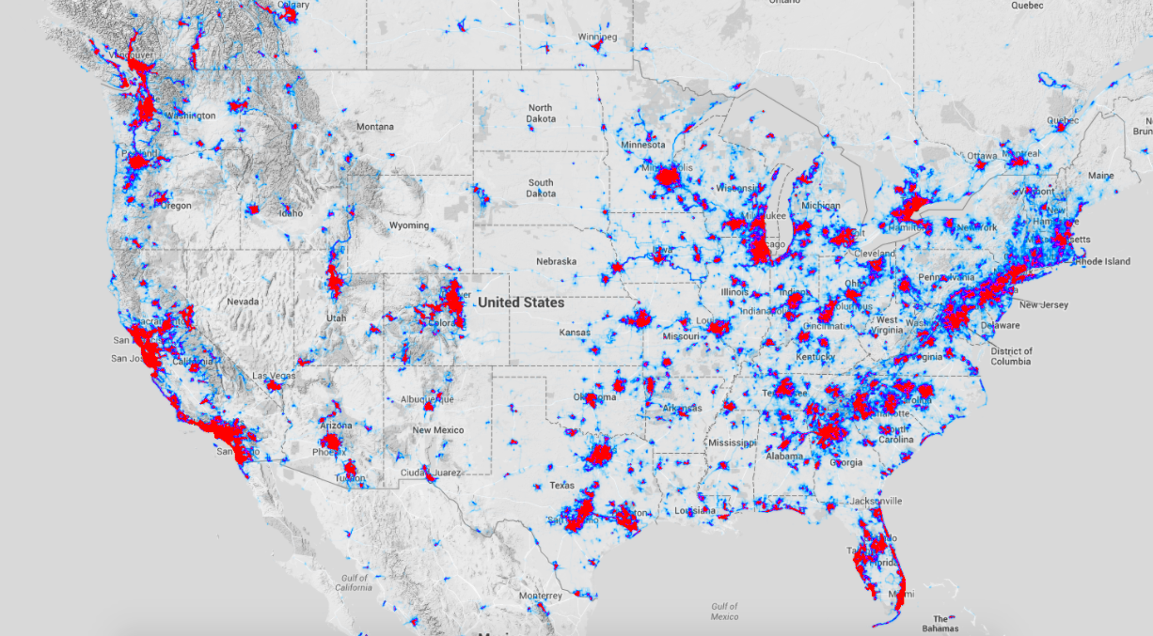

Millions of Americans Run and Bike
What do you notice, what do you wonder, why does it matter?
Notes:
What do you notice?
What do you wonder?
Why does it matter?

Slide 8
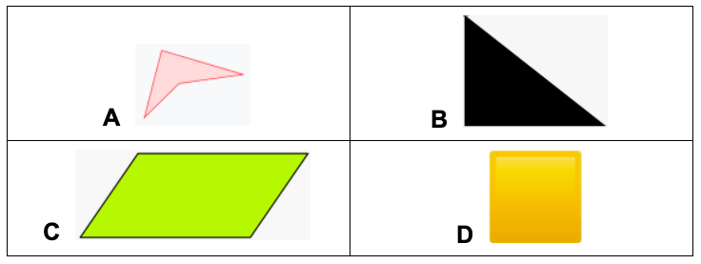
Which one doesn’t belong?
5.G.B3,4

Slide 9
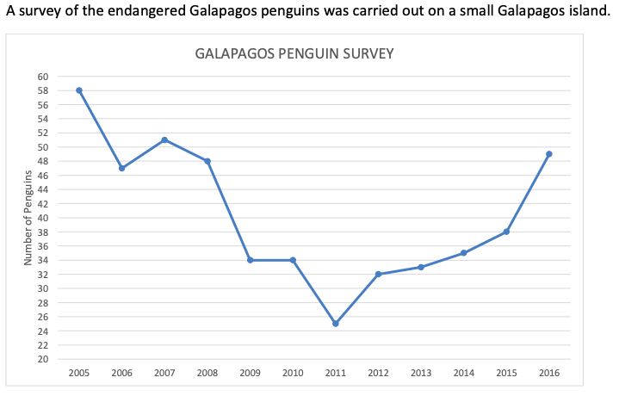
What’s going on in this graph?
What do you notice?
What do you wonder?
Why does it matter?
5.MD.B

Slide 10
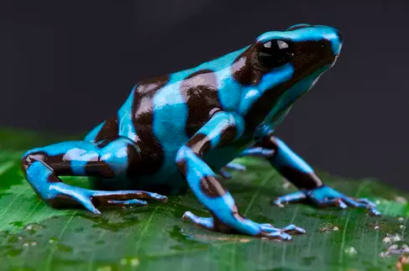
It’s Froggy Friday!
There are more than 6,000 species of FROGS in the world!
In the past 50 years, more than 500 amphibian species have experienced population declines worldwide, and 90 of them have gone extinct.
What fraction statements can you make about this?
5.NF.B3

Slide 11
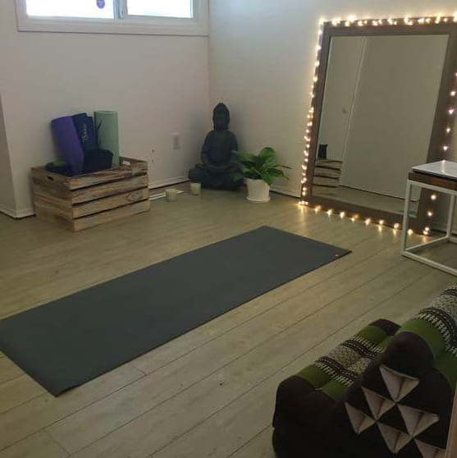
We are building a yoga studio in the basement!
We only have 120 square feet of wood flooring, so the AREA of the studio is going to be 120 square feet.
What are the possible dimensions?
(length and width)
5.MD.C
Notes:
Week of May 13, 2024

Slide 12
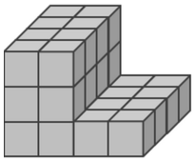
Check out this figure. Pretty interesting!
Jonny decided to break this into 2 rectangular prisms to find the volume.
What do you think he did?
Volume is the measure of all the blocks!
L x W x H
5.MD.C4

Slide 13
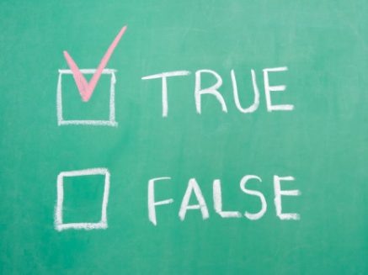
Add 8 and 7, then multiply by 2 = 8 + 7 x 2
6 x 30 > 5 x 3 x 2
7 x 4 - 3 = 7 x (4 - 3)
5.NF.B5

Slide 14
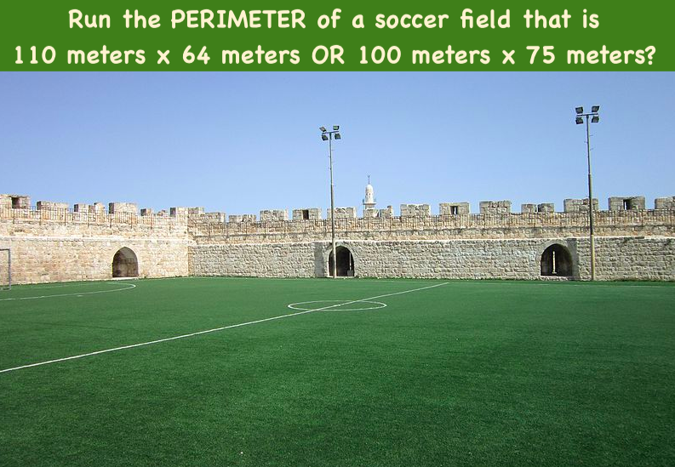
Would you rather ...
5.MD.C

Slide 15
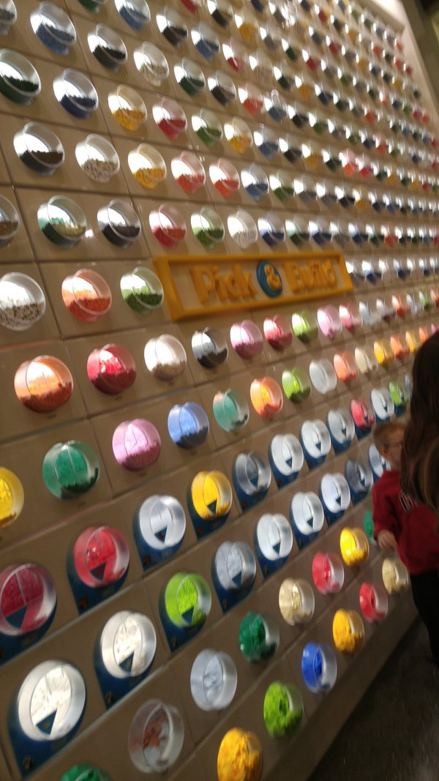
This is a picture of the Lego pick-a-brick wall at the Lego store in the Mall of America.
What do you notice?
What do you wonder?
How many Lego bins are there?
What is too low?
Too high?
What is your ESTIMATE?
5.NBT.B5

Slide 16
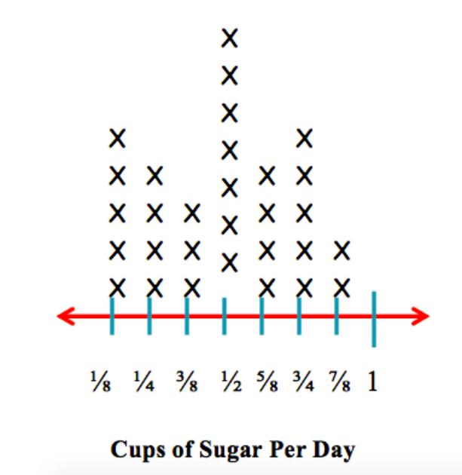
What’s going on in this graph?
What do you notice?
What do you wonder?
What could this be?
5.MD.B
Notes:
Week of May 20, 2024

Slide 17
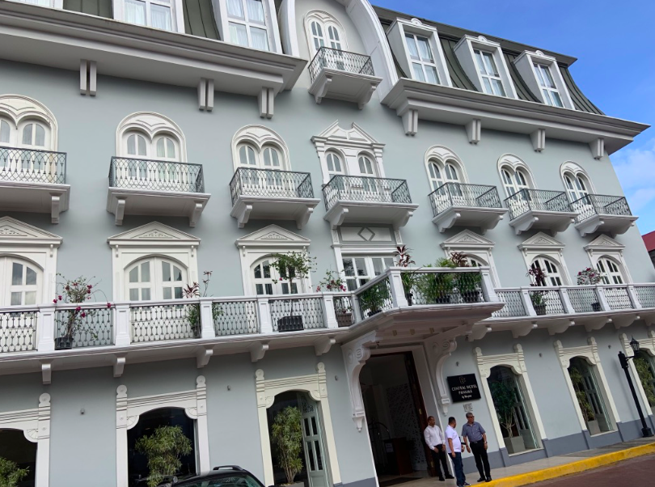
Where is the math in this picture?
How many different mathy statements and equations can you make?
Think about arrays and shapes, multiplication and symmetry!
5.G.B

Slide 18
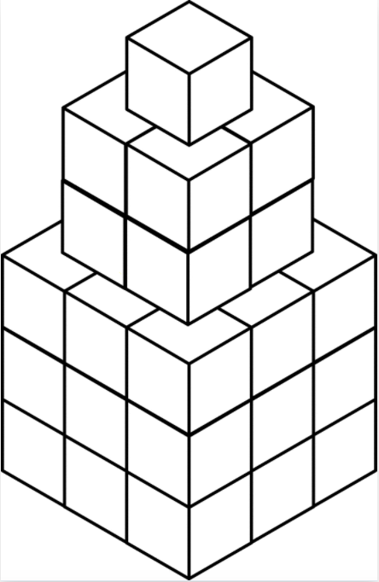
Crazy Figure!
What do you notice about this figure?
What is the VOLUME of this figure?
Write an equation to match what you are thinking?
Is there another way to solve it?
5.MD.C4

Slide 19
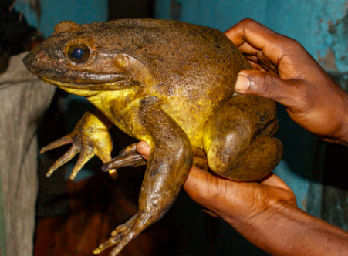
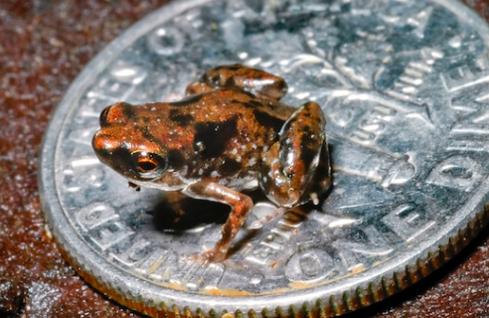
Heaviest frog in the world v. lightest frog in the world
The Goliath Frog from Cameroon can weigh up to 7.2 Pounds
This frog is from Papua New Guinea and weighs only .00455 of an ounce. What does that mean?
How can you compare them?
5.MD.A1

Slide 20
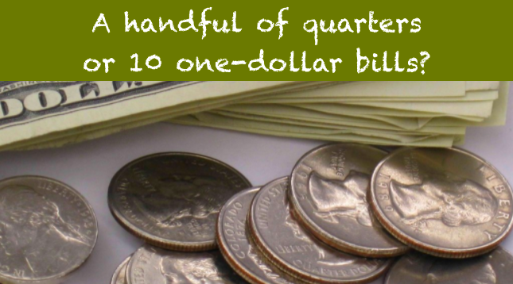
Would you rather . . .
5.NBT.A

Slide 21
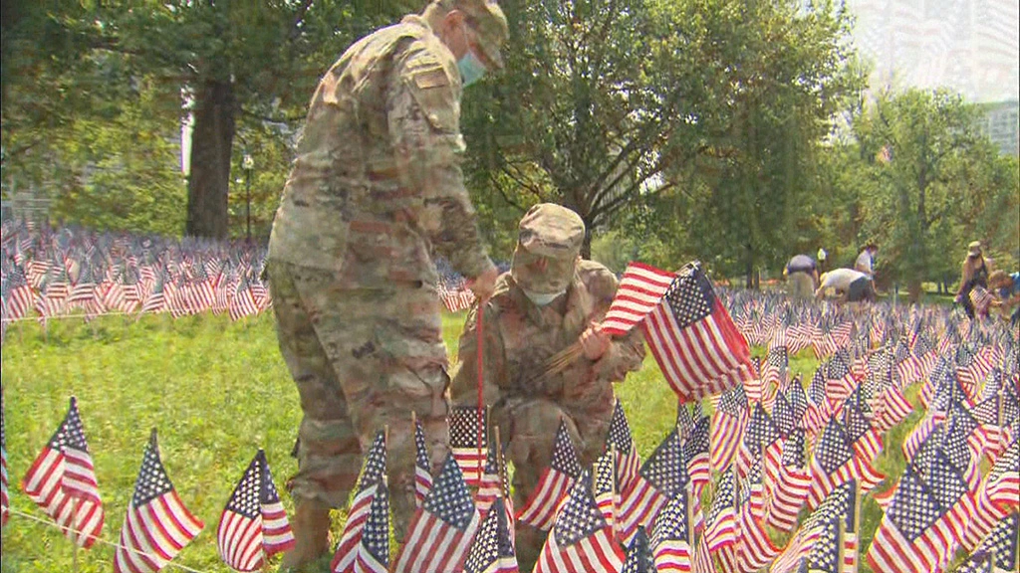
Volunteers placed 37,342 American Flags on the Boston Common to commemorate Memorial Day.
Create an equation using at least TWO operations to equal 37,342.
5.NBT.B7
Notes:
Week of May 28, 2024

Slide 22



47 < x 47
x 8 > 8 x
61 x > 61
Explain your reasoning!
5.NF.B5

Slide 23
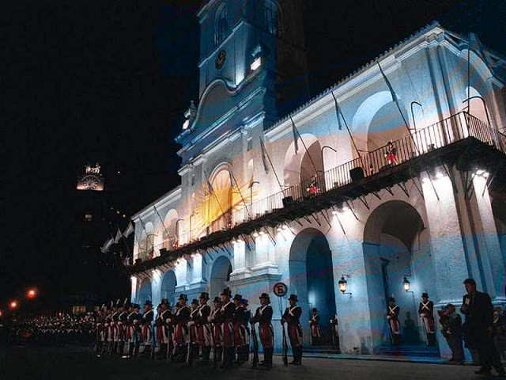
Dia de la Revolucion de Mayo!
It’s Revolution Day in Argentina!
The current population of Argentina is 45.96 million people! What does that mean?
About one-third of the population lives in the Buenos Aires Metropolis. What can we say about that?
5.NBT.A2
Notes:
Revolution Day, Argentina

Slide 24
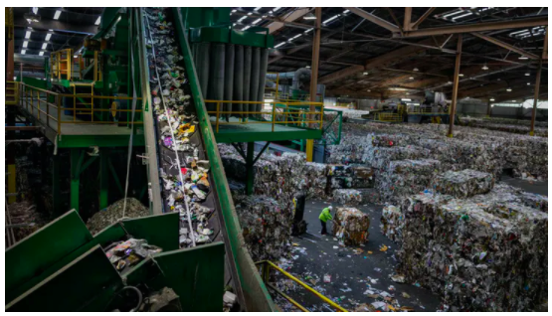
Recology’s largest San Francisco recycling plant handles
500 to 600 tons daily.
About how many tons does this recycling plant handle each year?
5.NBT.B5

