Slide 1
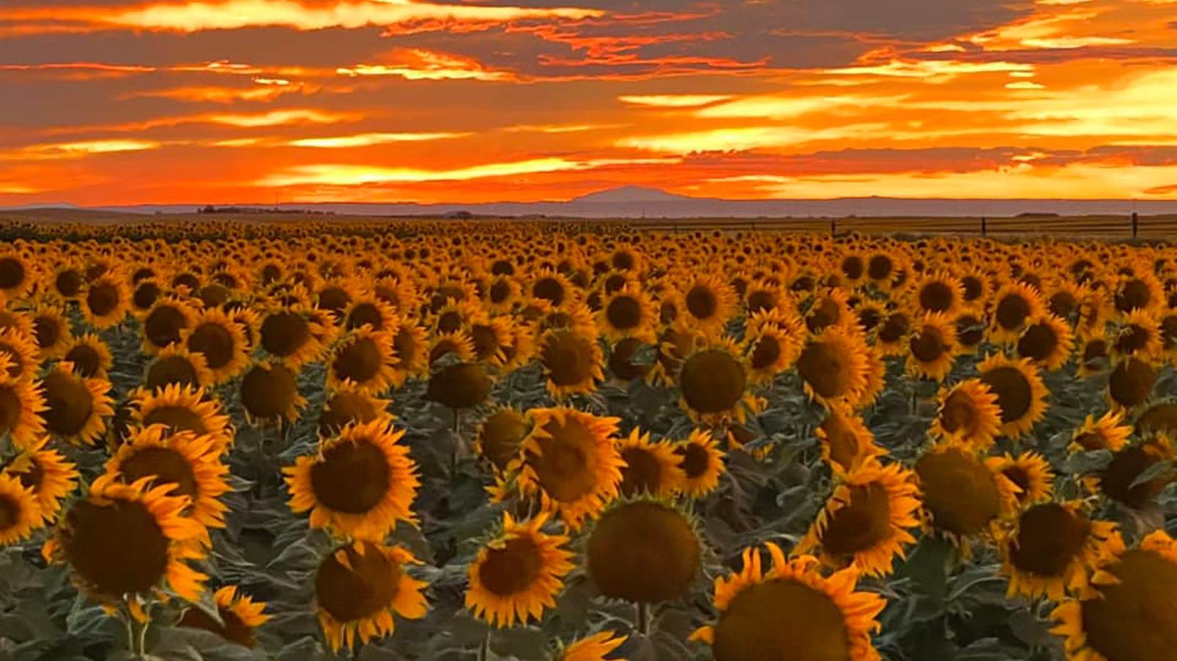
Happy National Sunflower Day!
Estimate the number of sunflowers in this field.
How can we come close?
Why does it matter?
Notes:
Week of April 29, 2024

Slide 2
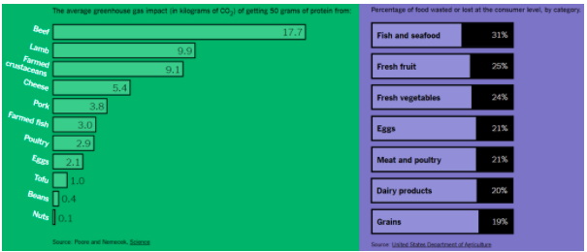
What do you notice? What do you wonder?
Why does it matter?
4.MD.B
Notes:
What effect does what we eat, and the food we waste, have on the environment?

Slide 3
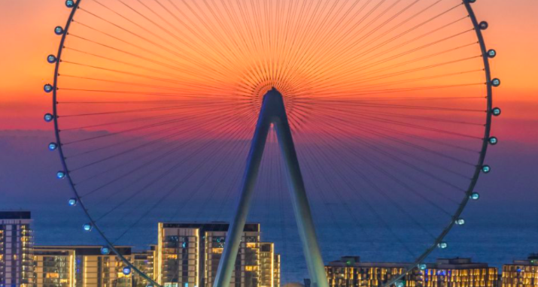
Ain Dubai (the eye of Dubai) is the world’s highest observation wheel.
It will take 48 minutes to make a full rotation! What fraction of an hour is that?
4.MD.A1

Slide 4



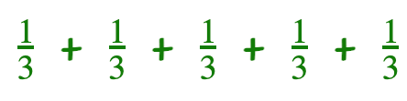
Which one does not belong?
 | + +
x 5
4.NF.B4

Slide 5
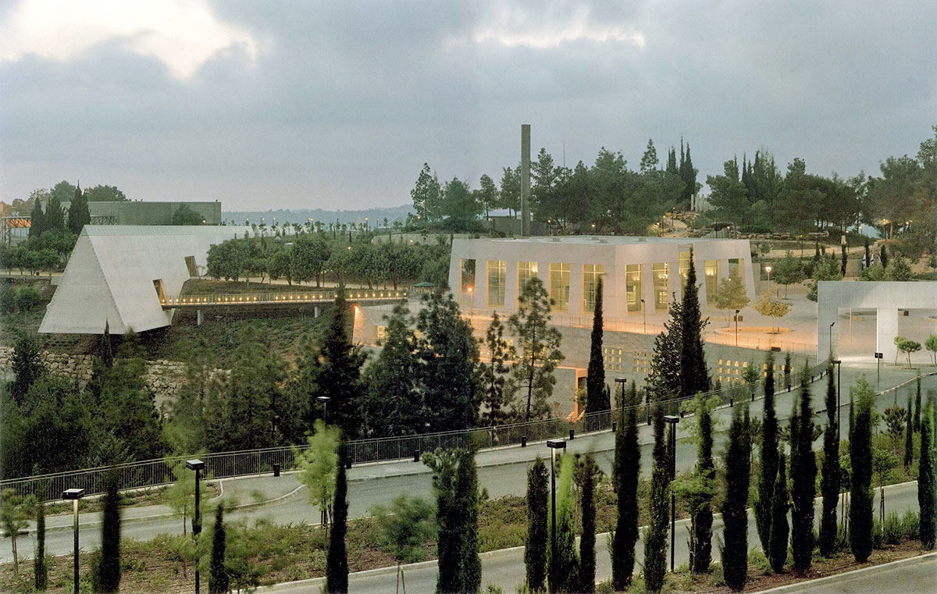
Yad Vashem ~ יָד וַשֵׁם ~ A Memorial and a Name
Yad Vashem is the second most visited site in Israel.
This Holocaust Memorial Museum was established in 1953.
How can we use mental math to figure out how long ago that was?
4.NBT.B4
Notes:
Yom Hashoah

Slide 6

Describe the shapes you see in this Mexican mandala.
Use as much rich vocabulary as you can!
Do you see any symmetry?
4.G.A2
Notes:
Week of May 6, 2024
Cinco de Mayo (yesterday)

Slide 7
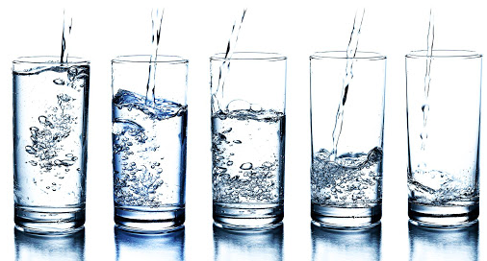
Where do you see fractions?
What fraction comparisons can you make?
4.NF.A2

Slide 8
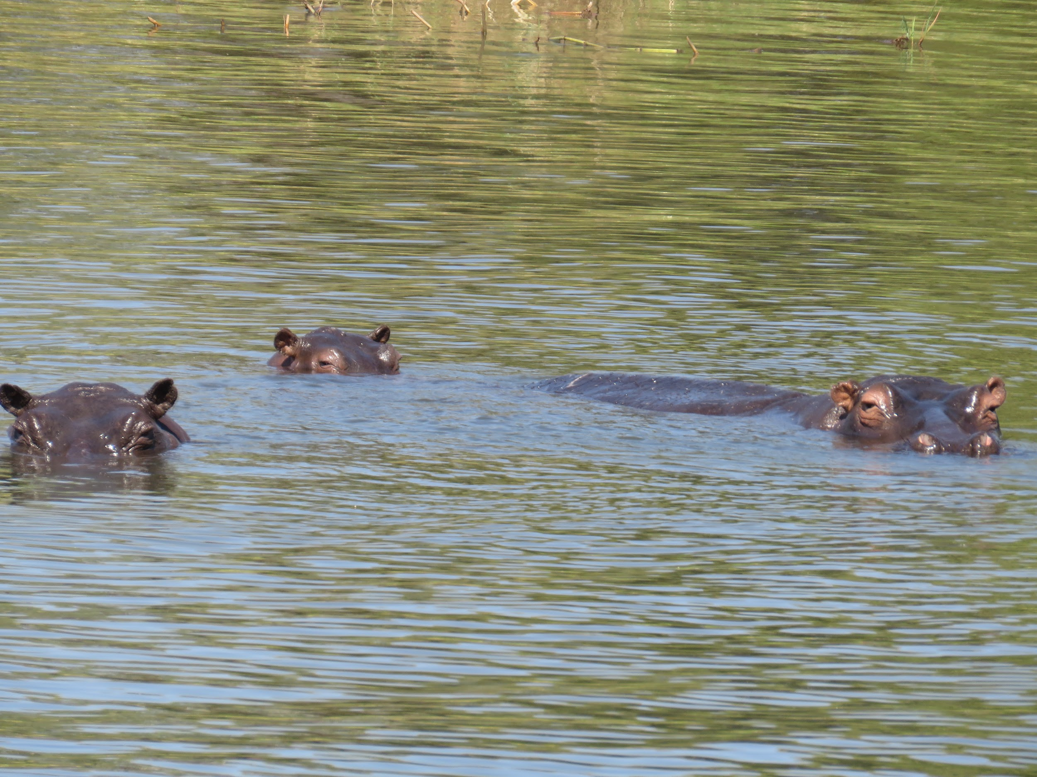
These Hippos at the Gwembe Reserve in Zimbabwe are living large!
Estimate what fraction of their bodies are underwater!
4.NF.A

Slide 9
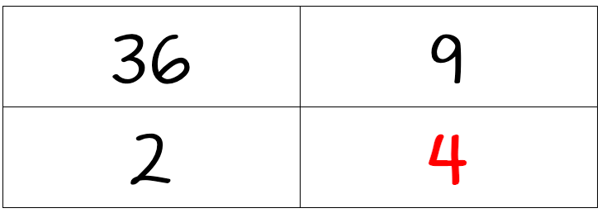
Which one doesn’t belong?
4.OA.B4

Slide 10
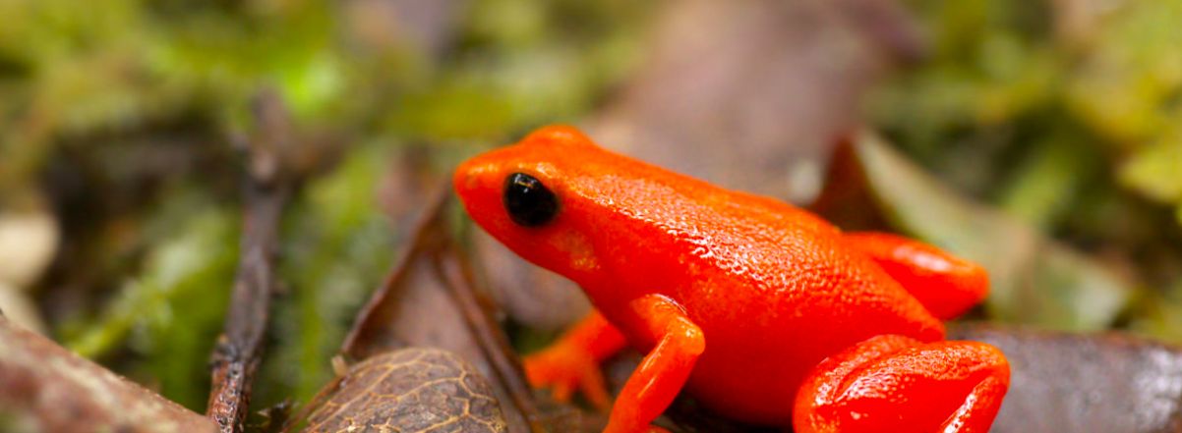
The Golden Mantella Frog lives exclusively in a 4 square mile area in the Moramanga region of Madagascar.
It is critically endangered.
Sketch what 4 square miles looks like. How many square feet is that?
4.MD.A1

Slide 11
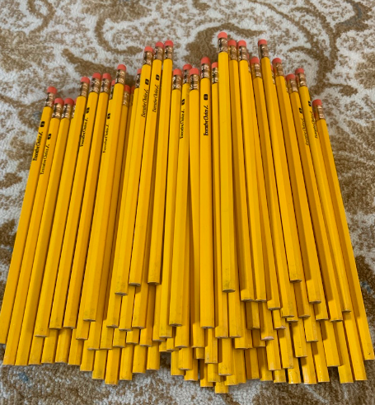
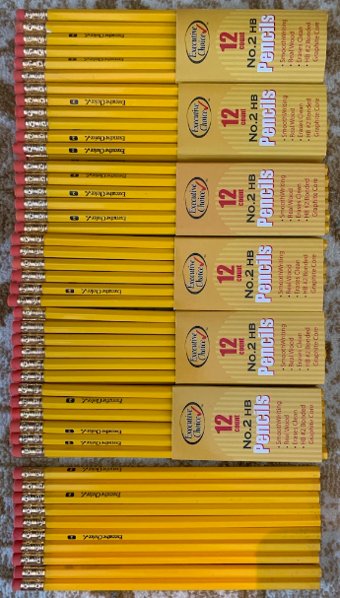
How many pencils are in the pile?
What is a too high estimate?
Too low? Just right?
4.OA.A3
Notes:
Week of May 13, 2024

Slide 12

Yay!! You won FIRST PLACE at the STEM Fair!
Would you rather . . . $20 right now OR $2 a day for the next 2 weeks
4.OA.2

Slide 13
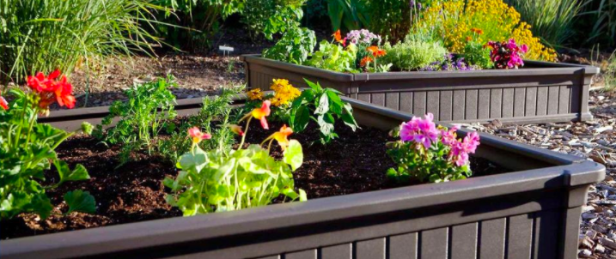
Celia and Jonny are building raised bed gardens.
Celia’s garden is
8 ft. x 10 ft. and Jonny’s is 16 ft. x 20 ft.
Jonny said “my garden is TWICE the size of yours!
Celia was NOT happy about that.
Is he right? Prove that he is right, or wrong!
4.NBT.B5

Slide 14
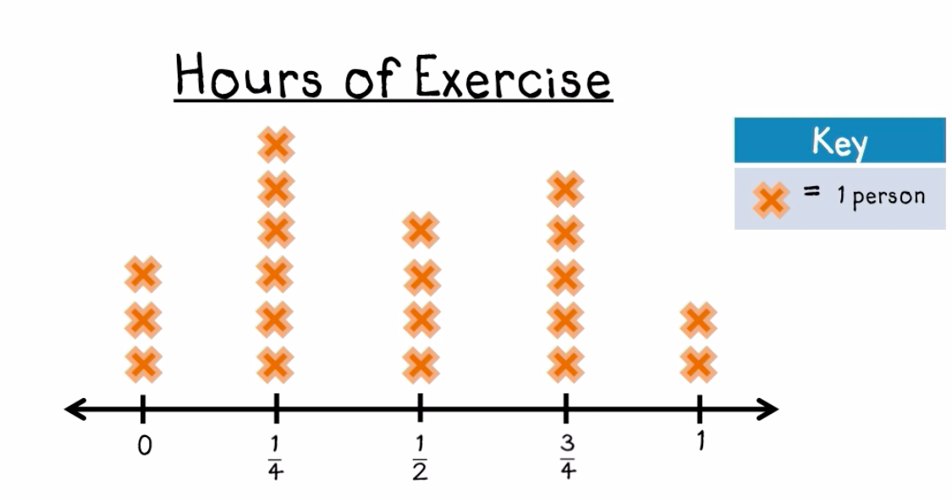
What do you notice in this LINE PLOT?
What do you wonder? Why does it matter?
4.MD.B4

Slide 15
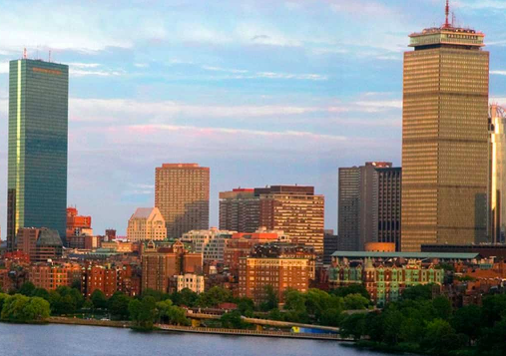
The distance between the Hancock Tower and the Prudential Center is .7 miles.
How far is that?
How many feet is that?
(There are 5280 feet in a mile)
Estimate!!
How can you solve this?
4.NBT.B5

Slide 16
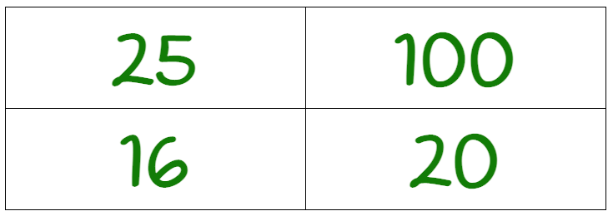
Which one doesn’t belong?
4.OA.B4
Notes:
Week of May 20, 2024

Slide 17
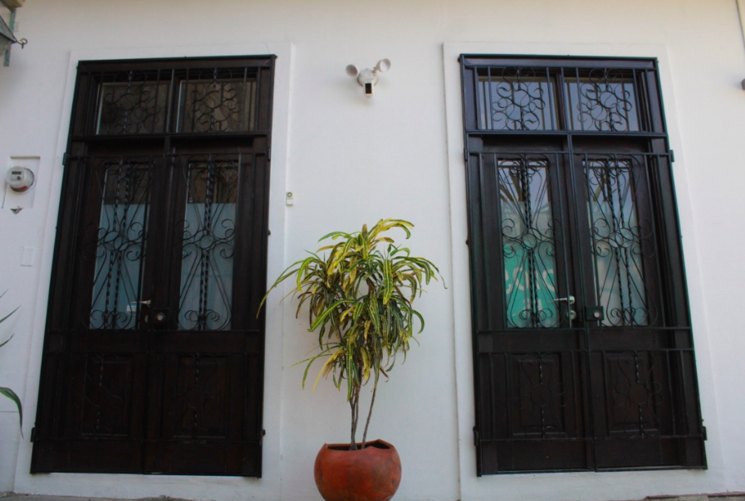
Where do you see symmetry in this picture?
What other math topics can you point out?
4.G.A3

Slide 18
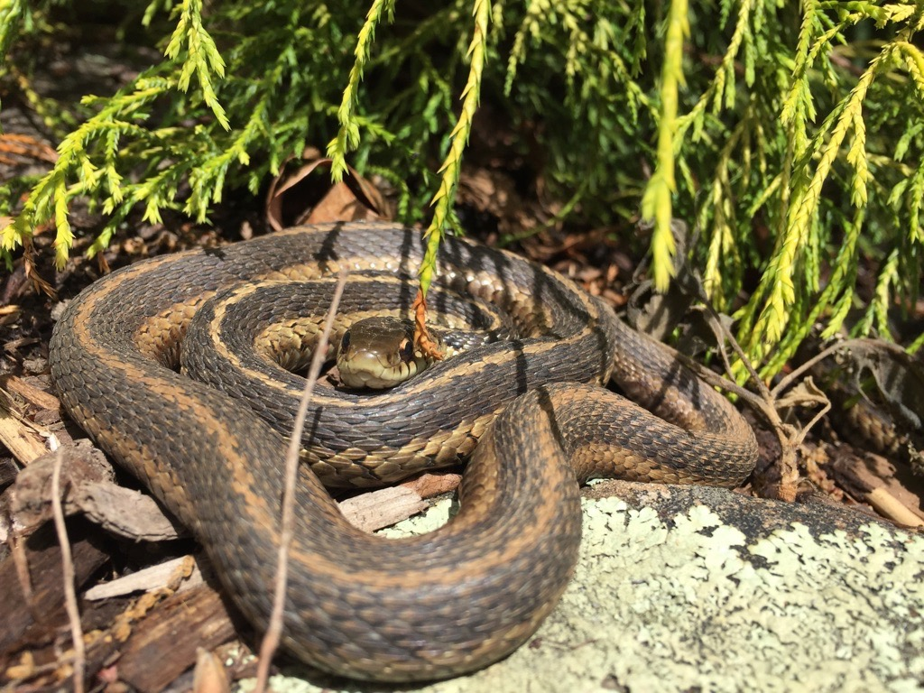
Meet Jimmy, our friendly garter snake.
Garter snakes are typically 3 to 4 feet long.
How many inches is that?
4.MD.A1

Slide 19



True or false?
4.NF.B3

Slide 20
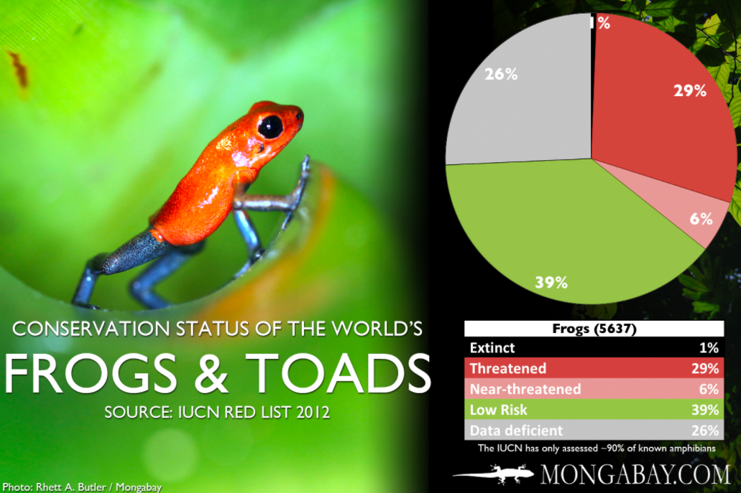
What’s going on in this graph?
If this graph could talk, what would it say?
Why does it matter?
4.MD.B

Slide 21
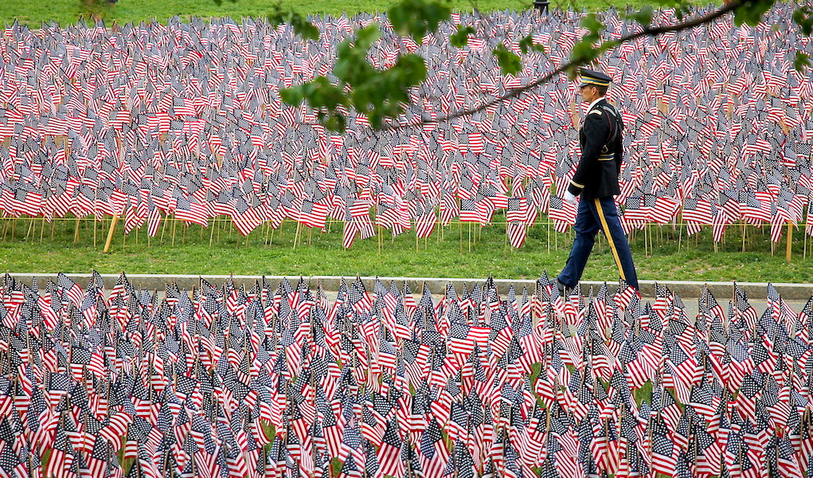
There are 37,342 American Flags on the Boston Common to commemorate Memorial Day.
Create a number puzzle for 37,342!
4.OA.A3
Notes:
Week of May 28, 2024
Memorial Day

Slide 22
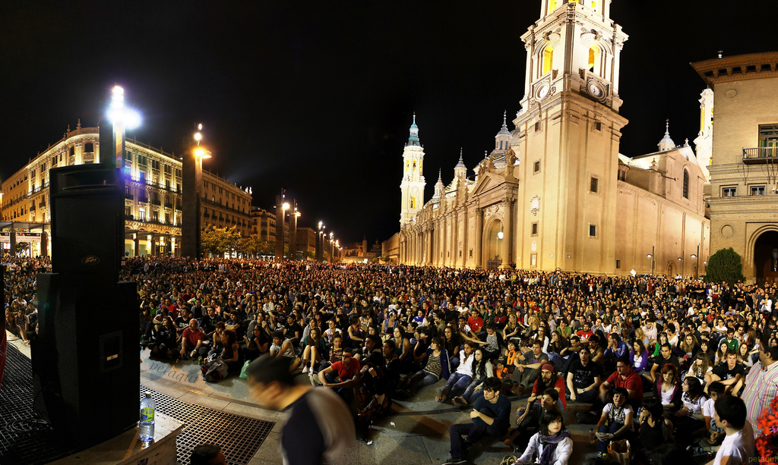
Dia de la Revolucion de Mayo!
Argentina covers an area of 2,780,425 km², making it the largest Spanish-speaking nation in the world by area.
Round 2,780,425 to the nearest
Million
Hundred thousand
Ten thousand
Thousand
4.NBT.A3
Notes:
Revolution Day, Argentina

Slide 23
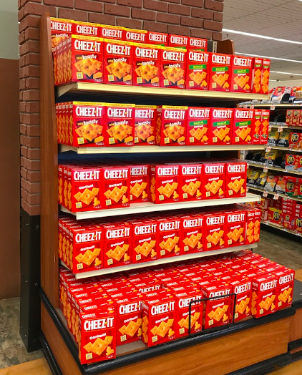
Wow! Look at all those boxes of Cheez-Its!
How many are there?
How can you figure it out?
How many different number sentences can you write to represent the problem?
4.NBT.B5

Slide 24
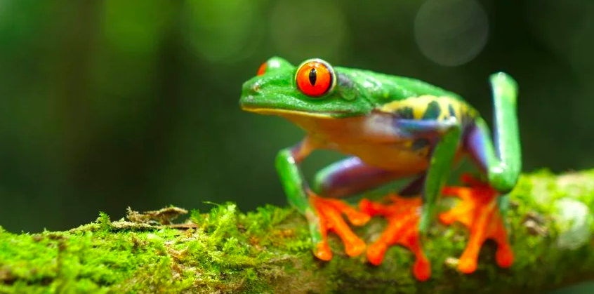
The rainforests of Brazil have the highest amphibian species count at 1,022.
Columbia is next at 771 species.
Then Ecuador with 626 species.
And Peru with 572 species.
What can you say about these populations?
How can you compare them?
4.NBT.A2,3

