Slide 1
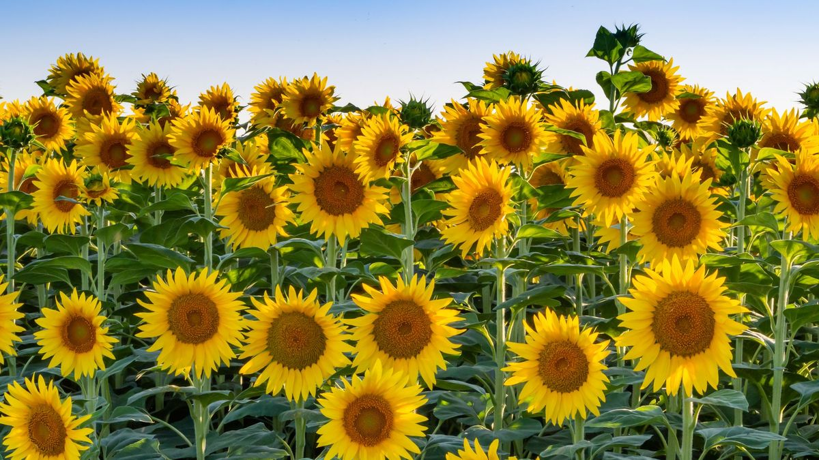
Happy National Sunflower Day!
Estimate how many sunflowers are in this field.
What are some strategies you can use?
Notes:
Week of April 29, 2024

Slide 2
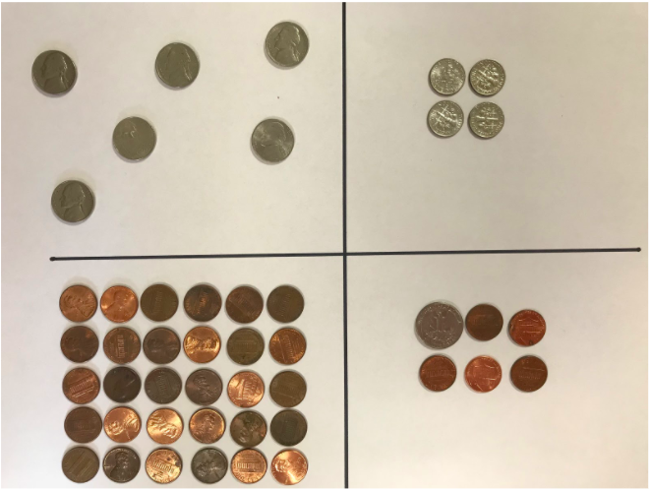
Which one doesn’t belong?
3.MD

Slide 3
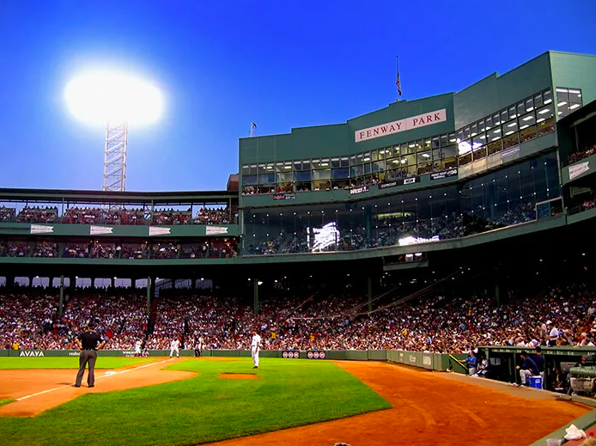
Fenway Park has a capacity of 37,731 fans!
At the beginning of the 2021 baseball season, because of Covid, seating for Red Sox games was only 4,500 fans.
How much less is that than full capacity?
3.NBT.A2

Slide 4
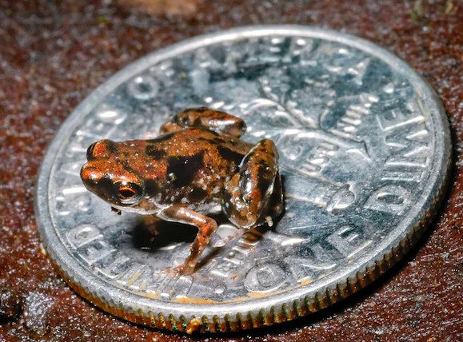
The smallest frog in the world can be found in the rain forests of Papua New Guinea.
Here he is sitting on a dime, he measures only 7 millimeters.
How small is that?
What can you compare that to?
3.MD.A2

Slide 5
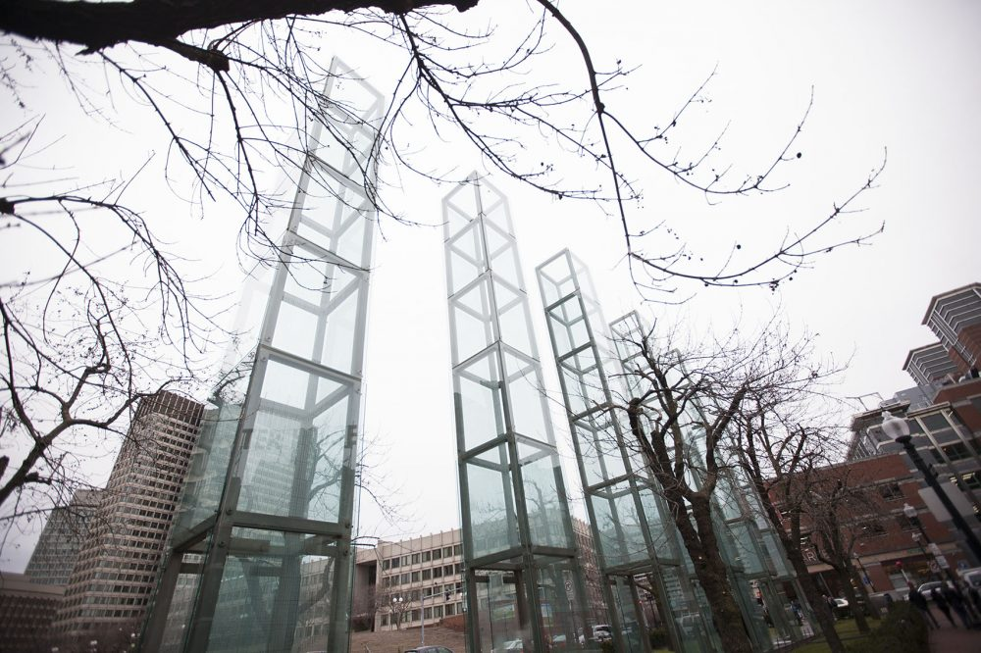
The Holocaust Monument in Boston is made up of 6 towers that each stand 54 feet tall.
How many feet is that in total?
3.MD.A2
Notes:
Yom Hashoah

Slide 6
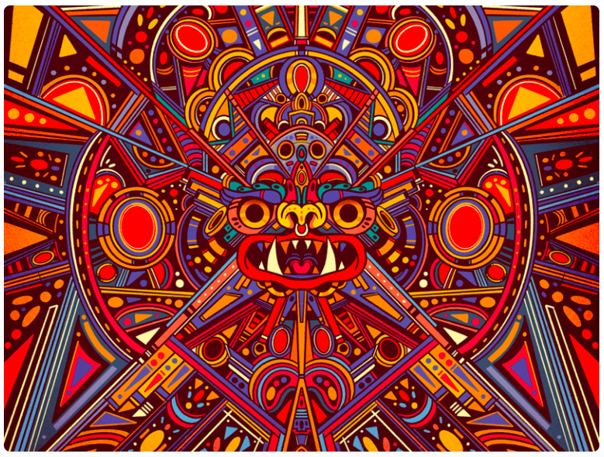
When we look closely at this Mexican art by Pequeno Capitan, we can see many different shapes.
Pick a shape, then find another one that has one attribute that is the SAME and one attribute that is different.
3.G.A1
Notes:
Week of May 6, 2024
Cinco de Mayo (yesterday)

Slide 7
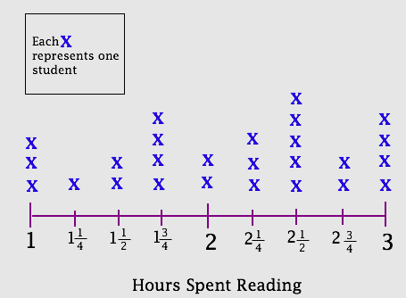
What’s going on in this graph?
What do you notice?
What do you wonder?
What questions do you have?
Why does it matter?
3.MD.B4

Slide 8
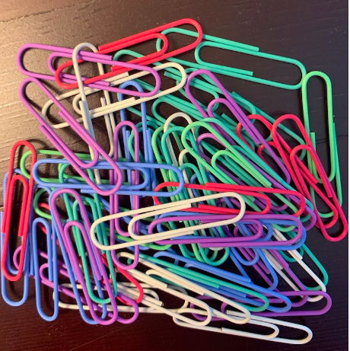
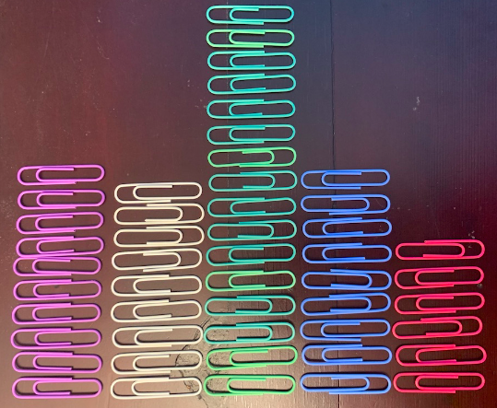
How many paperclips are in the pile?
What is too low?
What is too high?
What is your ESTIMATE?
3.MD.B

Slide 9
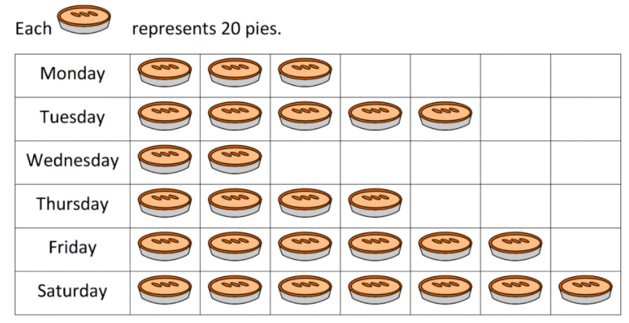
If this graph could talk, what would it say?
What’s a good name for this graph be?
3.MD.B3

Slide 10
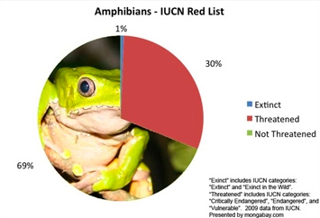
What’s going on in this graph?
What do you notice?
What do you wonder?
Why does it matter?
3.MD.B

Slide 11
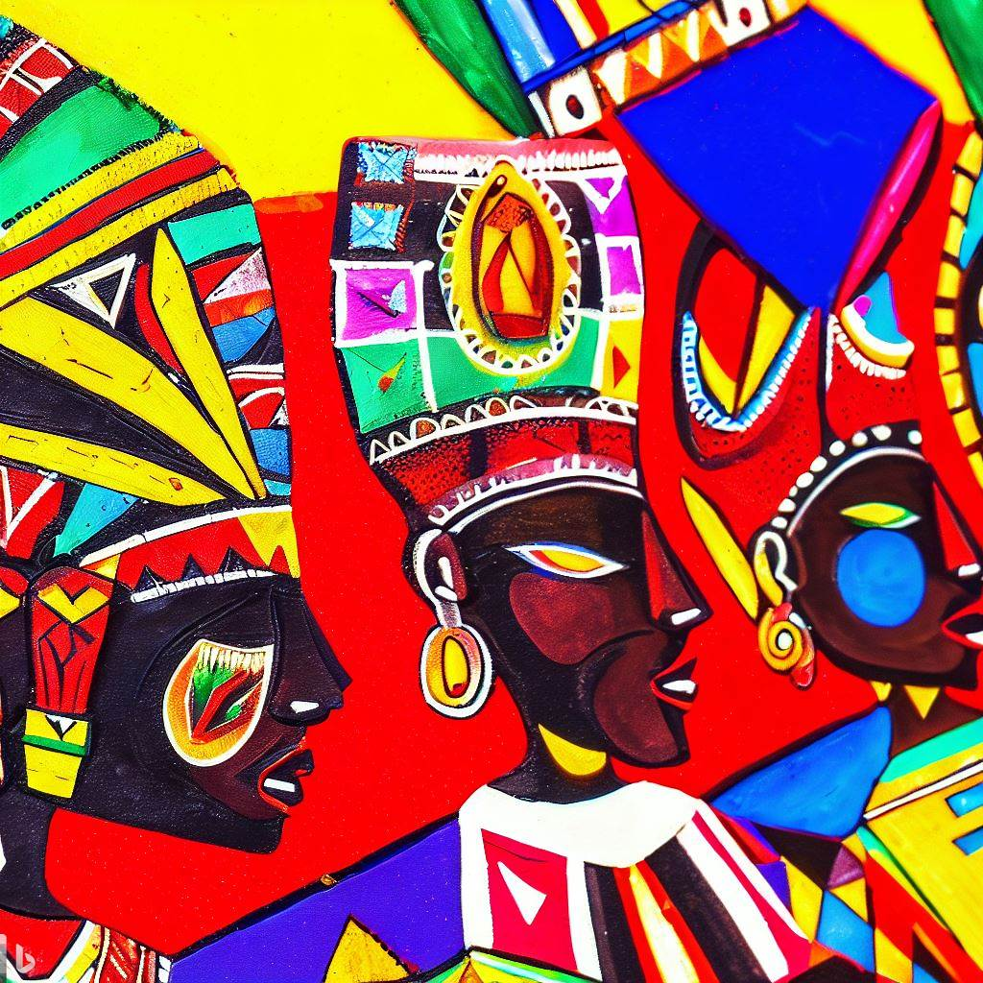
Let’s identify some shapes in this painting.
What would happen if we PARTITIONED one of the shapes?
Notes:
Week of May 13, 2024

Slide 12
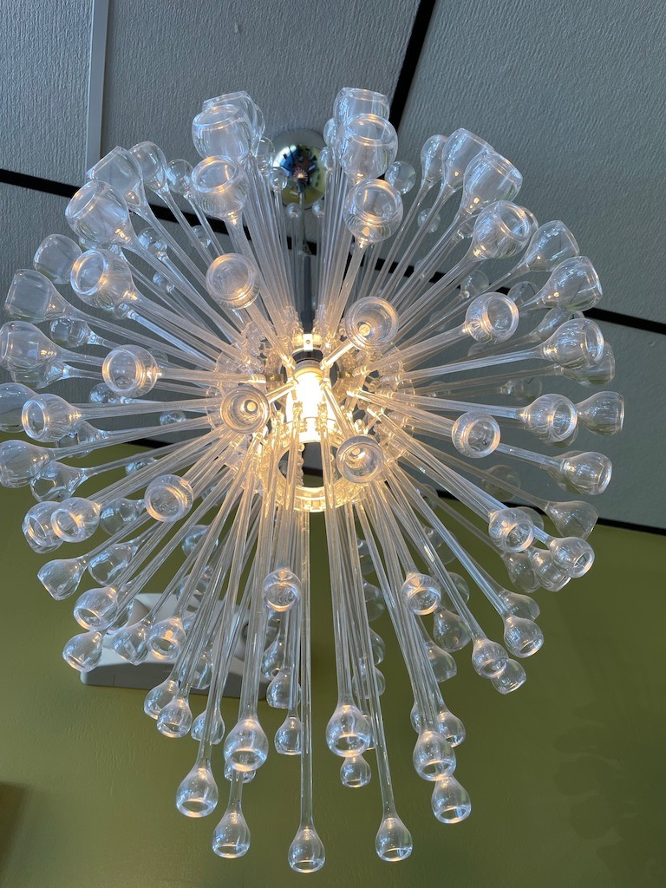
Wow! Look at that light!
What math questions can we ask?
What kinds of estimates can we make?
3.NBT.A1

Slide 13




Justify your reasoning!
3.NF.A3

Slide 14
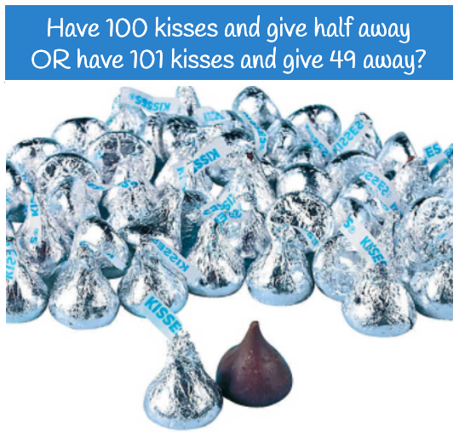
Would you rather...
3.OA.A2

Slide 15
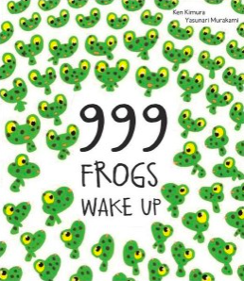
999 Frogs!
I wonder how many legs that would be?
How can we figure it out?
3.OA.B5

Slide 16
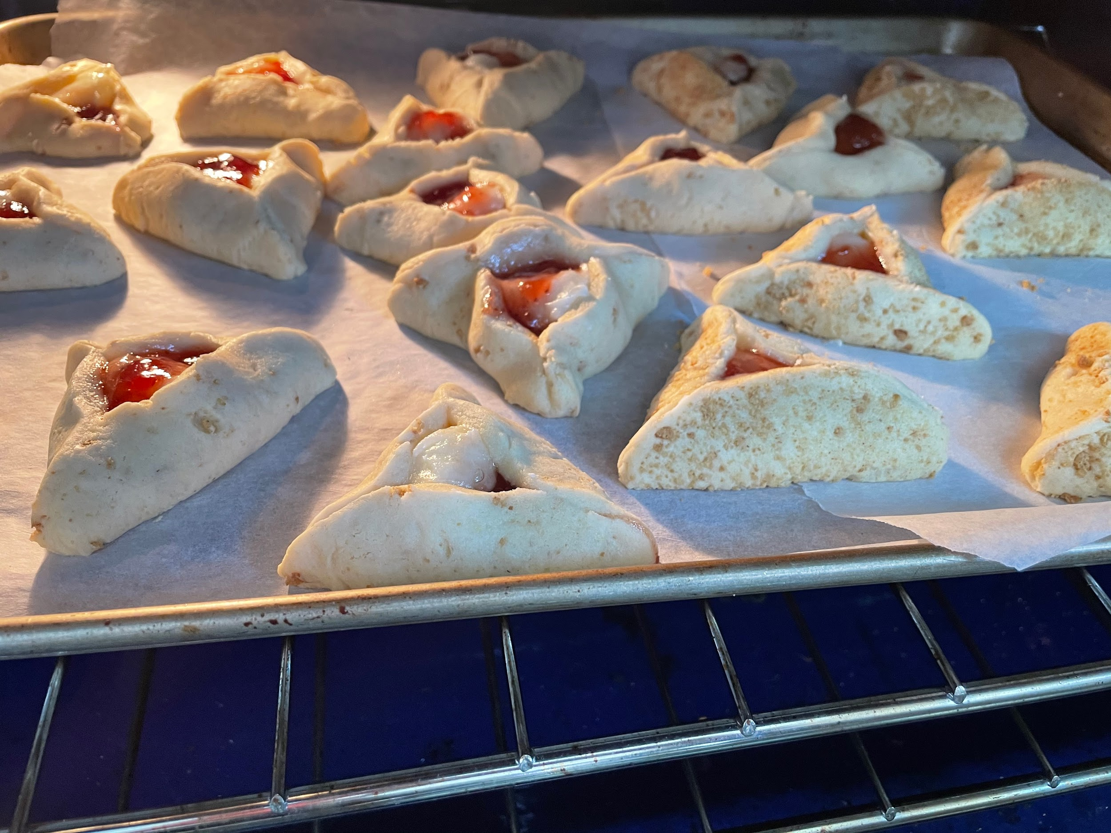

We just put these cookies in the oven.
They need to bake for 15 minutes
What time should we take them out of the oven?
3.MD.A1
Notes:
Week of May 20, 2024

Slide 17
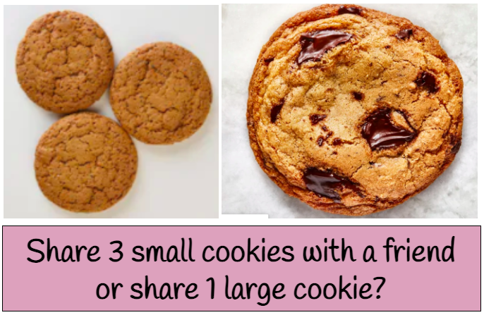
Would you rather...
3.NF.A1

Slide 18
Which one doesn’t belong?
3.G.A1

Slide 19
These 2 rectangles have different perimeters.
What do they have in common?
Can you find another rectangle that would also have this in common?
Perimeter = 20 ft
Perimeter = 28 ft
2 ft
4 ft
12 ft
6 ft
3.MD.D8

Slide 20
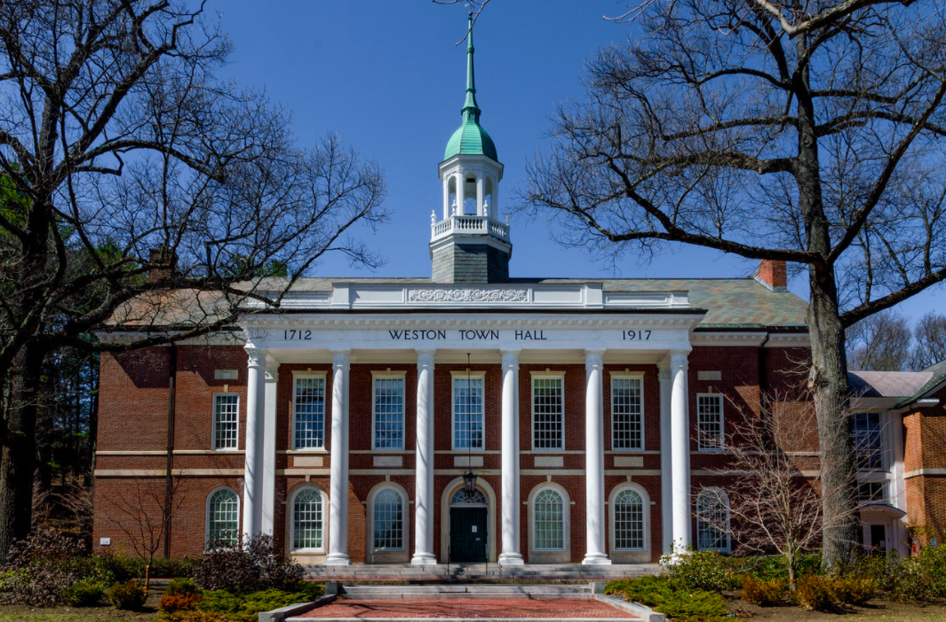
What do the numbers mean?
How old is the Weston Town Hall?
Where do you see arrays?
How can you use arrays to figure out how many window panes are here?
What would that equation look like?
3.NBT.A2

Slide 21
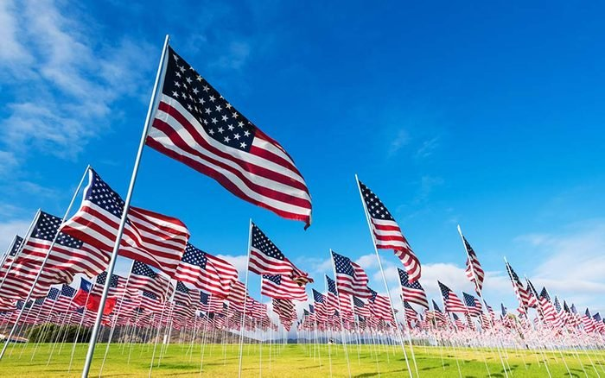
Memorial Day 2022!
Originally known as Decoration Day, Memorial Day originated in the years following the Civil War and became an official federal holiday in 1971.
How long ago was 1971?
Can we use mental math to figure it out?
3.NBT.A2
Notes:
Week of May 28, 2024
Memorial Day

Slide 22
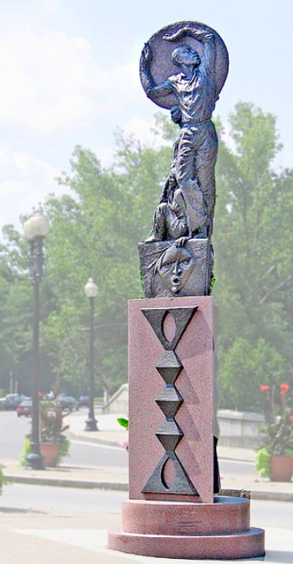
The “Rise” monument in Mattapan stands 19 feet tall.
How much taller is it than you?
How many times taller is it, or how many of YOU is it?
3.OA.D9

Slide 23

9 x 80 = 90 x 8
100 ÷ 2 > 5 x 4 x 2
8 x (5 + 2) < (8 x 5) + (8 x 2)
Prove it!
3.OA.B

Slide 24
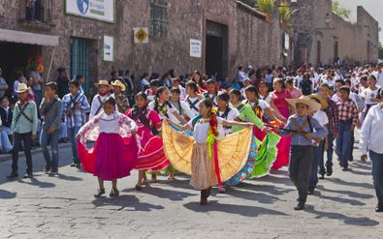
Happy Revolution Day Argentina!
Argentina’s May Revolution started on May 25 in 1810. Argentina had been part of Spanish colonial rule since 1516!
How long was Argentina under Spanish rule?
Create an equation to match your thinking!
3.NBT.A2
Notes:
Revolution Day, Argentina

