Slide 1
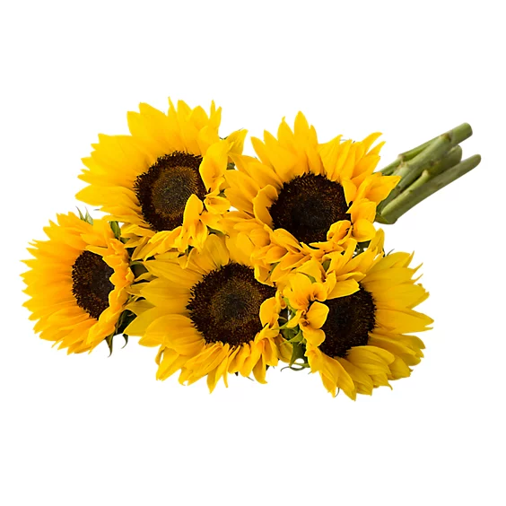
Happy National Sunflower Day
How many bunches of sunflowers are here?
How many sunflowers in each bunch?
How many sunflowers altogether?
Write an addition equation to show your thinking!
Notes:
Week of April 29, 2024

Slide 2
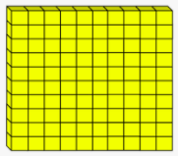
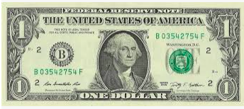
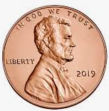


Which one doesn’t belong?
- | -
100 - 1
1.NBT.C4

Slide 3
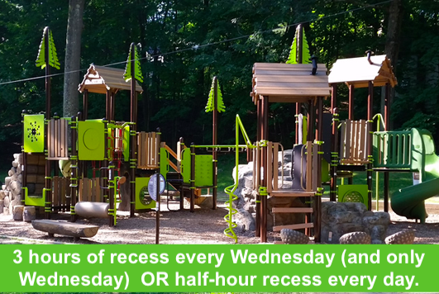
Would you rather ...
1.MD.B3

Slide 4
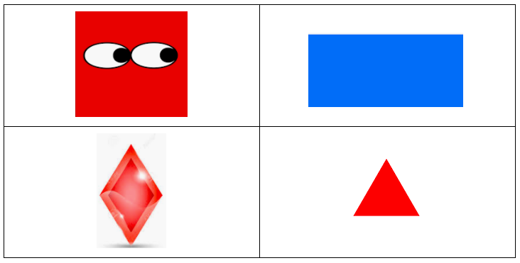
Which one doesn’t belong?
1.G.A1

Slide 5
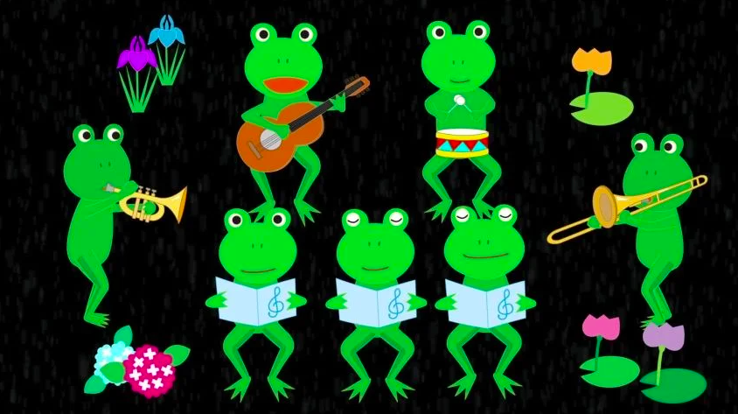
What fun number sentences can you create to match the froggies?
1.OA.C6

Slide 6
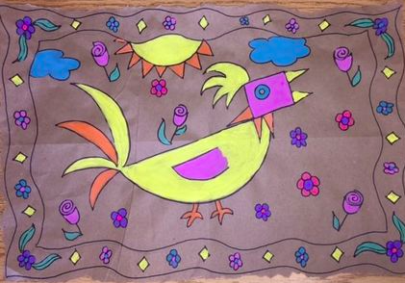
There is a lot of MATH hidden in this Amate bark painting from Mexico.
Describe some of the shapes you see.
Write a number sentence to match the flowers along the border.
1.OA.C5
Notes:
May 6, 2024
Cinco de Mayo (yesterday)

Slide 7
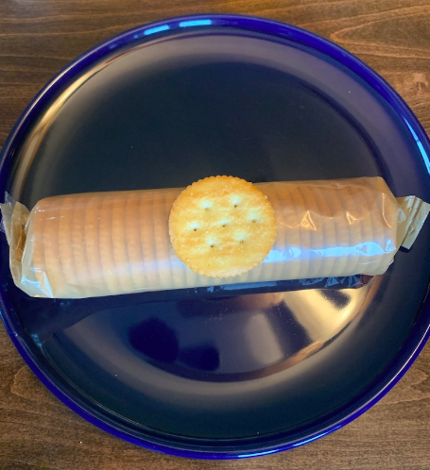
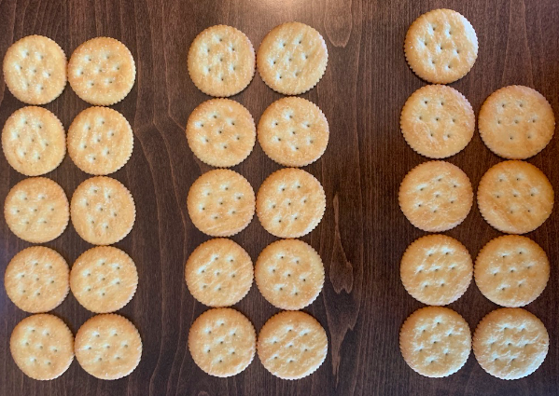
How many Ritz crackers?
What is an estimate that is too high?
What is too low?
What is just right?
1.NBT.A2

Slide 8
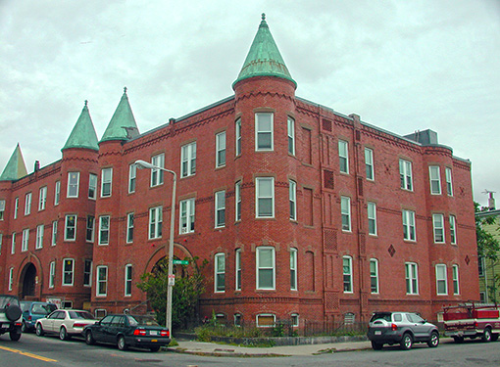
Look at this amazing architecture in Roxbury!
Where’s the math?
Name some of the shapes.
How many windows?
How can we figure it out without counting all of them?

Slide 9
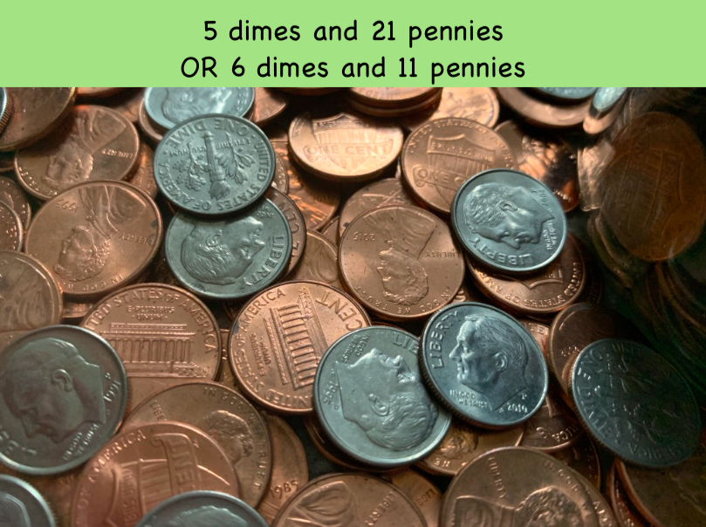
Would you rather have ...
1.MD.D5

Slide 10
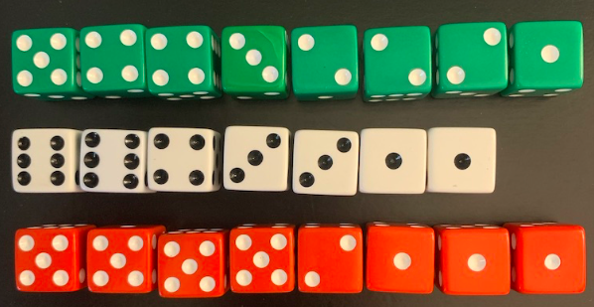
What can you say about these dice?
How many?
How many dots?
1.OA.B3

Slide 11
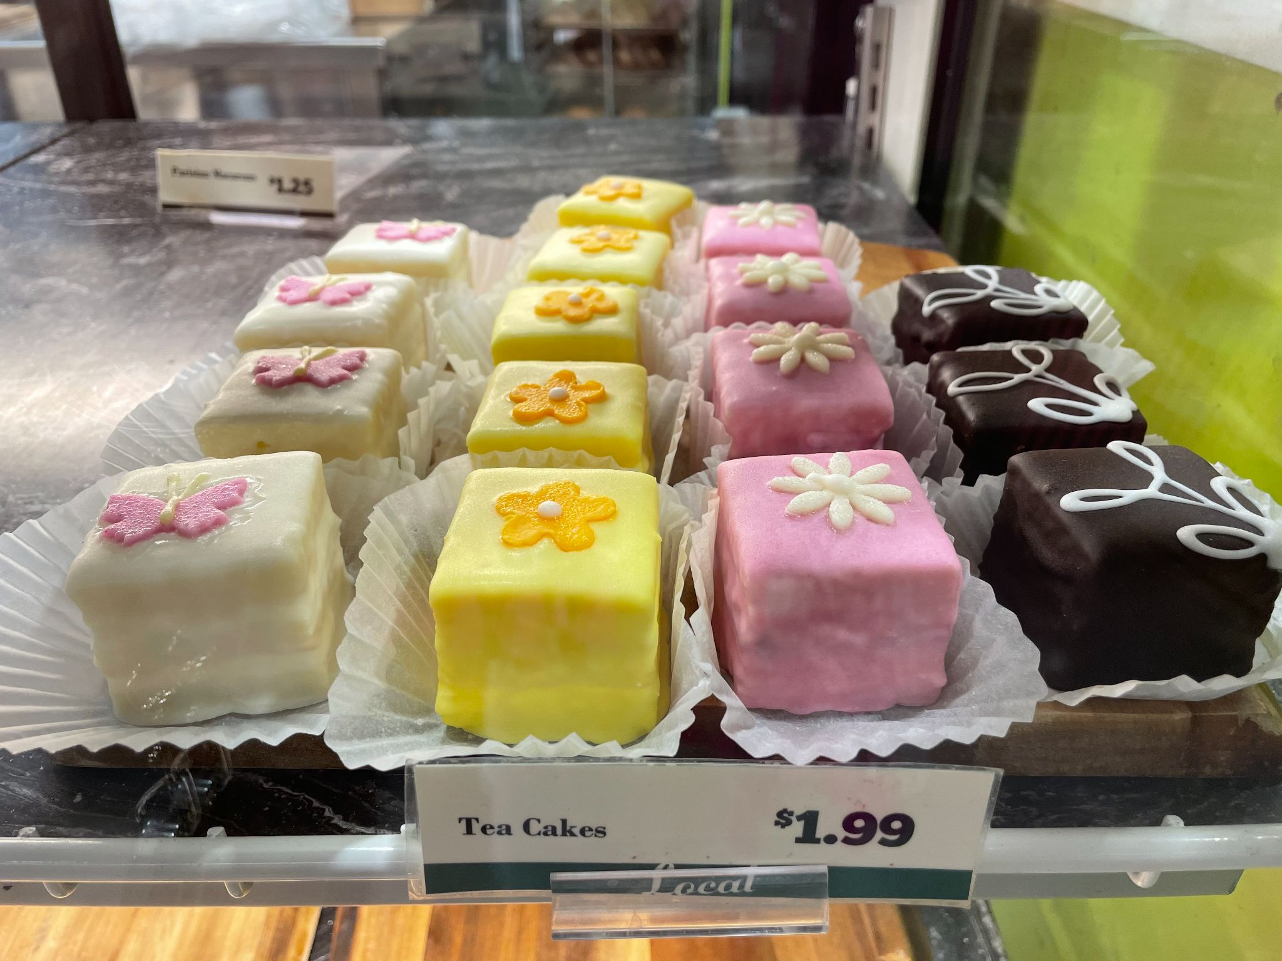
How many tea cakes are in the bakery case at Brother’s?
How many were there when it was full?
Can we write a number sentence to match our thinking?
1.OA.C5
Notes:
Week of May 13, 2024

Slide 12
Which one doesn’t belong?
3 + 2 = 1 + 4 | 10 - 5 = 8 - 3
1 + 2 + 2 = 6 - 1 | 3 + 3 = 4 + 2
1.OA.A1

Slide 13
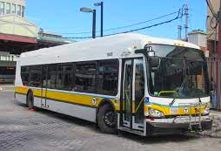
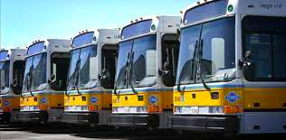
How many wheels on 1 bus?
How many wheels on 5 busses?
What would that number sentence look like?
1.OA.C5

Slide 14

Would you rather . . .
Count to 100 by ONES, TWOS, FIVES or TENS?
1.NBT.A1

Slide 15
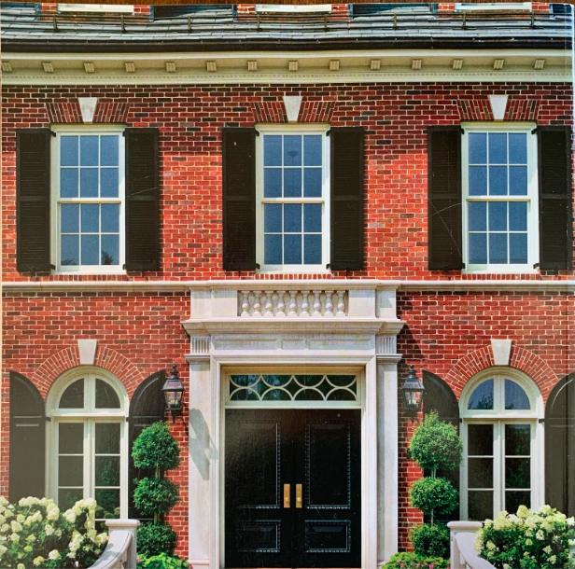
What fun shapes do you see?
How many windows do you see?
Are there some you can’t see?
1.G.A2

Slide 16
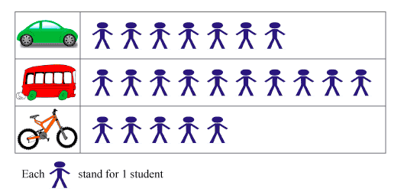
If this chart could talk, what would it say?
1.MD.C4
Notes:
Week of May 20, 2024

Slide 17

Let’s be shape detectives!
How many different shapes can we identify in this painting?
What would happen if we put some of the shapes together?

Slide 18
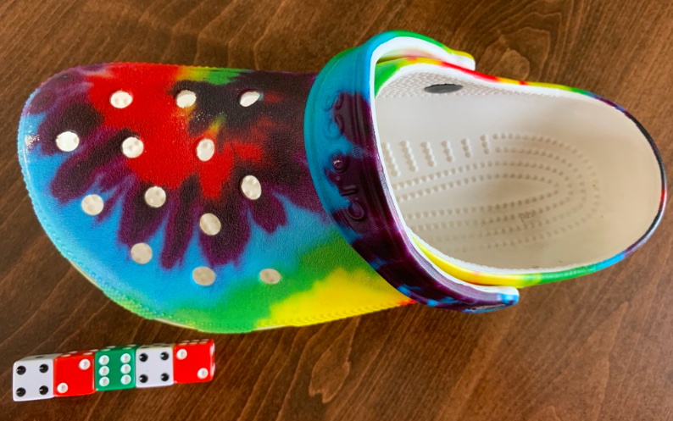
How many dice do you think it will take to measure the length of the Croc?
1.MD.A2

Slide 19
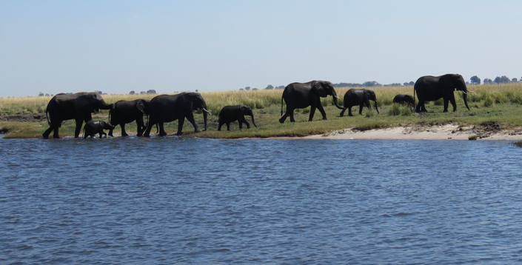
Mosi-Oa-Tunya National Park, Gwembe, Zambia (C.Manousaridis)
Elephants travel with their families! How many elephants are in the picture?
This family has 20 elephants! How many are missing?
1.OA.C6

Slide 20
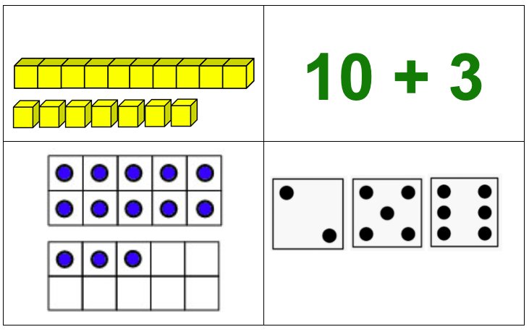
Which one doesn’t belong?
1.NBT.B2

Slide 21
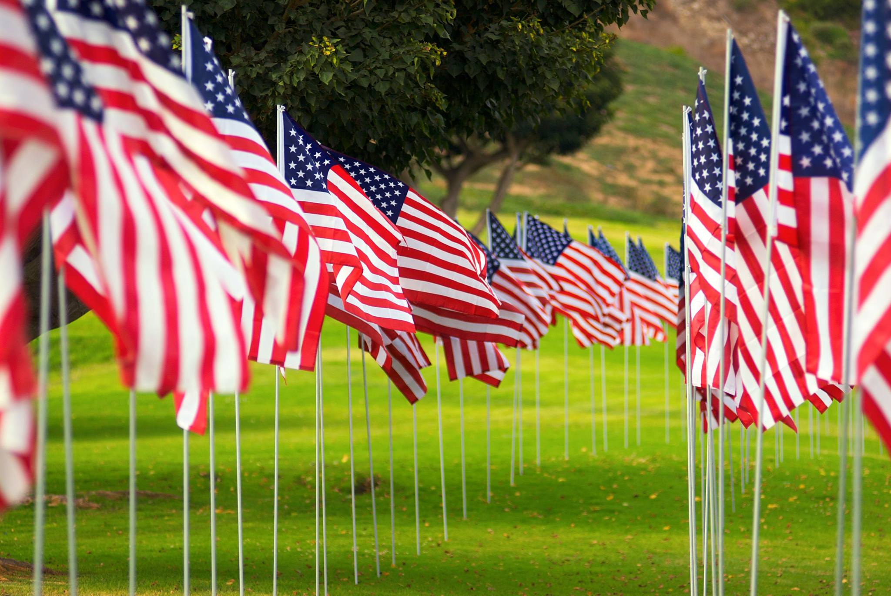
Memorial Day
There are 2 rows of flags here on the Town Common.
Estimate how many are here.
Each row has 46 flags.
1.NBT.C4
Notes:
Week of May 28, 2024
Memorial Day

Slide 22

Celebrate National Day of Ethiopia!
Let’s be shape detectives! What do we see here?

Slide 23
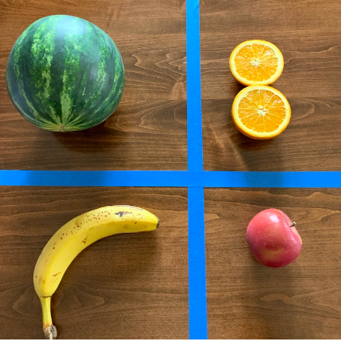
Which one does not belong?
How can we compare the different fruits?
1.MD.A1

Slide 24
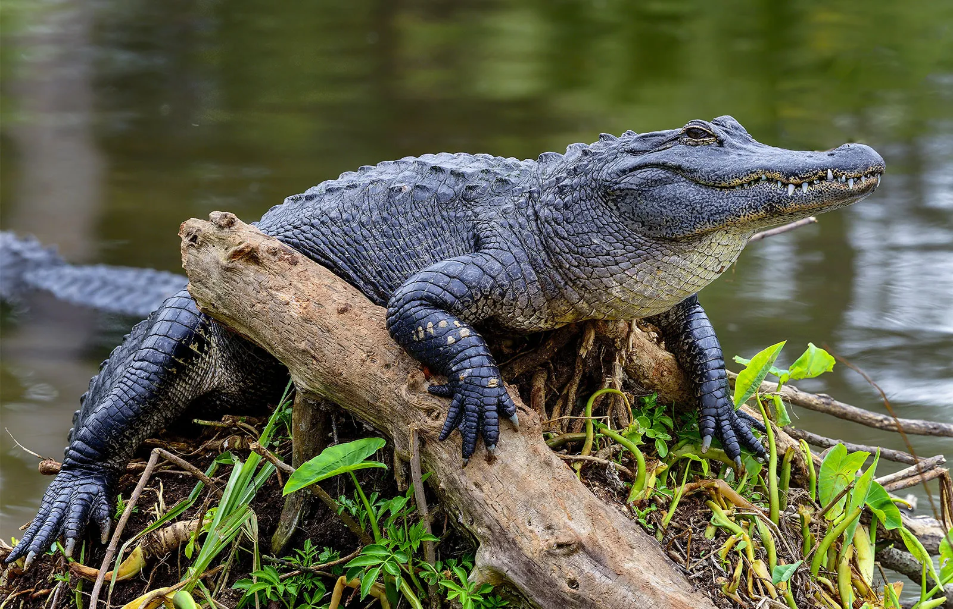
Happy National Alligator Day!
Alligators have between 74 and 80 teeth in their mouth at a time. As they wear down, they are replaced. An alligator can go through 3,000 teeth in a lifetime.
How many different expressions can we create that equal 74?

