Slide 1
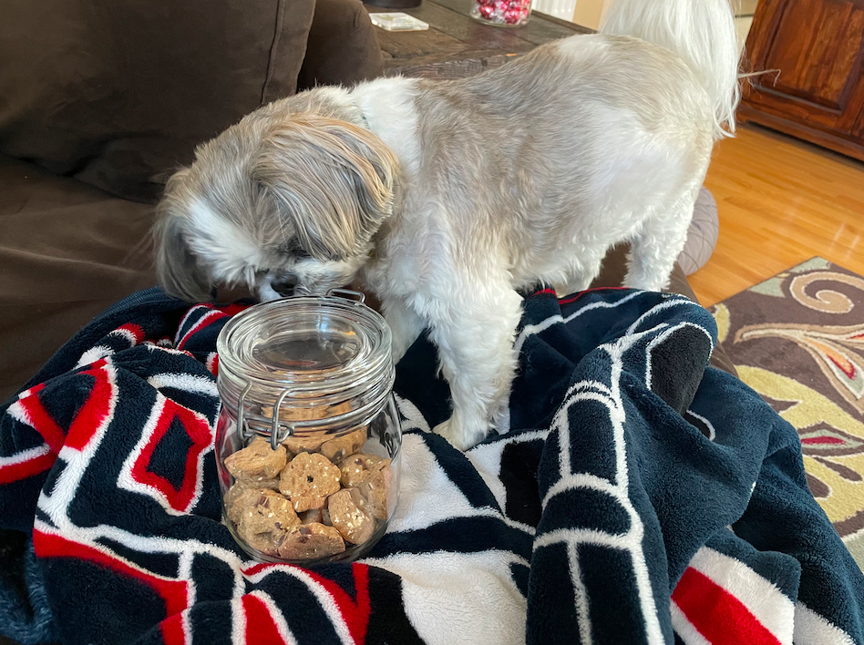
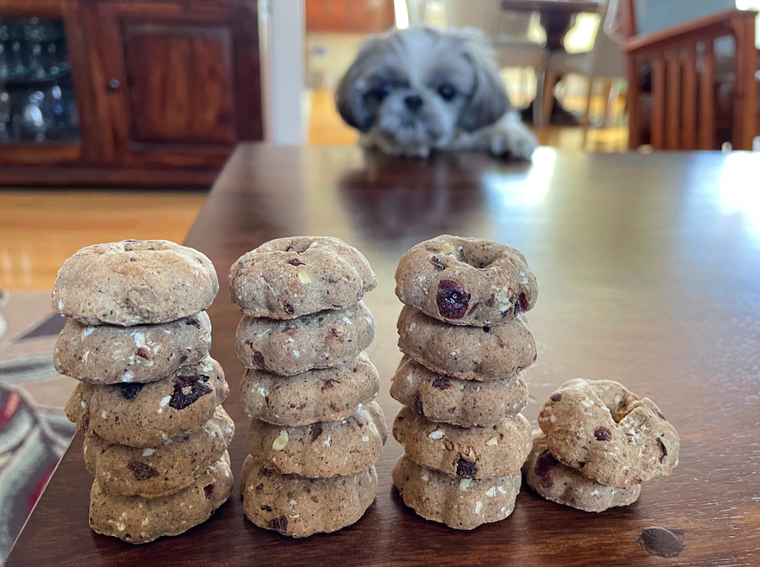
I wonder how many treats are in the jar?
Estimate!
How many different ways can you count them?
K.CC.B5
Notes:
Week of March 4, 2024

Slide 2
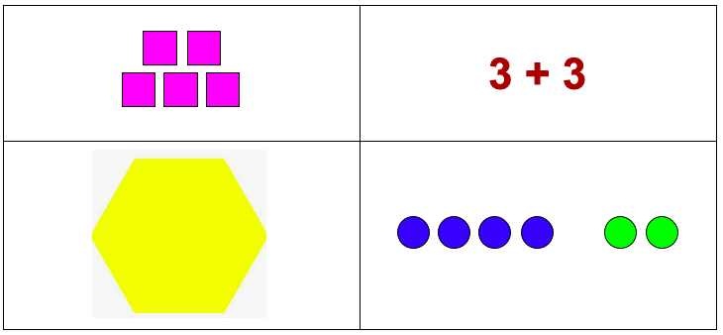
Which one doesn’t belong?
K.G.B4

Slide 3
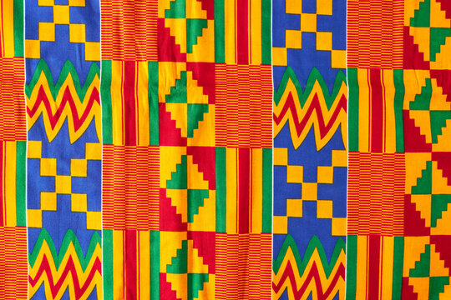
Today is Independence Day in Ghana!
Let’s be shape detectives!
What are some different shapes we see in this cloth from Ghana?
K.G.A2
Notes:
March 6, 2024
Independence Day in Ghana

Slide 4
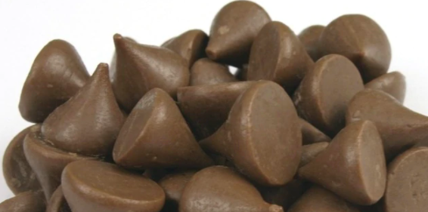
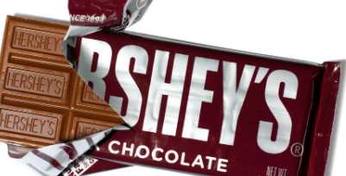
Would you rather . . .
A handful of kisses or a whole chocolate bar?
K.SMP.3

Slide 5
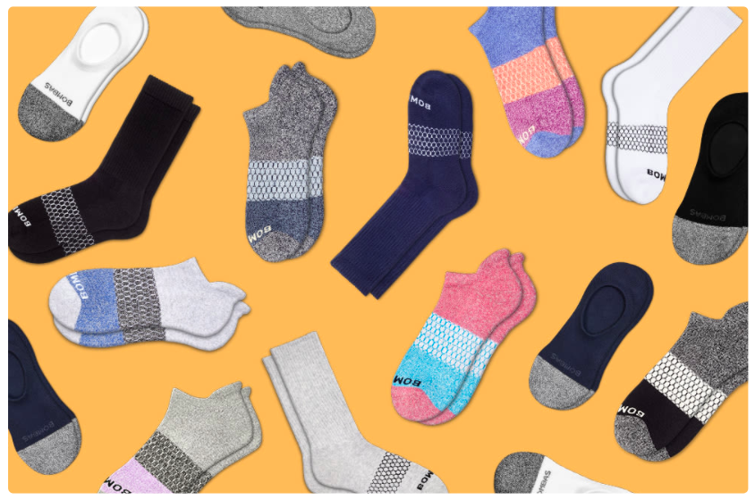
How would you sort these socks?
How many are there? How do you know?
K.MD.B3

Slide 6
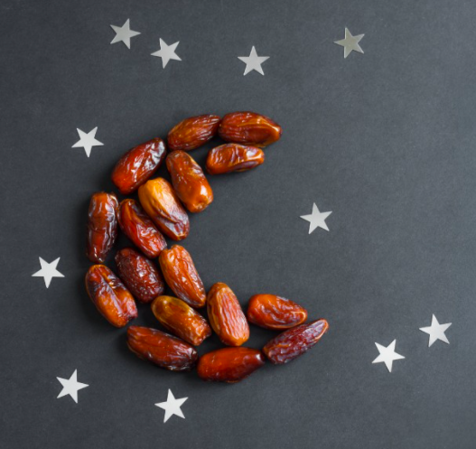
Dates are yummy Ramadan treats!
How many dates make up the moon?
10 + ____ = ____
How many stars?
10 + ____ = ____
K.NBT.1
Notes:
Week of March 11, 2024
Ramadan

Slide 7

Talk about the shapes you see.
K.G.A2

Slide 8
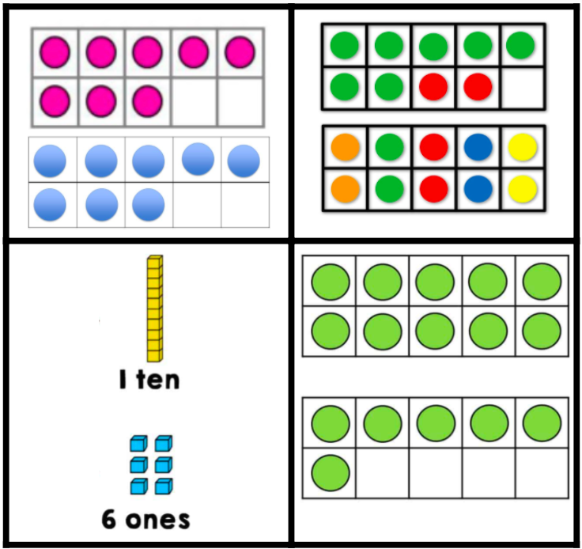
Which one does not belong?
K.NBT.A1

Slide 9
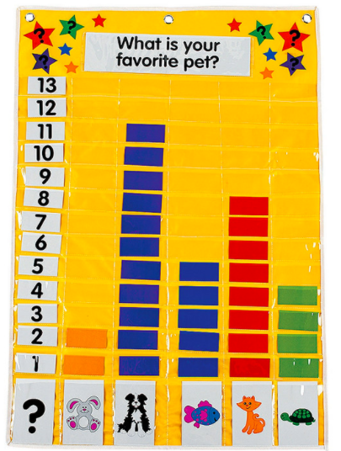
If this graph could talk, what would it say?
K.MD.B3

Slide 10
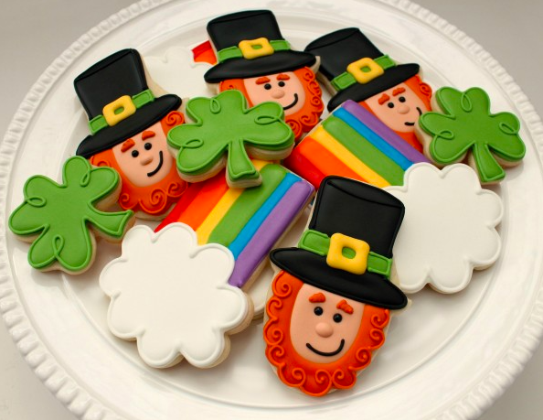
Create a number sentence to match this picture.
Can you create a different one?
K.OA.1
K.OA.A1

Slide 11

How many?
K.CC.A1
Notes:
Week of March 18, 2024

Slide 12
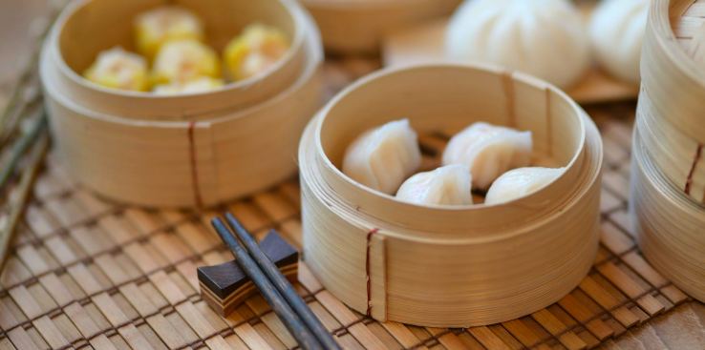
What shapes do you see?
K.G.A3

Slide 13
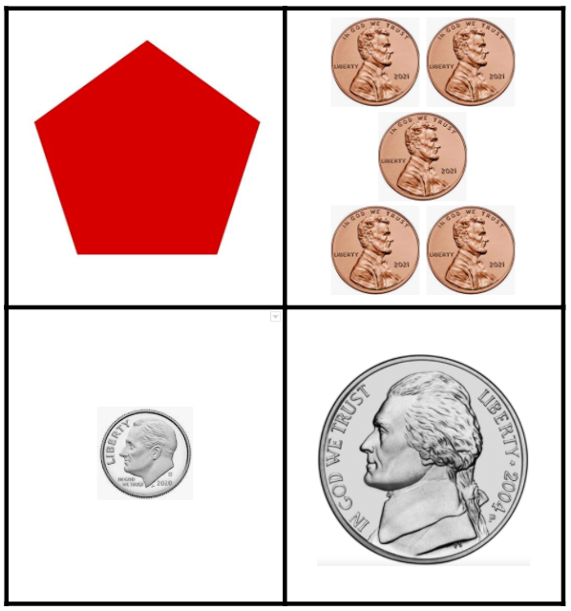
Which one doesn’t belong?
K.SMP.3

Slide 14
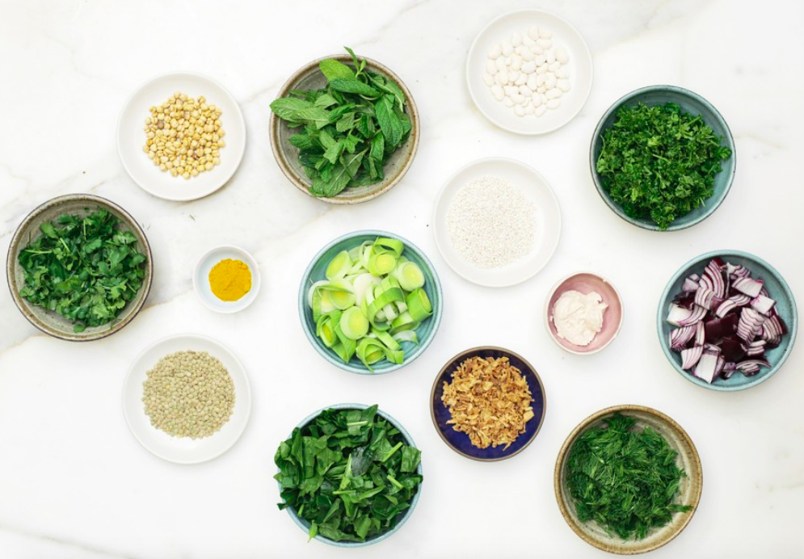
Happy Persian New Year Spring Equinox
We celebrate with yummy flavors of spring!
How can we sort these bowls?
How can we count them?
What number sentences can we write?
K.MD.B3

Slide 15
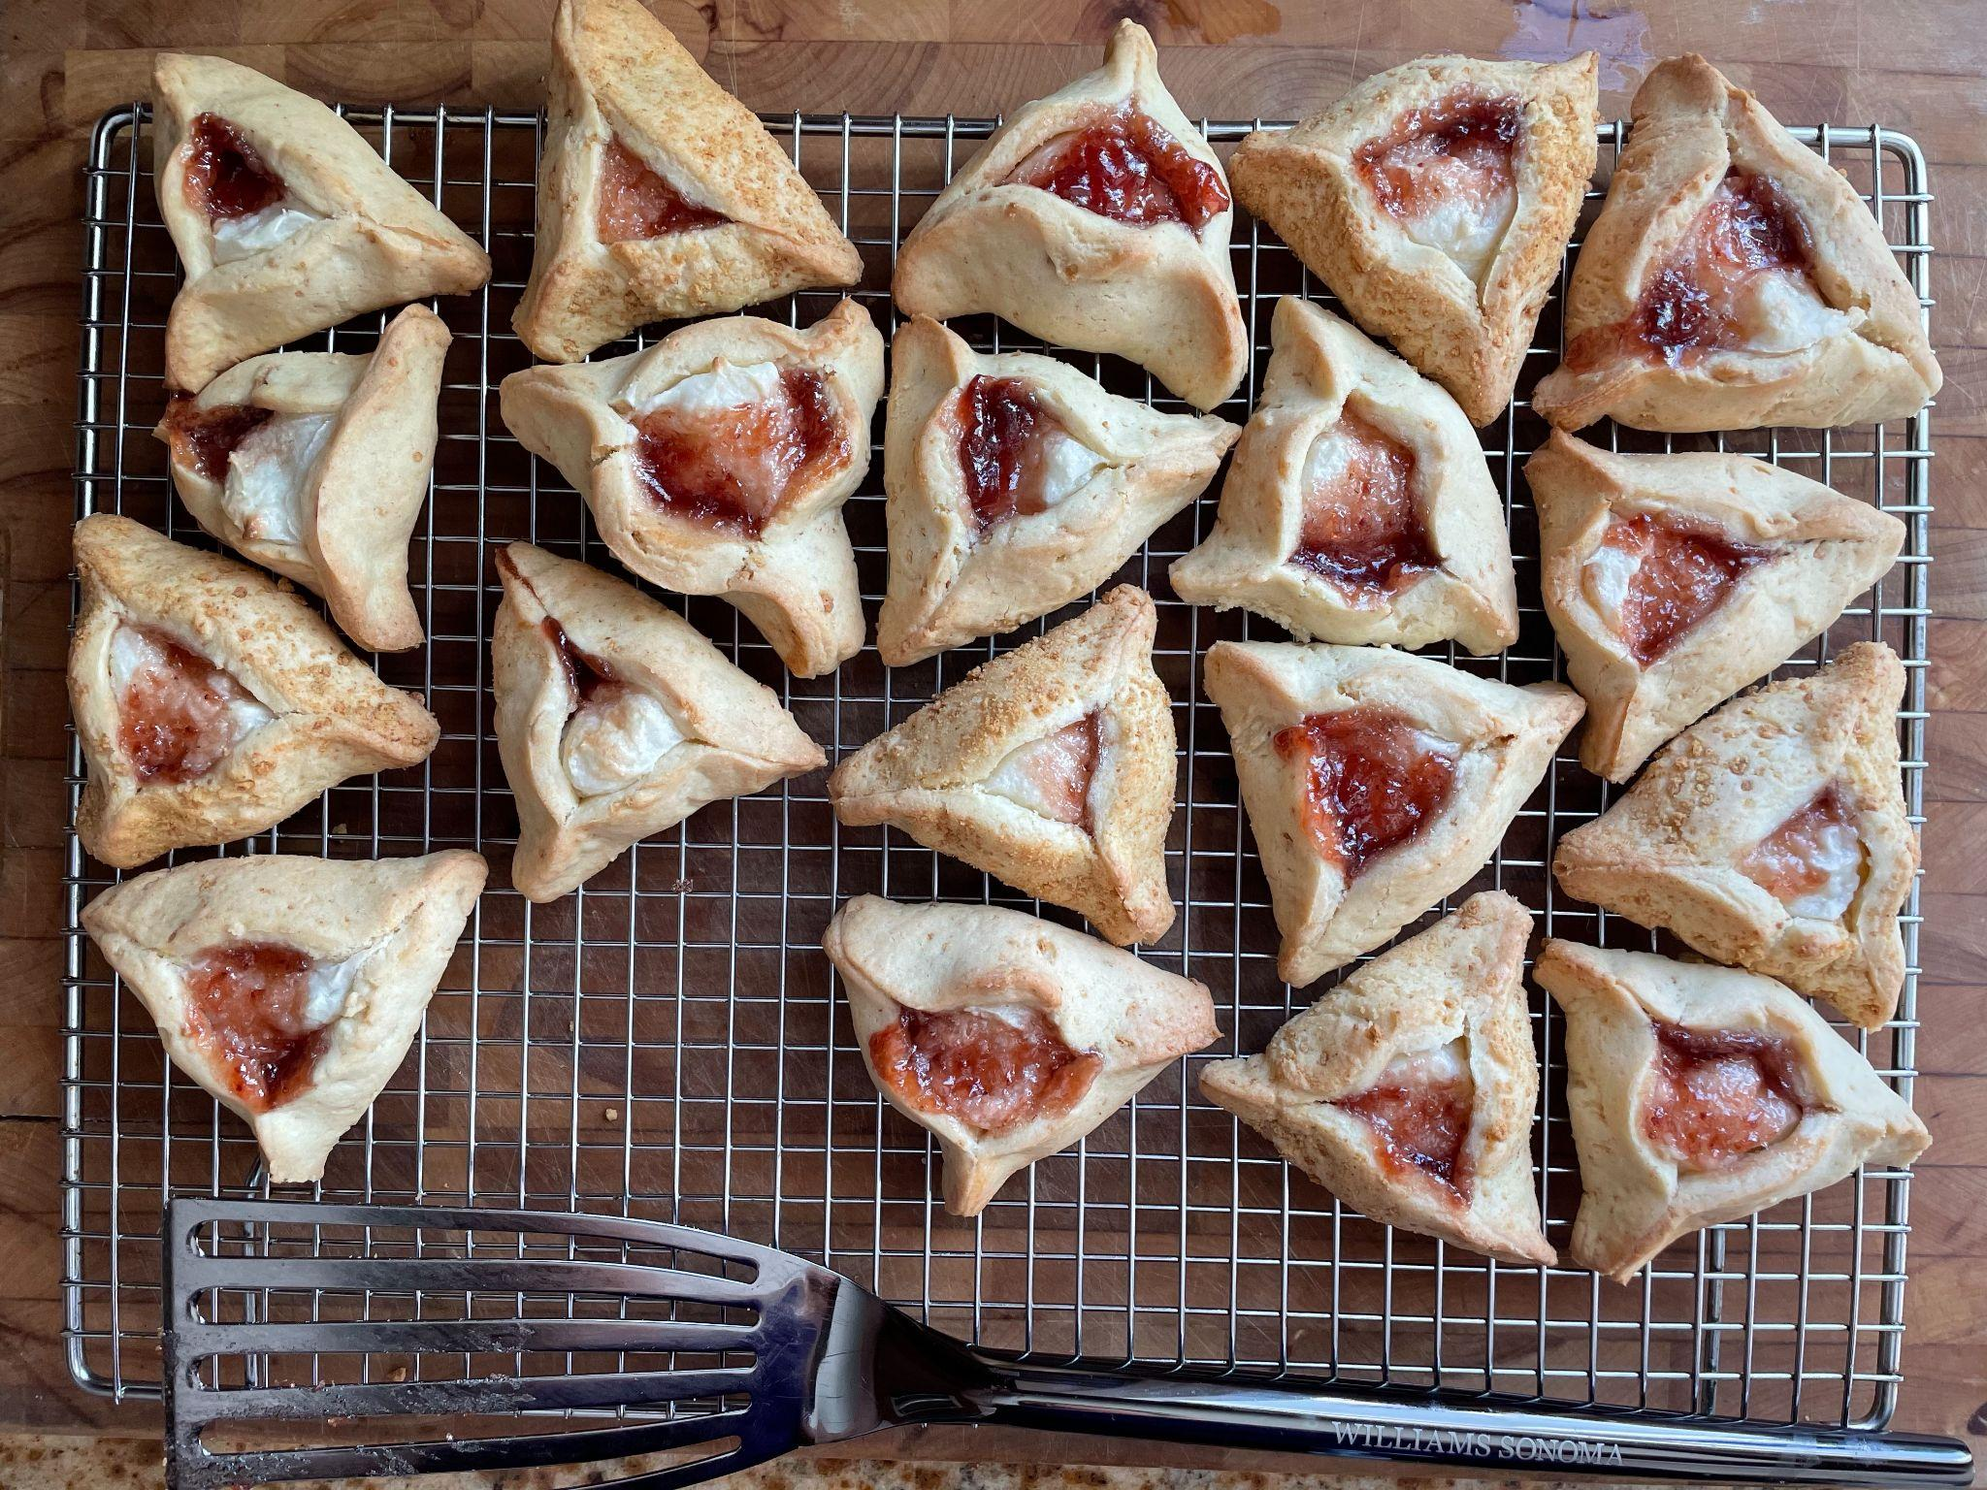
Happy Purim!
How many hamantaschen are here?
How many different ways can we count them?
K.CC.B4

Slide 16
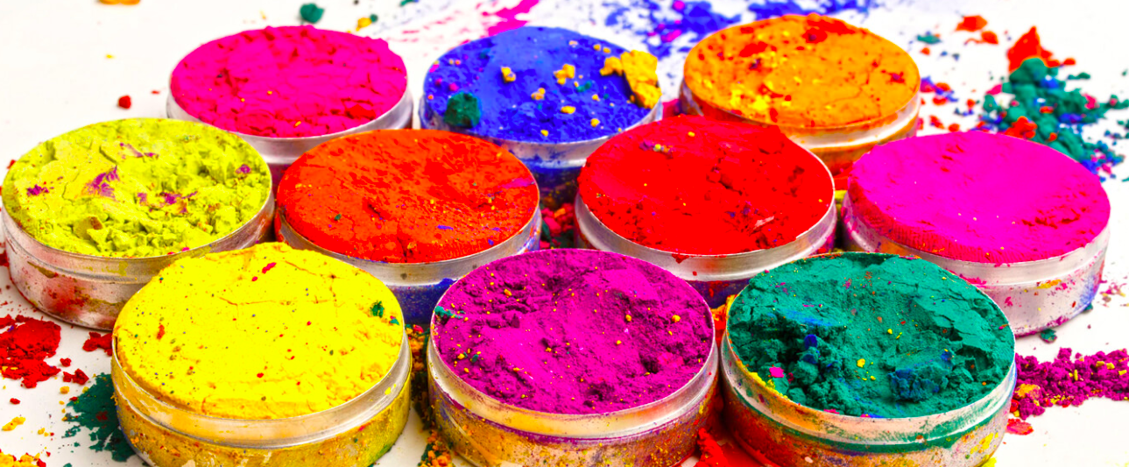
Happy Holi ~ A Festival of Colors
How many color pots are here? How do see them?
Can you write a number sentence to match this photo?
K.CC.5
K.OA.A3
Notes:
Week of March 25, 2024
Holi

Slide 17
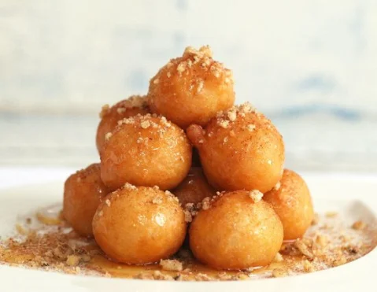
Happy Greek Independence Day!
How many Loukoumades do we see?
How many don’t we see?
How many might be here altogether?
K.CC.B5

Slide 18

Wow! Look at of these cool shapes!
Describe what you see.
Use words like next to, under, on top of.
K.G.A1

Slide 19
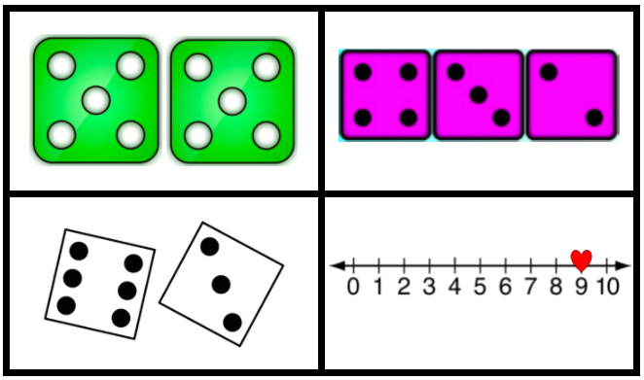
Which one doesn’t belong?
K.OA.A2

