Slide 1
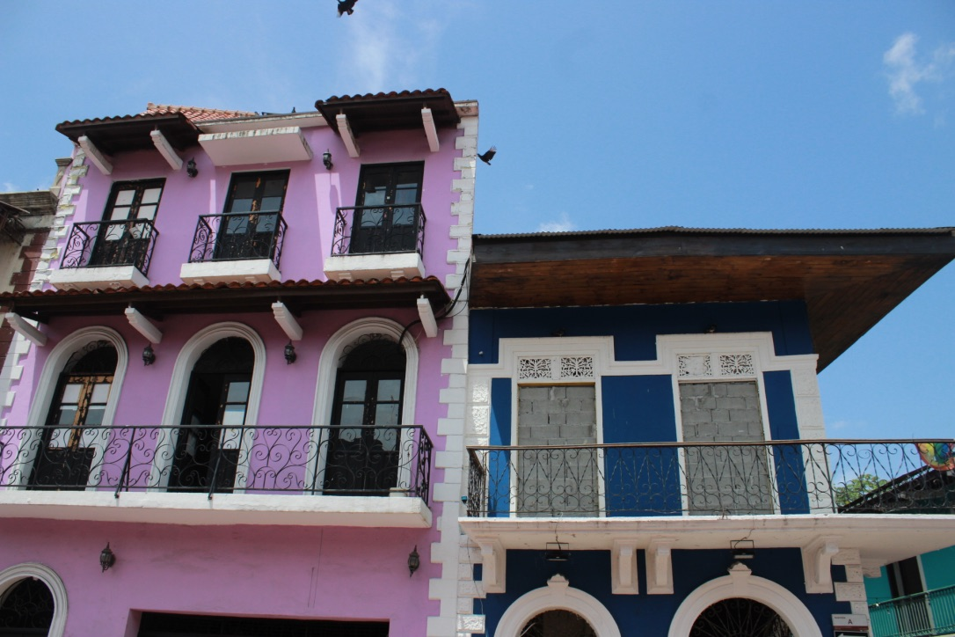
Where do you see parallel or perpendicular line segments in the picture?
Where do you see symmetry?
4.G.A3
Notes:
Week of March 4, 2024

Slide 2
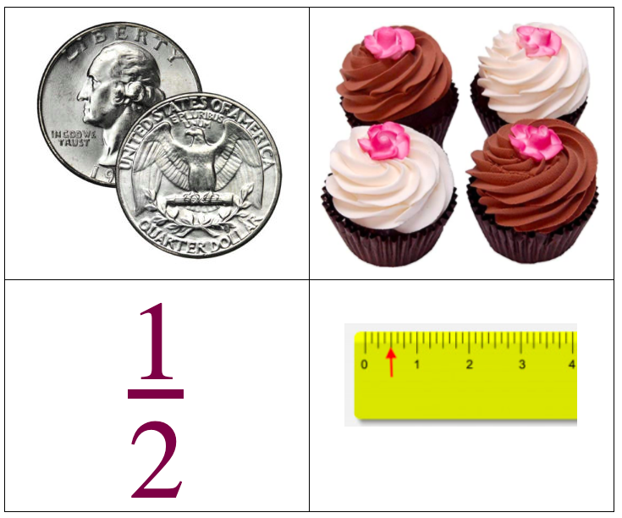
What’s the same?
What’s different?
4.NF.A1

Slide 3
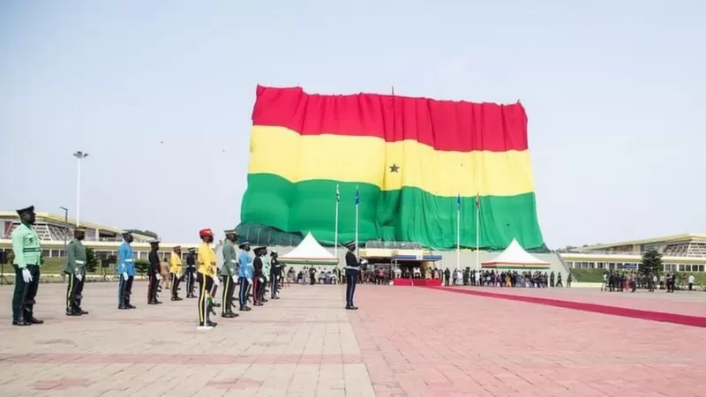
Happy Independence Day in Ghana!
This giant flag measures 85m x 50m
What can we say about the perimeter and the area?
3.MD.A3
Notes:
March 6, 2024
Ghana Independence Day

Slide 4
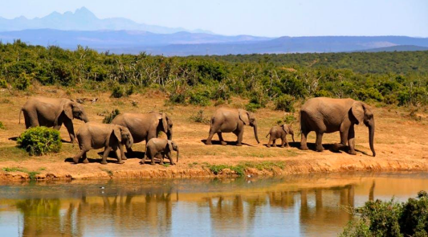
An African forest elephants’ tusks grow about 17 cm each year. If an elephant lives to be 65 years old,
about how long would their tusks be? How many meters is that?
4.MD.A2

Slide 5
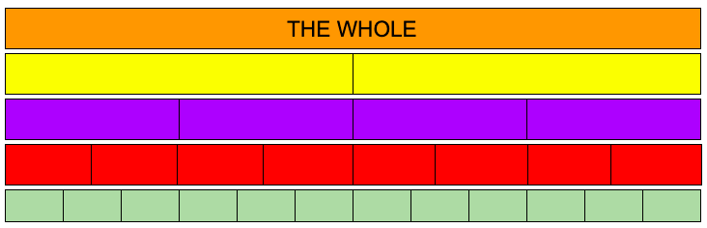
What do you notice here?
What fraction statements can you make?
Can you name the fractions you see?
Can you make some comparisons?
4.NF.A2

Slide 6
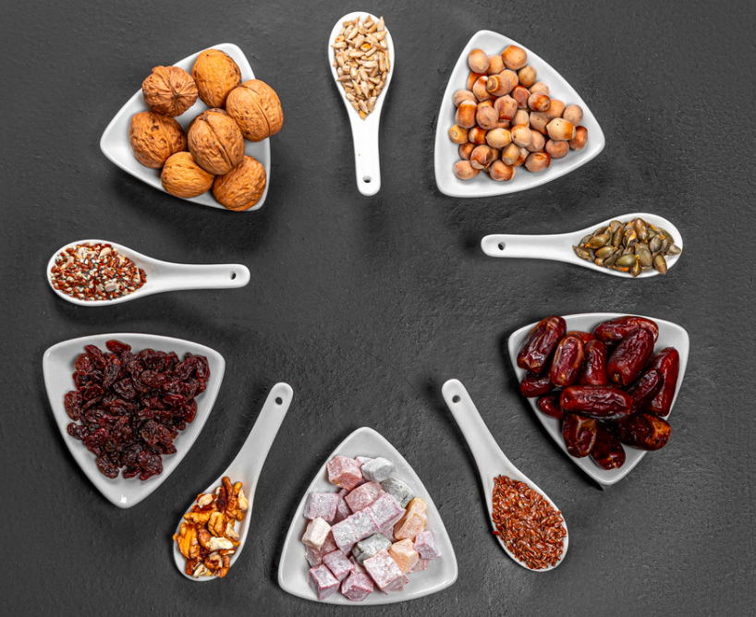
Dates and nuts are traditional foods served during Ramadan.
What fractions do you see here?
How many different fraction number sentences can you create with this photo?
5.NF.A2
Notes:
Week of March 11, 2024

Slide 7
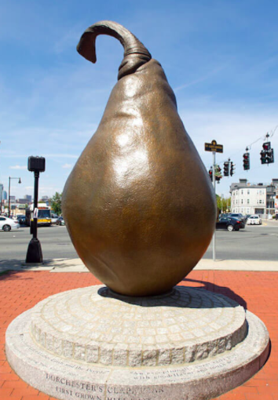

This Giant Pear bronze statue sits on what used to be an orchard in Dorchester. Did you know that Dorchester used to be mostly apple and pear farms?
The statue is 12 feet tall.
How much taller is it than you?
What fraction of the pear are you?
4.MD.A2

Slide 8


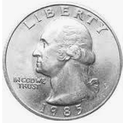
0
1
Which one doesn’t belong?
4.NF.A1

Slide 9
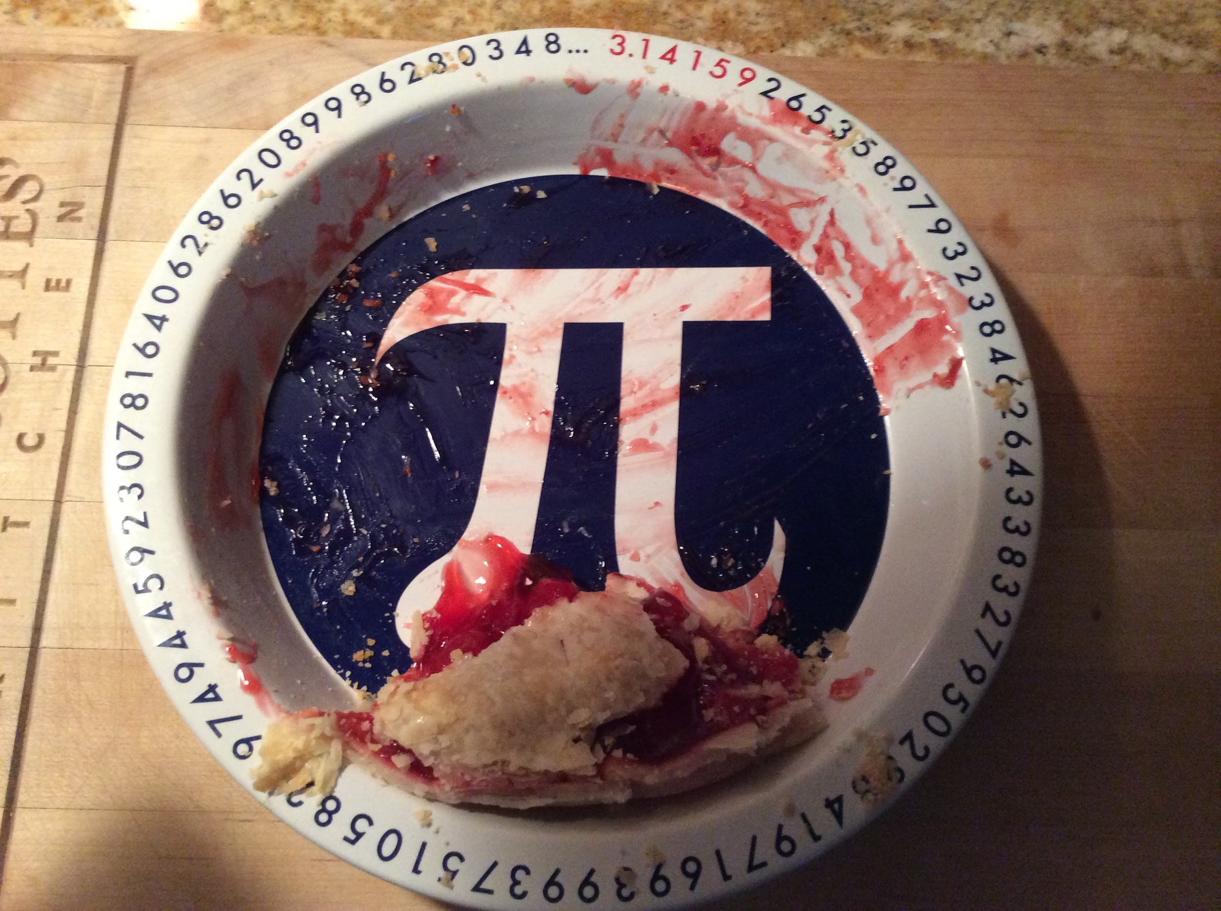
Happy Pi Day!
About what fraction of the pie is here?
4.NF.A2
Notes:
Pi Day

Slide 10
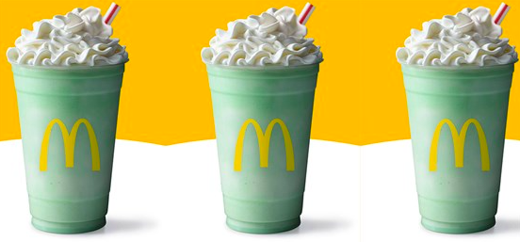
The McDonald’s Shamrock Shake!
Each of these shakes is 16 ounces, there are 46 calories per ounce.
How many calories in one shake? How many in 2 shakes? 3 shakes?
4.NBT.B5

Slide 11
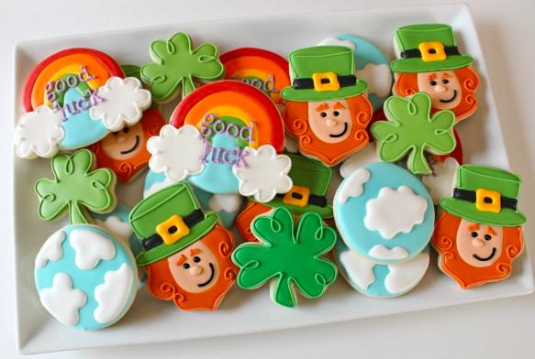
Happy St. Patrick’s Day!
What fraction of the whole tray of cookies are the clovers?
What fraction represents the leprechauns?
What about the cloudy cookies?
4.NF.B3
Notes:
Week of March 18, 2024

Slide 12
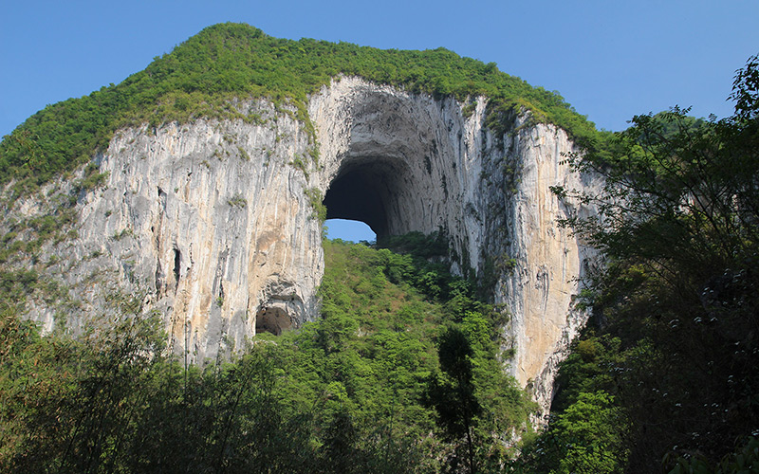
This is the Great Arch of Getu, Shuiyanba Dong, in China.
It is a very popular climbing destination!
The arch is 237 feet high!
If we were to climb one-half of the way up, how high would that be?
What if we only climbed one-third of the way?
4.MD.A2

Slide 13
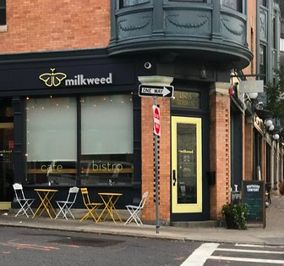
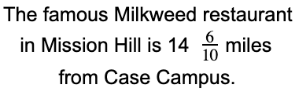
If went there for lunch, and then came right back to school, How many miles did we travel?
4.NF.B3

Slide 14
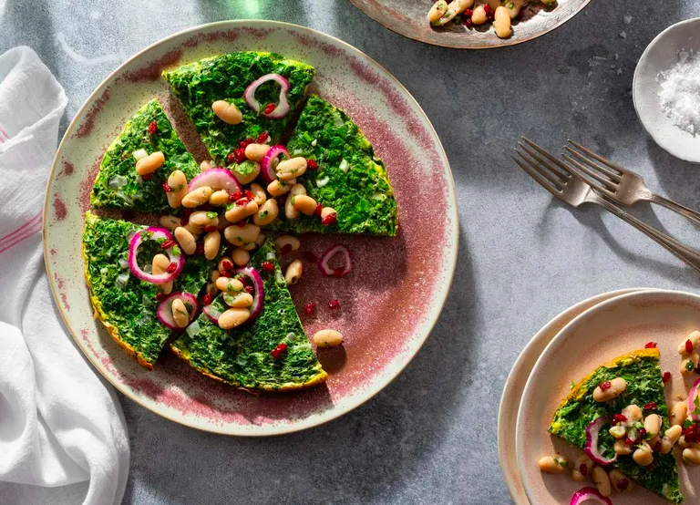
Happy Persian New Year Spring Equinox
What fraction of this delicious Kuku Sabzi is missing?
Write a number sentence with fractions to show your thinking.
4.NF.B3
Notes:
March 21, 2024
Nowruz

Slide 15
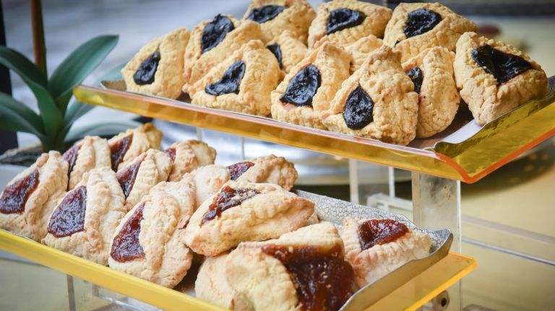
Happy Purim!
Moishe’s Bake Shop in New York City will bake 2,000 hamantaschen a day for the holiday.
What are some factor pairs of 2,000?
4.OA.B4

Slide 16
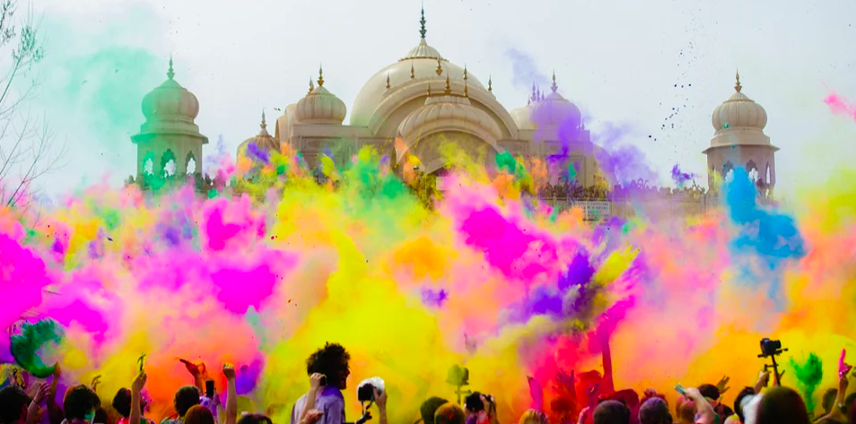
Happy Holi ~ The Festival of Colors
The Taj Mahal complex is believed to have been completed in its entirety in 1653 at a cost estimated at the time to be around 32 million rupees, which in 2021 would be approximately 70 billion rupees. What is the difference? How many times MORE? How can you figure it out?
4.NBT.A2
Notes:
Week of March 25, 2024
Holi (India)

Slide 17
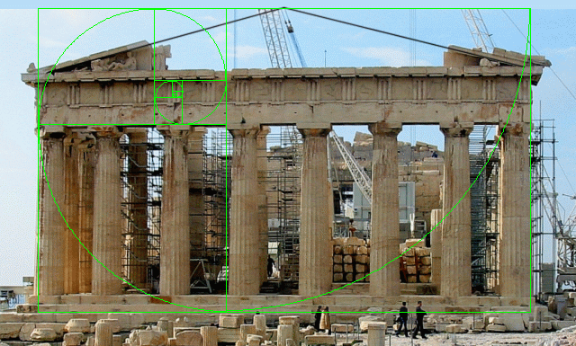
Happy Greek Independence Day!
The Parthenon was built to extremely precise dimensions according to the mathematical ratios of sacred geometry.
The rectangular building is 101 feet wide by 228 feet long. It was constructed of brilliant white marble, surrounded by 46 great columns, roofed with tiles, and housed a nearly 40 foot tall statue of the goddess Athena.
Where’s the MATH?
Think area, perimeter, height…
4.MD.A3
Notes:
Greek Independence Day

Slide 18
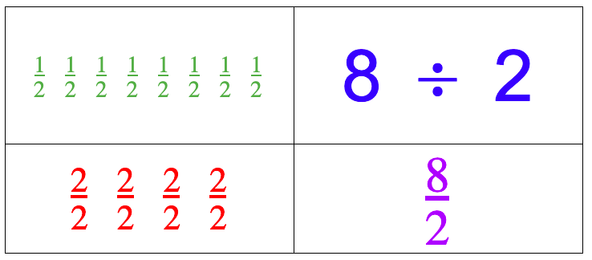
What do they all have in common? What is different about them?
4.NF.B4

Slide 19
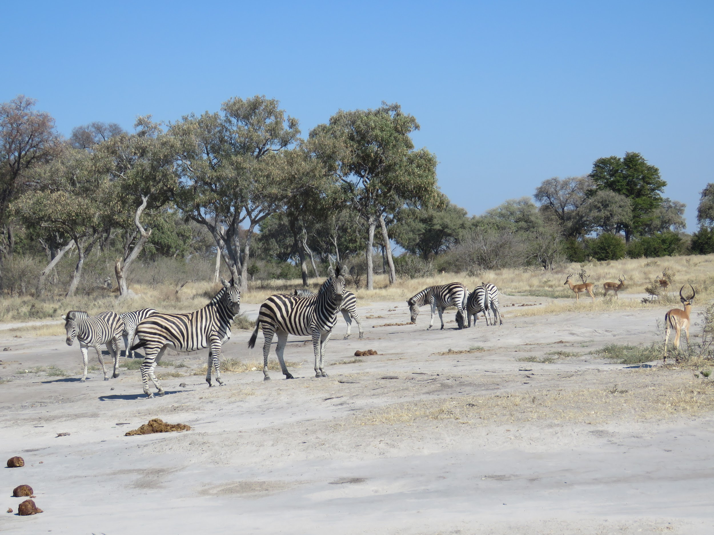
There are
8 zebras and
4 gazelles in this photo.
What fraction statements can you make?
4.NF.B3

