Slide 1
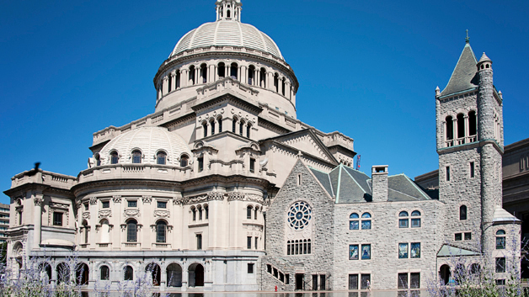
Wow! How many windows might be here?
WHAT strategies can you use to figure it out?
1.OA.C5
Notes:
Week of March 4, 2024

Slide 2
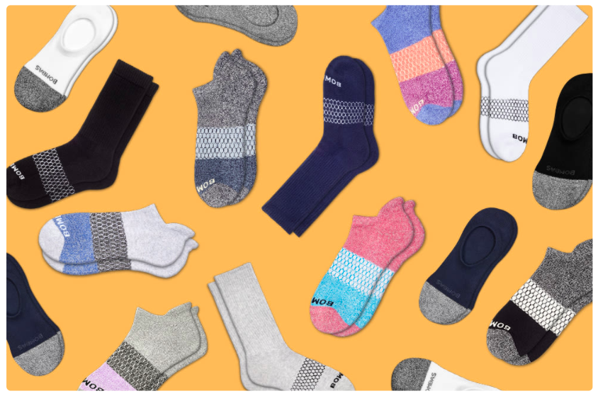
How many socks? How do you know?
How many different number sentences can you create
to match this picture?
1.OA.C6

Slide 3
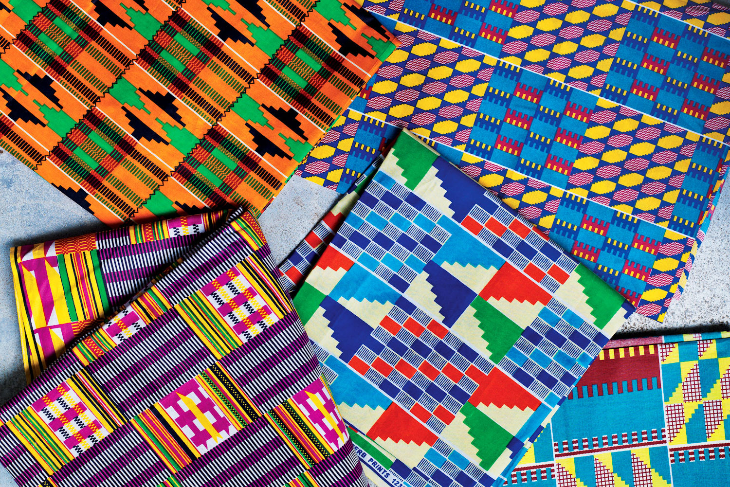
Happy Independence Day in Ghana
What interesting shapes do we see in this Kente Cloth from Ghana?
1.G.A1
Notes:
March 6, Ghana Indenpence Day

Slide 4
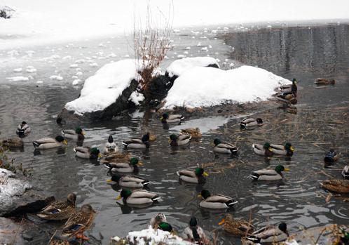
Winter Ducks!
How many are here?
Estimate
How many would be left if half of them flew away?
1.OA.A1

Slide 5
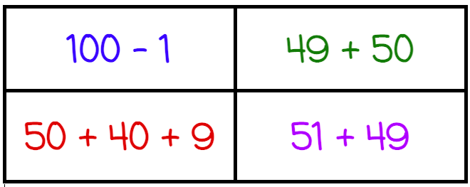
Which one doesn’t belong?
1.NBT.C4

Slide 6
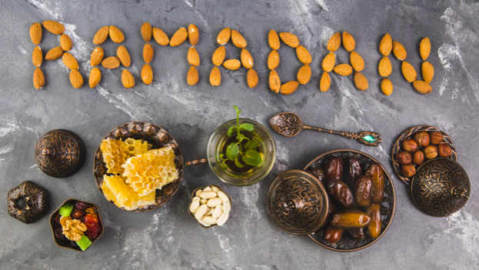
What interesting shapes do we see here?
1.G.1
Notes:
Week of March 11, 2024
Ramadan

Slide 7
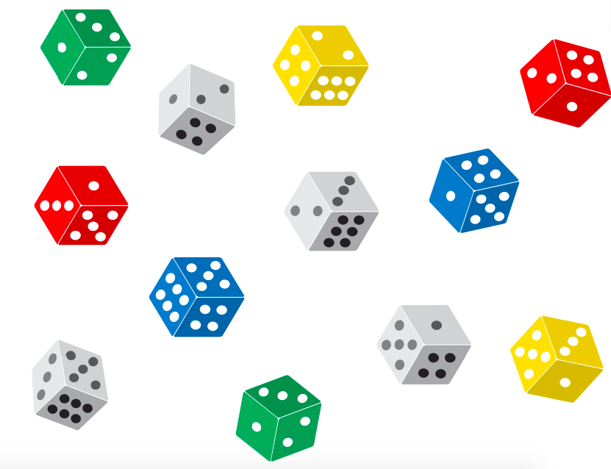
What can you say about this picture?
Write some number sentences to match what you see.
1.OA.D6

Slide 8
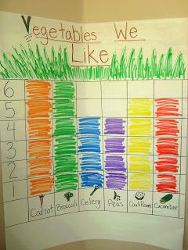
What do you notice?
What do you wonder?
If this graph could talk, what would it say?
1.MD.C4

Slide 9
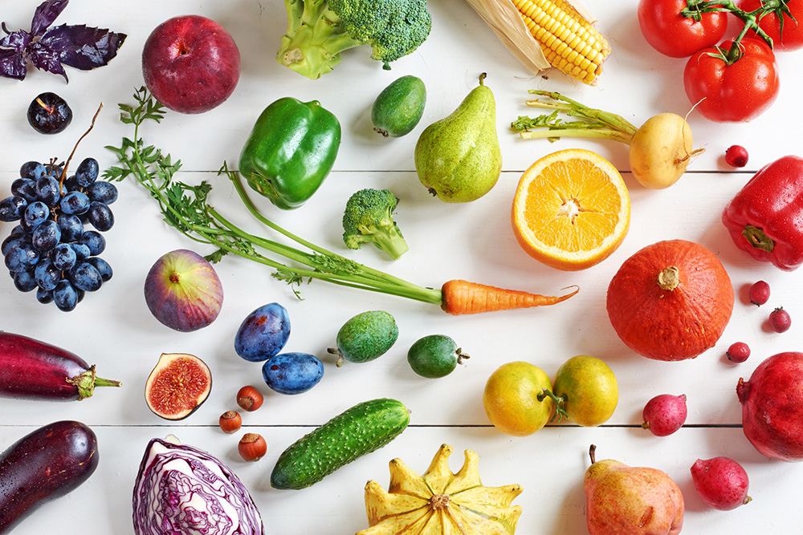
Think of 3 categories to sort the fruits and vegetables.
Which vegetable do you think is the heaviest?
Which is the lightest?
Which is the longest?
Which one is the shortest?
1.MD.A1

Slide 10
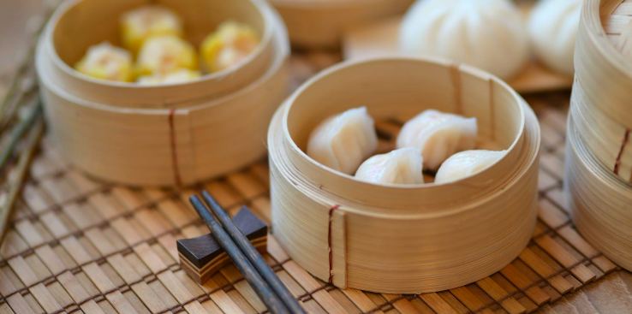
Choose a shape to sketch from the picture.
Draw a line to split your shape into 2 equal parts.
What words describe each equal part?
1.G.A3

Slide 11

Where’s the Math?
1.OA.A1
Notes:
Week of March 18, 2024

Slide 12

Which one doesn’t belong?
20 + 20 + 20 | 30 + 30
30 + 20
1.NBT.C5

Slide 13
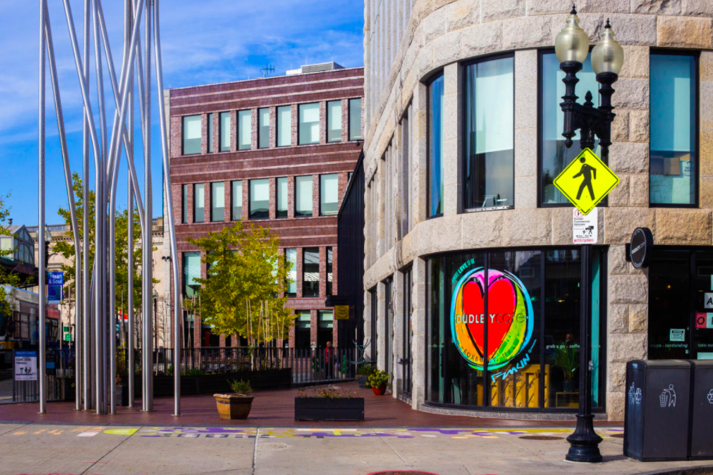
Wow! Look at of these cool shapes!
Describe what you see.
What would you see if you put some of the shapes together?
1.G.A2

Slide 14
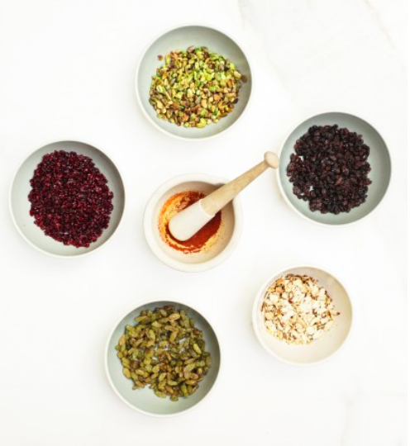
What do you notice?
What do you wonder?
How many beans do you think are in each bowl?
Make a reasonable estimate.
How many are there altogether if there are about 150 in each bowl?
Happy Persian New Year
Spring Equinox
1.NBT.B
Notes:
March 21, 2024
Nowruz

Slide 15
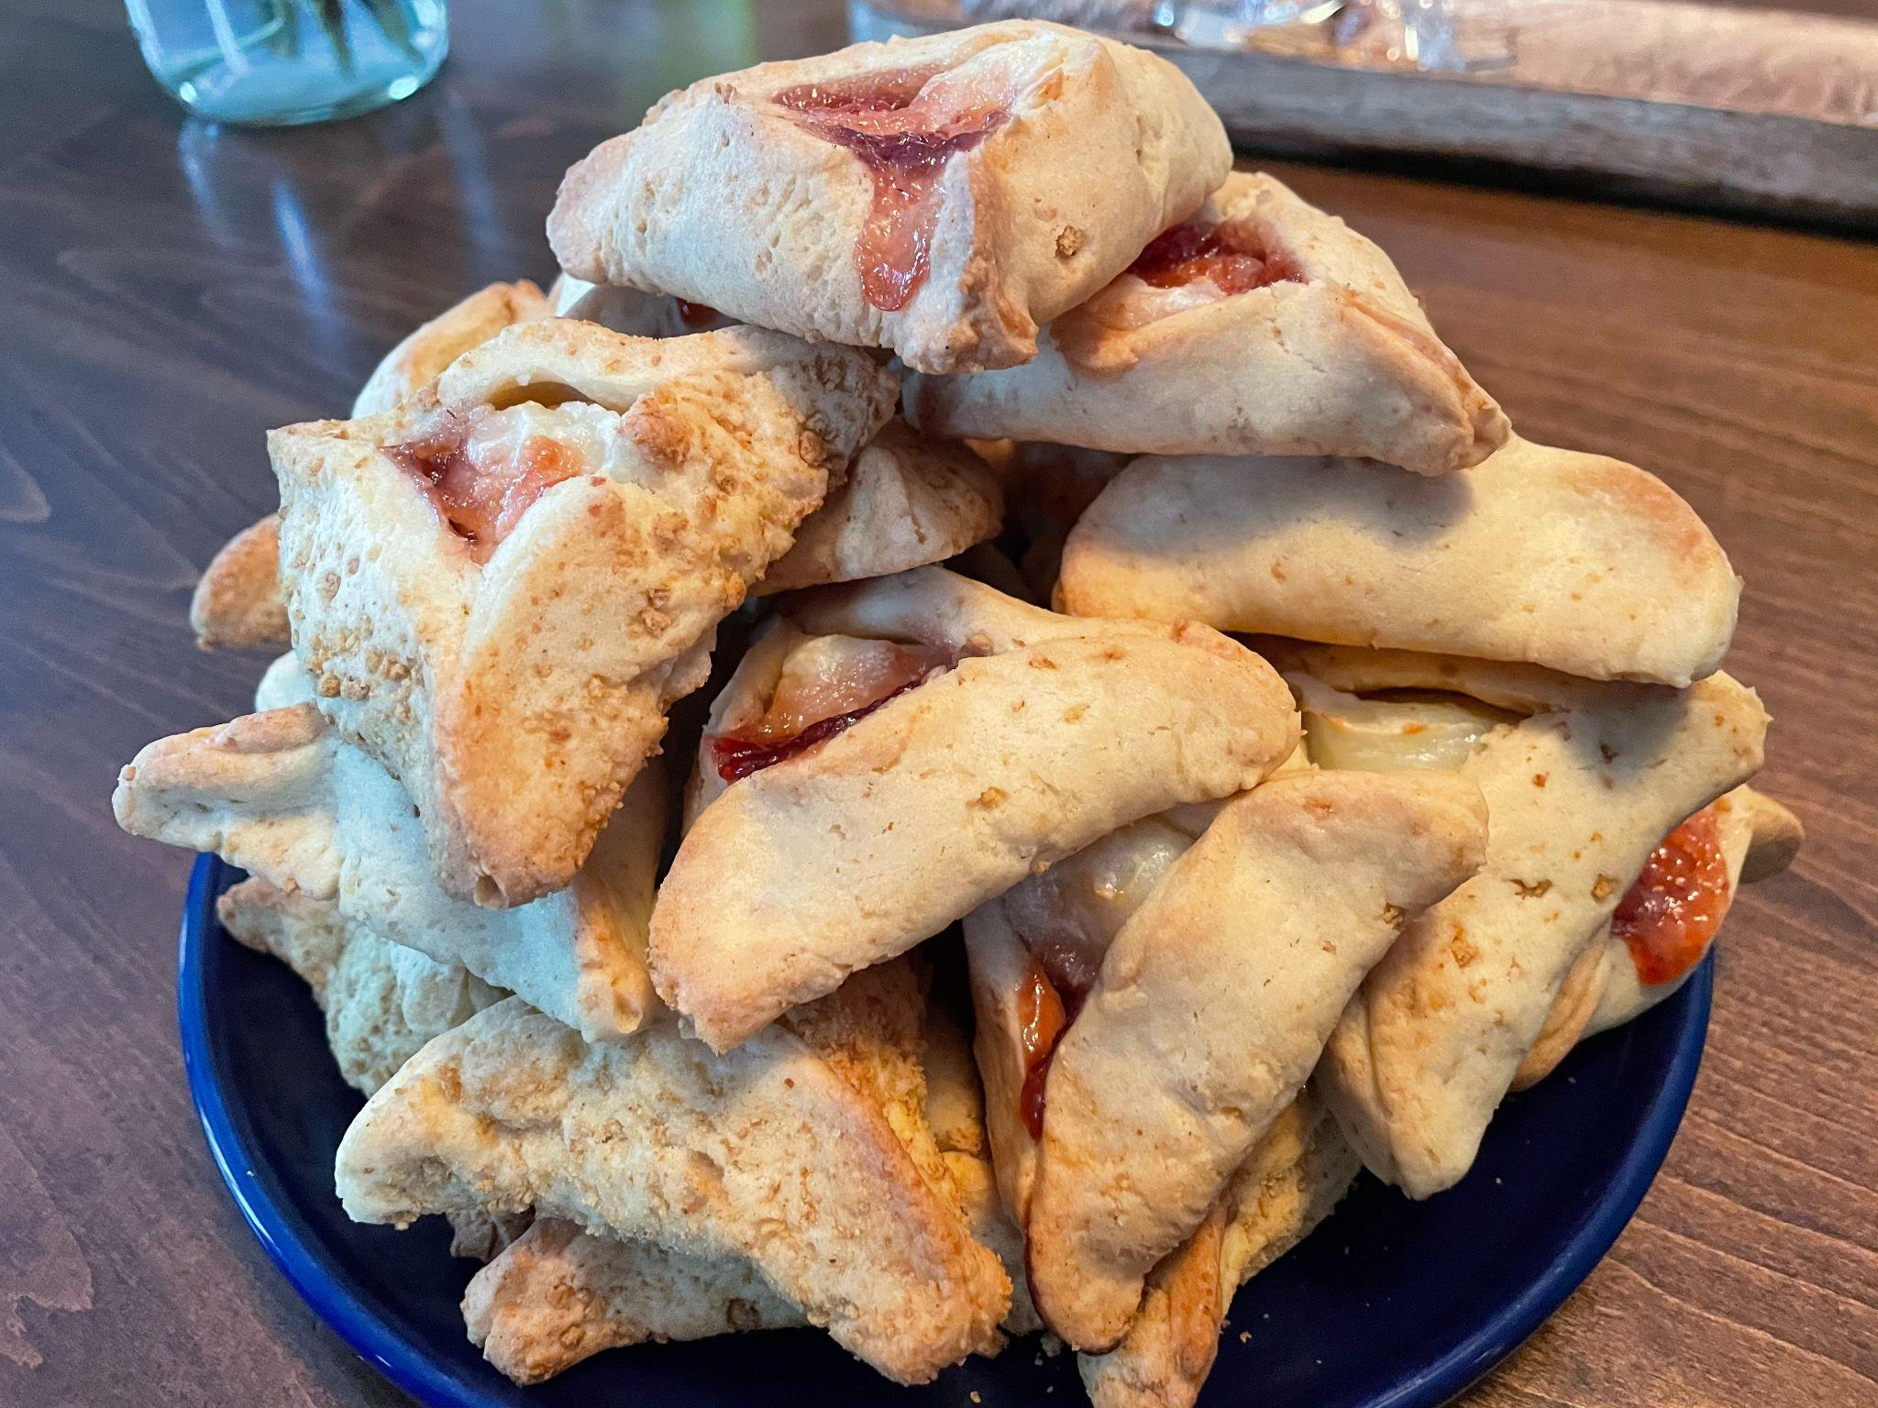
Happy Purim!
Estimate how many Hamantaschen are on the plate.
23
Were you close?
How many tens?
How many ones?
Create an expression to match!
1.NBT.C4
Notes:
Purim

Slide 16
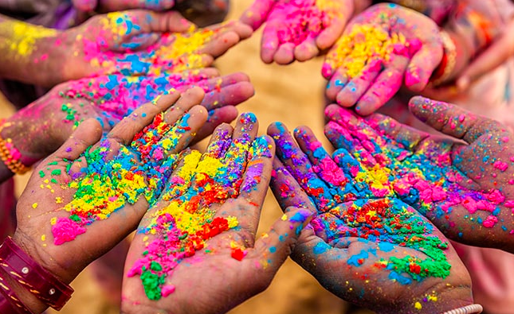
Happy Holi!
How many hands?
How many fingers?
1.NBT.A1
Notes:
Week of March 25, 2024

Slide 17
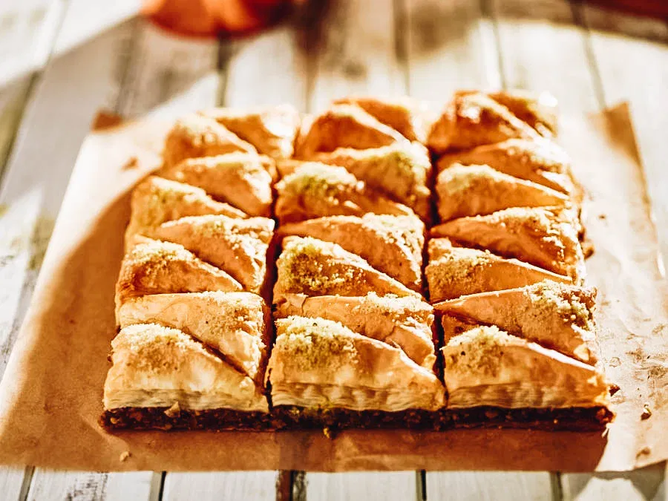
Happy Greek Independence Day!
How many pieces of Baklava do we see?
How many different ways can we count them?
How many tens?
How many ones?
1.NBT.B2

Slide 18
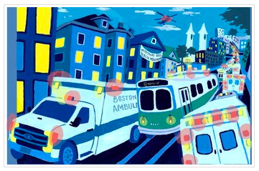
What are some interesting shapes you see here?
Can you draw them?
What if you put some of them together?
1.G.A2

Slide 19
Which one doesn’t belong?
1.G.A2

