Slide 1
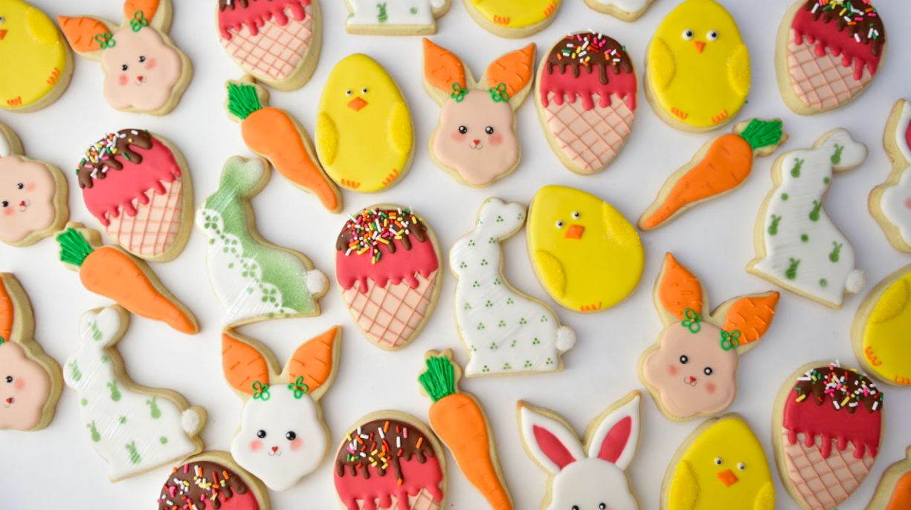
What interesting shapes do you see? How would you sort them?
K.G.1
Notes:
Week of April 1, 2024

Slide 2
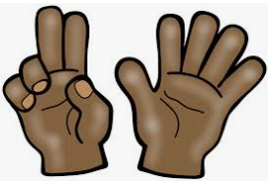
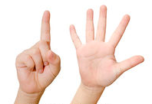
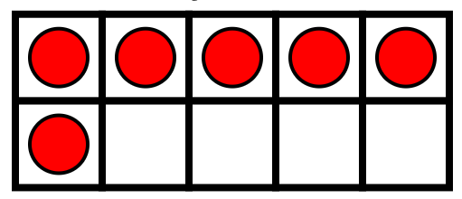

Which one doesn’t belong?
K.CC.4 OA.3.5

Slide 3
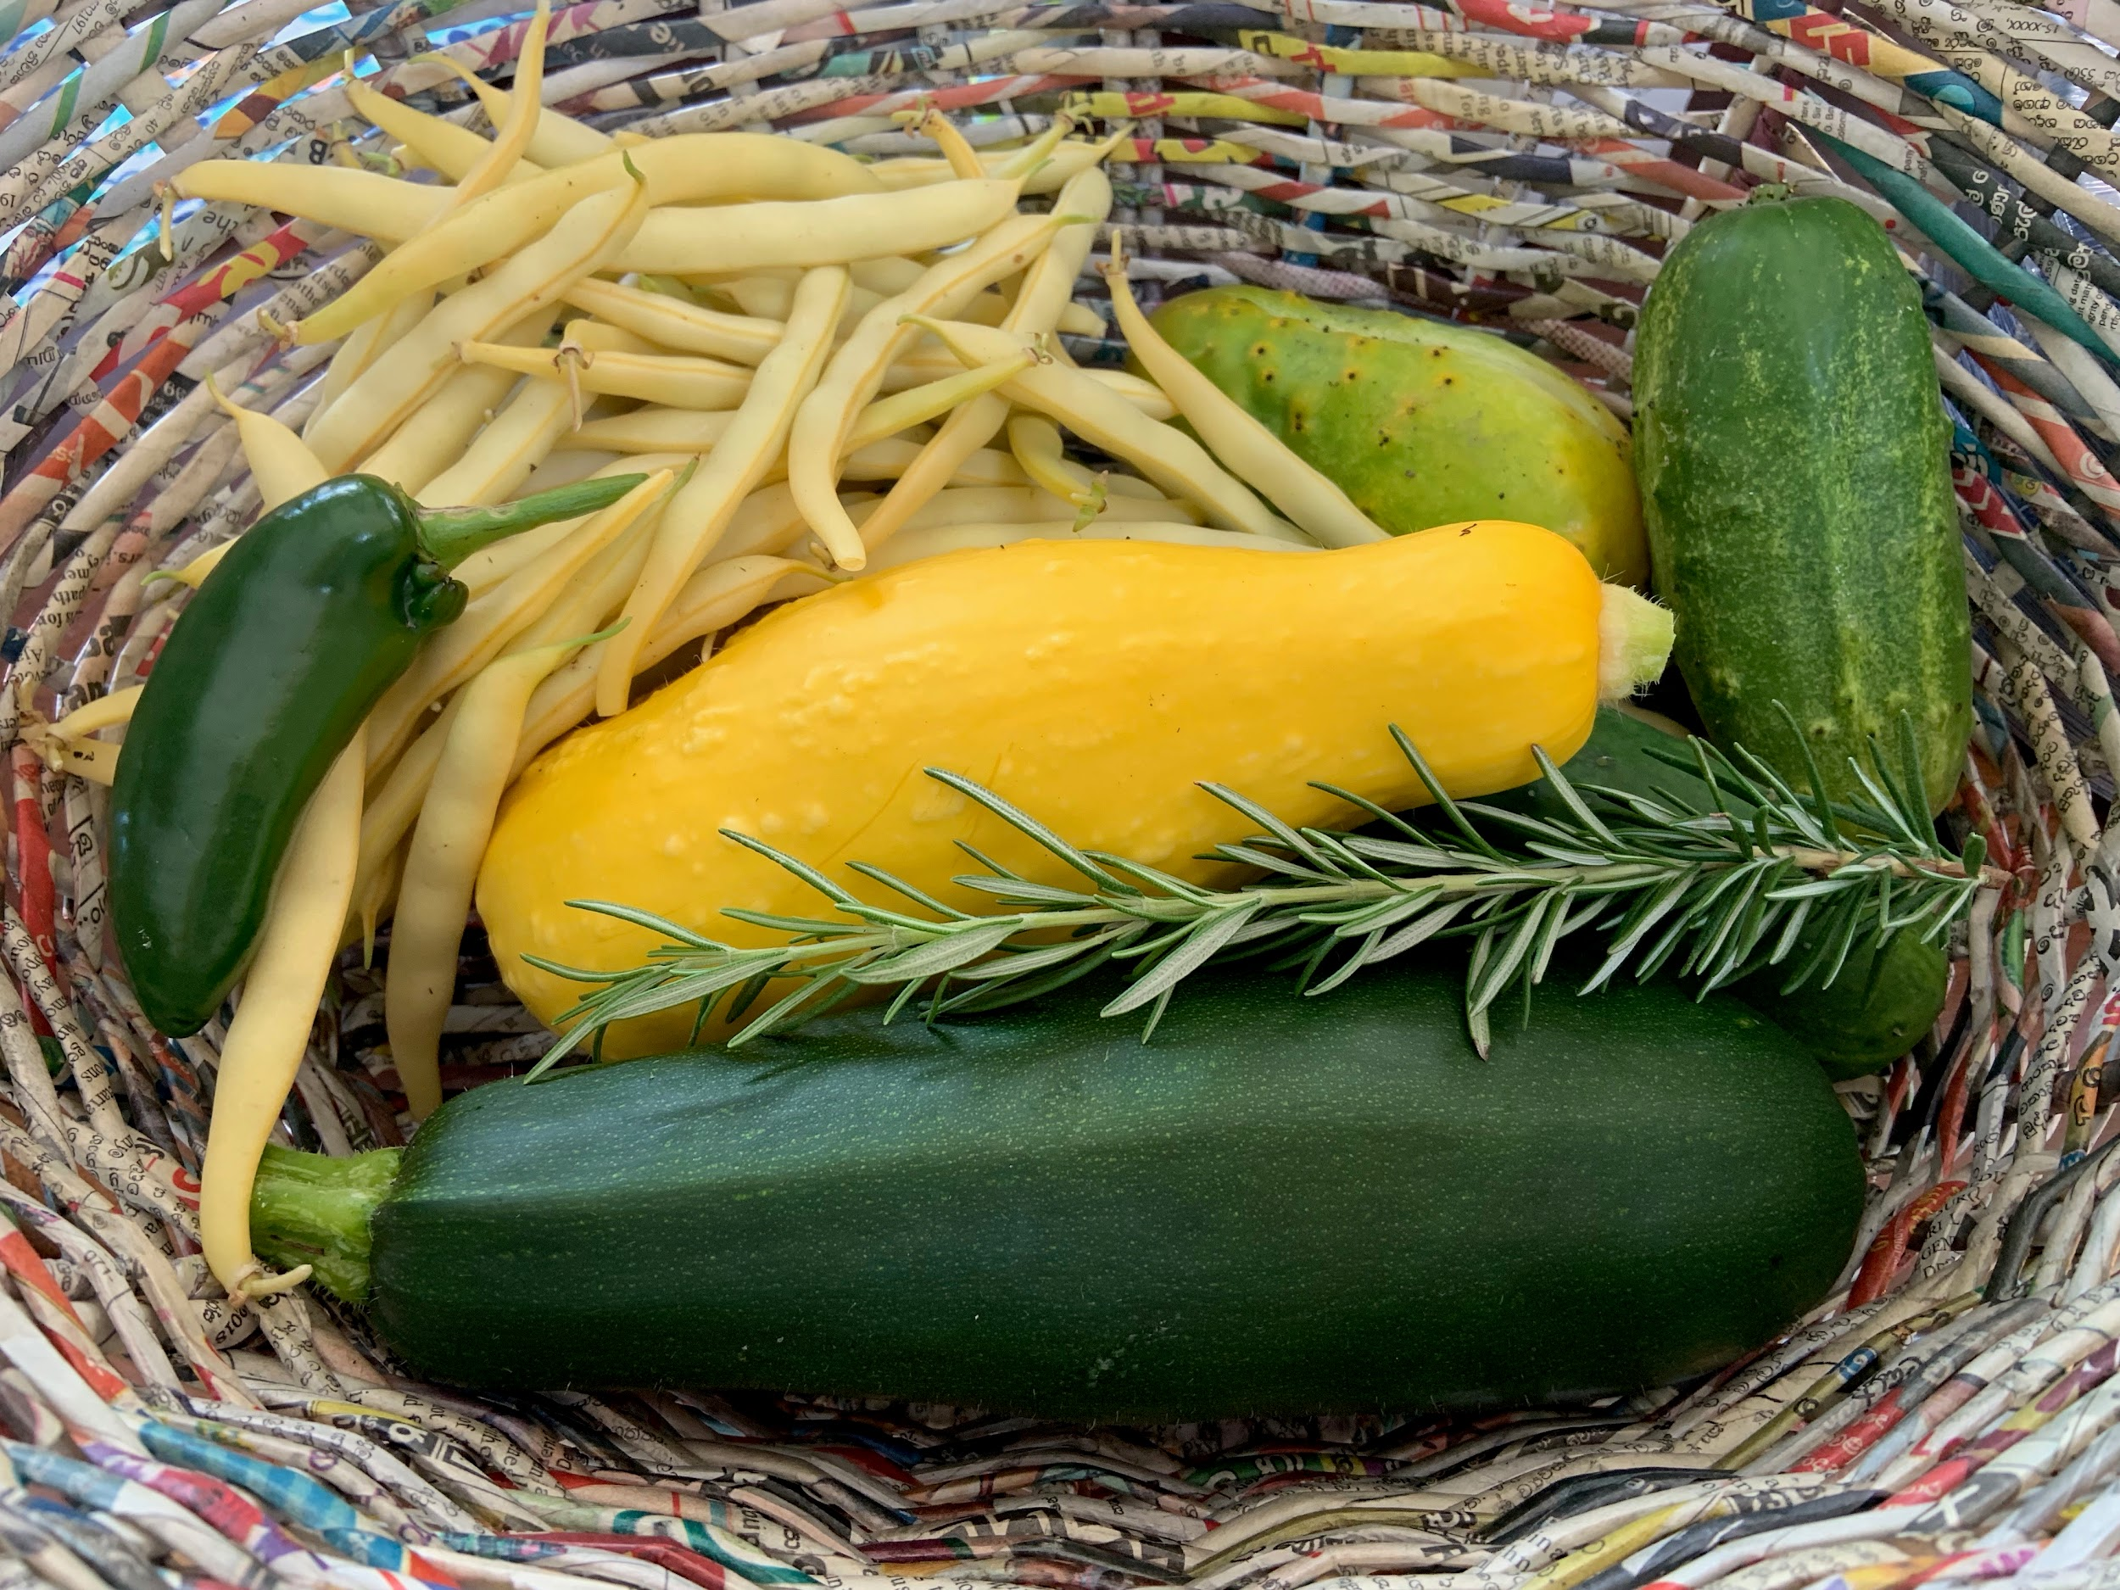
How would you sort these vegetables?
How many beans do you think are here?
Which vegetable weighs the most?
Which is the lightest?
K.CC.1.4.5.6. MD.1.2

Slide 4
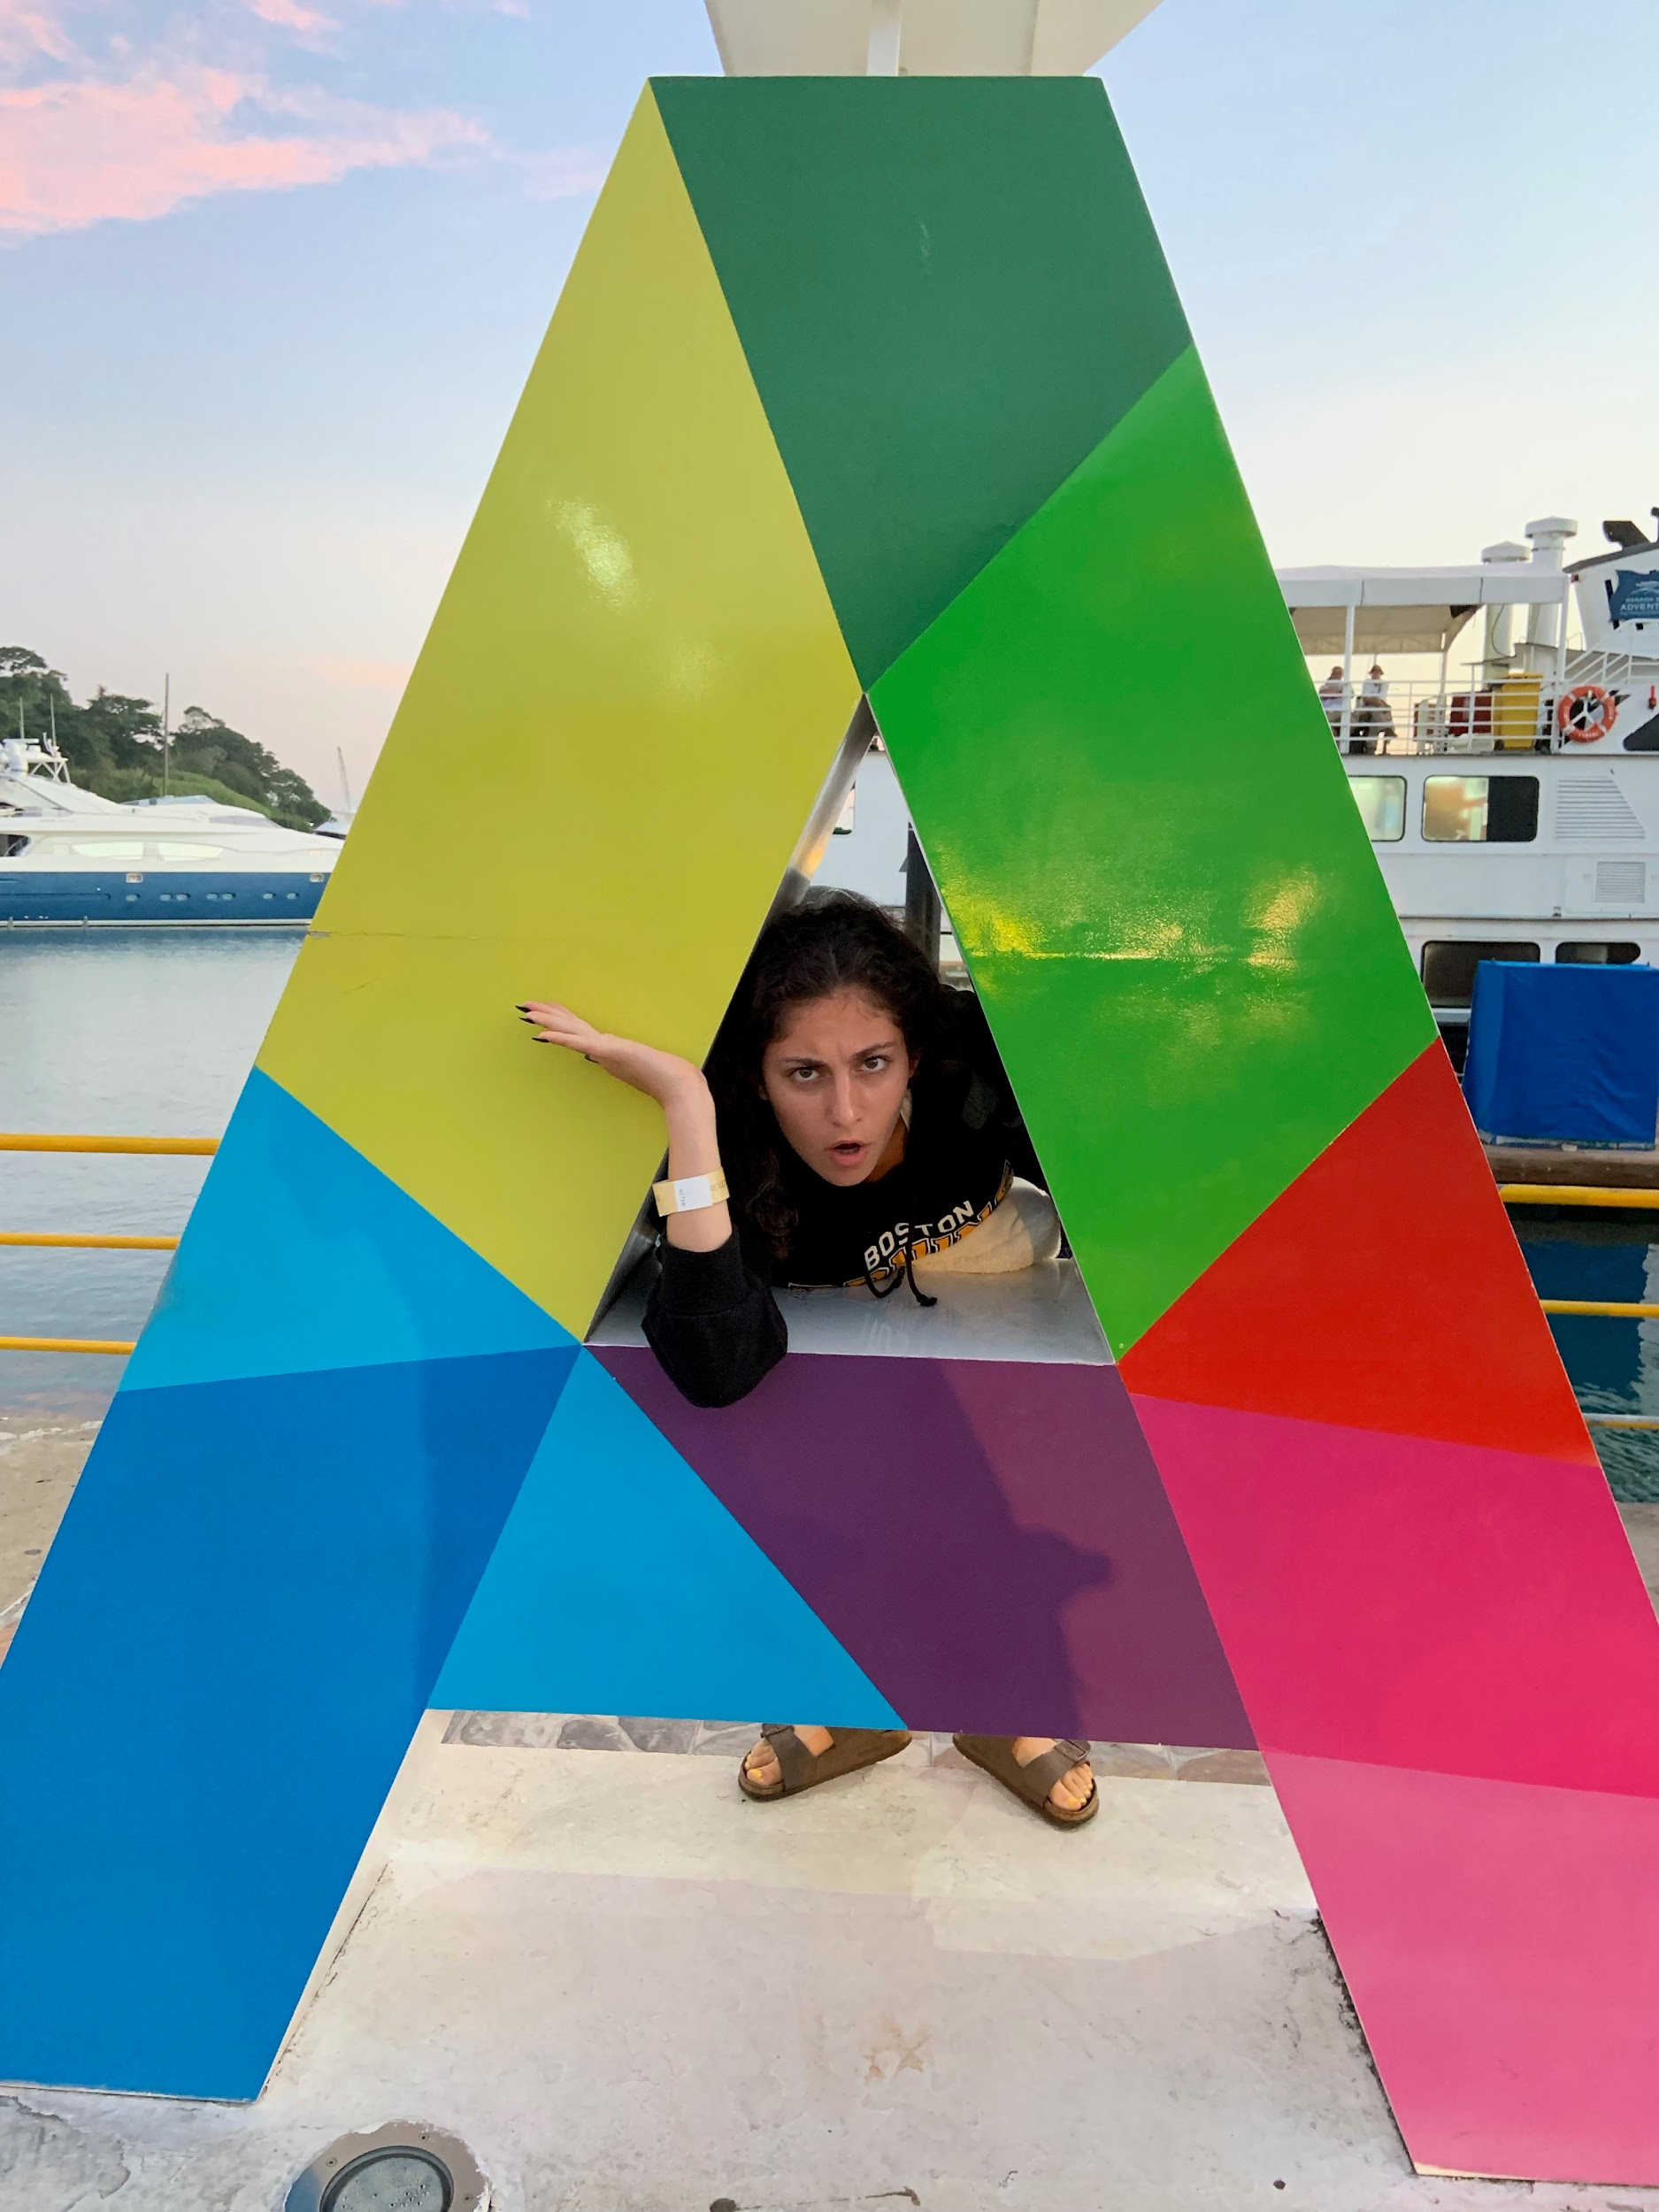
What are some of the shapes you see here?
Describe them.
How are they the same?
How are they different?
K.G1.2.3.4

Slide 5
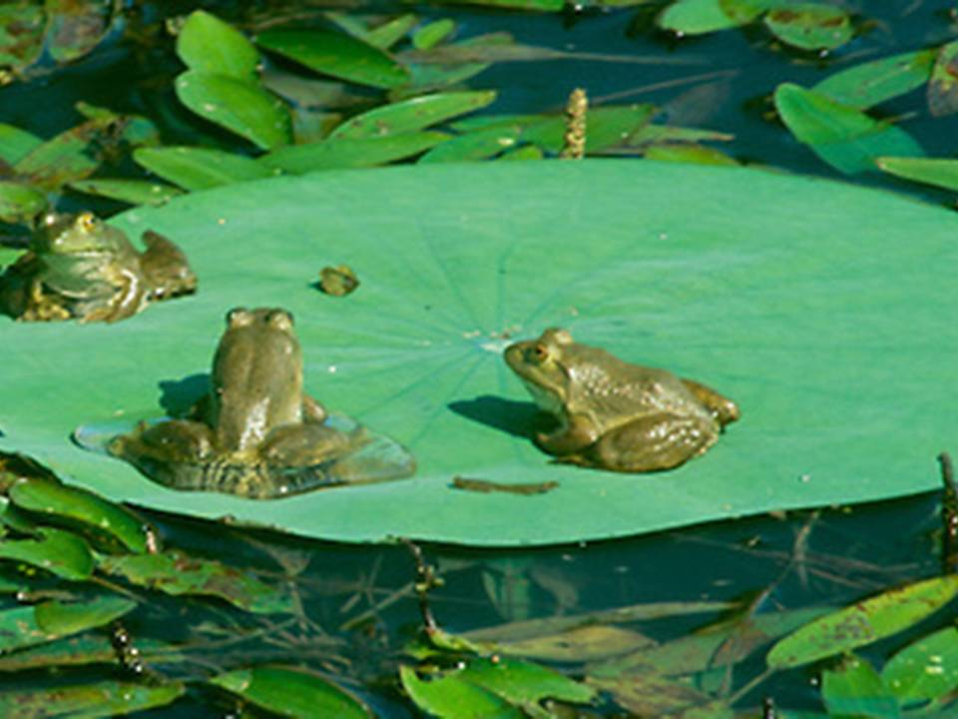
It’s Froggy Friday!
How many frogs are on the lily pad?
How many more will make 10 frogs?
K.OA.4

Slide 6
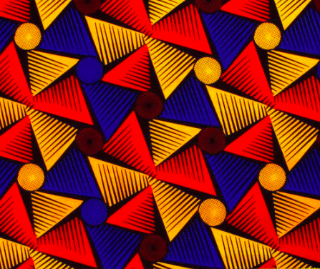
Let’s talk about the patterns we see in this Ankara fabric.
What shapes do we see?
What colors do we see?
K.G.1.2.3
Notes:
Week of April 8, 2024

Slide 7
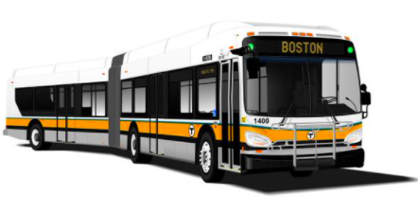
How many wheels do you see?
How many DON’T you see?
Can you write a number sentence to match your thinking?
K.OA.A

Slide 8
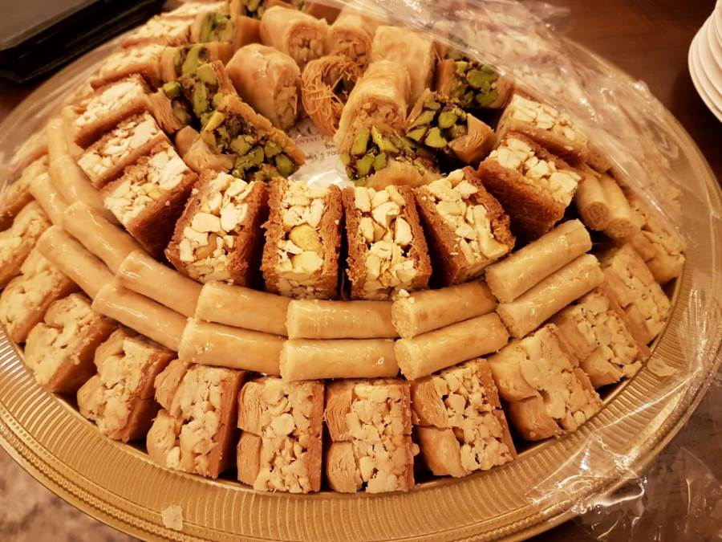
Today is the celebration of
Eid Al-Fitr
Look at all of these yummy sweets!
Describe some of the shapes you see?
How many sweets do we see?
How many don’t we see?
How can we count them?
K.CC.A1
Notes:
April 10, 2024
Eid al-fitr

Slide 9
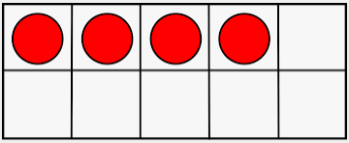
Which one doesn’t belong?
K.G.2.3.4

Slide 10
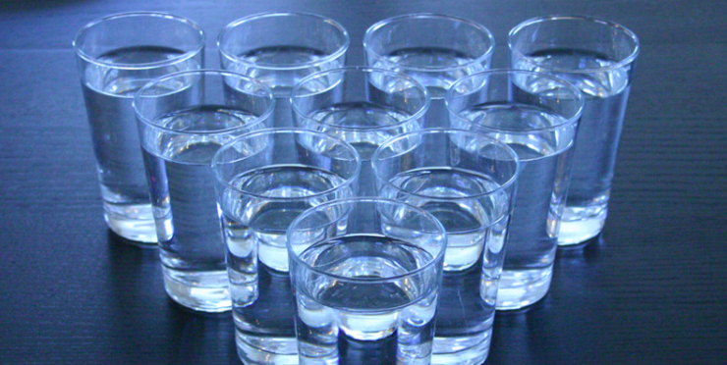
How many glasses of water are here?
Write a number sentence to match your thinking.
K.OA.3

Slide 11
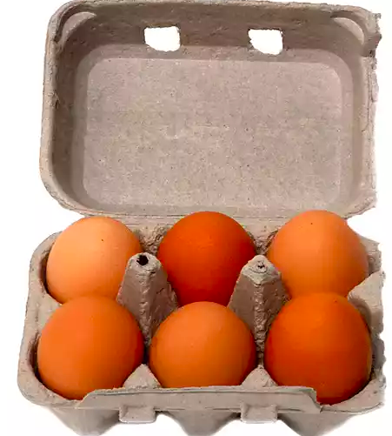
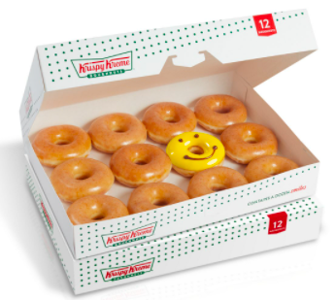


Which one doesn’t belong?
 | 10 + 2
K.NBT.1
Notes:
Week of April 22, 2024

Slide 12
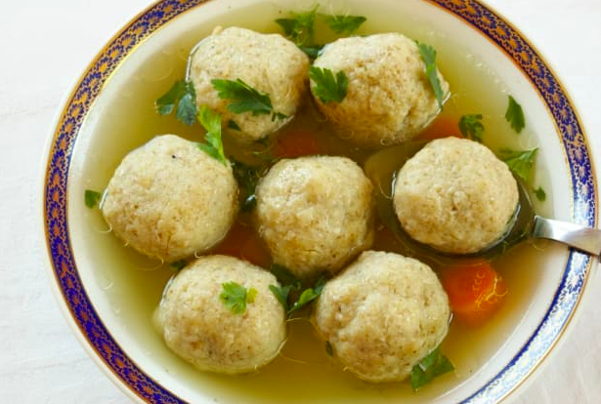
How many matzo balls are in the soup?
How many different number sentences can you create to match the bowl of soup?
K.OA.1

Slide 13
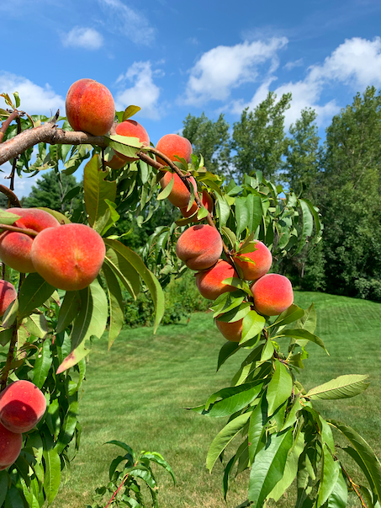
How many peaches might be on the tree?
How can you count them?
K.NBT.5

Slide 14
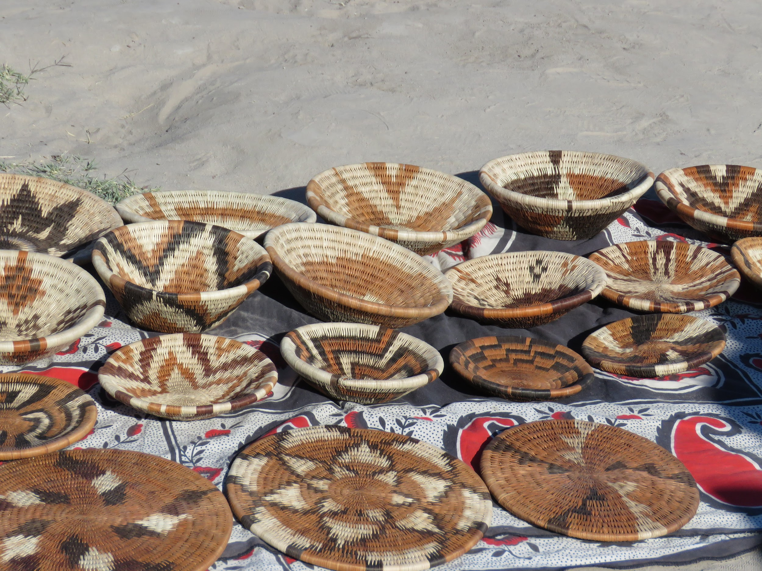
What interesting shapes do you see?
Can you draw some of them?
How would you sort these baskets?
K.G.2

Slide 15
Which one does not belong?
K.G.B4

