Slide 1
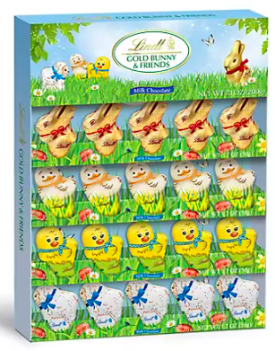
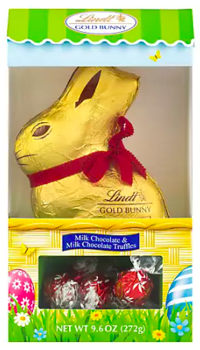
Would you rather . . .
$10.99
$9.99
Lindt Gold Bunny & Friends, 4 pk./1.7 oz. Lindt Gold Bunny, 9.6 oz.
5.NBT.B7
Notes:
Week of April 1, 2024

Slide 2
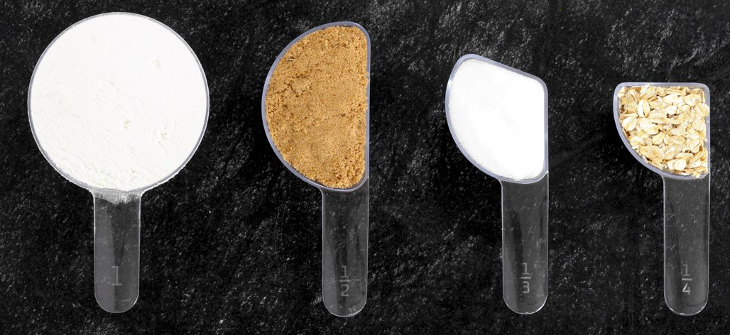
What can you say about these measuring cups?
What do you notice? What do you wonder?
Can you make EQUIVALENT fractions from what you see?
5.NF.A

Slide 3
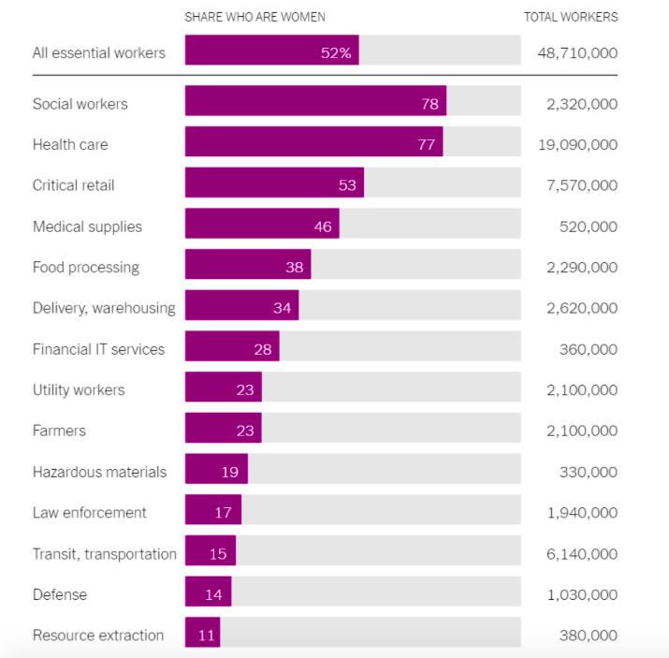
Who are our Essential Workers?
What do you notice?
What do you wonder?
What impact does this have on you and your community?
What’s going on in this graph? Write a catchy headline that captures the graph’s main idea.
5.MD.B

Slide 4
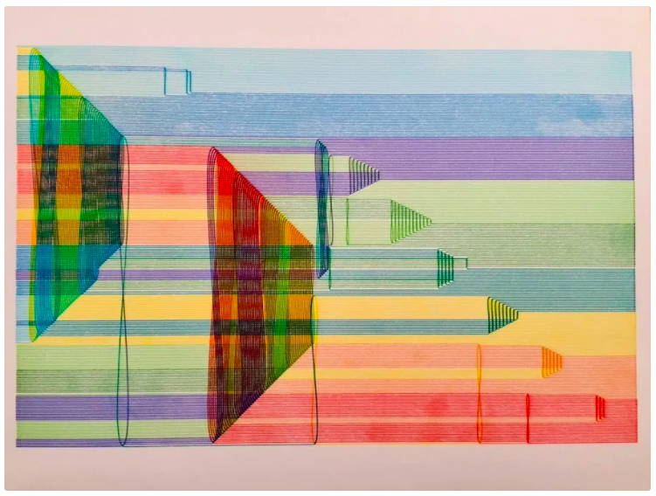
Talk about the math you see here.
5.G.B

Slide 5
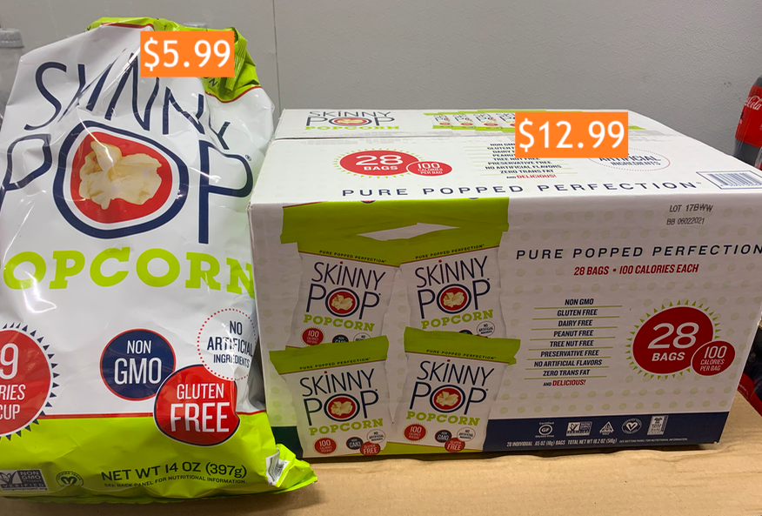
Would You Rather Buy ...
5.NBT.B7

Slide 6
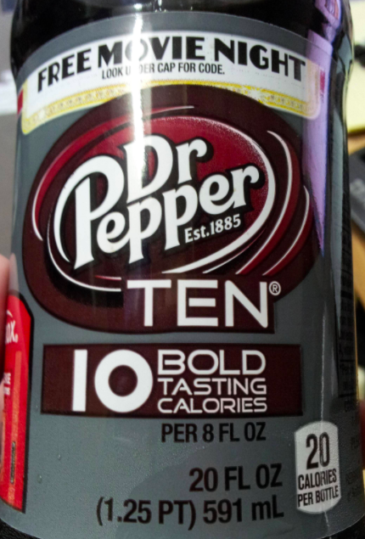
Look closely.
What do you notice?
What is the true calorie count?
5.NBT.B7
Notes:
Week of April 8, 2024

Slide 7
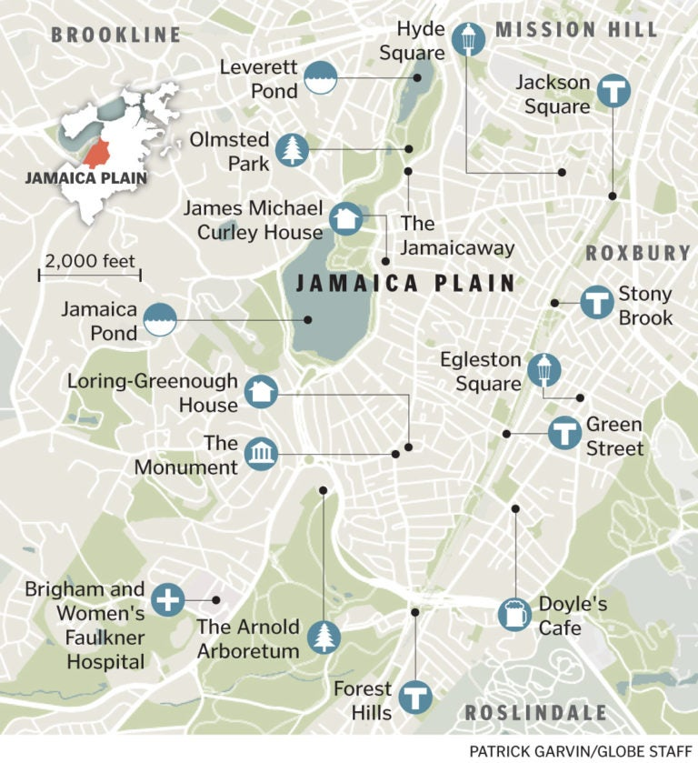
What do we notice?
What do we wonder?
About how far is it from Jamaica Pond to Hyde Square?
How do you know?
What other distances can we estimate?
5.NF.B5

Slide 8
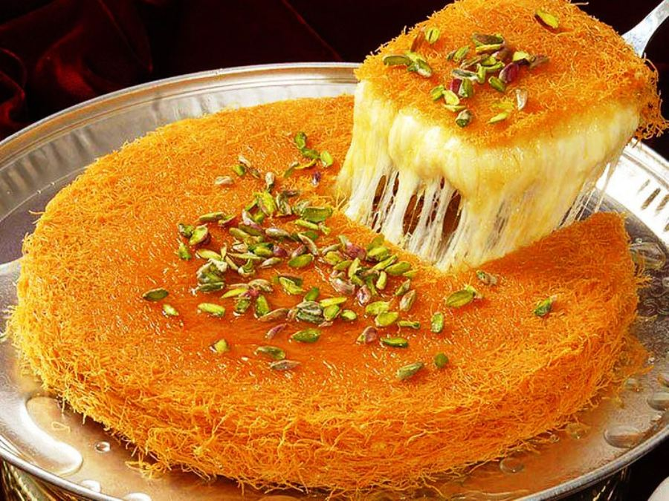
Eid Al-Fitr Celebration
عيد مبارك
Estimate what fraction of this yummy Knefeh is cut out.
Justify your estimation with math!
5.NF.A
Notes:
April 10, 2024
Eid Al-Fitr

Slide 9
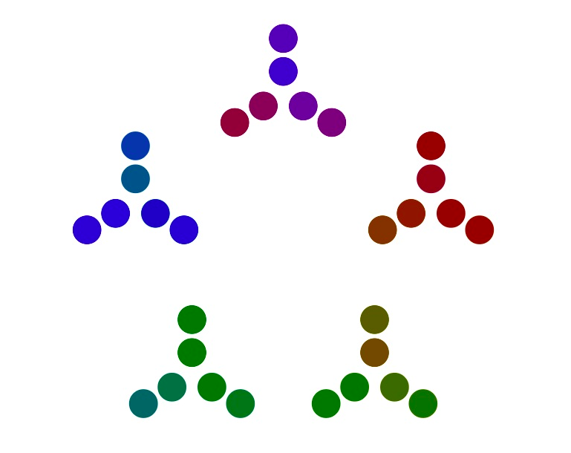
What can you
say about this number representation?
Think PRIME FACTORIZATION
5.OA

Slide 10
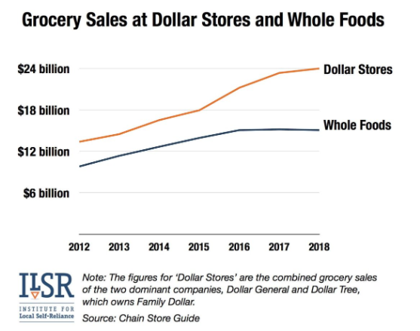
What do you notice
What do you wonder?
Why does it matter?
5.MD.B

Slide 11
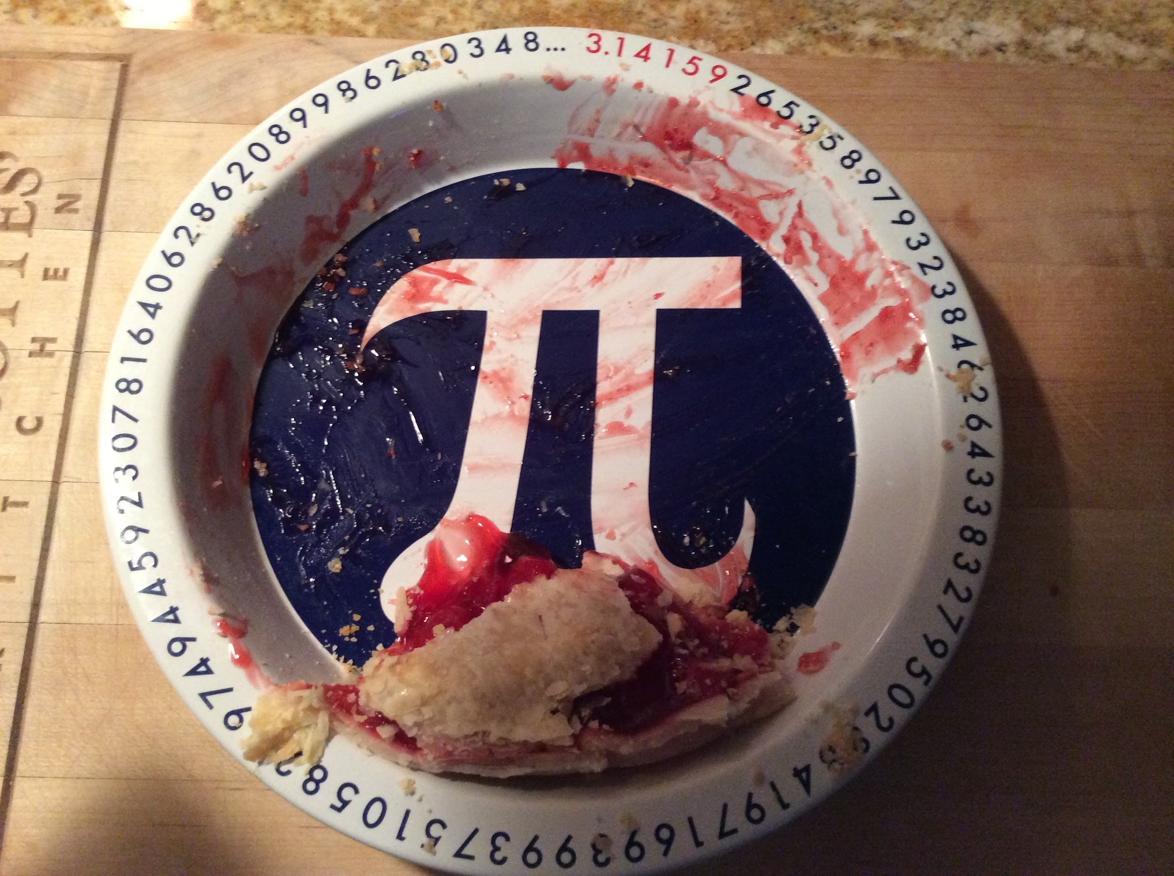
About what fraction of the pie is here?
5.NF.A
Notes:
Week of April 22, 2024

Slide 12
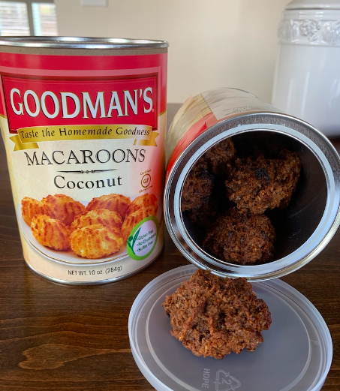
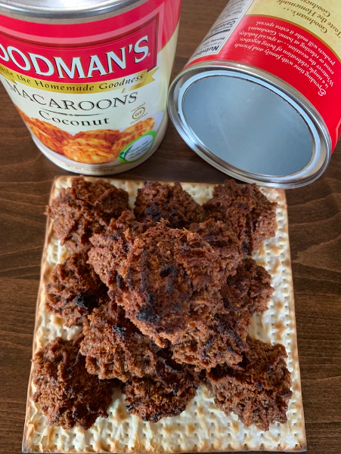
חַג פֵּסַח שַׂמֵחַ
How many macaroons are in BOTH cans?
What is an estimate that is too low?
Too high?
Just right?
9 + 4 + 1 + 1 = 15
15 x 2 = 30
30 Macaroons!
5.OA

Slide 13
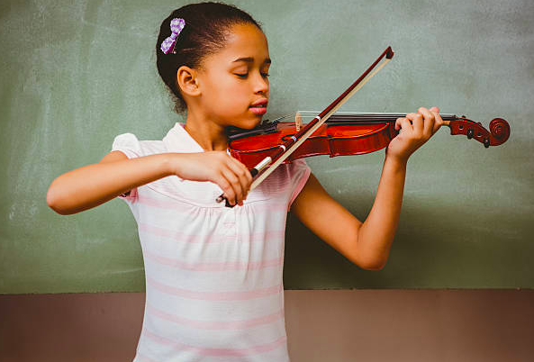
Would you rather… practice your violin every other day for 15 minutes,
OR practice for one hour once/week?
5.NBT.B

Slide 14
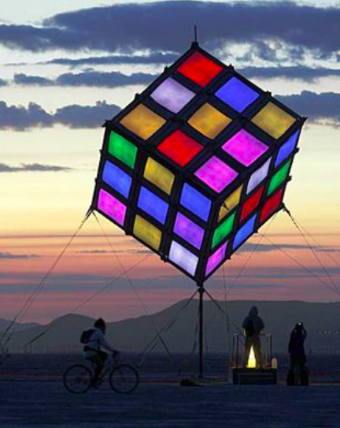
What do notice?
What do you wonder?
How many cubes IF the kite is a solid cube?
How many cubes IF the inside is empty?
How many cubes are painted with 3 colors? 2 colors? 1 color?
5.MD.C3,4

Slide 15

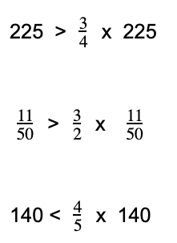
Prove it!
5.NF.B5

