Slide 1
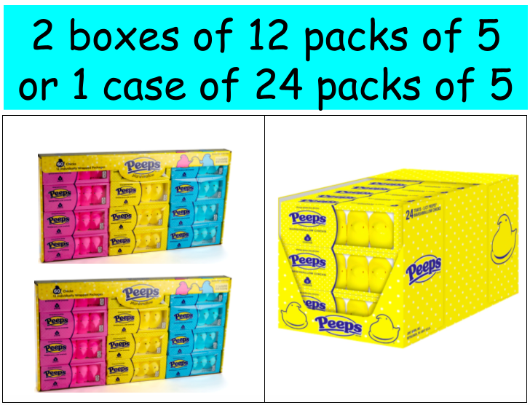
$19.50
$9.99 each
4.OA.A3
Notes:
Week of April 1, 2024

Slide 2
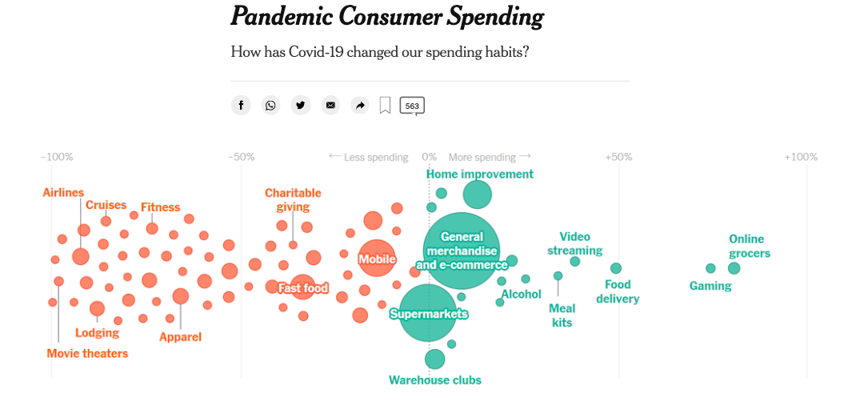
What do you notice? What do you wonder? What questions do you have? Why does it matter?
4.MD.B

Slide 3
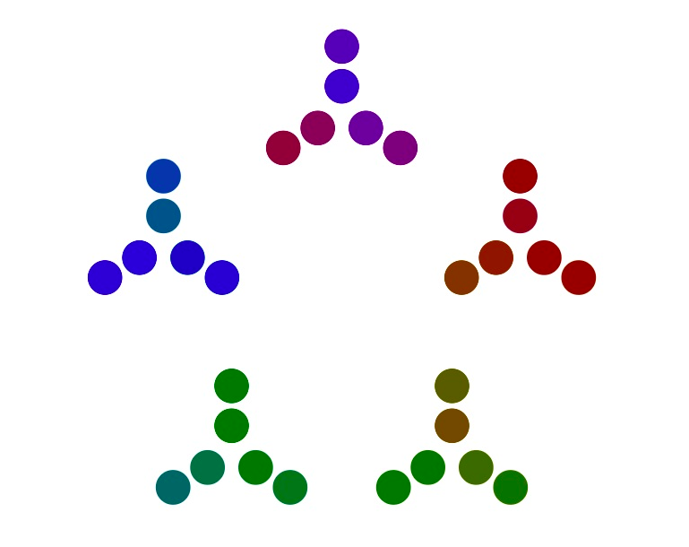
What can you
say about this number visualization?
Where do you see PRIME numbers?
4.OA.B4

Slide 4
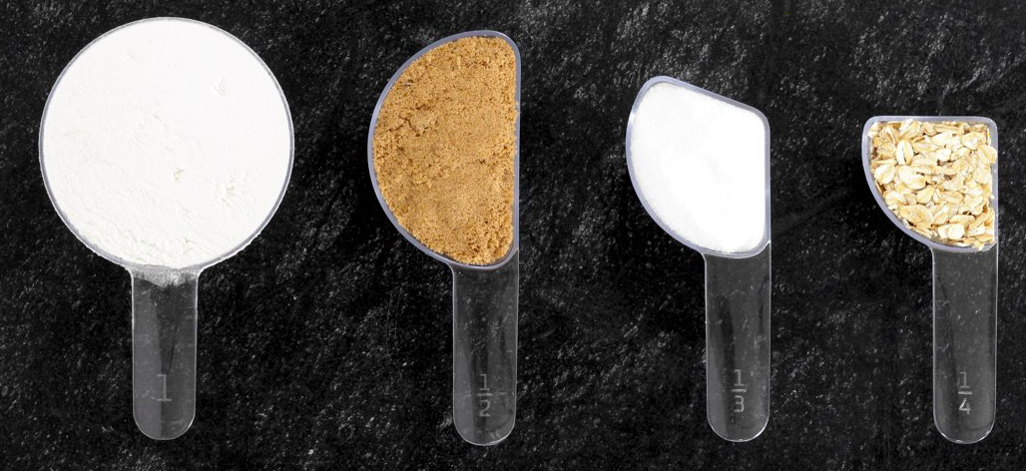
What can you say about these measuring cups?
What do you notice? What do you wonder?
Can you make EQUIVALENT fractions from what you see?
4.NF.A2

Slide 5
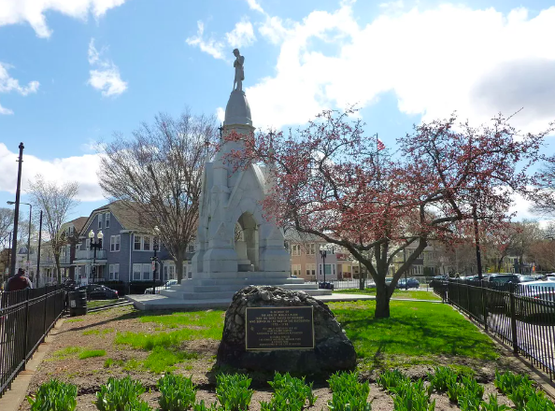
Soldier’s Monument in Jamaica Plain is a 28 foot monument to commemorate the Civil War contributions of the then-Town of West Roxbury.
The soldier on the top of the monument is 7 feet tall.
What FRACTION of the whole monument is he?
4.MD.A2

Slide 6
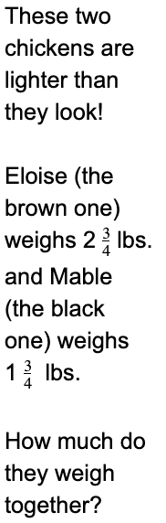
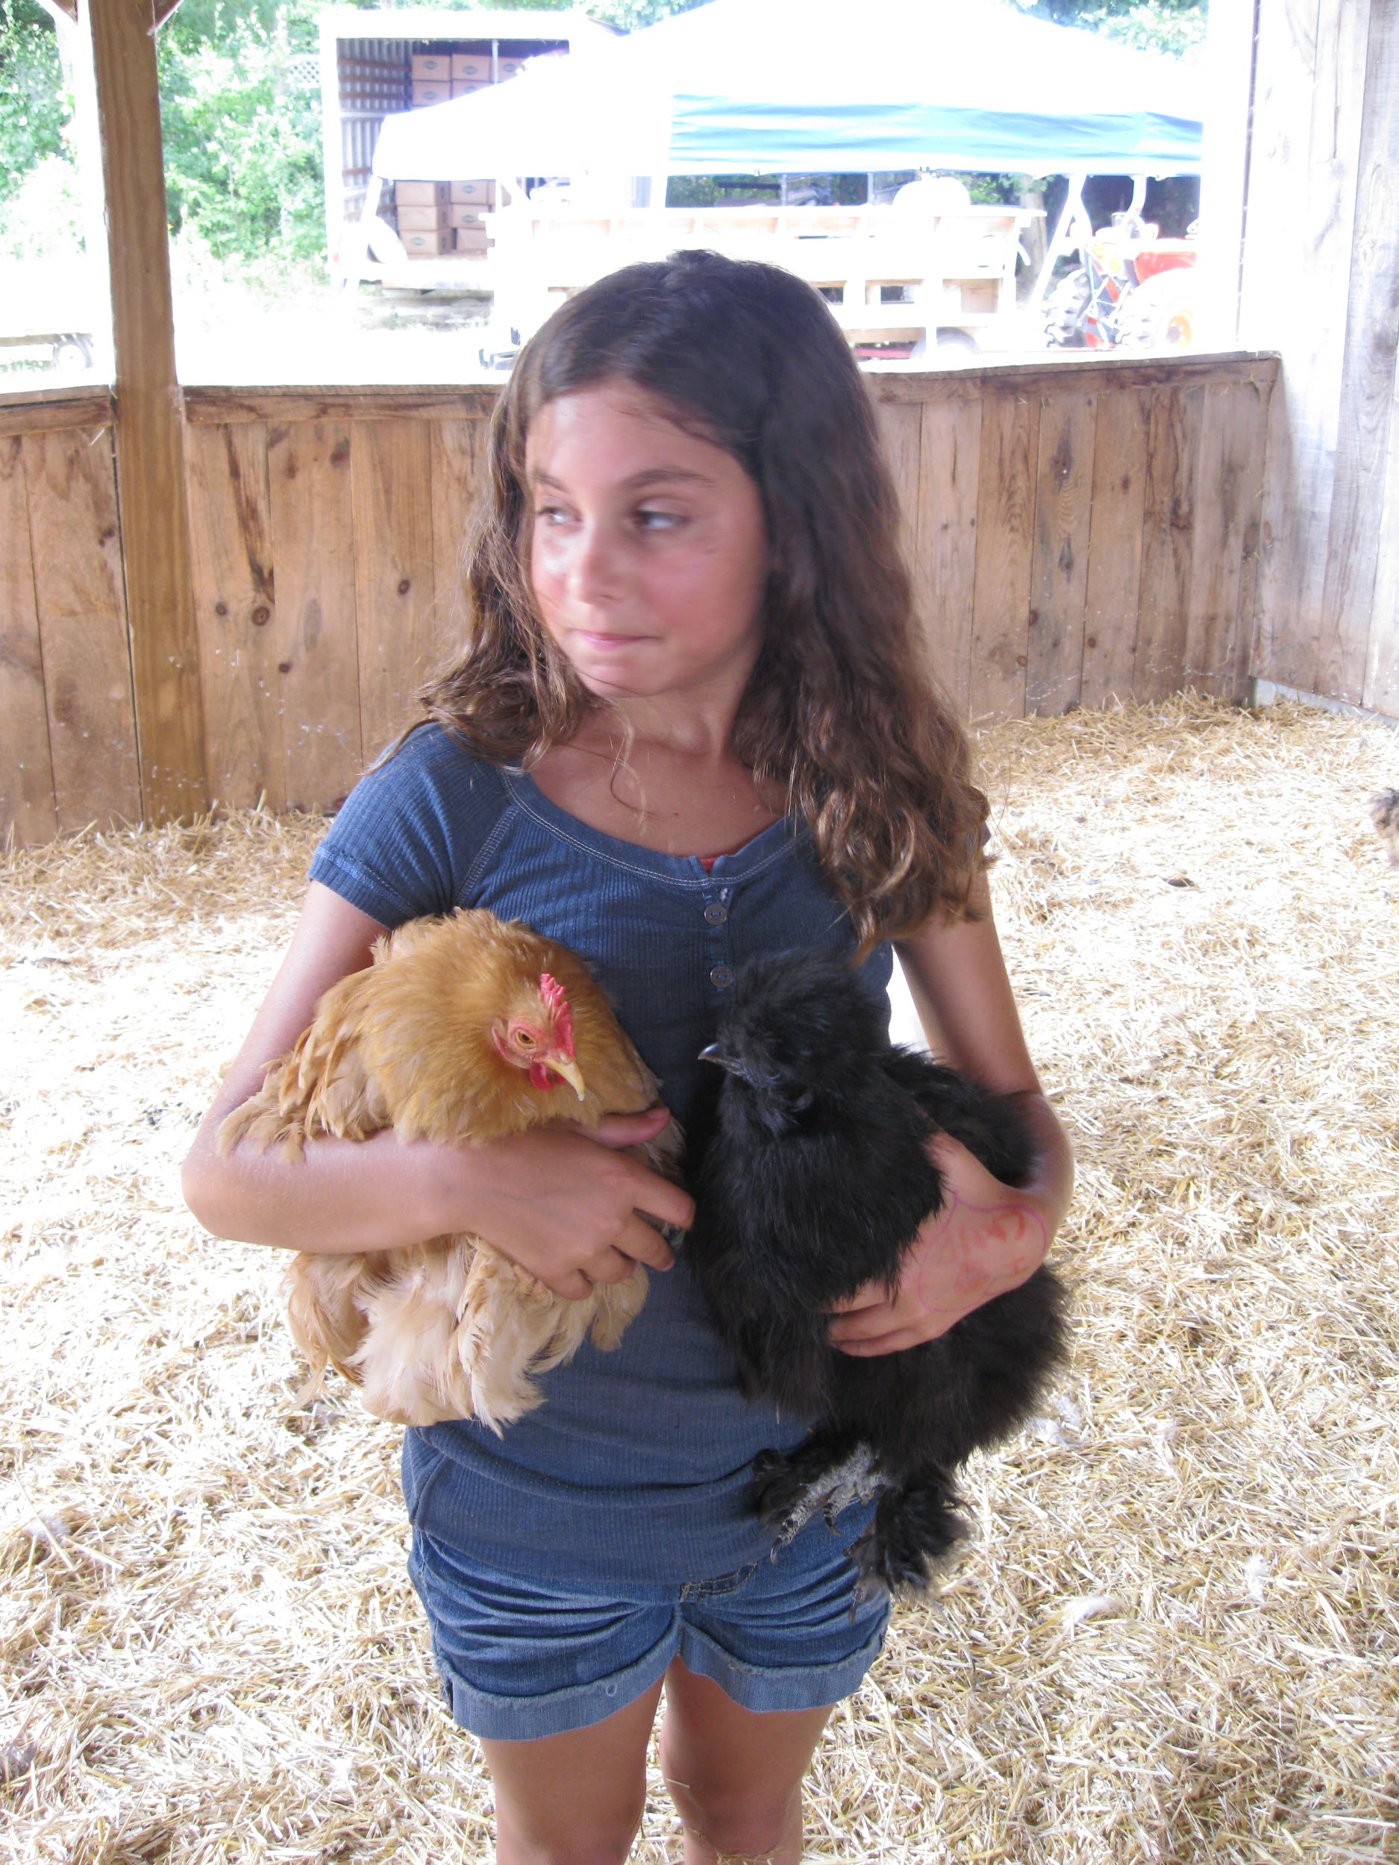
4.NF.B3
Notes:
Week of April 8, 2024

Slide 7
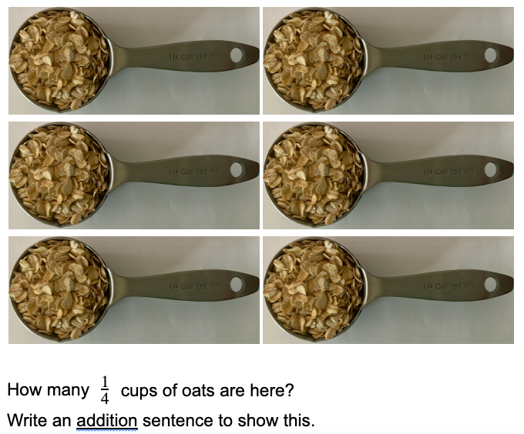
4.NF.B4

Slide 8
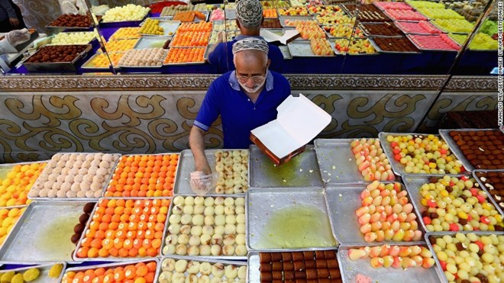
Today is the celebration of Eid Al-Fitr
عيد مبارك
Where do we see arrays in this bakery?
How can we use them to determine how many traditional sweets are here?
Create an equation to match your thinking.
4.NBT.B5
Notes:
April 10, 2024
Eid Al-Fitr

Slide 9


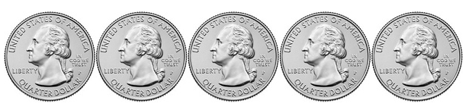
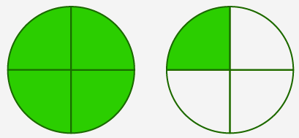
Which one doesn’t belong?
+
4.NF.A

Slide 10
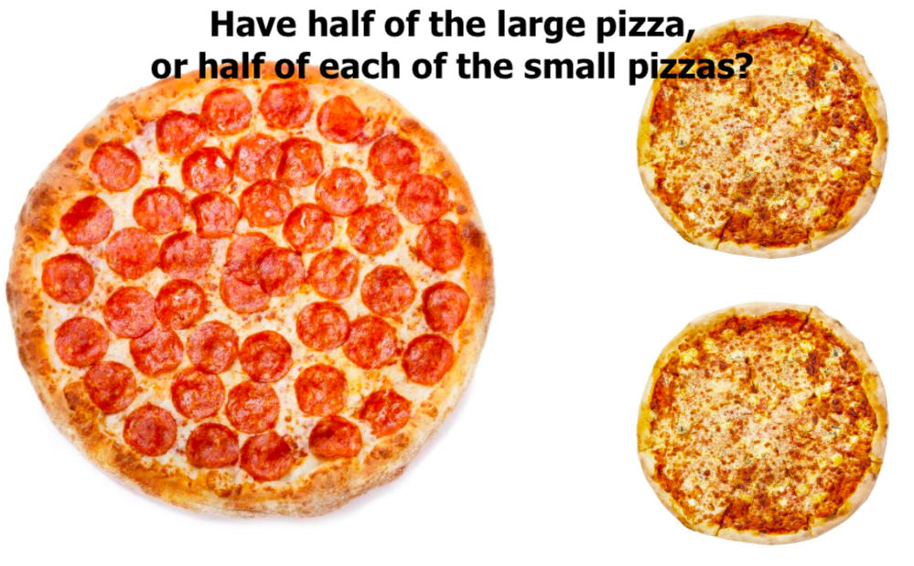
Would you rather . . .
4.NF.A

Slide 11
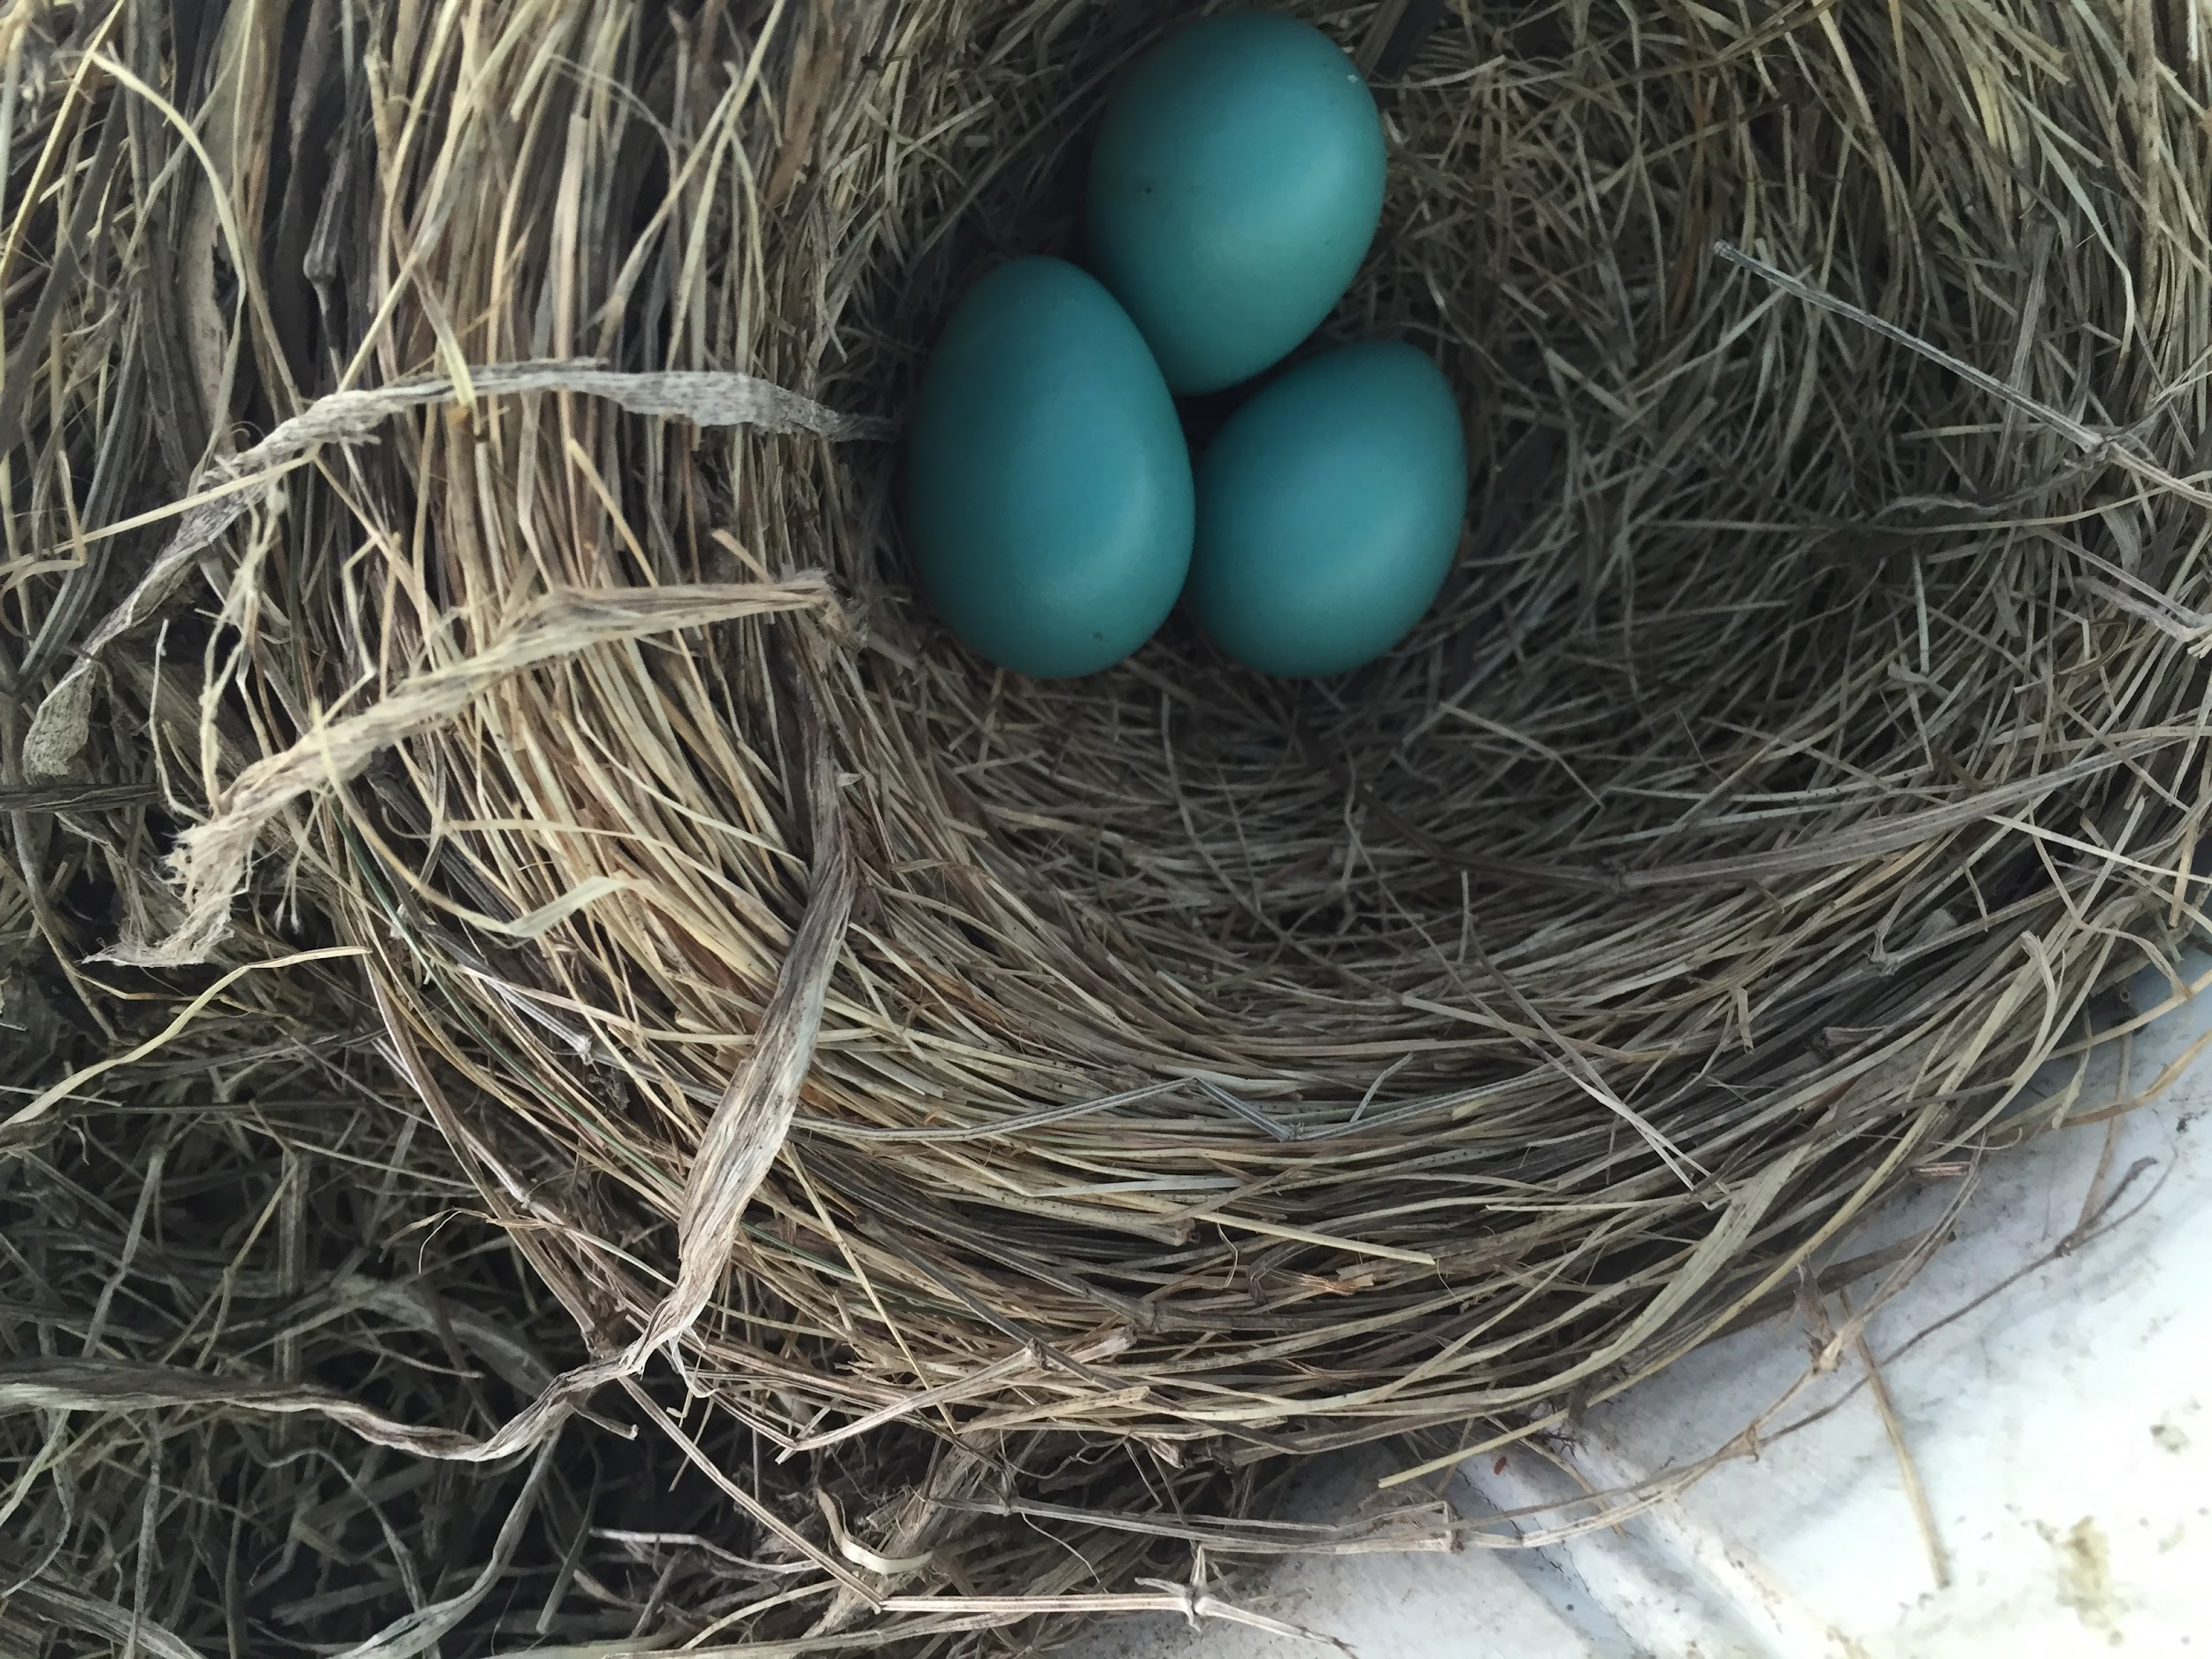
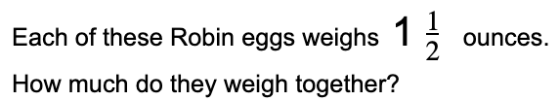
4.NF.B4
Notes:
Week of April 22, 2024

Slide 12
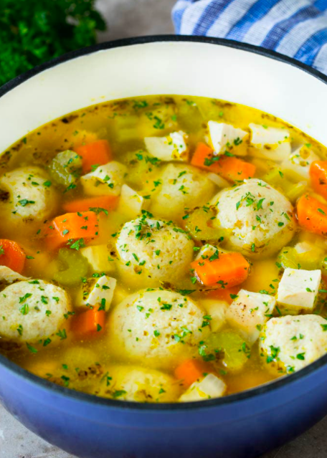
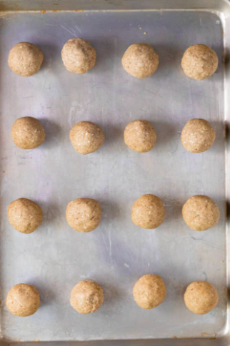
חַג פֵּסַח שַׂמֵחַ
How many matzo balls are in the soup?
Estimate!
What might be too low? Too high? Just right?
4.OA.A3

Slide 13
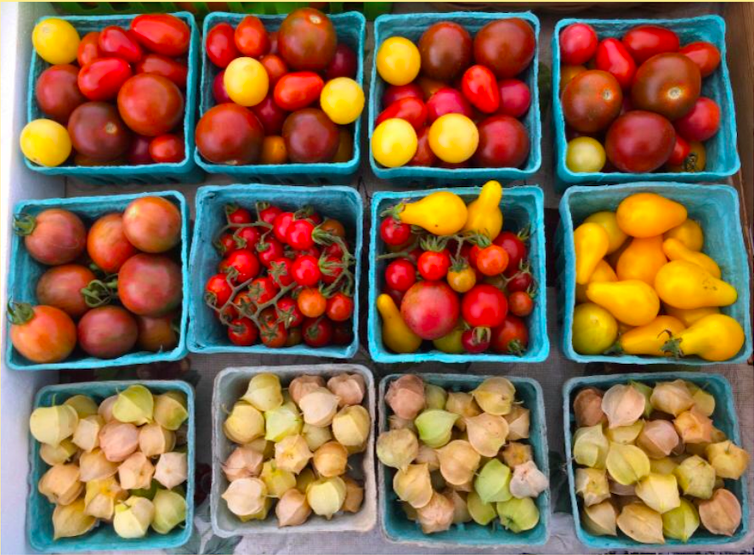
What math do you see here?
Do you see any fractions?
4.NF

Slide 14
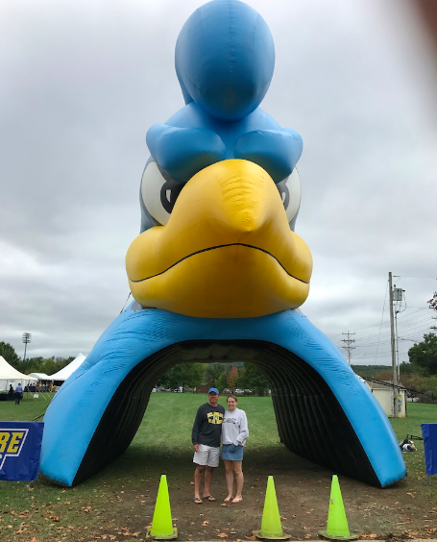
How tall is the University of Delaware BLUE HEN?
HINT! Mark (in the blue shirt) is about 6 feet tall, what fraction of the hen might he be?
4.NF.B3

Slide 15

What FRACTIONS can you see in this picture?
4.NF.A2

