Slide 1
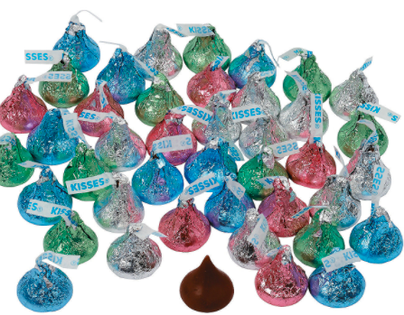
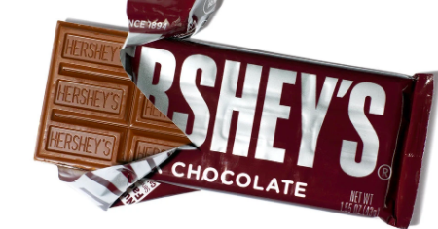
Would you rather ...
2 huge handfuls of Hershey Kisses or 1 Hershey bar?
2.MD
Notes:
Week of April 1, 2024

Slide 2
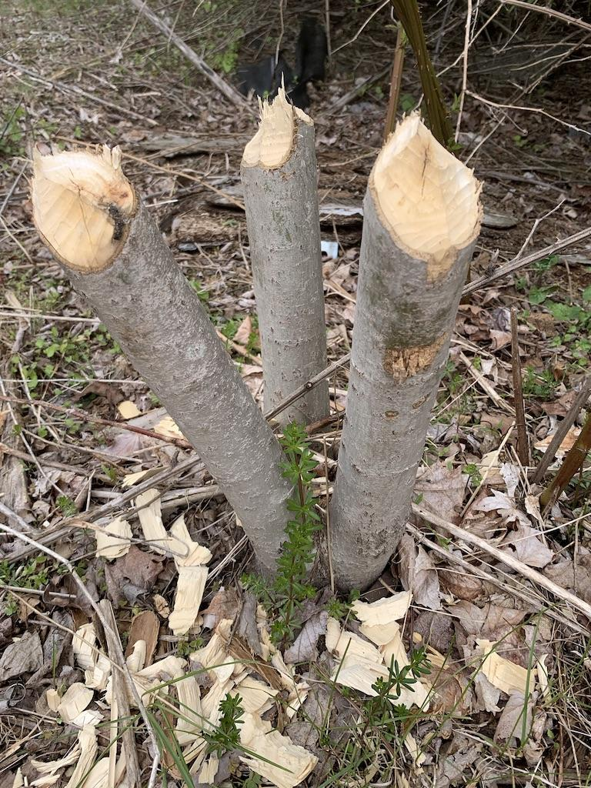
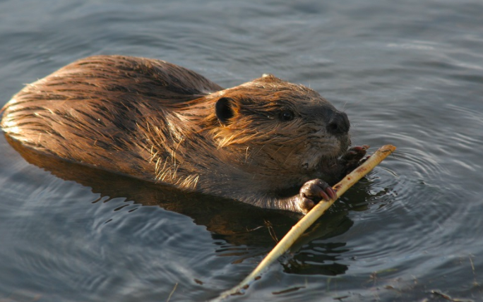
The beaver family that lives in our neighborhood took down these 3 small trees in one day.
How many trees will they be able to cut down in a week?
In a month?
2.NBT.B7

Slide 3
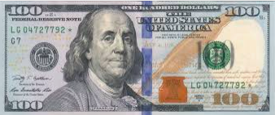
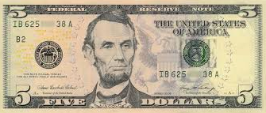
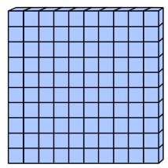

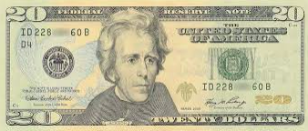
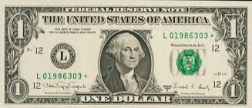
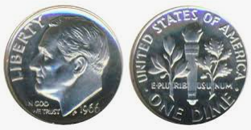
Which one doesn’t belong?
2.MD.C8

Slide 4
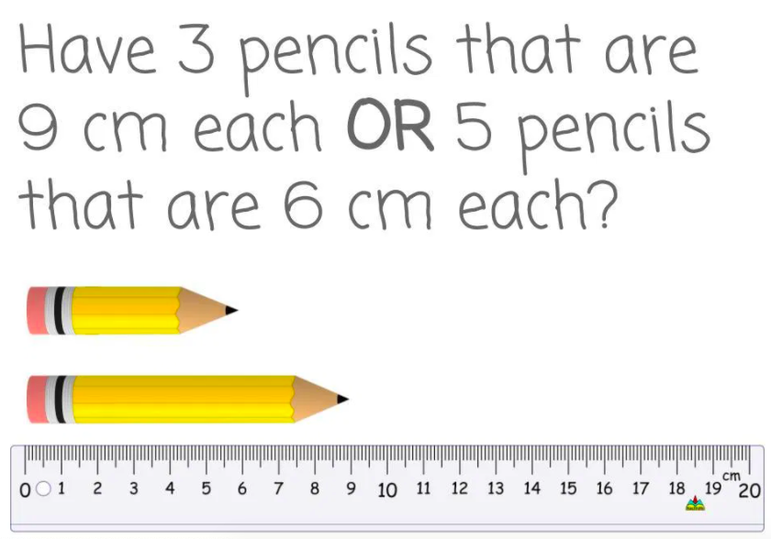
Would you rather...
2.MD.A3
wouldyourathermath.com

Slide 5
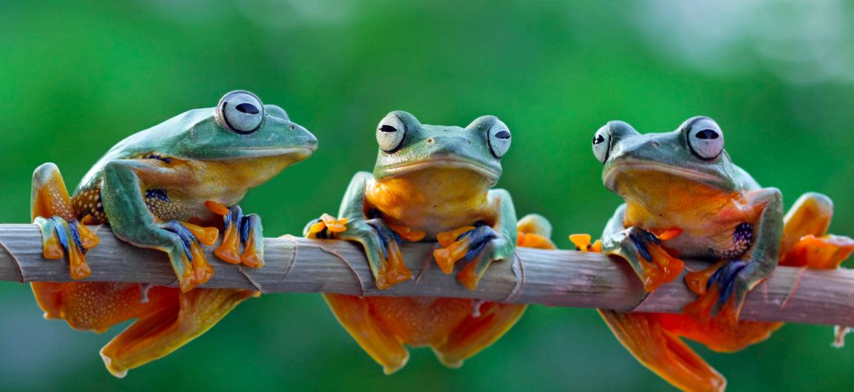
These Tree frogs weigh about 14 grams each.
How much do they weigh together?
2.MD.B5

Slide 6
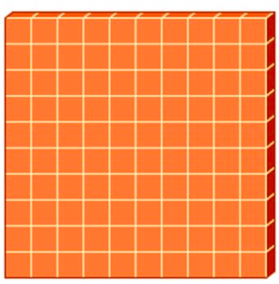


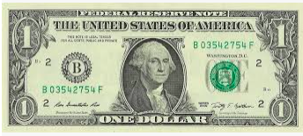
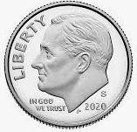
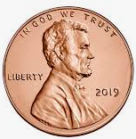
Which one doesn’t belong?
2.NBT.B4
Notes:
Week of April 8, 2024

Slide 7

20 + 345 > 20 + 245
657 - 40 < 657 - 30
999 + 10 < 999 + 20
2.NBT.A4

Slide 8
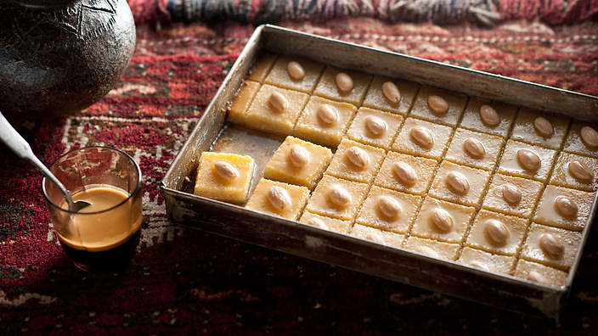
Today is the celebration of Eid Al-Fitr
عيد مبارك
How many delicious Nammoura are here?
What are some strategies we can use to figure it out?
Can you write an equation to match your thinking?
2.OA.C4
Notes:
May 10, 2024
Eid al-fitr

Slide 9
Draw this shape.
Now draw a shape that is DIFFERENT from the shape in 1 way, but the SAME in another way.
How are they DIFFERENT?
How are they ALIKE?
2.G.A1

Slide 10
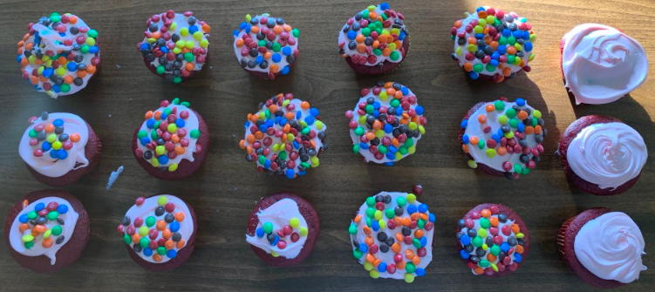
Where’s the Math?
2.OA.C4

Slide 11
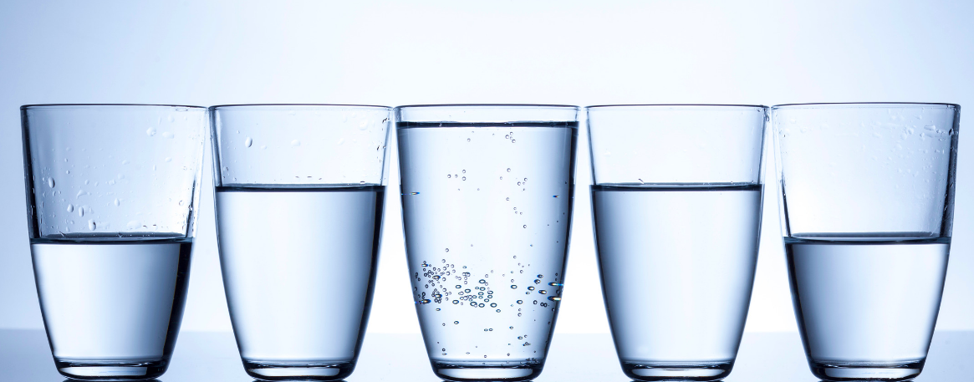
What do you notice? What do you wonder?
What math sentences can you create to match the photo?
2.G.A3
Notes:
Week of April 22, 2024

Slide 12
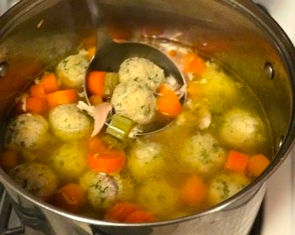
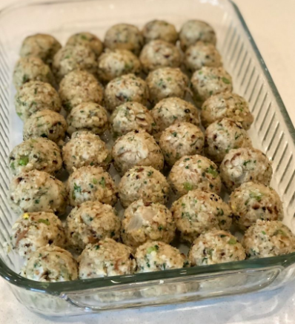
חַג פֵּסַח שַׂמֵחַ
How many matzo balls are in the soup?
What is too low estimate?
What is too high estimate?
What is your just right estimate?
2.OA.C4

Slide 13
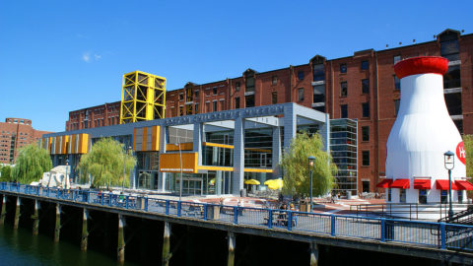
The Hood Milk Bottle is 40 feet tall.
If you are about 4 feet tall, how much taller is it than you?
How many TIMES taller is it than you?
2.MD.A4

Slide 14
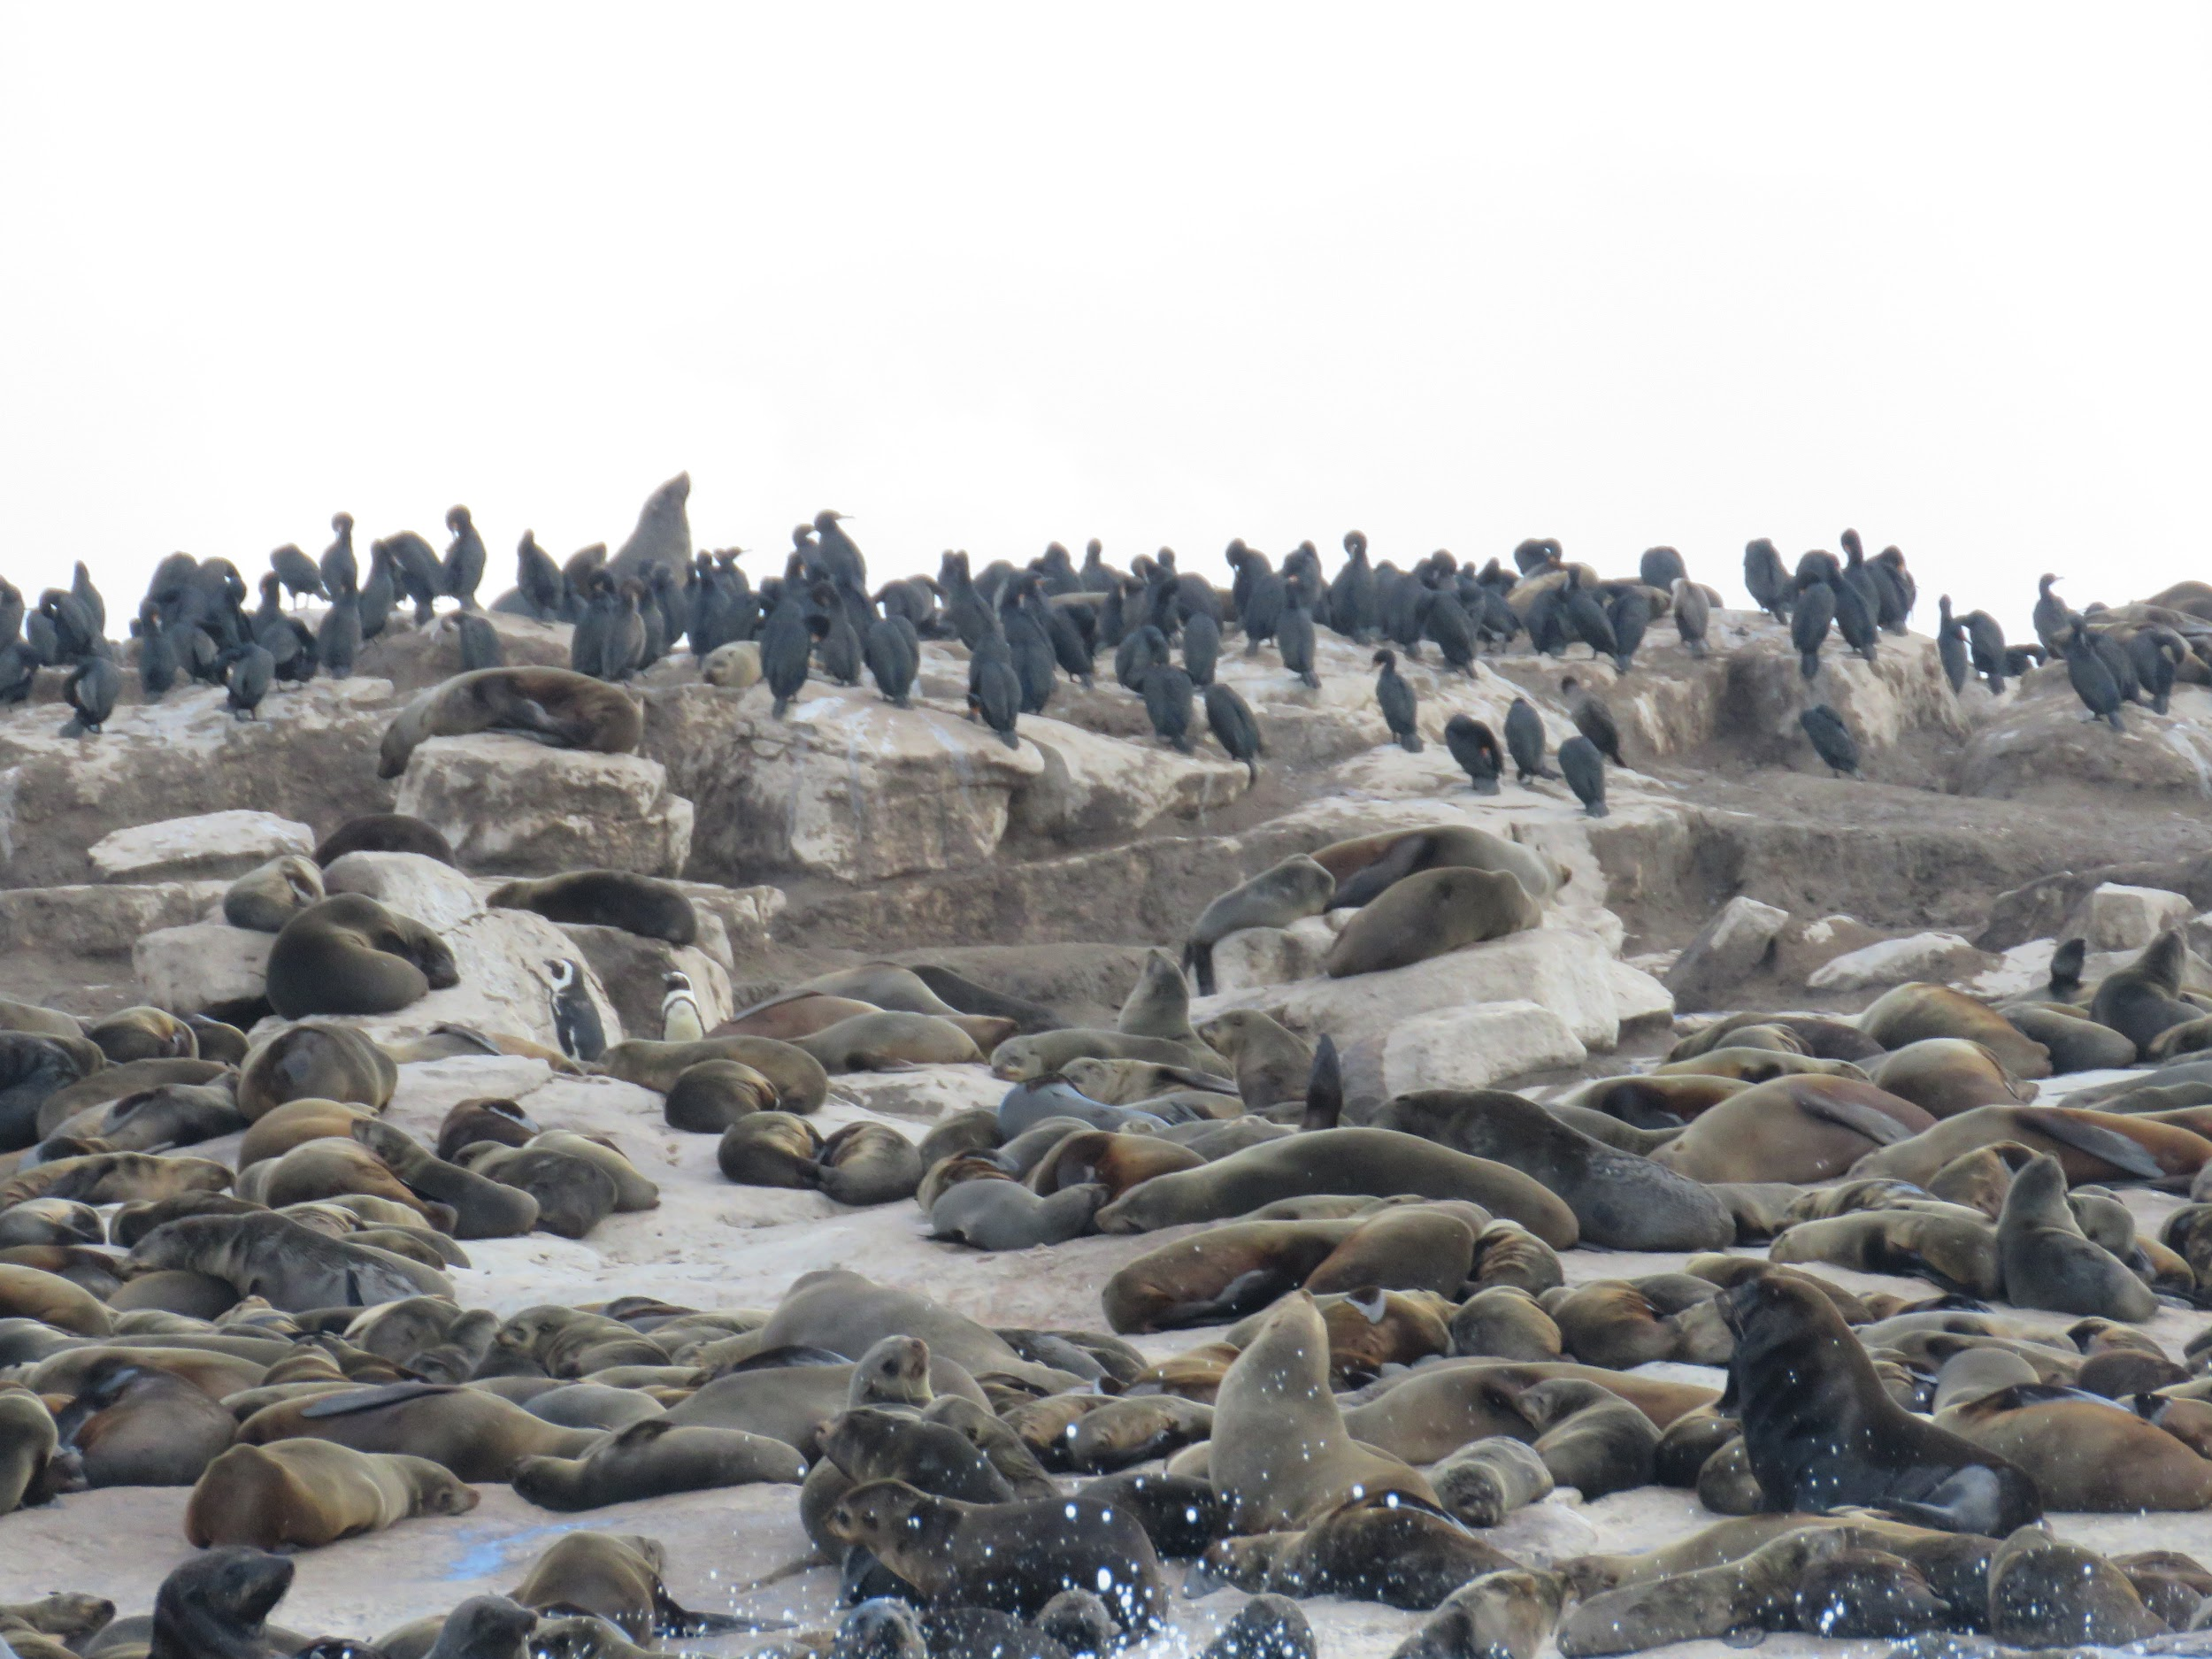
How many seals do you think are here on Robben Island in South Africa?
Estimate!
Why would you want to know?
2.OA.A

Slide 15
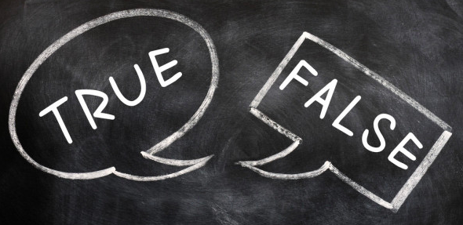
Prove it!
2 hundreds + 12 tens + 5 ones > 3 hundreds + 1 ten + 15 ones
8 hundreds + 1 ten + 32 ones = 7 hundreds + 40 tens + 12 ones
5 hundreds + 24 tens + 3 ones > 6 hundreds + 9 tens + 13 ones
2.NBT.A1

