Slide 1
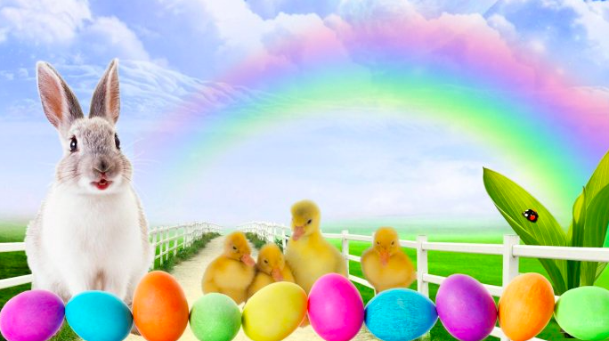
Where’s the math?
How many faces?
How many legs?
How many eggs?
What creative number sentences can you write to match the picture?
1.NBT.4
Notes:
Week of April 1, 2024

Slide 2
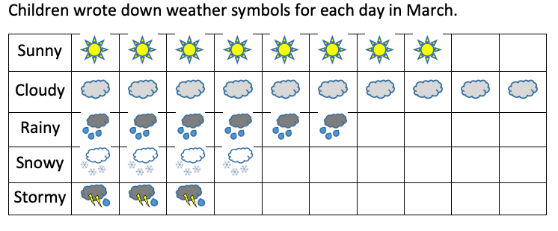
If this graph could talk, what would it say?
1.MD.4

Slide 3
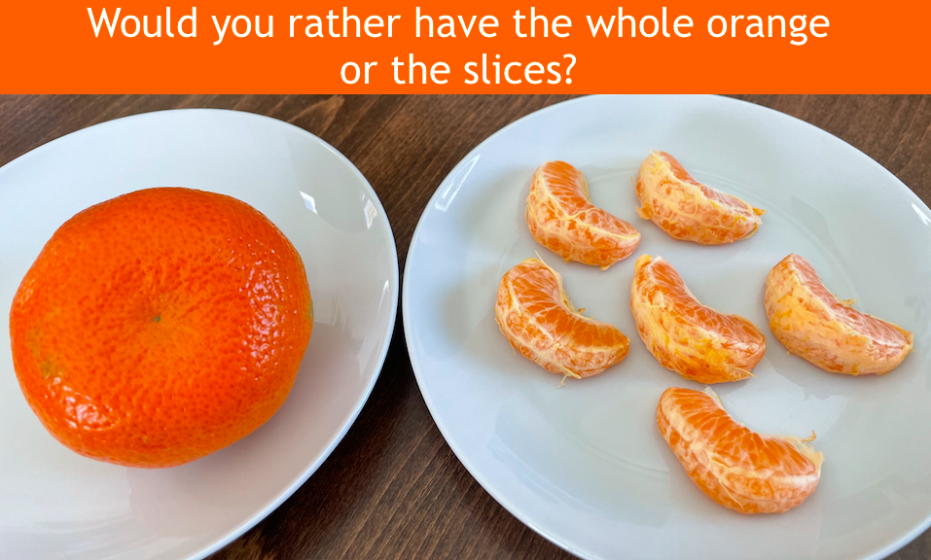
1.G.3

Slide 4
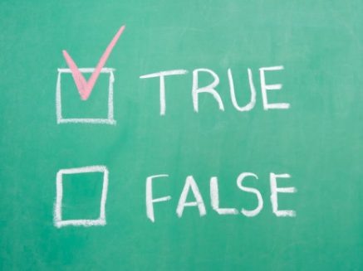
20 = 41 - 21
7 + 8 = 20 - 5
20 + 9 = 30 - 9
1.OA.7

Slide 5
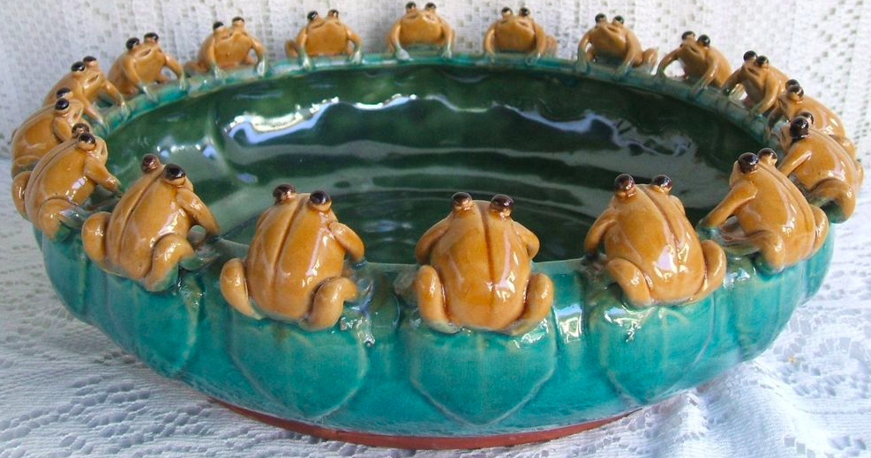
How many frogs?
How many different number sentences can you write to = 18?
1.OA.6

Slide 6

Would you rather
Read your favorite book ALL day
Or read 1 hour a day for the whole week?
1.MD.3
Notes:
Week of April 8, 2024

Slide 7
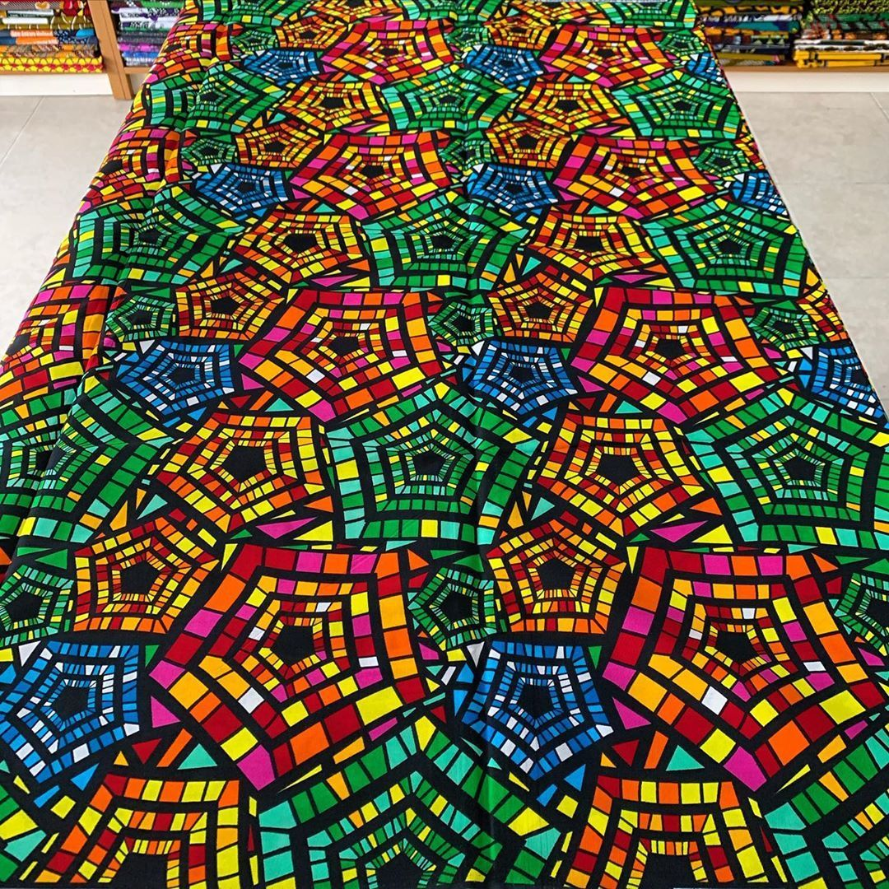
Let’s talk about all of the shapes and patterns in this Ankara cloth!
1.G.1.2

Slide 8
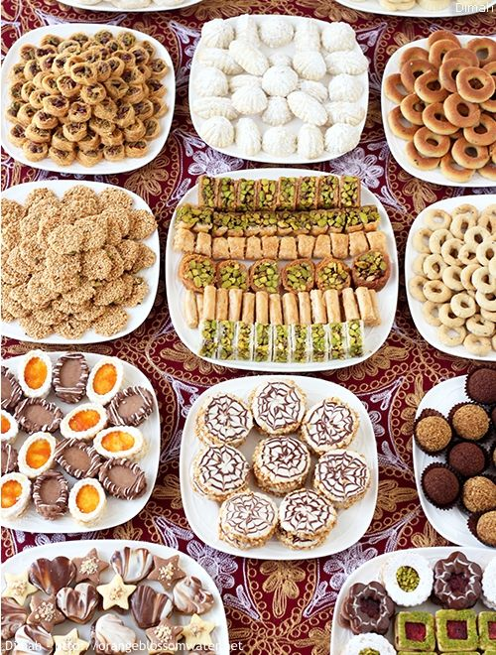
Today is the celebration of Eid Al-Fitr
Describe some of the shapes we see in these traditional holiday sweets.
What would happen if we put some of the shapes together?
What if we partitioned some of them?
1.G.A3
Notes:
May 10, 2024
Eid al-fitr

Slide 9
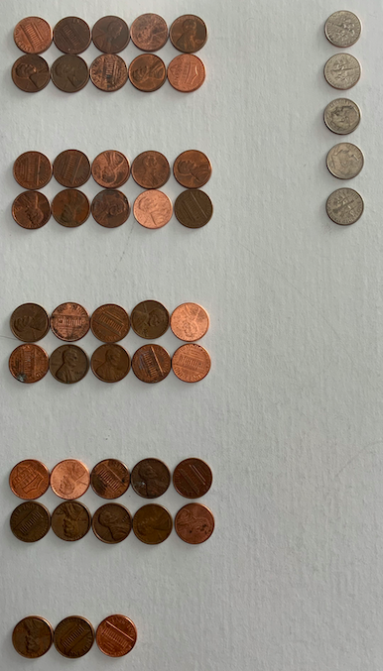
How many pennies?
How many dimes?
How do you see the coins?
How much money?
What number sentence matches this picture?
1.MD.5

Slide 10
Draw this shape.
Now draw a shape that is DIFFERENT from the shape in 1 way, but the SAME in another way.
How are they DIFFERENT?
How are they ALIKE?
1.G.1

Slide 11
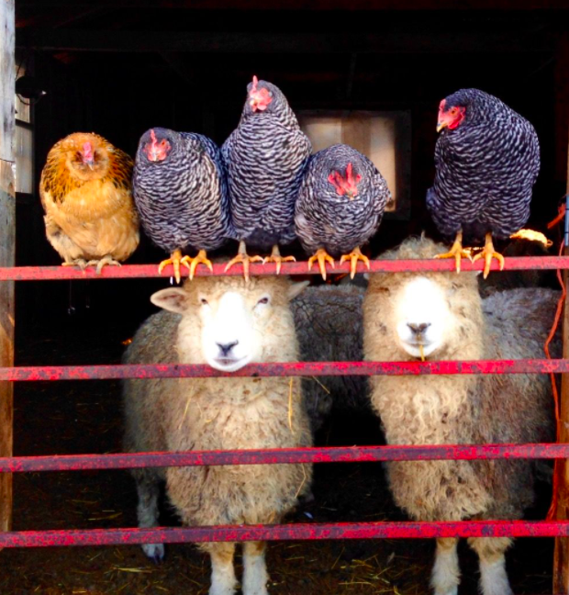
How many chickens?
How many sheep?
How many faces?
How many legs?
Create a number sentence!
1.OA.2
Notes:
Week of April 22, 2024

Slide 12
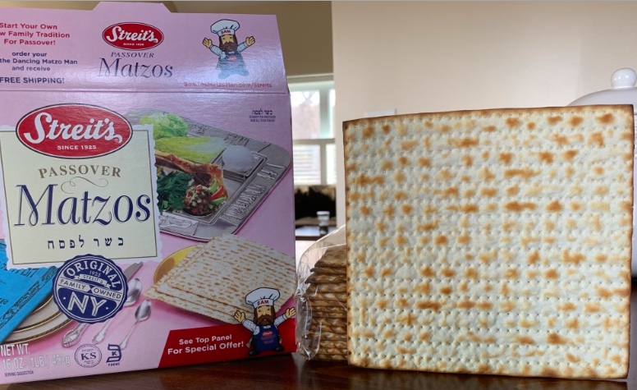
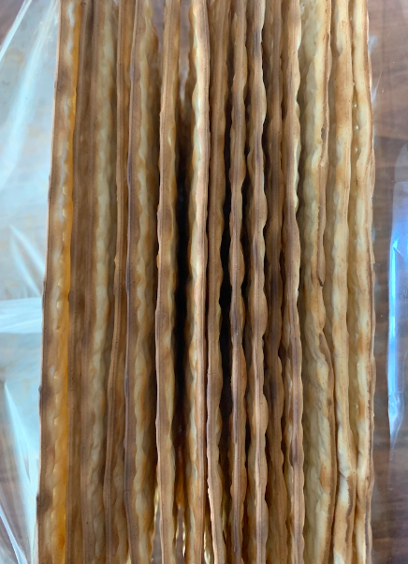
How many pieces of Matzo are in the box?
What is an estimate this is too low? Too high?
What is a just right estimate?
15
1.NBT.1

Slide 13
True or False?
3 dimes + 2 pennies = 32 pennies
5 nickels < 3 dimes
4 dimes < 8 nickels
1.MD.5

Slide 14

100 FROGS!!!!
How many legs is that?
How can we solve this?
1.OA.C

Slide 15

This scale is balanced.
What can you say about the weights of the shapes?
1.MD.A1

