Slide 1
What is the Same?
What is Different?
K.OA.A3
Notes:
Week of January 29, 2024

Slide 2
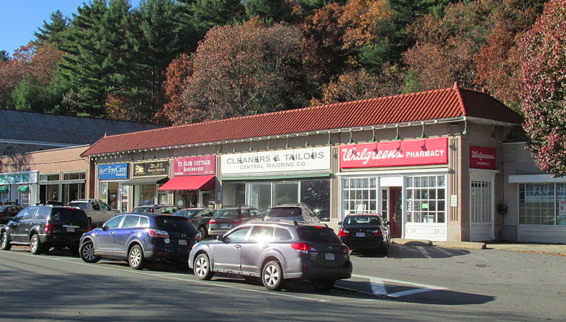
Talk about the different shapes you see here.
K.G.A2

Slide 3
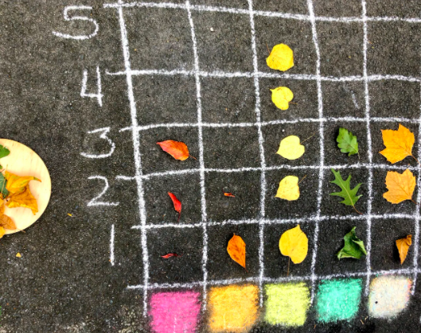
What can you say about this graph?
K.MD.B3

Slide 4
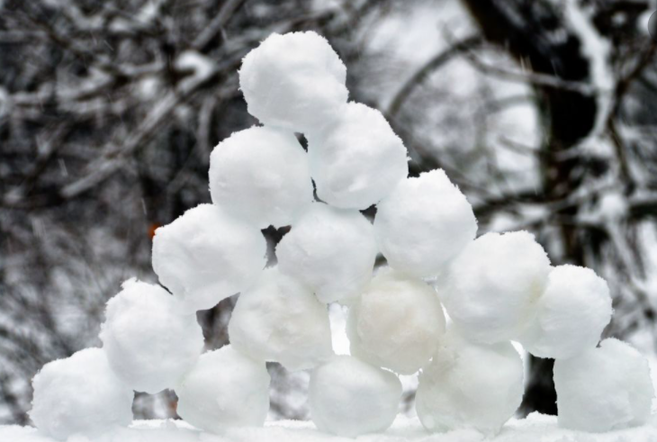
Are there more than 10 snowballs or less?
How can we count them?
K.CC.B5

Slide 5

The date is 2 / 2 / 24
What can we say about these numbers?
K.OA.A1
Notes:
February 2, 2024
Groundhog Day

Slide 6
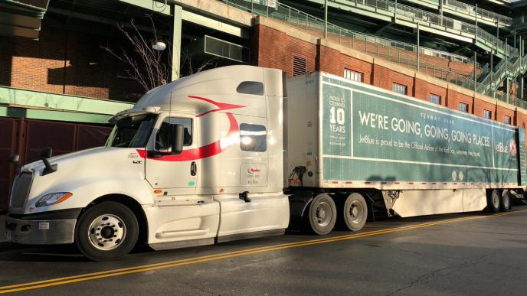
It’s Truck Day in Red Sox Nation!
Spring Training is in the air! What’s on the truck?
20,400 baseballs
1,100 bats
200 batting gloves
200 batting helmets
400 T-shirts
400 pairs of socks
20 cases of bubble gum
60 cases of sunflower seeds
How many wheels do you think are on that truck?
How many do you see?
How many don’t you see?
K.CC.B5
Notes:
Week of February 5, 2024
Red Sox Truck Day

Slide 7
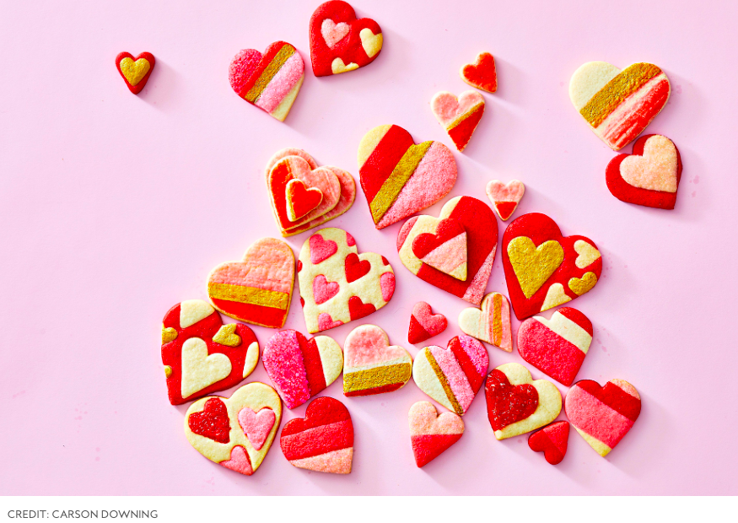
What do you notice?
What math do you see?
K.CC.B4

Slide 8
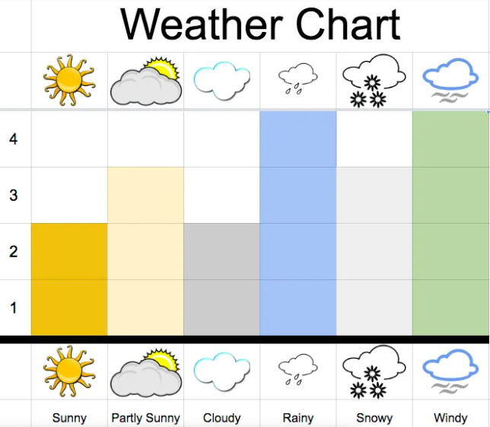
What you notice?
What do you wonder?
K.MD.B3

Slide 9
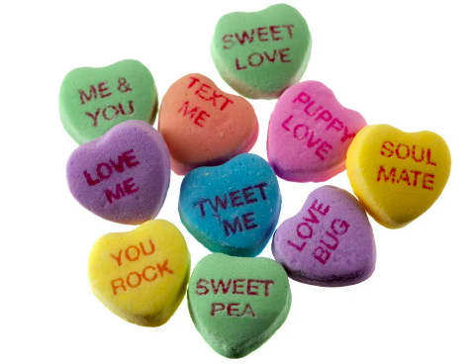
How many hearts are here?
How can we count them?
Let’s write an equation to match our thinking!
K.OA.A1

Slide 10

Happy Chinese
New Year!
Are there more than 10 lanterns or less than 10?
How do you know?
K.CC.B4
Notes:
Week of February 12, 2024
Chinese New Year (Feb. 10)

Slide 11
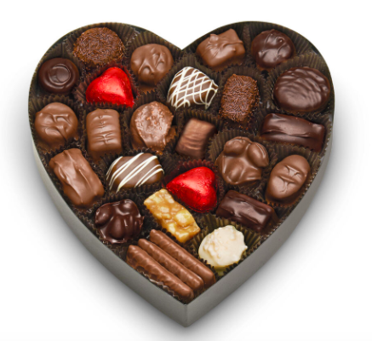
How would you sort these?
How would you count them?
K.MD.B3

Slide 12
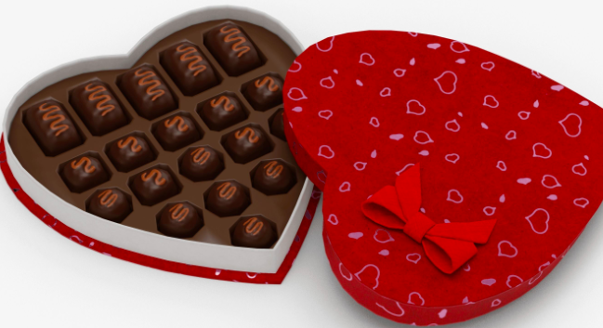
What shapes do you see?
What interesting number sentence can you create?
K.G.OA

Slide 13
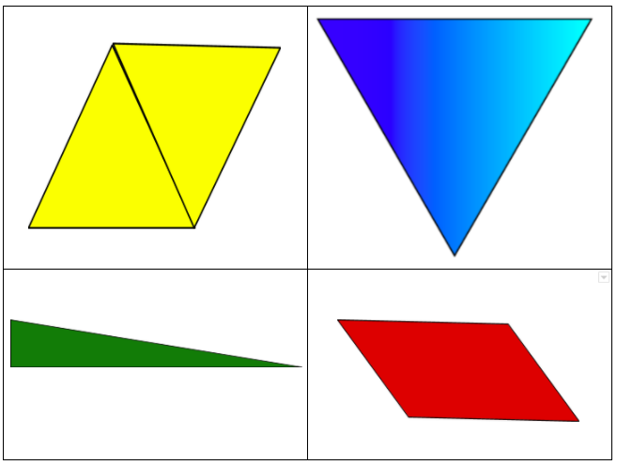
Which one does not belong?
K.G.B4

Slide 14
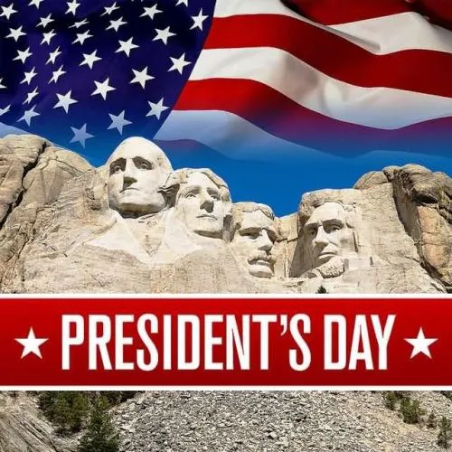
How many presidents are here?
Who are the presidents on Mount Rushmore?
How many different ways can we make 4?
K.OA.A3

Slide 15
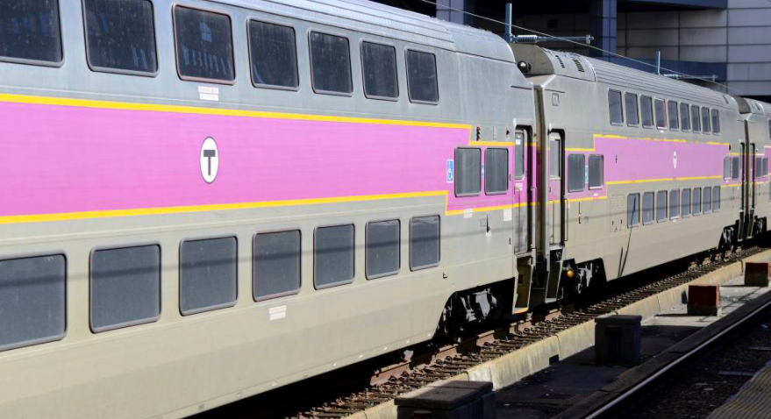
How many windows are on the train?
How many would be on 2 trains?
K.CC.B5
Notes:
Week of February 26, 2024

Slide 16
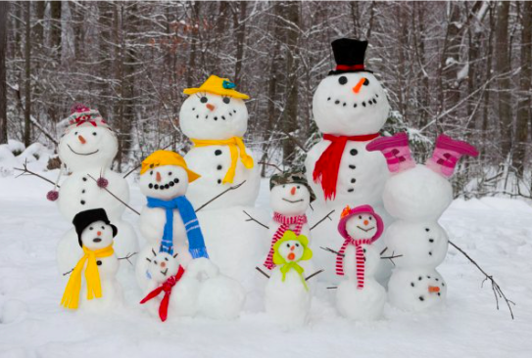
What can we say about this snow family?
Use words like next to, bigger, smaller…
What math do we see?
How many buttons? How many carrot noses?
How many eyes?
K.MD.B3

Slide 17
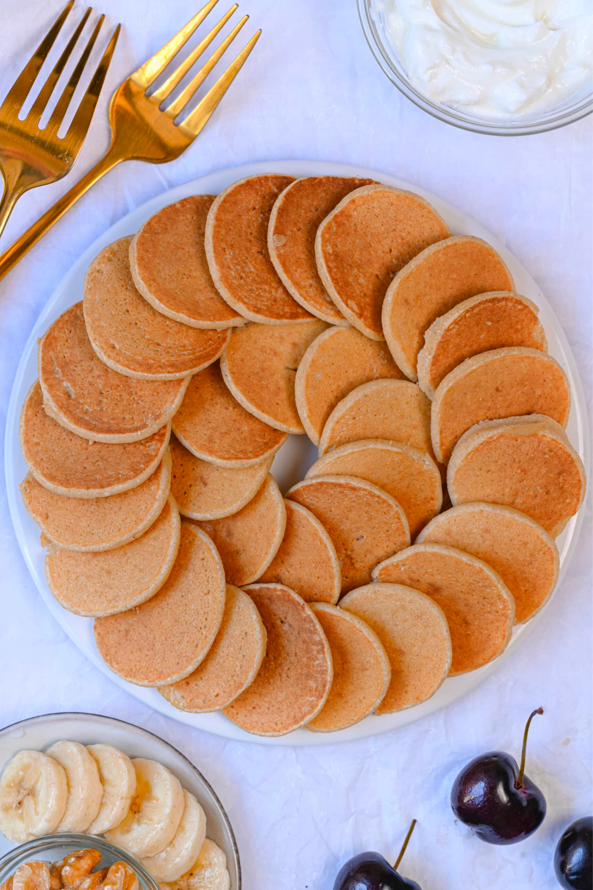
Happy International Pancake Day!
How many pancakes are on the plate?
How can we count them?

Slide 18
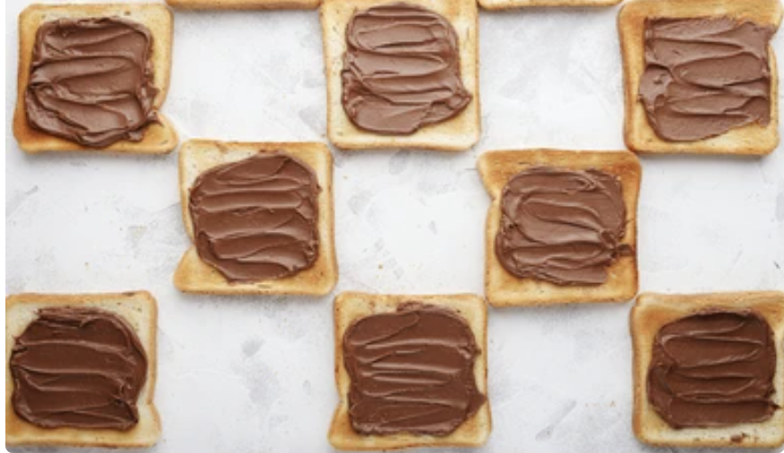
Today is National Toast Day!
What can we say about the shape?
How many pieces of toast do we see?
How do we see them?

Slide 19
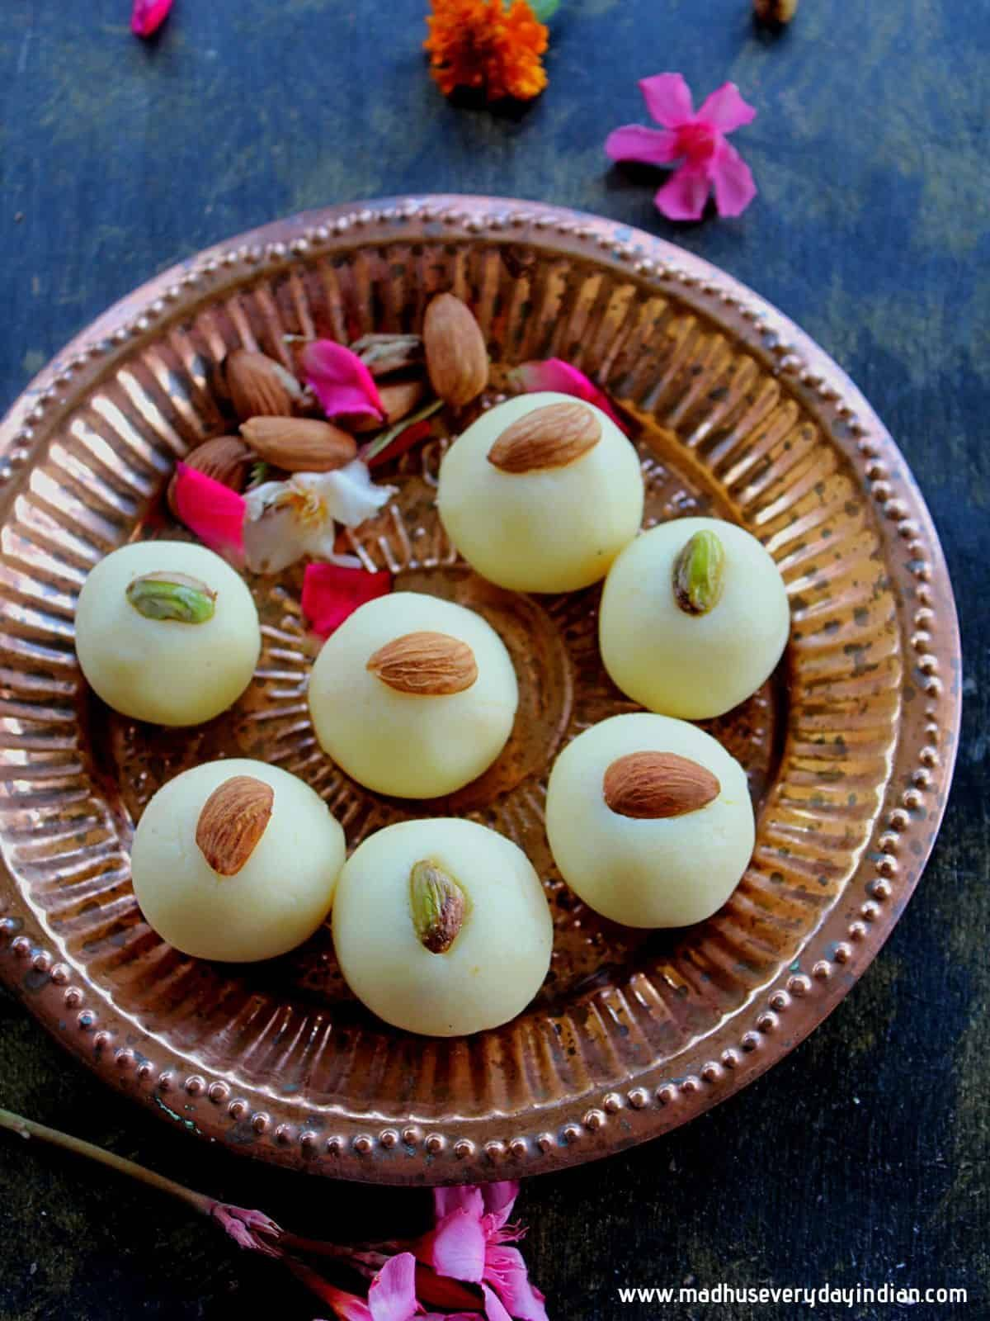
Maha Shivaratri Festival!
How many Malai Peda do we see?
How do we see them?
Create an equation to match your thinking!
K.CC.A5
Notes:
March 1, 2024
Maha Shivaratri Festival

