Slide 1
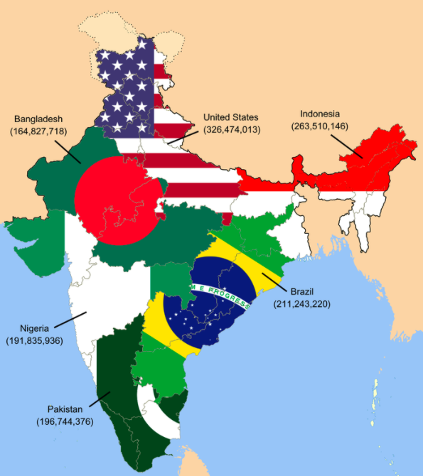
If this infographic could talk, what would it say?
This rough map illustrates that the population of India is as high as the next six most populated countries of the world... combined.
What is a good name for this graphic?
5.MD.B
Notes:
Week of January 29, 2024

Slide 2
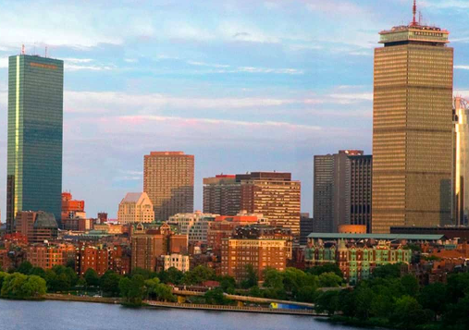
The distance between the Hancock Tower and the Prudential Center is .7 miles.
How far is that?
How many feet is that?
(There are 5280 feet in a mile)
Estimate!!
How can you solve this?
5.NBT.B7

Slide 3
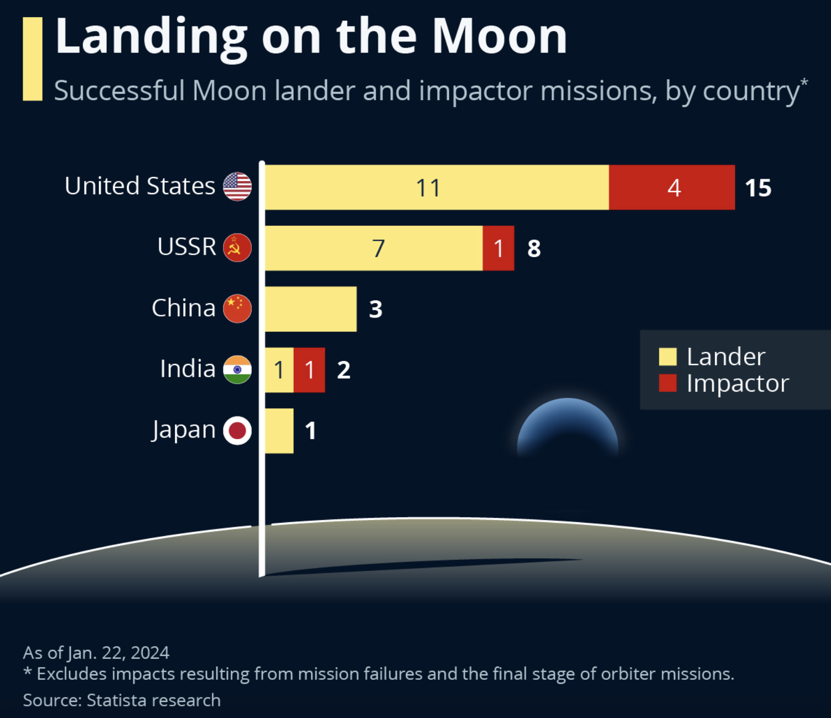
What do you notice?
What do you wonder?
What is going on in this data visualization?
5.MD.B

Slide 4
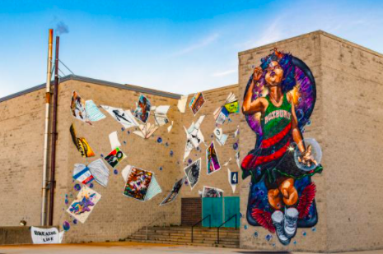
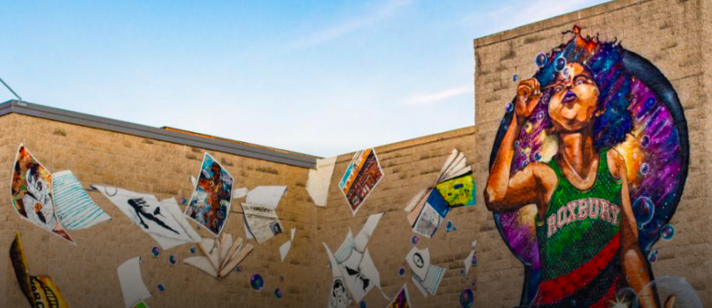
Use mathematics to estimate how high this mural is. Think in meters and centimeters!
5.MD.A1

Slide 5
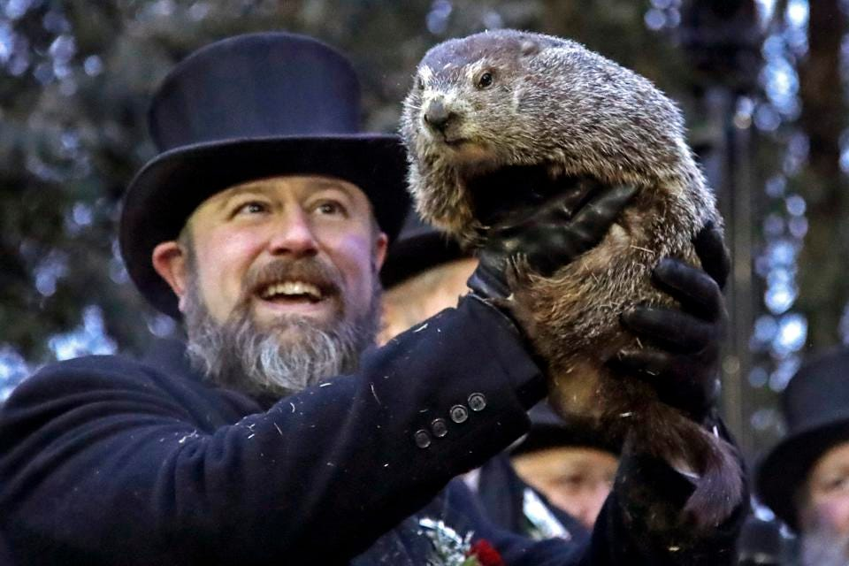
Did you know that an average Groundhog (which is exactly the same as a woodchuck!) weighs between 5 - 13 pounds.
If this little guy is EXACTLY in between 5 - 13 pounds, how many ounces is that? (There are 16 ounces in a pound)
Punxsutawney Phil checks for his shadow at Gobbler’s Knob in Punxsutawney, Pennsylvania each year. Will he see his shadow? Will we have an early Spring?
5.MD.A1
Notes:
February 2, 2024
Groundhog Day

Slide 6
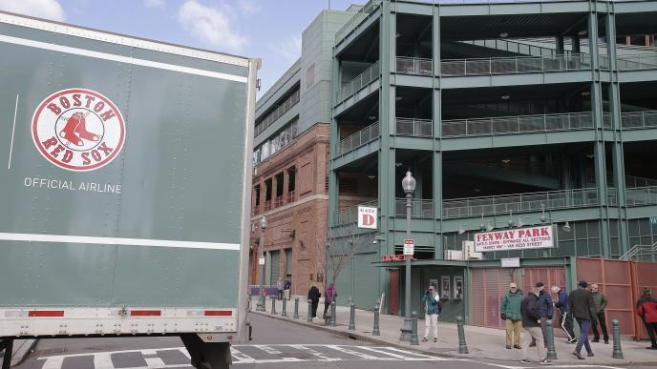
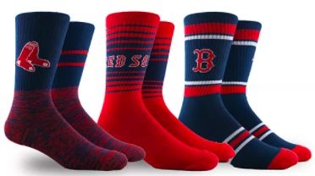
It’s Truck Day in Red Sox Nation!
Spring Training is in the air! What’s on the truck?
20,400 baseballs
1,100 bats
200 batting helmets
200 batting gloves
400 T-shirts
400 pairs of socks
20 cases of bubble gum
60 cases of sunflower seeds
5.NF.A
Let’s do some mental math!
How many pieces of equipment?
How many pieces clothing (gloves, shirts, socks)? What fraction of the all of the clothing are the
gloves? T-Shirts? Socks?
Notes:
Week of February 5, 2024

Slide 7
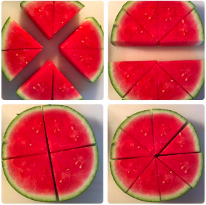
What fractions do you see?
5.NF.A

Slide 8
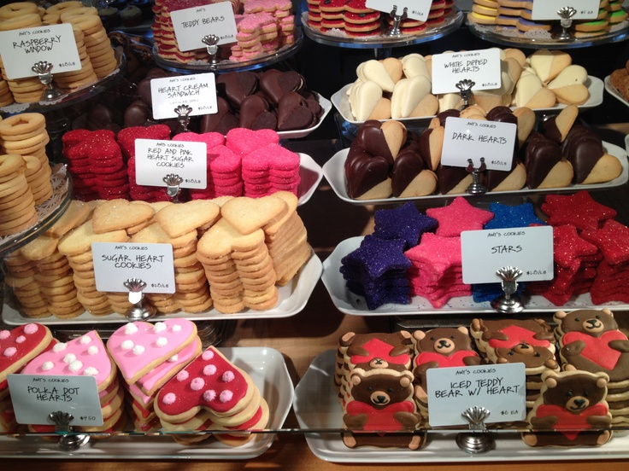
Where’s the Math?
5.NBT.5

Slide 9
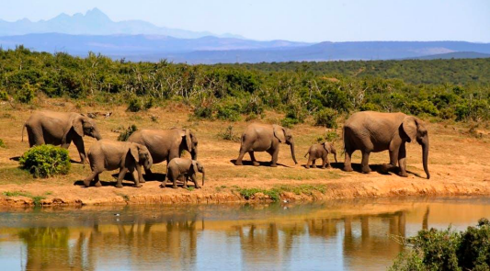
An African forest elephants’ tusks grow about 17 cm each year. If an elephant lives to be 65 years old,
about how long, in meters, would their tusks be?
5.MD.A1

Slide 10
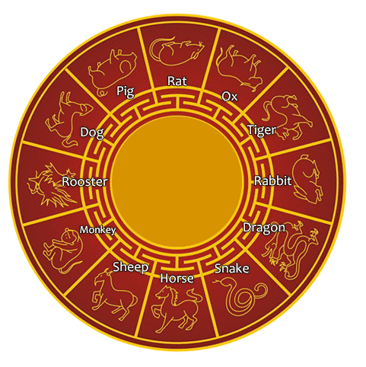
Happy Chinese New Year!
It’s the year of the Dragon!
What do you notice? What do you wonder?
The Chinese Zodiac is a 12 year cycle!
What year were you born? What animal was that?
Both Kevin Durant (Phoenix Suns) and Russell Wilson (Denver Broncos) are Dragons, can you figure out what year they were born?
5.NBT.5
Notes:
February 12, 2024
Chinese New Year (Feb 10)

Slide 11
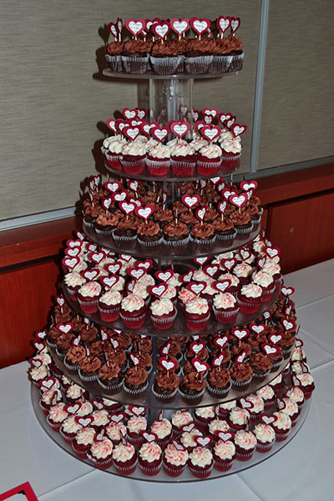
Estimate the number of cupcakes in this tower.
How can you use math to help you get close?
What fraction might be vanilla frosted? chocolate frosted?
5.NF.A

Slide 12
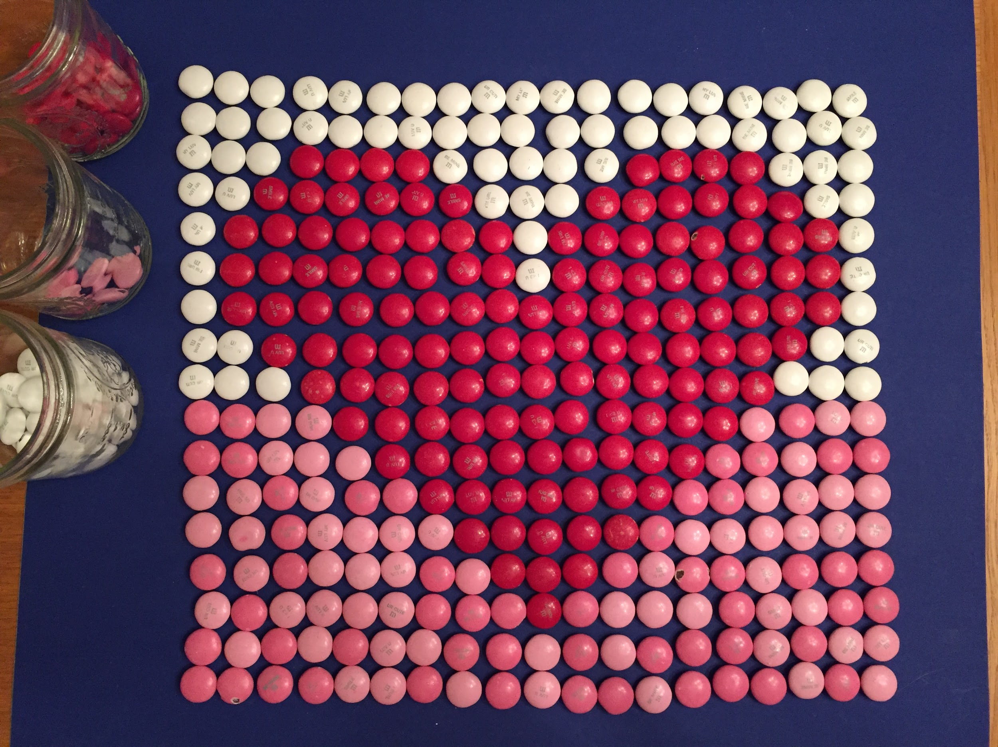
Estimate what fraction of the whole is made of white m&ms.
Red m&ms?
Pink m&ms?
How many m&ms are here altogether?
How can arrays help you solve this?
5.NF.NBT

Slide 13
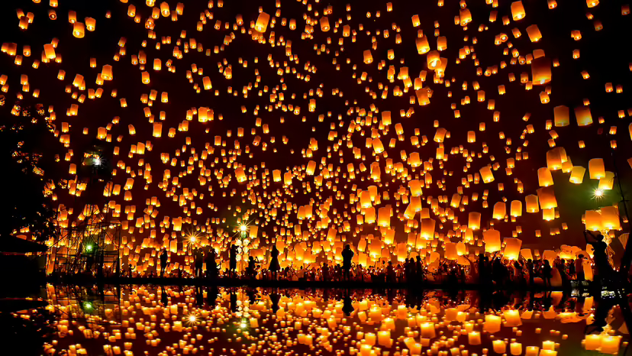
Today is the Lantern Festival in China!
How long ago was the year 104 B.C.?
How can we figure it out?
In 104 B.C., Emperor Wu of the Han dynasty declares that the LANTERN FESTIVAL ceremony should be held through the night to inspire light in the darkness of winter.
5.MD
Notes:
February 15, 2024
Lantern Festival (China)

Slide 14
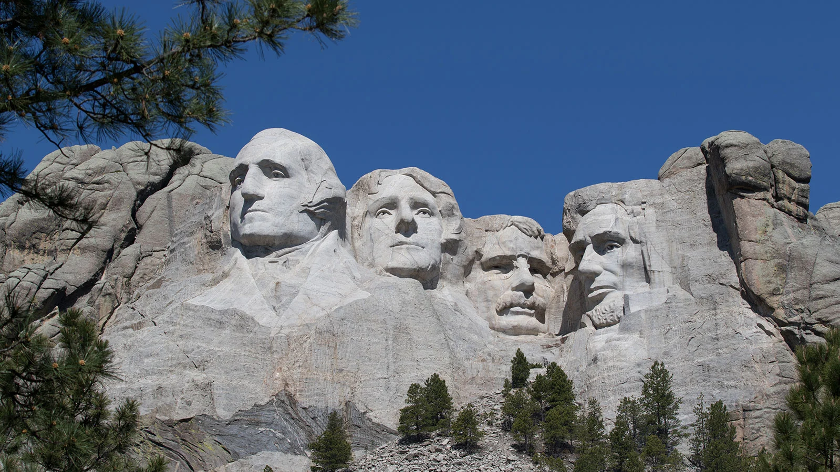
Construction began on Mount Rushmore in 1927. The monument was completed in 1941. How long did it take?
How many months was that?
How many days?
Before it became known as Mount Rushmore, the Lakota called this granite formation Tunkasila Sakpe Paha, or Six Grandfathers Mountain.
5.MD.A1
Notes:
PRESIDENTS ON MOUNT RUSHMORE: George Washington, the country’s first president, would represent its birth. Thomas Jefferson, who nearly doubled the country’s size with his purchase of the Louisiana Territory, stood for its westward expansion. Theodore Roosevelt, who had overseen the construction of the Panama Canal, was a symbol of economic growth. And Abraham Lincoln was selected for having fought to preserve the nation in the Civil War.

Slide 15
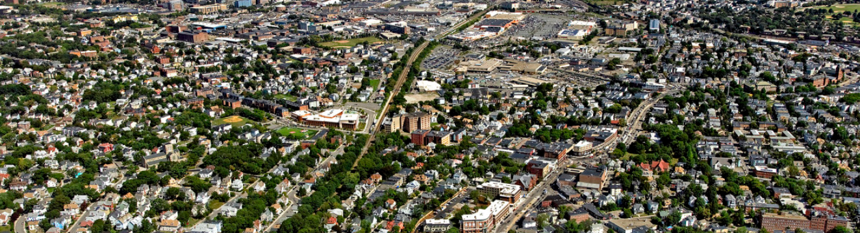
What estimation strategies can you use to determine how many homes
are in this photo of Dorchester?
5.NBT.A
Notes:
Week of February 26, 2024

Slide 16
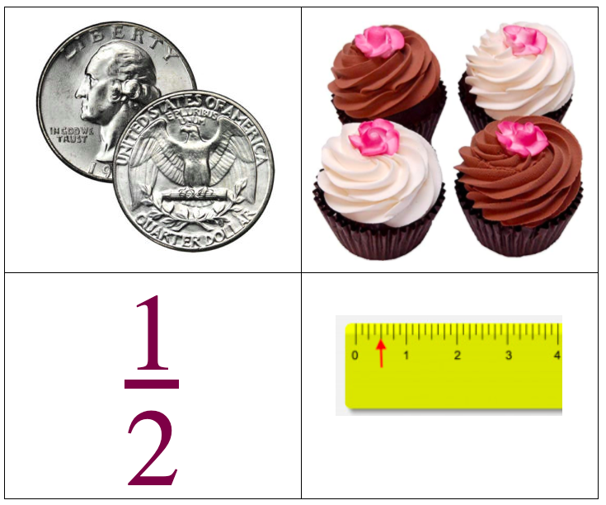
What’s the same?
What’s different?
5.NF.A

Slide 17
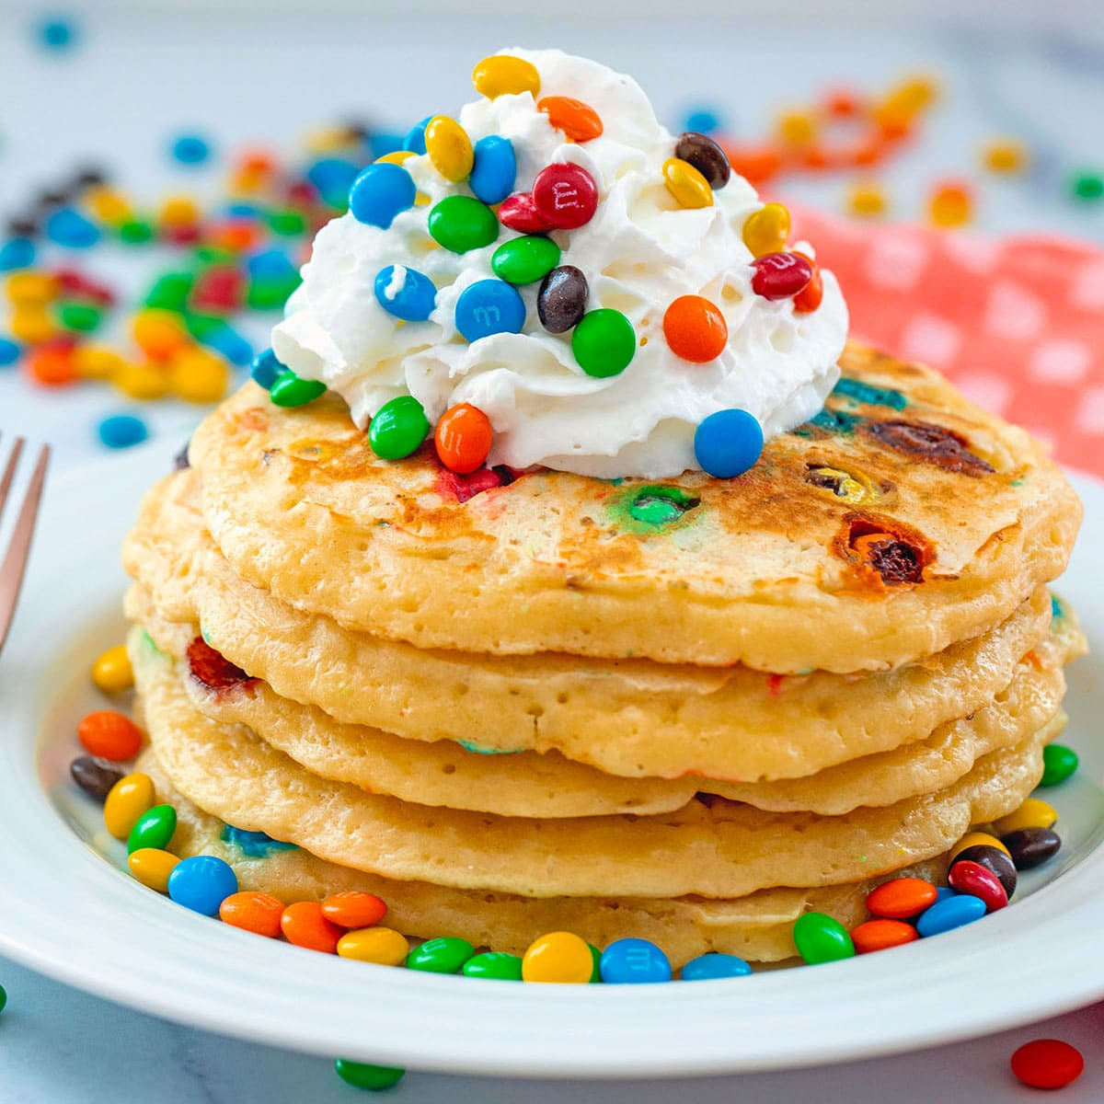
Happy National Pancake Day!
Let’s TRIPLE this recipe and make some pancakes!
2 ¼ cups all-purpose flour
4 teaspoons baking powder
¼ cup sugar
¾ teaspoon salt
2 large eggs
1½ cups milk
4 ½ tablespoons butter
What if we only need HALF of the recipe?

Slide 18
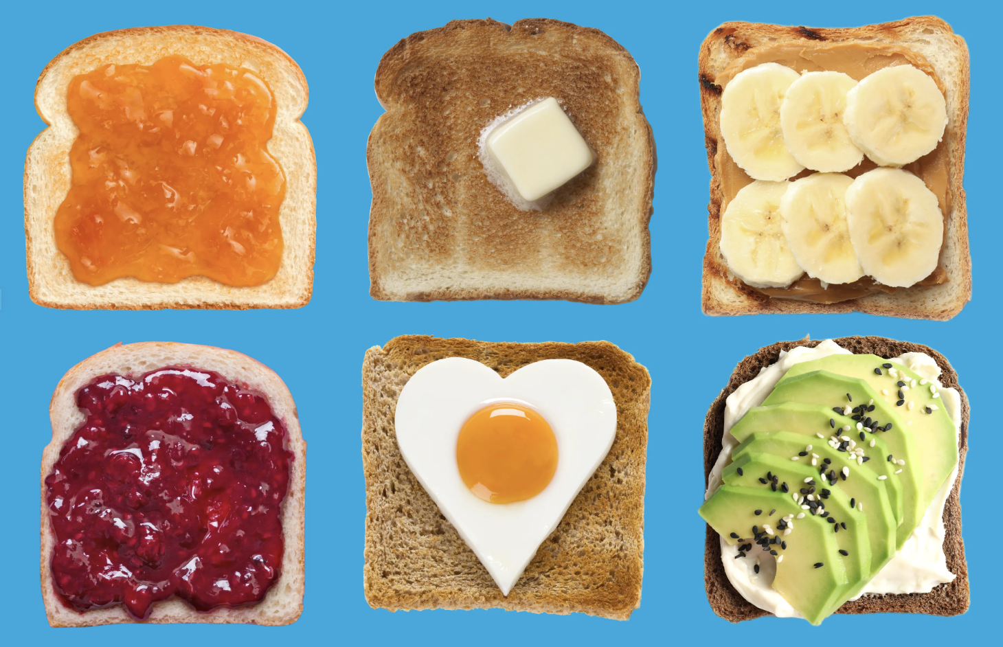
Today is International Toast Day!
There really is nothing quite like the smell and taste of fresh toast, the people of the UK love it, consuming on average 291 slices a year each!
The population of the UK is more than 67 million!
How much toast is that?
What is a close estimate?

Slide 19
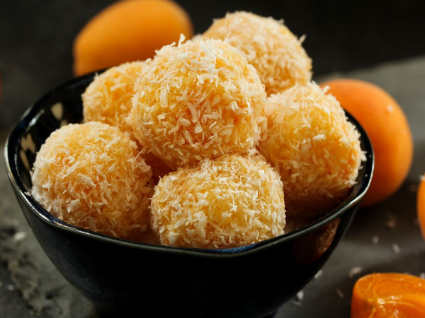
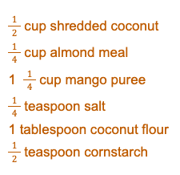
Happy Maha Shivaratri!
We are making Mango Ladoo.
We need to TRIPLE the recipe.
What if we needed “one-and-a-half” of the recipe?
5.NF.B4
Notes:
March 1, 2024
Maha Shivaratri (India)

