Slide 1

19 x 5 = (10 x 5) + (9 x 5)
19 x 15 = (10 x 10) + (9 x 5)
18 x 5 = (18 x 10) ÷ 2
4.NBT.B5
Notes:
Week of January 2, 2024

Slide 2
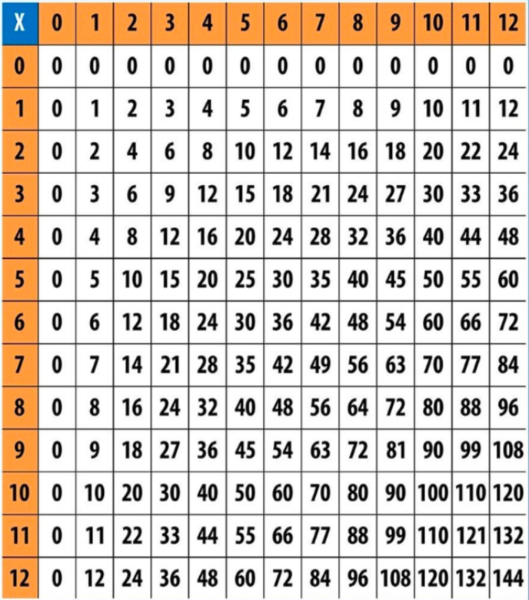
What patterns do you see in a multiplication table?
4.OA.C5

Slide 3
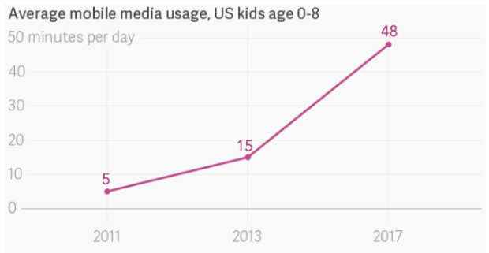
If this GRAPH could talk, what would it say?
What is a good NAME for this graph?
4.MD.B

Slide 4
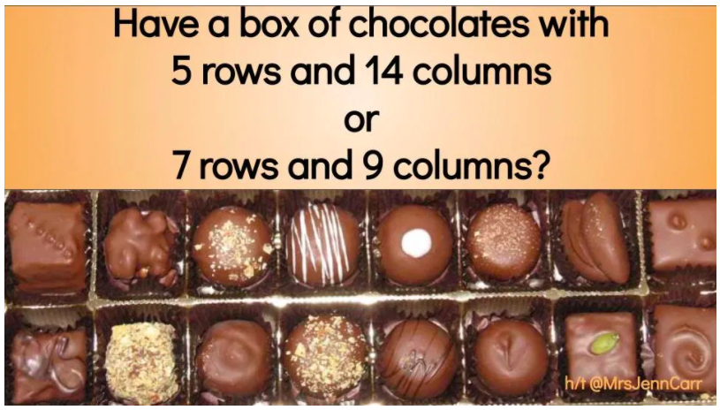
Would you rather ….
wouldyourathermath.com
4.NBT.B5

Slide 5
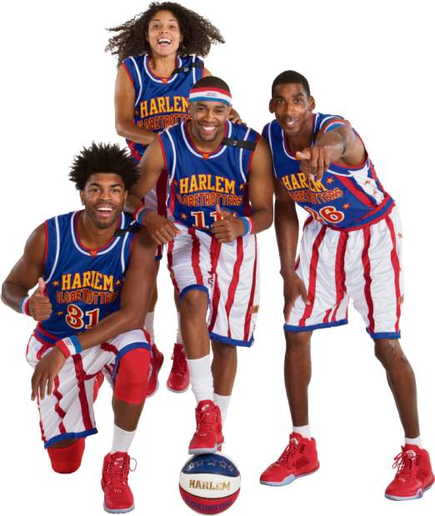
Happy Harlem Globetrotter’s Day!
This amazing basketball team was founded in 1926 in Chicago. Over the decades, they’ve won over 27,000 games! Harlem Globetrotters Day is a day to honor and remember the achievement of this great basketball team and all other teams worldwide.
What are some factor pairs of 27,000
(hint… think factor pairs of 27)
4.OA.B4
Notes:
Week of January 8, 2024
Harlem Globetrotter’s Day

Slide 6
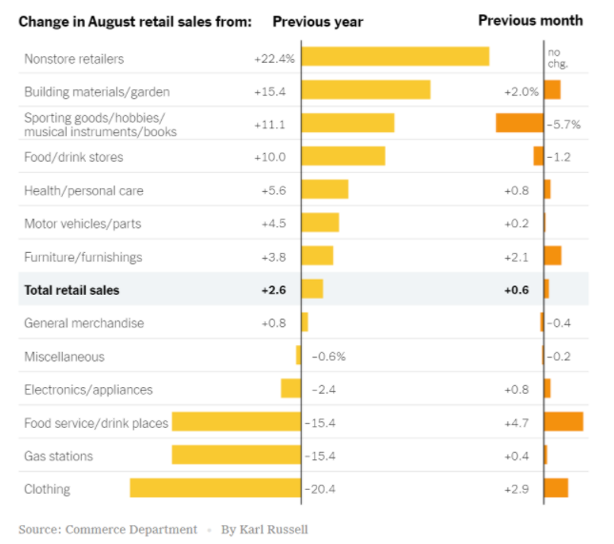
What do you notice?
What do you wonder?
What impact does this have on you and your community?
What’s going on in this graph?
Write a catchy headline!
4.MD.B

Slide 7
Which one doesn’t belong?
81 | 9
16 | 27
4.OA.B4

Slide 8
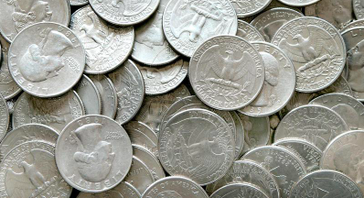
Would you rather have 45 quarters or a $10 dollar bill?
4.MD.A2

Slide 9

Happy Korean American Day
We celebrate and honor our friends of Korean descent who have made immeasurable contributions to our country.
The first immigration wave happened way back in 1903.
How long ago was that?
4.NBT.B4
Notes:
January 13, 2024
Korean American Day

Slide 10
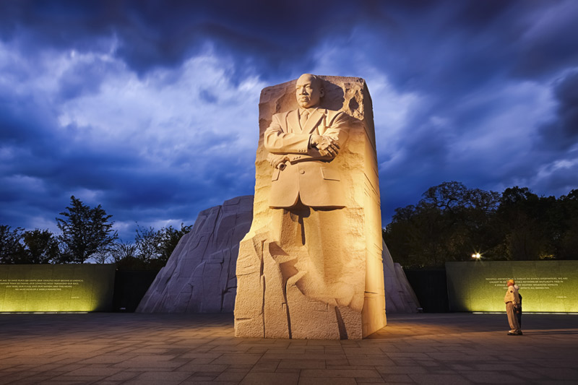
The “Stone of Hope” in Washington DC stands 30 feet tall.
How many times taller is than you?
What fraction might you be compared to the monument?
4.NF.B3
Notes:
Week of January 16, 2024
Martin Luther King Jr. Day

Slide 11
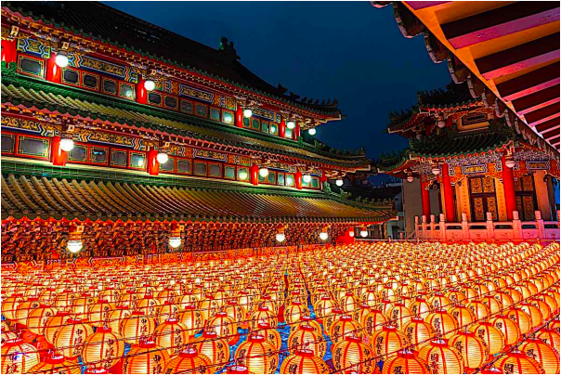
Happy Mahayana New Year!
How can we use multiplication and arrays to estimate how many lanterns are here?
What is a good estimate?
4.NBT.B5
Notes:
Mahayana New Year (Northeast Asia)

Slide 12

Would you rather . . .
$2.00 a day (every day) for a year or
$60.00 a month?
4.MD.A2

Slide 13
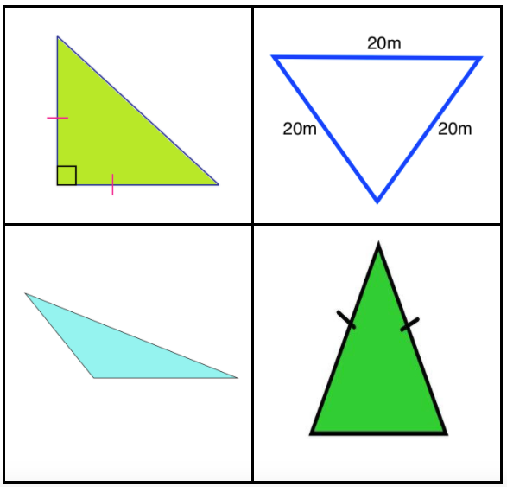
Which one doesn’t belong?
4.G.A2

Slide 14
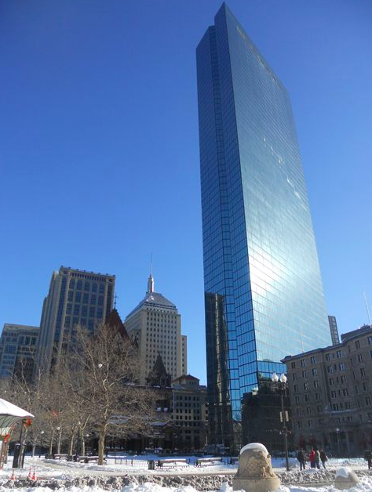
The John Hancock Tower is 790’ high.
ABOUT how many floors are there if each floor is ABOUT 12 feet high?
ANSWER: 62 floors!
4.OA.A3
Notes:
Week of January 22, 2022

Slide 15
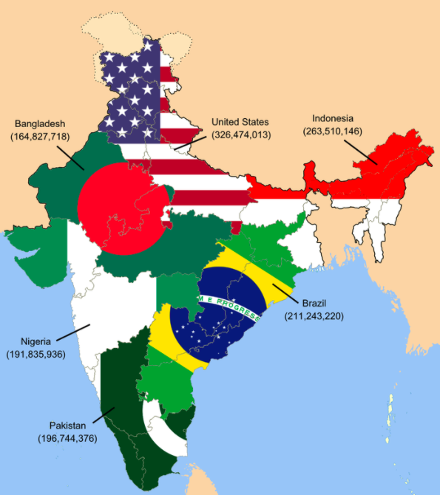
If this infographic could talk, what would it say?
This map illustrates that the population of India is as high as the next six most populated countries of the world... combined.
What is a good name for this graphic?
4.MD.B

Slide 16
What’s the SAME, what’s DIFFERENT?
13 cm x 13 cm
16 cm x 10 cm
4.MD.A3
Notes:
SAME perimeter, quadrilaterals (rectangles, 4 right angles)
DIFFERENT area, square, rectangles

Slide 17
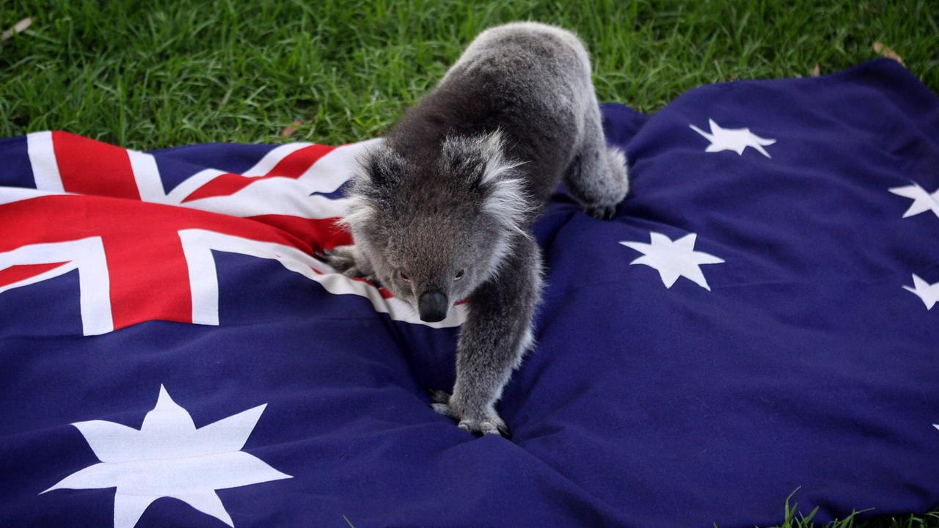
Happy Australia Day!
January 26 commemorates the arrival of British ships to establish the first settlement in 1788. These ships carried over 750 criminals who had been tried and convicted in Great Britain for mostly petty crimes and then transported to penal colonies established by the British throughout the world.
How long ago was 1788? How can we use MENTAL MATH to figure it out?
4.NBT.B4

Slide 18
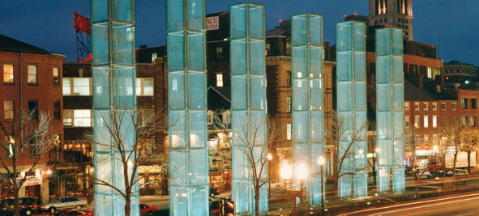
The New England Holocaust Memorial is along the Freedom Trail in Boston. The memorial is made of 6 towers that are each 54 feet high.
How many feet is that altogether?
Look closely at the towers, how many panels of glass make up the memorial?
4.OA.A3
Notes:
Holocaust Remembrance Day

