Slide 1
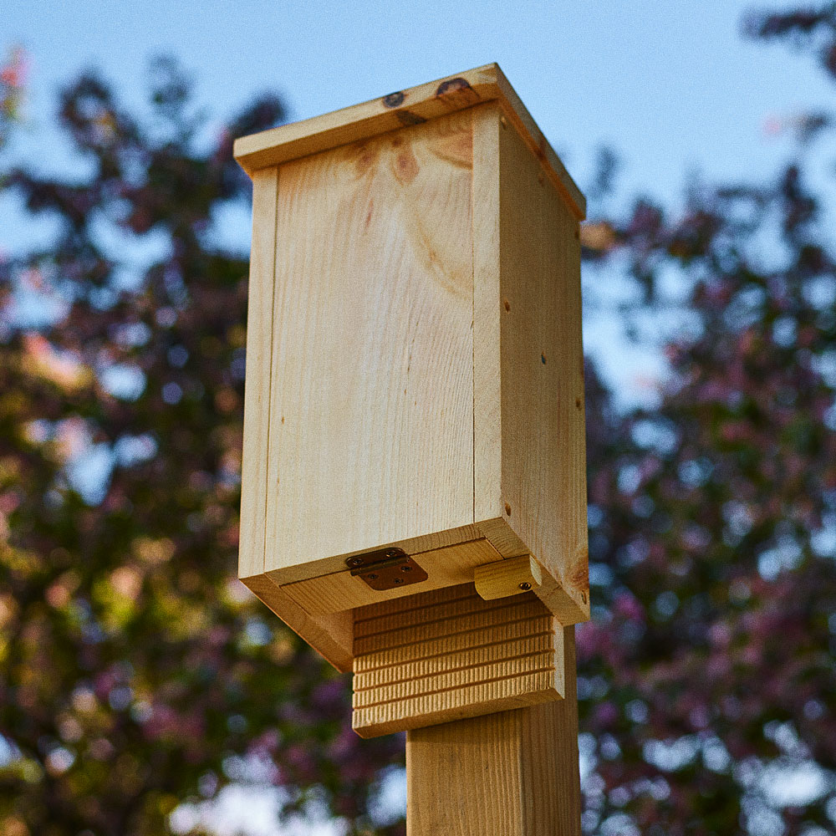
We are building a bat house!
For the walls, we need 4 pieces of wood that are 2 feet 5 inches long each.
How much wood is that altogether?
In feet? In inches?
4.MD.A1,2
Notes:
Week of January 29, 2024

Slide 2
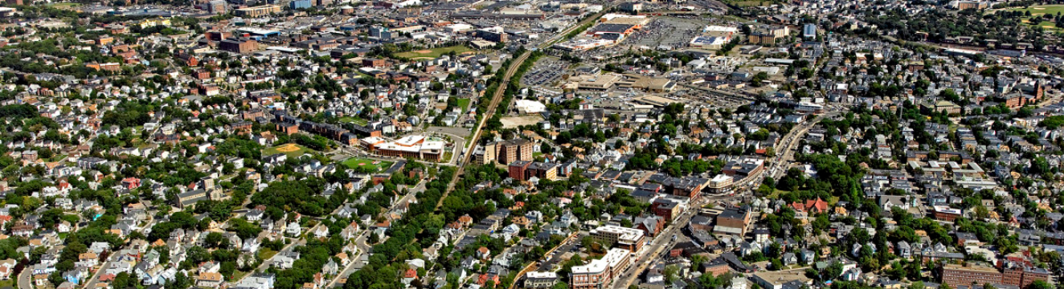
What estimation strategies can we use to determine how many homes
are in this photo of Dorchester?
4.NBT.A3

Slide 3
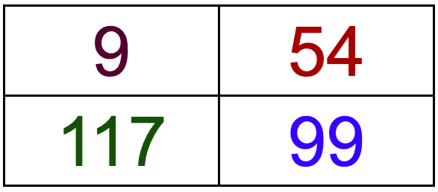
Which one does not belong?
4.OA.B4

Slide 4
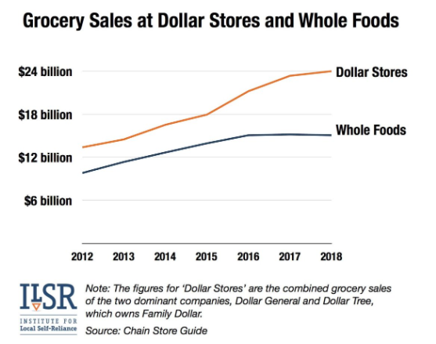
What do you notice
What do you wonder?
Why does it matter?
4.MD.B

Slide 5
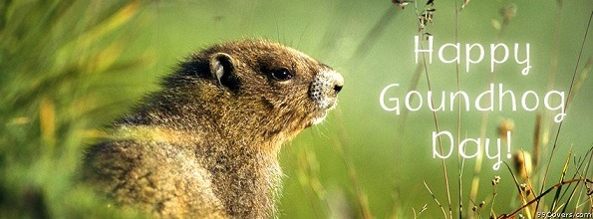
Will Punxsutawney Phil see his shadow? Are we going to have an early Spring?
Did you know that an average Groundhog (which is exactly the same as a woodchuck!) weighs between 5 - 13 pounds.
If this little guy is EXACTLY in between 5 - 13 pounds, how many ounces is that? (There are 16 ounces in a pound)
4.MD.A2
Notes:
February 2, 2024
Groundhog Day

Slide 6
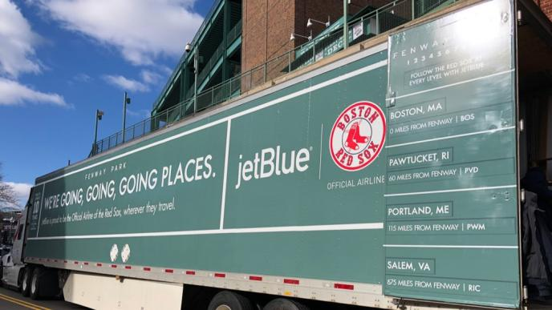
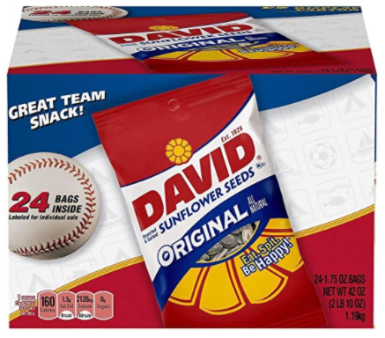
It’s Truck Day in Red Sox Nation!
Spring Training is in the air! What’s on the truck?
20,400 baseballs
1,100 bats
200 batting gloves
200 batting helmets
400 T-shirts
400 pairs of socks
20 cases of bubble gum
60 cases of sunflower seeds
Let’s do some mental math!
How many pieces of equipment?
How many pieces clothing?
How many packs of sunflower seeds if each
case has 24 packs?
4.NBT.B5
Notes:
Week of February 5, 2024
Red Sox Truck Day!

Slide 7
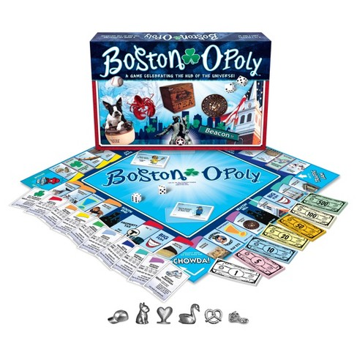
Boston-o-poly!
The full game board is a square with an area greater than 100 square inches, but less than 300 square inches.
What could be the length of each side of the game board?
4.MD.A3

Slide 8
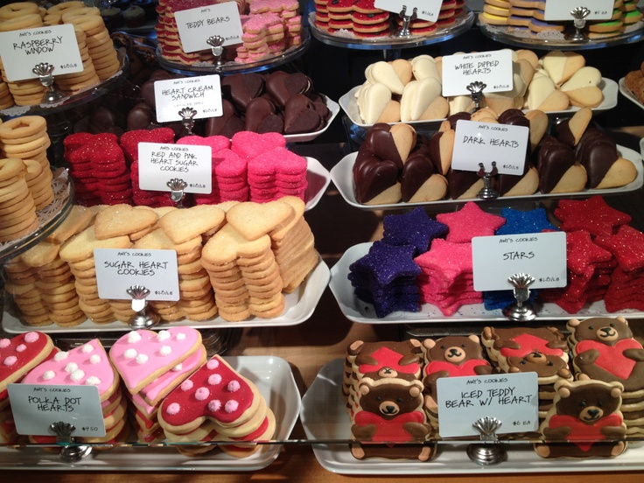
Where’s the Math?
4.NBT.B5

Slide 9
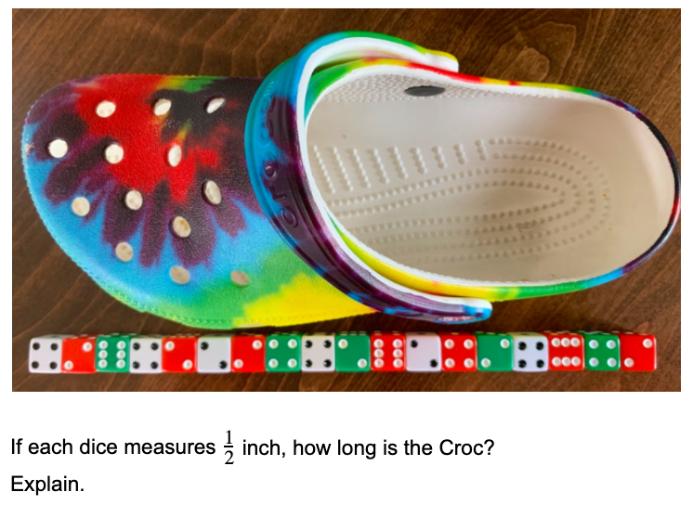
4.NF.B4

Slide 10
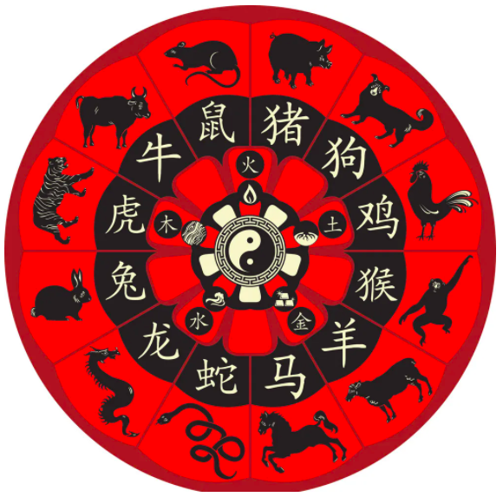
Happy Chinese New Year!
It’s the year of the Dragon!
What do you notice? What do you wonder?
The Chinese Zodiac is a 12 year cycle!
What year were you born? What animal was that?
Both Kevin Durant (Phoenix Suns) and Russell Wilson (Denver Broncos) are Dragons, can you figure out what year they were born?
4.OA.A3
Notes:
February 12, 2024
Chinese New Year (Feb 10)

Slide 11
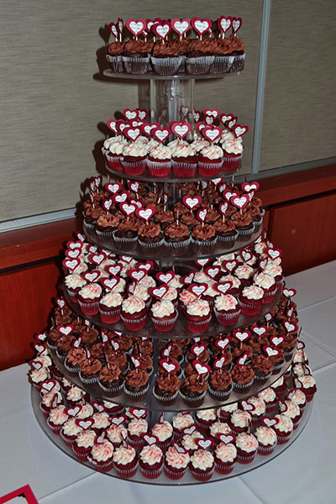
Estimate the number of cupcakes in this tower.
How can you use math to help you get close?
What fraction might be vanilla frosted? Chocolate frosted?
4.NF.B3

Slide 12
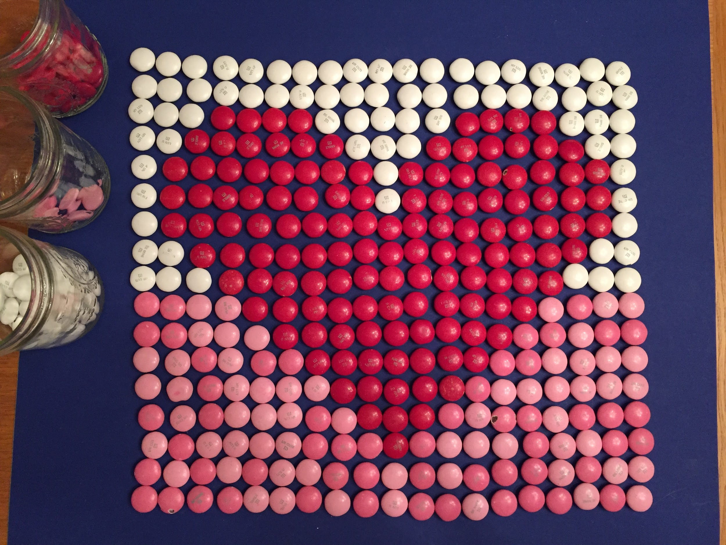
Estimate what fraction of the whole is made of white m&ms.
Red m&ms?
Pink m&ms?
How many m&ms are here altogether?
How can arrays help you solve this?
4.NF.B3
Notes:
Monday, February 14, 2022

Slide 13

Today is the Lantern Festival in China.
The largest standing lantern measures 66 feet high and was achieved by Tang Paradise in Xi'an, Shaanxi, China, in 2020.
How high is 66 feet?
About how many times higher is 66 feet than your height?
4.OA.A3
Notes:
February 15, 2024
Lantern Festival (China)

Slide 14
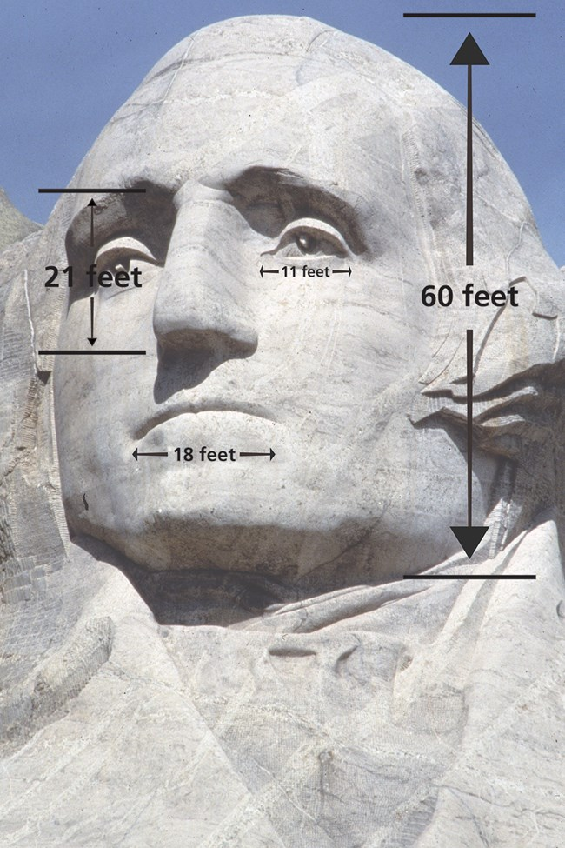
This is George Washington on Mount Rushmore.
What do you notice?
What do you wonder?
His head is 60 feet! How many inches is that?
How many times bigger is that than your head?
4.MD.A2
Notes:
PRESIDENTS ON MOUNT RUSHMORE: George Washington, the country’s first president, would represent its birth. Thomas Jefferson, who nearly doubled the country’s size with his purchase of the Louisiana Territory, stood for its westward expansion. Theodore Roosevelt, who had overseen the construction of the Panama Canal, was a symbol of economic growth. And Abraham Lincoln was selected for having fought to preserve the nation in the Civil War.

Slide 15
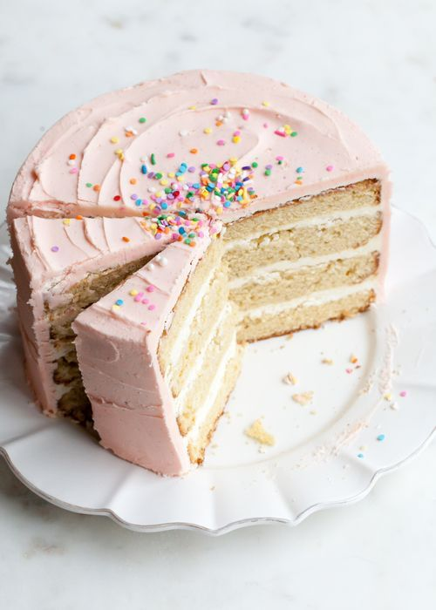
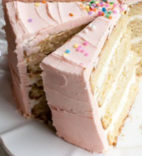
Estimate the fraction of cake that is missing.
What fraction do the two slices represent?
About what fraction of the cake is not cut yet?
4.NF.B3
Notes:
Week of February 26, 2024

Slide 16

5 x 6 = 5 x 2 x 3
5 x 6 = 5 x 3 x 3
10 x 3 = (5 x 3) + (5 x 3)
4.NBT

Slide 17
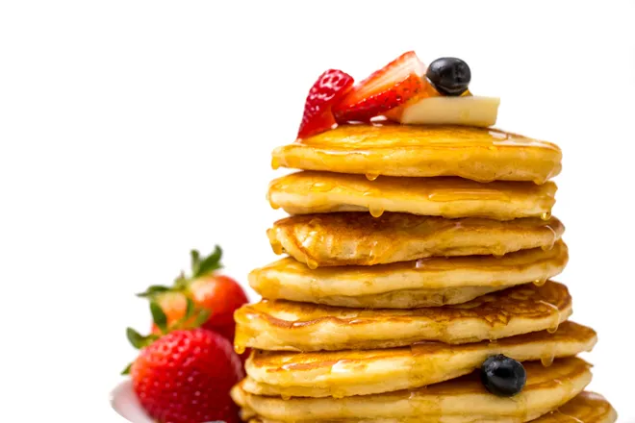
Happy National Pancake Day!
Let’s double this recipe and make some pancakes!
2 ¼ cups all-purpose flour
4 teaspoons baking powder
¼ cup sugar
¾ teaspoon salt
2 large eggs
1½ cups milk
4 ½ tablespoons butter
Can we triple it?

Slide 18
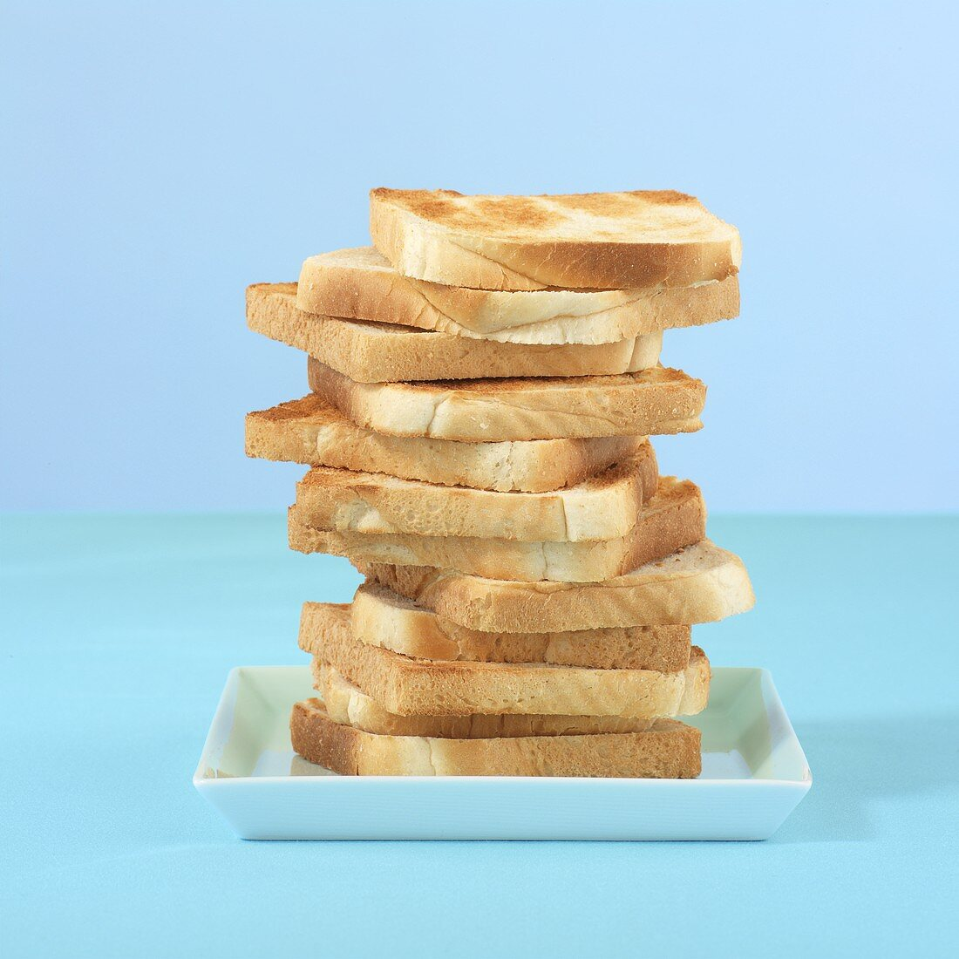
Today is National Toast Day!
It takes 4 ½ minutes to perfectly toast bread!
We can toast 4 slices of bread at a time.
How long did it take us to toast this stack of bread?

Slide 19
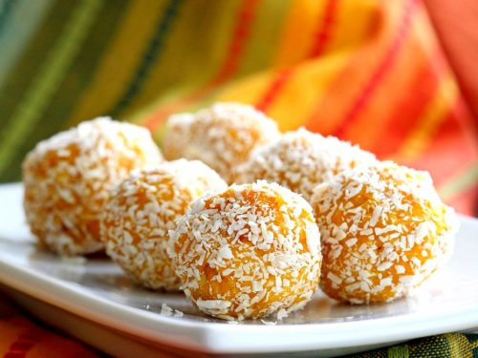
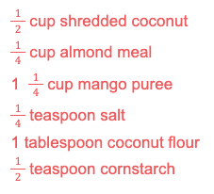
Happy Maha Shivaratri!
We are making Coconut Mango Ladoo.
We need to DOUBLE the recipe.
What if we TRIPLED the recipe?
4.NF.B4
Notes:
March 1, 2024
Maha Shivaratri (India)

