Slide 1
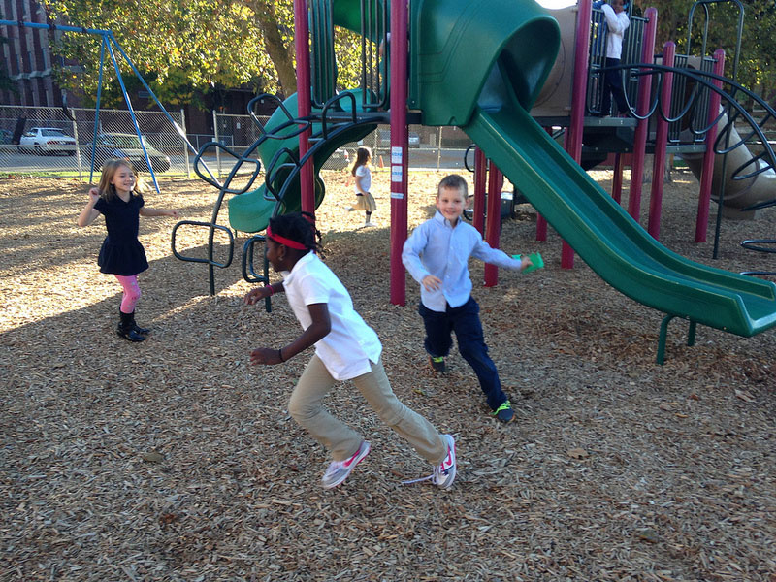
Would you rather have a half hour of recess EVERY DAY
or
3 hours of recess ONLY on Friday?
2.MD.C7
Notes:
Week of January 2, 2024

Slide 2
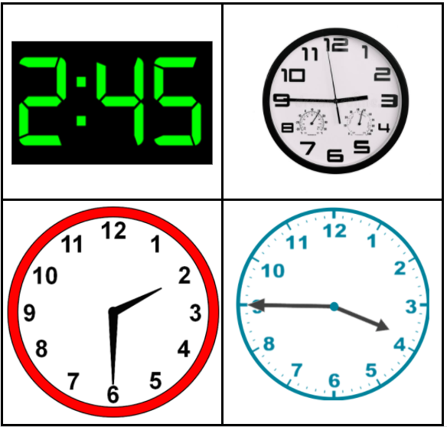
Which one doesn’t belong?
Can you find a reason why ALL of them may not belong?
2.MD.C7

Slide 3
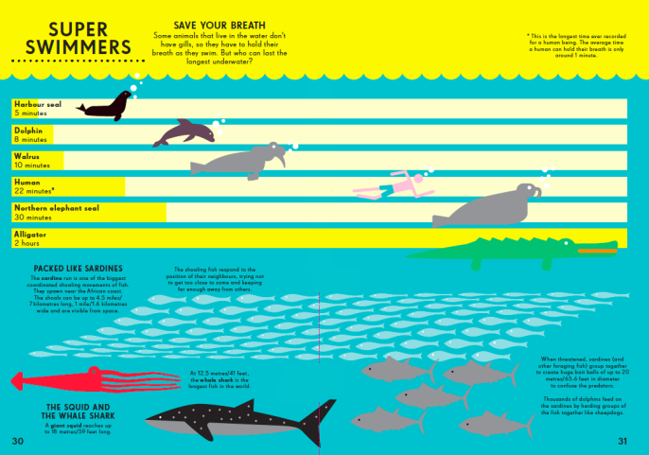
Super Swimmers: How long can animals hold their breath underwater?
Average Human
1 minute
Harbor Seal
5 minutes
Dolphin
8 minutes
Walrus
10 minutes
World Record Human
22 minutes
Northern Elephant Seal
30 minutes
Alligator
2 hours
If this graph could talk, what would it say?
2.MD.D9
Notes:
What new information did we just learn? Does any of it surprise you? Why or why not?

Slide 4
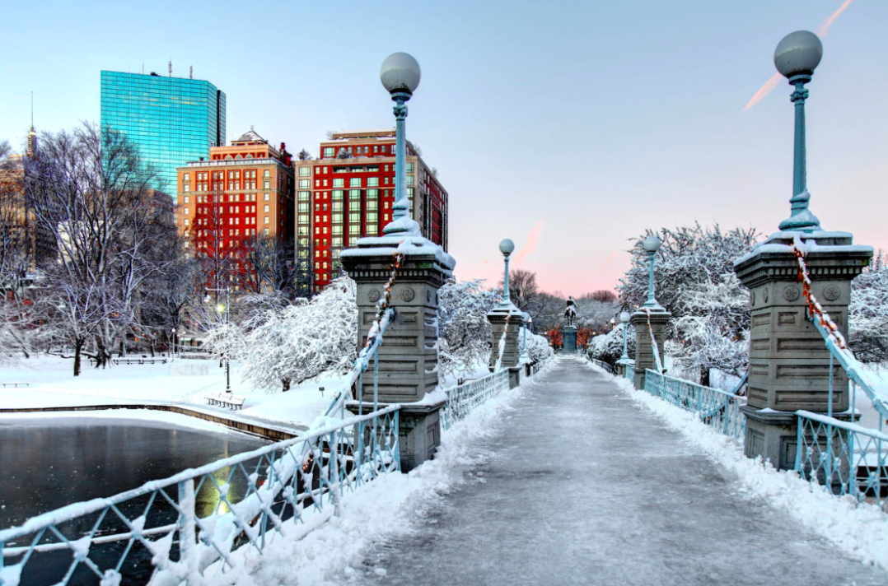
These light-posts are about 15 feet tall.
How tall is that?
How tall are you?
How many of YOU would be as tall?
2.MD.A4

Slide 5
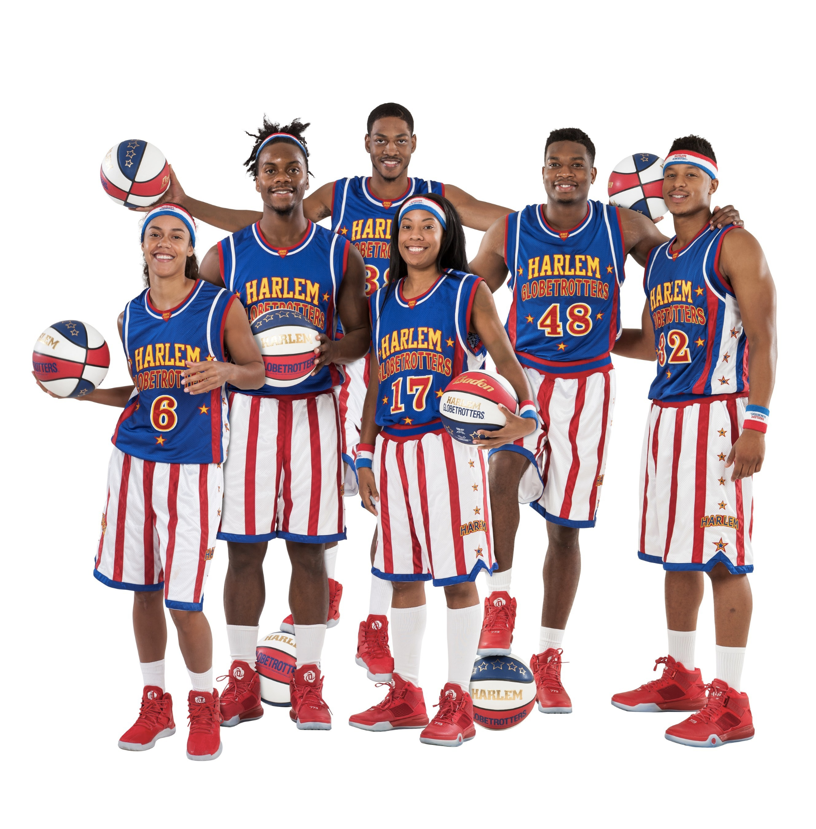
Happy Harlem Globetrotter’s Day!
This amazing basketball team began in 1926 in Chicago.
What can we say about the number 1,926?
2.NBT.A3
Notes:
Week of January 8, 2024
Harlem Globetrotter’s Day

Slide 6
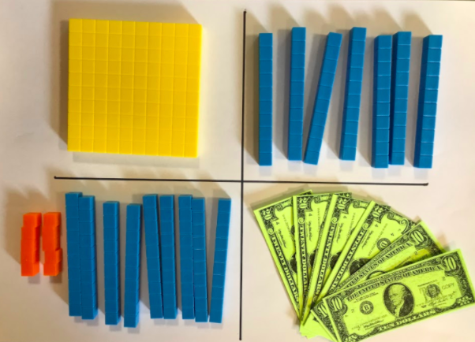
Which one DOES NOT belong?
2.NBT.A4

Slide 7


Would you rather ….
Share the cupcakes EQUALLY with your family or the cookies?
2.SMP.3

Slide 8
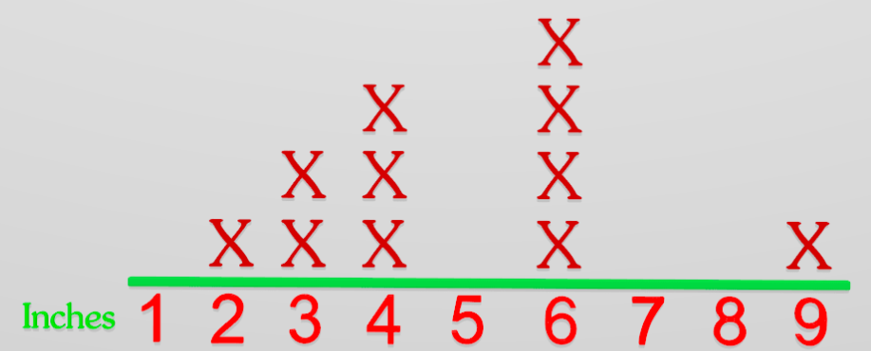
If this line plot could talk…. what would it say?
2.MD.D9

Slide 9

Happy Lohri!
How many different ways do we see this tray of Ladoo?
How many columns?
How many rows?
2.OA.C4
Notes:
Lohri (India)

Slide 10
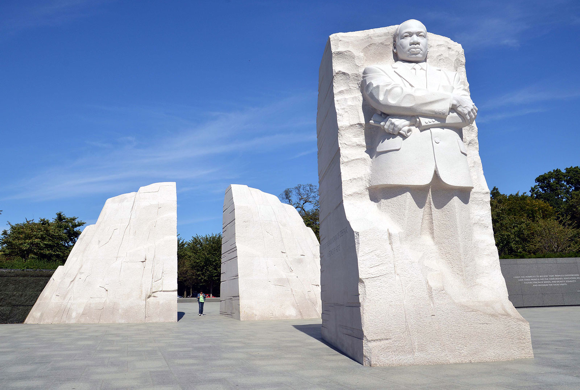
The “Stone of Hope” in Washington DC stands 30 feet tall.
How tall is that?
How many of YOU is that?
2.MD.A3
Notes:
Week of January 16, 2024
Martin Luther King Jr. Day

Slide 11
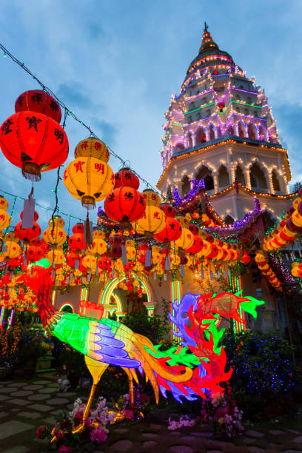
Happy Mahayana New Year!
Estimate how many yellow lanterns might be here?
How many red lanterns?
How do we know our estimates are close?
2.NBT.A2
Notes:
Mahayana New Year (Northeast Asia)

Slide 12
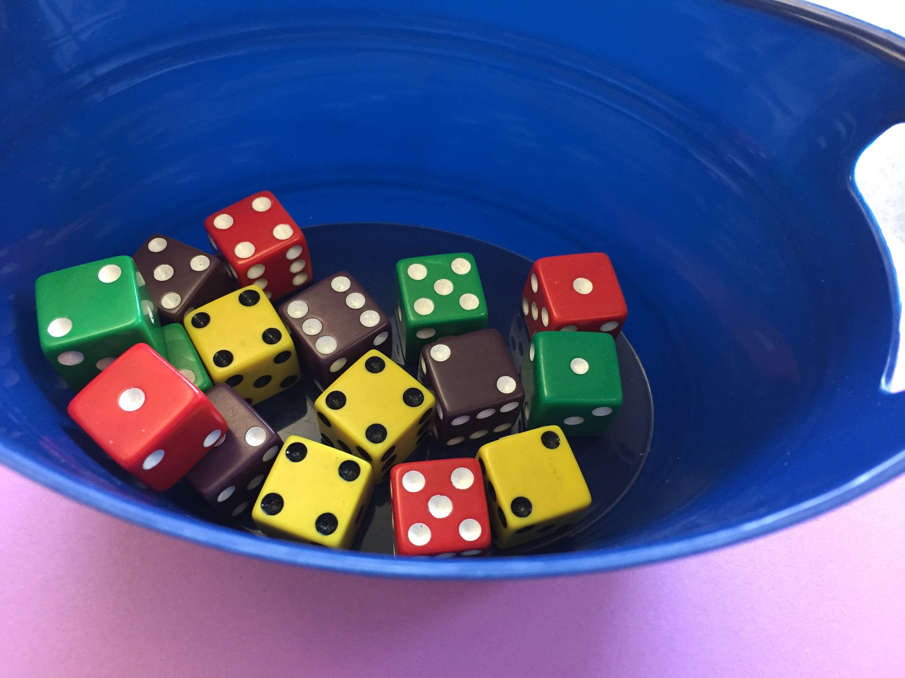
What MATHS do you see in this picture?
How many different NUMBER SENTENCES can you record to represent your mathematical thinking?
2.OA.B2

Slide 13
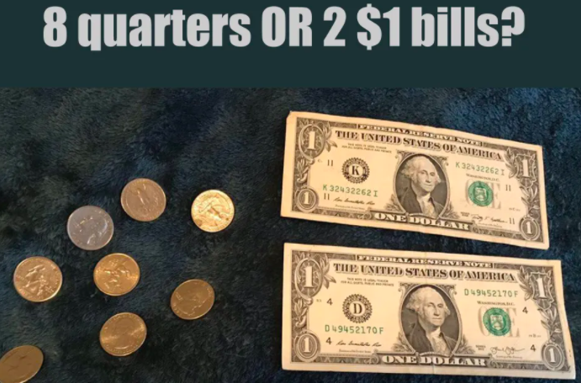
Would you rather have . . .
wouldyourathermath.com
2.MD.C8

Slide 14
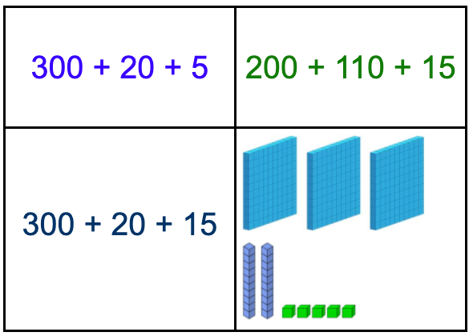
Which one doesn’t belong?
2.NBT.A4
Notes:
Week of January 22, 2024

Slide 15
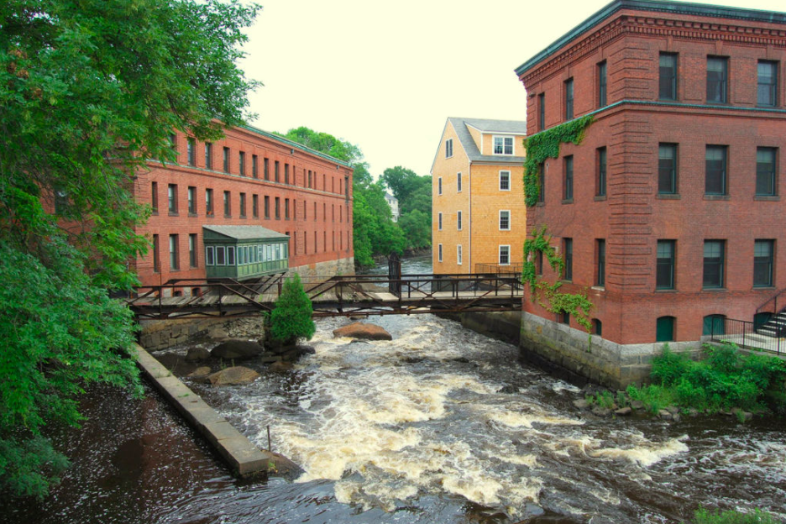
Estimate the number of windows you see in this picture of the Neponset River.
Where do you see arrays?
How can they help you determine the actual number?
2.OA.C4

Slide 16
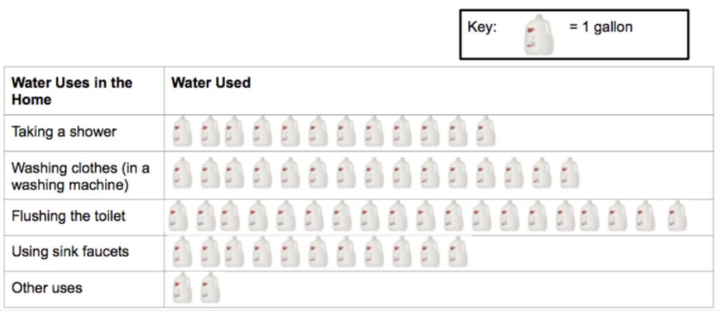
If this graph could talk, what would it say?
2.MD.D10

Slide 17
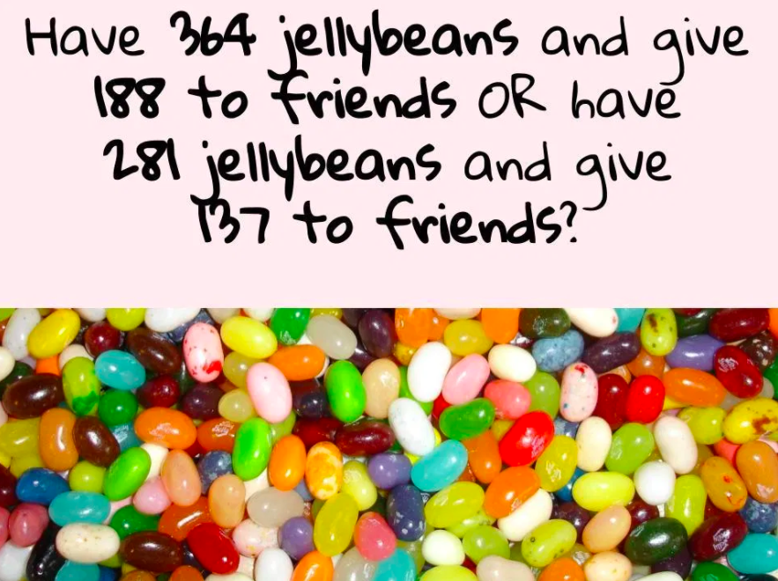
Would you rather...
2.NBT.B7
wouldyourathermath.com

Slide 18

The first settlement in Australia was in 1788!
About how long ago was that?
How can we figure it out?
2.NBT.B7
Notes:
January 2, 2024
Australia Day

