Slide 1
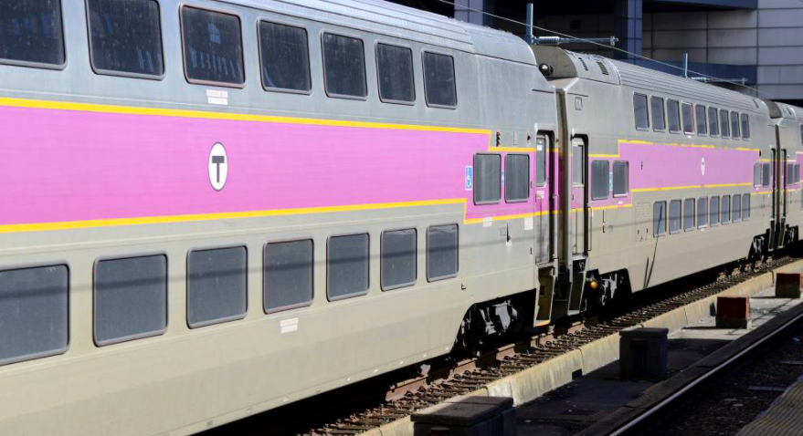
How many windows are on the train? How many don’t we see?
How many would be on 2 trains?
1.OA.C5
Notes:
Week of January 29, 2024

Slide 2
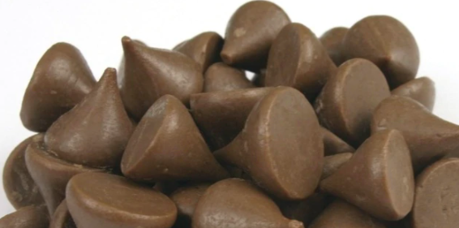
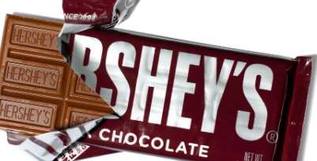
Would you rather have
A handful of kisses or a whole chocolate bar?
1.SMP.3

Slide 3
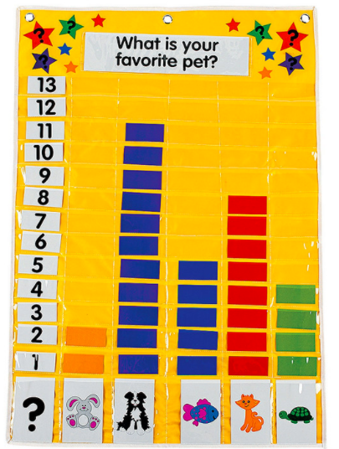
If this graph could talk, what would it say?
1.MD.C4

Slide 4
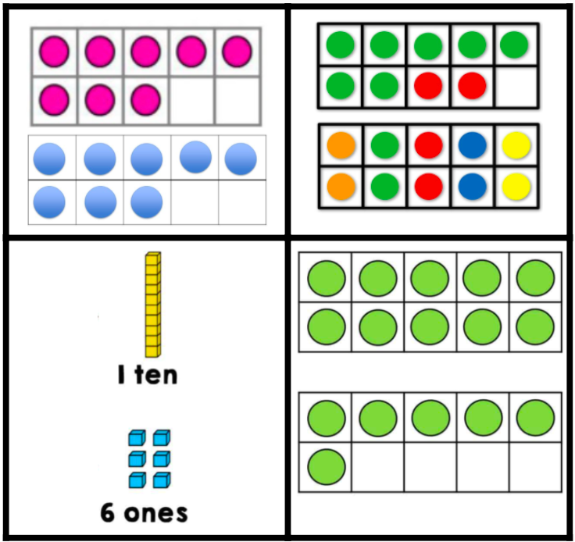
Which one does not belong?
1.NBT.B2

Slide 5
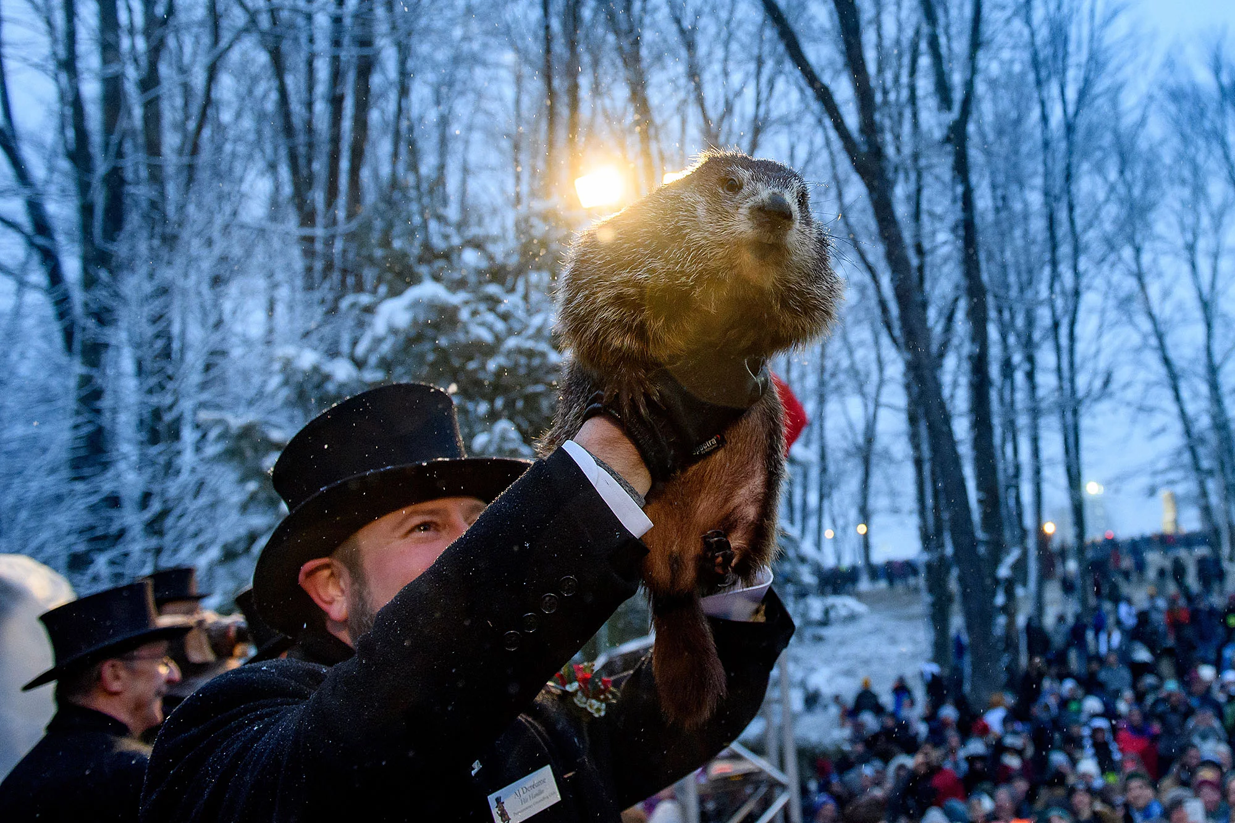
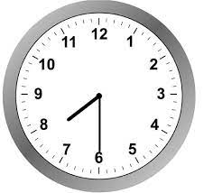
Punxsutawney Phil comes out today to see his shadow!
Will we have 6 more weeks of cold winter?
What time is he making his appearance?
1.MD.B3
Notes:
February 2, 2024
Groundhog Day

Slide 6
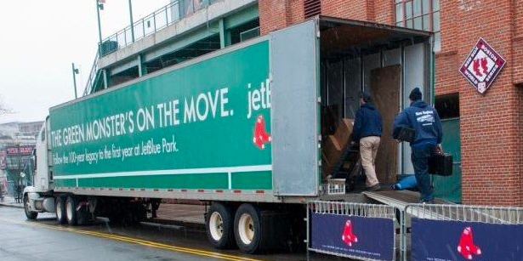
It’s Truck Day in Red Sox Nation!
Spring Training is in the air! What’s on the truck?
20,400 baseballs
1,100 bats
200 batting gloves
200 batting helmets
400 T-shirts
400 pairs of socks
20 cases of bubble gum
60 cases of sunflower seeds
Which item do you think weighs the MOST, or is the HEAVIEST?
Which is the LIGHTEST?
1.MD.A1
Notes:
Week of February 5, 2024
Truck Day

Slide 7
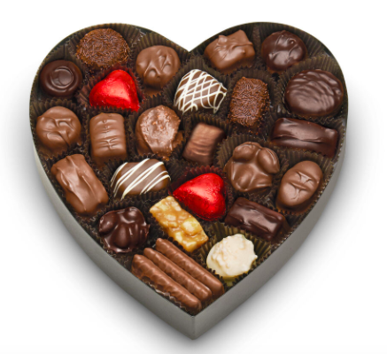
How might we sort these?
How can we count them?
Write an equation to match your thinking.
1.OA.C6

Slide 8
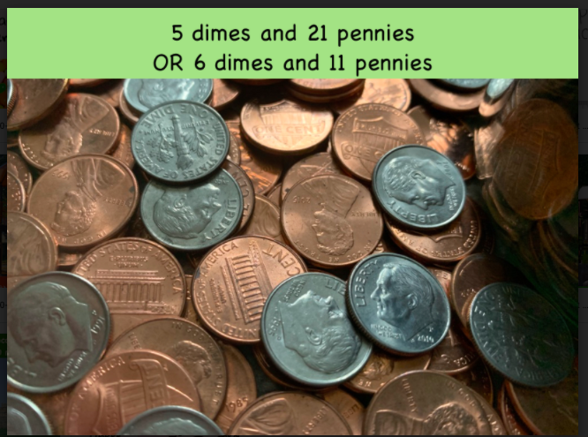
Would you rather have
1.MD.D5

Slide 9
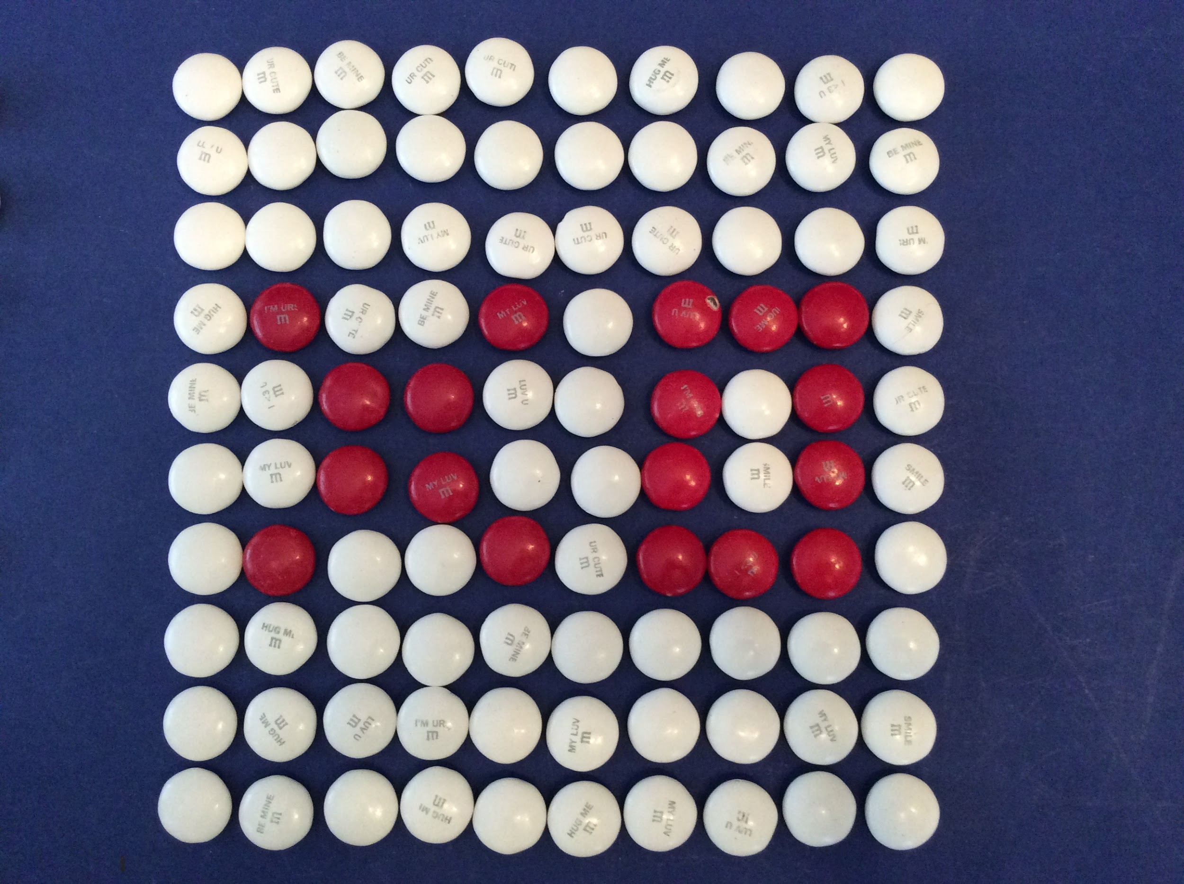
What do we notice?
What do we wonder?
Let’s create equations to match this picture!
1.NBT.C4

Slide 10
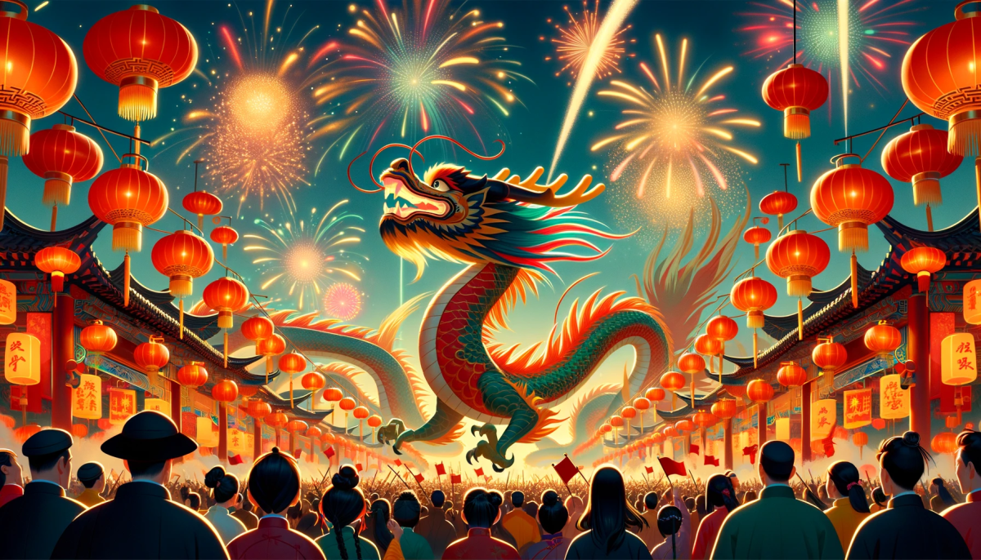
Happy Year of the Dragon!
Describe some of the shapes we see.
What would happen if we cut some of the shapes in half?
1.G.A3
Notes:
Week of February 12, 2024
Chinese New Year (Feb. 10)

Slide 11

Let’s talk about these shapes!
How are they the same?
How are they different?
1.G.A1

Slide 12
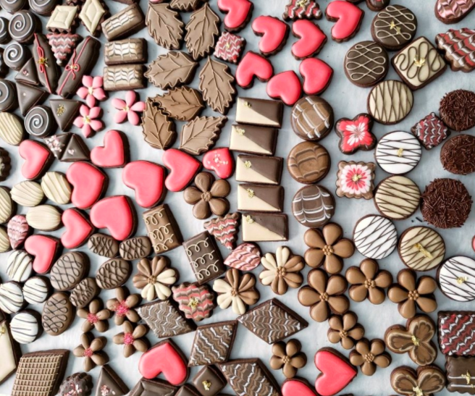
Talk about the interesting shapes you see.
What if you cut some of them in half? What would they look like?
1.G.A3

Slide 13
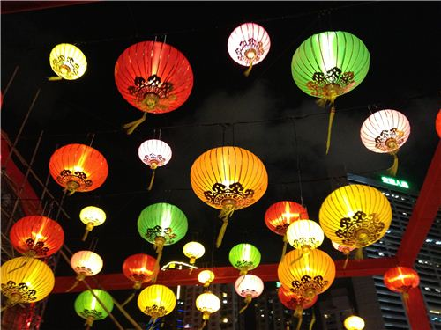
Today is the Lantern Festival in China
How many green lanterns do we see?
How many red ones?
How many white lanterns?
How many yellow ones?
Let’s create an expression to match our thinking!
1.NBT.C4
Notes:
February 15, 2024
Lantern Festival (China)

Slide 14
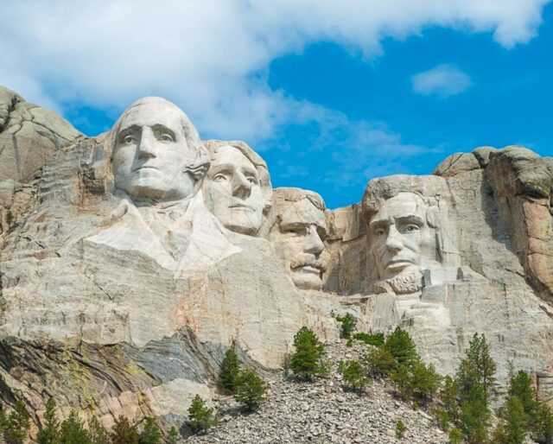
Happy President’s Day!
This is Mount Rushmore. What do you notice? What do you wonder?
Abraham Lincoln’s face is 62 feet tall.
What is 10 more than 62?
What is 10 less than 62?
Theodore Roosevelt’s face is 59 feet tall, what can we say?
1.NBT.C5,6

Slide 15
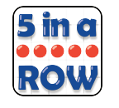
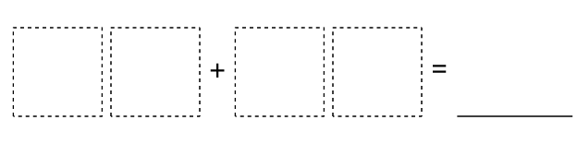
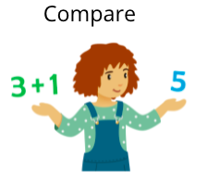
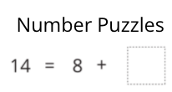
How Close?
If this graph could talk, what would it say?
1.MD.C4
Notes:
Week of February 26, 2024

Slide 16
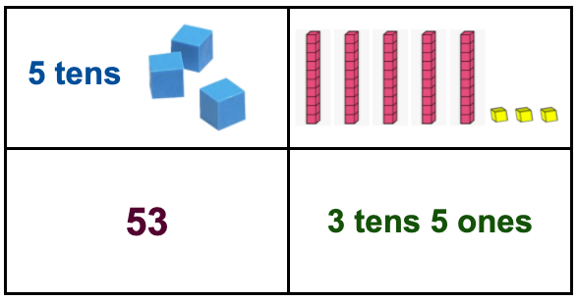
Which one doesn’t belong?
1.NBT.B2

Slide 17
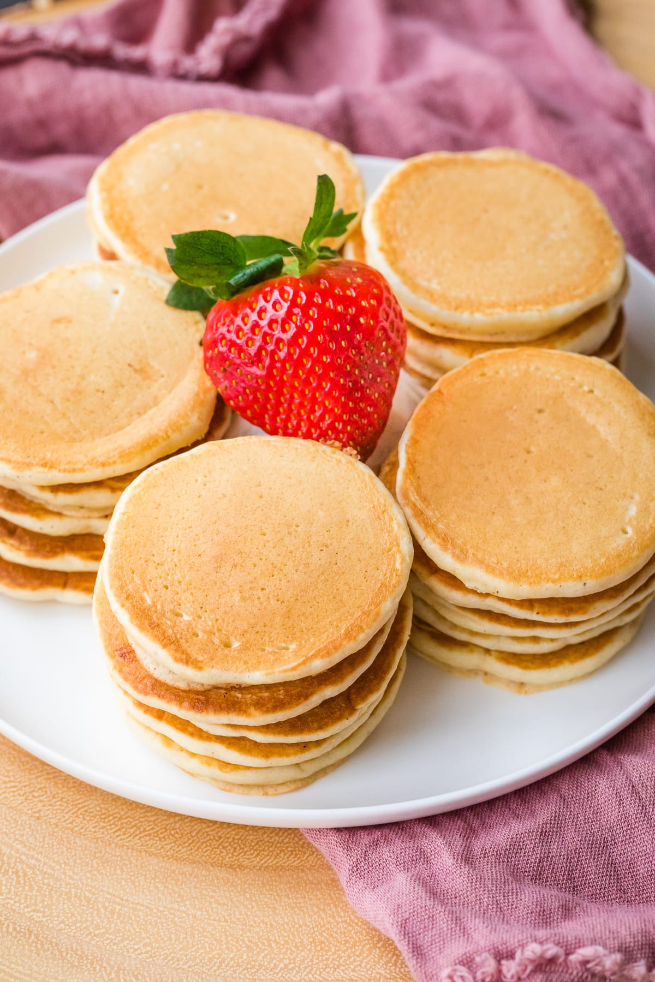
Today is International Pancake Day!
How many pancakes are here?
How can we use skip-counting to figure it out?

Slide 18
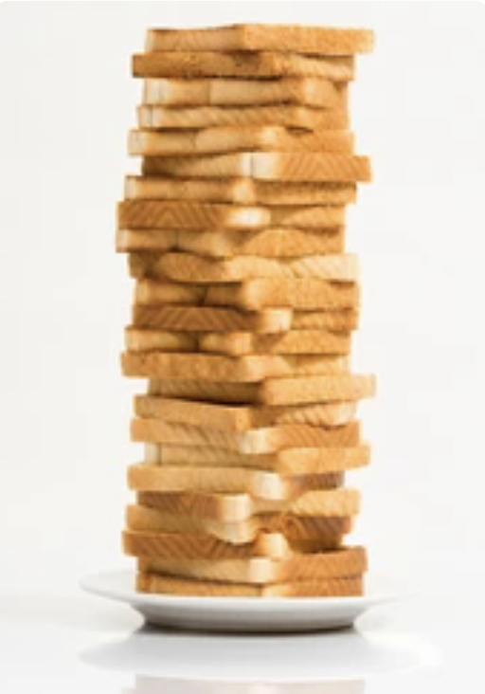
Happy National Toast Day!
Let’s estimate how much toast is on the plate!
What is an estimate that is too low?
What is too high?
What is just right?

Slide 19
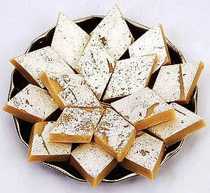
Happy Maha Shivaratri
How many kaju katli are here?
Estimate!
How can we count them?
Create an expression for 16 using 3 addends?
1.OA.A2
Notes:
March 1, 2024
Maha Shivaratri (india)

