Slide 1
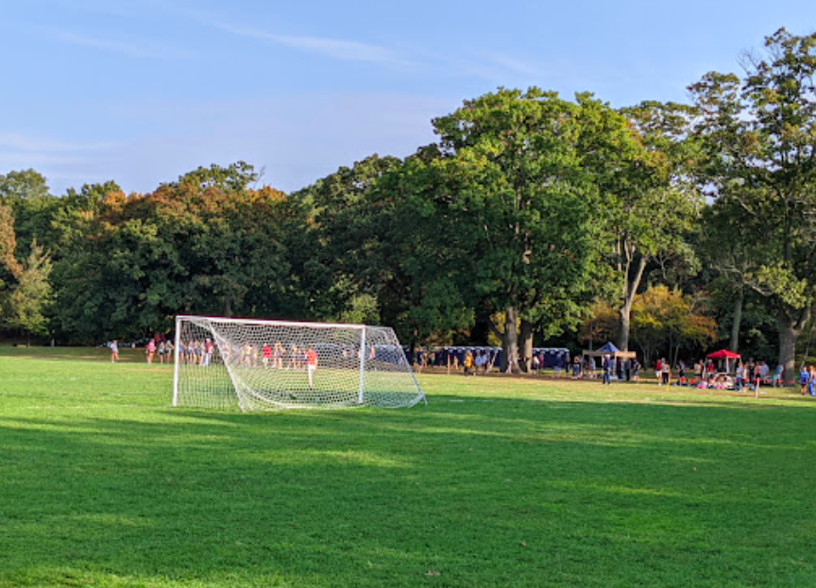
The soccer field at the Franklin Park Playstead is 110 yards long and 70 yards wide.
According to FIFA regulations, the dimensions of a soccer field are between 120 yards long and 80 yards wide, and 110 yards long and 70 yards wide.
What can we say about the AREA of a soccer field?
4.MD.A3
Notes:
Week of December 4, 2023

Slide 2
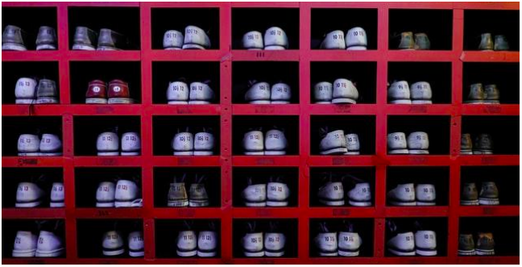
What can you count in the picture? How would you count them?
How does this picture show that 10 is a multiple of 2?
How does this picture show that 5 is a factor of 35?
How does the picture show that 70 is a multiple of 10?
Illustrative Mathematics
4.OA.B4

Slide 3
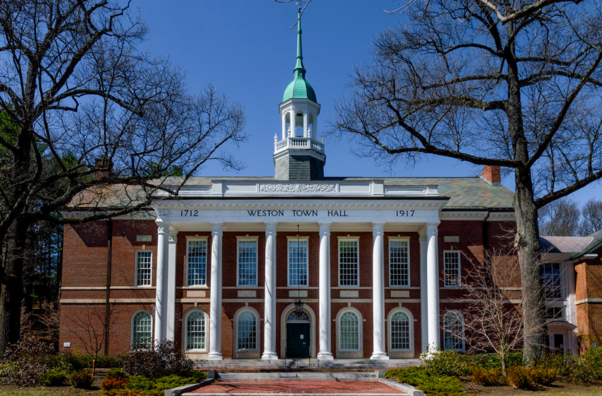
What do the numbers mean?
How old is the Weston Town Hall?
Where do you see arrays?
How can you use arrays to figure out how many window panes are here?
What would that equation look like?
4.NBT.5

Slide 4
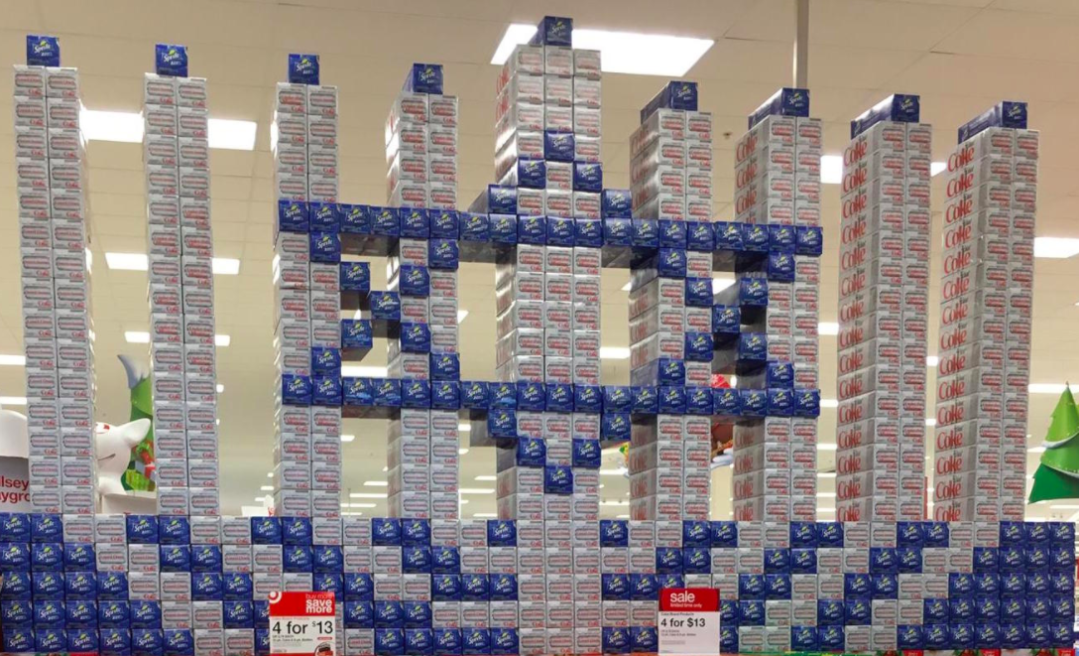
How many cans of soda do you think are here? What is a reasonable estimate?
Talk about strategies you could use to figure it out.
4.NBT.B5
Notes:
Week of November 29, 2021

Slide 5
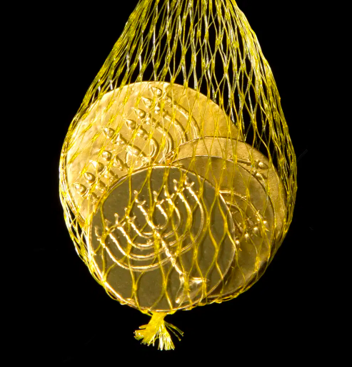
I wonder how much this bag of chocolate gelt would be worth if it was REAL GOLD?
The weight of the gelt is 202 grams.
The current price of GOLD is $34 per gram.
ESTIMATE!
4.OA.A3

Slide 6
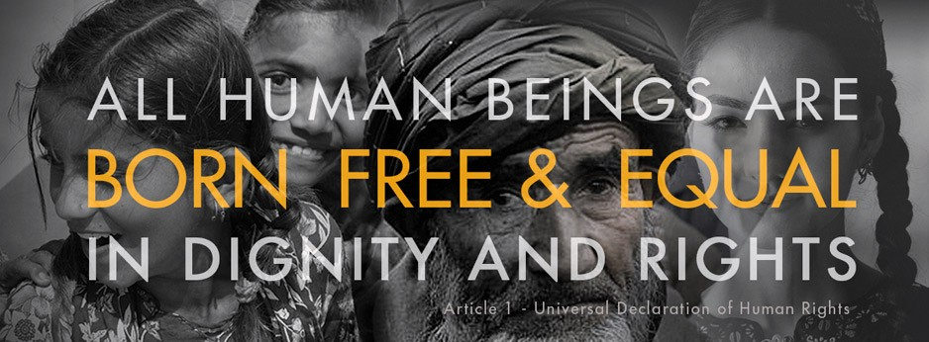
Human Rights Day is the day the UN adopted and proclaimed the Universal Declaration of Human Rights in 1948. It has inspired all of us to start treating every person with the right to life, liberty, property, and the pursuit of happiness. It is the most translated document around the world and is available in over 500 languages.
What are some factor pairs of 500? Can you find all of them?
4.OA.B4
Notes:
Week of December 11, 2023

Slide 7
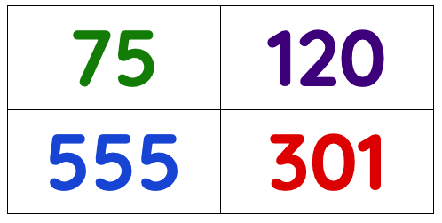
Which one DOES NOT belong?
4.OA.B4

Slide 8
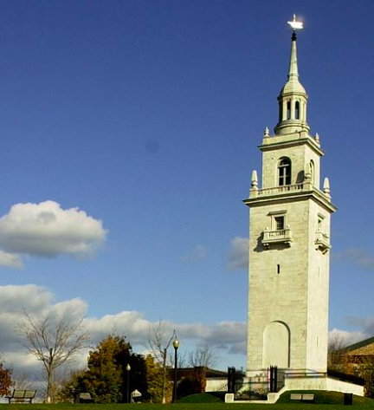
The Dorchester Heights Monument is 115 ft. tall
About how many times taller is it than you?
4.NBT.B5

Slide 9
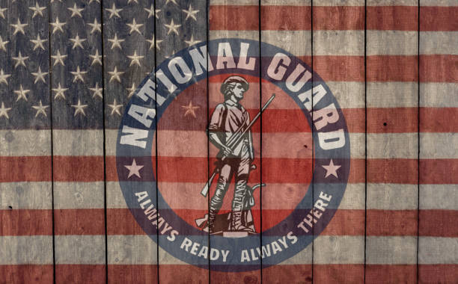
Happy Birthday to the US National Guard
Established in 1636, the National Guard is the oldest military organization in America. Its members serve during times of war and emergency.
How long ago was 1636?
What are some factors of 1,636?
4.NBT.B4

Slide 10
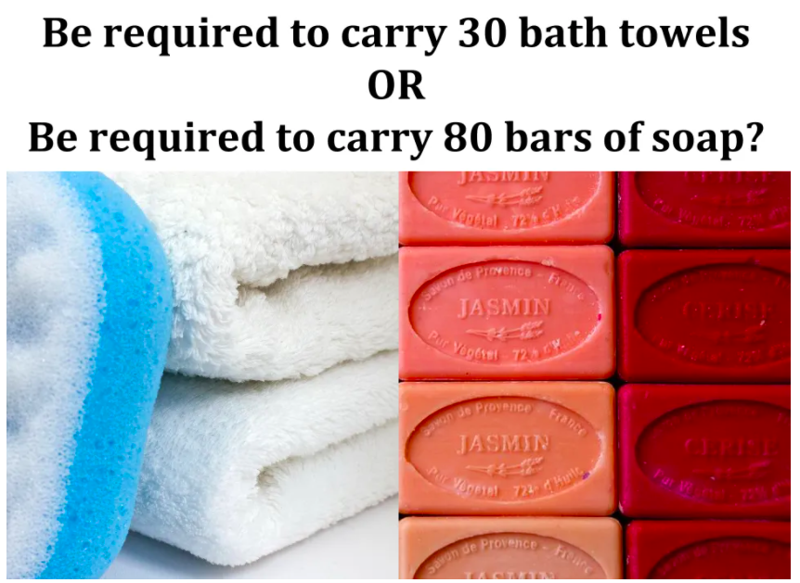
Would You Rather ...
4.SMP
wouldyourather.com

Slide 11
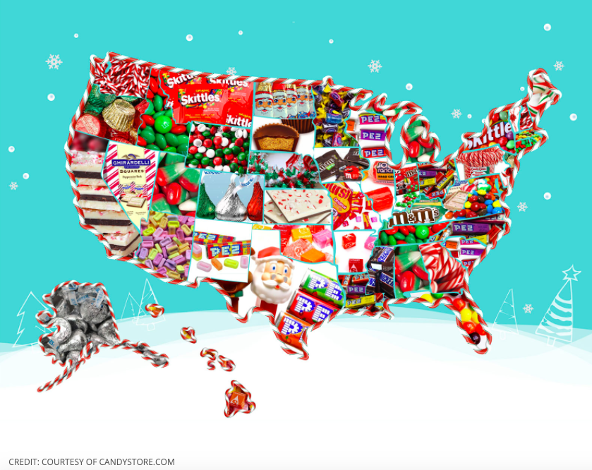
What do you notice?
What do you wonder?
What is this infographic telling us?
Create a catchy title!
4.MD.B
Notes:
Week of December 18, 2023

Slide 12
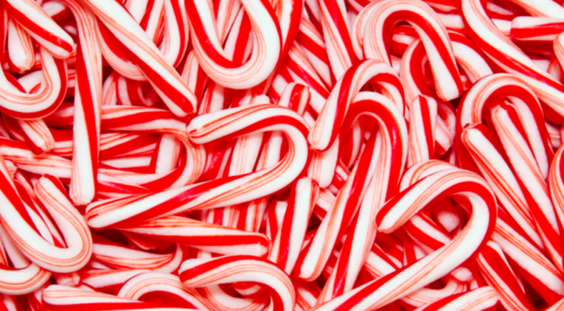
According to the National Confectioners Association, about 1,000,000,000 candy canes are made annually, and 90 percent of those are sold between Thanksgiving and Christmas.
What do those numbers mean?
4.NBT.B

Slide 13
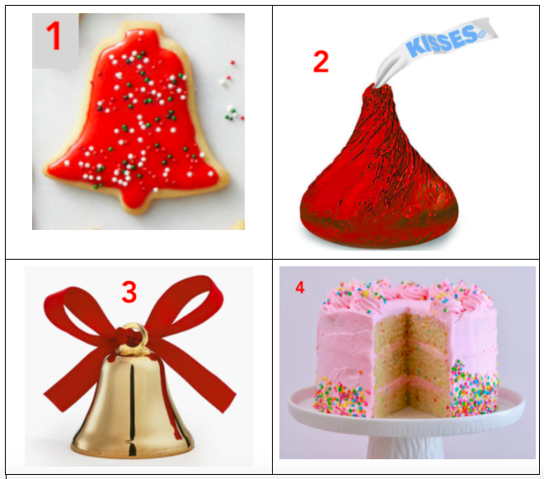
Which one doesn’t belong?
4.SMP.3
Notes:
Bell (not food)
Kiss (wrapped)
Cake (not red/holiday)
Cookie (not 4-letters)

Slide 14
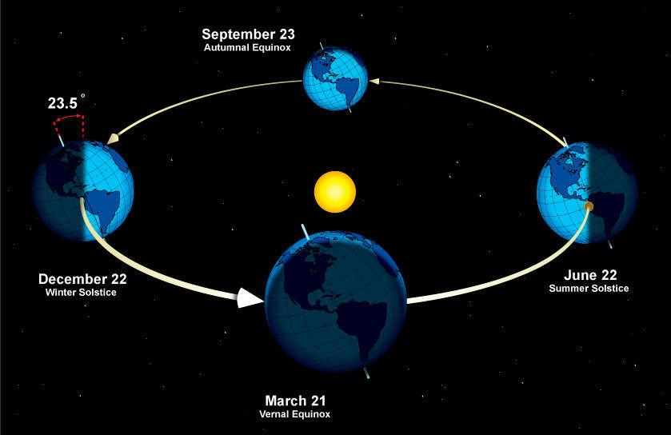
According to the astronomical definition winter began with the winter solstice at 5:13 am.
How many hours ago was that?
It’s the SHORTEST day of the year!
The sun rises at 7:12 am and sets at 4:18.
How many hours of daylight do we get today?
4.MD
Notes:
December 21, the winter solstice!

Slide 15
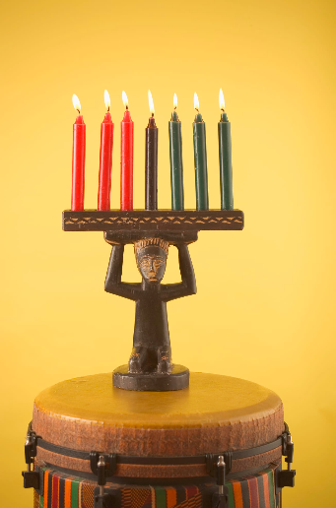
Kwanzaa, celebrated from December 26 to January 1, is an African American and pan-African seven-day cultural holiday that celebrates family and community.
If we had a Kinara for every student at Field School (286 students), estimate how many red candles we would need.
How many green candles?
How many black candles?
How many candles altogether?
4.OA.A3

