Slide 1
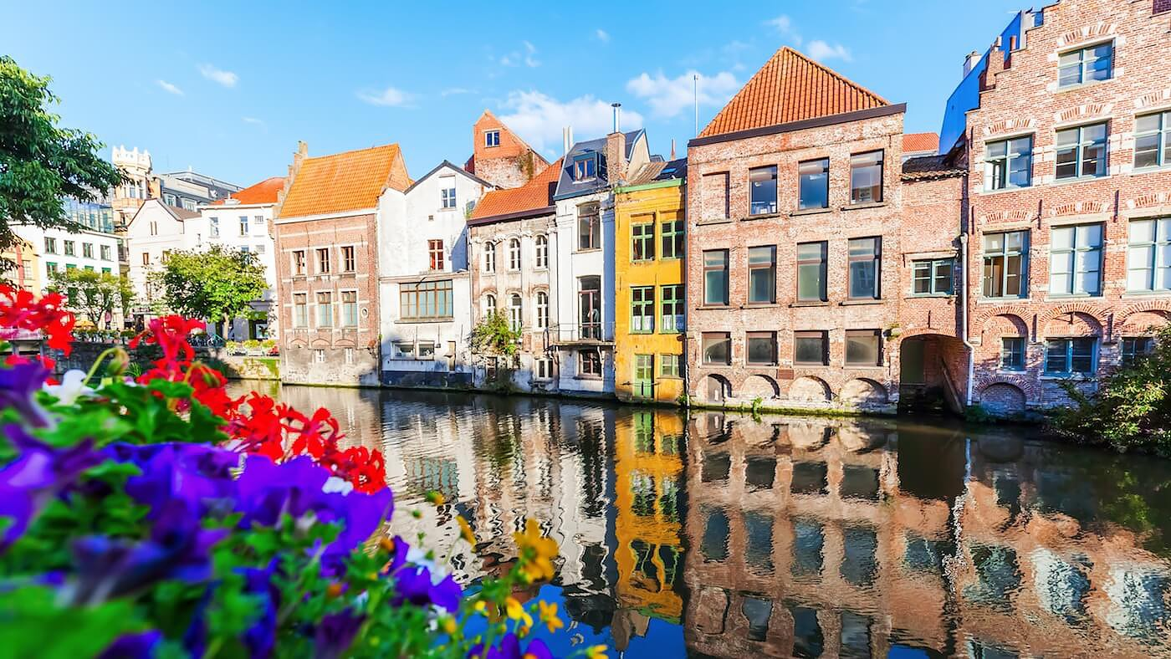
What interesting shapes do we see here? Estimate how many windows we see.
1.G.A1
Notes:
Week of December 4, 2023

Slide 2
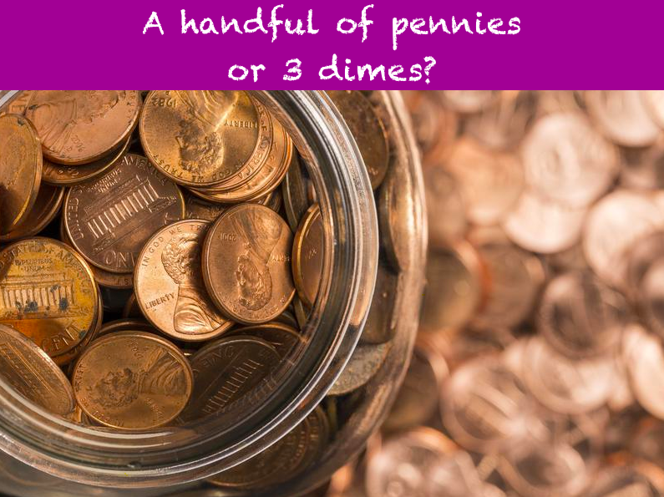
Would you rather have...
1.MD.D5

Slide 3
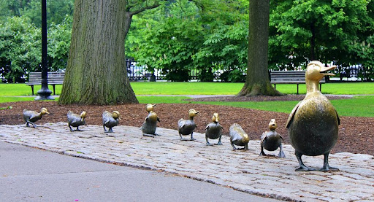
If 10 more ducks joined the group, how many would there be altogether?
What if 20 more ducks joined them?
1.NBT.C5

Slide 4
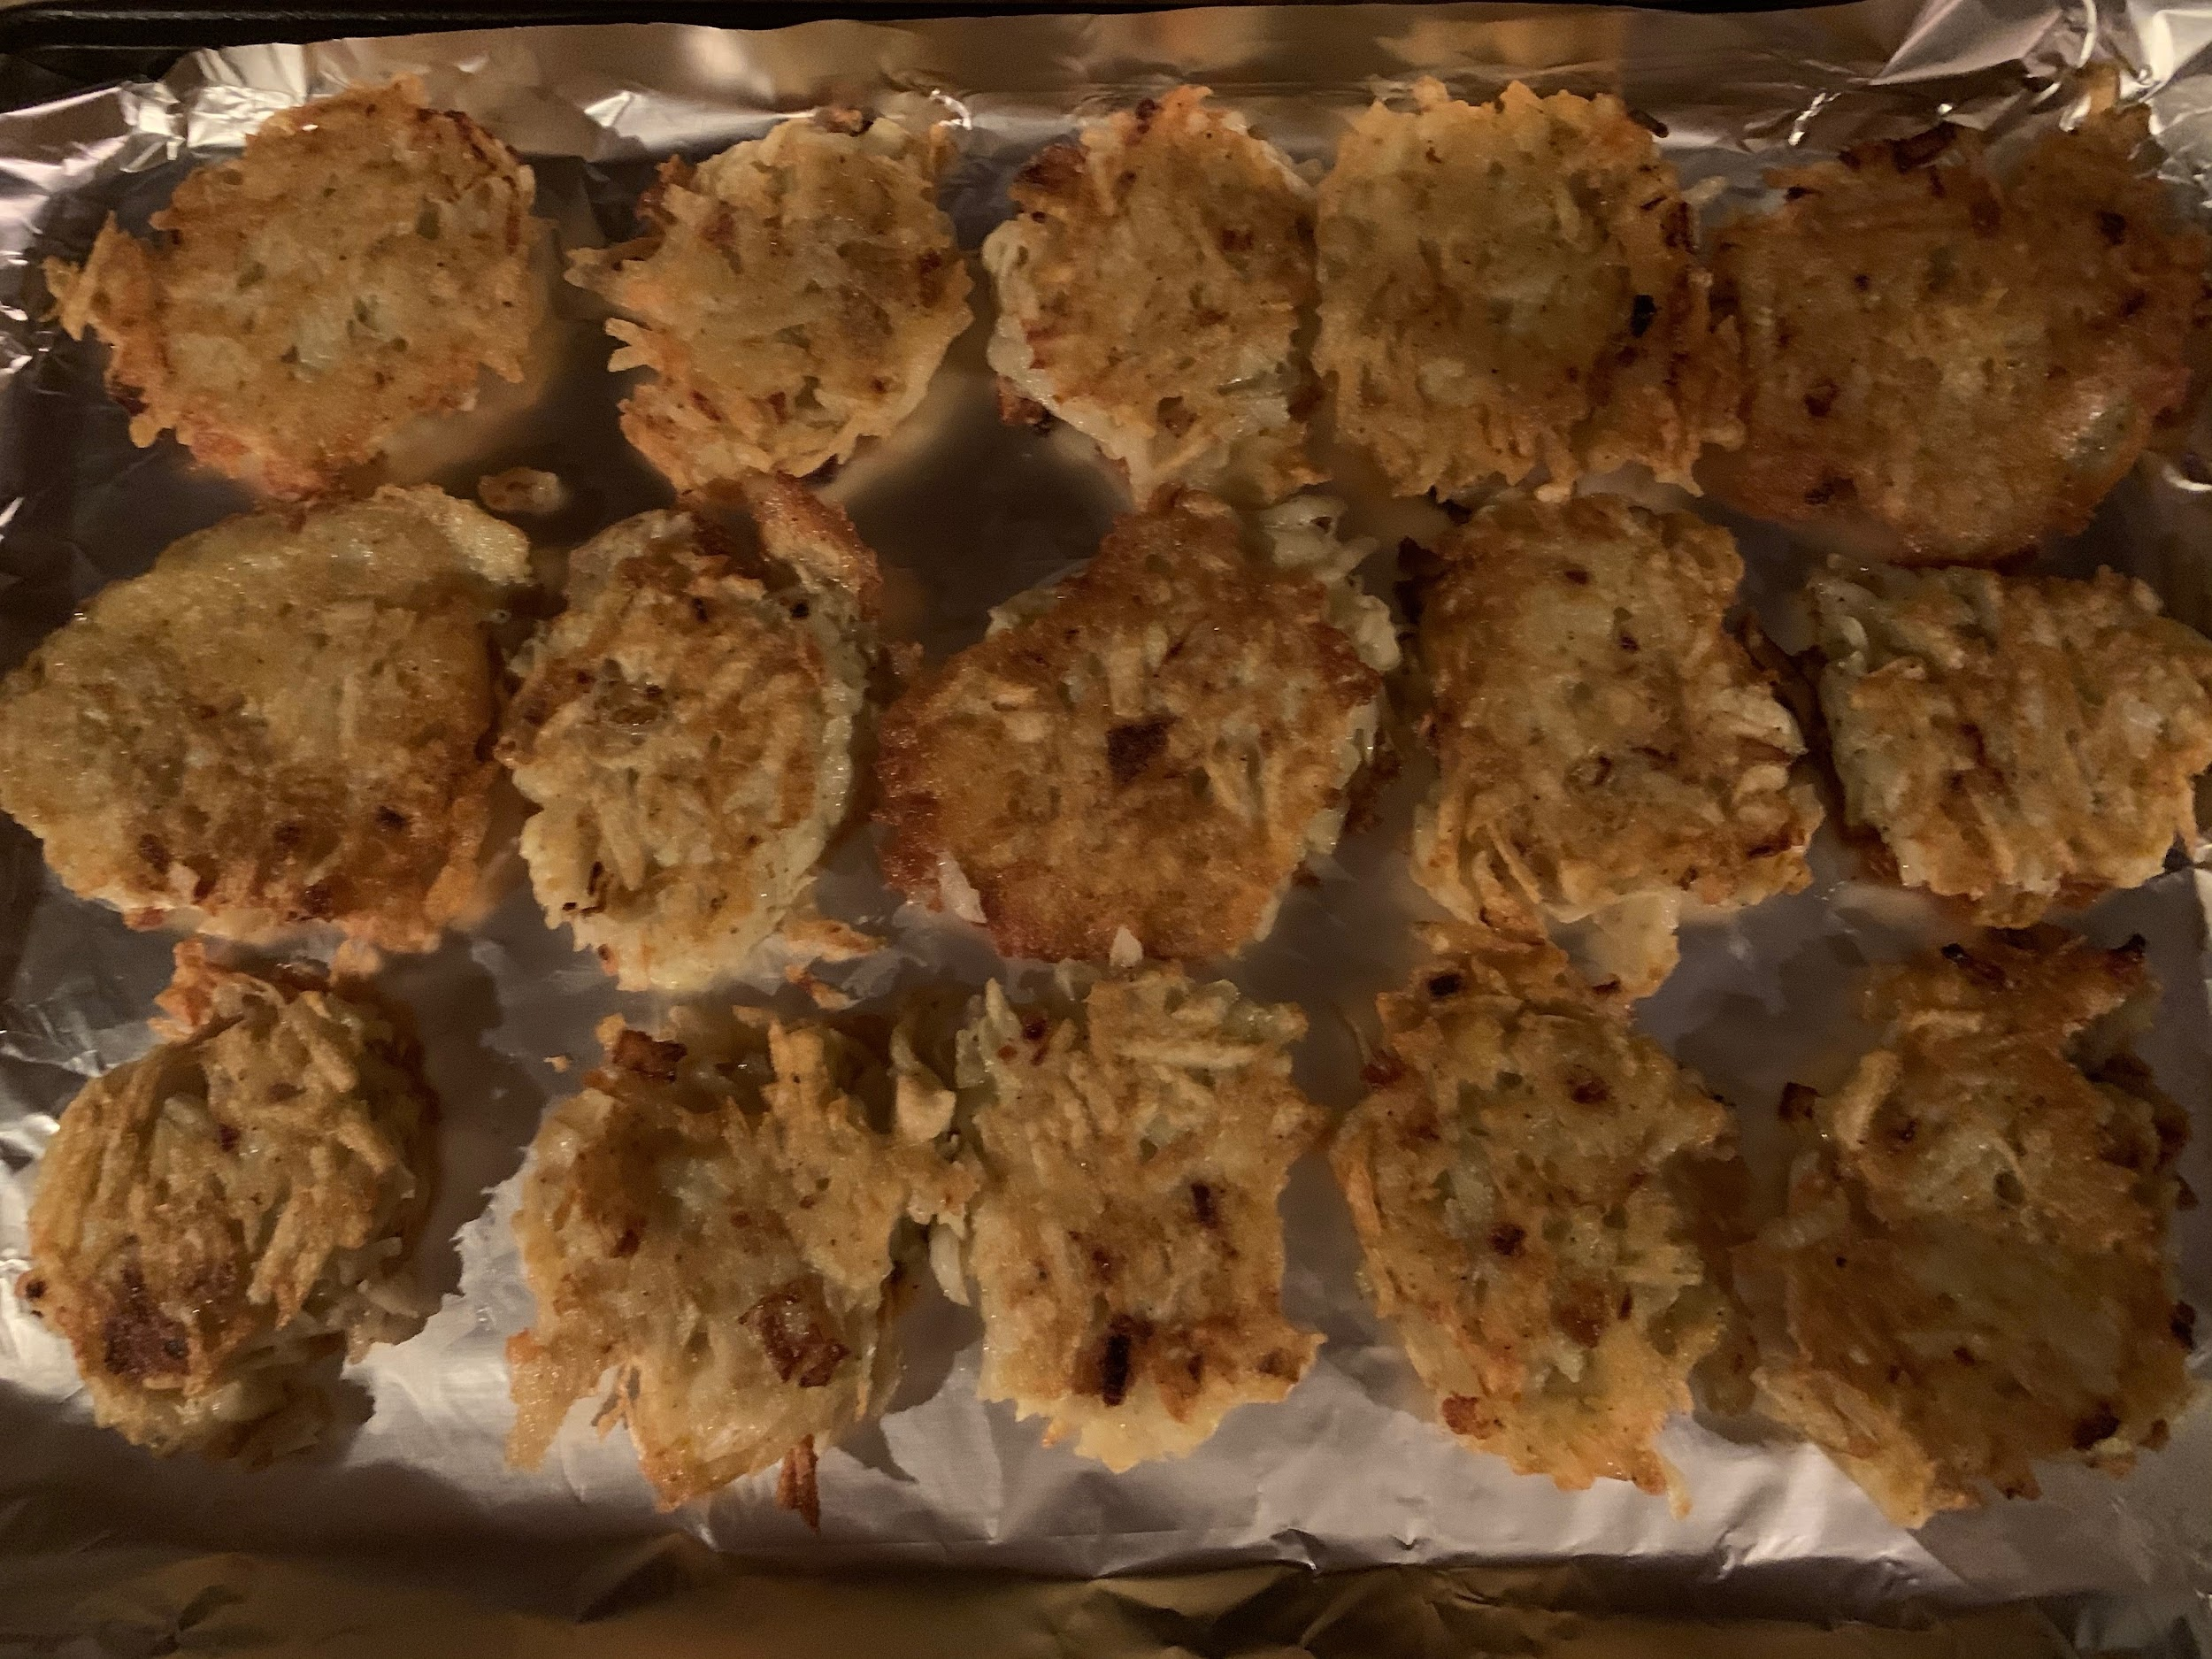
Happy Hanukkah!
How many potato pancakes do you see?
How do you see them?
1.OA.A2

Slide 5
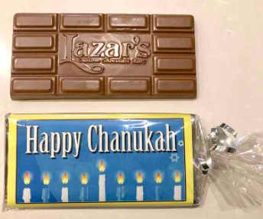
How many pieces of chocolate do you see?
How many might be in the middle?
Can you write a number sentence to match your thinking?
1.OA.C5

Slide 6
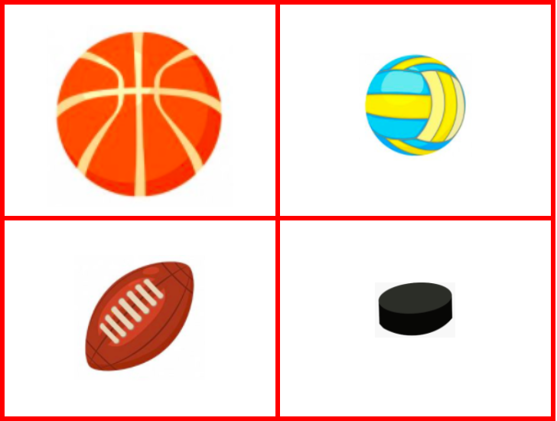
Which one DOES NOT belong?
1.G.A1
Notes:
Week of December 11, 2023

Slide 7
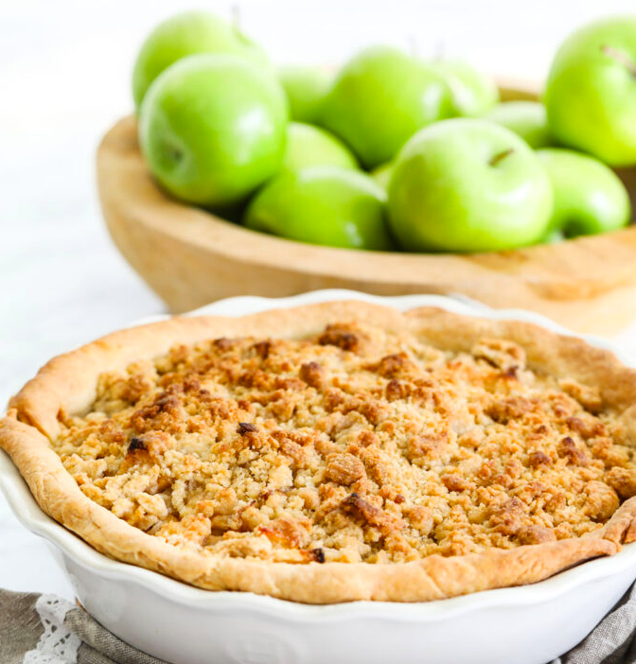
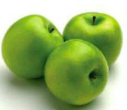

How many apples are in the pie?
Estimate!
1.NBT.A1

Slide 8
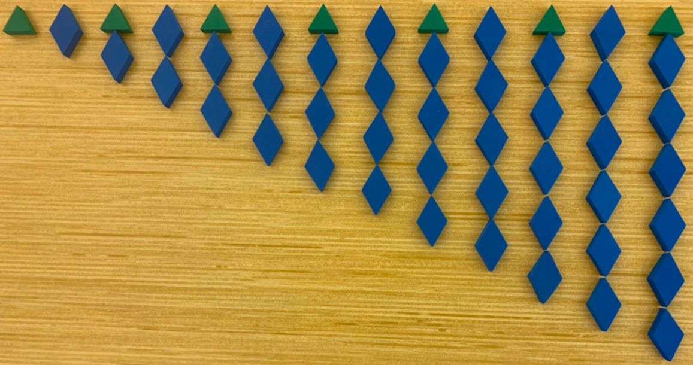
What do you notice?
What do you wonder?
1.OA.C5

Slide 9
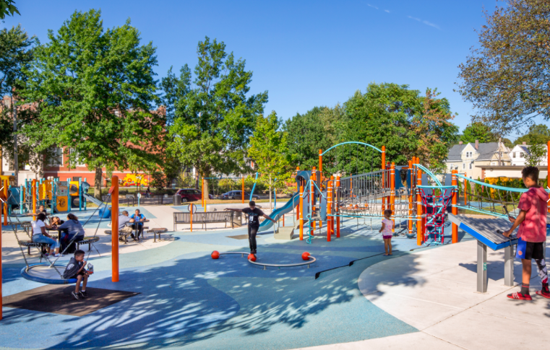
Describe the shapes you see in the playground
Can you put some of them together to make other shapes?
1.G.A2

Slide 10

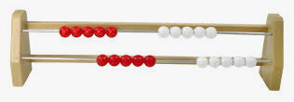
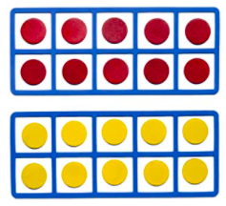
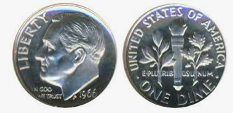
What do you notice?
Can you think of another way to show 20?
1.NBT.2A

Slide 11
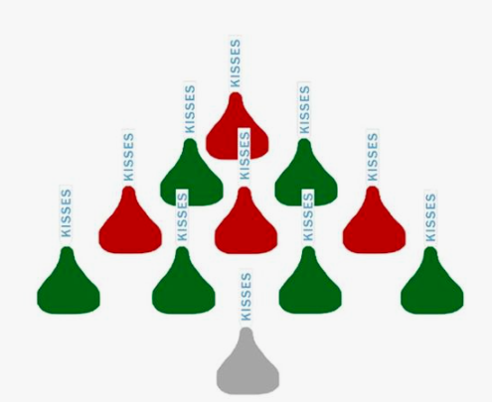
How many kisses do you see?
How do you see them?
How many different ways can you count them?
Can you write a number sentence to match your thinking?
1.OA.A2
Notes:
Week of December 18,2023

Slide 12
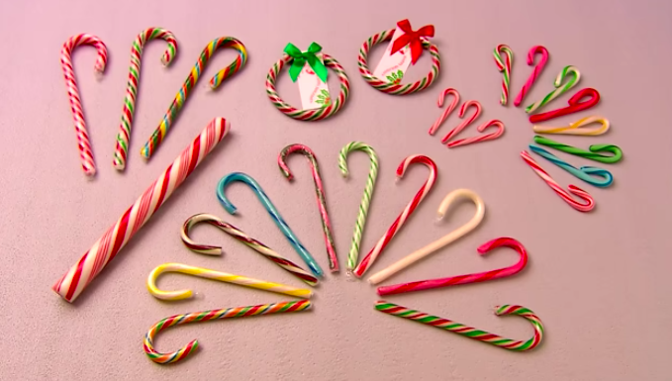
How can you count the candy canes?
Is there another way?
1.MD.C4

Slide 13
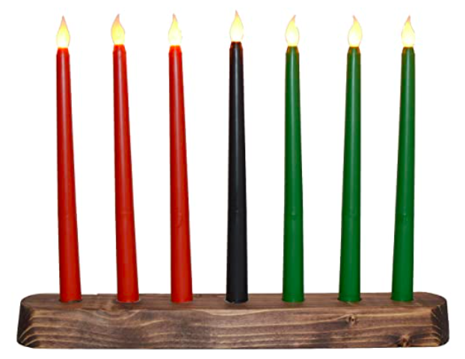
What do you notice about the candles in this Kinara?
Write a number sentence to match your thinking.
Now there are 2 Kinaras.
How does your number sentence change?
1.OA.C6

Slide 14
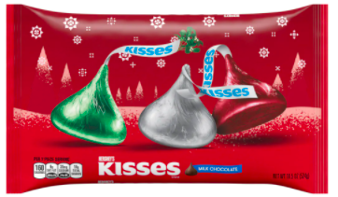
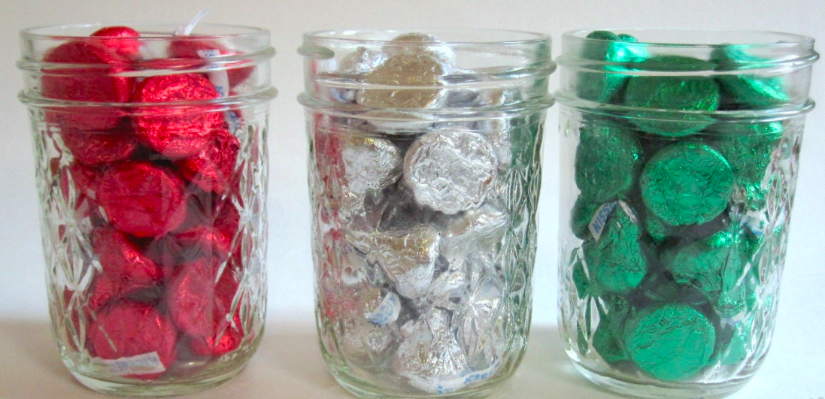
How many kisses do you think are in all 3 jars?
Use your math skills to ESTIMATE!
40
40
1.NBT.C5

Slide 15




Which one does not belong?
1.SMP.3

