Slide 1
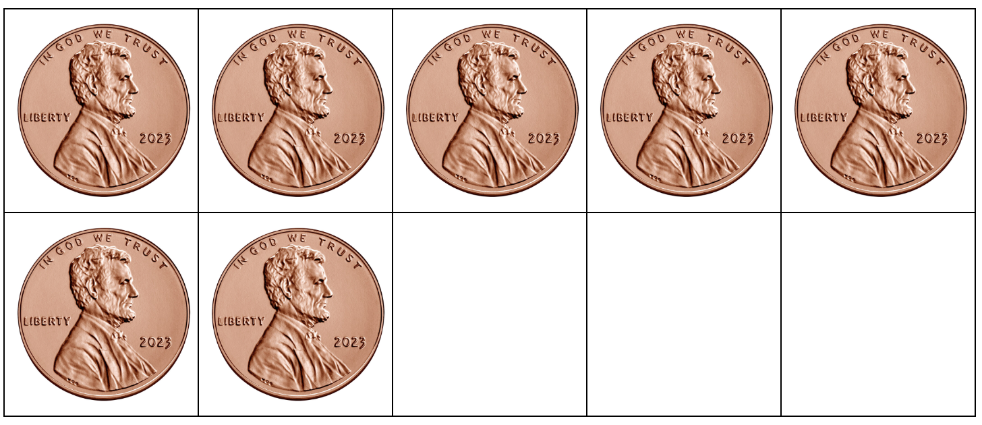
Today is GIVING TUESDAY!
What do we think GIVING TUESDAY is?
How many pennies are here? How do we see them?
How many more will make 10?
Notes:
Week 13
November 28 - December 1

Slide 2
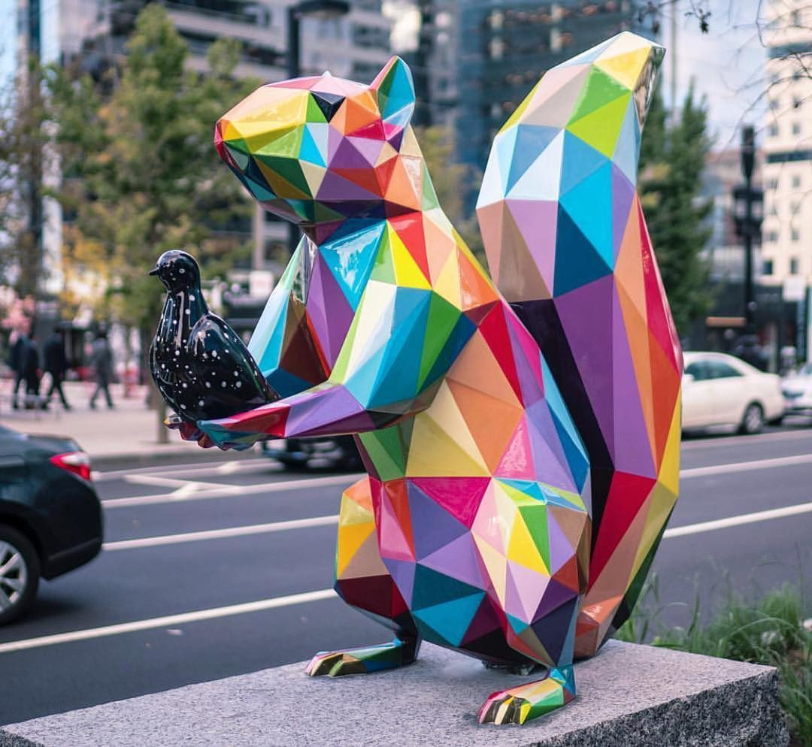
Let’s be shape
Let’s talk about the shapes we see in this sculpture by Spanish artist Okuda San Miguel.
What do they have in common?
What makes them different?

Slide 3
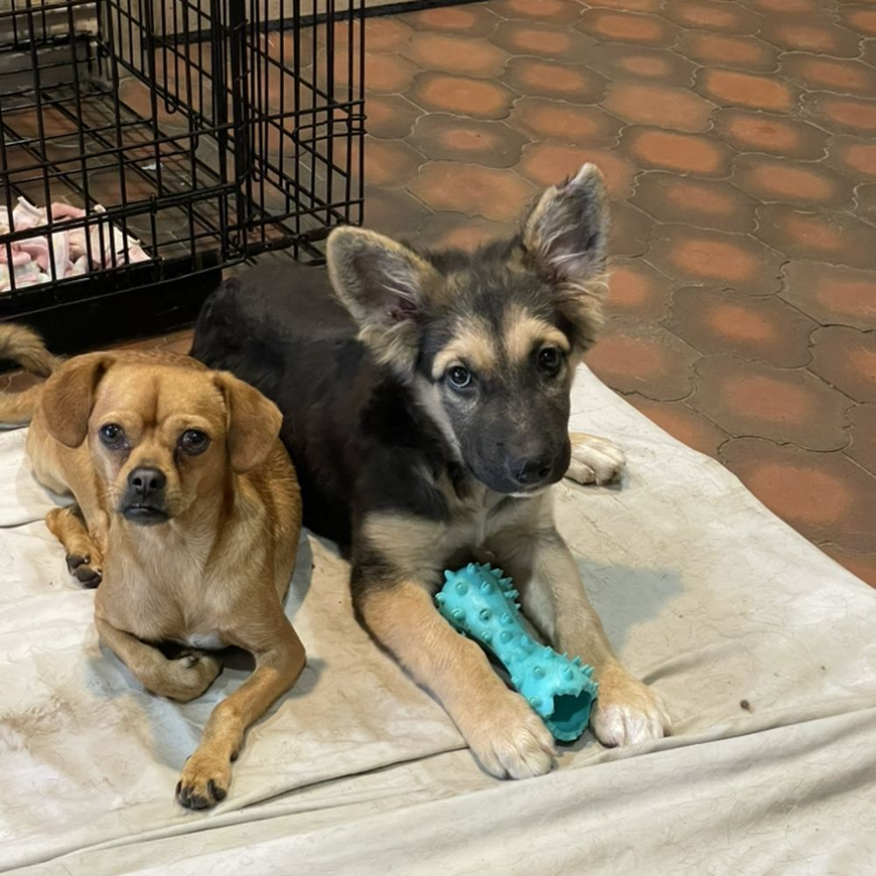
Today is Shelter Pets Day!
These two puppies were just adopted from the shelter!
How many puppy ears?
How many puppy paws?

Slide 4
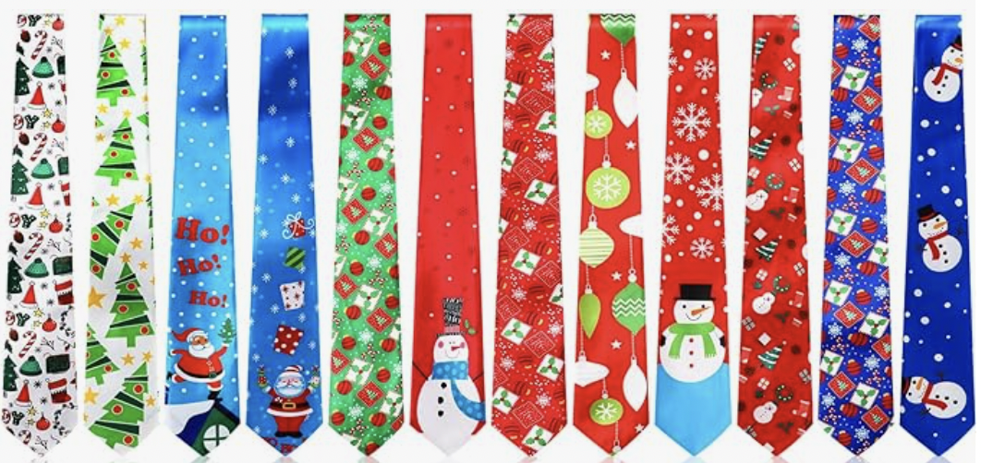
December is National Tie Month!
How many ties are here? How might we sort them?

